Slide 1
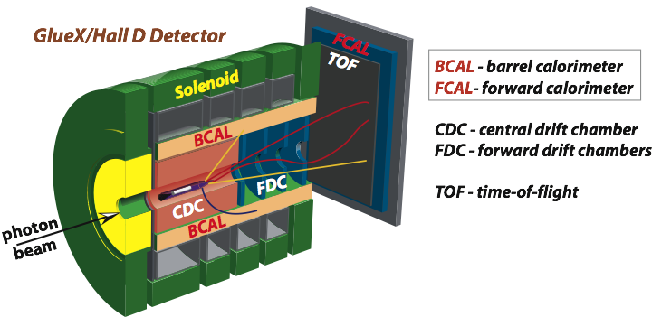

JLAB η Factory Experiment in Hall D
A. Somov, Jefferson Lab
for the GlueX Collaboration
The 10th International Workshop on Chiral Dynamics 2021
Beijing, China, November 16, 2021

Slide 2
Outline
GlueX detector in Hall D
Jefferson Lab η Factory (JEF) experiment with the GlueX detector
Physics Program
Upgrade of the GlueX Forward Calorimeter

Slide 3
GlueX Detector in Hall D
Photons: σ_{E} / E ~ 6 % /√E ⊕ 2.0 %
Tracks: σ_{p} / p ~ 2 – 5 %
Acceptance: 1° < θ < 120°
Beam of photons (linear polarization)
Optimized to detect multi-particle final states

Slide 4
Experiments with the GlueX detector
GlueX experiment: search for mesons with exotic quantum numbers; a study of meson and baryon decays to strange final states |  |  |  |  | 2016 – present collected ∼30% of data
A precision measurement of the η radiative decay width via the Primakoff effect (see talk by I. Jaegle) |  | Calorimeter prototype |  | Spring 2019, Fall 2021 (~50 % of data)
Measuring the charged pion polarizability (see talk by R. Miskimen) |  |  |  | Scheduled for 2022
Studying short range correlations with real photon beams at GlueX |  |  |  | Taking data
Upgrade Forward Calorimeter
Eta decays with emphasis on rare neutral modes: The JLab Eta Factory experiment (JEF) |  |  |  | 2023 Run in parallel with GlueX

Slide 5
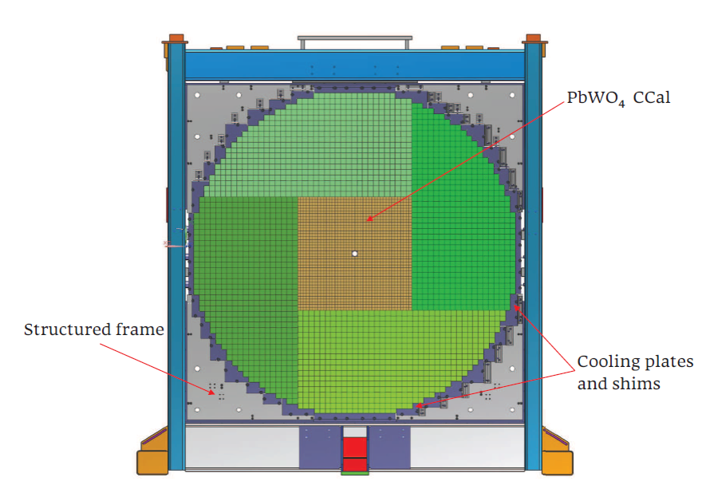
JEF Experiment using GlueX Detector
FCAL 2
Upgrade the inner part of the lead glass Forward Calorimeter with high-granularity high-
resolution PbWO₄ crystals to improve reconstruction of multi-photon final states
Produce η / η ′ using a beam of tagged photons with the energy between 8.4 - 11.7 GeV
Reconstruct η / η ′ in exclusive reactions:
Run in parallel with other GlueX experiments: collect large data set of η / η ′ mesons
γ+p → η/ηꞌ + p
η/ηꞌ → γγ, π⁰ γ γ , . . .

Slide 6
Expected Rate of η/η′
Previous Experiments:
Experiment | Total η | Total η’
CB at AGS | 10⁷ | -
CB MAMI-B | 2x10⁷ | -
CB MAMI-C | 6x10⁷ | 10⁶
WASA-COSY | ~3x10⁷ (p+d), ~5x10⁸ (p+p) | -
KLOE-II | 3x10⁸ | 5x10⁵
BESIII | ~10⁷ | ~5x10⁷
JEF for 100 days of beam:
 | η | η’
Tagged mesons | 6.5x10⁷ | 4.9x10⁷
JEF will produce a competitive sample of η/η′ events
(see also proposed experiment REDTOP, talk by Corrado Gatto)

Slide 7
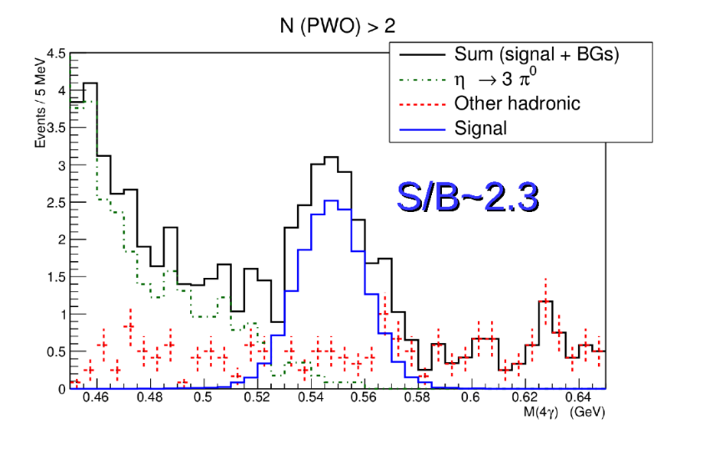
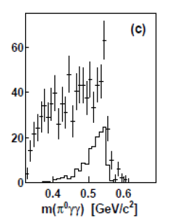
Unique Capabilities of JEF
High production rate of η / η ′ mesons
- about 5×10⁷ tagged η per 100 days of beam time
- large data sample compared to existing η(′) experiments, such as
A2-MAMI, WASA-at-COSY, KLOE-II, BES-III
Produce η / η ′ with high boost. Good reconstruction of photons in the
upgraded lead tungstate Forward Calorimeter
- significantly smaller background compared to other low-energy experiments
A2 at MAMI (E_{γ} = 1.5 GeV)
JEF (E_{γ} = 9-11.7 GeV)
simulation
Phys.Rev. C90, 025206,2014
η → π⁰ , γ γ

Slide 8
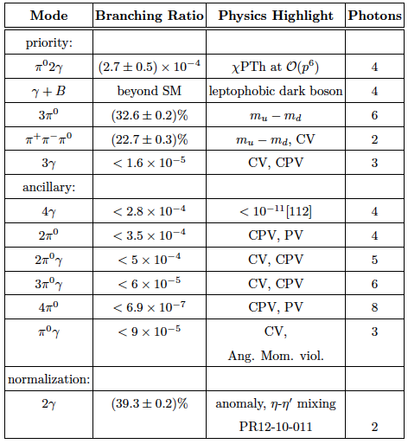
JEF Physics Program
Upgrade the Forward Calorimeter
Main physics topics:
1. Test of low-energy QCD
2. Search for dark
matter
3. Directly constrain
CVPC new physics
4. Constrain the light
quark mass ratio

Slide 9
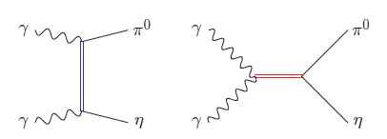
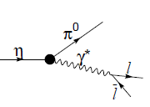
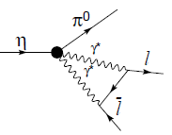
Impact of η → π⁰γγ measurements on
Chiral Perturbation Theory
Unique probe for the high order ChPT:
- contribution from two O(p⁶) counter-terms in the chiral Lagrangian
L. Ametller, et.al, Phys. Lett., B276, 185 (1992)
Study contribution of scalar resonances in calculation of O(p⁶) low-energy
constants (LEC) in the chiral Lagrangian
Shape of Dalitz distribution is sensitive to the role of scalar resonances
Higher order LEC’s are dominated by resonances
Gasser, Leutwyler 84; Ecler, Gasser, Pich, de Rafael 1989; Donoghue, Ramirez, Valencia 1989
a₀, a₂
ρ, ω
A cross-check of LEC's with different processes
C and CP violating
C and CP conserving background
J.N. Ng, et al., Phys. Rev., D46, 5034 (1992)

Slide 10
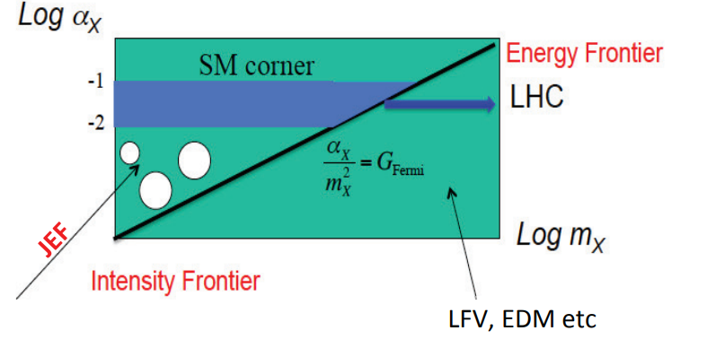
Dark Matter Search in η Decays
Search for dark matter in sub-GeV range:
Vector
leptophobic vector boson B:
η, η′ → γ B B → π⁰ γ ( 0.14 < m_{B} < 0.62 GeV )
B → π⁺ π ⁻ π⁰ ( 0.62 < m_{B} < 1.0 GeV )
dark photon:
η, η′ → A′ γ → e⁺ e ⁻ γ
Scalar
η → π⁰ S S → γ γ, e⁺ e ⁻ ( m_{S} < 2 m_{π} )
η, η′ → π⁰ S S → π ⁺π ⁻ ( m_{S} > 2 m_{π} )
η′ → η S
Light pseudoscalar (axion-like particle)
η, η′ → π π γ γ, π π e⁺ e⁻

Slide 11
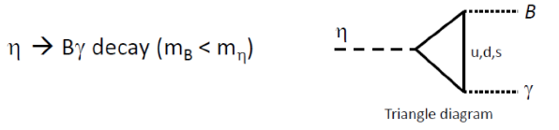
Search for B-boson in η decay
B production: A.E. Nelson, N. Tetradis, Phys. Lett., B221, 80 (1989)
B decay: B→π⁰γ in 140-600 MeV mass range
S. Tulin, Phys.Rev.,D89,
14008 (2014)

Slide 12
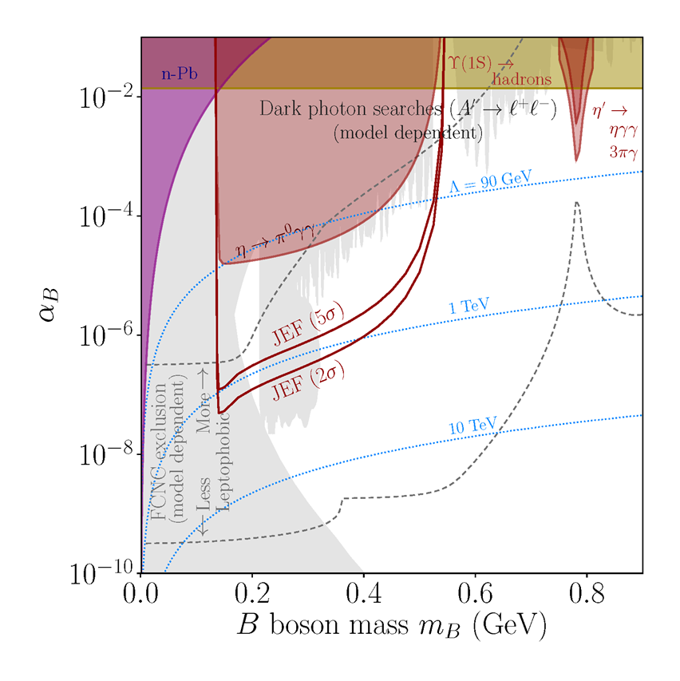
JEF Experimental Reach (η → Bγ → π⁰γγ )
A stringent constraint on the leptophobic
B-boson in
140 - 550 MeV range
100 days of taking data

Slide 13
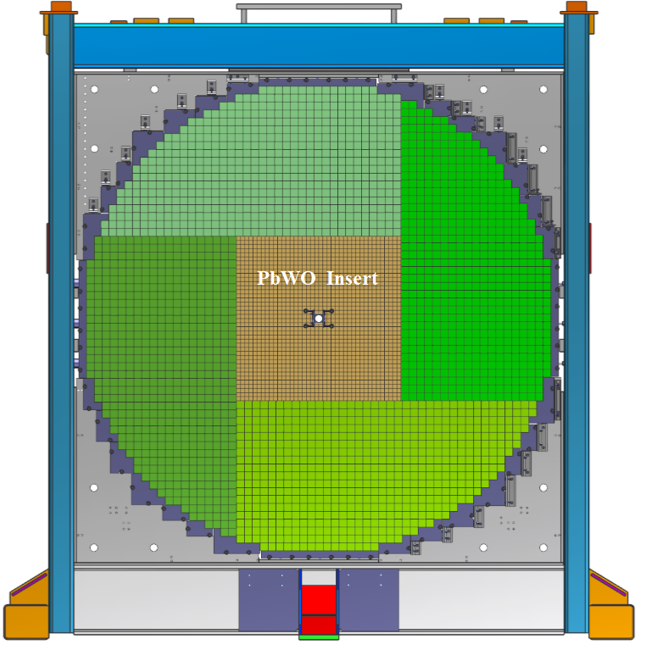
Calorimeter Upgrade
Forward Calorimeter
PbWO₄ module
Install an array of 40 x 40 PbWO₄ modules in the inner part of the FCAL
(replace lead glass modules)
- 2 cm x 2 cm x 20 cm PbWO₄
- 4 cm x 4 cm x 45 cm lead glass
A factor of 4 better detector granularity
- significantly improve shower separation
Improves the energy and position resolution by about a factor of 2

Slide 14
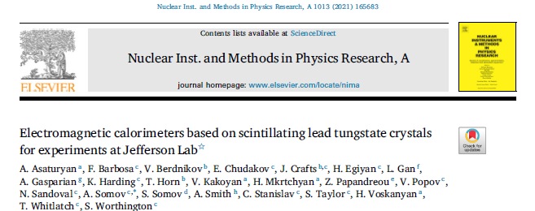

Calorimeter Prototype
Beam test of calorimeter prototype
-12 x 12 modules
- used as a Compton calorimeter
in the PrimEx experiment
in 2019 / 2021
Energy resolution
$\frac{σ \left(E\right)}{E}\left(\%\right)= \frac{2.6 }{\sqrt{E}} \text{⊗}\frac{ 1.1}{E}$ ⊗ 0.6
NIM, A 1013 (2021)

Slide 15
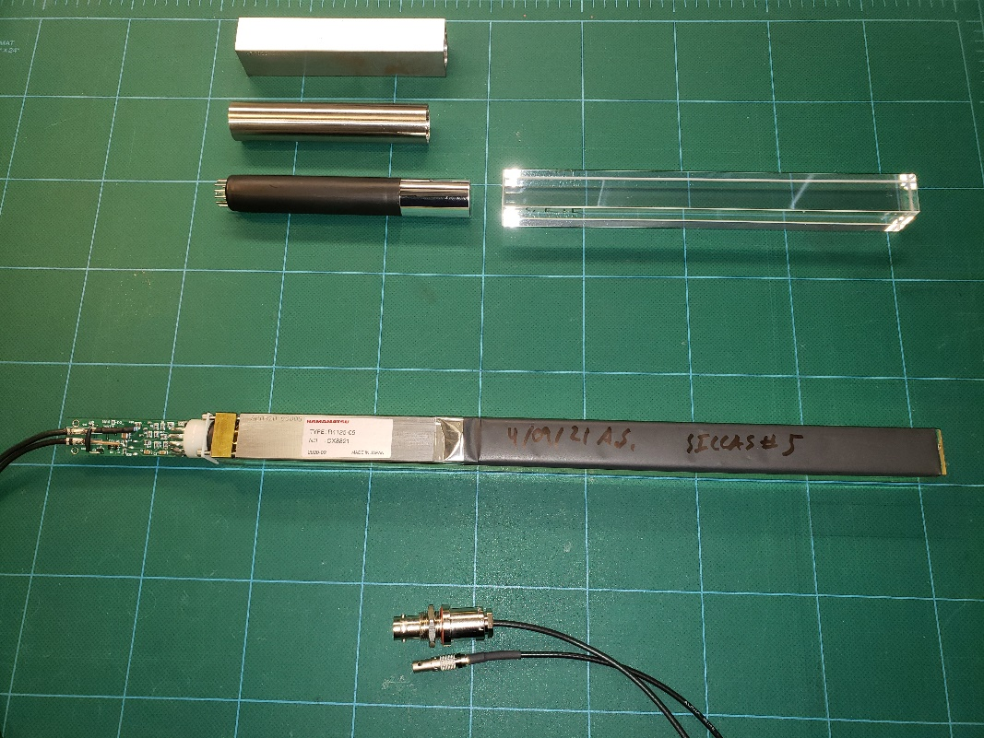
Finalizing Module Design
PMT shield
Magnetic shielding studies
- use soft iron and mu-metal
PMT housing
- use light-guides
Optimize geometry of light guides
(light collection studies)
Optimize design of PMT divider (active base)
Study properties of PbWO crystals, perform quality checks:
- procure from two vendors: SICCAS (China) and CRYTUR (Czech Republic)
- measure dimensions, light transmittance and yield
PMT + LG
Crystal
NIM A 956 (2020) 163375

Slide 16
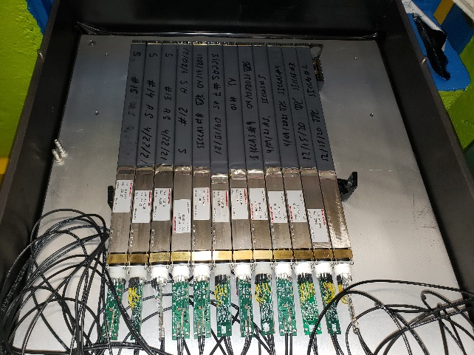
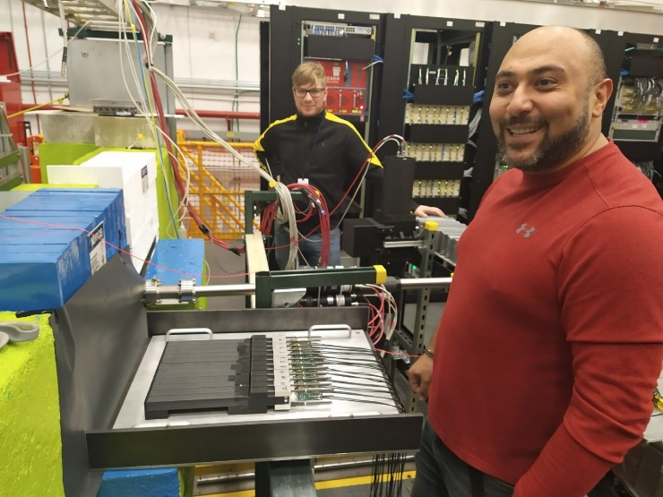
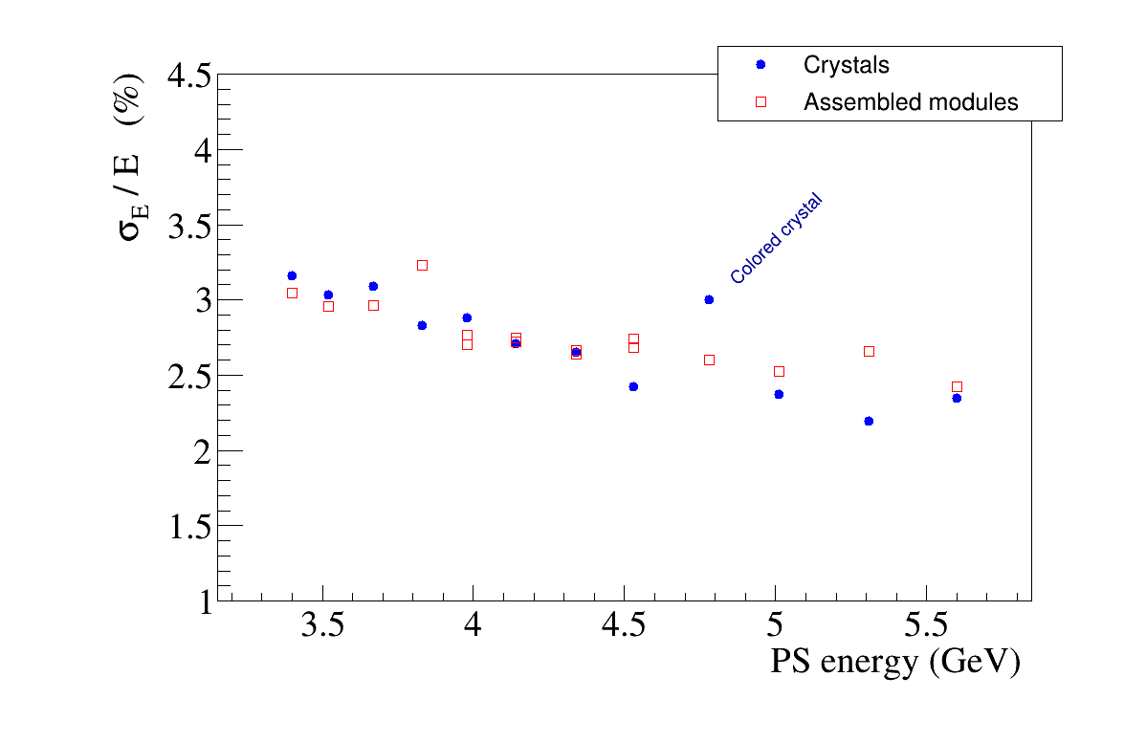
Beam Tests of Fabricated PbWO Modules
Test fabricated modules using electrons/positrons with known energies
provided by the GlueX Pair Spectrometer
Perform tests in parallel with GlueX data taking
NIM A 956 (2020) 163375, NIM A 795 (2015)
Test up to 12 PbWO modules
Pair Spectrometer setup in Hall D
Energy resolution of a single module
Fabrication of FCAL2 modules in
progress
Installation in Hall D: 2023

Slide 17
Summary
The new JEF experiment in Hall D will extend the physics potential of the GlueX detector. The JEF physics program spans from the study of rare decays of η mesons to the dark matter searches in the sub-GeV mass region.
The experiment requires upgrade of the lead glass GlueX forward calorimeter with high-granularity, high-resolution PbWO₄ crystals
The new calorimeter will be installed in Hall D in 2023

Slide 18
Backup Slides

Slide 19
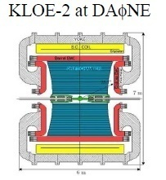
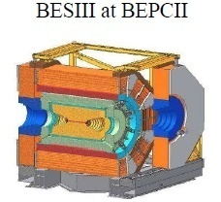
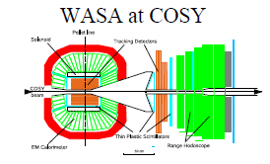
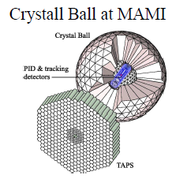
World competition in η decays
e⁺e⁻
Collider
Low energy
η-facilities
High energy η-facility
Fixed-target
hadroproduction
CBELSA/TAPS at ELSA
JEF at Jlab
photoproduction

Slide 20
Search for B boson
Dark leptophobic B-boson
Arises from a new gauge baryon symmetry U(1)_{B}
Unified genesis of baryonic and dark matter
the region is strongly constrained by long-range forces search exp. ; the has been investigated by the collider experiments
GeV-scale domain is poorly constrained
discovery opportunity!
Early studies by Lee and Yang, Phys.Rev.,98 (1955) 1501; Okun, Yad.Fiz., 10 (1969) 358,

Slide 21
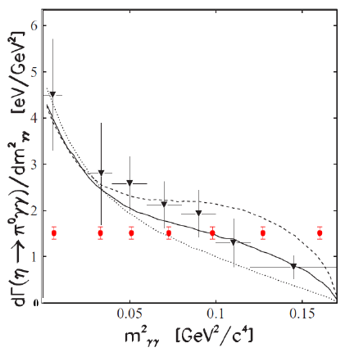
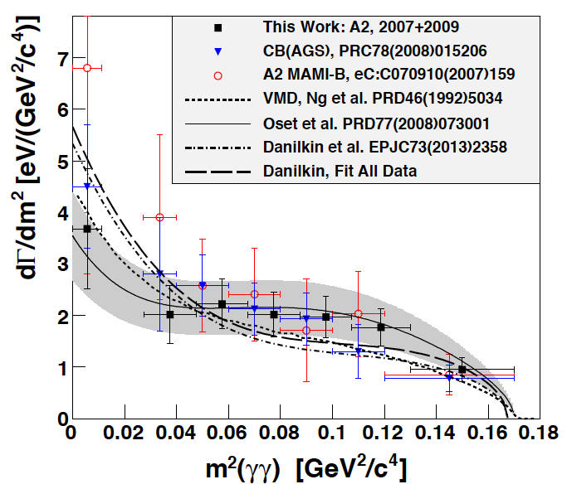
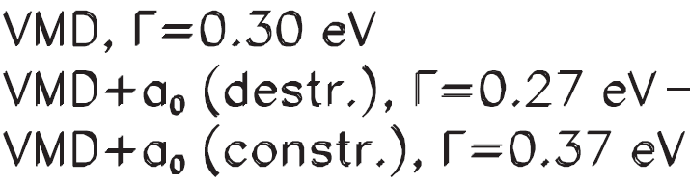
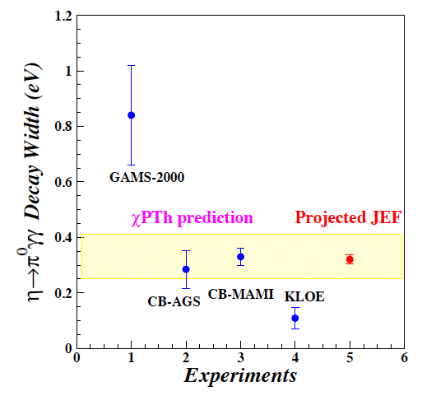
Projections for η→π⁰γγ Decay
Prakhov et al., Phys. Rev. C78, 015206 (2008)
A2 at MAMI arXiv:1405.4904, 2014
CB-AGS
Projected JEF
Constrain contribution of scalar resonances
in the calculation of O(p⁶) low-energy constants

Slide 22
C Invariance
C Violating η neutral decays
Maximally violated in the weak force
and is well tested
SM prediction:
BR(η→3γ) <10⁻¹⁹ via P-violating
weak interaction.
Study constraints on CVPC from EDM
- no constraints in the presence of a
conspiracy or new symmetry; only
the direct searches are unambiguous
Final State | Branching Ratio (upper limit) | Gammas in Final State
3γ | < 1.6•10⁻⁵ | 3
π⁰γ | < 9•10⁻⁵
2π⁰γ | < 5•10⁻⁴ | 5
3γπ⁰ | Nothing published
3π⁰γ | < 6•10⁻⁵ | 7
3γ2π⁰ | Nothing published
M. Ramsey-Musolf, phys. Rev., D63 (2001);
talk at the AFCI workshop,
studies are in progress
24

