Slide 1
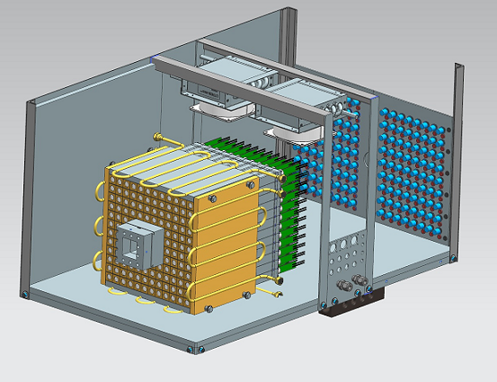
Beam Tests of PbWO₄ Crystals and
Calorimeter Modules using Hall D Pair Spectrometer
JLab EIC meeting, January 28
A. Somov, V. Berdnikov, T. Horn, J. Crafts, and A. Asaturyan

Slide 2
Introduction
Two PbWO₄-based calorimeters are currently under construction at Jefferson Lab
Crystal size:
2.05 cm x 2.05 cm x 20 cm
Procured from two vendors:
- SICCAS (China)
- Crytur (the Czech republic)
NPS (Hall C)
FCAL 2 (Hall D)
Crystals of the same size are considered for EIC

Slide 3
Beam Tests
Crystal characterization for JLAB and future EIC
Optimization of readout electronics
Optimization of the module design ( FCAL 2 )
Study detector properties
Use leptons provided by Hall D pair spectrometer to check / study crystals and small prototypes
Build a large scale prototype (140 modules). Used to reconstruct Compton scattering events in the
PrimEx - η experiment during runs in 2019 and 2021

Slide 4
Timeline
April 2018 - First test of the 3 x 3 prototype using PS test setup
Study read out electronics, operation conditions (some features observed)
October 2018 - Construction of Compton Calorimeter (140 modules). Installed in Hall D
for the PrimEx-η experiment. Study electronics, detector resolution, performance at high rate
Spring 2019 - first tests of crystals using PS setup. Continue with the PS beam tests since then
Fall 2019 - new tests of 3 x 3 prototypes using PS test setup (new electronics). Good agreement
of the energy resolution with CCAL. Some results added to Nucl. Inst. Meth. A956 (2020) 163375
Fall 2019 - optimize design of the FCAL 2 module. Study light guides.
Fall 2021 - CCAL 2 in the new PrimEx-η run (new electronics, updated LMS system)
Fall 2021 - test fabricated FCAL 2 modules using the PS setup
Fall 2021 - various tests of calorimeter prototypes (PMT and SiPM readout), test scintillator
glass modules using the PS setup
Nucl. Inst. Meth. A 1013 (2021) 165683
A lot of details about testing of prototypes are in Vlad’s talk

Slide 5
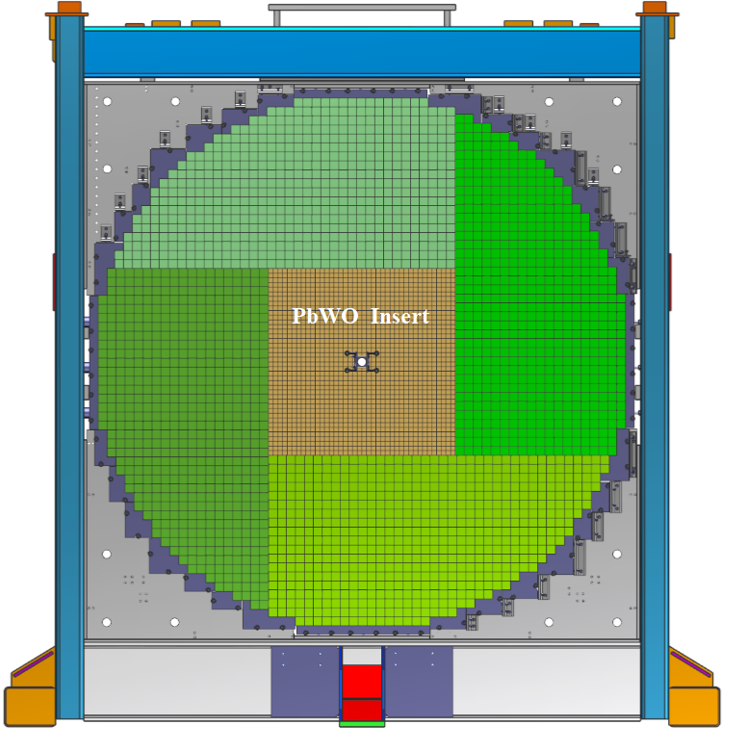
Hall D Calorimeter Upgrade (FCAL 2)
Forward Calorimeter
PbWO₄ module
Install an array of 40 x 40 PbWO₄ modules in the inner part of the FCAL
(replace lead glass modules)
- 2 cm x 2 cm x 20 cm PbWO₄
- 4 cm x 4 cm x 45 cm lead glass
A factor of 4 better detector granularity
- significantly improve shower separation
Improves the energy and position resolution by about a factor of 2

Slide 6
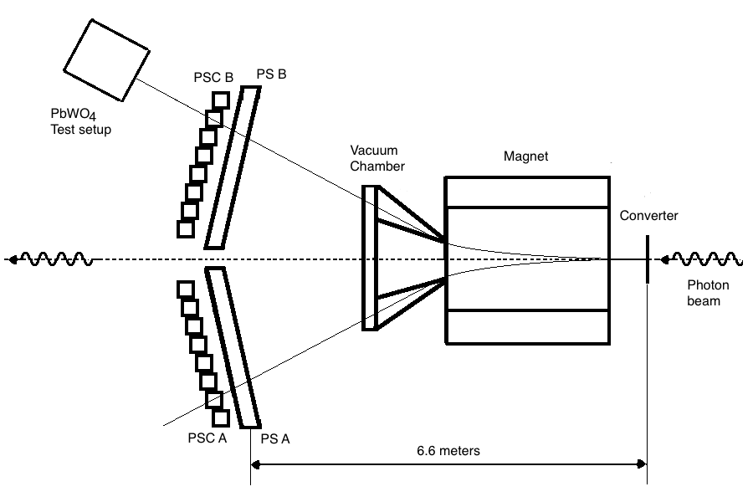
Hall D Pair Spectrometer and Test Stand
Pair Spectrometer Scintillator Counters:
PSC coarse counters, trigger, time
PS high-granularity, energy measurement
145 counters per PS arm
- energy range: 3 GeV – 6.25 GeV
- size of the counters: 1 mm and
2 mm (at 6 GeV)
Beam collimator size:
- 5 mm (GlueX production), 3.4 mm, and 1 mm
Typical energy resolution:
0.5 % - 0.8 % for 3 GeV and 6 GeV leptons
(0.4 % is 1 mm collimator is used)
Rate (coincidence of arms) during production runs: ~6 kHz
Time resolution: ~100 ps
Nucl. Inst. Meth. A795 (2015) 376
new paper in preparation
Converter: 75 μm and 750 μm Be
Note, the energy range can be changed by changing the
magnetic field (special runs)

Slide 7
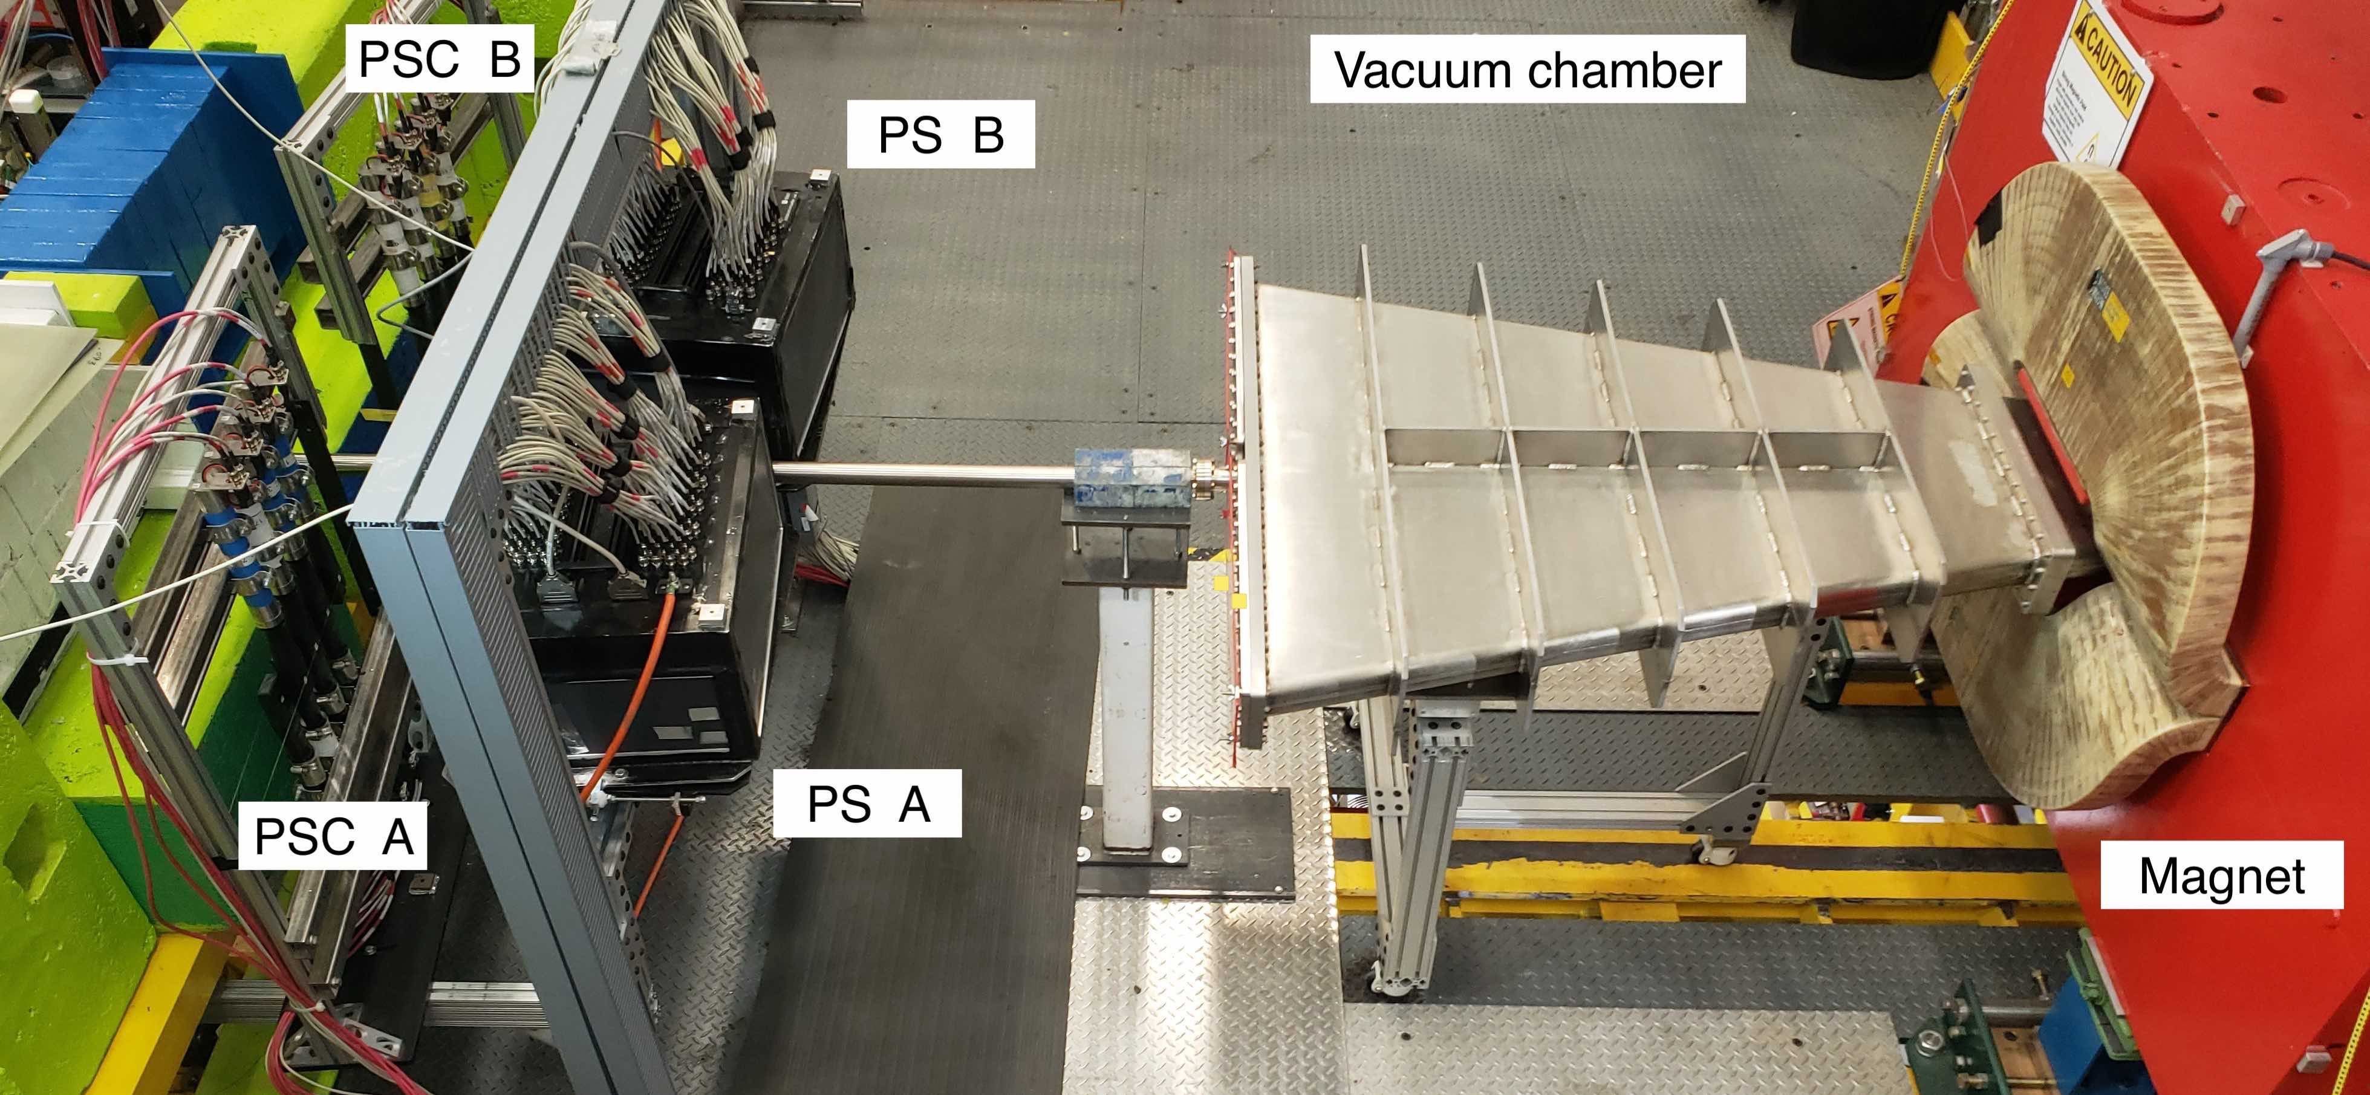
Hall D Pair Spectrometer

Slide 8
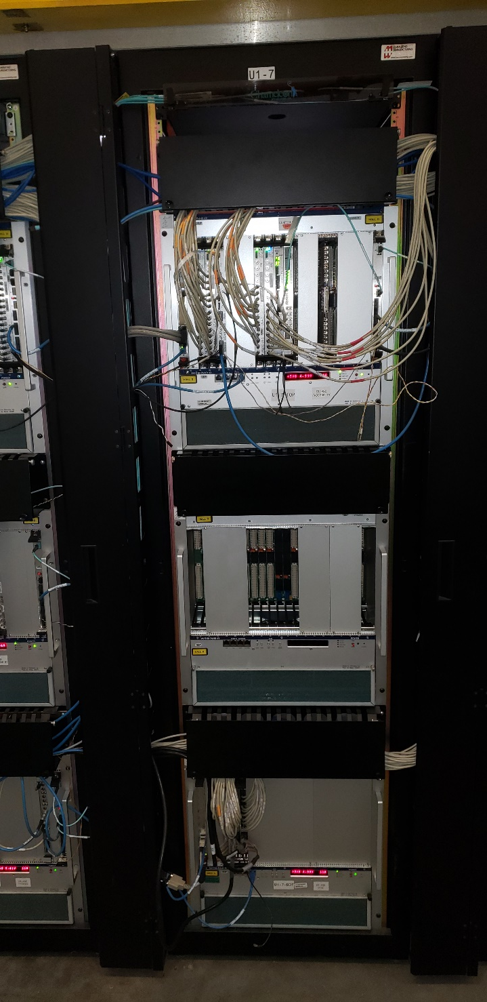
Electronics and Trigger
12 channels of the crystal tests stand
10 channels for the calorimeter prototype
- HV and signal cables
Read out using FADC 250
- two FADC modules placed in one of the Hall D VXS crate
Integrated to the GlueX DAQ / trigger system
- readout using Pair Spectrometer trigger
- independent configuration of test stand FADCs
(change thresholds, readout mode, … )
Test stand FADCs
Perform tests in parallel with the GlueX data taking

Slide 9
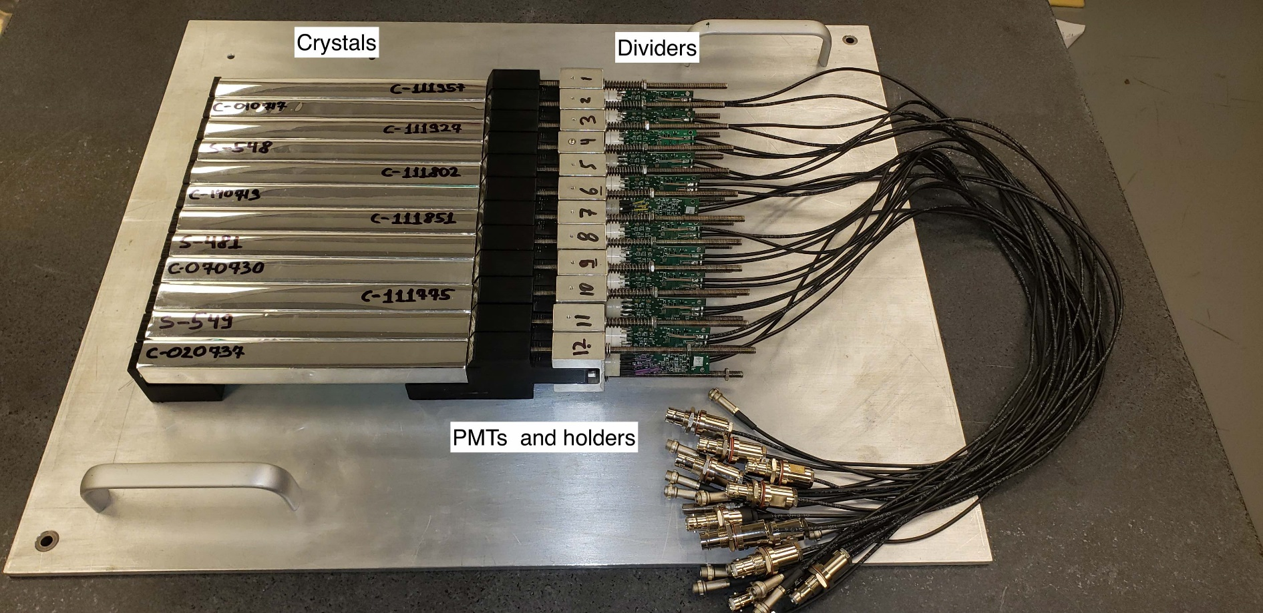
Test Setup for Crystals

Slide 10
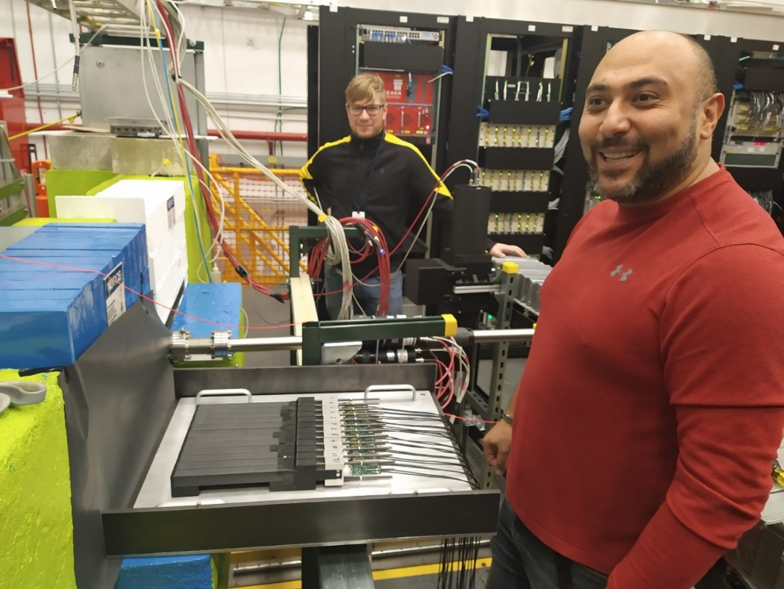
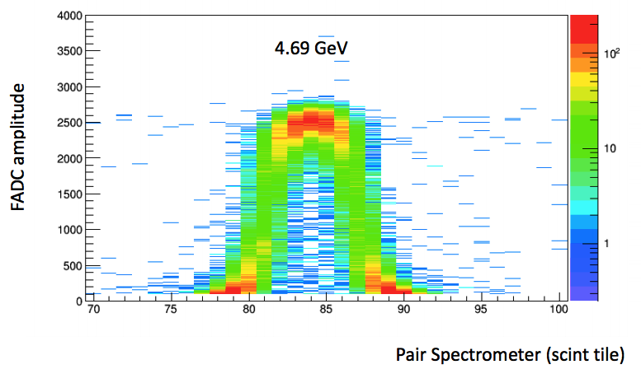
PS Test Setup in Hall D
‘Projection’ of the crystal to the PS
hodoscope
GlueX-doc-3590,
V. Berdnikov, A.Somov, J. Crafts
Measure light yield of 12 crystals
Crystals can be easily installed during opportunistic access to the hall
(install crystals on the plate and bring the setup to the hall)
Perform measurements in parallel with GlueX data taking

Slide 11
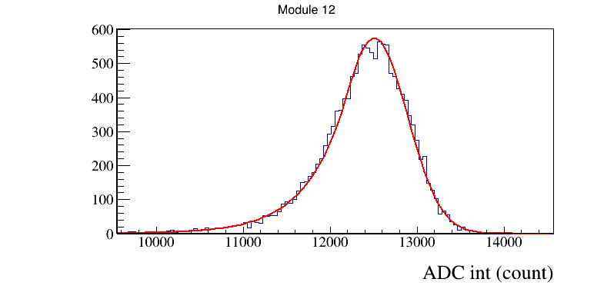
Crystal Testing Using Pair Spectrometer
Leptons going through the middle of the crystal
Energy distribution (pulse integral)
Couple different crystals to the same PMTs
Estimate light yields
Estimate relative energy resolution of a single crystal

Slide 12
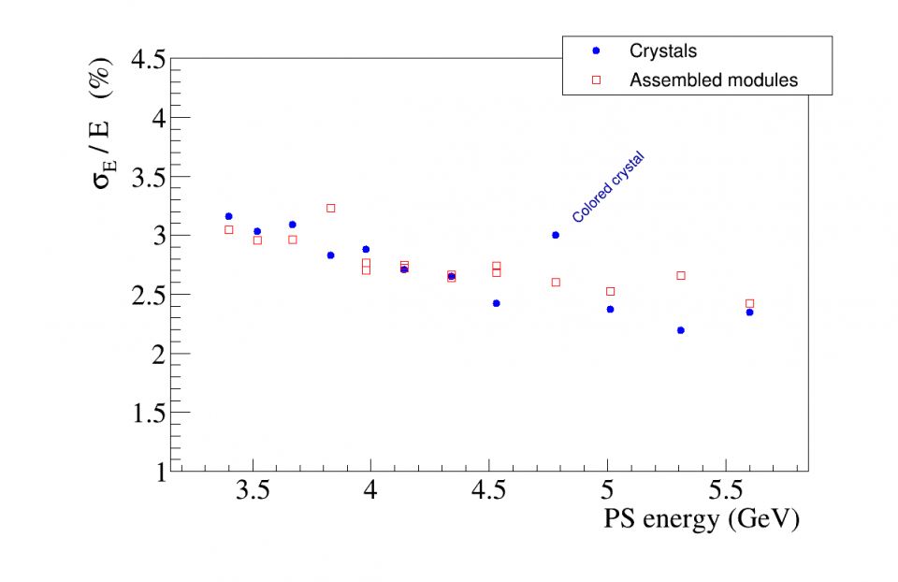
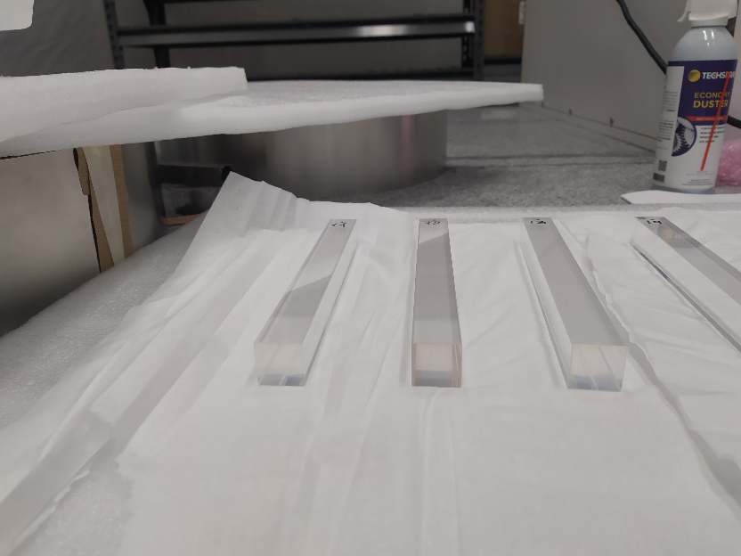
Test Results
Energy resolution of a single crystal
Test ‘suspicious’ SICCAS crystals
Brown crystal
Test crystals (more than 100 SICCAS and CRYTUR) and
FCAL 2 fabricated modules

Slide 13
Test Results
PS test setup
CCAL
Energy resolution 140 modules installed on CCAL.
Measurements during CCAL beam calibration
6 GeV
Spread of the distribution ~ 5 %

Slide 14
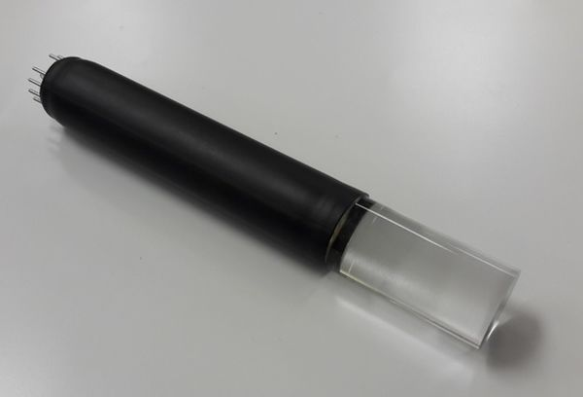
Design Optimization of FCAL 2 Modules
FCAL2 will be positioned in the fringe field of the Solenoid magnet ( B ~ 50 Gauss)
- light guides are required to shield PMTs (TOSCA calculation & measurements with Helmholz coils)
- PS setup was used to study different light guide configurations
- size, wrapping, coupling to the crystal
PMT
LG

Slide 15
Large Scale Prototype: CCAL in PrimEx - η
Nucl. Inst. Meth. A 1013 (2021) 165683
12 x 12 modules (SICCAS crystals)
Used as a Compton calorimeter in PrimEx
in 2019 and 2021
Positioned in a movable platform
(inserted into the beam for energy calibration)
- initial calibration with respect to Hall D tagger
(energy resolution 0.1 %)
- Temperature stabilization (17° ± 0.2° during run)

Slide 16

CCAL in PrimEx - η
Energy resolution
Elasticity distribution (Compton Candidates)
σ(E) = 125 MeV
( 6 GeV < E beam < 7 GeV)
$\frac{σ \left(E\right)}{E}\left(\%\right)= \frac{2.6 }{\sqrt{E}} \text{⊗}\frac{ 1.1}{E}$ ⊗ 0.6
Separation of beam bunches
Time resolution

Slide 17
Next Steps
Continue with tests of PbWO₄ crystals (mostly SICCAS) and FCAL 2 fabricated modules (test crystals for EIC if needed)
Study prototypes with SiPM readout and glass scintillator modules
(see Vlad’s talk)

