Slide 1
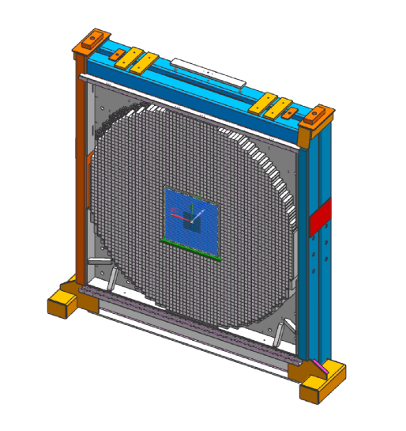
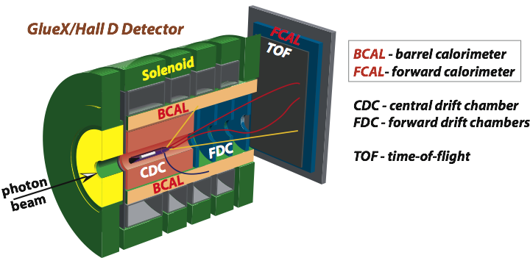
Production of FCAL2 Modules
A. Somov
on behalf of the JEF and FCAL2 construction groups
GlueX collaboration meeting, September 21, 2022

Slide 2
Introduction
- Project overview
- Fabrication of the FCAL2 insert modules
- Module design
- PbWO4 crystals
- Manpower
- Fabrication Schedule
- PMT and Active Base
- Construction schedule
https://halldweb.jlab.org/wiki/index.php/FCAL_Insert

Slide 3
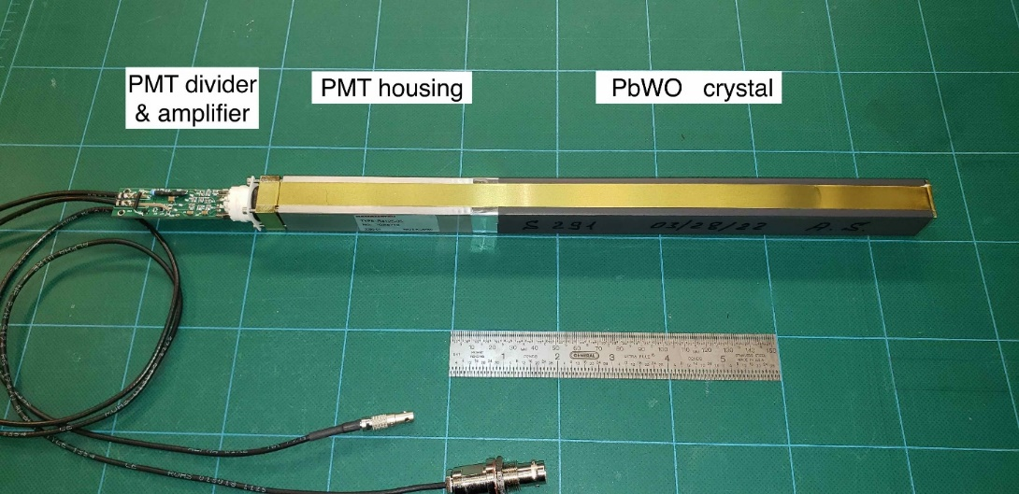
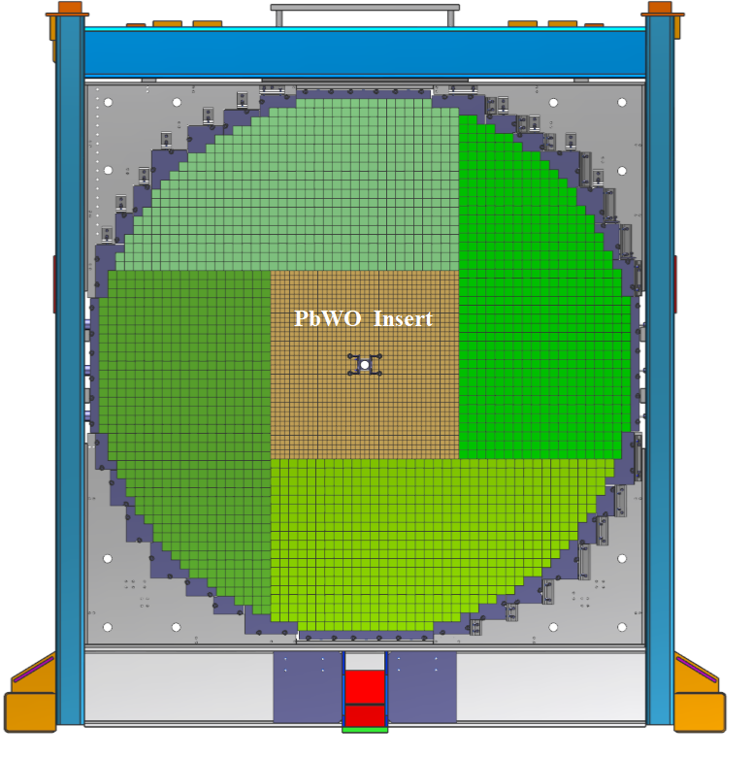
Calorimeter Upgrade
PbWO₄ module
Forward Calorimeter
Install an array of 40 x 40 PbWO₄ modules in the inner part of the FCAL
(replace lead glass modules)
- 2 cm x 2 cm x 20 cm PbWO₄
- 4 cm x 4 cm x 45 cm lead glass
A factor of 4 better detector granularity
- significantly improve shower separation
Improves the energy and position resolutions by about a factor of 2

Slide 4
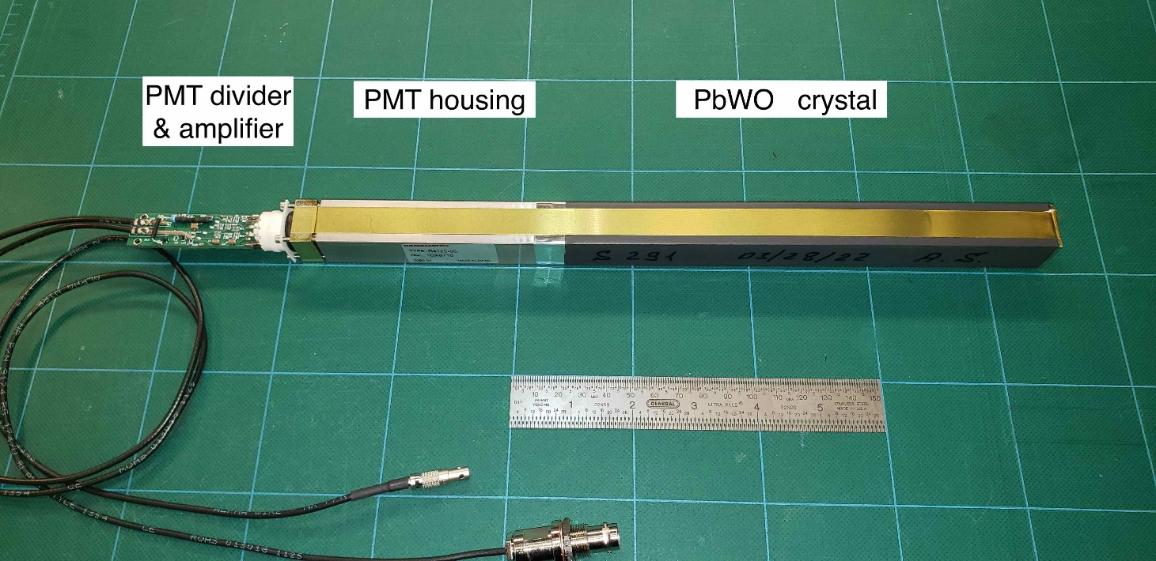
Module Design
Nucl. Inst, Meth. A, 1013, 2021
PbWO4 crystal wrapped with the ESR reflective foil and light-tight Tedlar
PMT placed inside the mu-metal cylinder(s) and soft iron housing
3.5 mm long light guide (18.5 mm diameter) is glued to the PMT and coupled to
the crystal using a silicon cookie

Slide 5
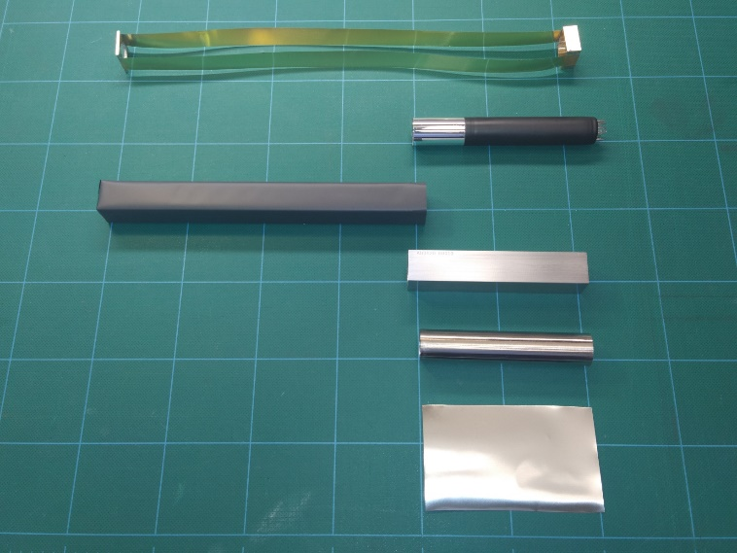
Parts for Module Assembly
Brazed strips
PMT with LG and
Silicon cookie
Wrapped PbWO₄ module
PMT housing
mu-metal cylinder
50 μm mu-metal foil

Slide 6
Project Deadline and Schedule
End of the Spring 2023 run: March 15 2023
Start working on the FCAL upgrade in April (?)
Installation of the FCAL2 modules is scheduled on the middle of June 2023
- tentative installation schedule by Tim
Expected time to integrate the FCAL2 insert into the Hall D detector is about 10 months
https://halldweb.jlab.org/wiki/images/0/0c/FCAL2_strawman_schedule.pdf
All PbWO₄ modules have to be fabricated and tested by June / July 2023
(including PMT dividers)

Slide 7
Status of PbWO₄ Crystals
SICCAS:
576 + 140 (installed on CCAL) = 716
- disassemble CCAL in January (or in March after the GlueX run)
CRYTUR:
Available: 722
Ordered: 105 (Physics DIV) Due date: December 2022
70 (Hall - D) Due date: May 2023
Total : 716 (SICCAS) + 897 (CRYTUR) = 1613
https://halldweb.jlab.org/wiki/index.php/CRYTUR
The inner part of the FCAL insert will be instrumented with the CRYTUR crystals

Slide 8
Manpower for Module Fabrication
Jefferson Lab
Sasha, Arshak, Igal - crystal fabrication, preparation of parts
Chris Alan, Keith Bklackburn - brazing straps
Bobby Bunton - honing soft iron PMT housing
Tim / Mark - coordinating engineering efforts
JLab Detector support group
George Jackobs - preshaping ESR foils, fabricating modules
Mindy Leffel - wrapping crystals
GWU
Olga Cortes – testing PMTs, producing Silicon cookies, future divider testing
UNCW
future divider testing
Summer students !

Slide 9
Summer Students
Name | Affiliation |  | May | June |  | July |  | August
Jaden Sicotte | GWU
Dax Kay | GWU
Logan Earnest | GWU
Vadim Murakhovskiy | NOVA
Jared Curry | UNCW
Adam Sears | UNCW
Gavin Boilton | UNCW
Brandyn New | Lamar
Christopher Lowe | Lamar
Aaron Martinez | Lamar
Bradley Friedman | W&M
11 summer students at JLab from: GWU, UNCW, Lamar, and William & Marry
Tasks:
QA checks of SICCAS crystals taken from Hall C
Wrapping crystals
Cutting mu-metal, ESR, Tedlar, and Kapton foils
Gluing light guides
Module fabrication

Slide 10
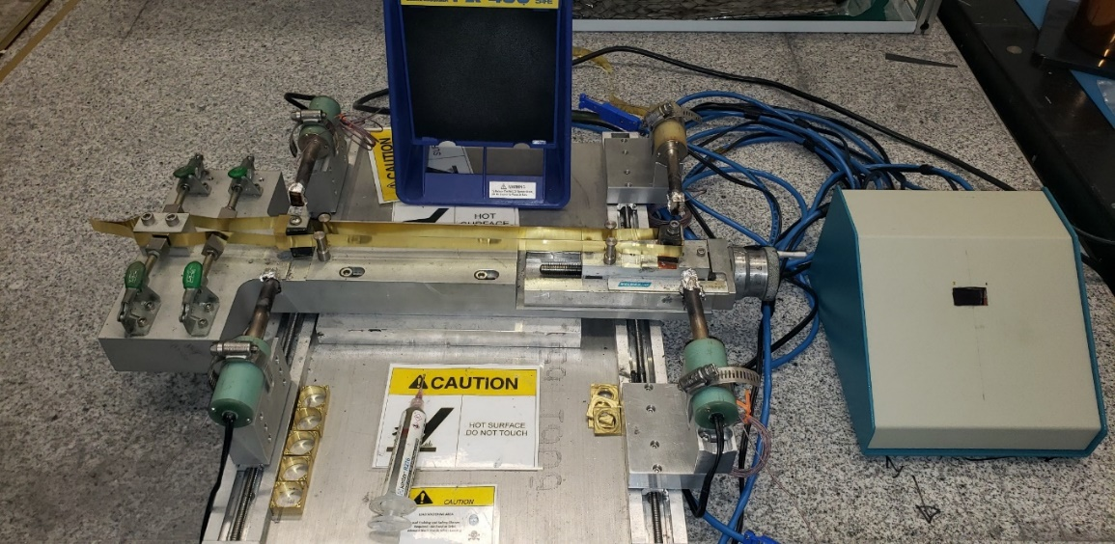
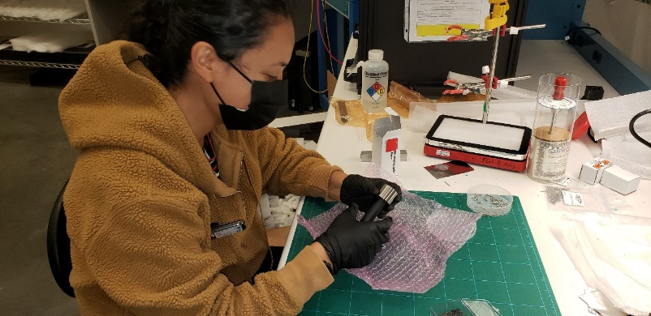
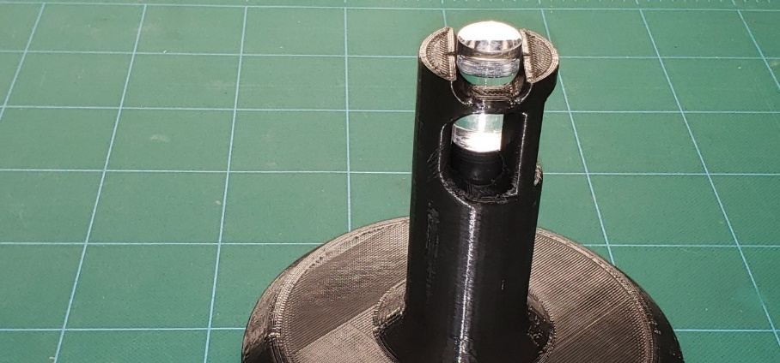
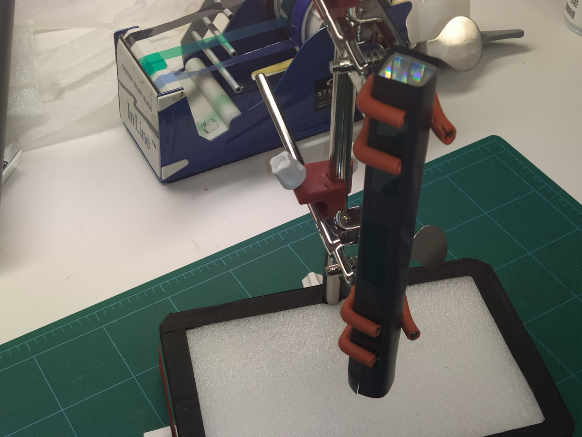
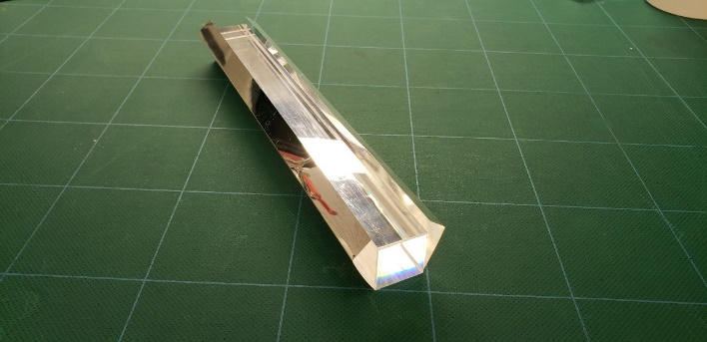
Preparation of Parts
Brazing brass assemblies
Checking PMTs
Flange
Brass strap
Flange
Heat elements
Gluing Light guides
Light guide
Wrapping crystals
PMT
Wrapping ESR

Slide 11
Parts for the FCAL Insert
receive by December
receive by the end of 2022
produce by the end of 2022

Slide 12
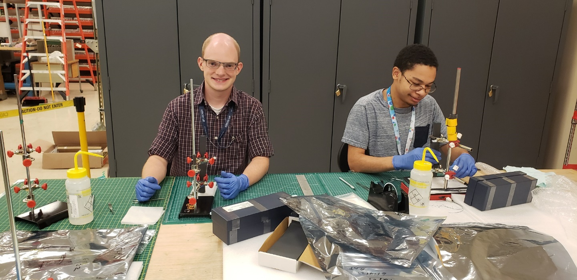
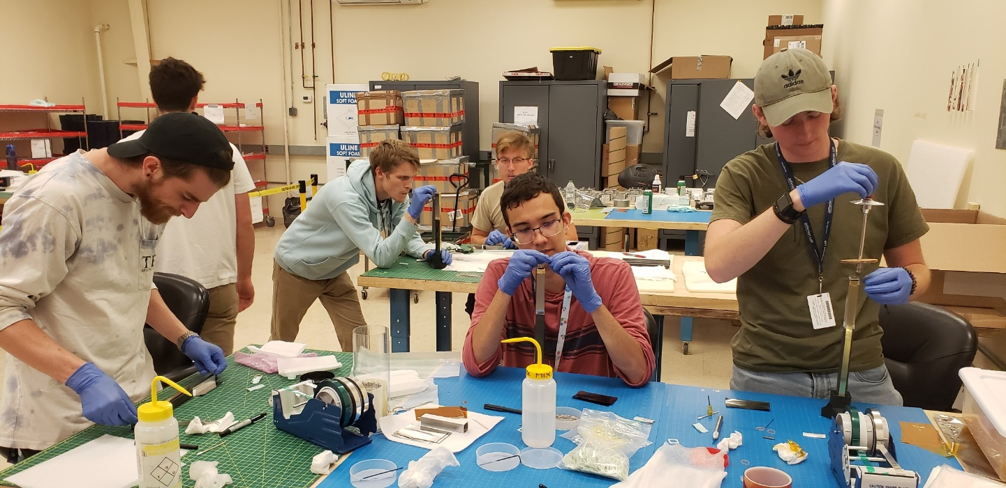
Module Fabrication

Slide 13
Module Fabrication
https://halldweb.jlab.org/wiki/index.php/Module_assembly

Slide 14
Status of Fabrication
Started module fabrication
in Feb 2022
Total number of fabricated modules: 1221
Students in the Lab
https://halldweb.jlab.org/detectors/fcal2/module_fabrication/status/

Slide 15
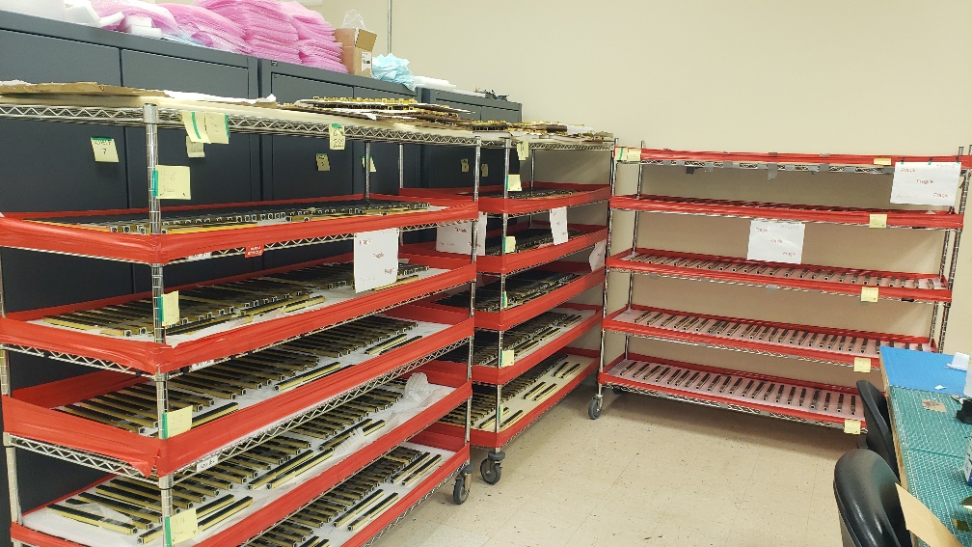
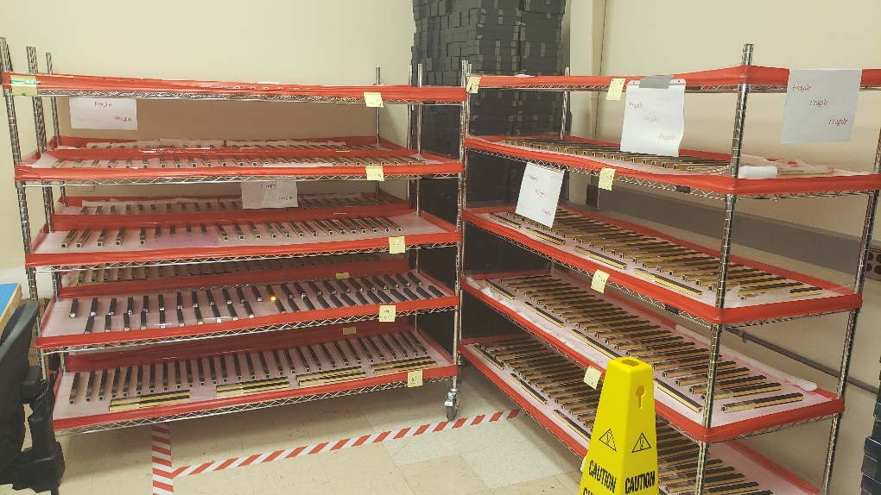
Fabricated Modules in EEL126
5 shelves and 3 lockers
https://halldweb.jlab.org/detectors/fcal2/module_fabrication/status

Slide 16
Module Fabrication Schedule
September 2022 1221 modules
December 31, 2022 1403 modules
wrap 135 crystals (Mindy)
fabricate 182 modules
January – April, 2023 1543 modules
disassemble CCAL
fabricate 140 modules
May – June, 2023 1613 modules
receive 70 Hall D CRYTUR crystals (May 2023)
(discuss if we can borrow crystals from EIC before we receive ours)
Expect to fabricate all modules by the middle of June 2023

Slide 17
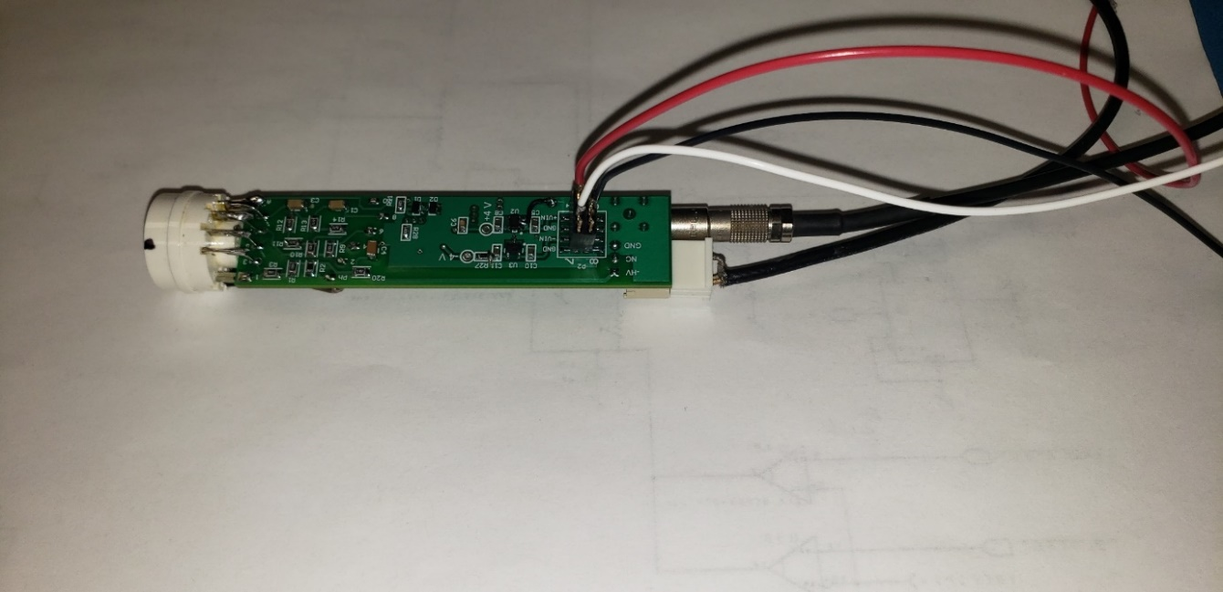
PMT Active Base
Fernando
low voltage
Signal
HV
New design of the PMT active base
- no modifications of the divider (installed on the CCAL, linear performance)
- OPS –based amplifier with a separate power (+- 5V). The default gain is 3
- switches allow to by-pass the amplifier
- initially checked in the Lab; need to perform more tests (ongoing)
- need about 6 months to produce and test all dividers
- order in October / November

Slide 18
Preparation for the FCAL2 Installation
Regular FCAL2 installation meetings organized by Tim
see Tim’s talk (s)
https://halldweb.jlab.org/wiki/index.php/FCAL_2_Installation_Meetings
- Coordinating with Fernando cable distributions
and connectors
- Installation procedures (module stacking, etc.)
Tasks for summer students:
- disassemble & sort out FCAL modules
- refurbish lead glass modules
- check PbWO modules in Hall D before installation
We will need at least 6 students during summer 2023

Slide 19
Summary
We have 1438 PbWO crystals available in the lab
- expect to receive 105 crystals by the end of this year and 70 crystals by
May of 2023
We expect to fabricate all modules by the middle of June 2023
We have fabricated 1221 FCAL insert modules (about 77 % )
- a lot of work was done by students during summer
- 11 students were involved in the project
PMT active base prototypes are being tested in the lab. We expect to order them
in October / November
- active bases will be tested at JLab (GWU and UNCW)
We started working on the FCAL installation procedures
- Tim is organizing a biweekly installation meeting

Slide 20
Backup Slides

Slide 21
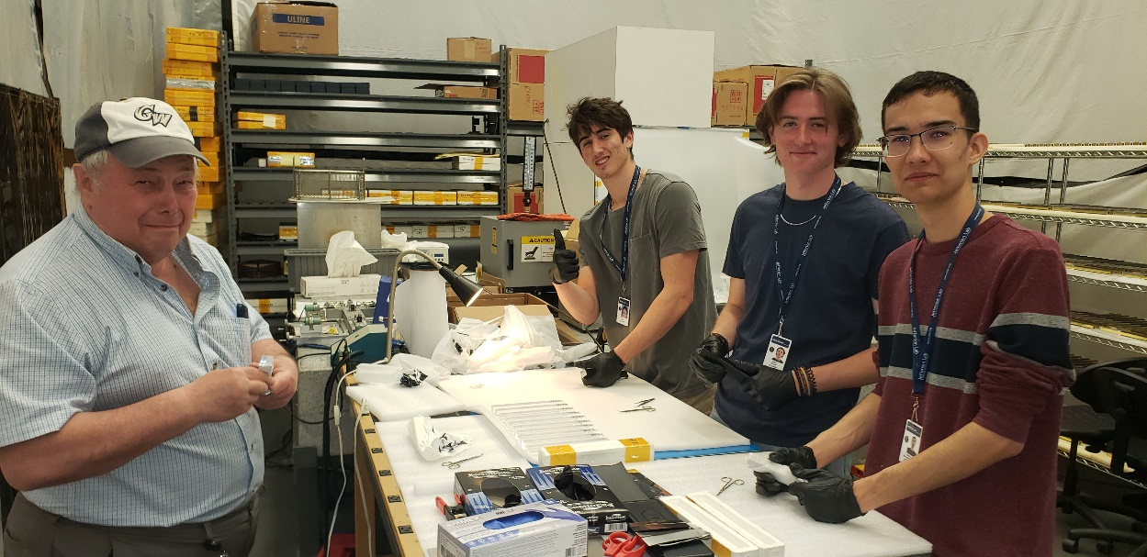
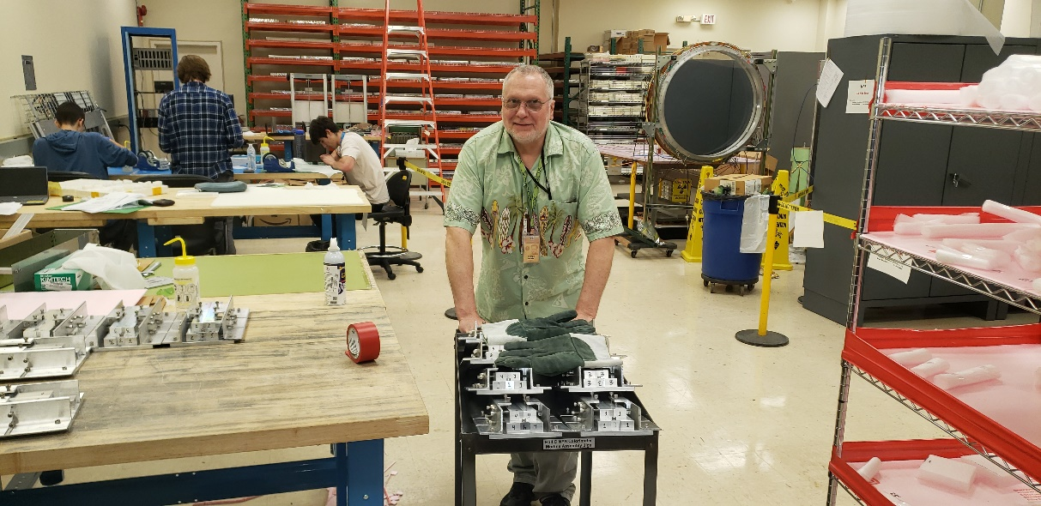
FCAL 2 Fabrication Labs
TEDF high bay
EEL 118

Slide 22
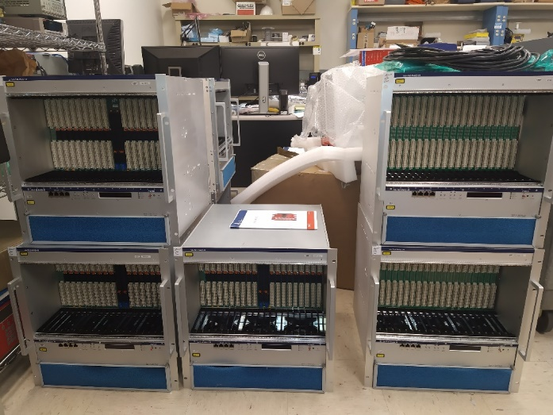
Electronics
Main components have been purchased for
the FCAL insert (1600 modules)
VXS crates
VXS crates
VXS Controllers
FADC 250
Trigger electronics (TI, SD, VTP, SSP, TD)
CAEN HV (A 7030 N) units and main frames
LV MPOD HV and signal cables
Recently ordered: LEMO connectors
Need to order: LV cables, LV and HV (3 pin) connectors, electronics for the LMS (TDB)

Slide 23
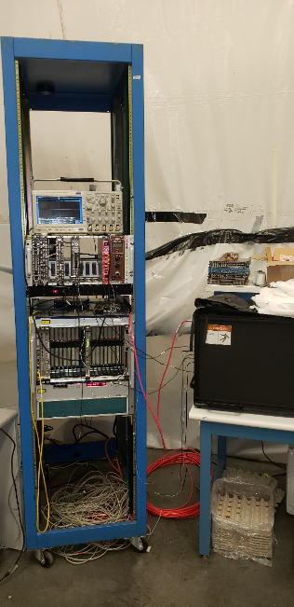
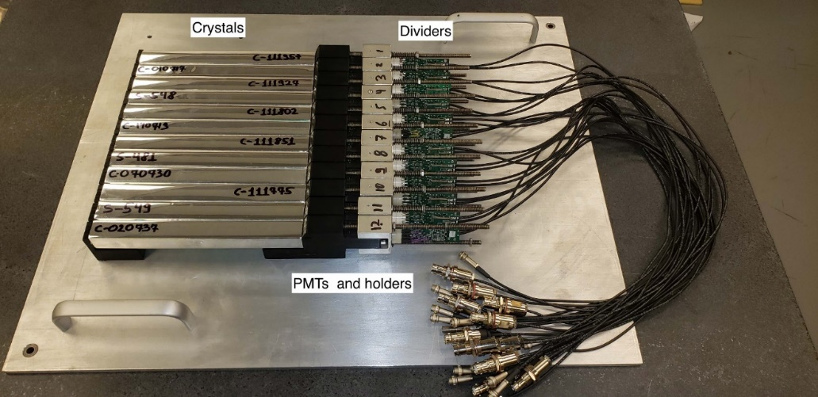
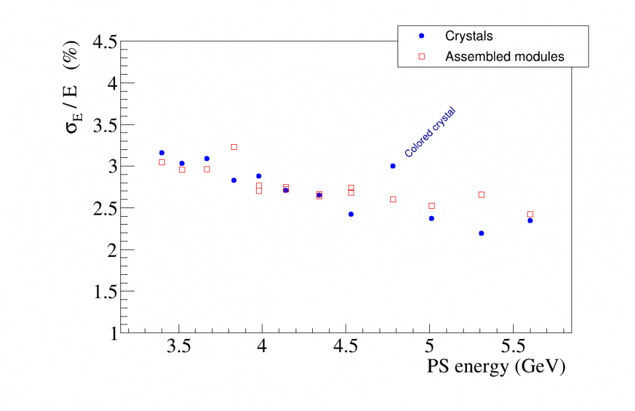
Tests of Fabricated Modules
1 ) Use LEDs to check PMTs on fabricated modules
- have to check all modules
2 ) Use PS test setup to check some preselected modules
Energy resolution of a single crystal
3) Test PMT active bases (JLab, GWU, UNCW)
- check all active bases

Slide 24
Cable Distribution inside FCAL Dark Room
Fernando and Chris

Slide 25
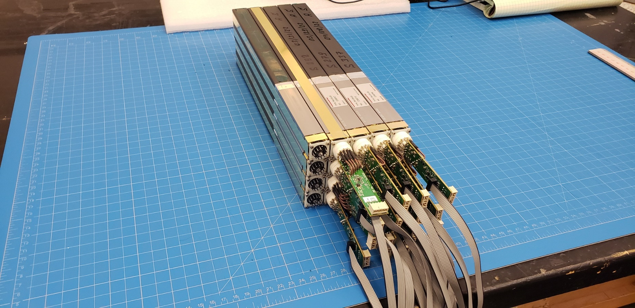
LV Cable distribution

Slide 26
Crystal QA Tests
Visual inspection
Measurement of crystal dimensions
Measurement of light transmission
Measurement of light yield
Crystal properties and testing procedures
Nucl.Instrum.Meth. A956 (2020) 163375
Initial inspection of crystals at SICCAS by Wuhan group
- about 15% of crystals from the second batch rejected !
https://halldweb.jlab.org/wiki/index.php/PWO_Crystals

Slide 27
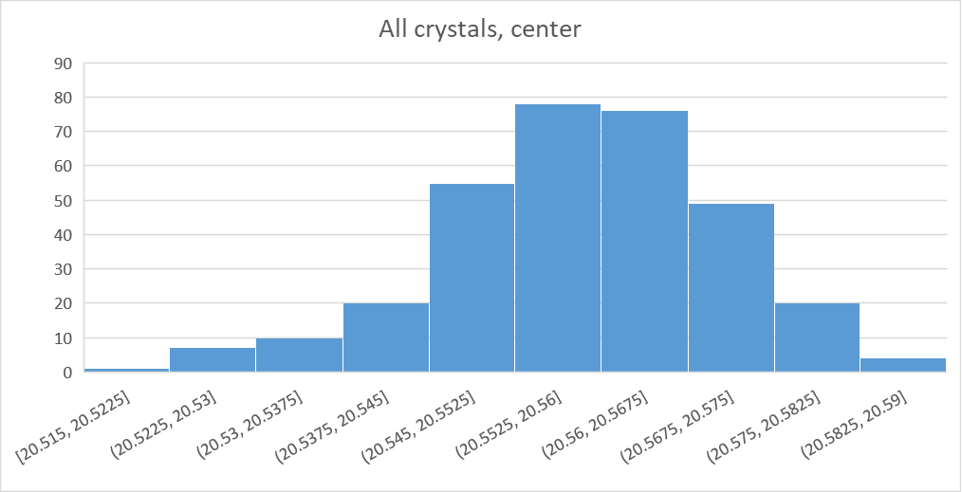
Crystal Dimensions
Perform visual inspection and measure dimensions of all received crystals
Crystal quality chart:
https://halldweb.jlab.org/wiki/index.php/Second_Batch_(160_crystals)
Crystal | Size |  |  | Size |  |  | Color | Scratch/Chip/Face | Bubble (%) /Layer | Blur | Chamfers | PS setup
246 | 20.501 | 20.555 | 20.502 | 20.514 | 20.565 | 20.506 | 0.5 |  |  |  | face small
247 | 20.533 | 20.558 | 20.511 | 20.519 | 20.557 | 20.527 |  |  | 30/0
248 | 20.518 | 20.554 | 20.521 | 20.504 | 20.55 | 20.529
249 | 20.53 | 20.562 | 20.512 | 20.529 | 20.565 | 20.521
250 | 20.518 | 20.557 | 20.512 | 20.491 | 20.537 | 20.493 |  | 1/0/0 | 5/2
251 | 20.514 | 20.553 | 20.51 | 20.502 | 20.548 | 20.496
252 | 20.476 | 20.549 | 20.506 | 20.503 | 20.558 | 20.515
253 | 20.509 | 20.549 | 20.507 | 20.513 | 20.55 | 20.512 |  | 0/0/1 | 30/1 | 1
254 | 20.502 | 20.563 | 20.516 | 20.519 | 20.562 | 20.514 | 1 brown |  | 10/0
Average crystal size (SICCAS):
20.56 mm
- consistent with crystals from
previous batches
The size of CRYTUR crystals is
20.5 mm

Slide 28
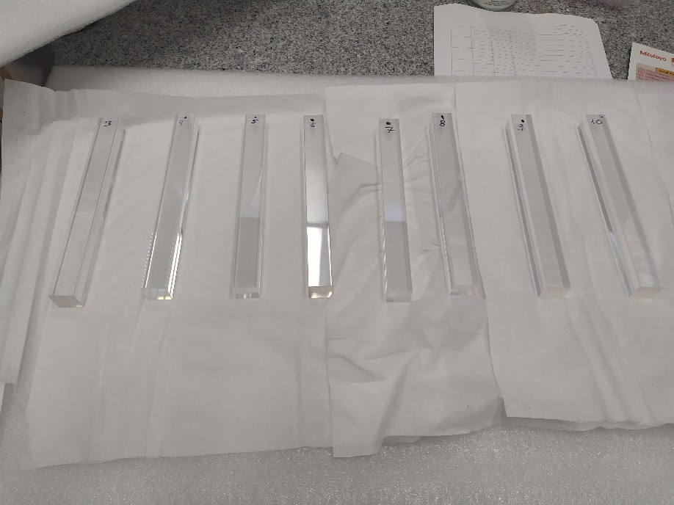
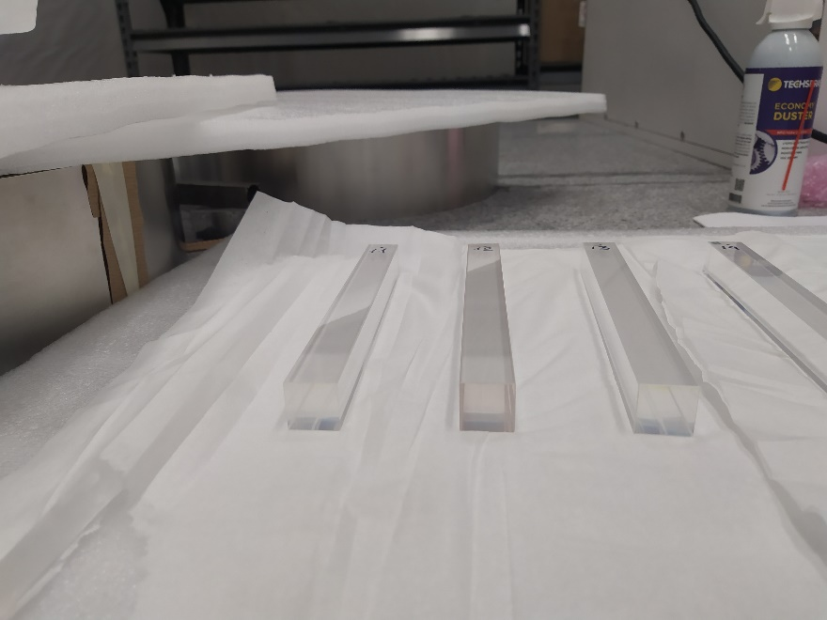
Visual Inspection
Check crystal color
Use laser pointer to observe cloudy regions
Check edge quality for scratches and chips
Brown
about 10 % crystals have some small discoloration signs

Slide 29
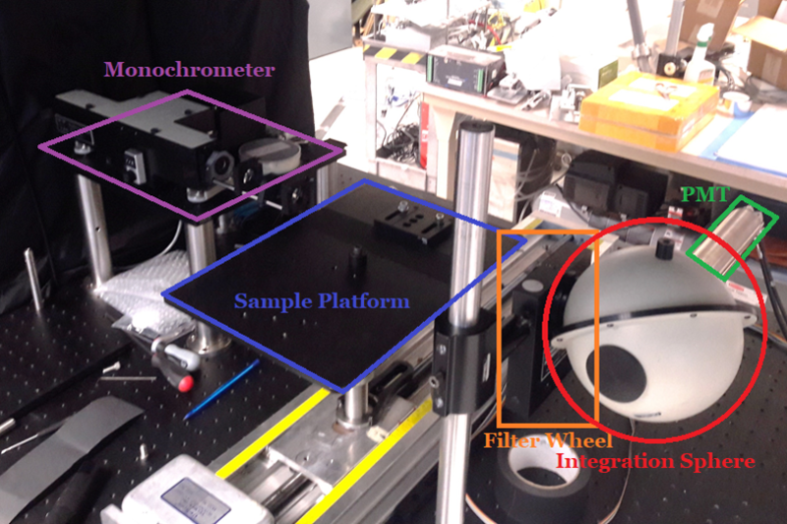
Light Transmission Measurement
Setup in Carl Zorn’s lab
Measured transmission of 30 SICCAS crystals from the second batch:
- selected crystal with some discoloration signs after optical inspection
- correlation between the crystal color and transmission

Slide 30
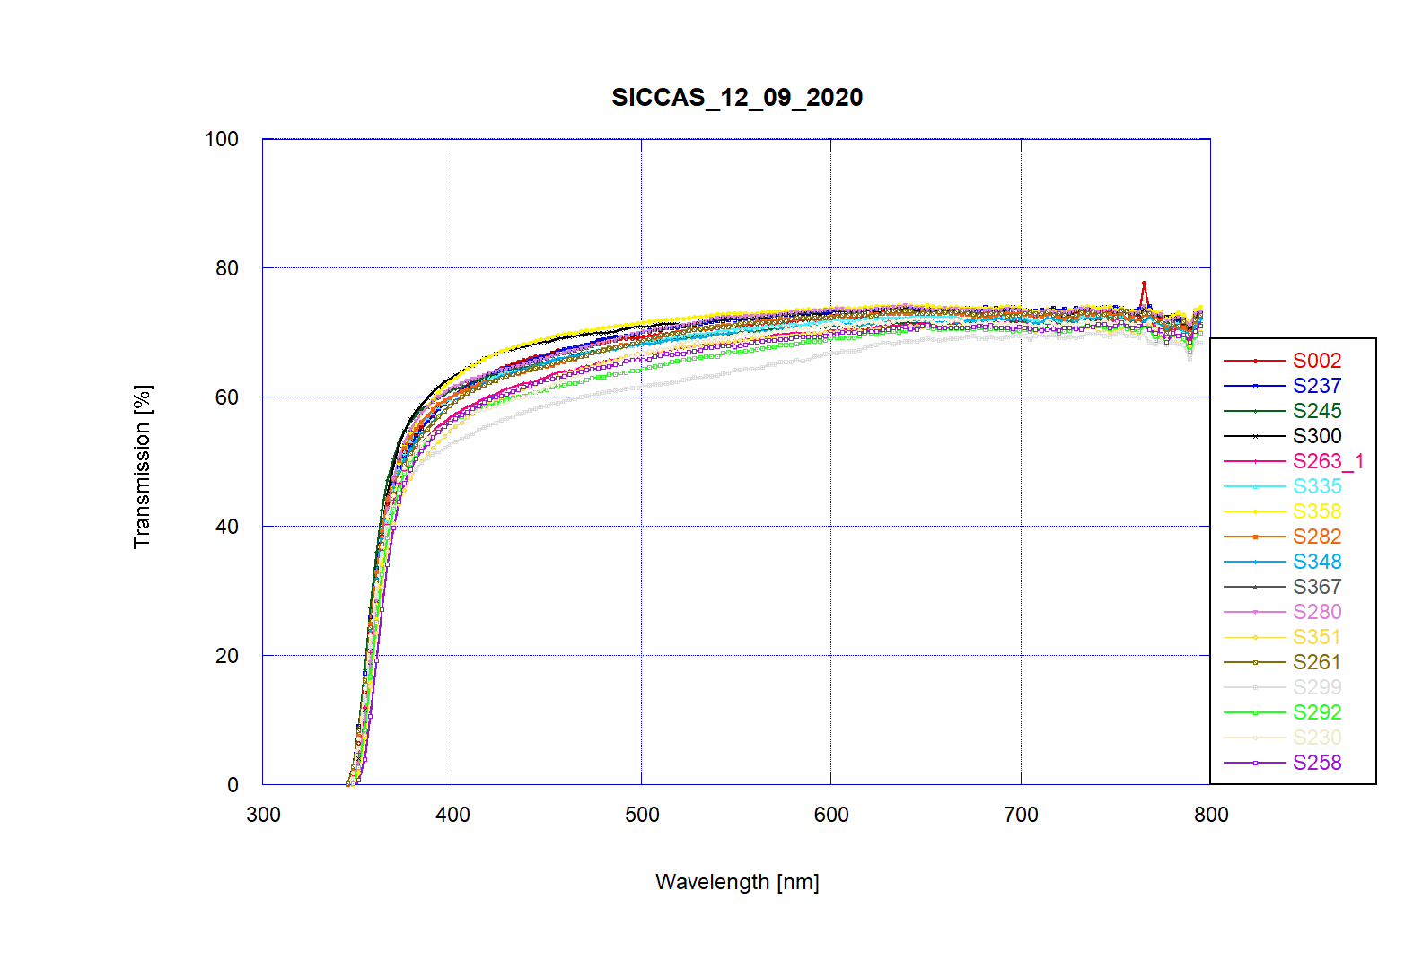
Light Transmission Measurement
colored crystals
10 colored crystals
in the test
Measured crystals meet our specs
Good consistency between our results and measurements at SICCAS

Slide 31
PMT Active Base
Consider to use an active PMT base designed for the NPS (Hall C)
- the base consists of the divider and an amplifier (original gain of 24)
The Active Base was installed on CCAL and used during the PrimEx run in spring 2019
- observed non-linear performance
- linearity was improved after reducing gain
- non–linear performance verified using bench tests
https://halldweb.jlab.org/JEF/meetings/feb_11_2021/fcal_amp_lin.pdf
New Active PMT Base for PbWO4 (Popov, H. Mkrtchyan, presentation at IEEE, Nov 2012)
CCAL was testes in GlueX runs at high luminosity
- studied detector rates
- an amplifier will the small gain ( between 3 and 6) will be needed for inner FCAL layers

Slide 32
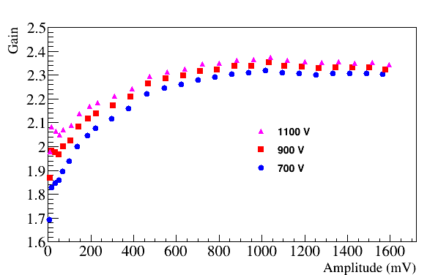
PMT Active Base
Amplifier Gain (A _{amp} / A _{HP} )
2.5 GeV
10 GeV
Relatively stable gain for amplitudes between 0.5 V and 1.6 V
Non linearity on the level of 10 % below 0.5 V

Slide 33
PMT Active Base
Several improvements by Vlad Popov in order to improve performance
- tests are ongoing
Several meetings with Fernando and Vlad. May consider to use
alternative solutions:
- use on-board amplifier, provide additional power to the amplifier
(decouple power for divider and amplifier), use one extra cable to each PCB)
- use external amplifiers for modules in inner layers (place inside dark room ?)
Test of PMT dividers can be performed outside JLab
- several universities are interested to participate: Regina, GWU, UNCW

Slide 34
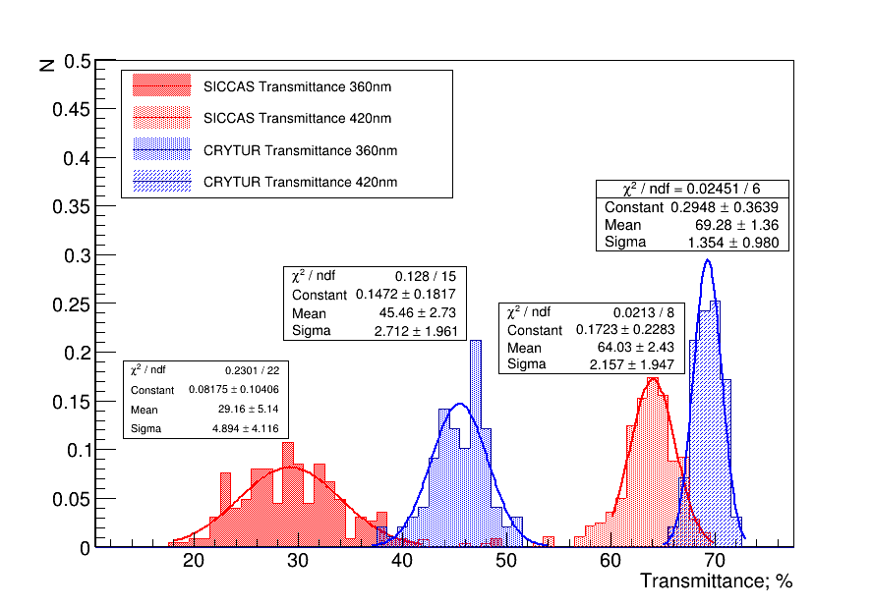
Crystal Transmittance

Slide 35
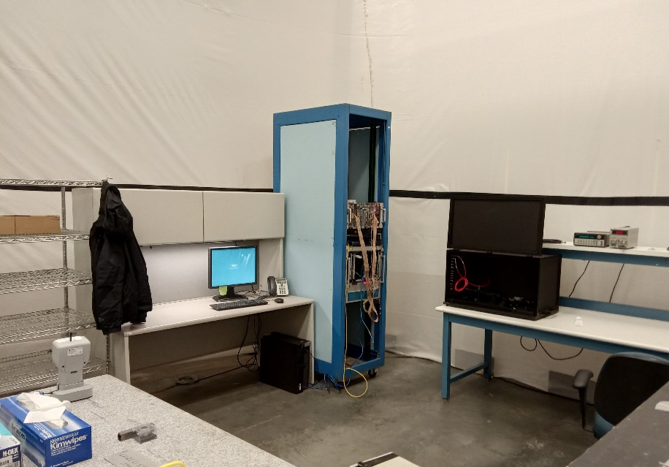
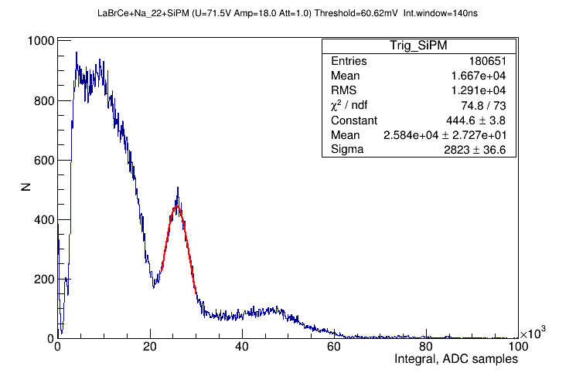
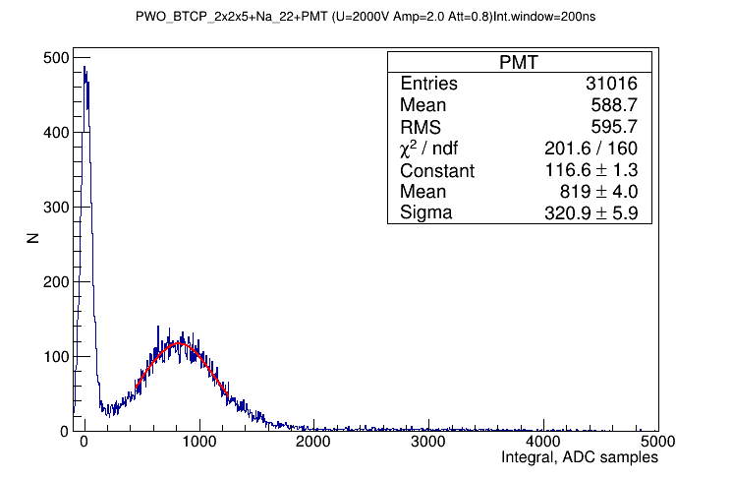
Light Yield Setup
Trigger
LaB_{r}(Ce) scint
Na-22 β+ and gamma source
- two 0.511 MeV photons. One used
for the trigger
New setup at TEDF (similar to NPS lab)
- crate with readout electronics
- CODA running on local PC
PWO

Slide 36
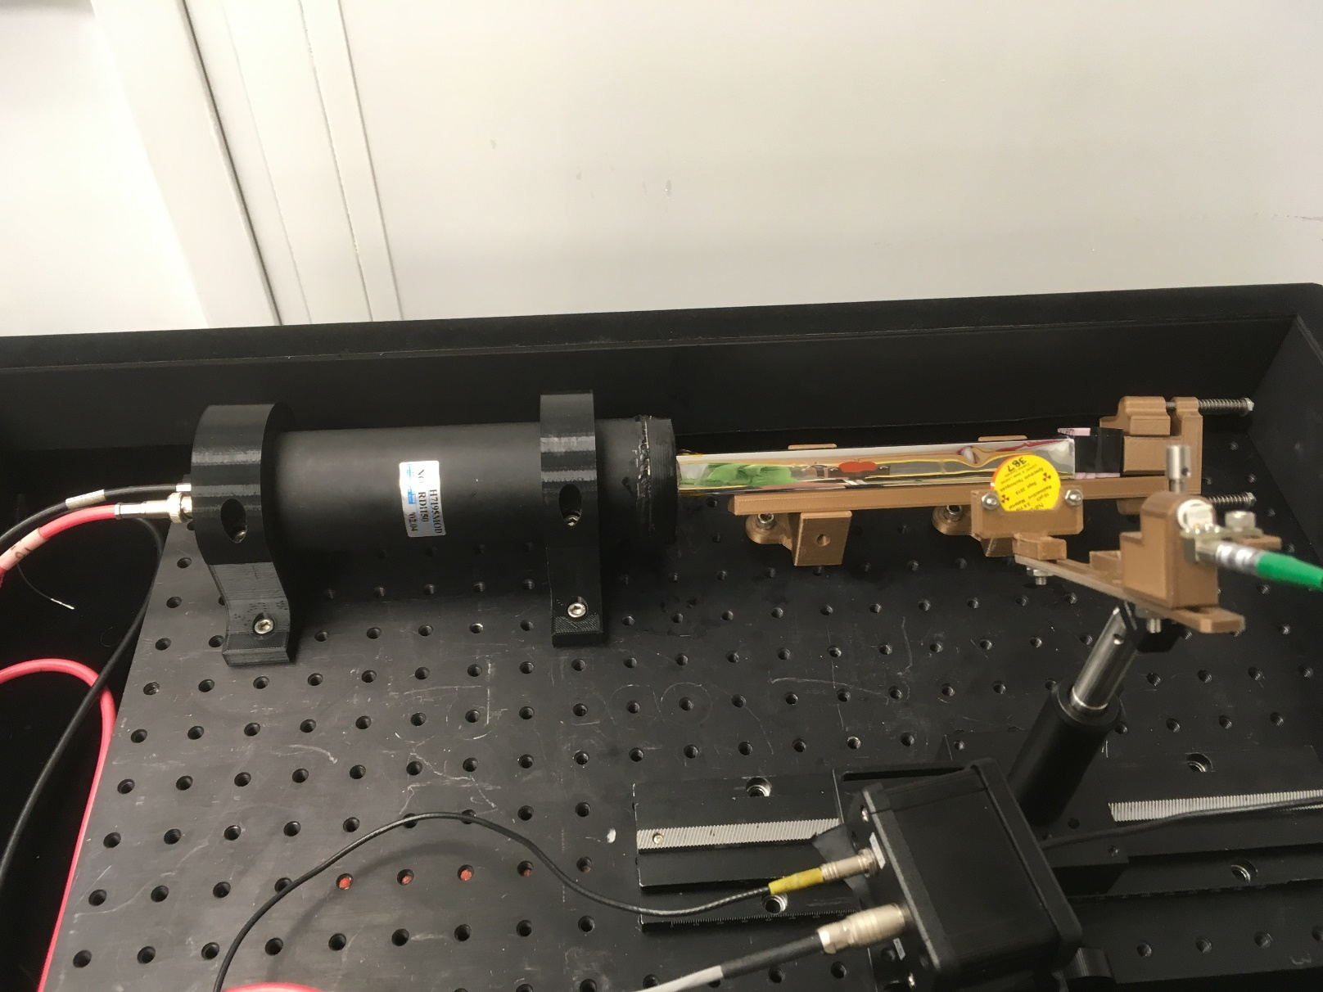
Light Yield Setup

