Slide 1



AI/ML optimized polarization
Naomi Jarvis, Workshop on Polarized Target Studies with Real Photons in Hall D, 21 February 2024
2y DOE grant, EPSCI-led, waiting for funds to arrive
David Lawrence, Thomas Britton and Torri Jeske (JLab Experimental Physics Software and Computing Infrastructure)
Naomi Jarvis and Jiawei Guo (CMU Physics), Cristiano Fanelli and Patrick Moran (W&M Data Science)
Steven Goldenberg, Daniel Lersch and Malachi Schram (JLab Data Science)
Hovanes Egiyan (JLab diamond target expert) and James Maxwell (JLab cryo-target expert)

Slide 2
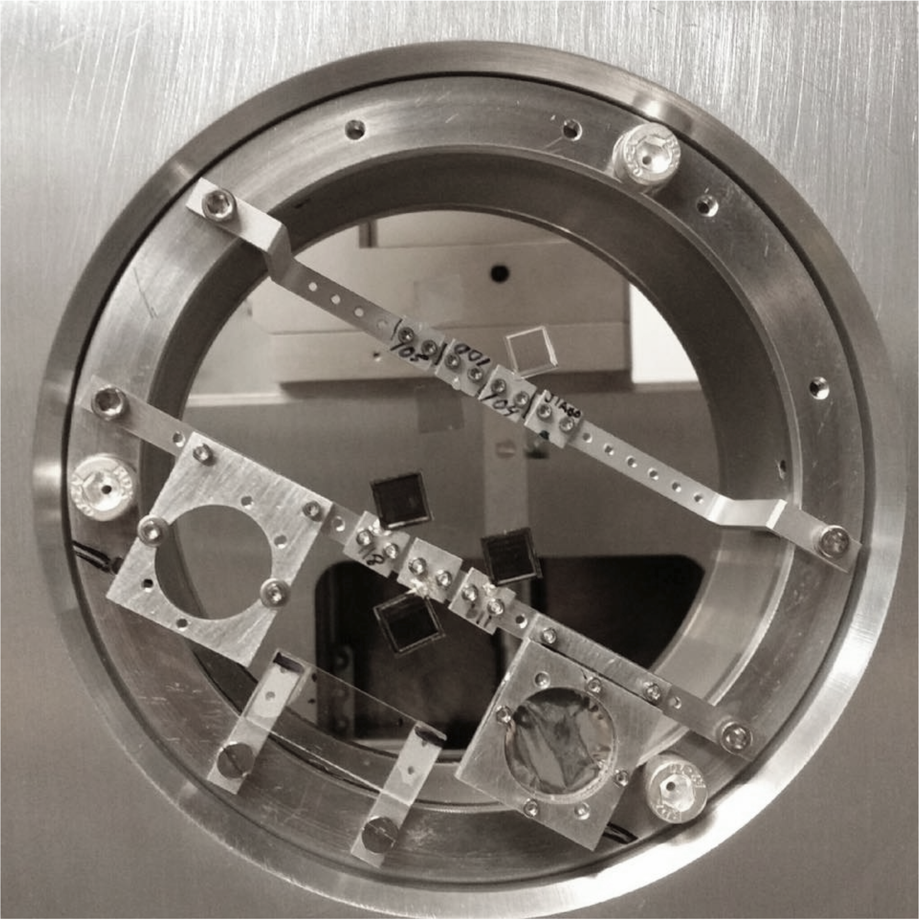
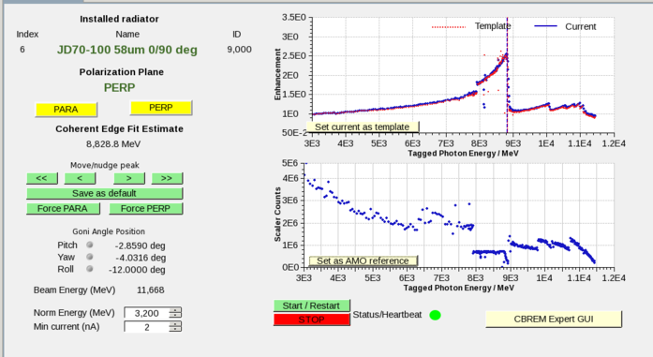
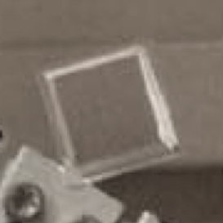
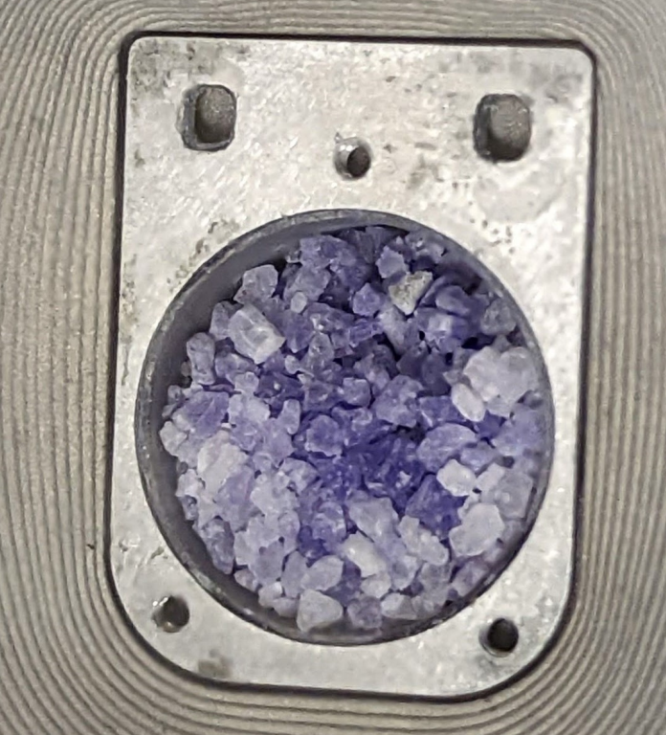
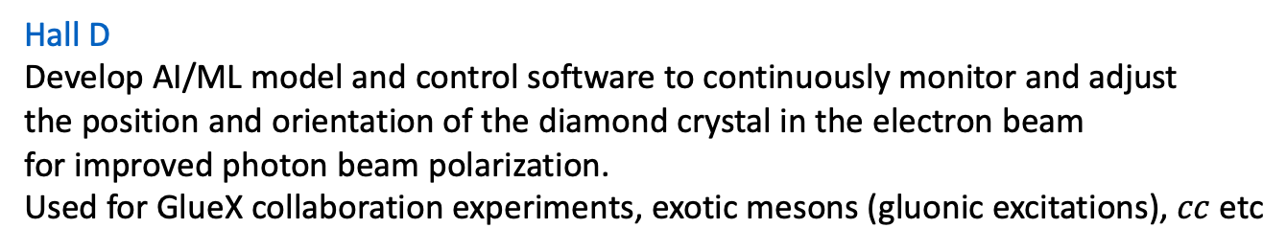
AI/ML optimized polarization at Jefferson Lab
Hall D
Develop AI/ML model and control software to continuously monitor and adjust
the position and orientation of the diamond crystal in the electron beam
for improved photon beam polarization.
Used for GlueX collaboration experiments, exotic mesons (gluonic excitations), $cc$ etc
_
Hall B
Develop AI/ML model and control software to continuously monitor and adjust
the frequency of the microwave source used for polarizing the cryo-target protons
via hyperfine interaction. Use NMR to measure polarization.
Used for CLAS-12 collaboration experiments, quark spin studies, etc.
Naomi Jarvis, Workshop on Polarized Target Studies with Real Photons in Hall D, 21 February 2024

Slide 3
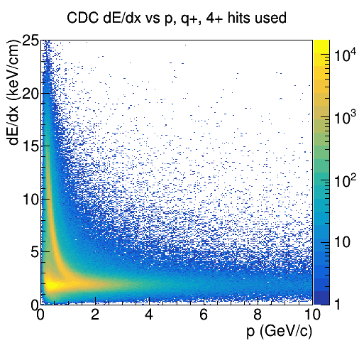
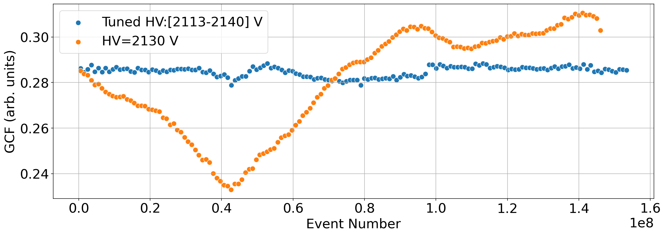
Our earlier work: RoboCDC – automatic gain stabilization for GlueX CDC
The polarized target projects would follow a development strategy broadly similar to that for RoboCDC, different in detail.
CDC: central drift chamber, straw tube gas filled tracking detector surrounding GlueX target
Signal time used to locate charged particle tracks
Energy deposition used for charged particle identification
Pulse height varies +/- 15% with atmospheric pressure, data acquisition stops & restarts whenever ΔP > limit
Calibrations afterwards correct for gain changes. RoboCDC reduces gain changes, improves monitoring, speeds calibrations.
Gain correction factor vs time, ML-tuned and constant HV
Event number, approximately proportional to time
Naomi Jarvis, Workshop on Polarized Target Studies with Real Photons in Hall D, 21 February 2024

Slide 4
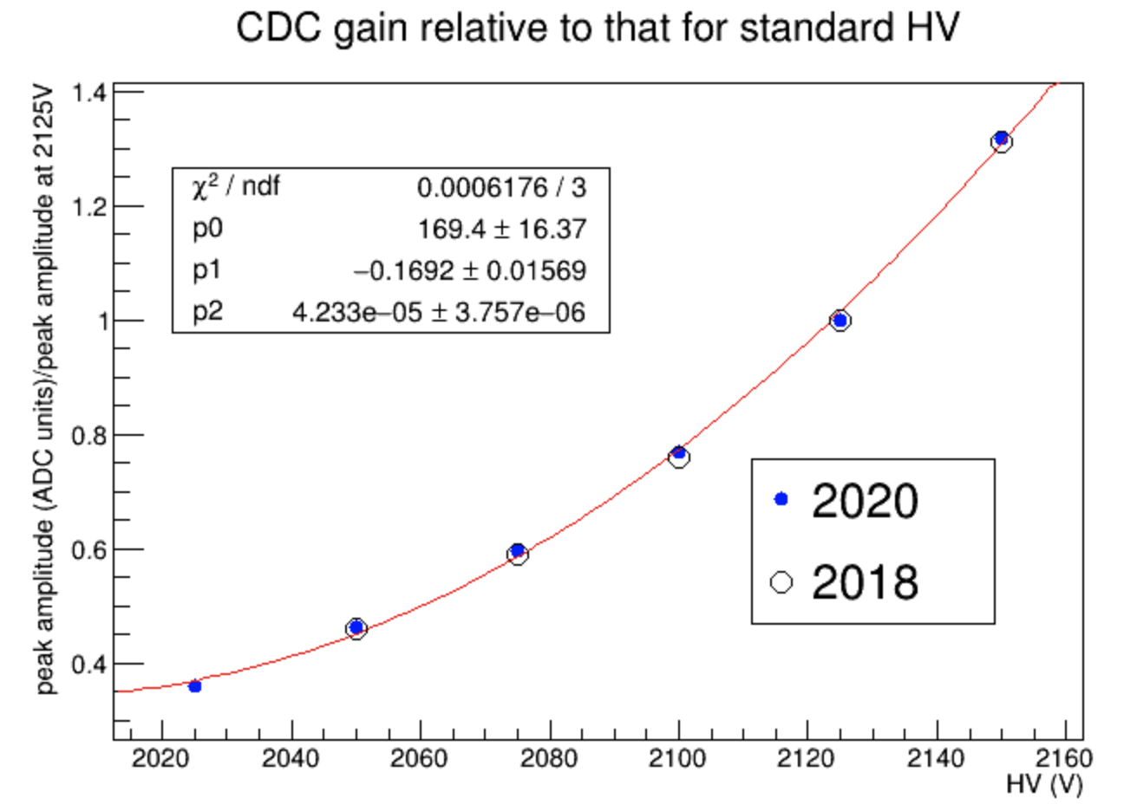
RoboCDC – how it works
Atmospheric pressure
Hit rate (HVB current)
ML
Gain
Calibration Factors
CDC HV
CDC gain
Temperature
AI/ML model: Gaussian Process Regression
Trained using environmental data + conventional GCFs
Main dataset has 984 runs, divided 80:20 for train/test
The model uses environmental data to predict GCF in a few seconds
ACAT-2021 paper
Naomi Jarvis, Workshop on Polarized Target Studies with Real Photons in Hall D, 21 February 2024

