Slide 1
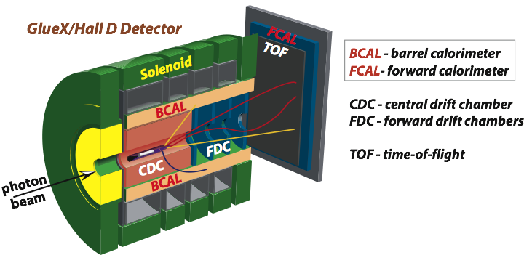

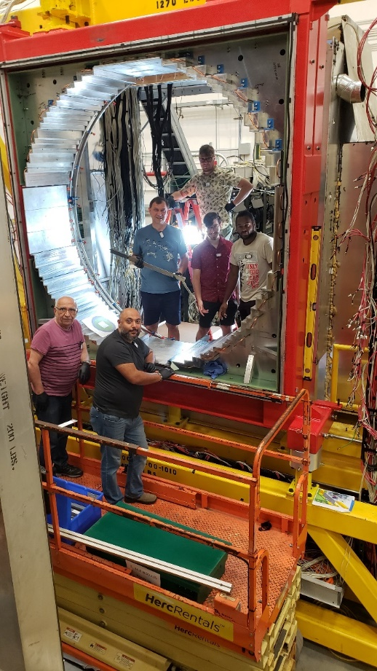
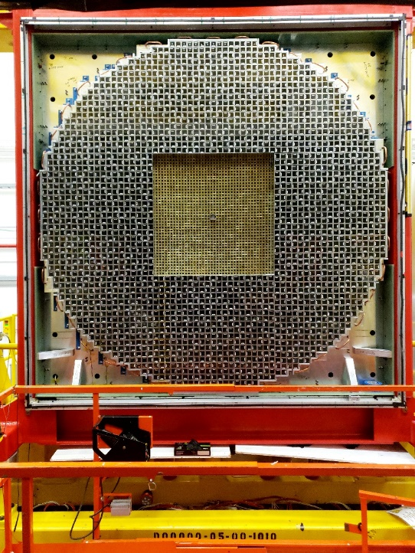
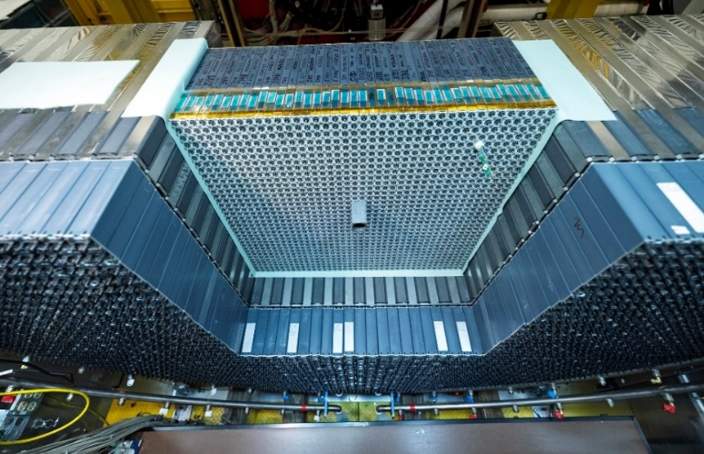
Status of the ECAL Commissioning
Somov Jefferson Lab
on behalf of the JEF working group
February 14, 2024

Slide 2
Overview
Calorimeter upgrade for the JEF experiment
ECAL requirements (charge 3)
ECAL overview
ECAL installation and testing (charge 1)
Temperature of ECAL dividers and modules (charge 1, 2, and 3)
Commissioning and testing schedule (charge 1 and 3)
Procedures for tuning the detector (charge 3)
Operation manual (charge 4 and 6)
Safety documents (charge 6)

Slide 3
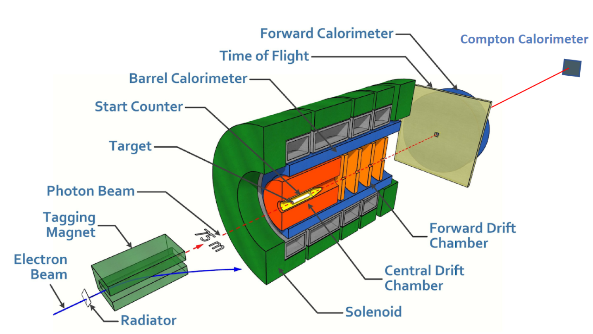
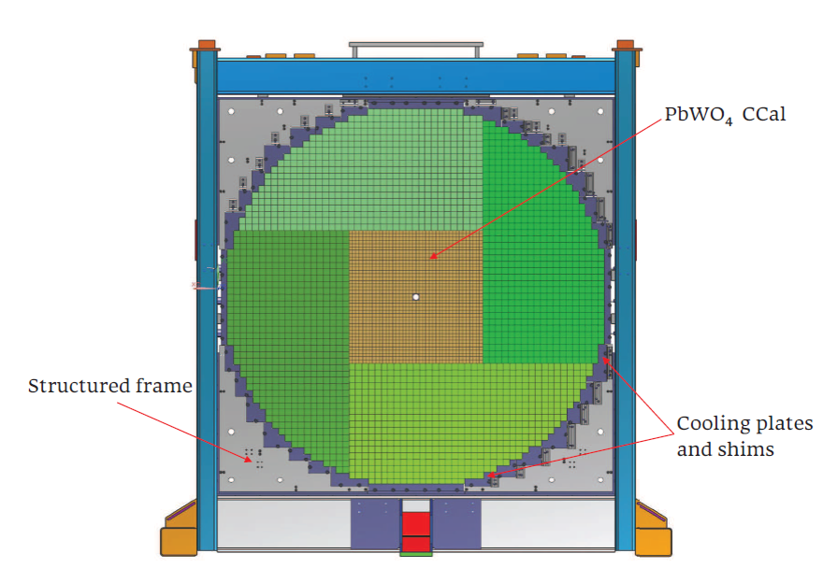
JEF Experiment using GlueX Detector
Forward Calorimeter Upgrade
Eta Calorimeter (ECAL)
Upgrade the inner part of the lead glass Forward Calorimeter with high-granularity high-
resolution PbWO₄ crystals to improve reconstruction of multi-photon final states
Produce η / η ′ using a beam of tagged photons with the energy between 8.4 - 11.7 GeV
Reconstruct η / η ′ in exclusive reactions:
Run in parallel with other GlueX experiments: collect large data set of η / η ′ mesons (approved for 100 PAC days)
γ+p → η/ηꞌ + p
η/ηꞌ → γγ, π⁰ γ γ , . . .

Slide 4
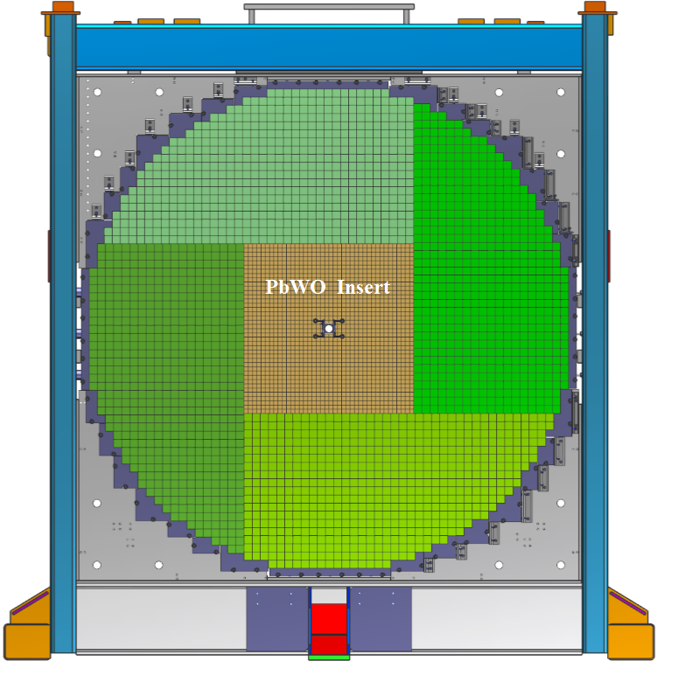
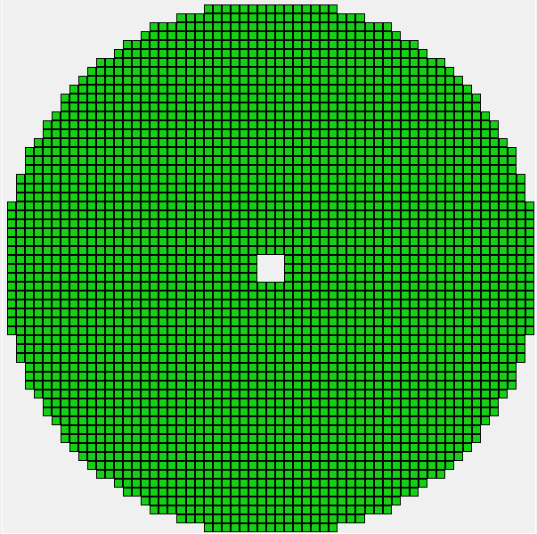

Forward Calorimeter Upgrade
Nucl. Instrum. Meth. A 987, 164807 (2021)
ECAL
2800 lead glass modules (taken from E852 experiment at BNL)
- lead glass block size: 4 cm x 4 cm x 45 cm
Photodetectors: FEU 84-3 PMTs with Cockroft-Walton bases
The energy resolution:
Replace lead glass modules in the inner part
of the detector with high-granularity high-
resolution lead tungstate scintillating crystals
$\frac{σ \left(E\right)}{E}\left(\%\right)= \frac{6.2 }{\sqrt{E}} $ 4.7
Eta Calorimeter (ECAL)

Slide 5
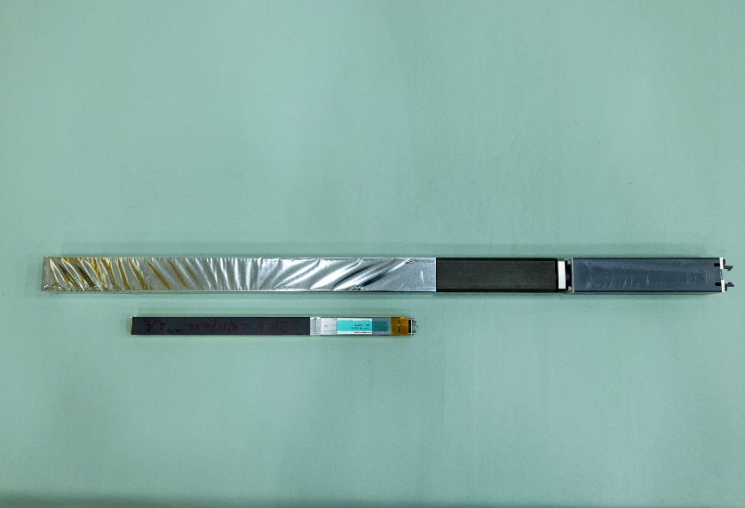
Lead Tungstate Eta Calorimeter (ECAL)
ECAL consists of an array of 40 x 40 PbWO₄ (1596) modules
(50 x 50 modules in the original proposal)
- 2 cm x 2 cm x 20 cm PbWO₄ crystal (SICCAS, CRYTUR)
- 4 cm x 4 cm x 45 cm lead glass block
Lead Glass & PbWO₄ modules
ECAL installation required:
- removing all lead glass blocks
- modifying the detector mounting frame, installing cooling blocks
- installing lead glass and lead tungstate modules (ECAL installation time 1.5 years, the project cost of $5.5 M)

Slide 6
ECAL Requirements
Charge 3
Improves reconstruction of photons in the forward direction
About a factor of 4 better granularity (small Moliere radius) of the ECAL compared to the FCAL significantly
improves separation of showers
About a factor of two better energy and position resolutions
- stochastic term in the energy resolution better than 3 % , constant term 1-2 %
- light yield depends on temperature ~3% /C at room temperature
- cool down the detector frame
- temperature stability: ± 0.2° C
Timing resolution: Capable of resolving beam bunches (for multi-photon final states)
the PbWO4 crystals are also more radiation resistant than glass
Verified the key performance parameters using a large-scale prototype
used in the PrimEx η experiment in Hall D
in 2019, 2021, 2022 to reconstruct Compton
scattering events

Slide 7


Beam Tests of the Calorimeter Prototype
Nucl. Inst. Meth. A 1013 (2021) 165683
Energy resolution
Elasticity distribution (Compton candidates)
$\frac{σ \left(E\right)}{E}\left(\%\right)= \frac{2.6 }{\sqrt{E}} ⊕\frac{ 1.1}{E}$ $$ 0.6
σ(E) = 125 MeV
( 6 GeV < E beam < 7 GeV)
Time resolution
Separation of beam bunches
σ _{t}$\left(ns\right)= \frac{0.32 }{\sqrt{E}} ⊕ 0.09$

Slide 8
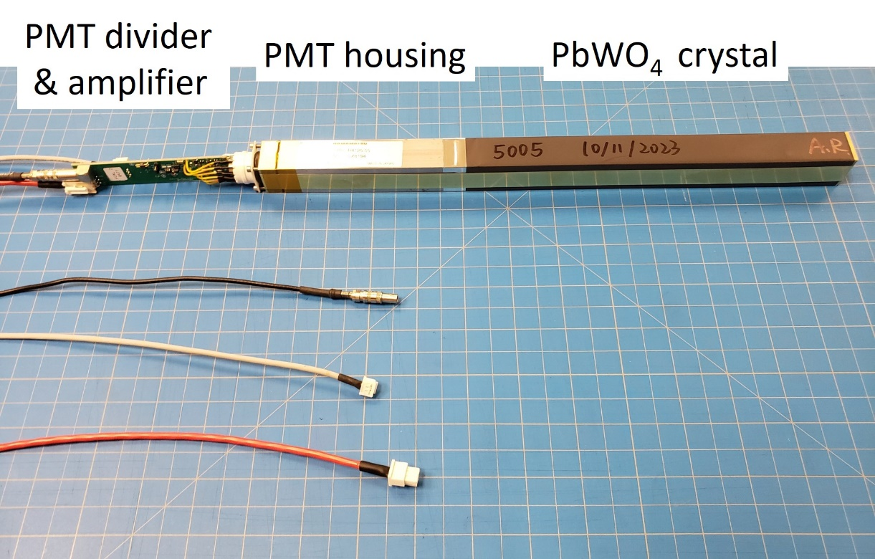
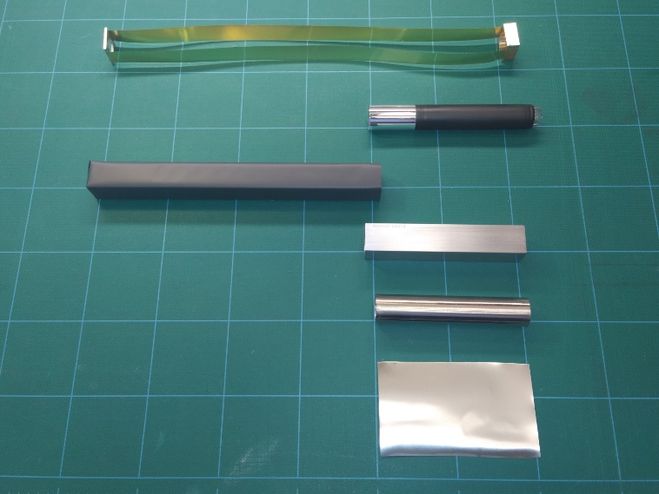
ECAL Module Design
Brazed brass strips
PMT with light guide and
silicon cookie
Wrapped PbWO₄ module
PMT housing
mu-metal cylinder
50 μm mu-metal foil
PbWO₄ crystal wrapped with the 65 μm thick ESR reflective foil and light-tight Tedlar
Hamamatsu R4125 PMT placed inside the 350 μm and 50 μm mu-metal cylinders and soft iron housing
3.5 cm long light guide (18.5 mm diameter) is glued to the PMT and coupled to the crystal using a silicon cookie
PMT divider attached to the socket

Slide 9
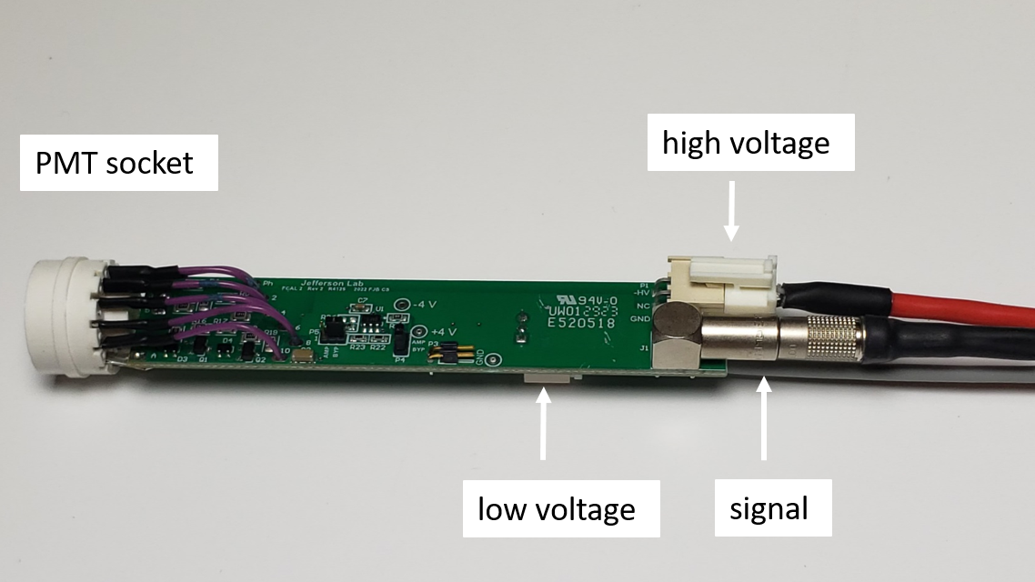
PMT Active Base
Designed at JLab
Modified the original Hamamatsu voltage divider by
adding two bipolar transistor to the last two dynodes
- gain stabilization at high rate
- optimized design using Compton calorimeter
Added an amplifier positioned on the same PCB with
the divider
- lower the PMT operating voltage and reduce
the anode current. Prolongs the PMT’s life
- requires to supply ± 5 V
- operating voltage: 920 V – 1 kV
(divider current: 350 – 400 μA)
Switches on the PCB allow to by-pass the amplifier
- enable amplifier on layers around the beam
Three cables are connected to each divider:
signal, LV, and HV
All dividers were tested using LED
Studied radiation hardness

Slide 10
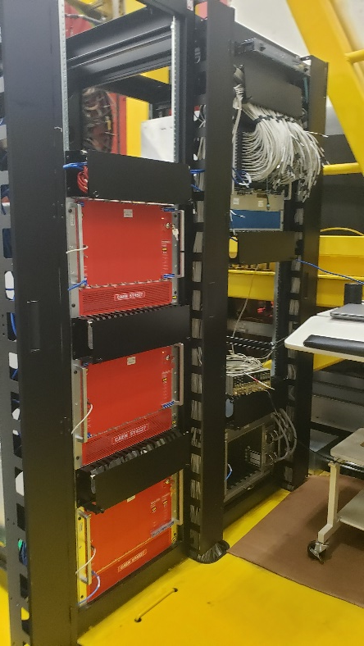
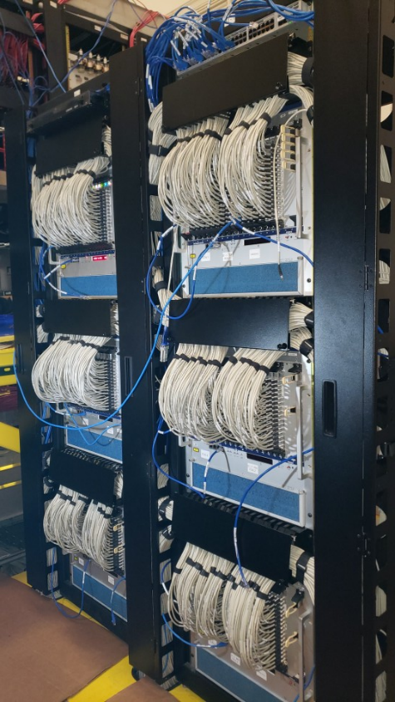
ECAL Electronics
7 VXS crates with 100 flash ADCs, ROCs, and trigger electronics
modules
Three SY4527 CAEN HV mainframes
- 36 48-channel A7030 modules
WIENER crates
- 2 MPOD modules
- Supply ± 5V for PMT active base
amplifiers
Light monitoring system:
CAEN1495 module, MPOD
Four new racks are positioned on the
FCAL mezzanine platform

Slide 11
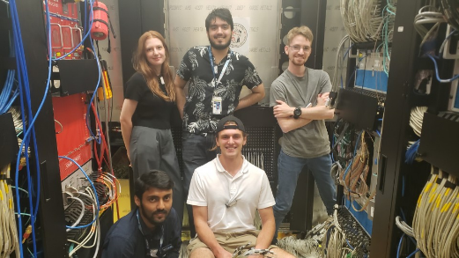
Manpower for ECAL Construction and Installation
Hall D Sasha, Arshak, Igal, Simon, Hovanes, tech group
UNCW Laveen, Liping
JLab detector imaging group Vlad B.
JLab detector support group George J., Mindy L., Aaron B.
RadCon group Vlad Popov
JLab FE group Chris C., Fernando B. , Chris S., S. Fiedler, other group members
GWU Olga C.
ErPhy Hakob V.
Wuhan University: Aoran, Zhikun Baoxin
Summer students: 23 summer students from 9
universities

Slide 12
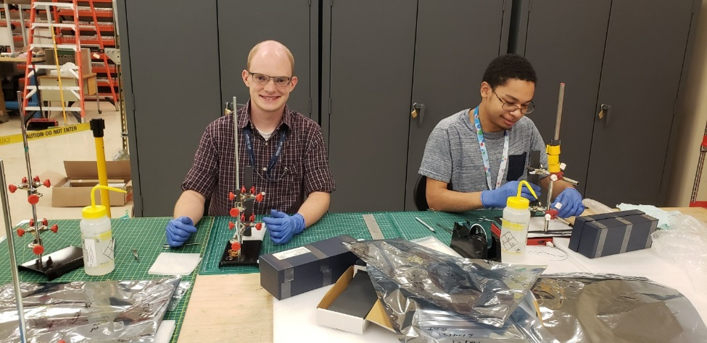
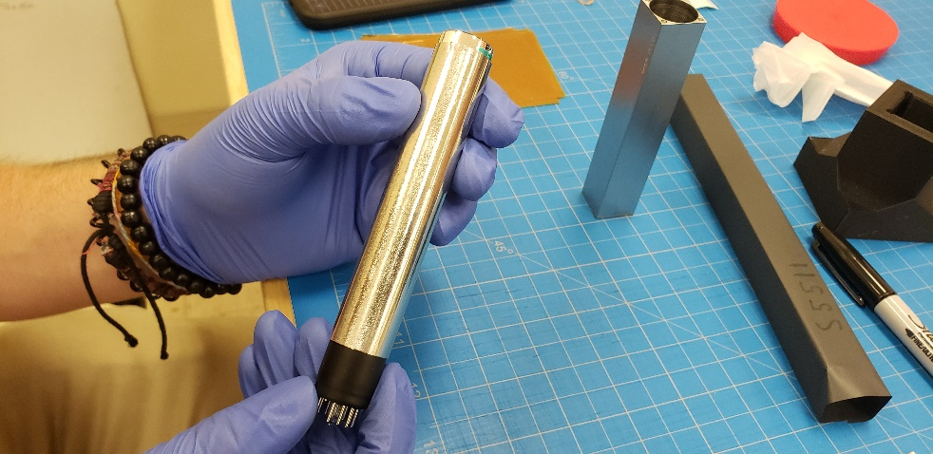
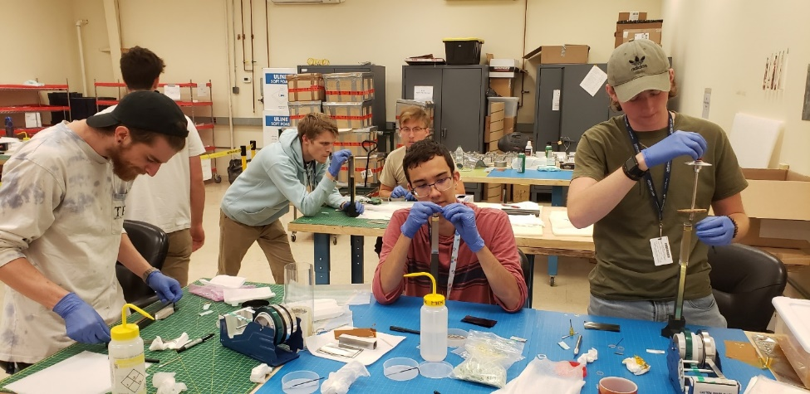
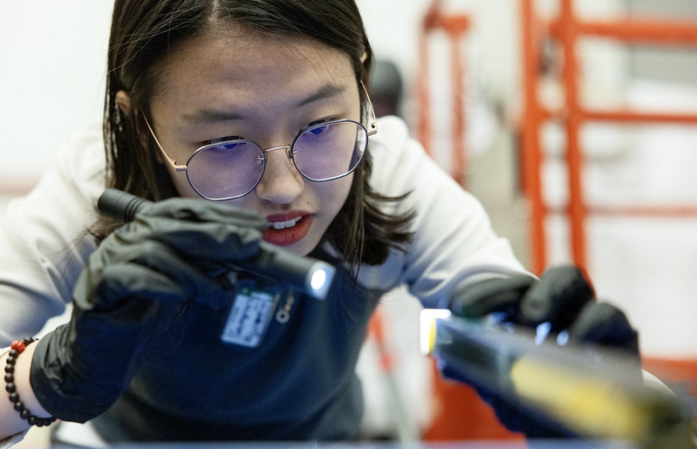
Fabrication of ECAL Modules at Jefferson Lab
Wrapping modules with the ESR and Tedlar
Installation of PMT
Module fabrication
Final quality check

Slide 13

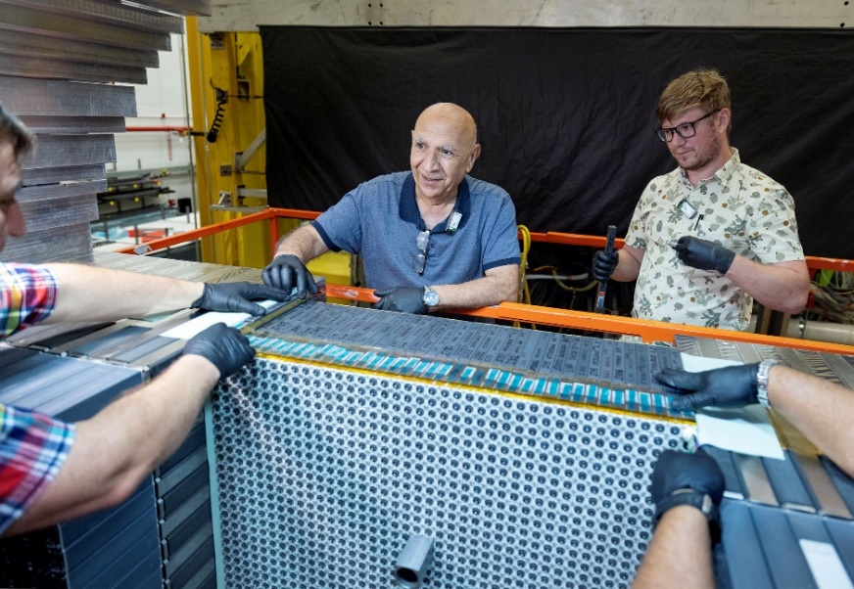

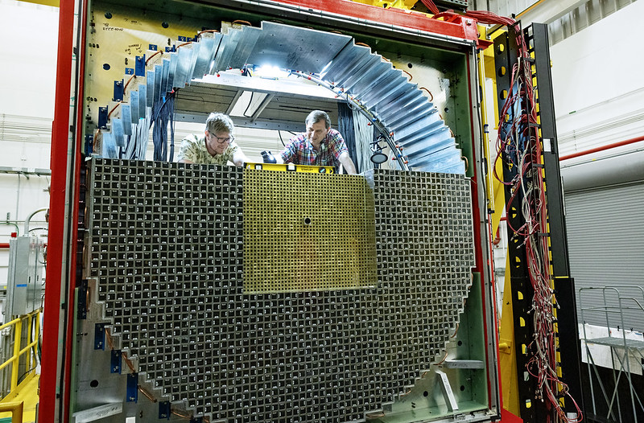
Detector Installation in Hall D
Charge 1
First module installed
Detector installation: July 12 – Oct 6, 2023 (3 months)
Installing PbWO₄ modules

Slide 14
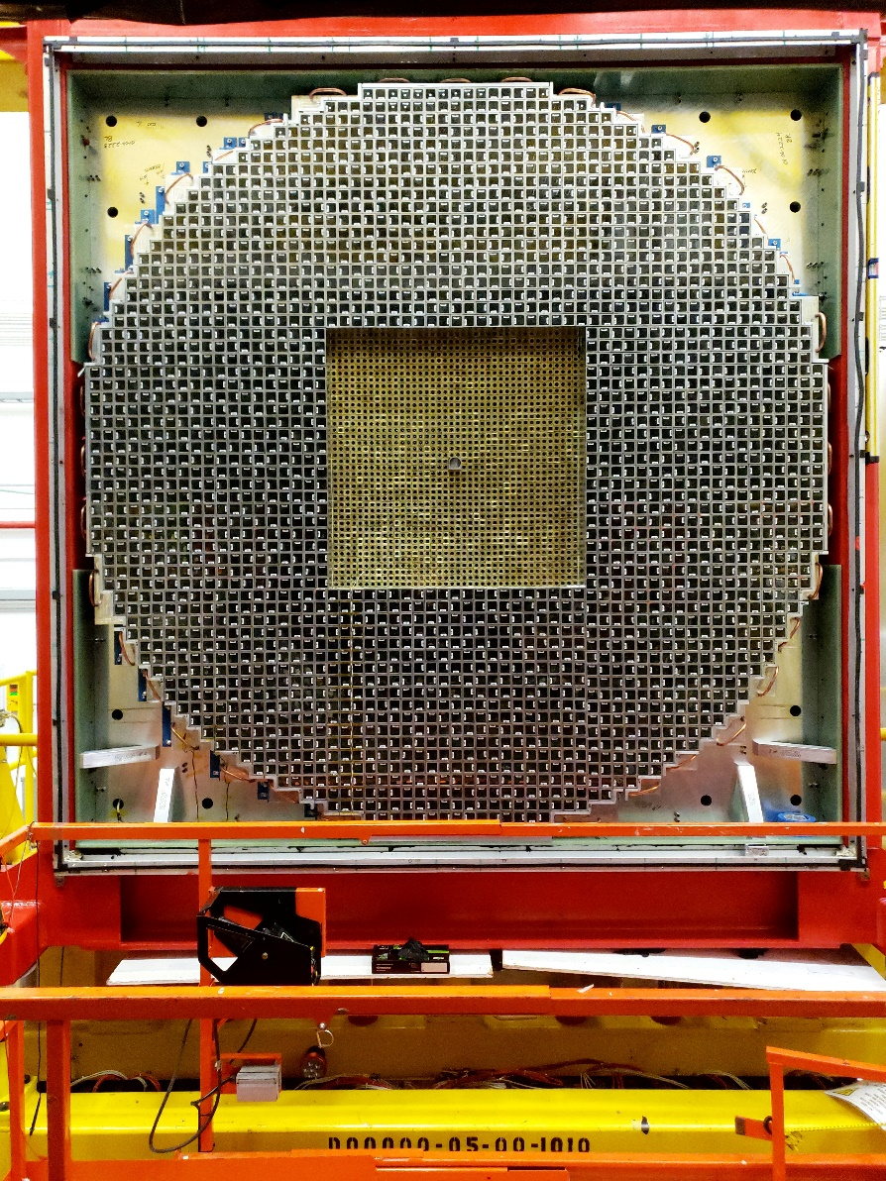
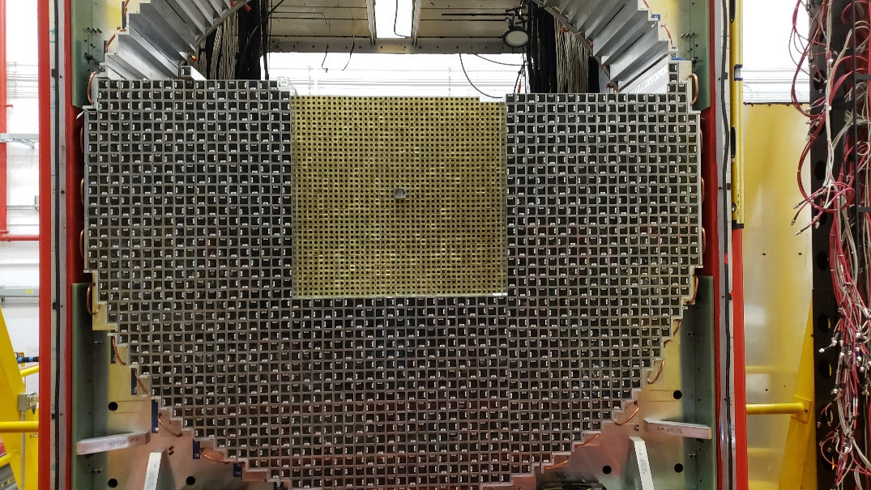
Detector Installation
Charge 1
October 6, 2023
September 20, 2023
Completed installation of the whole detector by October 6

Slide 15
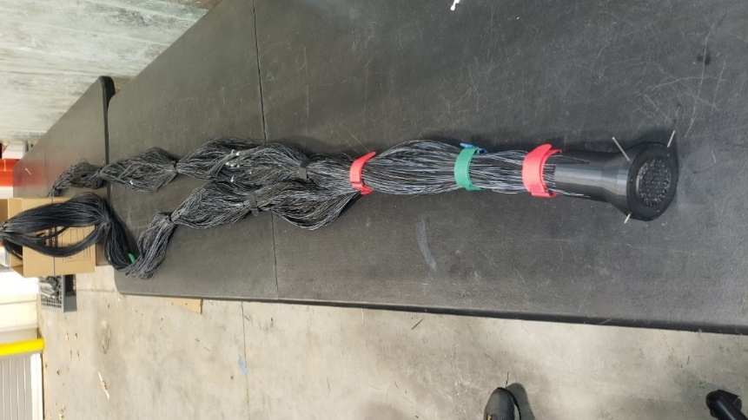
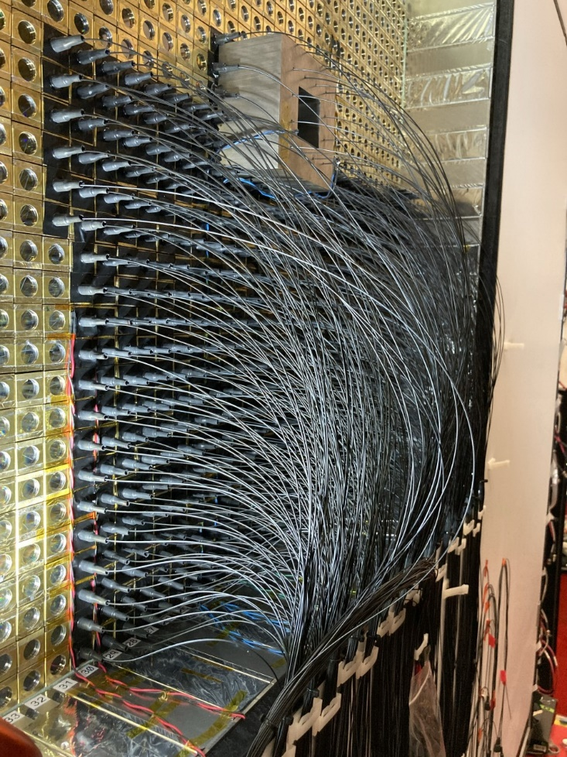
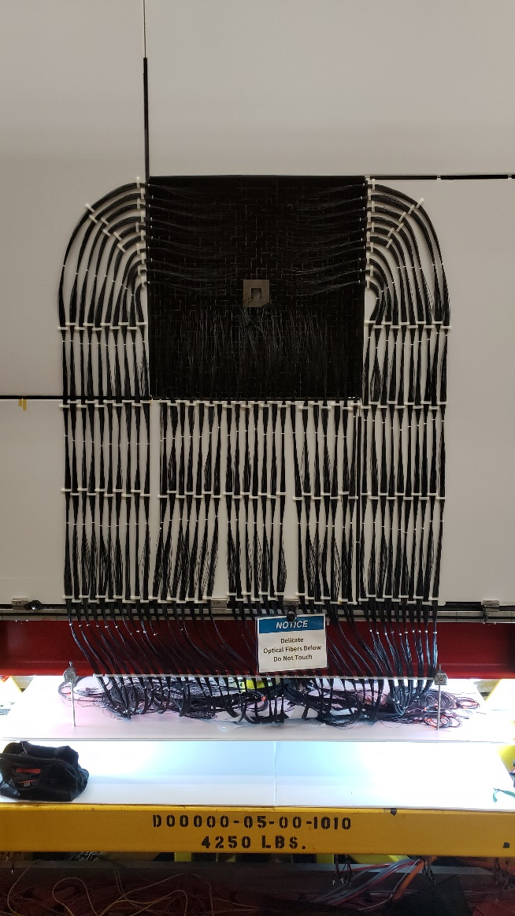
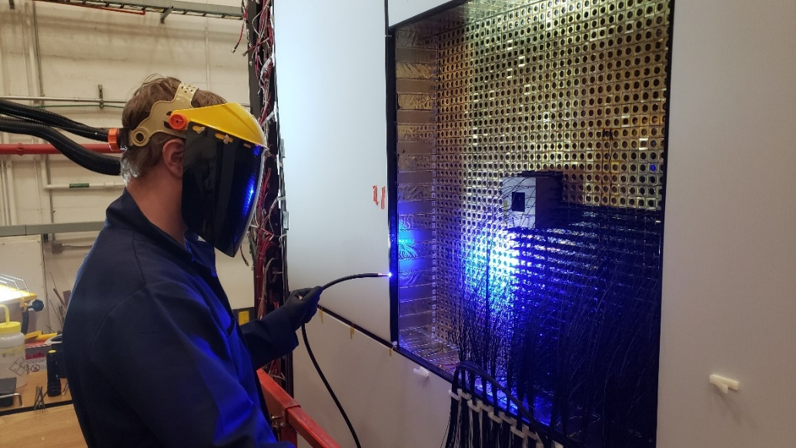
LMS Installation
Charge 1
Installation of light monitoring systems (Nov 2023 - April 2024)
ECAL LMS installed
Optical fibers ready for installation
Optical fibers installed
Gluing optical fibers to crystals (UV curing)

Slide 16
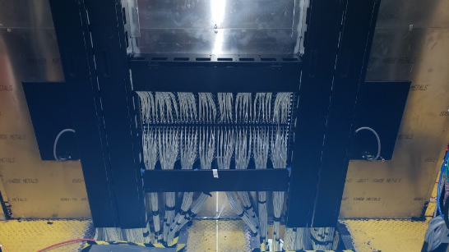
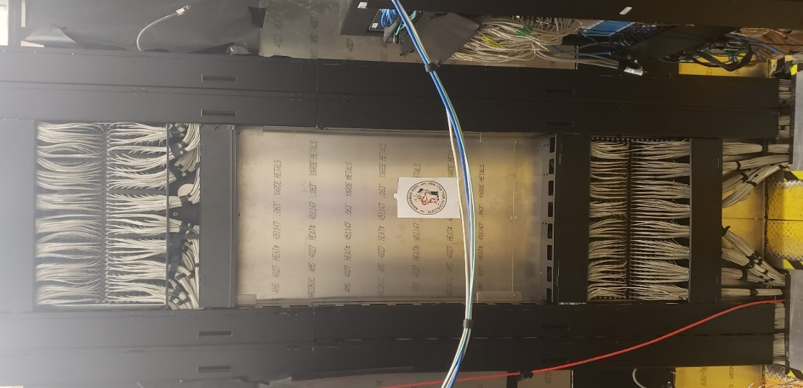
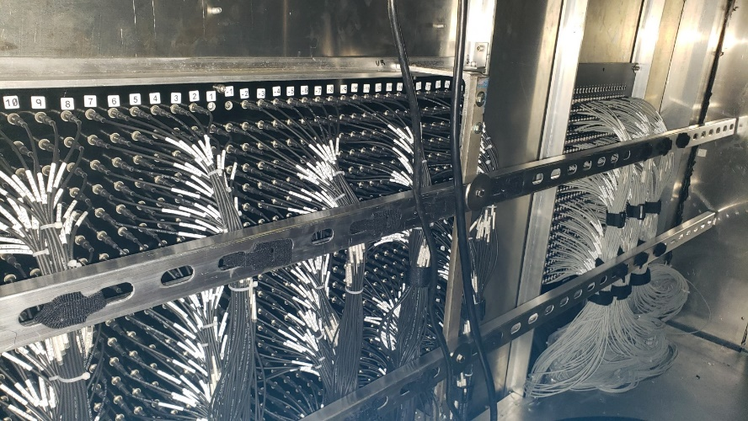
Installation of Distribution Boards and Cables
Charge 1
Short signal, HV, and LV cables (1596 of each type) connected to PMT active bases and
to 2 signal patch panels, 4 HV, and 4 LV distribution boards
Long signal cables outside the dark room
LV distribution
board
LV distribution
board
Cable managers
signal patch panel
Signal and LV
patch panels
installed on the
FCAL2 frame
Top patch panel
Low voltage and
signal patch panels
(view from the inside of
the detector dark box)
Bottom patch panel
Installation has been completed in summer 2024

Slide 17
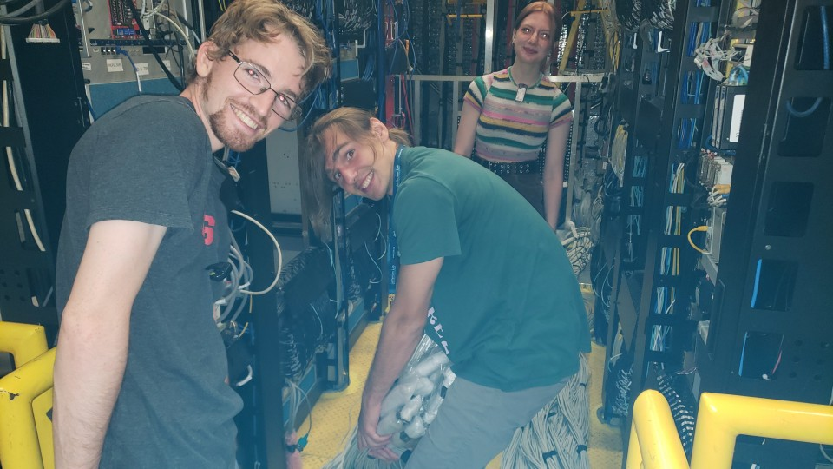
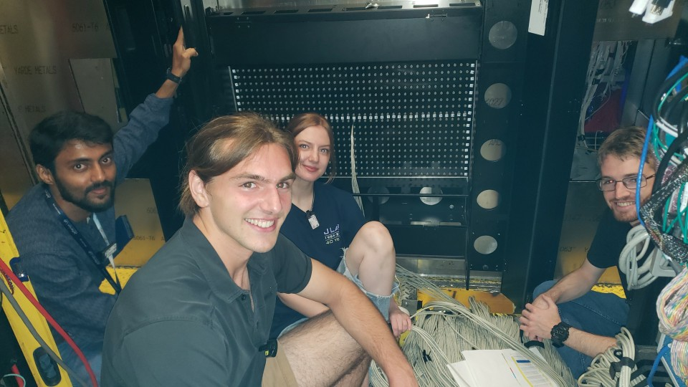
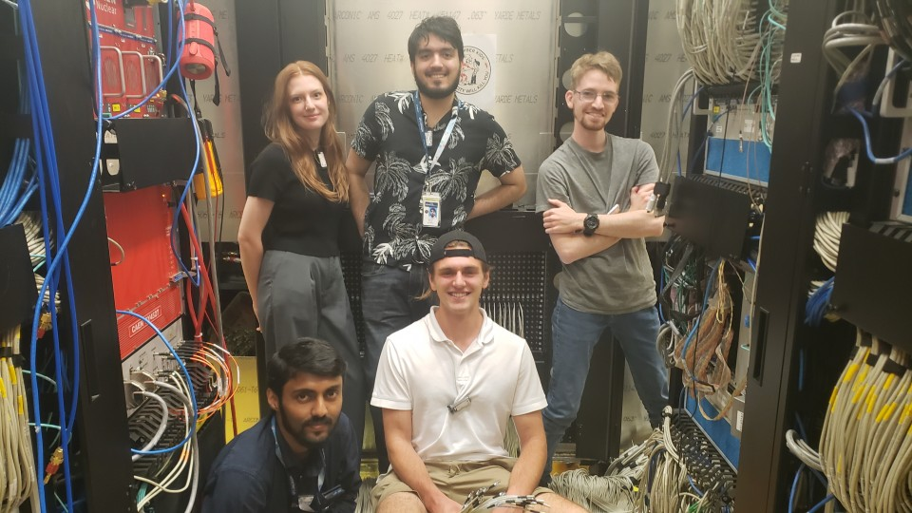
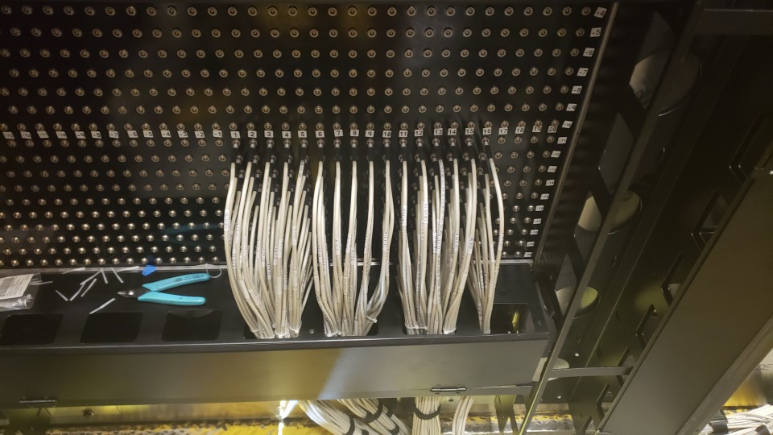
Connecting Cables to Signal Patch Panels
Charge 1
Install vertical cable managers
Pull cables to the calorimeter platform
Connect to the signal patch panels
Connecting signal cables to the patch panel
Signal cables on
the platform

Slide 18
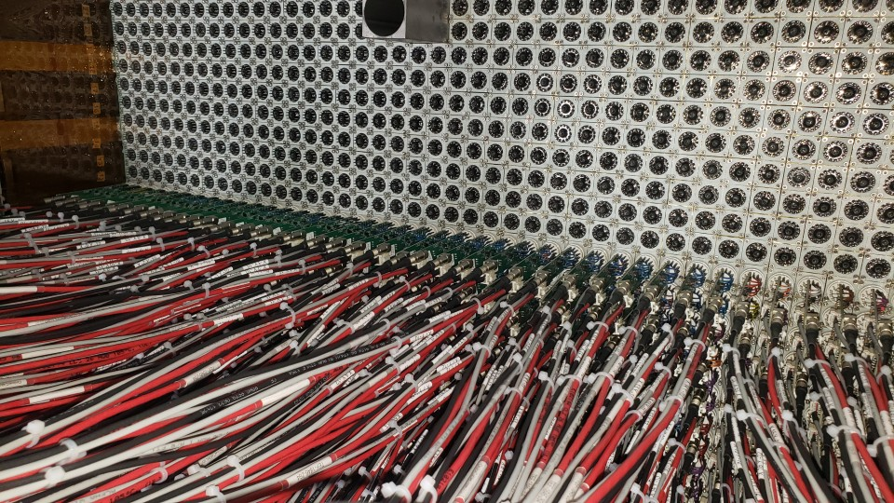
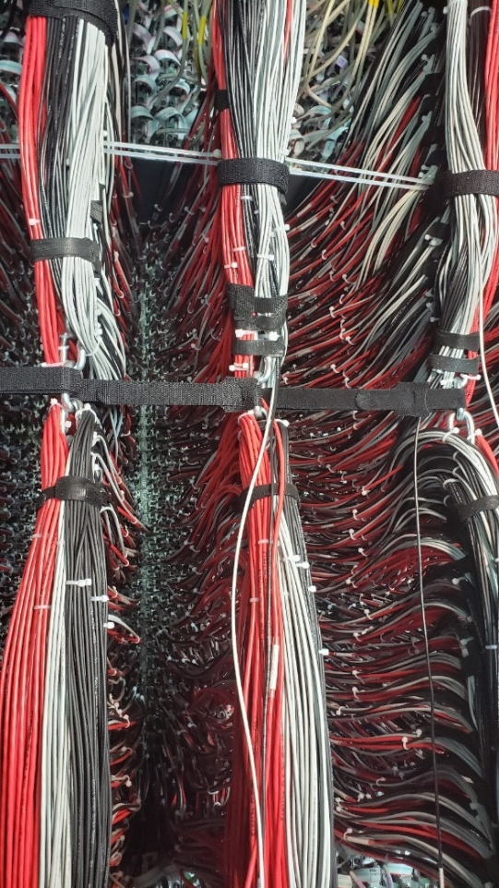
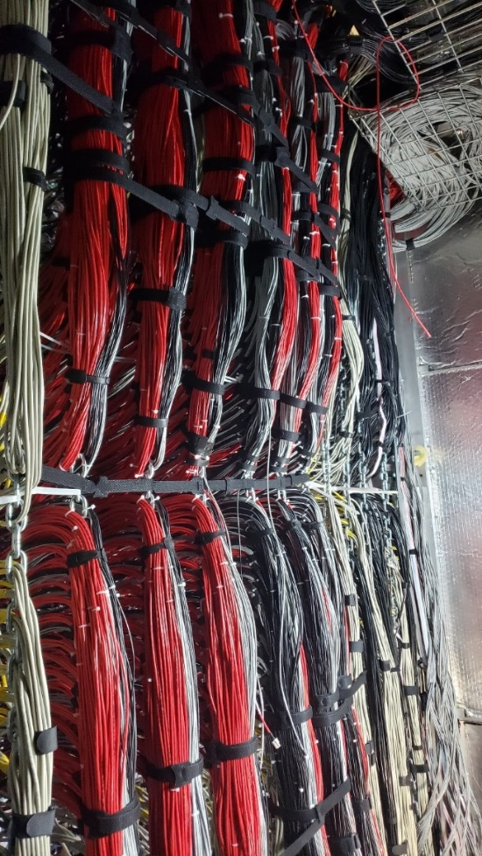
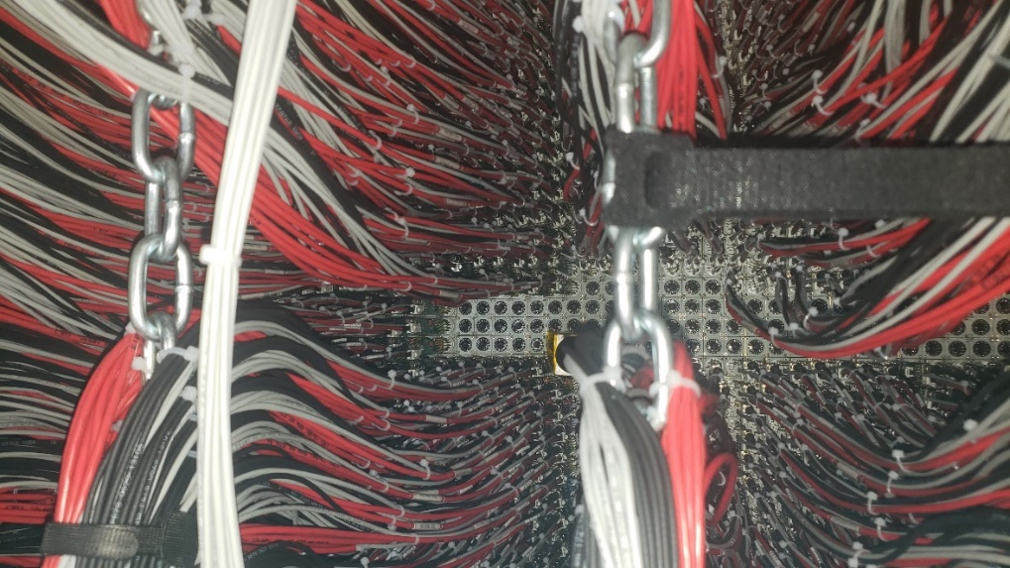
Installing Cables and Dividers
Charge 1
Three cables are attached to each divider: signal, HV and LV
The cables are installed on chains, share chains with the FCAL
Installation has been completed in September 2024
all dividers installed
all cables arranged on the chains

Slide 19
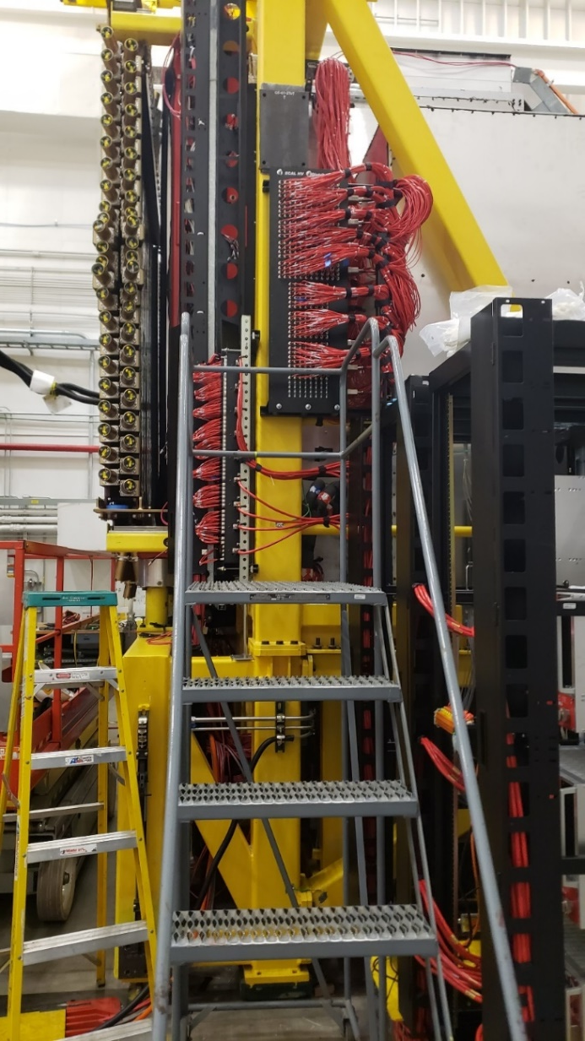
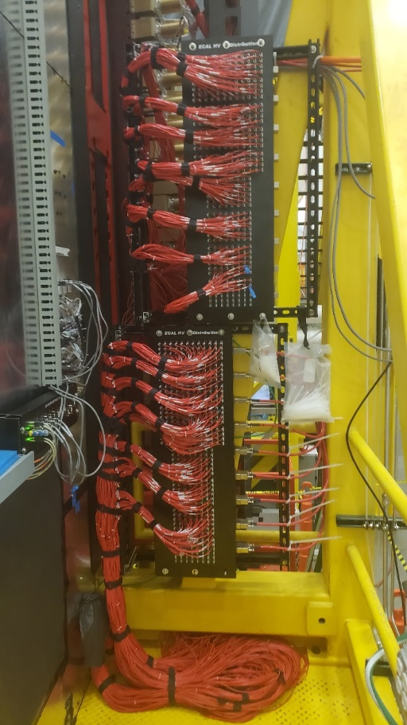
Installation of High Voltage Distribution Boards
Charge 1
South side
North side
Significant delay with delivering parts
HV distribution boards were ready for installation on Dec 20th, 2024
Completed installation before
holidays

Slide 20
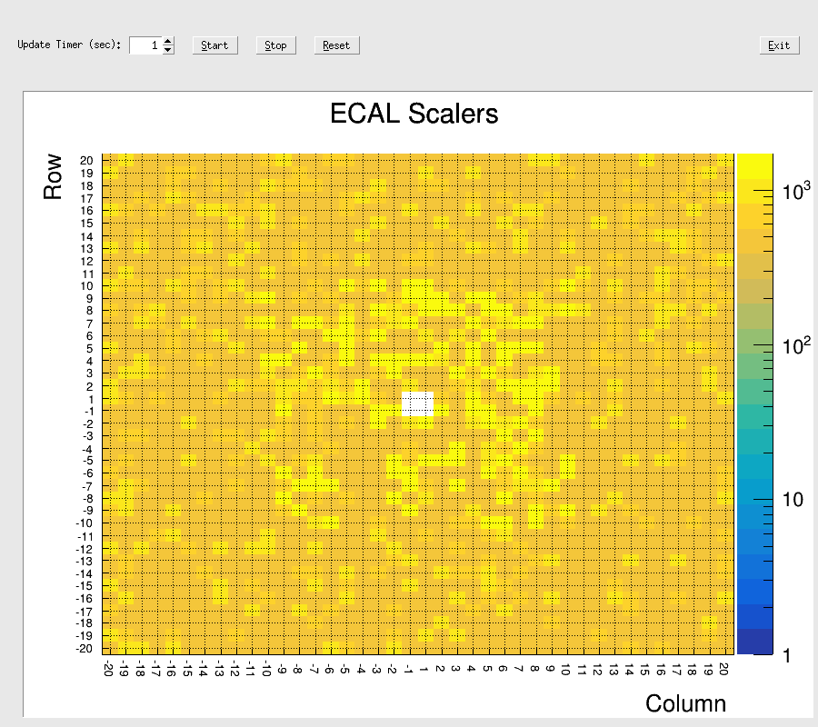
Testing ECAL: Flash ADC Scalers
Charge 1
Flash ADC scaler rate induced by the LMS
1) Use light monitoring system to identify
and fix suspicious channels
- used LMS during installation of PMT divider
(check dividers after installing them on each layer)
- many problems with modules were successfully
fixed during the early commissioning phase
All ECAL modules are operational
Flash ADC baselines and thresholds have to be tuned

Slide 21
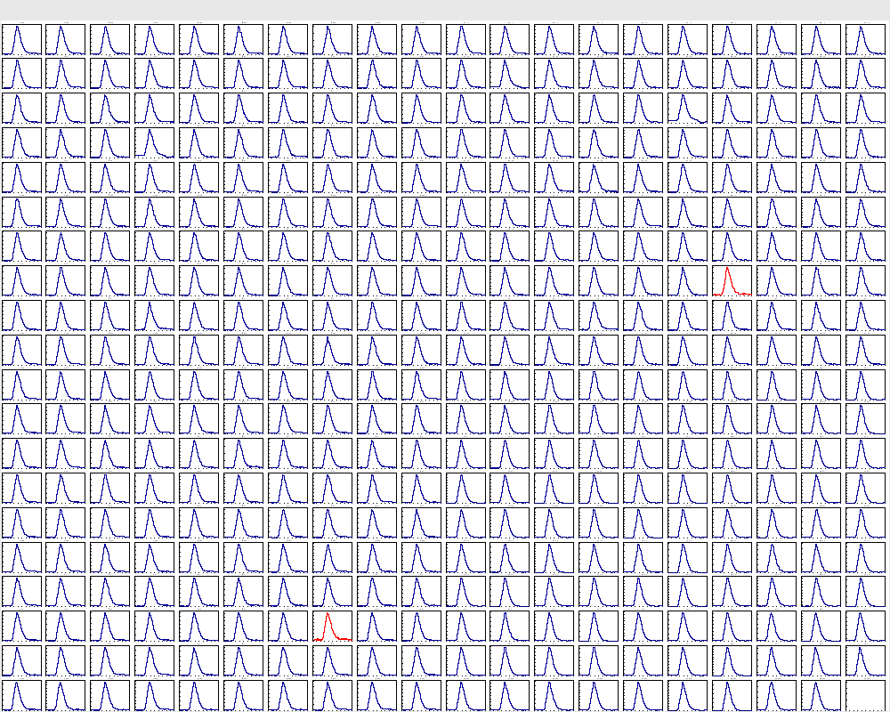
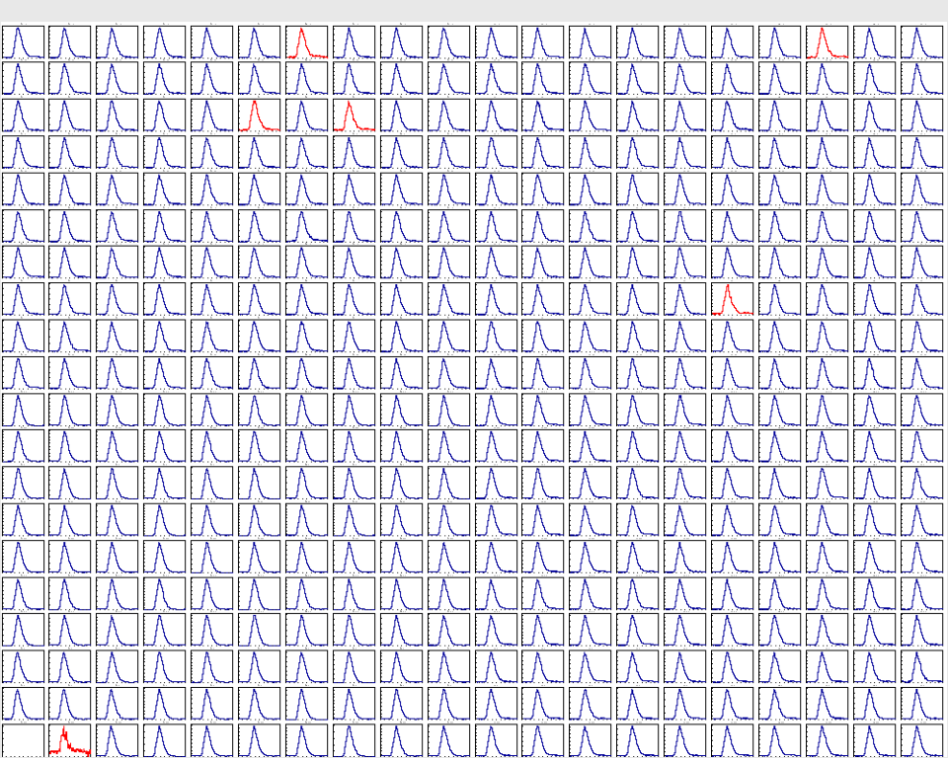
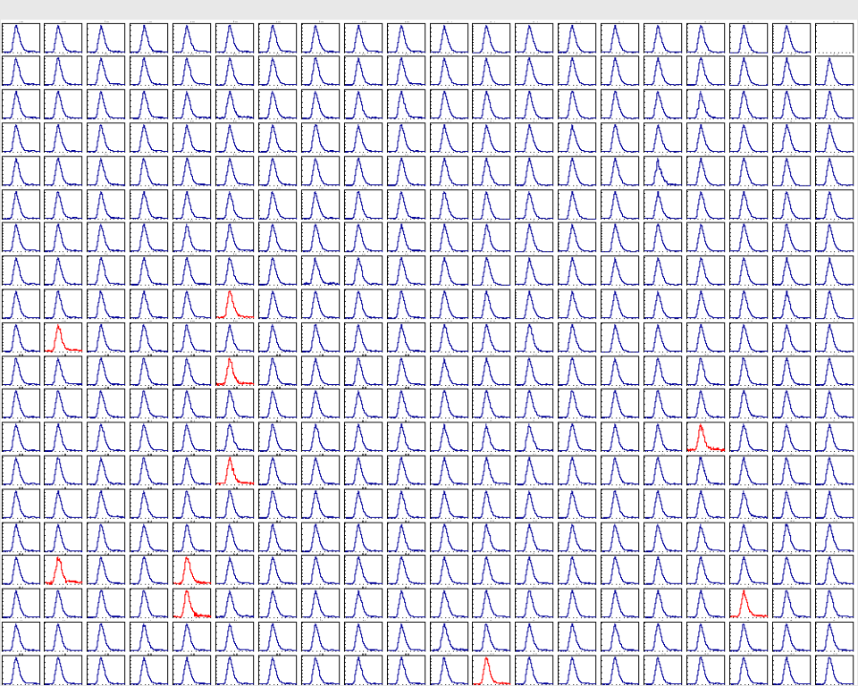
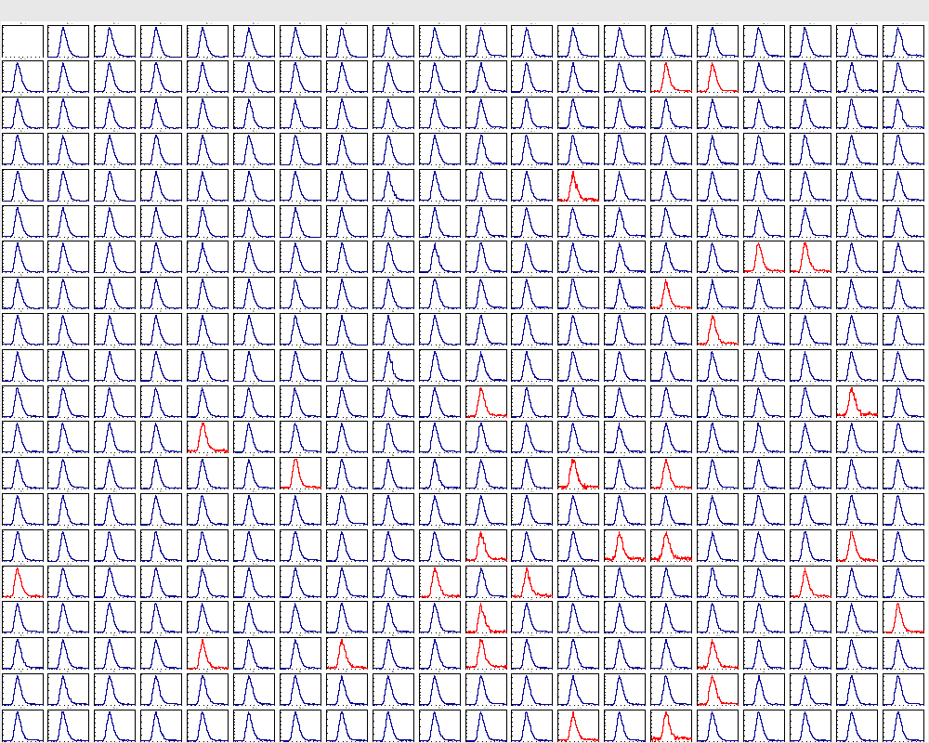
Testing ECAL: Reading out Signal Waveforms
Charge 1
Flash ADC signal waveforms induced by the LMS
2) Integrated ECAL into the DAQ. Integrated
the LMS into the trigger
- recorded signal waveforms induced
by the LMS
- several issues with the dividers
were resolved. These issues were not
detected when using the flash ADC scalers
- the LMS trigger will be active during
data acquisition, running at a rate of about
10 Hz to monitor the stability of gains
and the overall health of the detector
- high-voltage scans were conducted
to determine calibration curves for
the gain calibration
https://logbooks.jlab.org/entry/4326773

Slide 22
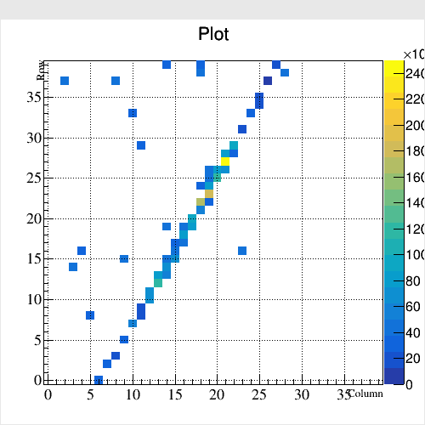
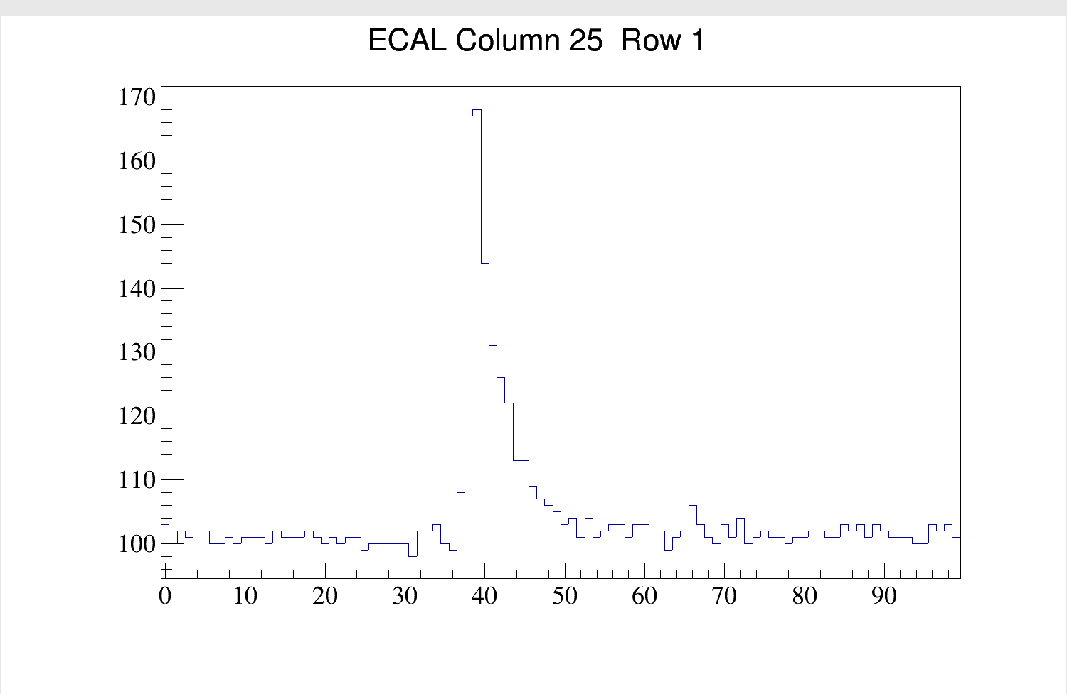
Testing ECAL with Cosmic Rays
Charge 1
3) Use cosmic rays to check the ECAL and perform initial gain calibration
- Installed scintillator paddles on the top and bottom of the detector
- Required hit coincidence between the top and bottom scintillators
- Readout ECAL using triggers from the scintillators
Hits in the ECAL
Row
Signal waveform induced by cosmic particle
ADC sample
Column

Slide 23
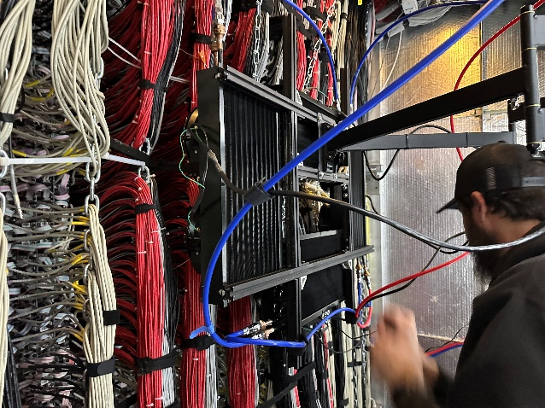
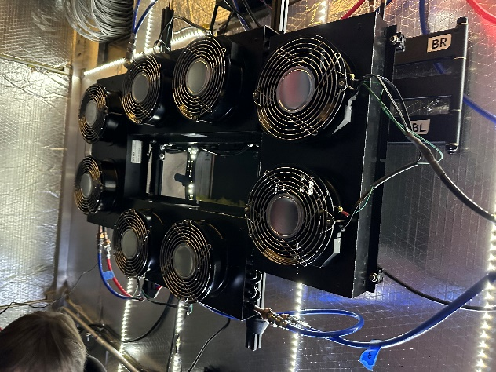
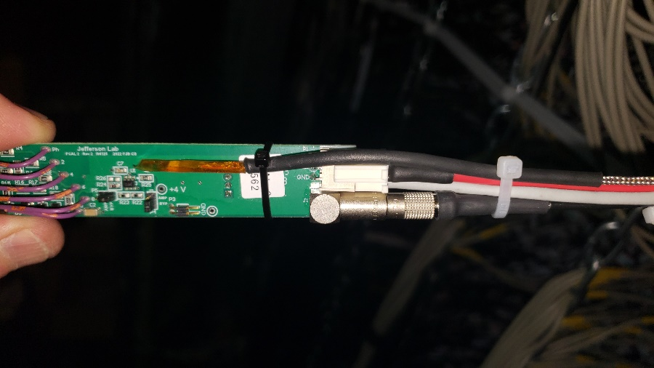
ECAL Temperature
Charge 1, 2, 3
See Tim’s talk about design of the cooling system
Cooling system and temperature stabilization:
- cooling detector frame, fans in the ECAL
divider region, insulated FCAL2 detector room
- main hit sources:
ECAL dividers: 0.5 W ⋅ 1596 ∼ 800 W
FCAL dividers: 0.2 W ⋅ 2360 ∼ 500 W
Fans blowing cold air to the ECAL divider region
Temperature sensors (RTDs) installed:
- face flange of the ECAL modules
- on the FCAL modules
- inside the dark room
- on the dividers
- sensor’s reading are archived to EPICS
Temperature sensor attached to the divider

Slide 24

ECAL Temperature
Charge 1, 2, 3
After powering on FCAL2, the maximum temperature in the divider region increases to approximately 40°C
The temperature in the divider region ranges from 25°C
at the periphery to 28°C in the middle region of the ECAL
The maximum temperature gradient along the crystal < 4 °C
(as calculated by Tim)
Impact of the temperature on the performance:
- degradation of energy resolution
- change in pulse shape
- non-linear energy response if there is
a temperature gradient along the crystal
- modification of shower shape (used in reconstruction)
-added challenges to the detector calibration
We anticipate that temperature-related effects will be
relatively small, but to account for this:
- perform measurements of the energy resolution
both after powering on the detector and once the
temperature has stabilized
- measure shower shapes using a prototype with
the pair spectrometer
chiller at 11° C
RTDs on the dividers
RTDs on the detector face
3 days
Good temperature stability over time (Δ t within ± 2 °C)

Slide 25
Commissioning and Testing Schedule
Charge 1
Install and test the final version of the LMS light source 0.5 week
Install and configure LMS power supply (MPOD) 1 day
Perform final integration of the LMS into the CSS control system 0.5 week
Perform final integration of the LMS into the trigger system 2 days
Final check of the ECAL performance, fix loose divider connections to PMTs, if needed 1 week
- typical time needed to fix a divider: about 4 hours
Install reference PMTs, perform final test of the LMS 0.5 week
Integrate the ECAL/FCAL trigger 2 weeks
Some tasks can be performed in parallel
The detector should be ready for commissioning with the beam in about 3 weeks

Slide 26

Procedures for Tuning the Detector
Charge 3
1) Use light monitoring system to identify and fix suspicious channels
- performed high-voltage scans to determine calibration curves for the gain calibration
The initial gain equalization is performed using cosmic ray data
- individual high voltages are set based on the energy response of minimum ionizing particles
- trigger with external scintillating paddles, the self-trigger is currently being checked
Signal peak amplitude in the module induced by cosmic particles
Signal pulse amplitude for ECAL modules
Set HV’s to equalize
energy response across the modules
- the pulse amplitude
must be 8 flash ADC counts
Several HV iterations are
required
- expected energy deposition for cosmic muons is ~20 MeV (simulated with Geant)

Slide 27

Procedures for Tuning the Detector
Charge 3
3) Use Compton scattering data to determine a global scaling factor for high voltages. Refine individual HV settings
in the inner part of the detector
set amplitudes for 10 GeV photons to the flash ADC count 3900 (to be verified)
equalization of gains on the level 5 – 10 % is required for the trigger (there are the same gains in the trigger)
large cross section of Compton scattering process, allow for several iterations of HV settings during a short period of time
data collected will be used for the subsequent pi0 calibration
ECAL and FCAL will be operated at separate trigger thresholds
the calibration code exists
4) Calibration using π⁰
calibrate gains for modules in the periphery, perform final adjustment of gains
determine non-linearity energy corrections
will require to collect several data sets to adjust voltages
- the calibration code exists (Igal)
see Simon’s talk
Stability of the ECAL dividers at high rate
some studies using CCAL prototype
if any issues, will switch flash ADC to 1 V range (lower HVs)

Slide 28
Commissioning Run Plan with Beam
Charge 3
Trigger commissioning 1 week
Initial ECAL gain calibration using Compton scattering events
- run at small small photon flux; use low-energy TAGH counters to constrain the total energy
- run conditions:
    amorphous radiator 10-4 R.L., 100 nA beam current, Solenoid magnet on, beam
    polarization doesn’t matter
    - ECAL & FCAL ( & BCAL trigger), small energy threshold on the total energy (TBD)
    run duration (TBD)
May require 3 – 4 iterations to adjust HVs 3 – 4 days
Adjust trigger thresholds, take data sets for π⁰ calibration 8 days
- may require 3 – 4 iterations (based on the PrimEx experience)
- can run at the GlueX nominal production current
Perform the final adjustment of the ECAL (FCAL2) voltages
Expected overall commissioning time: 3 - 4 weeks
ECAL commissioning time is not included in the approved PAC days for the experiments. The physics data production time will be utilized

Slide 29


ECAL Operation Manual
Charges 4 and 6
Hovanes
High voltages, low-voltages are
controlled through the CSS screen
- configuration files exist
- voltages and currents are archived in EPICS
FCAL2 environment and interlocks
- 10 temperature sensors attached to detector
- 4 temperature sensors installed on the ECAL dividers
- PLC-based interlock based on:
ECAL divider temperature, humidity, light sensors,
cooling fans, darkroom door status
- all interlocks were testes and are currently used
- monitored values are archived in EPICS
Josh B. , Hovanes

Slide 30


ECAL Operation Manual
Charges 4 and 6
ECAL LMS control
- Similar to the PrimEx Compton Calorimeter
- Will be tested after the installing reference PMTs
and the light source (see slide 10)
The ECAL operation page for shift crew
https://halldweb.jlab.org/hdops/wiki/index.php/Electromagnetic_Calorimeter_Shift

Slide 31
Repairing Dividers and PMTs During Run
Charge 6
- Necessity and urgency of repair
- Accessing dark room temperature protocol
Known issues with the FCAL bases:
- over 1200 bases were replaced during the course of the experiments (with 200 in SAD 2020)
- initially the failure rate was about 10 dividers per week, was reduced to 2 per week during the last run
- regular maintenance of dividers and PMTs is anticipated
ECAL modules: possible issues with loosening of the divider connection to the PMT, potentially caused by
shaking cable chains
- very difficult to fix due to the high density of cables
- both ECAL and FCAL share the same cable chains (see slide 10). Some issues were observed during installation,
no clear correlations with the shaking of the chains
- no problems observed during one-week period of taking cosmic data, when there was no access to the dark room
- if the problem persists during the run, may need a backup plan for securing ECAL cables closer to the divider
(add additional cable support)

Slide 32

Dark Room Temperature Protocol
Charge 6
Turn off
FCAL2 voltages
Turn on
FCAL2 voltages
The temperature on the face of the
crystal strongly depends on the
ECAL (FCAL2) voltages
Study temperature behavior after
maintenance of the detector
- 4 hour long access time
- 9 hours is required for the
module temperature to restore
Protocol:
- Wait approximately two times the access
time (with voltages off) after powering the
detector back on before starting the physics
run
Access to the detector dark room has to be
carefully planned
RTDs on the dividers
RTDs on the detector face
9 hours

Slide 33
Safety Documents
Charge 6
ESAD, COO, ERG, and RSAD documents are linked to the review page
https://halldweb.jlab.org/wiki/index.php/FCAL2_Readiness_Review
The following ePASes will enable the operation and maintenance of FCAL2
- JLab-PTW-5236, Maintenance of the Hall D ECAL
- JLab-PTW-3811, Maintenance of the GlueX trigger system
- JLab-PTW-6092, Maintenance of FCAL2 lead glass part

Slide 34
Summary
The fabrication of the electromagnetic calorimeter (ECAL) for the JEF experiment began in January 2022. The detector consists of 1,596 PbWO4-based modules, which replaced the inner section of the existing Hall D calorimeter.
The detector, along with the surrounding FCAL modules, was installed into the new detector frame. By September 2024, the installation of cables, PMT dividers, signal patch panels, and low-voltage (LV) distribution boards was completed.
The readout system, comprising VXS, CAEN HV, and Wiener LV crates with their electronic modules, was also installed. Additionally, the ECAL was fully integrated into the Data Acquisition (DAQ) and trigger systems.
On December 19, 2024, the detector was fully integrated into the GlueX framework, and commissioning has been ongoing since then (Note: acceptance of the HV distribution boards was delayed.)
The detector's dark room environment and voltage controls were incorporated into the GlueX Slow Control system.
Initial testing of the ECAL was conducted using LMS and flash ADC scalers, followed by the collection of cosmic ray data.
Procedures for tuning the detector, along with the operation manual and safety documentation, were prepared.

Slide 35
Backup Slides

Slide 36


ECAL Temperature
Charge 1
Impact of the temperature on the performance:
- degradation of energy resolution
- change in pulse shape
- non-linear energy response if there is
a temperature gradient along the crystal
- modification of shower shape (used in reconstruction)
-added challenges to the detector calibration
We anticipate that temperature-related effects will be
relatively small, but to account for this:
- perform measurements of the energy resolution
both after powering on the detector and once the
temperature has stabilized
- measure shower shapes using a prototype with
the pair spectrometer
https://logbooks.jlab.org/entry/4326773

Slide 37


Installation of ECAL Cables and Dividers
Signal, HV, and LV cables are connected
to the ECAL active base
Cables are organized into bundles
(with 6 and 7 cables) and are installed on
6 vertical chains
First, install active bases on the bottom half of
the ECAL

Slide 38


Installation of the PMT Dividers Completed
It took about 4 months to install and test all ECAL PMT dividers
all dividers installed
all cables arranged on the chains
https://logbooks.jlab.org/entry/4316213

Slide 39



Installation of Dividers on the Upper Part of the ECAL

Slide 40


Lead Tungstate Crystals
ECAL consists of 1596 crystals (Type II) forming an array of 40 x 40
Crystal dimensions: 20.5 x 20.5 x 200 mm³ (22 R.L.)
Crystals procured from two vendors: 900 crystals from CRYTUR in the Czech Republic
700 crystals from SICCAS in China
Performed quality assurance of crystals used in the ECAL
- longitudinal optical transmittances of crystal 360 nm: 29 % (SICCAS) 45 % (CRYTUR)
420 nm: 64 % (SICCAS) 69 % (CRYTUR)
NIM A 956 (2020) 163375
Light yield
Light transmittance
Transmittance [%]
Maximum of the
emission spectrum
Light yield phe/MeV
Wavelength [nm]

Slide 41




Calorimeter Testing Facility in Hall D
NIM A 795 (2015) 376-380
Calorimeter
prototypes
Position various detector prototypes downstream
the PS
Beam of electrons and positrons with known energy
- the energy range between 3 GeV and 6 GeV
Perform tests in parallel with GlueX data taking
- trigger provided by the PS
- can use flash ADCs, and TDCs; readout
integrated into the GlueX DAQ
Pulse amplitude as a function of
the hit position
Testing modules for Hall D ECAL

Slide 42



Magnetic Shielding for Hamamatsu R4125 PMT
Fringe field of the GlueX solenoid magnet
maximum B_{z} ~ 50 Gauss, B_{r} < 10 Gauss
- optimize PMT shielding using TOSCA simulation
- study shielding using prototypes positioned into Helmholz coils.
Check performance in the field using LED
Prototype positioned inside
Helmholz coils
TOSCA Simulation
Extend PMT shielding above the face
of the photo cathode
- 3.5 cm long acrylic light guide
with a diameter of 18.5 mm
PMT is placed inside the soft iron
housing (AISI 1020 steel)
Two layers of mu-metal cylinders with
the thickness of 350 μm and 50 μm
Field inside
shielding
LED response

Slide 43





Preparation Parts for ECAL Modules at Jefferson Lab
Preparation of parts and fabrication of ECAL modules were performed at JLab, several groups were involved
Brazing brass assemblies (holding module assembly)
Checking PMTs
Flange
Brass strap
Flange
Heat elements
Wrapping crystals
Preshaping ESR foils
Gluing Light guides
Light guide
PMT

Slide 44

Students in the ECAL Project
16 students from 10 universities and colleges worked on the project during the summer of 2023
https://halldweb.jlab.org/detectors/fcal2/installation/students_2023/

Slide 45
Fabrication of ECAL Modules at Jefferson Lab
Wrapping modules with the ESR and Tedlar
Installation of PMT
Module fabrication
Final quality check

Slide 46


Disassembling Lead Glass Calorimeter
All modules removed
Removing lead glass modules

Slide 47



Light Monitoring System (LMS) for the ECAL
Light source: multiple blue and green LEDs at the input of the integrating sphere (used to mix light)
500 μm acrylic optical optical fibers (Edmund optics) glued to the face of each module
optical fibers inside
the plastic cap
optical cap glued
to the crystal
Light stability is controlled by two reference PMTs, which receive light from two sources:
- a single fiber from LED and
- a YAP:Ce scintillating crystal glued to the PMT activated by ²⁴¹ Am α source
The LMS is integrated into the detector trigger system and will run during data taking. The
typical rate is 10 Hz
The system was successfully tested a small-scale prototype during the PrimEx η experiment

Slide 48



Readout Electronics
VXS crate with flash ADC modules
Signals from PMTs are digitized using a 12-bit 16-channel flash ADC
module operated at a sampling rate of 250 MHz
- programmable FPGA logic allows pulse processing algorithms for
readout and trigger
Signal waveform
Flash ADCs are positioned in a VXS (ANSI/VITA 41.0 standard) crate
- VME-bus used to readout data
- high speed serial bus provides network between modules for the trigger
100 flash ADCs positioned in 7 VXS crates

Slide 49

Level-1 Trigger & DAQ
ECAL energy is used in the GlueX trigger
Custom designed boards at JLab
Front-end crates are connected to 2 trigger crates
using optical links
- energy sums are sent from the calorimeter crates
to the trigger crates
- trigger Supervisor (TS) module distributes triggers
to the front-end crates to initiate readout. Also
provides 250 MHz clock and crate synchronization
Fixed trigger latency of about 3 μs
Pipeline on ADCs and TDCs < 3.9 μs
Typical trigger rate for high-intensity GlueX experiments
is 60 – 70 kHz. The data size from the detector is ~1.3 Gbps
57 front-end
crates

Slide 50

Calorimeter Prototype
Nucl. Inst. Meth. A 1013 (2021) 165683
Consists of an array of 12 x 12 modules made of SICCAS crystals
- beam hole: 2 x 2 modules
Used in PrimEx η experiment in Hall D in 2019, 2021, 2022
to reconstruct Compton scattering events
Positioned on a movable platform
- each module was inserted into the photon beam for energy calibration
Temperature stabilization (17° ± 0.2° during run)
Beam tests were used to optimize design of the PMT active base
Instrumented with a light monitoring system, prototype of the ECAL
Cooling Plates
PMT housing

