Slide 1
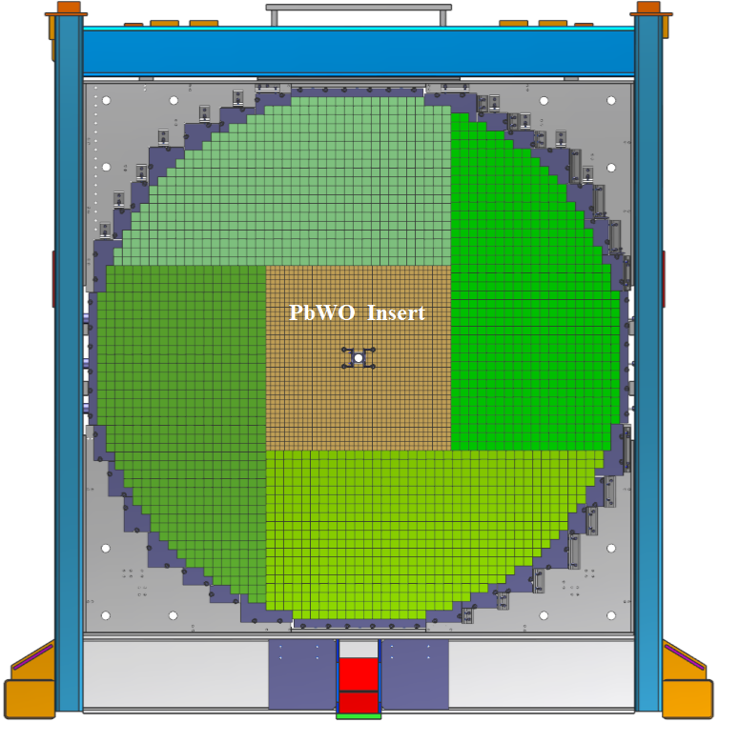
Upgrade of the Forward Calorimeter (FCAL 2)
Replace inner part of the lead glass
calorimeter by PbWO₄ crystals
(the goal is to install an array of 50 x 50 crystals)
Property | Improvement factor
Energy σ | 2
Position σ | 2
Granularity | 4
Radiation-resistance | 10
Significantly improves reconstruction of GlueX channels of interest and allows to
study rare η decays such as η→π⁰γγ

Slide 2
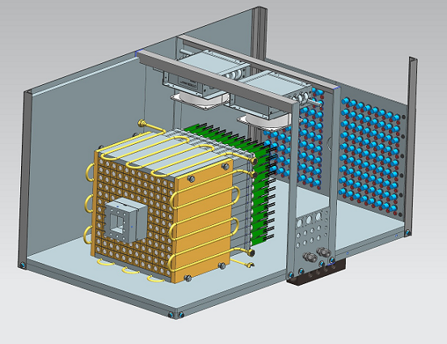
PWO Calorimeter Prototype: Compton Calorimeter
Used during the PrimEx - η experiment in Hall D for reconstruction of Compton event (Spring 2019)
built in collaboration with Hall C
Array of 12 x 12 PbWO₄ crystals
Beam hole: 2 x 2 crystals
Water cooling (18° C), nitrogen purge
LED-based gain monitoring system
Positioned on X-Y movable platform

Slide 3
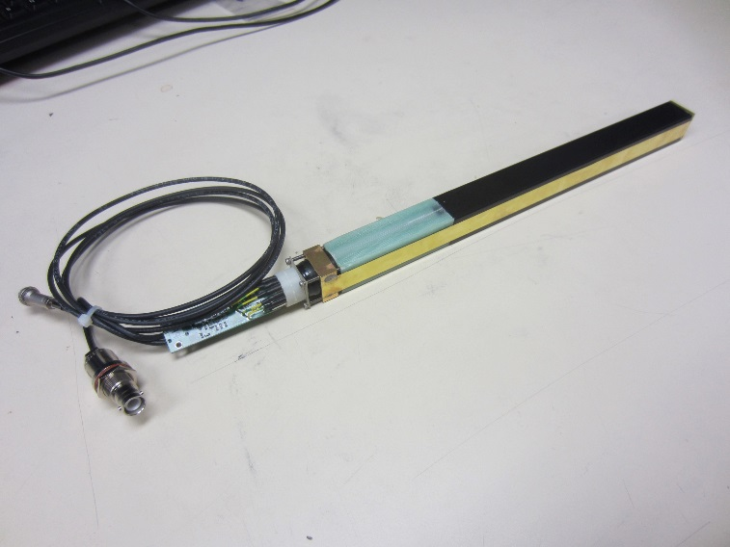
Compton Calorimeter: Module Assembly
PbWO₄ crystal
20.5 mm x 20.5 mm x 200 mm
PbWO₄ crystal wrapped with a
ESR reflective foil and Tedlar
Hamamatsu R4125 PMT
PMT divider and amplifier
designed at JLab
PMT housing
Brass strip
Popov, et. al, IEEE proceedings, Nov 2012
PMT divider & Amplifier
FCAL insert will be position in the fringe field of solenoid magnet ( B_{z} < 50 G, B_{xy} < 10 G)
Magnetic shielding simulated with TOSCA and measured using Helmholz coils
Use soft iron PMT housing and acrylic light guides GlueX-Doc-4166
light collection studied using the Hall D pair spectrometer test setup
https://halldweb.jlab.org/wiki/index.php/Ligh_Guide

Slide 4
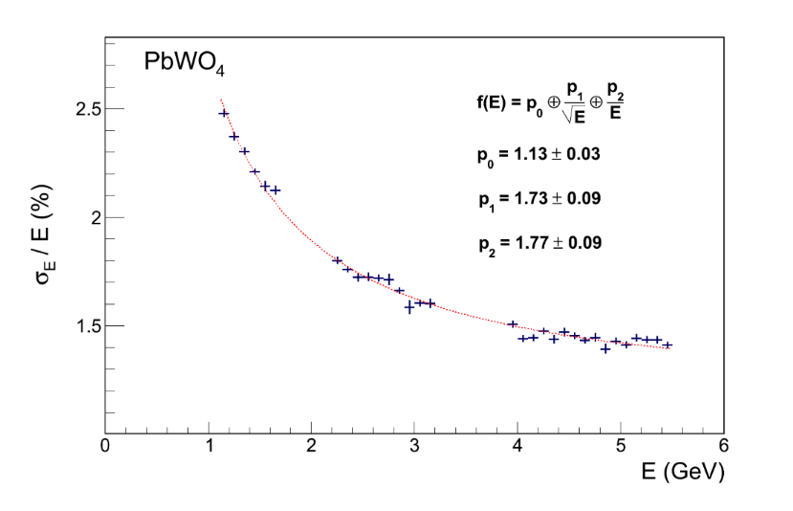
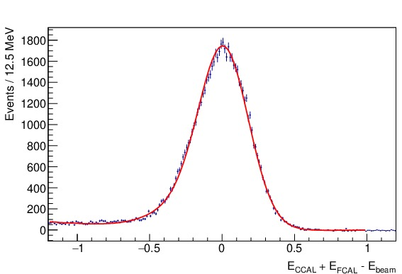
Compton Calorimeter: Performance
Energy Resolution
Compton
Calorimeter
compared with Hall B hybrid calorimeter
(built from SICCAS crystals produced more
than15 years ago)
•
•
•
Reconstruction of Compton events
in PrimEx
Two cluster events
Clean reconstruction of Compton candidates

Slide 5
Status of Calorimeter Construction
PbWO crystals from two vendors: SICCAS and CRYTUR
- Ordered 1000 crystals. About 200 crystals delivered to the lab
- perform various QA checks
Received from Hamamatsu 500 R4125 PMTs.
Finalizing design of the PMT active base
Ordered readout / trigger electronics, HVs for 1600 modules
Preliminary engineering design of the calorimeter frame and installation procedures
Have already fabricated several modules. Ready to start mass production
NIM A956 (2020) 163375
https://halldweb.jlab.org/wiki/index.php/FCAL_Insert

Slide 6
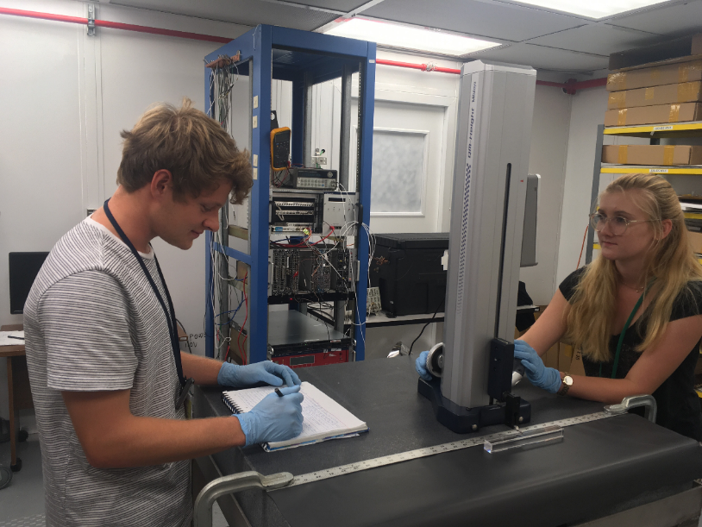
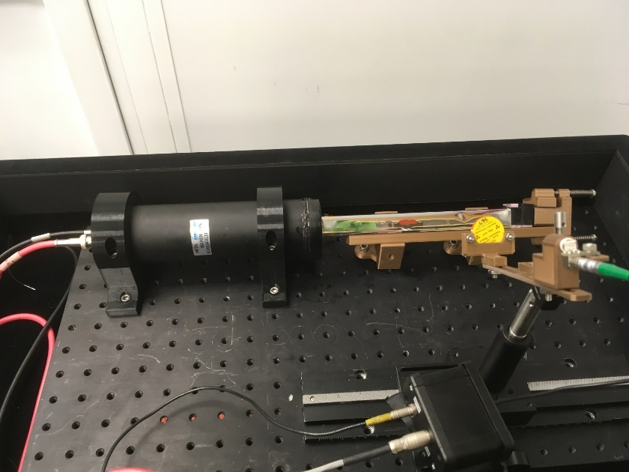
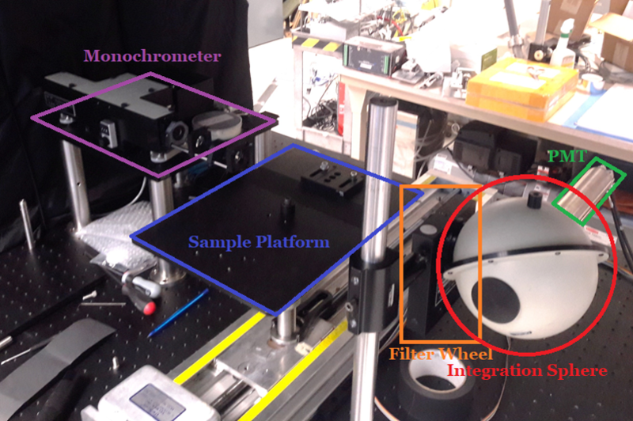
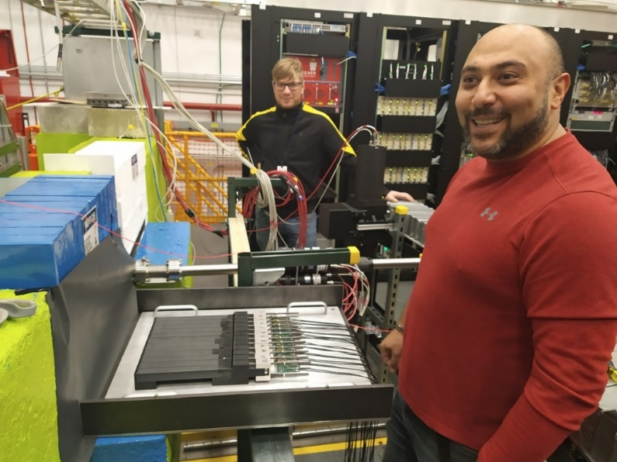
Testing of PbWO₄ Crystals
Dimension measurements
Light yield measurement (Na22 source)
Light transmission measurement
Pair Spectrometer test setup in Hall D

Slide 7
Installation Schedule
We expect to start the detector installation after the Spring run in 2023
- the size of the insert may vary depending on availability of funds. The project is
funded by the Jefferson Lab. Applied for the NSF grans (PI, Prof. L. Gan, UNCW)
The FCAL 2 can be integrated to the Hall D detector in about 6 months
- the installation plan has been developed
( T. Whiltatch presentation at GlueX collaboration meeting, May 2020 )
- main installation steps: Disassemble FCAL modules, modify FCAL frame,
Install lead glass and PbWO₄ modules, connect cables

Slide 8
Backup Slides

Slide 9
Compton Calorimeter: Module Assembly
PbWO₄ crystal
PMT housing
New module features:
- Soft iron PMT housing
- Acrylic light guide
Brass strip
PMT divider & Amplifier
PbWO₄ crystal wrapped with a ESR reflective foil and Tedlar
Brass tension strips (25 μm) are brazed to flanges and hold the module together
PMT is placed inside G-10 housing, wrapped with mu-metal foil

Slide 10
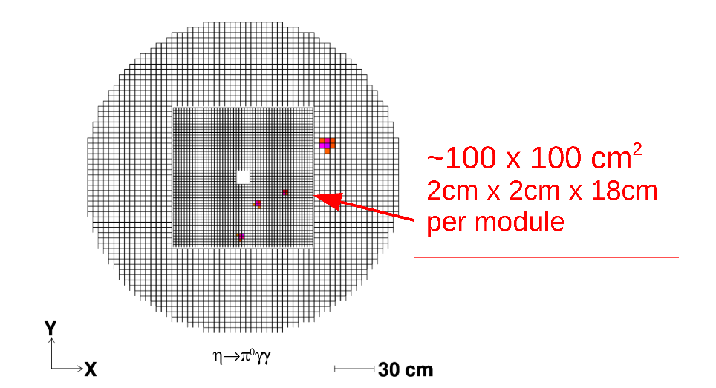
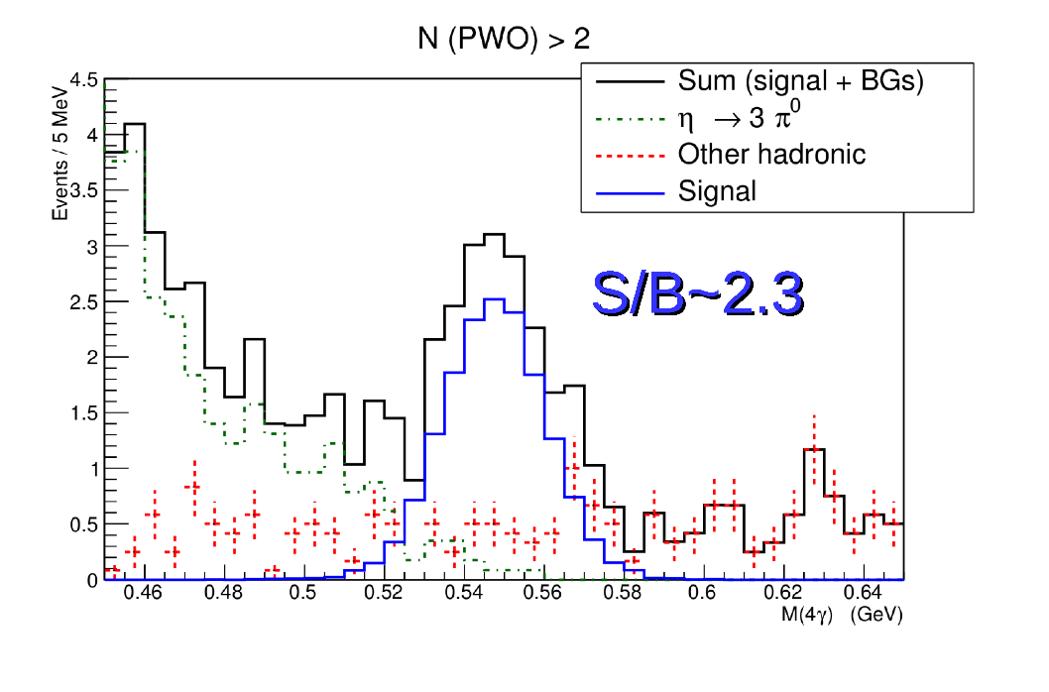
Upgrade of the Forward Calorimeter
Replace inner part of the lead glass calorimeter by PWO crystals
Property | Improvement factor
Energy σ | 2
Position σ | 2
Granularity | 4
Radiation-resistance | 10
MC simulation:
- Reconstructed η→π⁰γγ events during
1 day of taking data

Slide 11
Project Overview
PbWO Crystals
Module Design
PMT and Active Base
Electronics
Frame Design / Engineering
https://halldweb.jlab.org/wiki/index.php/FCAL_Insert

Slide 12
PWO Crystals: Procurement Status
64 crystals received from CRYTUR, all accepted
500 crystals ordered from SICCAS
- 183 crystals received (60 Hall C replacement + 123 Hall D)
- All produced crystals were checked at SICCAS by Wuhan group
Preparing a new contract for ordering 500 more crystals
- Paperwork is in place, coordinated with SICCAS (DOE approval will be needed)
- Expected delivery of all crystal - end of January 2021 (150, 150, 200 crystals)
Additional financial support - UNCW NSF grant is under review

Slide 13
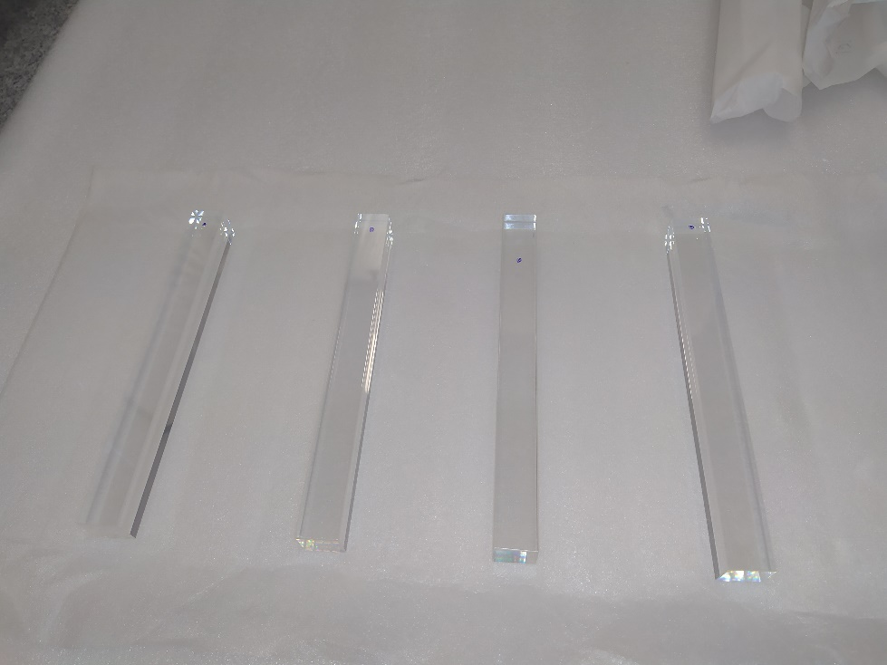
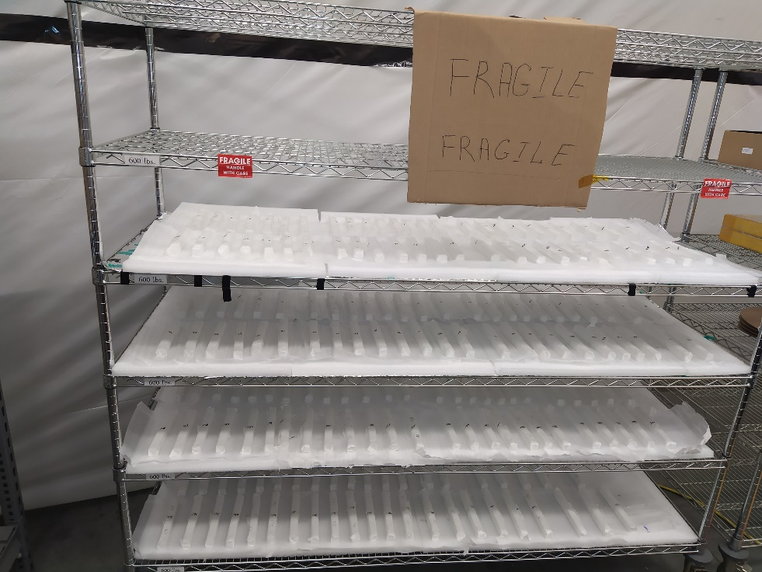
PWO Crystals
192 SICCAS crystal received in the middle of April (first batch)
Performed quick inventory and visual inspection check
Visually all crystals look Ok

Slide 14
Crystal QA Tests
Visual inspection
Measurement of crystal dimensions
Measurement of light transmission
Measurement of light yield
Crystal properties and testing procedures
Nucl.Instrum.Meth. A956 (2020) 163375

Slide 15
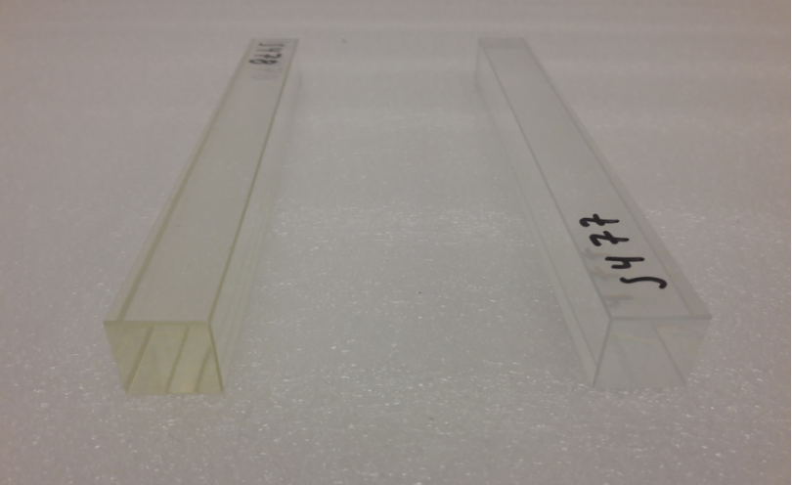
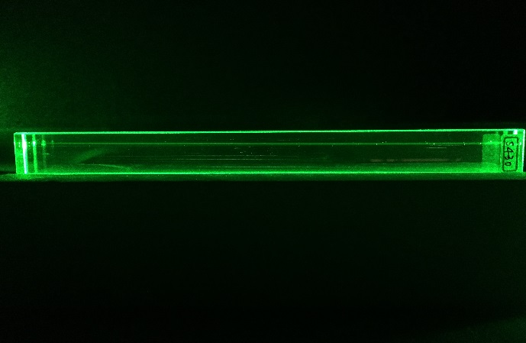
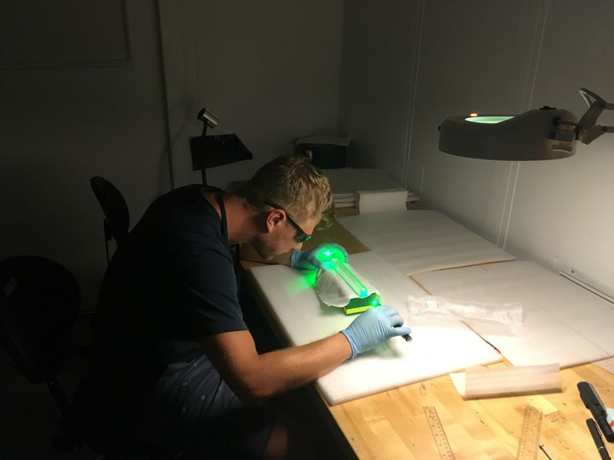
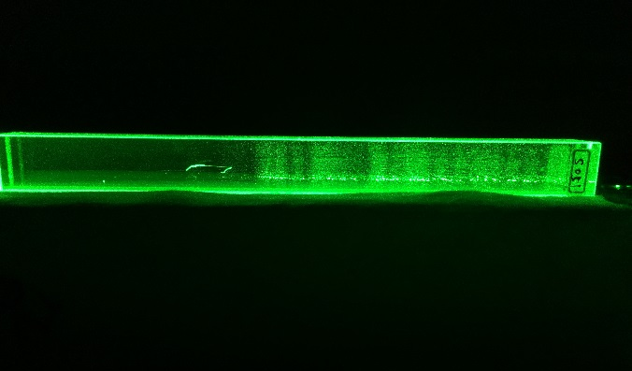
Visual Inspection
NPS Lab
Check crystal color
Use laser pointer to observe cloudy regions
Check edge quality for scratches and chips
yellow discoloratiuon
Clear crystal
Cloudy regions

Slide 16
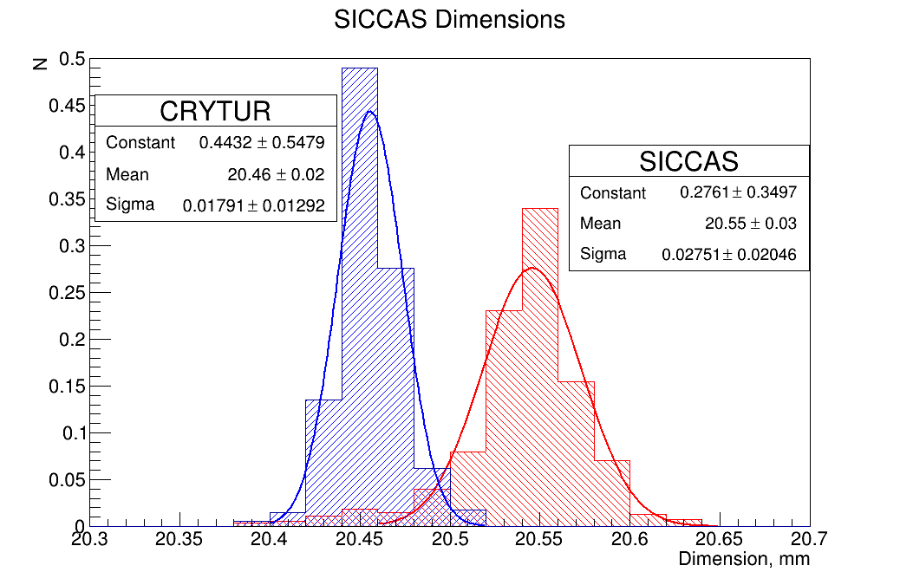
Crystal Dimensions
NPS test Lab
- Granite table
- Vertical height gage
Crystal measurement for NPS
(CCAL)
The lab and setup will be used to measure the Hall D crystals as well.

Slide 17
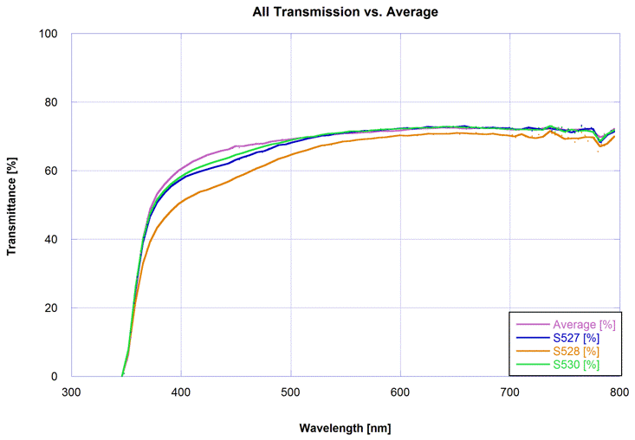
Light Transmission Measurement
crystal transmittance as a function of
wavelength
crystal with yellow
discoloration
Setup at Jefferson Lab (Carl Zorn’s lab)
- automatic operation for measurements
- will be used by Hall D
Reproduce transmittance measurements
performed with the setup at CUA
Measurement procedure:
Correlation between crystal
transmittance and crystal color
https://halldweb.jlab.org/wiki/index.ph/Measurement_Light_Transmission

Slide 18
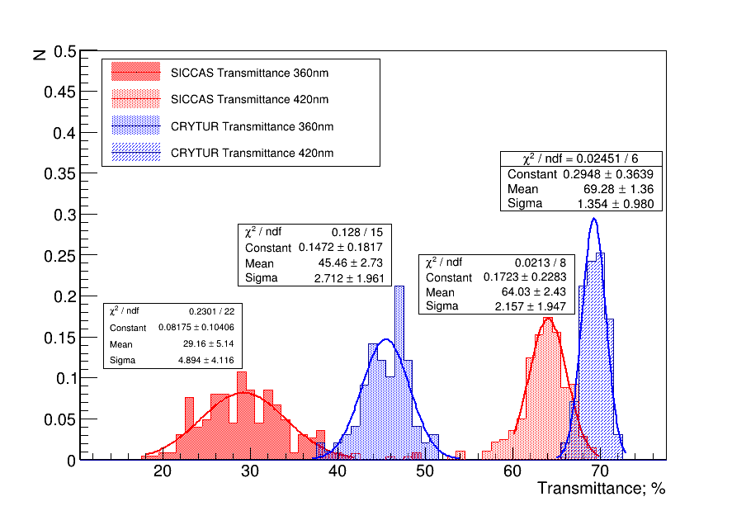
Crystal Transmittance

Slide 19
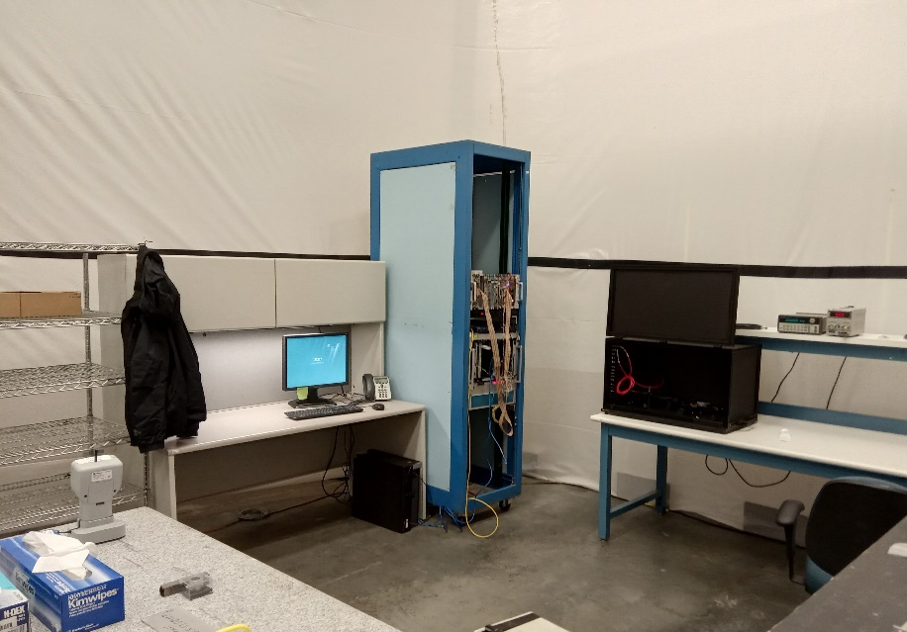
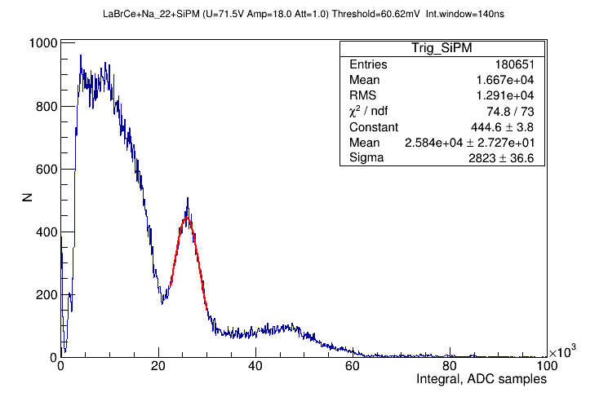
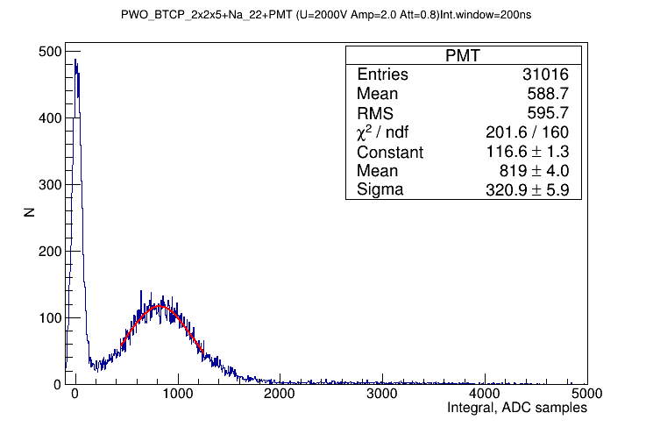
Light Yield Setup
Trigger
LaB_{r}(Ce) scint
Na-22 β+ and gamma source
- two 0.511 MeV photons. One used
for the trigger
New setup at TEDF (similar to NPS lab)
- crate with readout electronics
- CODA running on local PC
PWO

Slide 20
Light Yield Setup

Slide 21
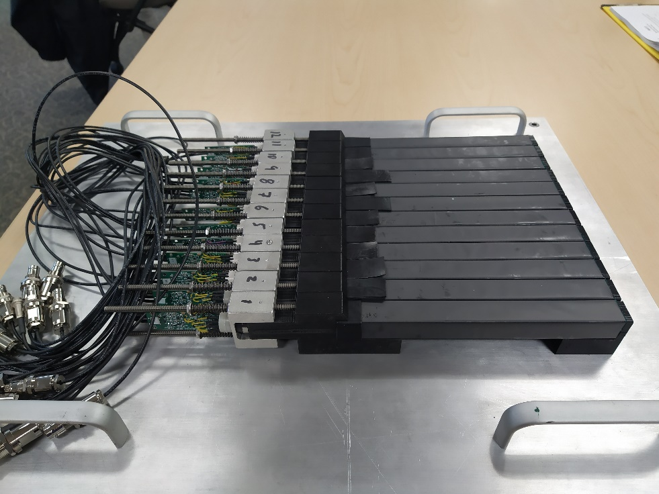
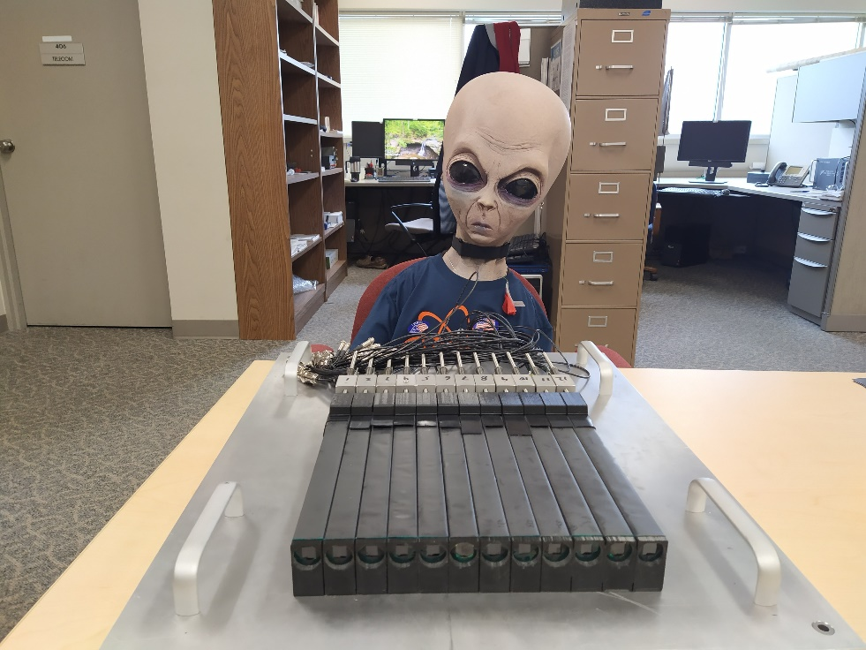
Crystal Testing Using Pair Spectrometer
Setup allows to test 12 modules, installed downstream the Pair Spectrometer
Run setup in parallel with GlueX data taking

Slide 22
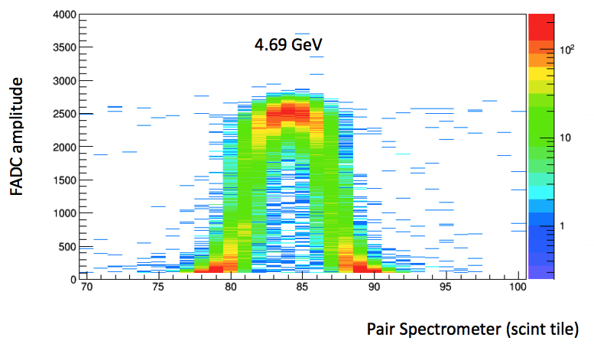
Crystal Testing Using Pair Spectrometer
‘Projection’ of the crystal to the PS
hodoscope
GlueX-doc-3590,
V. Berdnikov, A.Somov, J. Crafts
The setup has been aligned
Crystals can be easily installed during opportunistic access to the hall

Slide 23
Module Assembly
CCAL module (design based on HyCal, Hall B)
PbWO₄ crystal
PMT housing
New module features:
- Soft iron PMT housing
- Acrylic light guide
Brass strip
PMT divider & Amplifier
PbWO₄ crystal wrapped with a ESR reflective foil (60 μm) and Tedlar (40 μm)
Brass tension strips (25 μm) are brazed to flanges and hold the module together
PMT is placed inside G-10 housing, wrapped with mu-metal foil

Slide 24
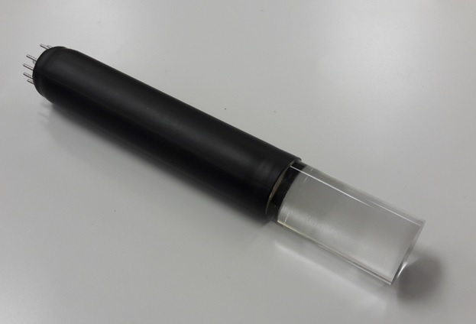
Finalizing Module Design
Magnetic shielding studies
https://halldweb.jlab.org/wiki-private/index.php/Private:Eta_Rare_Decay,
TOSCA simulation
GlueX-Doc-4166, Shielding studies using Helmholz coils
Light guides
LG length: 3.5 cm (magnetic shielding)
Diameter: 18.5 mm
Glue LG to the PMT (UV glue)
Couple LG to the crystal using Silicon
cookie (RTV 615)

Slide 25
Light Guide Studies
Installed light guides on 2 modules in the PS setup
- Studied relative light collection for several LG configurations
(unwrapped, wrapped with ESR, coupled to the crystal using optical grease
and Silicon cookie, use LG with different diameters)
- Beam tests using light guides with 2 diameters: 18 mm and 18.8 mm
Light losses of 25 % (compared with the direct coupling of PMT to the crystal)
Can improve light collection by a few present if use LG with the diameter larger
than 18 mm
https://halldweb.jlab.org/wiki/index.php/Ligh_Guide

Slide 26
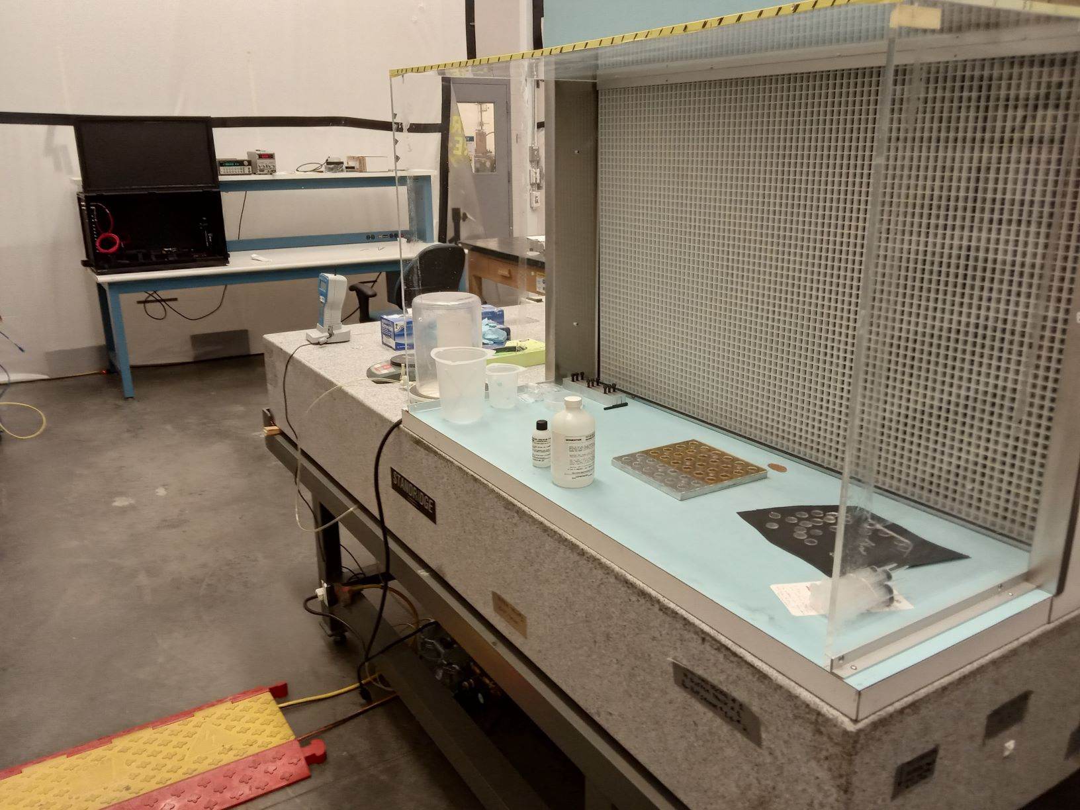
Clean Box to Produce Silicon Cookies
Use plexiglas plate with holes, produce 36 cookies at the same time
Cure silicon at room temperature (no heating)
Need to redo the fixture according to the final LG size of 18.5 mm

Slide 27
Fabrication Procedures
Improving strap brazing setup
- extend base plate to accommodate 20 cm long crystals
- new heating nozzle caps, implement temperature control
- clean flanges before brazing (JLab chemist group) with acetic acid
Checked strength of 25 μm strips, force analysis

Slide 28
Preparation for Module Fabrication
Item | Availability | Comments
PMT housing | 20 | Production rate 100/month
 |  | Produced at CMU, Annealed at Jlab
350 um mu-metal schileding cylinder | 20 | Ordered for 1600 modules
50 um mu-metal foil | 1600 modules
Light Guides | 5 | Wait for evaluation
 |  | Production rate: fast
ESR | 1600 modules
Flanges | 20 | Ordered for 500 modules
Brass strips | 1600 modules
PMT tension plate (G10) | 1600 modules
Kapton, Tedlar, Screws, Tape | Available
Fabrication tools are ready (ESR pre-shaping, brazing, LG gluing, etc)
Most fabrication procedures are finalized (used during CCAL fabrication)
https://halldweb.jlab.org/wiki-private/index.php/CompCal_Construction
OSP for module fabrication (GlueX-doc-4379)
Ready to start module fabrication !

Slide 29
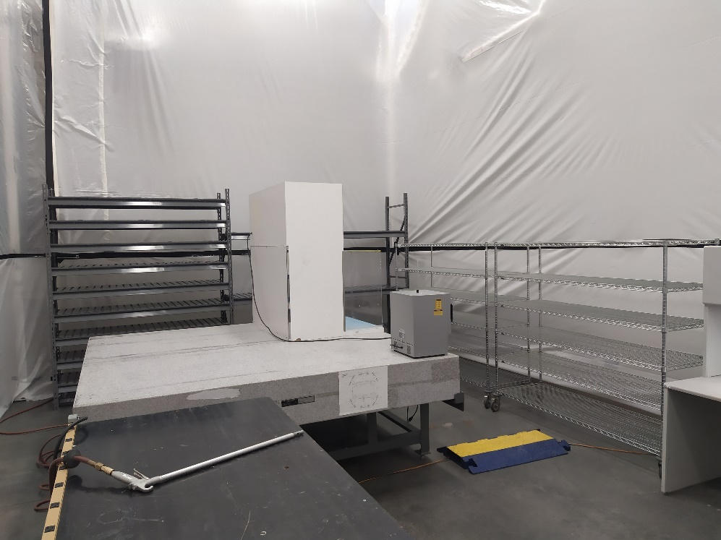
Clean Room for Module Fabrication (TEDF)

Slide 30
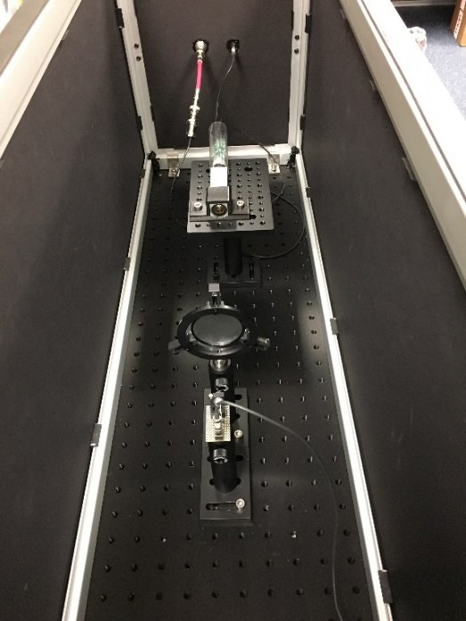
PMT and Active Base
Received 500 R4125 PMTs
Tested diameter of 250 PMTs (about 15 % have somewhat smaller diameter, trade in
with Hall C)
Check PMTs using an LED setup at JLAB
- have already tested a few hundred PMTs for CCAL and NPS, no defective PMTs found
https://halldweb.jlab.org/wiki-private/index.php/PMT_testing
PMT will be instrumented with an Active Base
- amplifier gain – 24 (reduce HV, small anode current)
- stable gain at high rate (up 2 – 3 MHz)
The Active Base was installed on CCAL and used during
PeimEx run in spring 2019
New Active PMT Base for PbWO4
(Popov, H. Mkrtchyan, presentation at IEEE, Nov 2012)

Slide 31
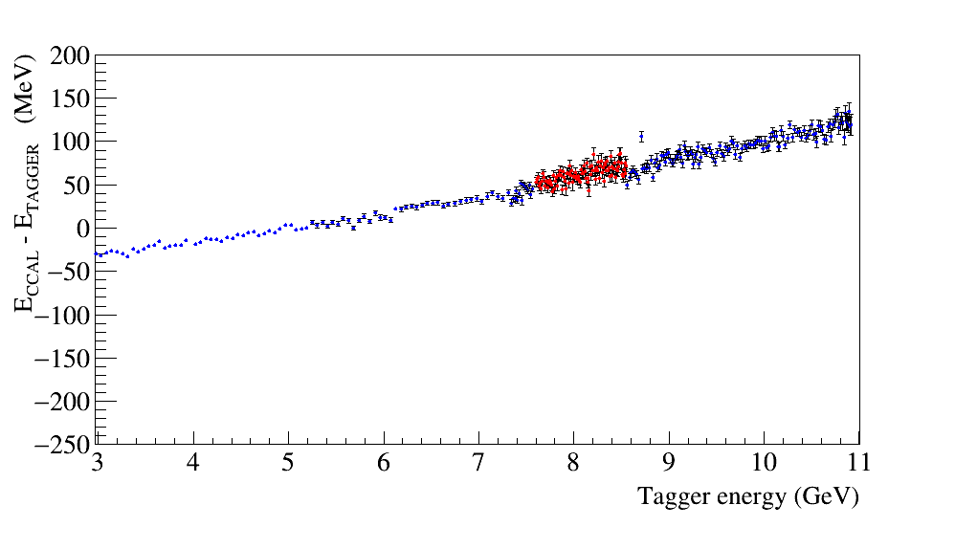
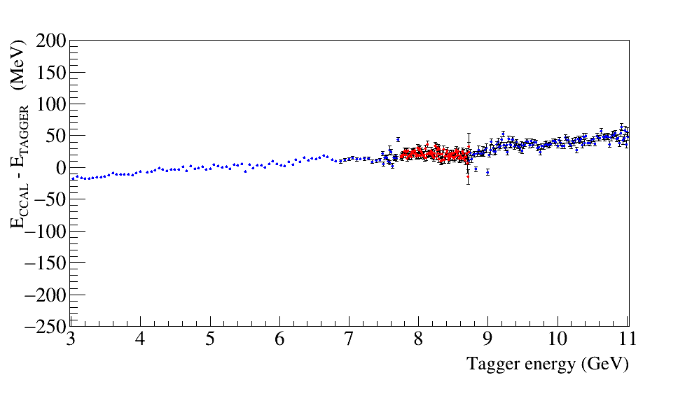
PMT Active Base Linearity
Found somewhat non-linear performance of the active base during CCAL testing
The linearity can be improved by reducing the amplifier gain and increasing HV
Some tuning of the PMT base are required
V. Popov modified the active divider (increase the anode current, changed resistors
in the amplifier chain )
- three modified bases were installed on CCAL and tested in January 2020
Linearity of the FADC peak amplitude
Original PMT base, gain ∼25
Modified base, gain 6
700 V
2 V FADC range
825 V
2 V FADC range
https://logbooks.jlab.org/entry/3780745

Slide 32
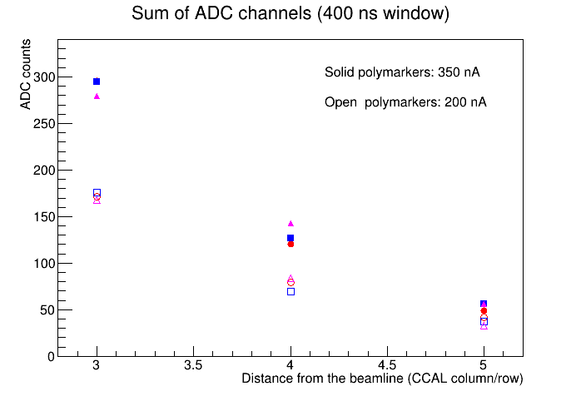
Sum of FADC amplitudes in 400 ns time window
Example:
Current seen by FADC in the 3rd row: 30 muA
Current through the divider: 30 muA / 24 =
1.25 muA
Current estimates for FCAL:
Beam hole: 2x2
1 layer covered by an absorber
The 3rd layer in FCAL – 5th layer
In CCAL (factor of two difference in Z)
Solid angle correction is 2x2 = 4
If no amplifier used: 5 x 4 = 20 muA
30 muA / 24
15 muA / 24
5 muA / 24
Discussion:
- Use active bases with the gain 3 (or 6) in the inner layers of the FCAL 2
- Don’t need amplifiers on other layers
Install 24 active bases with modified dividers (gain 3 and 6) on the CCAL inner layers
Notes:
*

Slide 33
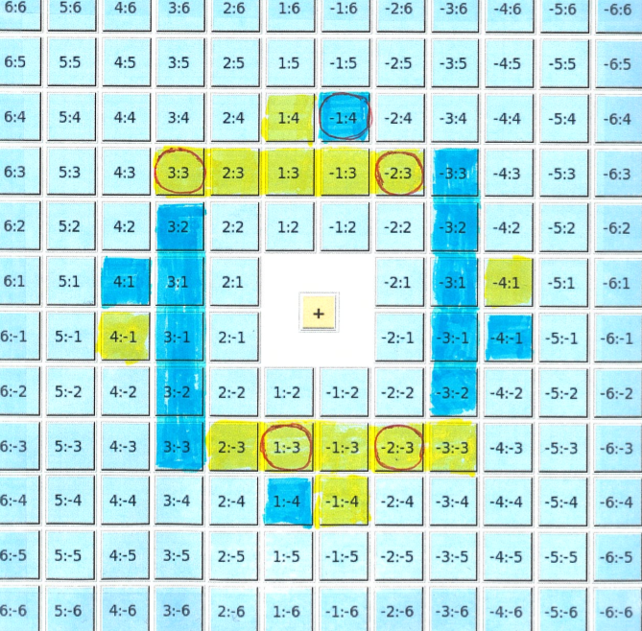
Install Modified Bases on 24 CCAL Modules
Sssds https:/ /logbooks.jlab.org/entry/3807923, 3807924, 3808592
Voltages calibrated using a snake scan (CCAL as TAC)
Use CCAL during GlueX production for about 1.5 days
- stable performance
- looking on data now
Implemented CCAL to the trigger
x24 gain 670 V 260 μA
x 3 gain 870 V 980 μA (modified base)

Slide 34
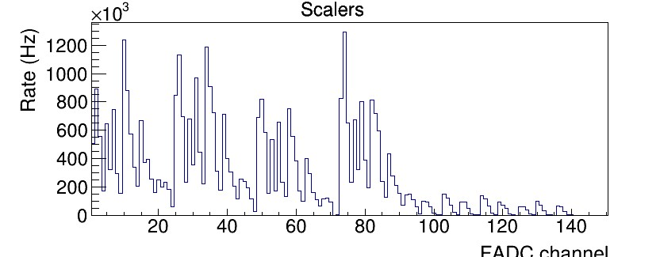
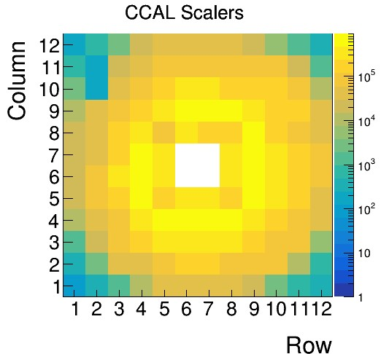
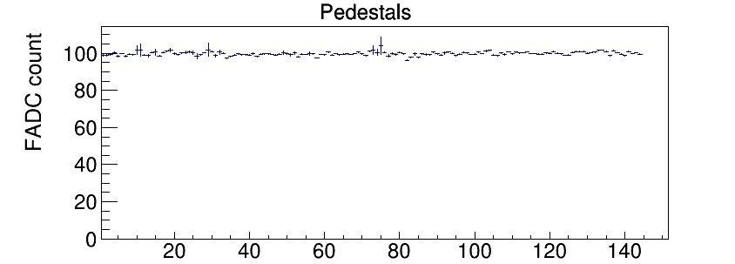
Performance of CCAL Modified Bases in GlueX
FADC channel
8 mV ADC Threshold (45 MeV)
Stable performance during data taking
Checking LED response (gain stability) now
Use CCAL with GlueX runs (instrument with dividers with gain x3)
FADC channel

Slide 35
Next Steps
Perform detailed check of 192 crystals received from SICCAS
(visual inspection, dimension measurements, optical transmission, light yield)
- check transmission and light yield only for preselected crystals from future batches
- check some crystals using PS setup (?)
Check/order more light guides when the lab will be opened again
Start fabricating modules. Currently have parts for 5 modules (5 light guides)
Check PMTs (check dimensions of 250 PMTs, check gains for 100 – 150 PMTs)
Finalize design of the active base
- Test active bases with the gain of 3 during PrimEx run (to be coordinated)
- Fernando is currently working on the PCB layout (use dip switch or soldering point
to change between gain 3 and bypassed amplifier). Some coordination is needed
Test fabricated modules using the PS setup

Slide 36
Backup Slides

Slide 37
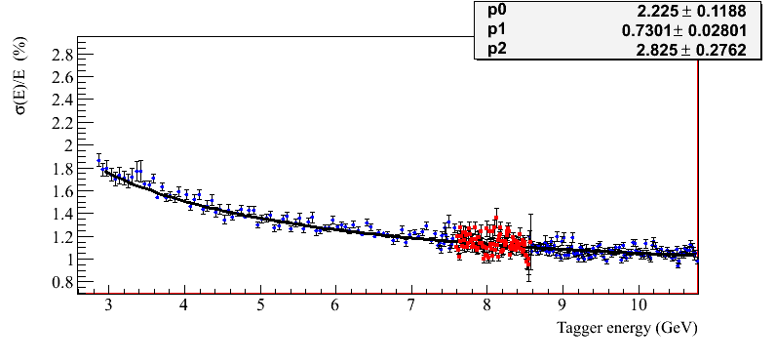
Energy Resolution Measured with CCAL
Preliminary plot, will be updated
NPS Prototype
HyCal (Hall B)
3x3 array
bypassed amplifier
NPS prototype
$\frac{σ(E)}{E}=p1⊕\frac{p0}{\sqrt{E}}⊕\frac{p2}{E}$
•
•
•
Relatively good energy resolution, which is consistent with the resolution of the
Hall B HyCal calorimeter
Rate and PMT anode current have to be considered (some measurements were performed)
More details can be found in
GlueX-doc-3590, GlueX-doc-3998, V. Berdnikov, A.Somov, J. Crafts

Slide 38
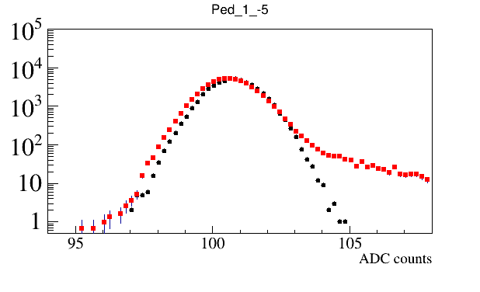
Measurement of the PMT Anode Current
What amplifier gain do we need ?
Use CCAL to estimate the PMT anode current
Collect FADC waveforms using random and PS triggers
Two beam currents: 350 nA and 200 nA
- no data sparsification (no threshold applied)
- estimate current using waveforms acquired
with the random trigger
- Use PS trigger to monitor beam trips
Sum up FADC amplitudes above the threshold
(1 count above the baseline) in a 400 ns window
(100 fadc samples)
Estimate anode current as follows:
A = 5 x 10⁻⁴ V / 50 Om <A (FADC) > / 100 samples / Gain (Amp)
FADC Pedestals
Threshold
Notes:
*

Slide 39
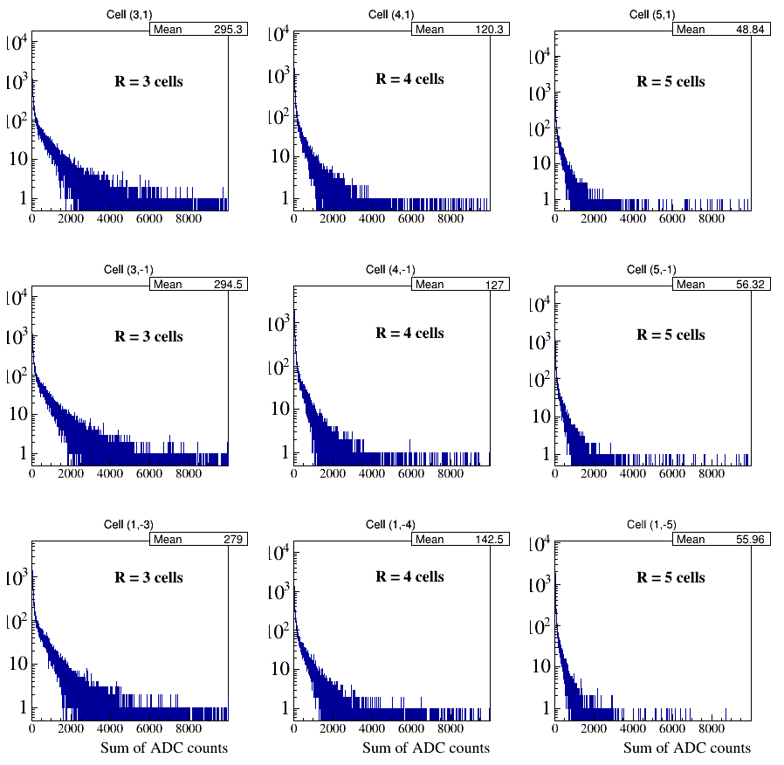
Sum of FADC amplitudes in 400 ns time window
Notes:
*

Slide 40
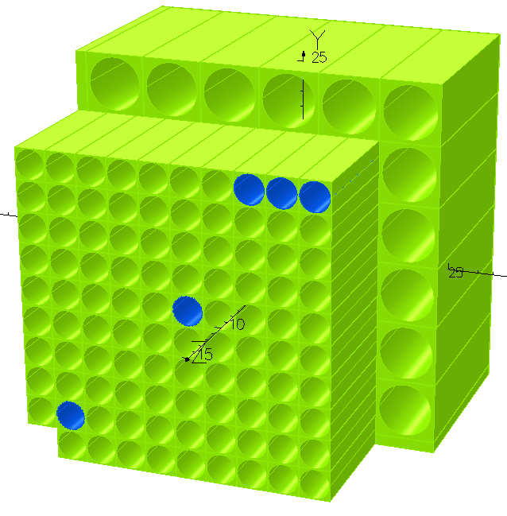
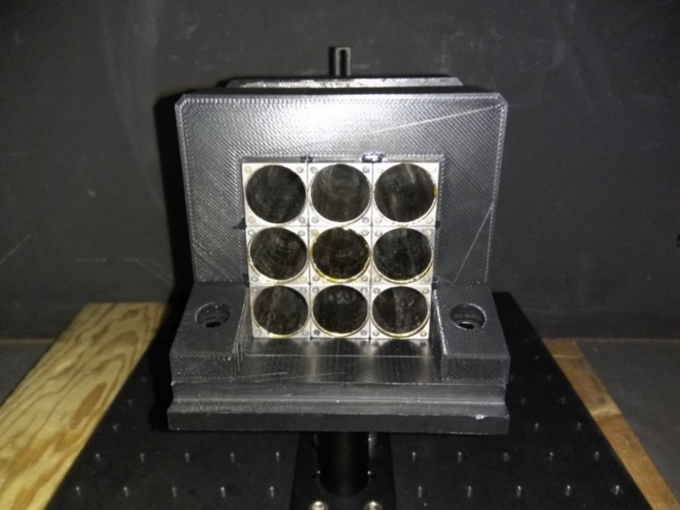
Magnetic Shielding
Simulated magnetic shielding using TOSCA (S. Glamazdin)
https://halldweb.jlab.org/wiki-private/index.php/Private:Eta_Rare_Decay
5
4
3
2
Build a 3x3 prototype and measured magnetic field
and PMT performance using Helmholz coils
1
GlueX-Doc-4166
20.6 mm
Housing D = 19.9mm
Mu-metal foil: 350 μm
50 μm
(350 μm foil welded and
annealed)
Steel 1020 (not annealed)
No significant degradation of performance of the shielded PMT observed

Slide 41
Light Guide Studies
LG length: 3.5 cm (magnetic shielding)
Diameter: 18 mm
Glue LG to the PMT (UV glue)
Couple LG to the crystal using Silicon
cookie (RTV 615)

Slide 42
PWO Crystals
PWO crystals: 20.5 mm x 20.5 mm x 200 mm ( FCAL insert: an array of 40 x 40 crystals)
Two vendors:
SICCAS: Shanghai Institute of Ceramics
CRYTUR: Integrated crystal based solution, Czech Republic
https://halldweb.jlab.org/wiki-private/index.php/Crystal_Specifications
Procurement status:
64 crystals received from CRYTUR, all accepted
500 crystals ordered from SICCAS
- 160 crystals are ready to be shipped to us
- All produced crystals were checked at SICCAS by Wuhan group
Preparing a PR for 500 more crystals
Many crystal QA tests were performed during CCAL fabrication
Collaborate with the Hall C NPS group
- building PbWO calorimeter, already have about 1100 crystals

Slide 43
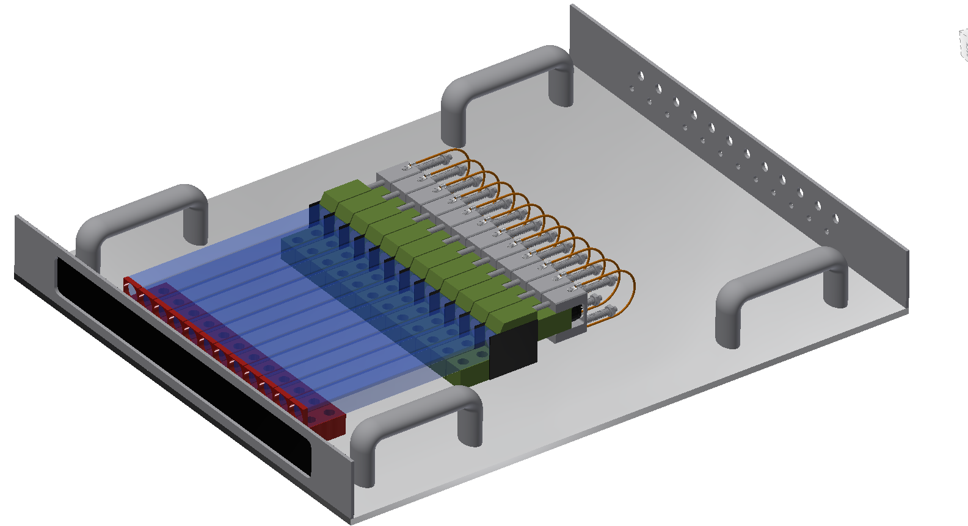
Crystal Testing Using Pair Spectrometer
Test up to 12 PWO crystals (modules) at the same time
Install test bench on the platform behind the PS
Take data in parallel with GlueX (fadc in the ST crate)
Module assembly for testing
Crystral
PMT
Divider
Can measure light yield,
energy resolution
Study light guides
12 modules
on the test bench

Slide 44
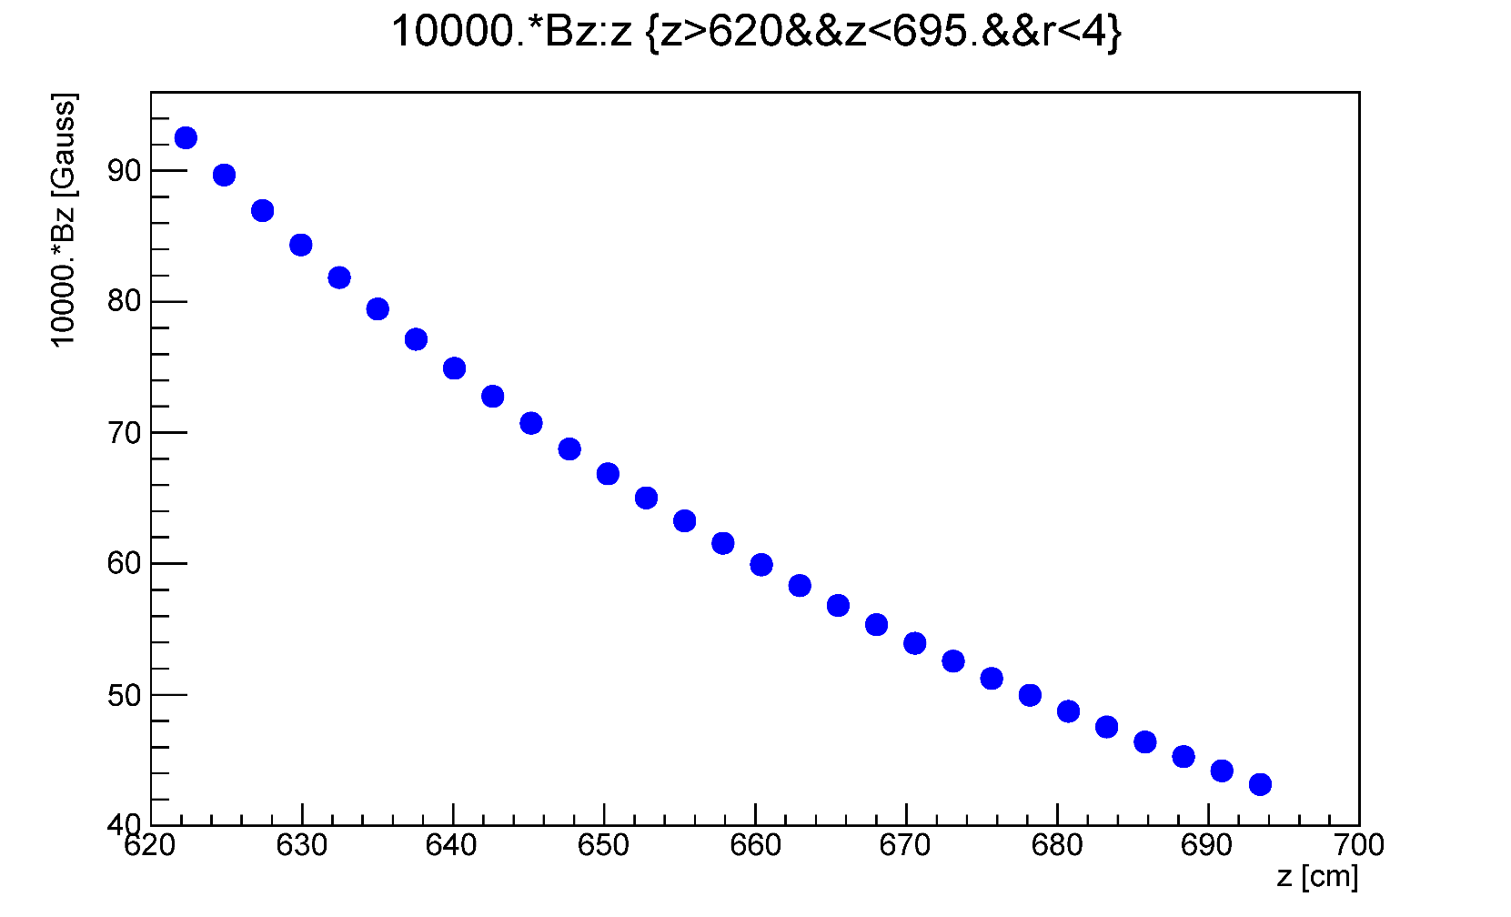
Solenoid Magnetic Field
GlueX-doc-4166-v3
Longitudinal field at beamline (r = 0)
B _{Z} (Gauss)
FCAL lead glass
face
lead glass
downstream end
Z (cm)
The field was also measure in front of the FCAL (TOF)
- good agreement with the field map

Slide 45
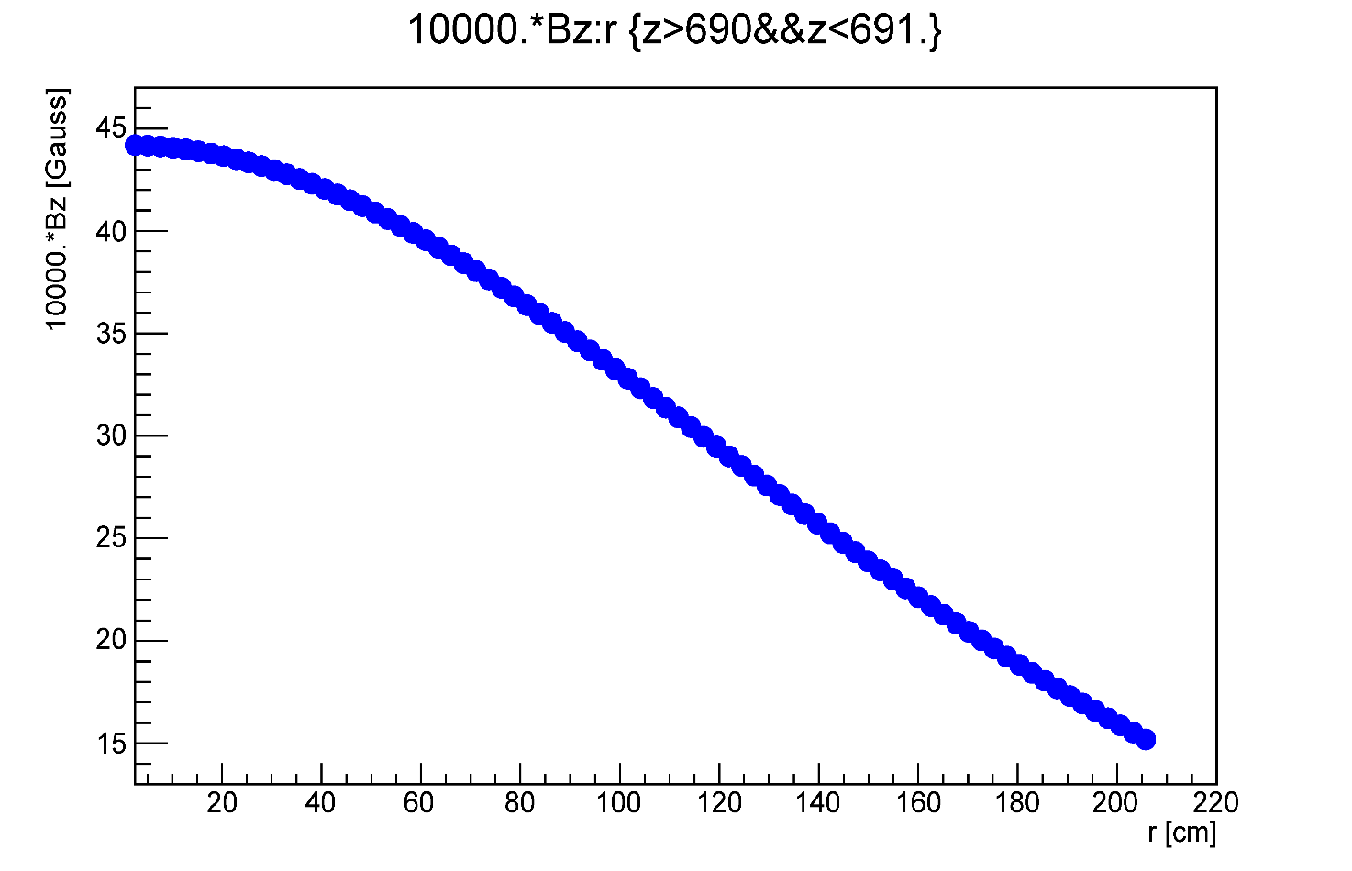
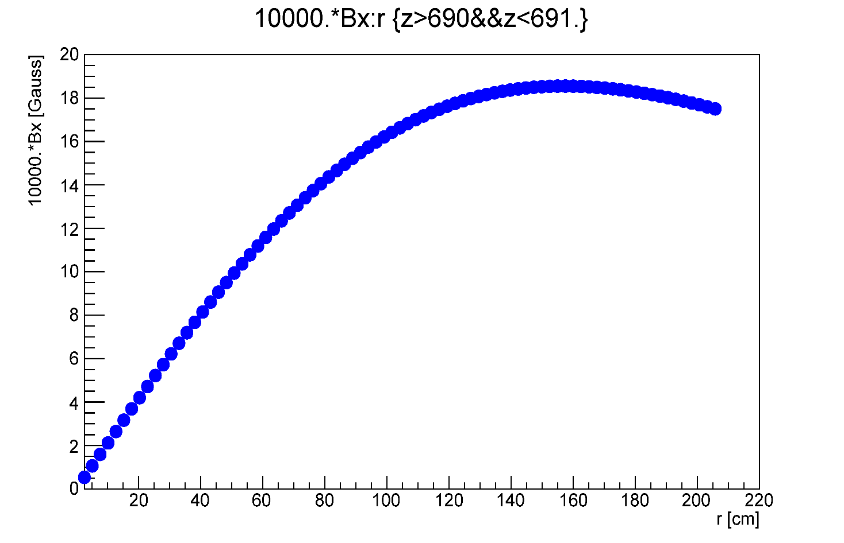
Solenoid Magnetic Field
20 cm downstream the FCAL lead block
B _{Z} at Z = 690 cm
B _{x} at Z = 690 cm
B _{Z} at Z = 690 cm
B _{Z} (Gauss)
B _{X} (Gauss)
Insert
Insert

Slide 46
Proposed Position of
the FCAL II
Z = 625 cm
Z = 670 cm
Lead Glass L = 45 cm
10 cm
PWO L = 20 cm
move downstream by 35 cm
Beam
Z = 635 cm
Z = 655 cm
Two FCAL outer rings cannot be calibrated using
photons from the target
Move FCAL downstream the beam by 35 cm
Maximum field at Z = 690 cm 44 Gauss
Bz (r = 0) = 44 Gauss, Bx (r = 40 cm) = 8 Gauss
FCAL modules from the inner part (replaced by PWO)
can be used to instrument one extra outer layer
Z = 660 cm
Lead Glass L = 45 cm
PWO L = 20 cm
Beam
Z (CCAL) = 690 cm

Slide 47
Solenoid Magnetic Field
Z (cm) | Z (cm) | Bz (r = 0 cm) G | Bx (r = 40 cm ) G
625 | FCAL upstream face | 87 | 20
645 |  | 68 | 15
670 | FCAL downstream face | 54 | 10
690 |  | 44 | 8
625 cm
670 cm
Lead Glass L = 45 cm
PWO L = 20 cm
Beam
635 cm
655 cm

Slide 48
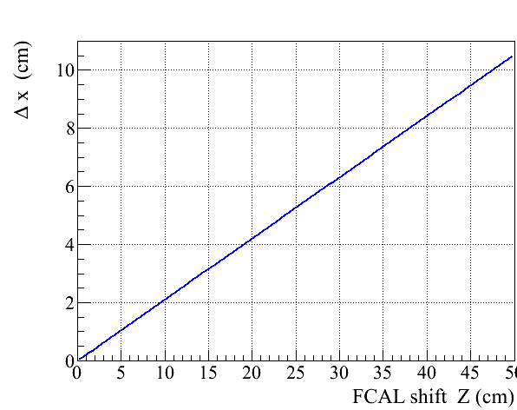
FCAL Acceptance
Move FCAL platform downstream
the beam by 35 cm
FCAL aperture is decreased by
Δr = 7.5 cm

Slide 49
PMT Housing: 3 x 3 Prototype
20.6 mm
Housing D = 19.9mm
Mu-metal foil: 350 μm
50 μm
(350 μm foil welded and
annealed)
Steel 1020 (not annealed)
PMT length (no leads): 8.73 cm
LG length: 3.5 cm
Total: 12.23 cm
Flange (+gap): 0.8 cm
12.23 – 0.8 = 11.43 cm
PMT housing length 10.5 cm
can make PMT housing 6 – 7 mm longer
Average crystal width: 20.55 mm ( sigma ± 25 μm )
ESR thickness: 65 μm
20.55 + 0.13 = 20.68 mm (+ Tedlar)
cannot make housing wider
PMT diameter < 19.0 mm

Slide 50
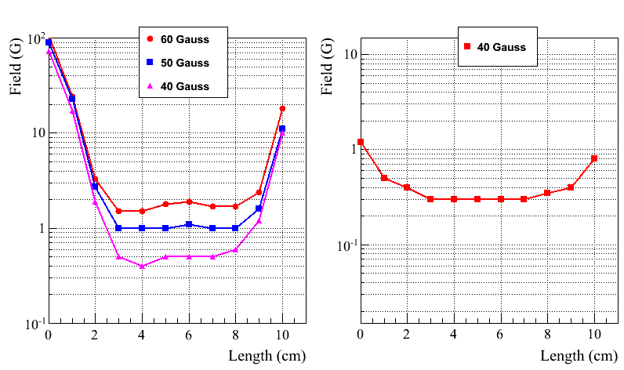
Field Measurement
Longitudinal Field
Transverse Field
Expected maximum
transverse field is
8 Gauss
(at Z = 690 cm)
Transverse field can be easily shielded
PMT is much less sensitive to the longitudinal field

Slide 51
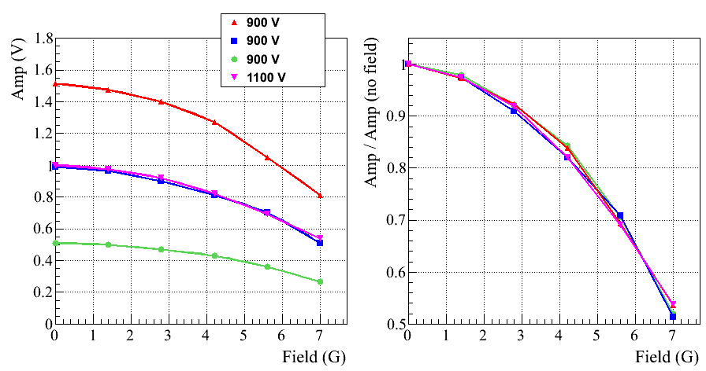
PMT Response to LED (no Shielding)
Longitudinal Field

Slide 52
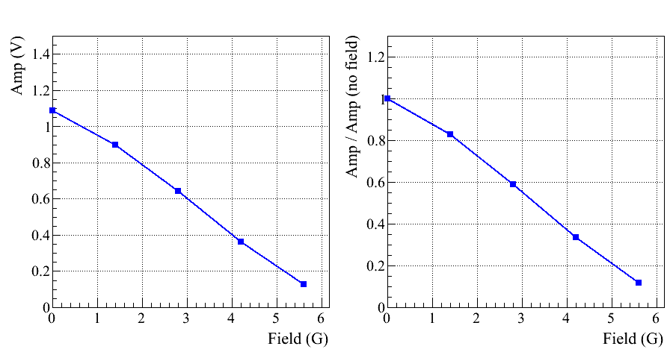
PMT Response to LED (no shielding)
Transverse Field

Slide 53
LED Setup
Check PMT response for different field values using an LED system

Slide 54
PMT Response to LED ( with Shielding)
Response to the longitudinal field
B_{z}
B_{z}

Slide 55
PMT Response to LED ( with Shielding )
Rotate prototype by about 10 degrees
- longitudinal and transverse components
GlueX-doc-4166-v3
Total Field (G)
Total Field (G)

Slide 56
Magnetic shielding (TOSCA Simulation)
A. Glamazdin
https://halldweb.jlab.org/wiki-private/index.php/Private:Eta_Rare_Decay
Magnetic field shielding simulated
with TOSCA
Field measurements were performed
in Hall D and using Helmholz coils
Realistic 3x3 prototype (PMT housing)
is ready
- will be tested using Helmholz coils
shortly
4
3
5
2
1

Slide 57
19x19 Hybrid FCal with Solenoid
P=5cm, µ-shield 360µm
Sol-1: x=y=3.125cm
Sol-2: x=y=19.925cm
Sol-3: x=y=38.825cm
Sol-4: x=36.725, y=38.825cm
PMT’s face
(3cm guide)
PMT’s face
(4cm guide)
PMT’s face
(5cm guide)
Magnetic field can be reduced below 0.5 Gauss

Slide 58
Readout Electronics
See talk by Fernando
Use standard readout (fadc250) and trigger electronics. Will require
5 new VSX crates
VXS crates - ordered
FADC 250 - ordered
Procurement of CTP (VTP) is in process
Trigger Interface modules - ordered

Slide 59
Frame Design
See talk by Tim
Stephanie, Keith Harding
Regular meetings with engineering group
https://halldweb.jlab.org/wiki/index.php/FCAL_Insert_Design_Meetings
Working on the frame design
Cooling
Light monitoring system
Electronics patch panels

Slide 60
Di-photon Yield
FCAL XY of clusters
Compute tagged flux for all PrimEx production
runs (CCDB)
Flux normalized yield of di-photons
Run period: 1 day
Run period: 2 days
Relatively stable
performance
Problematic modules in FCAL
Runs
Runs

Slide 61
CCAL Light Monitoring System
Reference PMT receives light from
LED and Alpha source
- good LED stability measured
with respect to Alpha, ± 0.2 %
A (LED) / A (Alpha)
1st run
last run
Runs
LED response in various CCAL
modules
A (LED)
2 %
1st run
last run
Runs

Slide 62
PMT Active Base Performance
Observed non – linear response of the calorimeter (couple of percents)
during commissioning run in December 2018
- somewhat worse energy resolution than expected
- PMTs were operated at relatively small HVs (650 – 700 V), HV recommended
by Hamamatsu is about 1 kV
Changed FADC voltage range to 2 V and increase HV by 50 V in January
Study linearity using calibration runs (CCAL in the beam)
FADC amplitude as a function of the beam energy
10 GeV : 3200 FADC channels
Rate < 30 kHz

Slide 63
Linearity as a Function of Operational HV
Calorimeter CELL = -4, -4
Fall, 2018
Spring, 2019
570 V
630 V
680 V
750 V
Signal attenuator (0.1)
Linearity is improved with the HV increase

Slide 64
Test Modified Active Base with the Bypassed Amplifier
Install 9 PMT bases with
the bypassed amplifier
two bases with the reduced gain:
gain 3 and 6

Slide 65
Linearity: ADC Peak Amplitude
Cell 4, 4
Cell 4, 4
Cell 4, 4
Cell 4, 4
Divider limitations
CCAL Spring 2019, gain 24
750 V
2 V range
Bypassed amplifier
810 V
0.5 V range
Bypassed amplifier
960 V
2 V range
Vpeak = 1.7 V (3501 cnt)
Vpeak = 0.4 V ( 3474 cnt)
Vpeak = 1.6 V (3228 cnt)
Cell -5, 4
Cell -5, 5
gain 3
850 V
2 V range
gain 6
800 V
2 V range
Vpeak = 1.2 V ( 2480 cnt)
Vpeak = 1.6 V ( 3359 cnt)

Slide 66
Hall D Compton Calorimeter
V. Berdnikov, T. Horn,
H. Voskonyan, H. Mkrtchyan
Collaboration between Hall D and Hall C (NPS prototype)
Array of 12x12 PbWO₄ crystals
Beam hole: 2 x 2 crystals
Tungsten absorber covers the inner
most layer (taken from HyCal)
Water cooling (minimum 5° C),
nitrogen purge
LED-based gain monitoring system
Positioned on X-Y movable platform
Hamamatsu R4125 PMT
HV dividers with amplifiers, designed by Vlad Popov

Slide 67
Calorimeter Fabrication
Cooling Plates
PMT housing

Slide 68
Light Monitoring System
Two reference PMTs are installed to monitor LED stability
Each PMT receives light from the LED fiber and YAP:CE Am light source
LED and Alpha-source triggers are used during data taking (special trigger types)
Reference PMT FADC amplitudes
PMT1
PMT2

Slide 69
Rate per Counter (PrimEx D Conditions)
Maximum rate per counter
is 250 kHz
(at ∼30 MeV threshold)
Rates are in a good agreement with the simulation for PrimEx D
250 kHz
FADC scalers

Slide 70
Linearity: ADC Peak Amplitude
(Bypassed amplifier, 1000 V, 2 V range, Spring 2019)
Cell 4, 4
Better linearity at small amplitudes
Negative non-linearity at large amplitudes

