Slide 1
Time corrections for TAGH/TAGM counters
Sasha, 1/20/2022
TAGH RF is determined using ADC time for each TAGH/TAGM counters
- Timing calibration is performed with respect to the RF
If counter times (both ADC and TDC) are shifted by the time multiple to 4 ns, wrong
RF can be assigned
- it does not impact TW calibration
This effect can be seen when the ‘external’ reference time is used ( PSC RF )

Slide 2
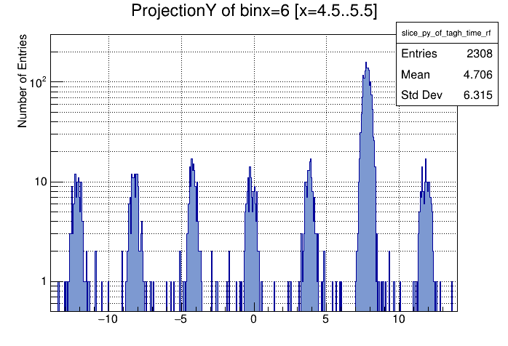
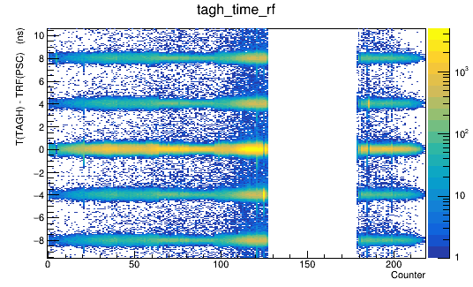
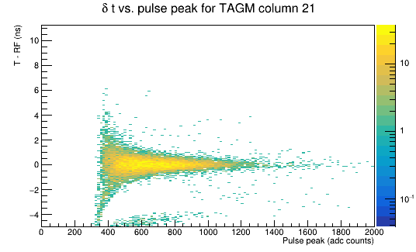
Time corrections of TAGH/TAGM counters
T (TAGH) – RF (PSC)
TW calibration (with respect to
the RF (TAGH), no time shift

Slide 3
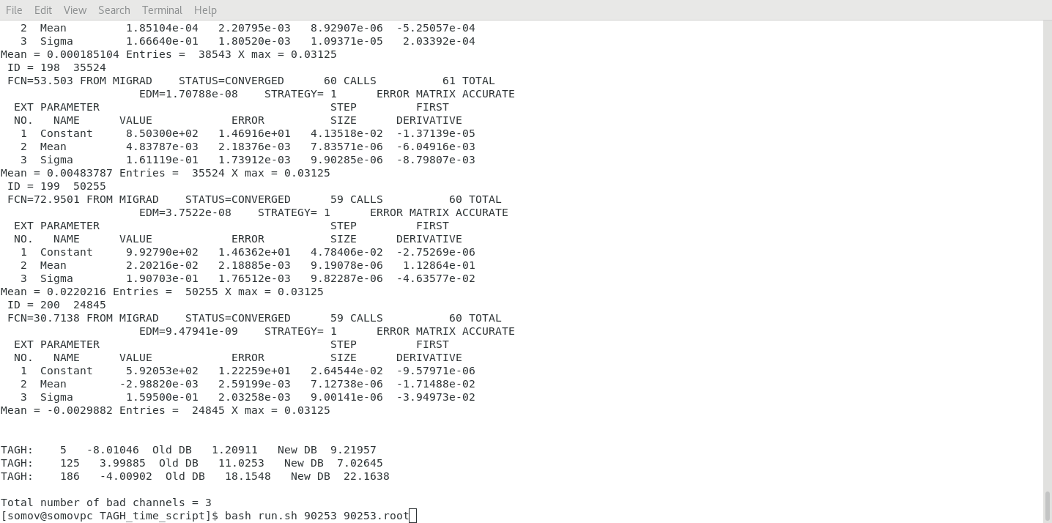
Calibration of Timing Offsets
New script in TAGH_timewalk to calibrate this shift
Both ADC and TDC times
are shifted (by the same amount)
Correct times for a couple of
channels after TAGH / TAGM times
are calibrated
- use script (TAGH_timewalk)
see run_time_shift.sh to calibrate offsets of individual channels

Slide 4
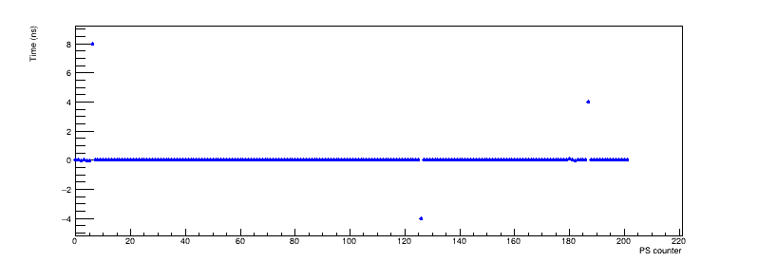
Calibration of Timing Offsets
Run 90535
T (TAGH) – T (PSC) (ns)

Slide 5
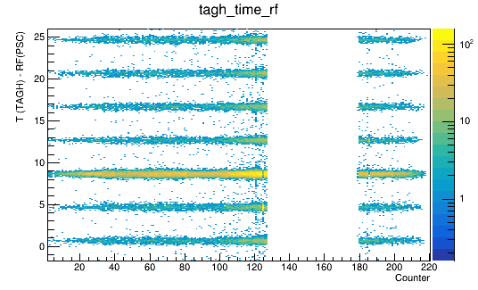
Timing offset with respect to the PSC RF
Run 90535
Reference: PSC RF
Time shift seen with respect to the
TAGH RF: 0.7 ns
(two missing RFs)
Real time shift: 8 ns + 0.7 ns

Slide 6
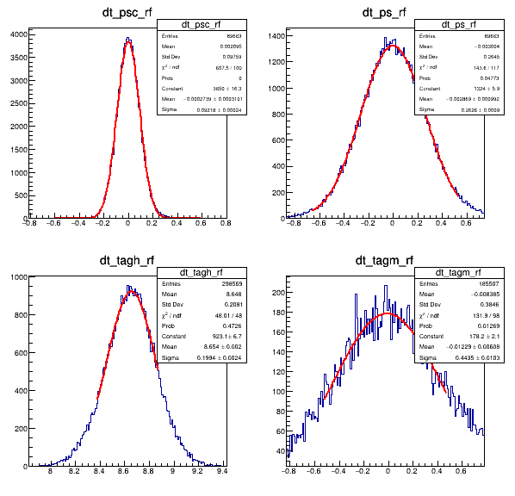
Timing offsets with respect to the PSC RF (before calibration)
Run 90535
PS
PSC
TAGH times shifted, PS/PSC/TAGM are
aligned
TAGH
TAGM
8.7 ns time shift
T – T(RF PSC) (ns)

Slide 7
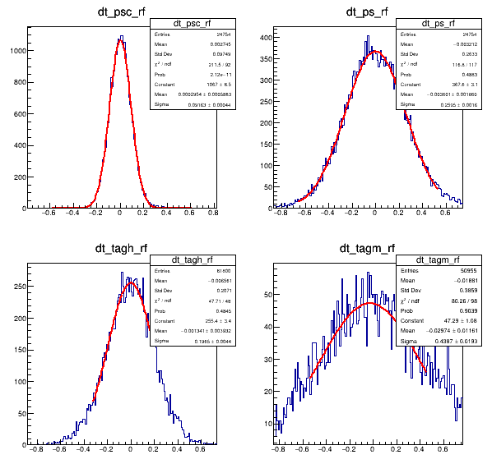
Timing offsets with respect to the PSC RF (after calibration)
Run 90535
PS
PSC
TAGH
TAGM
no time shift
T – T(RF PSC) (ns)

Slide 8
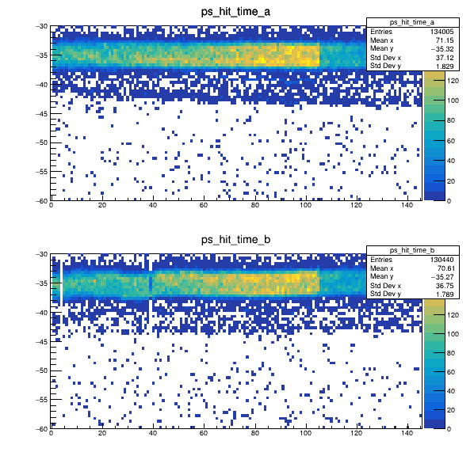
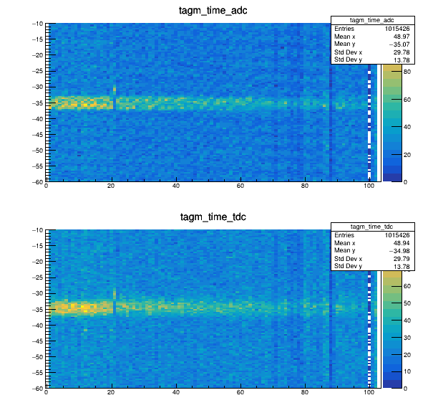
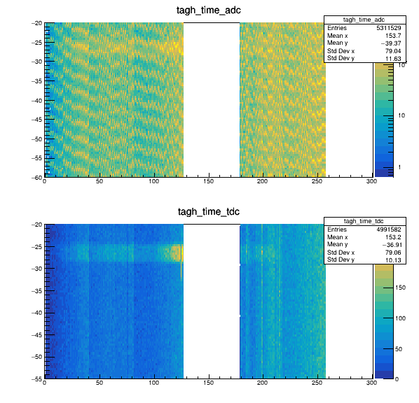
Detector Times
Run 90535
Expect the ‘same’ time (ADC and TDC) for sub-detectors
PS
TAGM
TAGH
Time (ns)
Counters
Typical ADC / TDC time: 35 ns

Slide 9
Next Steps
Produce root files for all runs. Check quality
Align individual channels
Final quality check

