Slide 1
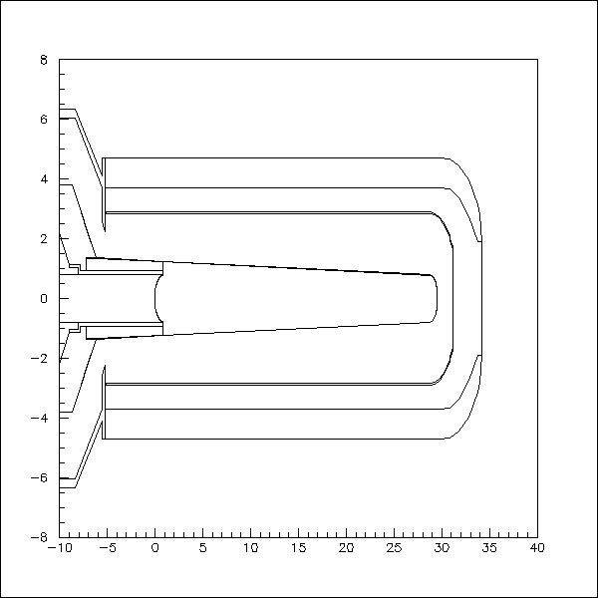
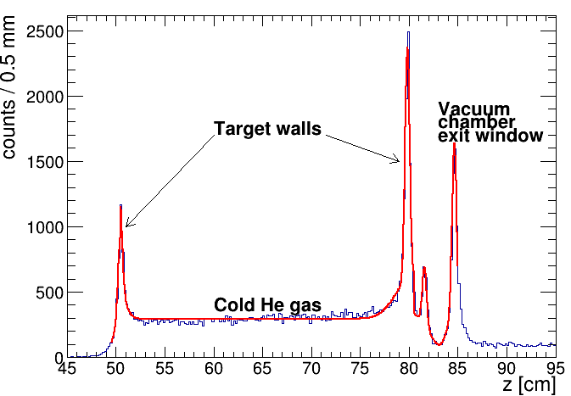
Liquid He and D Targets in Geant
Sasha
SRC analysis meeting, April 4, 2022
Heat shield
(0.5 mm Al. 25 um front window)
Rohacell (vacuum chamber)
Empty target run (Simon)
Target cell

Slide 2
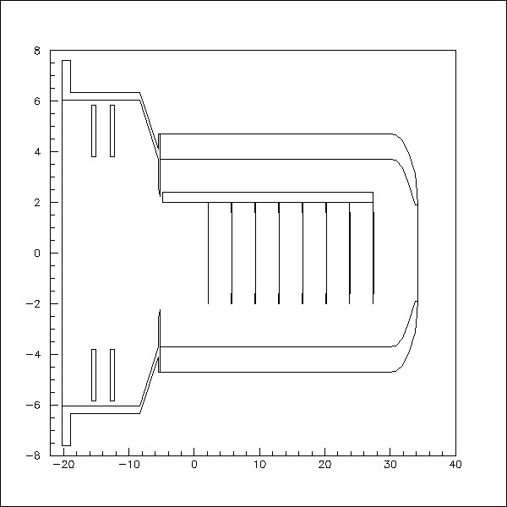
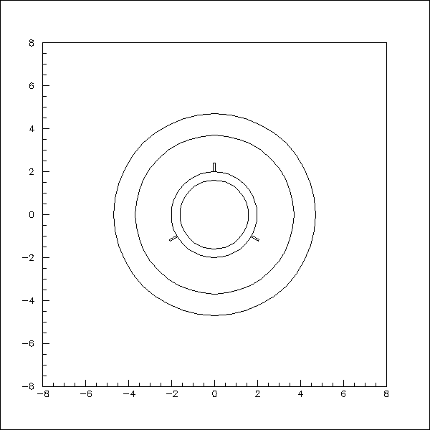
Carbon Target Ladder in Geant
YZ projection (X = 0)
XY projection (at first C target)
Rohacell (vacuum chamber)
Carbon support ring
8 carbon targets
Rohacell
Support
rod
Support rods

Slide 3
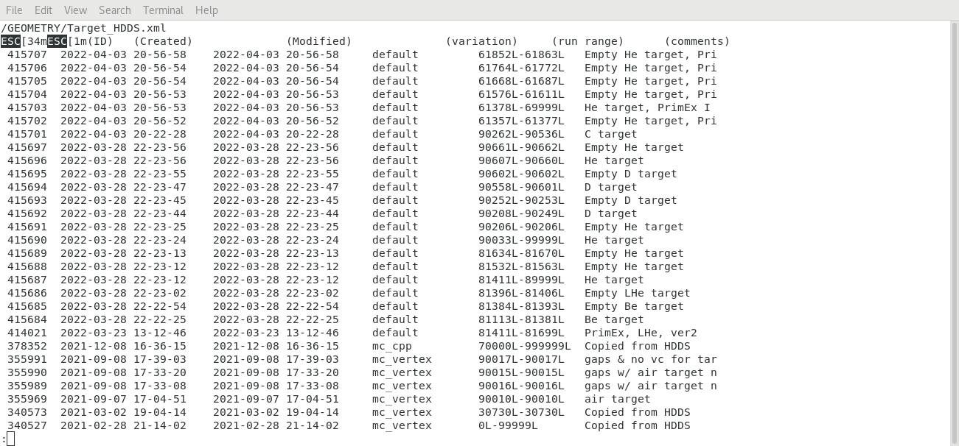
Run Dependent Target Geometry in CCDB
SRC runs
Material map for tracking is (will be) provided based on the target geometry by Simon

