Slide 1
Estimates of the CCAL (FCAL2) Anode Current

Slide 2
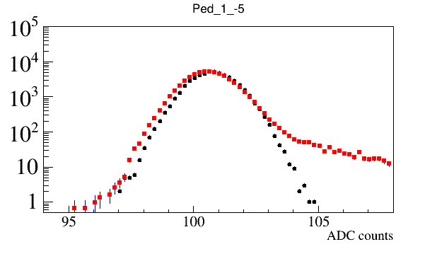
Overview
Collect CCAL FADC waveforms using random and PS triggers
Two beam currents: 350 nA and 200 nA
- no data sparsification (no threshold applied)
- estimate current using waveforms acquired with
the random trigger
- Use PS trigger to monitor beam trips
Sum up FADC ampilitudes above the threshold
(1 count above the baseline) in 400 ns window
(100 fadc samples)
Estimate anode current as follows:
A = 5 x 10⁻⁴ V / 50 Om <A (FADC) > / 100 samples / Gain (Amp)
FADC Pedestals
Threshold
Notes:
*

Slide 3
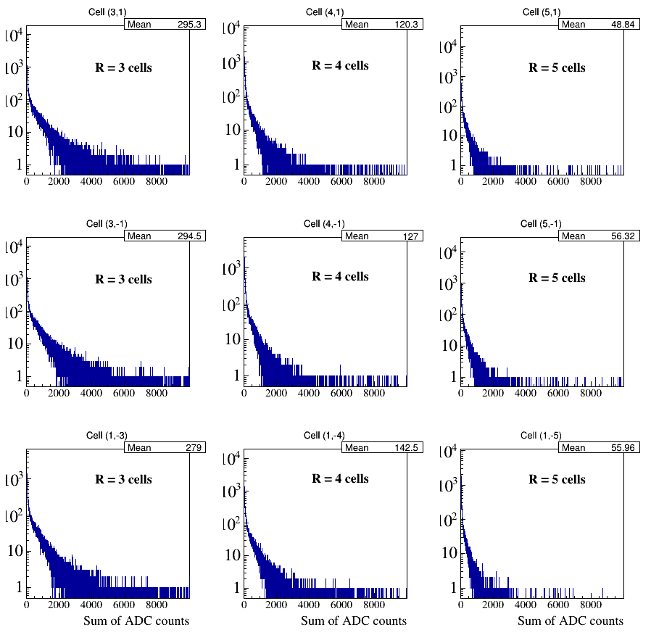
Sum of FADC amplitudes in 400 ns time window
Notes:
*

Slide 4
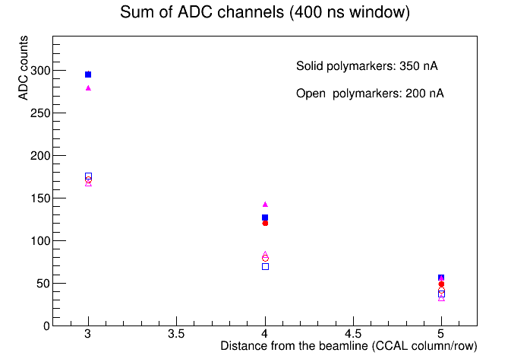
Sum of FADC amplitudes in 400 ns time window
Example:
Current seen by FADC in the 3rd row: 30 muA
Current through the divider: 30 muA / 24 =
1.25 muA
Current estimates for FCAL:
Beam hole: 2x2
1 layer covered by an absorber
Beginning of the 3rd layer in FCAL – 4th layer
In CCAL (factor of two difference in Z)
Solid angle coorection is 2x2 = 4
If no amplifier used: 5 x 4 = 20 muA
30 muA / 24
15 muA / 24
5 muA / 24
Notes:
*

Slide 5
Discussion
Can probably use active bases without dividers except in the inner FCAL 2 layers
(check amplification 3 or 6)
Modify dividers in the CCAL (coordinated with Fernando). Check in March/April
Notes:
*

Slide 6
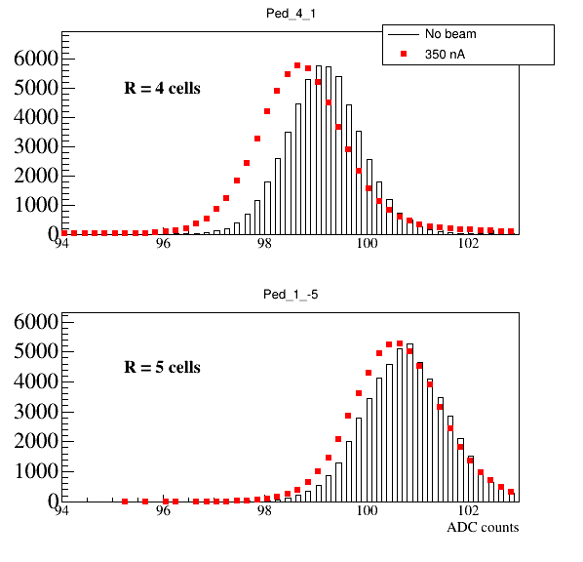
Baseline shift as a function of rate
Notes:
*

