Slide 1
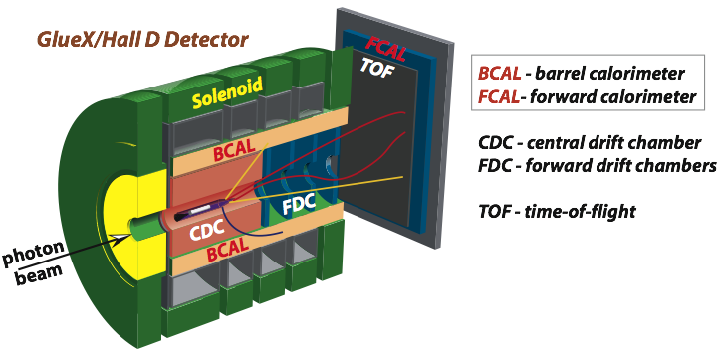

JLAB η Factory Experiment in Hall D
A. Somov, Jefferson Lab
for the GlueX collaboration
APS meeting, April 20, 2021

Slide 2
GlueX Detector in Hall D
Beam of photons (linear polarization)
Optimized to detect multi-particle final states

Slide 3
Experiments with the GlueX detector
GlueX experiment: search for mesons with exotic quantum numbers; a study of meson and baryon decays to strange final states |  |  |  |  | 2016 – present collected ∼30% of data
(see talks by M. Khachatryan and J.Stevens)
A precision measurement of the η radiative decay width via the Primakoff effect |  | Calorimeter prototype |  | Spring 2019 (30 % of data) Scheduled in fall 2021
(see talk by A. Smith and T.Hague)
Measuring the charged pion polarizability |  |  |  | Scheduled for 2022
Studying short range correlations with real photon beams at GlueX |  |  |  | Scheduled in fall 2021
Upgrade Forward Calorimeter
Eta decays with emphasis on rare neutral modes: The JLab Eta Factory experiment (JEF) |  |  |  | 2023 Run in parallel with GlueX

Slide 4
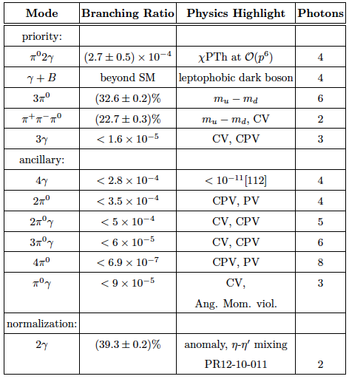
JEF Physics Program
Upgrade the Forward Calorimeter
Main physics topics:
1. Test of low-energy QCD
2. Search for dark
matter
3. Directly constrain
CVPC new physics
4. Constrain the light
quark mass ratio

Slide 5
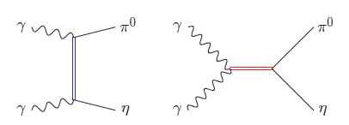
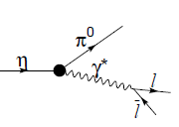
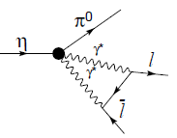
Impact of η → π⁰γγ measurements on
Chiral Perturbation Theory
Unique probe for the high order ChPT:
- contribution from two O(p⁶) counter-terms in the chiral Lagrangian
L. Ametller, et.al, Phys. Lett., B276, 185 (1992)
Study contribution of scalar resonances in calculation of O(p⁶) low-energy
constants (LEC) in the chiral Lagrangian
Shape of Dalitz distribution is sensitive to the role of scalar resonances
Higher order LEC’s are dominated by resonances
Gasser, Leutwyler 84; Ecler, Gasser, Pich, de Rafael 1989; Donoghue, Ramirez, Valencia 1989
a₀, a₂
ρ, ω
A cross-check of LEC's with different processes
C and CP violating
C and CP conserving background
J.N. Ng, et al., Phys. Rev., D46, 5034 (1992)

Slide 6
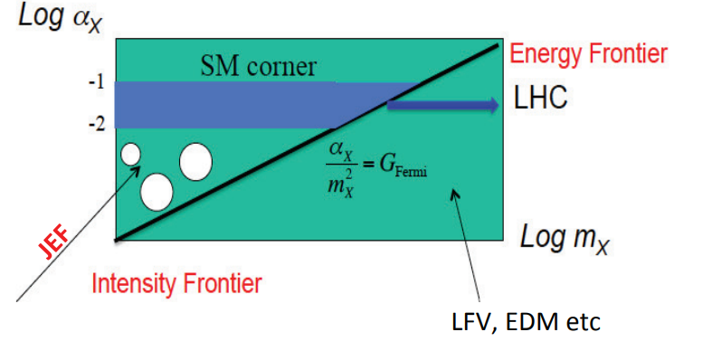
Dark Matter Search in η Decays
Search for dark matter in sub-GeV range:
Vector
leptophobic vector boson B:
η, η′ → γ B B → π⁰ γ ( 0.14 < m_{B} < 0.62 GeV )
B → π⁺ π ⁻ π⁰ ( 0.62 < m_{B} < 1.0 GeV )
dark photon:
η, η′ → A′ γ → e⁺ e ⁻ γ
Scalar
η, η′ → π⁰ S S → π⁰ γ γ, π⁰ e⁺ e ⁻ ( m_{S} < 2 m_{π} )
S → 3 π ( m_{S} > 2 m_{π} )
Light pseudoscalar (axion-like particle)
η, η′ → π π γ γ, π π e⁺ e⁻

Slide 7
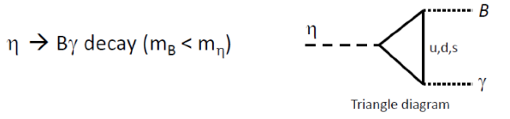
Search for B-boson in η decay
B production: A.E. Nelson, N. Tetradis, Phys. Lett., B221, 80 (1989)
B decay: B→π⁰γ in 140-600 MeV mass range
S. Tulin, Phys.Rev.,D89,
14008 (2014)

Slide 8
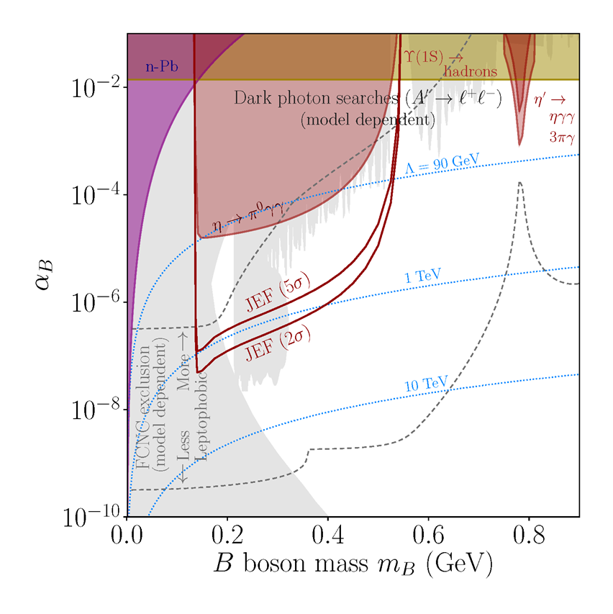
JEF Experimental Reach (η → Bγ → π⁰γγ )
A stringent constraint on the leptophobic
B-boson in
140 - 550 MeV range
100 days of taking data

Slide 9
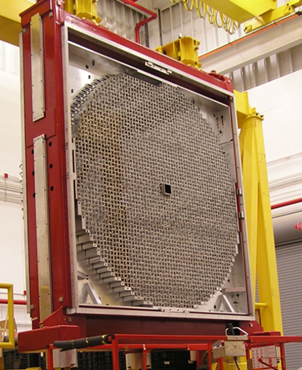
GlueX Calorimeter Upgrade
FCAL
Upgrade the inner part of the lead glass Forward Calorimeter with the
PbWO₄ crystals (FCAL-II)
- improve reconstruction of photons in forward direction
- improve reconstruction of rare η decay modes such as η → π⁰ γ γ

Slide 10
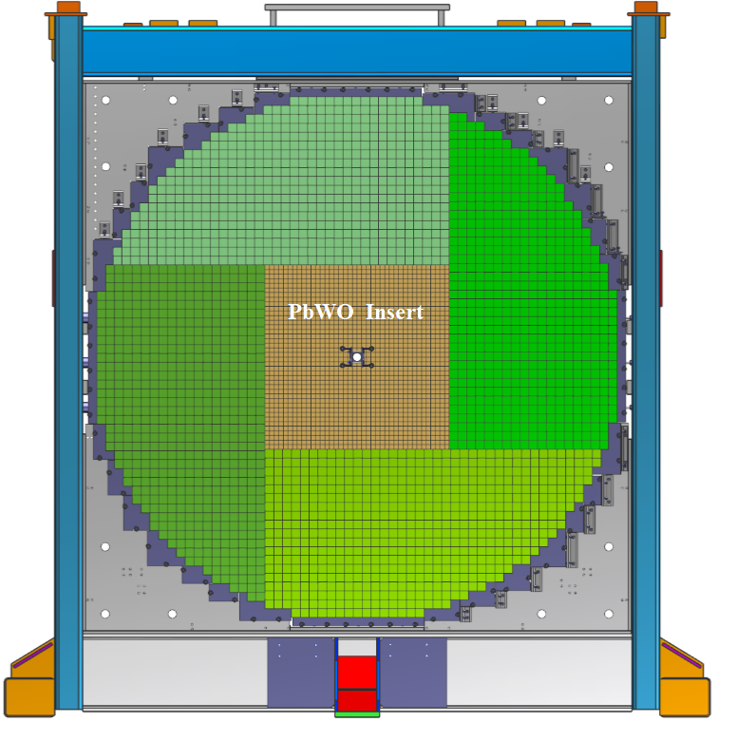
Calorimeter Upgrade
Forward Calorimeter
PbWO₄ module
Install an array of 40 x 40 PbWO₄ modules in the inner part of the FCAL
(replace lead glass modules)
- 2 cm x 2 cm x 20 cm PbWO₄
- 4 cm x 4 cm x 45 cm lead glass
A factor of 4 better detector granularity
- significantly improve shower separation
Improves the energy and position resolution by about a factor of 2

Slide 11

Calorimeter Upgrade
Beam test of calorimeter
prototype
-12 x 12 modules
- used as a Compton calorimeter
in PrimEx (see A. Smith talk)
Energy resolution
$\frac{σ \left(E\right)}{E}\left(\%\right)= \frac{2.6 }{\sqrt{E}} \text{⊗}\frac{ 1.1}{E}$ ⊗ 0.6
Fabrication of FCAL2 modules in
progress
Installation in Hall D: 2023

Slide 12
Summary
The new JEF experiment in Hall D will extend the physics potential of the GlueX detector. The JEF physics program spans from the study of rare decays of η mesons to the dark matter searches in the sub-GeV mass region.
The experiment requires upgrade of the lead glass GlueX forward calorimeter with high-granularity, high-resolution PbWO₄ crystals
The new calorimeter will be installed in Hall D in 2023
GlueX acknowledges the support of several funding
agencies and computing facilities: gluex.org/thanks

Slide 13
Backup Slides

Slide 14
Search for B boson
Dark leptophobic B-boson
Arises from a new gauge baryon symmetry U(1)_{B}
Unified genesis of baryonic and dark matter
the region is strongly constrained by long-range forces search exp. ; the has been investigated by the collider experiments
GeV-scale domain is poorly constrained
discovery opportunity!
Early studies by Lee and Yang, Phys.Rev.,98 (1955) 1501; Okun, Yad.Fiz., 10 (1969) 358,

Slide 15
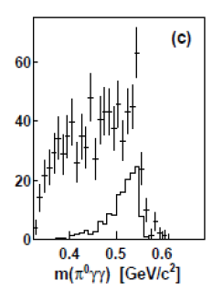
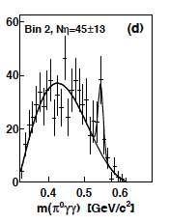
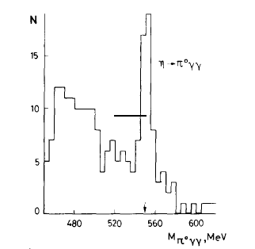
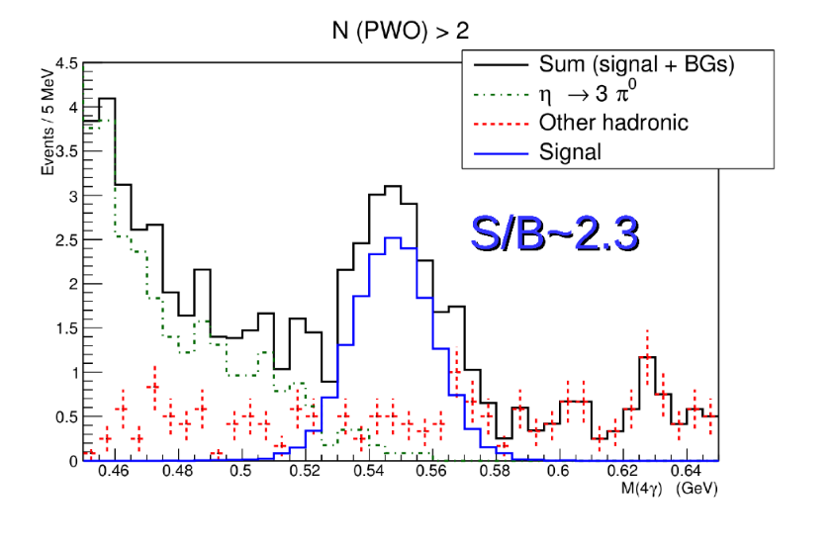
Measurements of η →π⁰γγ
A2 at MAMI (Phys.Rev. C90, 025206,2014)
γp→ηp (E_{γ}=1.5 GeV)
GAMS (Z. Phys. C25,225, 1985)
π⁻p→η p ( E_{π}= 30 GeV )
JEF (proposed)
γp→ηp (E_{γ} = 9-11.7 GeV)
Smaller background with η energy boost
Large statistics
1 day of running

Slide 16
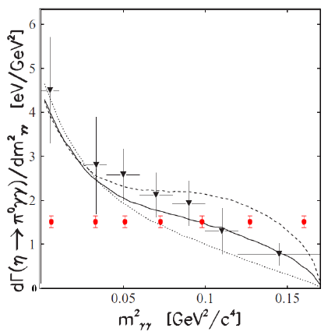
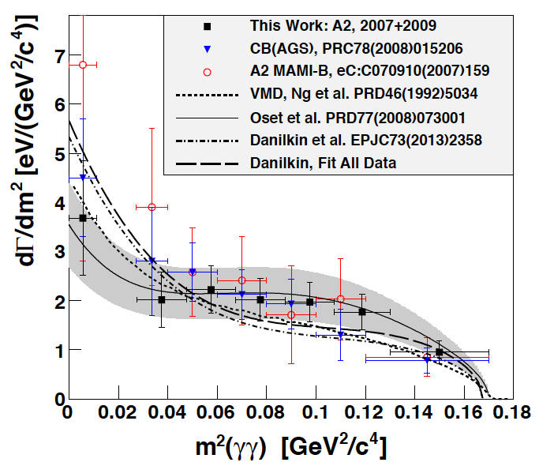
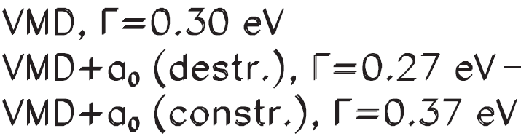
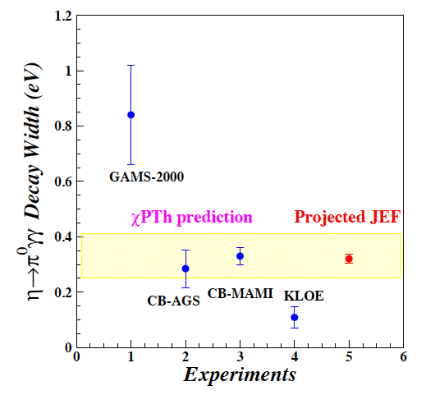
Projections for η→π⁰γγ Decay
Prakhov et al., Phys. Rev. C78, 015206 (2008)
A2 at MAMI arXiv:1405.4904, 2014
CB-AGS
Projected JEF
Constrain contribution of scalar resonances
in the calculation of O(p⁶) low-energy constants

Slide 17
C Invariance
C Violating η neutral decays
Maximally violated in the weak force
and is well tested
SM prediction:
BR(η→3γ) <10⁻¹⁹ via P-violating
weak interaction.
Study constraints on CVPC from EDM
- no constraints in the presence of a
conspiracy or new symmetry; only
the direct searches are unambiguous
Final State | Branching Ratio (upper limit) | Gammas in Final State
3γ | < 1.6•10⁻⁵ | 3
π⁰γ | < 9•10⁻⁵
2π⁰γ | < 5•10⁻⁴ | 5
3γπ⁰ | Nothing published
3π⁰γ | < 6•10⁻⁵ | 7
3γ2π⁰ | Nothing published
M. Ramsey-Musolf, phys. Rev., D63 (2001);
talk at the AFCI workshop,
studies are in progress
24

Slide 18
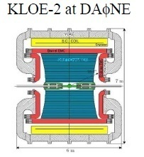
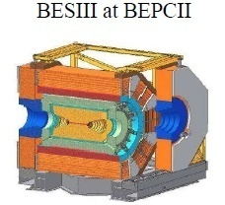
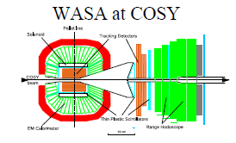
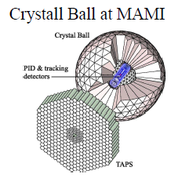
World competition in η decays
e⁺e⁻
Collider
Low energy
η-facilities
High energy η-facility
Fixed-target
hadroproduction
CBELSA/TAPS at ELSA
JEF at Jlab
photoproduction

