Slide 1
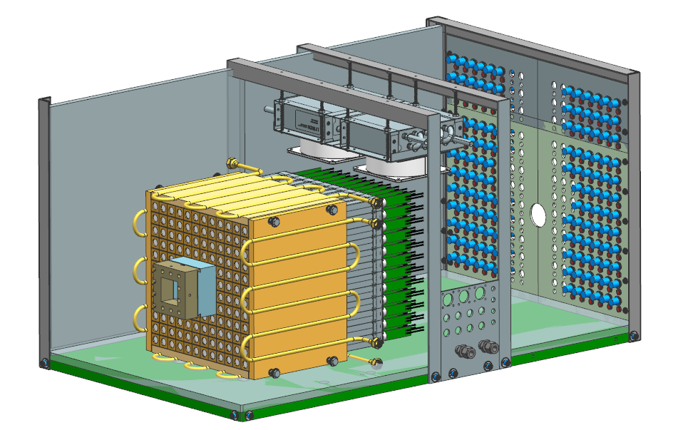
PbWO₄ crystals
Cooling Fans
Beam
PMT & Dividers

