Slide 1
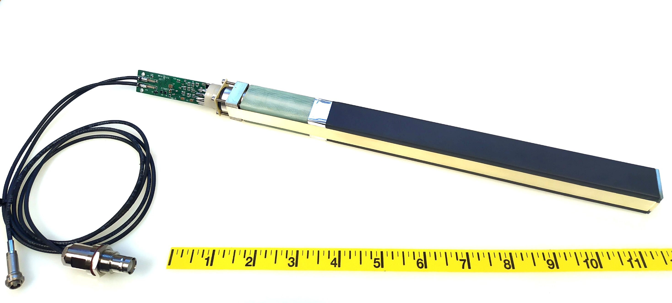
PMT divider & amplifier
PMT housing
PbWO₄ crystal
Brass strip

