Slide 1
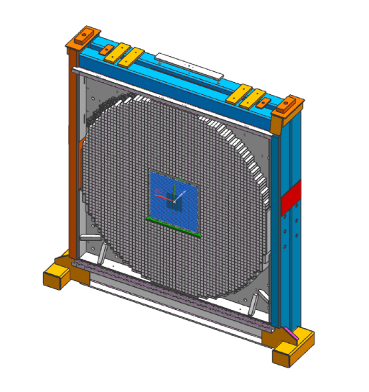
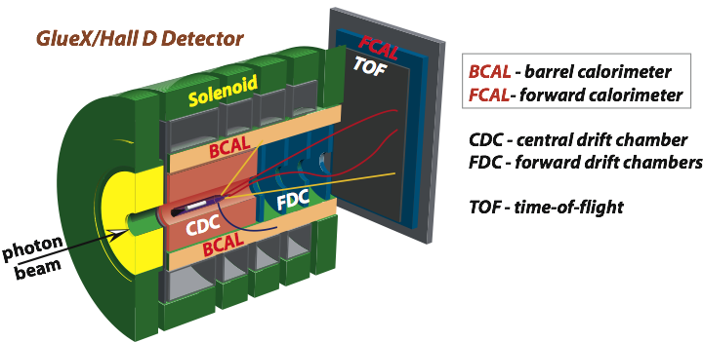
Status of the FCAL Insert
A. Somov
GlueX collaboration meeting, October 3, 2019
T. Whitlatch, M. Stevense, J. Crafts, E. Chudakov , L. Gan, A. Gasparyan, S. Taylor,
Z. Papandreou, F. Barbosa, C. Stanislav, N. Sandoval, B. Bunton T. Black, T. Daniel,
Z. Zhang
support from members of the NPS collaboration
T. Horn, V. Berdnikov, A. Asaturyan, H. Voskanyan

Slide 2
Project Overview
PbWO Crystals
Module Design
PMT and Active Base
Electronics
Frame Design / Engineering
https://halldweb.jlab.org/wiki/index.php/FCAL_Insert
<number>

Slide 3
PWO Crystals
PWO crystals: 20.5 mm x 20.5 mm x 200 mm ( FCAL insert: an array of 40 x 40 crystals)
Two vendors:
SICCAS: Shanghai Institute of Ceramics
CRYTUR: Integrated crystal based solution, Czech Republic
https://halldweb.jlab.org/wiki-private/index.php/Crystal_Specifications
Ordered for Hall D:
500 crystals from SICCAS ( expect to receive 150 crystals in November )
64 crystals from CRYTUR ( will receive 37 crystals in October )
Visited SICCAS in August (L. Gan, Z. Zhang, A. Somov) and discussed QA tests
- trying to get Wuhan University involved to perform crystal preselection at SICCAS
Many crystal QA tests were performed during CCAL fabrication
Collaborate with the Hall C NPS group
- building PbWO calorimeter, already have about 1100 crystals
<number>

Slide 4
Crystal QA Tests
Visual inspection
Measurement of crystal dimensions
Measurement of light transmission
Measurement of light yield

Slide 5
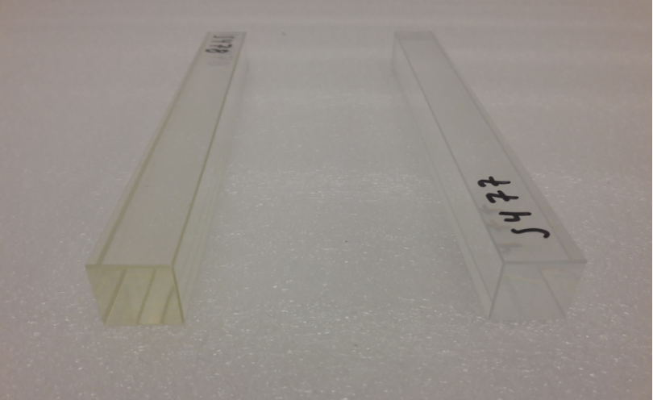
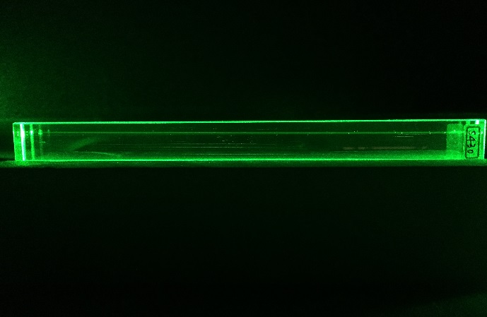
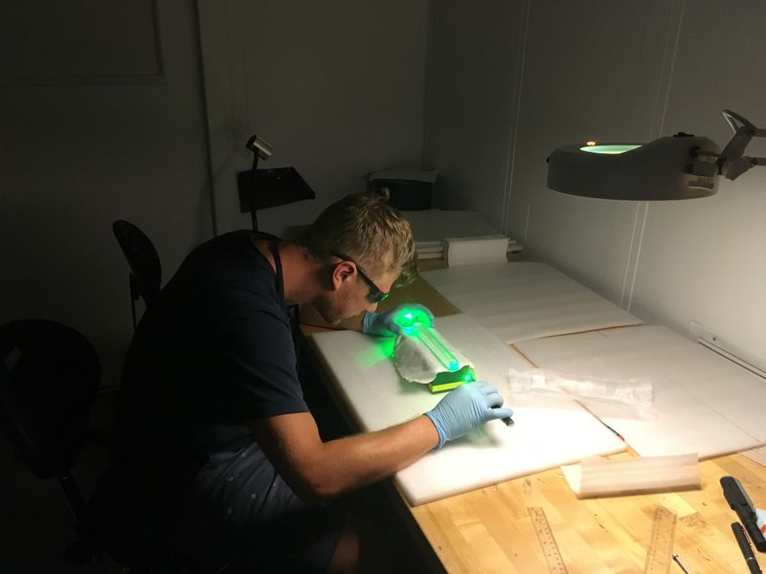
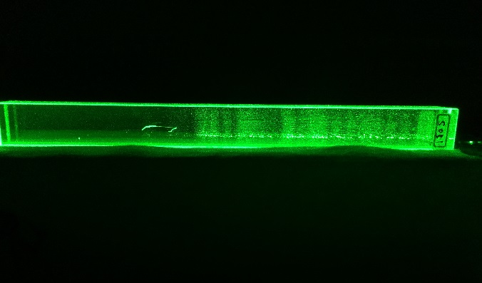
Visual Inspection
Check crystal color
Use laser pointer to observe cloudy regions
Check edge quality for scratches and chips
yellow discoloratiuon
Clear crystal
Cloudy regions

Slide 6
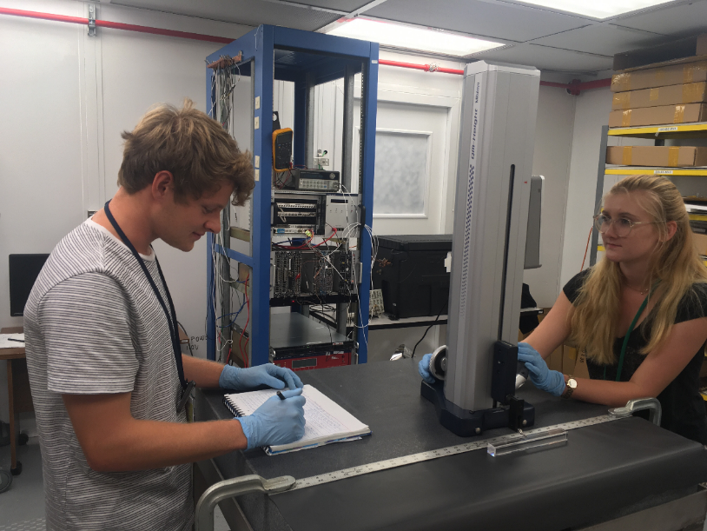
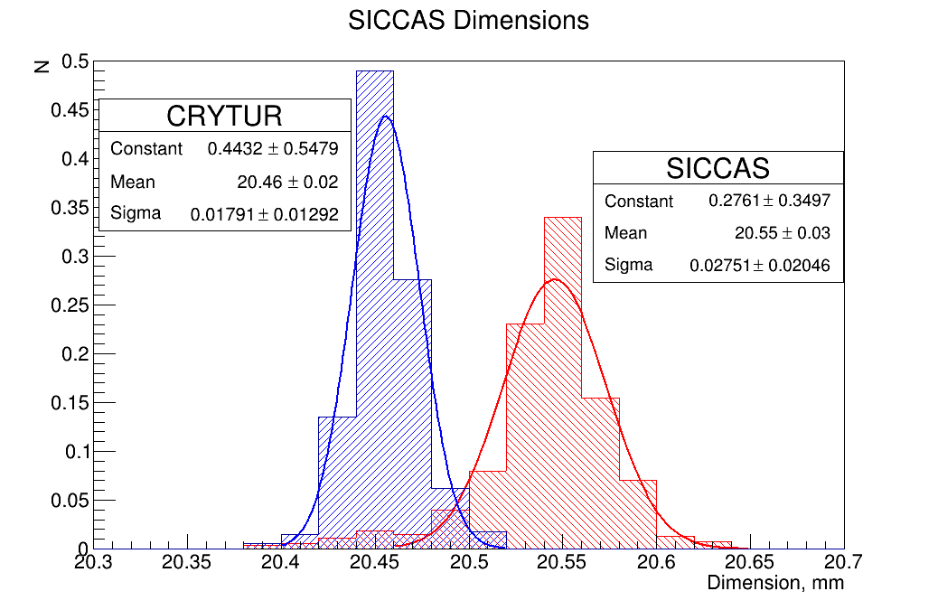
Crystal Dimensions
NPS test Lab
- Granite table
- Vertical height gage
Crystal measurement for NPS
(CCAL)
The lab and setup will be used to measure the Hall D crystals as well.

Slide 7
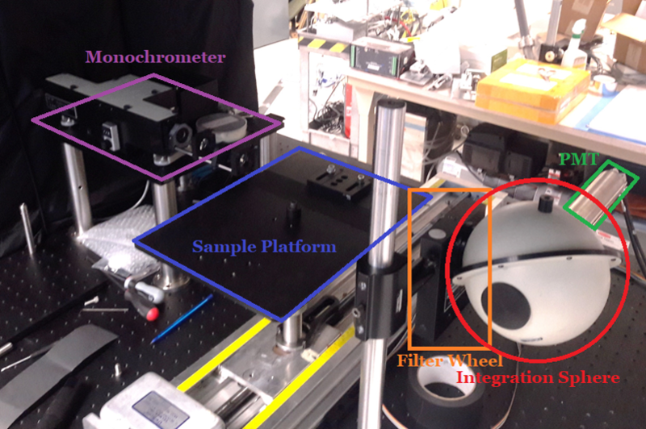
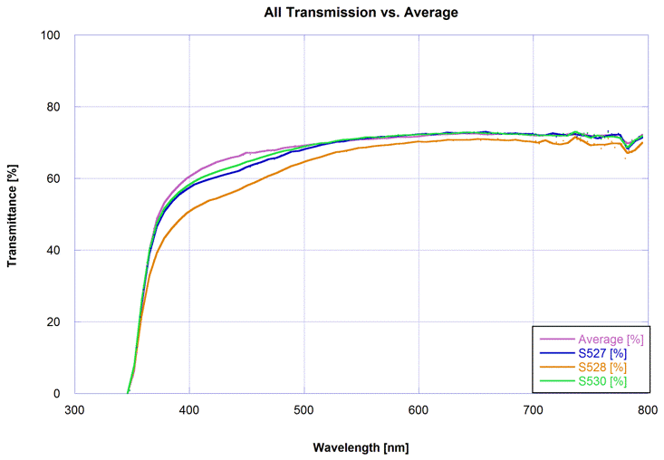
Light Transmission Measurement
crystal transmittance as a function of
wavelength
crystal with yellow
discoloration
Setup at Jefferson Lab (Carl Zorn’s lab)
- automatic operation for measurements
- will be used by Hall D
Reproduce transmittance measurements
performed with the setup at CUA
Measurement procedure:
Correlation between crystal
transmittance and crystal color
https://halldweb.jlab.org/wiki/index.ph/Measurement_Light_Transmission
<number>

Slide 8
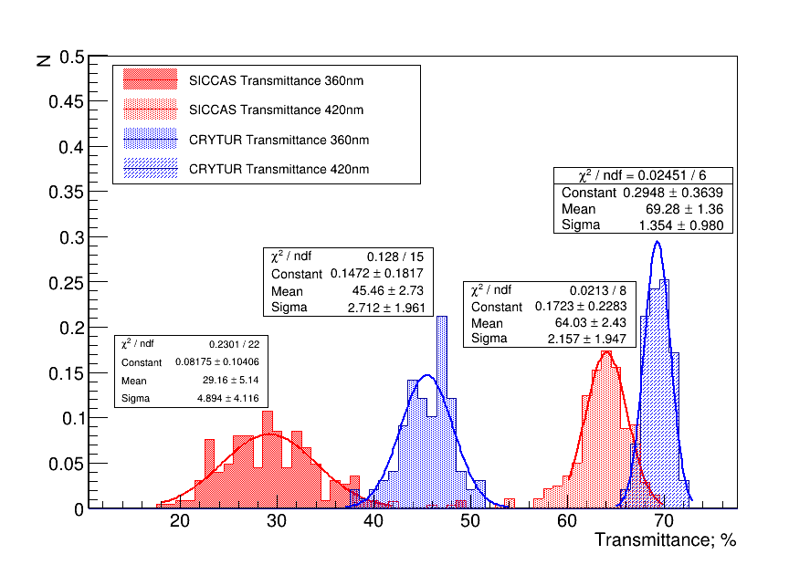
Crystal Transmittance
Crystal Transmittance Measured at CUA

Slide 9
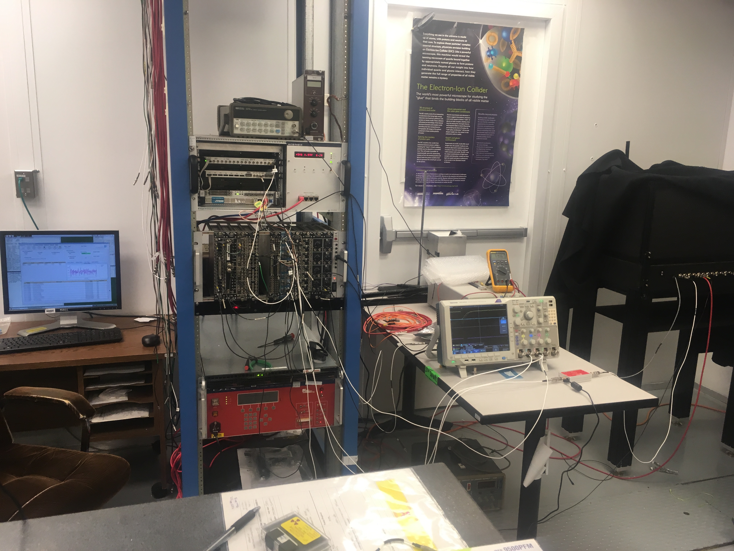
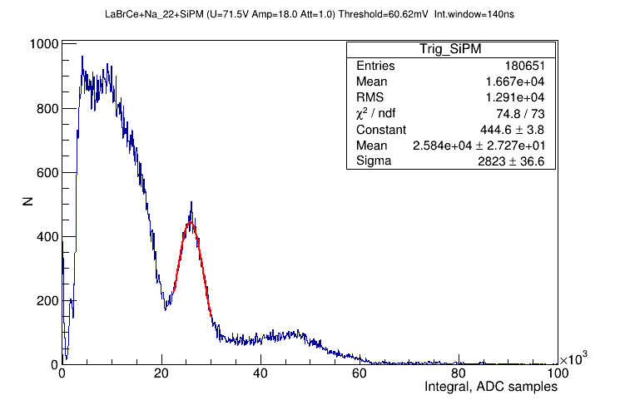
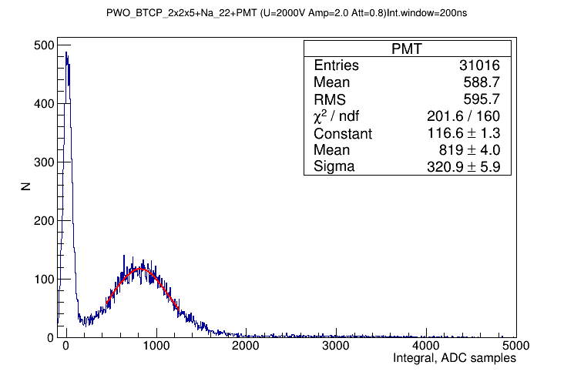
Light Yield Setup
V. Berdnikov
Trigger
LaB_{r}(Ce) scint
Na-22 β+ and gamma source
- two 0.511 MeV photons. One
used for the trigger
PWO
<number>

Slide 10
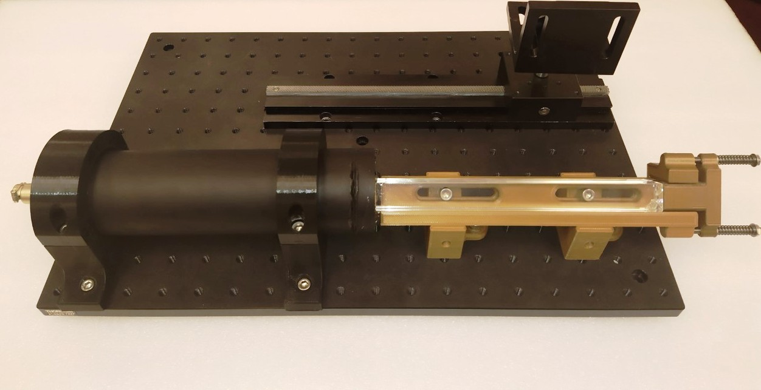
Light Yield Setup
Holder for the Reference PMT with scintillator
(movable platform)
2’’ Hamamatsu PMT
Crystal
All parts have been ordered
<number>

Slide 11
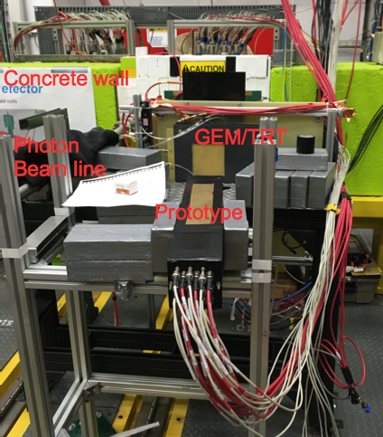
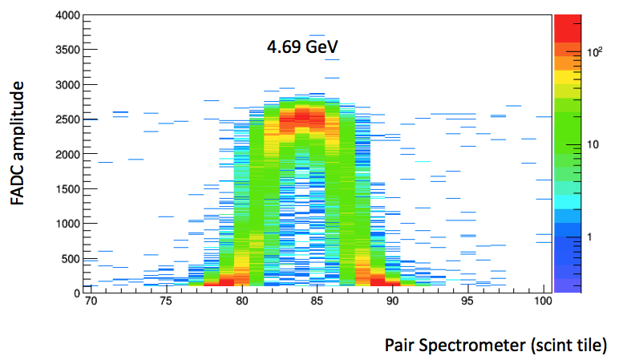
Crystal Testing Using Pair Spectrometer
GlueX-doc-3590,
V. Berdnikov, A.Somov, J. Crafts
Study SICCAS and CRYTUR crystals using a 3x3 calorimeter prototype installed behind
the pair spectrometer
‘Projection’ of the crystal to the PS hodoscope
https://halldweb.jlab.org/wikiprivate/index.php/Crystal_Quality
Draft of the NPS NIM paper describing crystal properties

Slide 12
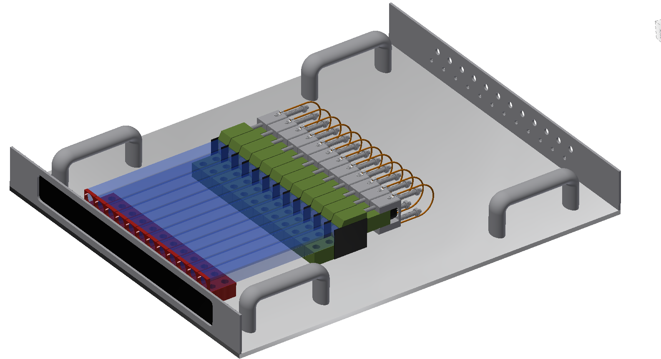
Crystal Testing Using Pair Spectrometer
Test up to 12 PWO crystals (modules) at the same time
Install test bench on the platform behind the PS
Take data in parallel with GlueX (fadc in the ST crate)
Module assembly for testing
Crystral
PMT
Divider
Can measure light yield,
energy resolution
Study light guides
12 modules
on the test bench
<number>

Slide 13
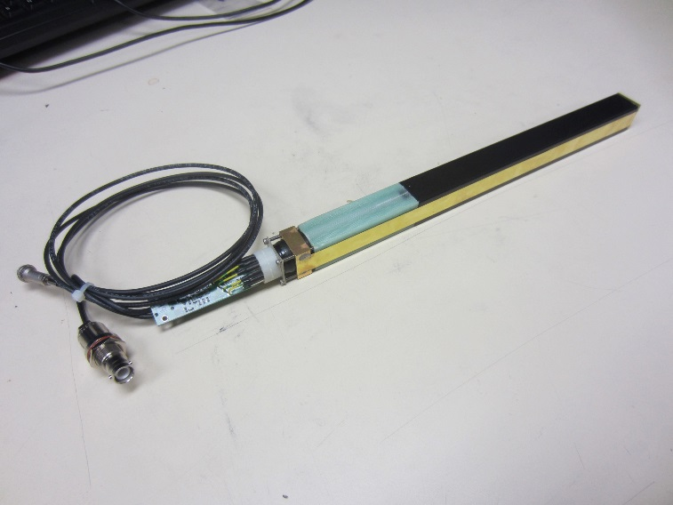
Module Assembly
CCAL module (design based on HyCal, Hall B)
PbWO₄ crystal
PMT housing
New module features:
- Soft iron PMT housing
- Acrylic light guide
Brass strip
PMT divider & Amplifier
PbWO₄ crystal wrapped with a ESR reflective foil (60 μm) and Tedlar (40 μm)
Brass tension strips (25 μm) are brazed to flanges and hold the module together
PMT is placed inside G-10 housing, wrapped with mu-metal foil
<number>
Notes:
<number>

Slide 14
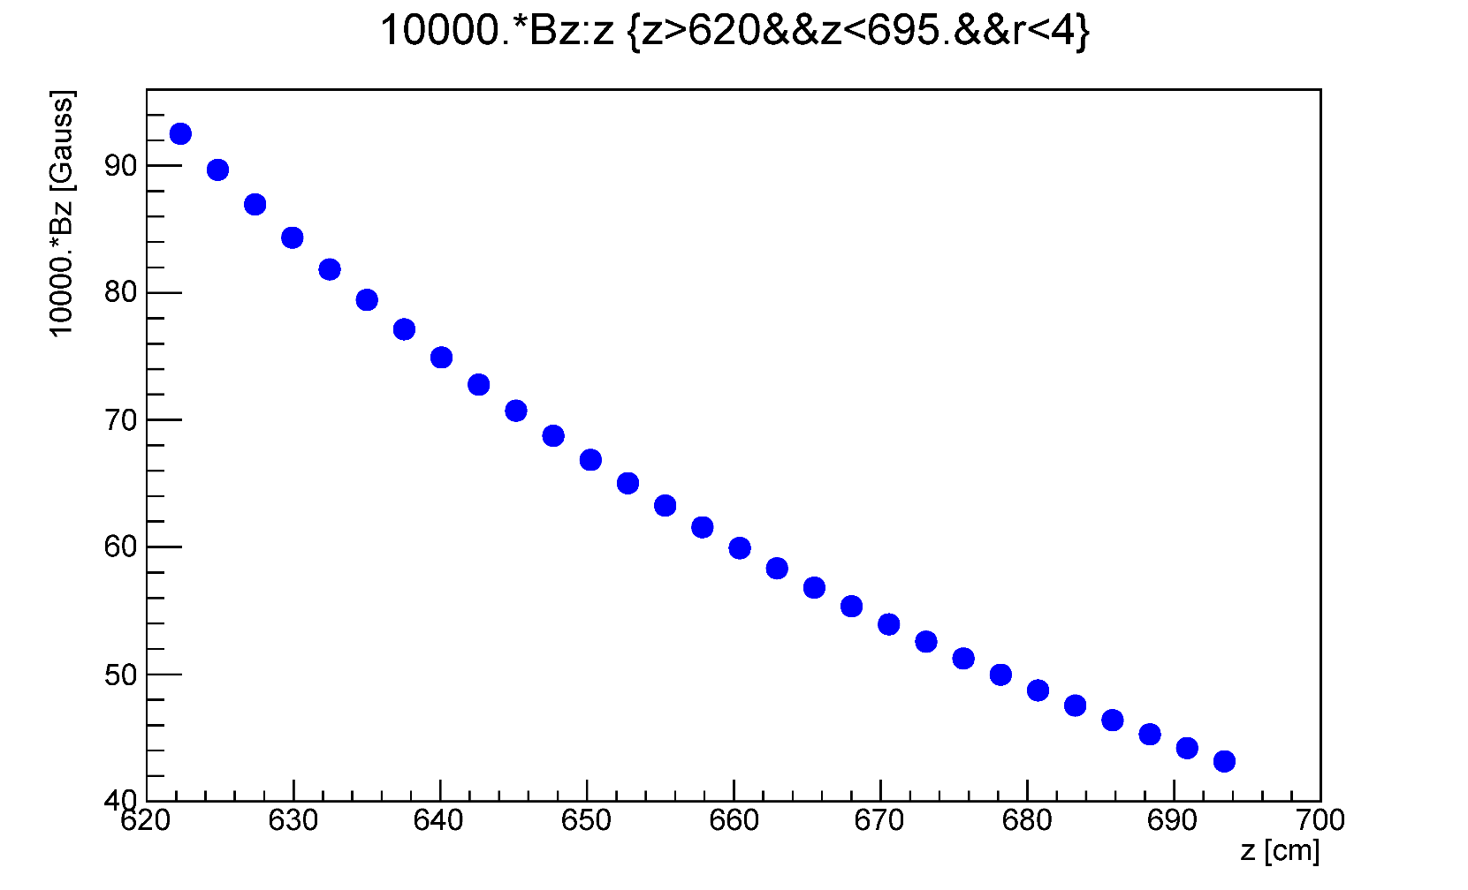
Solenoid Magnetic Field
GlueX-doc-4166-v3
Longitudinal field at beamline (r = 0)
B _{Z} (Gauss)
FCAL lead glass
face
lead glass
downstream end
Z (cm)
The field was also measure in front of the FCAL (TOF)
- good agreement with the field map
<number>

Slide 15
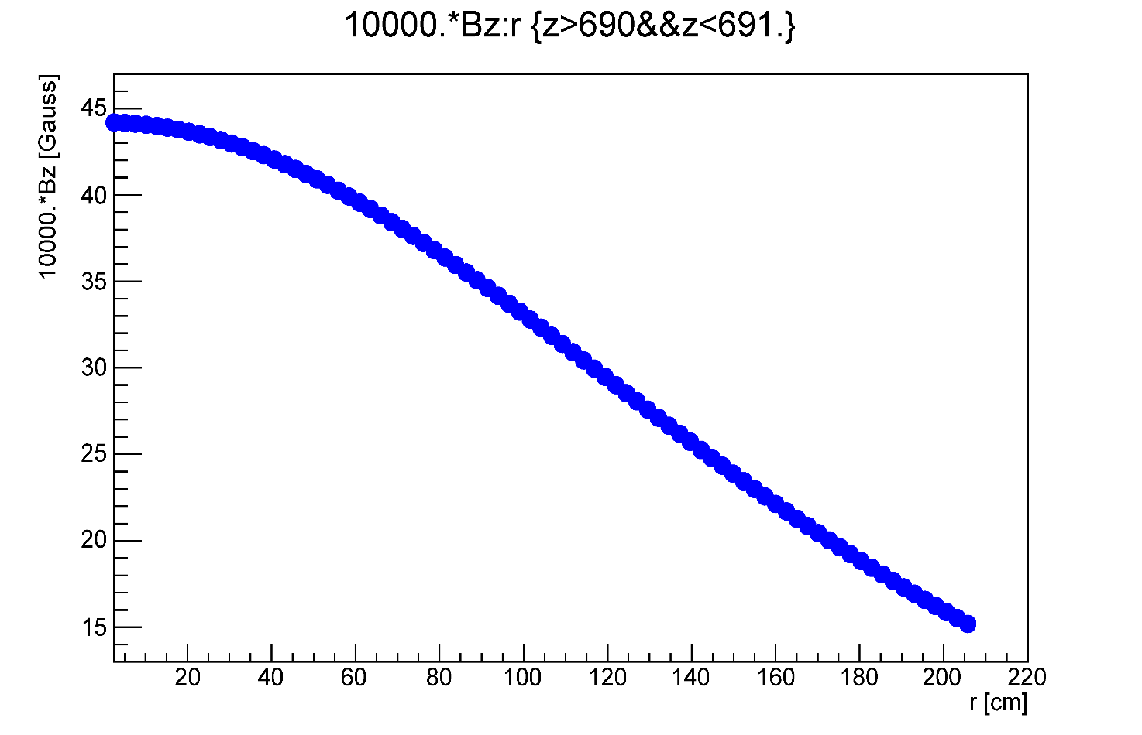
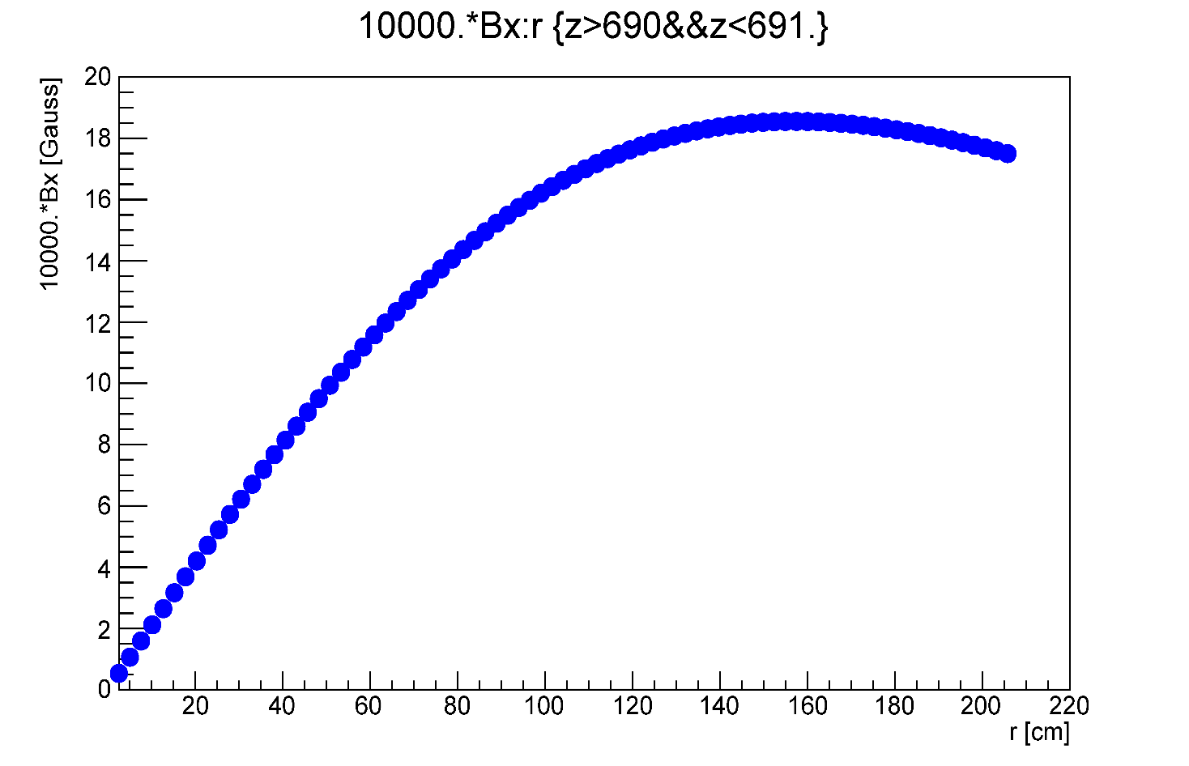
Solenoid Magnetic Field
20 cm downstream the FCAL lead block
B _{Z} at Z = 690 cm
B _{x} at Z = 690 cm
B _{Z} at Z = 690 cm
B _{Z} (Gauss)
B _{X} (Gauss)
Insert
Insert
<number>

Slide 16
Solenoid Magnetic Field
Z (cm) | Z (cm) | Bz (r = 0 cm) G | Bx (r = 40 cm ) G
625 | FCAL upstream face | 87 | 20
645 |  | 68 | 15
670 | FCAL downstream face | 54 | 10
690 |  | 44 | 8
625 cm
670 cm
Lead Glass L = 45 cm
PWO L = 20 cm
Beam
635 cm
655 cm
<number>

Slide 17
Proposed Position of
the FCAL II
Z = 625 cm
Z = 670 cm
Lead Glass L = 45 cm
10 cm
PWO L = 20 cm
move downstream by 35 cm
Beam
Z = 635 cm
Z = 655 cm
Two FCAL outer rings cannot be calibrated using
photons from the target
Move FCAL downstream the beam by 35 cm
Maximum field at Z = 690 cm 44 Gauss
Bz (r = 0) = 44 Gauss, Bx (r = 40 cm) = 8 Gauss
FCAL modules from the inner part (replaced by PWO)
can be used to instrument one extra outer layer
Z = 660 cm
Lead Glass L = 45 cm
PWO L = 20 cm
Beam
Z (CCAL) = 690 cm
<number>

Slide 18
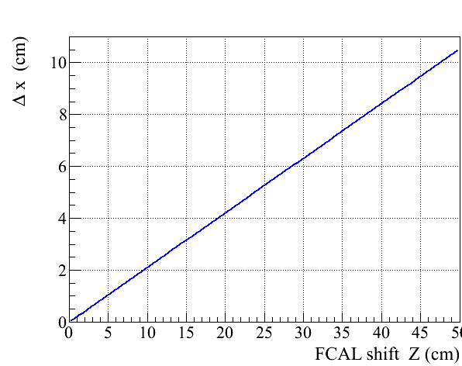
FCAL Acceptance
Move FCAL platform downstream
the beam by 35 cm
FCAL aperture is decreased by
Δr = 7.5 cm
<number>

Slide 19
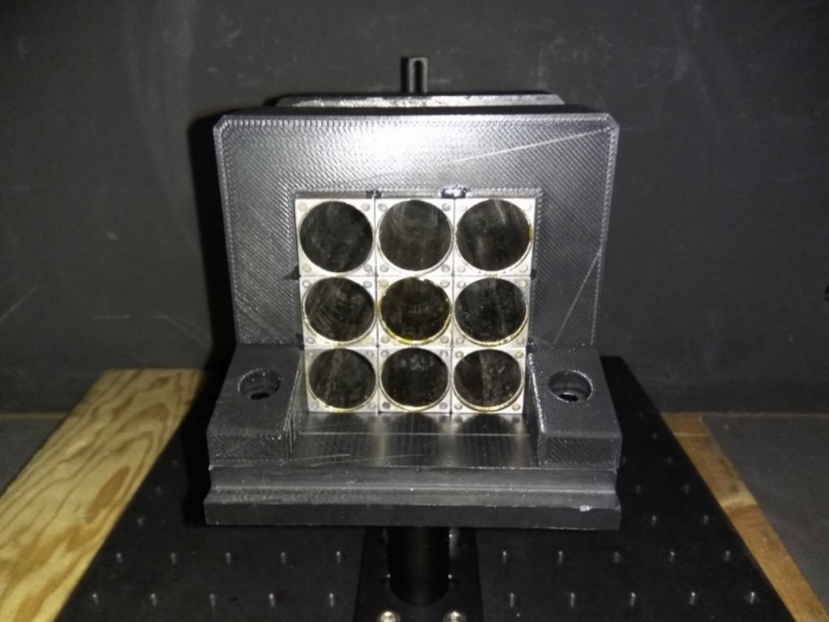
PMT Housing: 3 x 3 Prototype
20.6 mm
Housing D = 19.9mm
Mu-metal foil: 350 μm
50 μm
(350 μm foil welded and
annealed)
Steel 1020 (not annealed)
PMT length (no leads): 8.73 cm
LG length: 3.5 cm
Total: 12.23 cm
Flange (+gap): 0.8 cm
12.23 – 0.8 = 11.43 cm
PMT housing length 10.5 cm
can make PMT housing 6 – 7 mm longer
Average crystal width: 20.55 mm ( sigma ± 25 μm )
ESR thickness: 65 μm
20.55 + 0.13 = 20.68 mm (+ Tedlar)
cannot make housing wider
PMT diameter < 19.0 mm
<number>

Slide 20
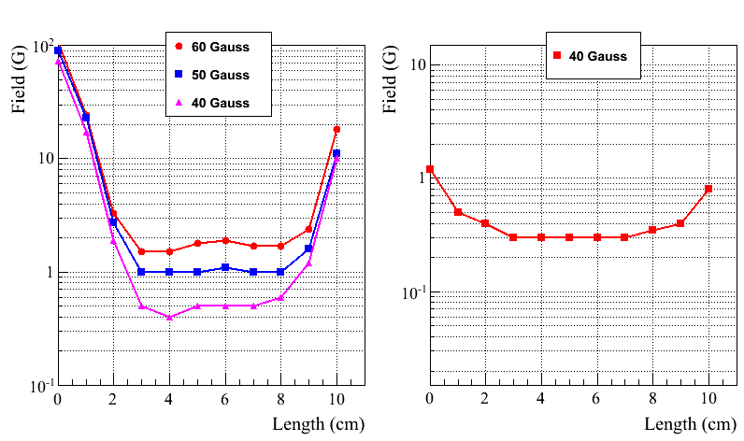
Field Measurement
Longitudinal Field
Transverse Field
Expected maximum
transverse field is
8 Gauss
(at Z = 690 cm)
Transverse field can be easily shielded
PMT is much less sensitive to the longitudinal field
<number>

Slide 21
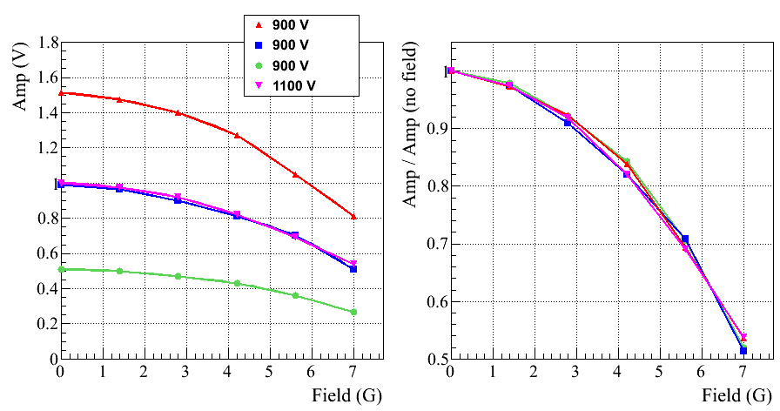
PMT Response to LED (no Shielding)
Longitudinal Field
<number>

Slide 22
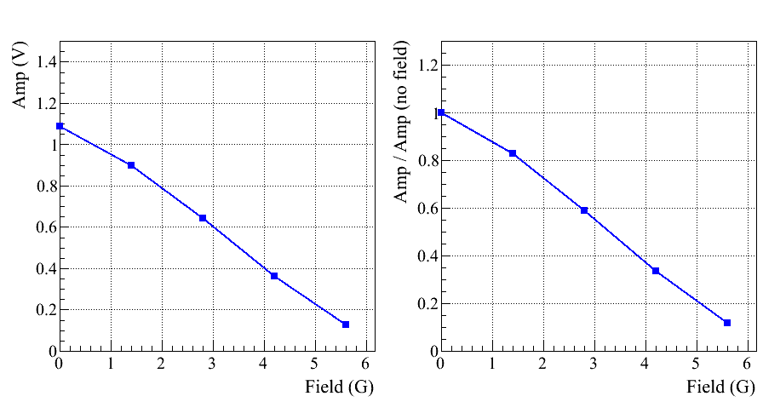
PMT Response to LED (no shielding)
Transverse Field
<number>

Slide 23
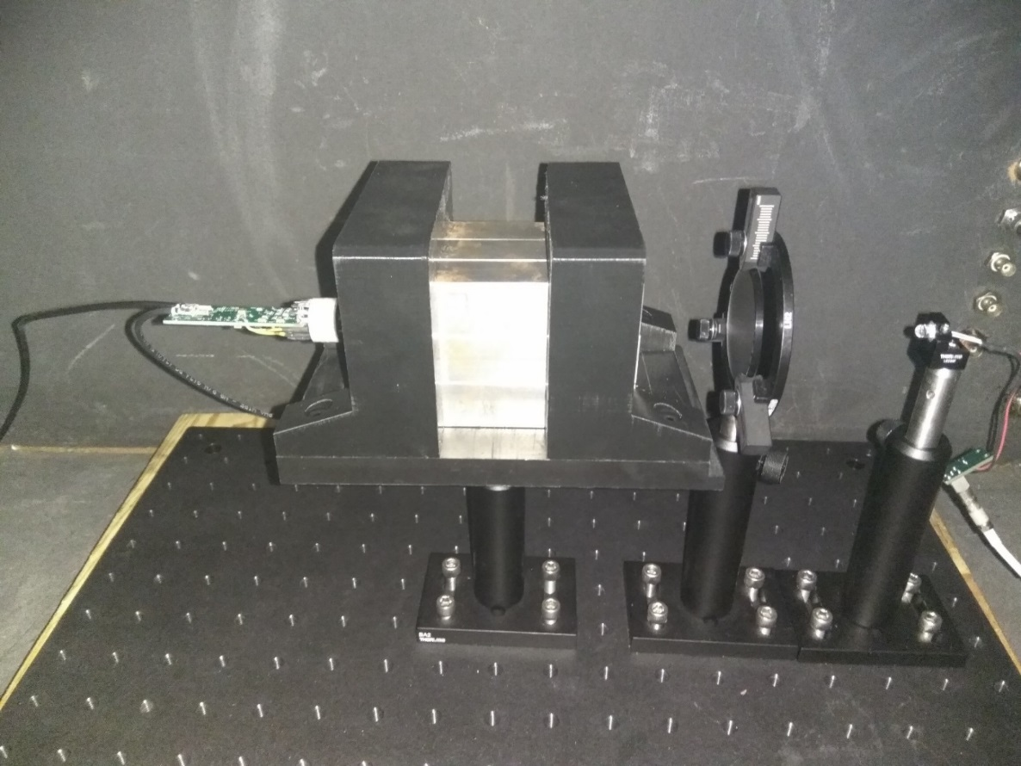
LED Setup
Check PMT response for different field values using an LED system
<number>

Slide 24
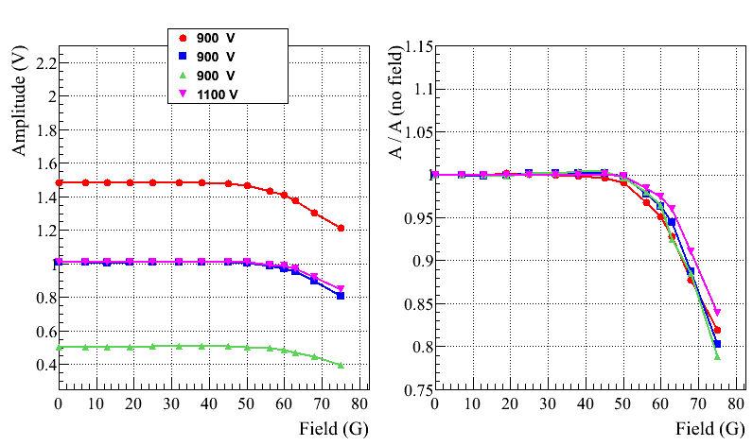
PMT Response to LED ( with Shielding)
Response to the longitudinal field
B_{z}
B_{z}
<number>

Slide 25
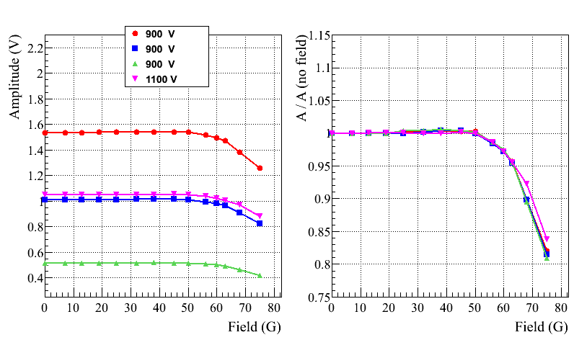
PMT Response to LED ( with Shielding )
Rotate prototype by about 10 degrees
- longitudinal and transverse components
GlueX-doc-4166-v3
Total Field (G)
Total Field (G)
<number>

Slide 26
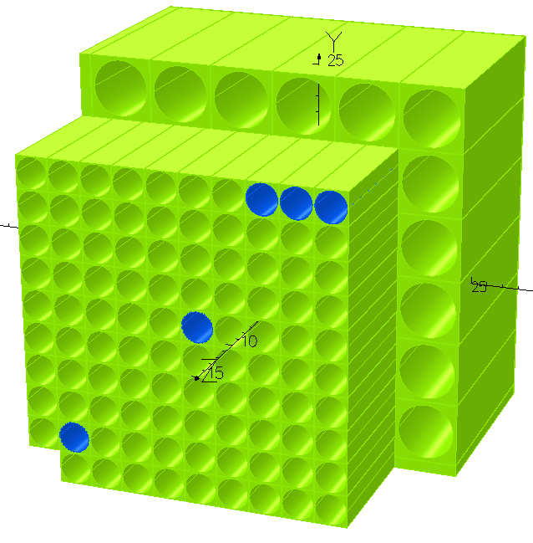
Magnetic shielding (TOSCA Simulation)
A. Glamazdin
https://halldweb.jlab.org/wiki-private/index.php/Private:Eta_Rare_Decay
Magnetic field shielding simulated
with TOSCA
Field measurements were performed
in Hall D and using Helmholz coils
Realistic 3x3 prototype (PMT housing)
is ready
- will be tested using Helmholz coils
shortly
4
3
5
2
1

Slide 27
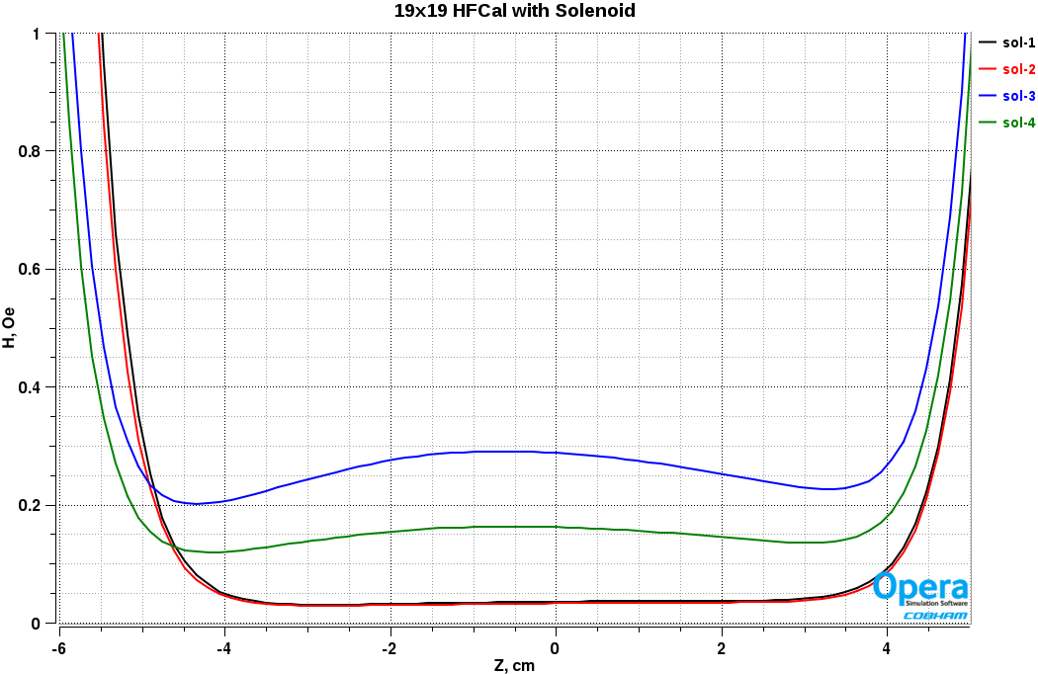
19x19 Hybrid FCal with Solenoid
P=5cm, µ-shield 360µm
Sol-1: x=y=3.125cm
Sol-2: x=y=19.925cm
Sol-3: x=y=38.825cm
Sol-4: x=36.725, y=38.825cm
PMT’s face
(3cm guide)
PMT’s face
(4cm guide)
PMT’s face
(5cm guide)
Magnetic field can be reduced below 0.5 Gauss
<number>

Slide 28
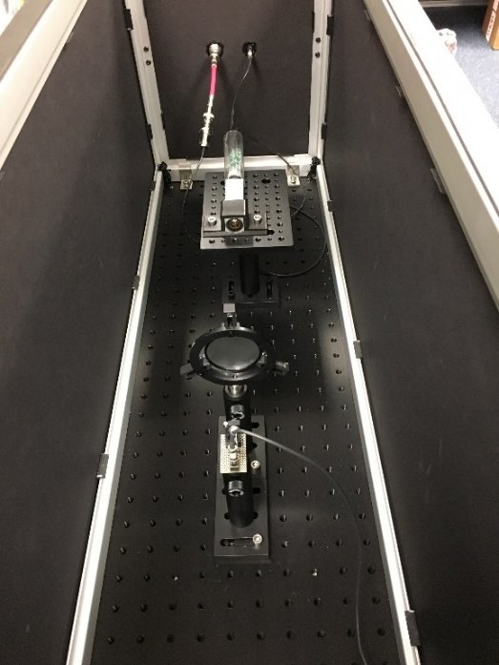
PMT and Active Base
500 R4125 PMTs were ordered for Hall D
- will be delivered by the end of April 2020, first 50 by the end of November
Check PMTs using an LED setup at JLAB
- have already tested a few hundred PMTs for CCAL and NPS (no defective PMTs found)
https://halldweb.jlab.org/wiki-private/index.php/PMT_testing
PMT will be instrumented with the Active Base
- amplifier gain – 24 (reduce HV, small anode current)
- stable gain at high rate (up 2 – 3 MHz)
The Active Base was installed on CCAL and used for
PeimEx data taking
New Active PMT Base for PbWO4
(Popov, H. Mkrtchyan, presentation at IEEE, Nov 2012)
<number>

Slide 29
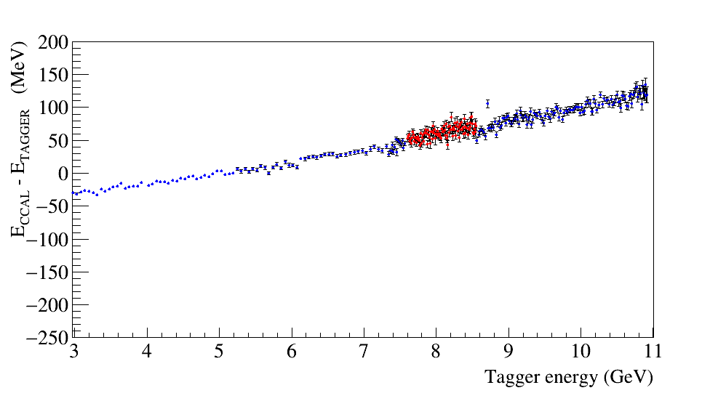
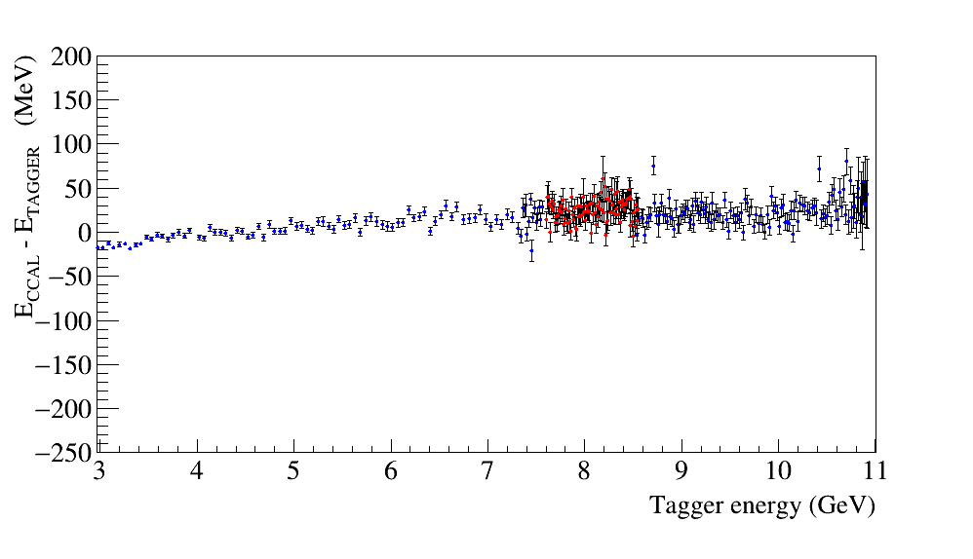
PMT Active Base Linearity
Linearity of the FADC peak amplitude
Original PMT base, gain ∼25
Modified base, gain 3
750 V
2 V FADC range
850 V
2 V FADC range
Found somewhat non-linear performance of the active base during beam tests
The linearity can be improved by reducing the amplifier gain and increasing HV
Some tuning of the PMT base are required
V. Popov is going to tune the active base design
- the new version will be available in November, will be tested with CCAL

Slide 30
Readout Electronics
See talk by Fernando
Use standard readout (fadc250) and trigger electronics. Will require
5 new VSX crates
VXS crates - ordered
FADC 250 - ordered
Procurement of CTP (VTP) is in process
Trigger Interface modules - ordered
<number>

Slide 31
Frame Design
See talk by Tim
Stephanie, Keith Harding
Regular meetings with engineering group
https://halldweb.jlab.org/wiki/index.php/FCAL_Insert_Design_Meetings
Working on the frame design
Cooling
Light monitoring system
Electronics patch panels
<number>

Slide 32
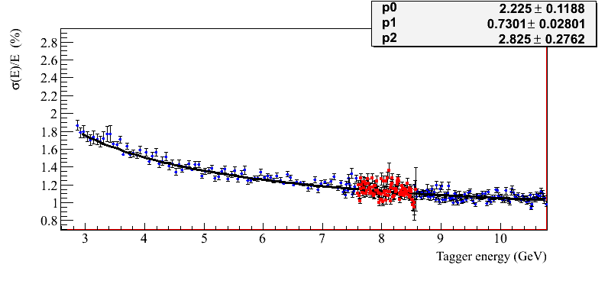
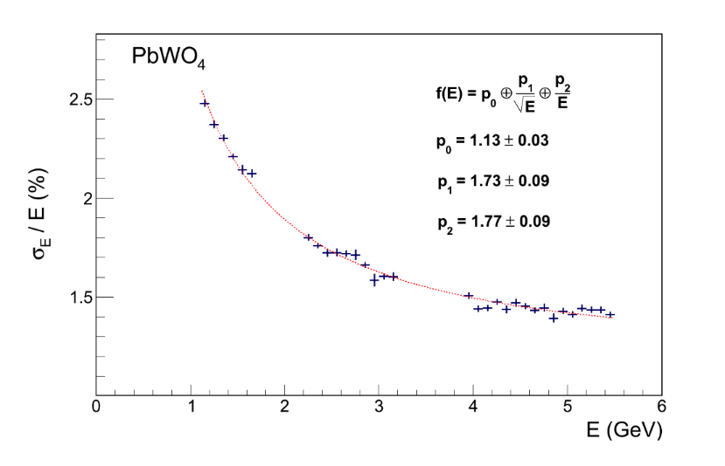
Energy Resolution Measured with CCAL
Preliminary plot, will be updated
NPS Prototype
HyCal (Hall B)
3x3 array
bypassed amplifier
NPS prototype
•
•
•
Relatively good energy resolution, which is consistent with the resolution of the
Hall B HyCal calorimeter
Rate and PMT anode current have to be considered (some measurements were performed)
More details can be found in
GlueX-doc-3590, GlueX-doc-3998, V. Berdnikov, A.Somov, J. Crafts

Slide 33
Action Items and Next Steps
Prepare testing facility for crystals (In progress)
Finalize the module design:
- Test light guide materials and coupling (Silicon cookies, type of glue to attach to PMT)
- Size of the module holding strap and brazing compound
Finalize design of the PMT active base
- Measure PMT anode current (decide of the amplifier gain) using CCAL
- Planning to test modified dividers using CCAL (V. Popov is tuning the active base)
Finalize the design of the frame (cooling, electronics patch panels)
Start testing PWO crystals (November) and assembling modules (summer 2020)
<number>

Slide 34
Backup Slides
<number>

Slide 35
PMT Active Base
<number>

Slide 36
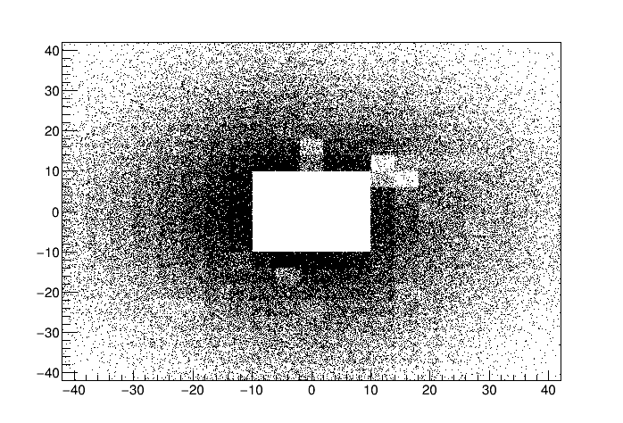
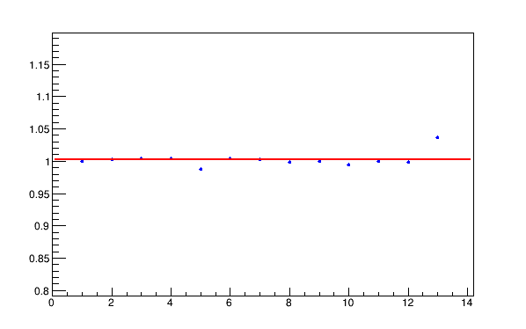
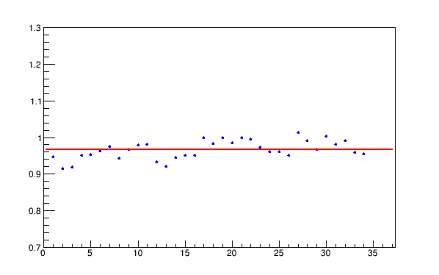
Di-photon Yield
FCAL XY of clusters
Compute tagged flux for all PrimEx production
runs (CCDB)
Flux normalized yield of di-photons
Run period: 1 day
Run period: 2 days
Relatively stable
performance
Problematic modules in FCAL
Runs
Runs
<number>

Slide 37
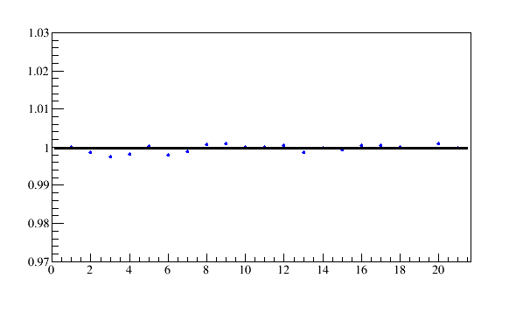
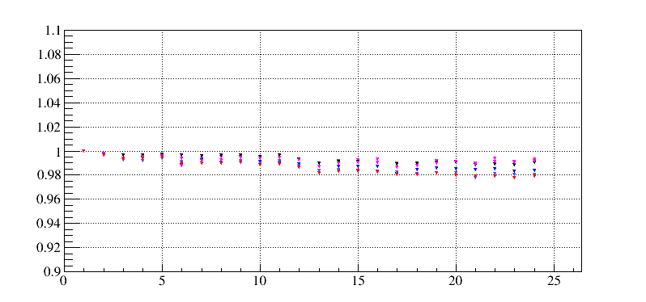
CCAL Light Monitoring System
Reference PMT receives light from
LED and Alpha source
- good LED stability measured
with respect to Alpha, ± 0.2 %
A (LED) / A (Alpha)
1st run
last run
Runs
LED response in various CCAL
modules
A (LED)
2 %
1st run
last run
Runs
<number>

Slide 38
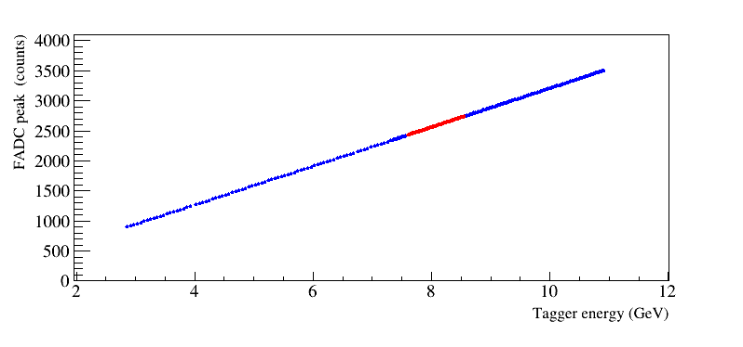
PMT Active Base Performance
Observed non – linear response of the calorimeter (couple of percents)
during commissioning run in December 2018
- somewhat worse energy resolution than expected
- PMTs were operated at relatively small HVs (650 – 700 V), HV recommended
by Hamamatsu is about 1 kV
Changed FADC voltage range to 2 V and increase HV by 50 V in January
Study linearity using calibration runs (CCAL in the beam)
FADC amplitude as a function of the beam energy
10 GeV : 3200 FADC channels
Rate < 30 kHz
<number>

Slide 39
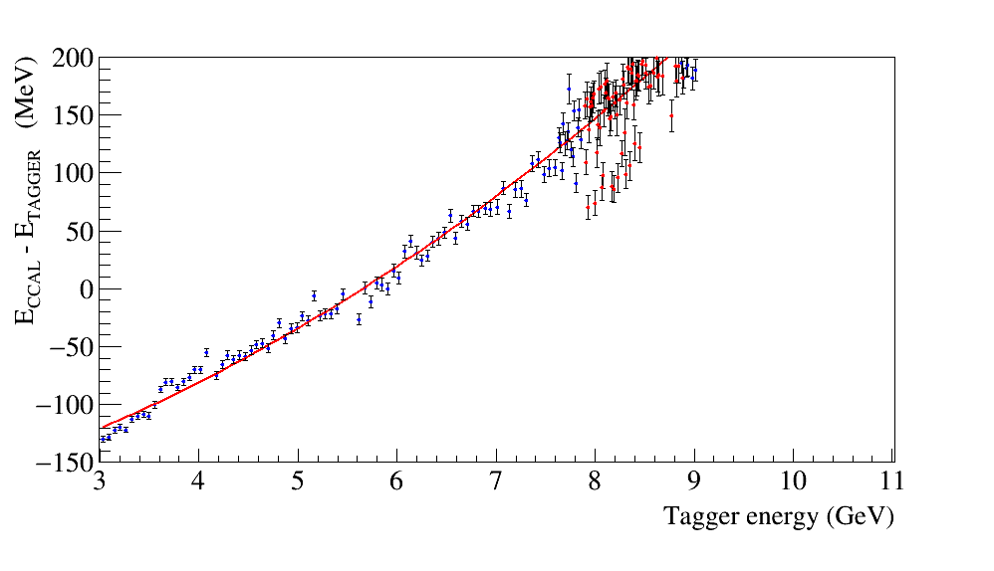
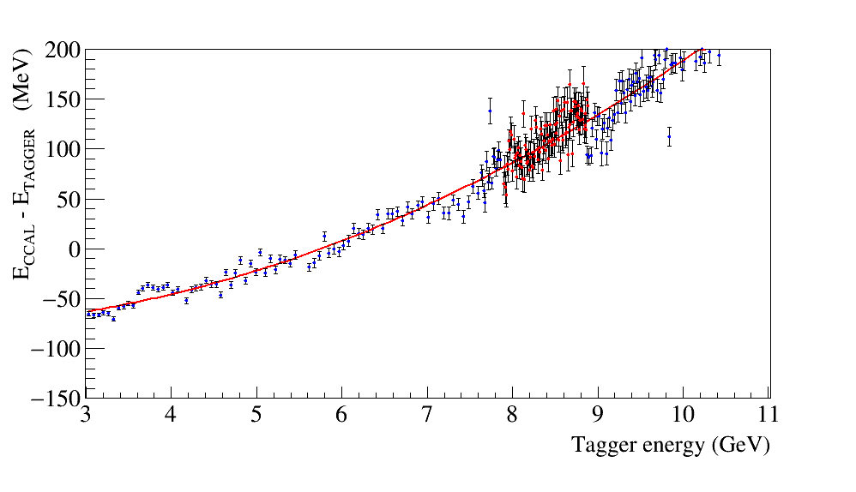
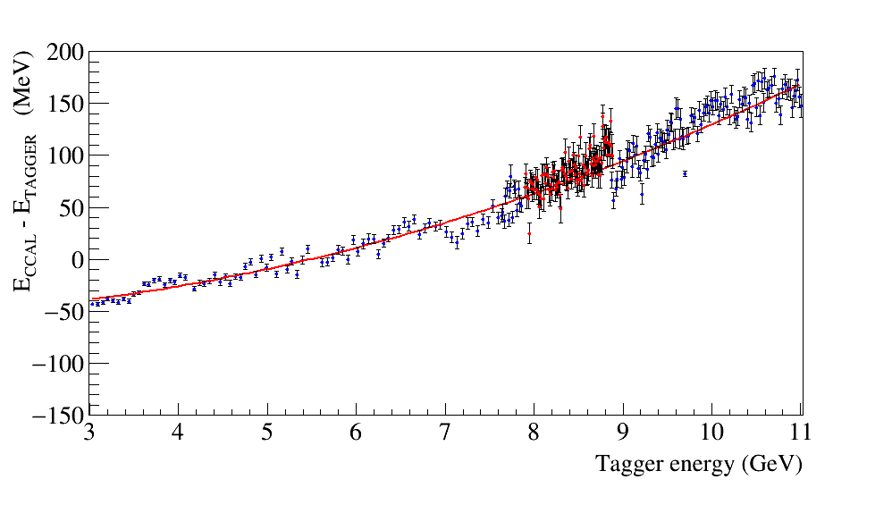
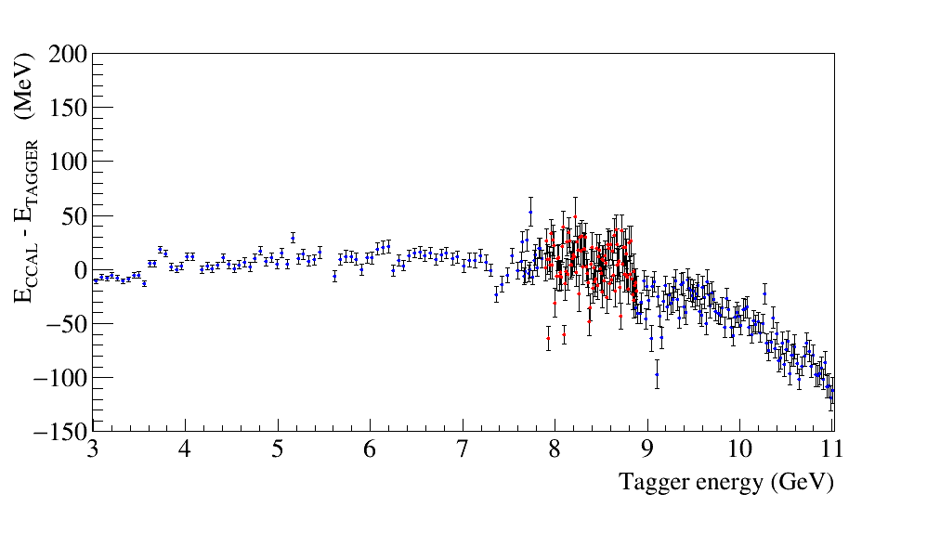
Linearity as a Function of Operational HV
Calorimeter CELL = -4, -4
Fall, 2018
Spring, 2019
570 V
630 V
680 V
750 V
Signal attenuator (0.1)
Linearity is improved with the HV increase

Slide 40
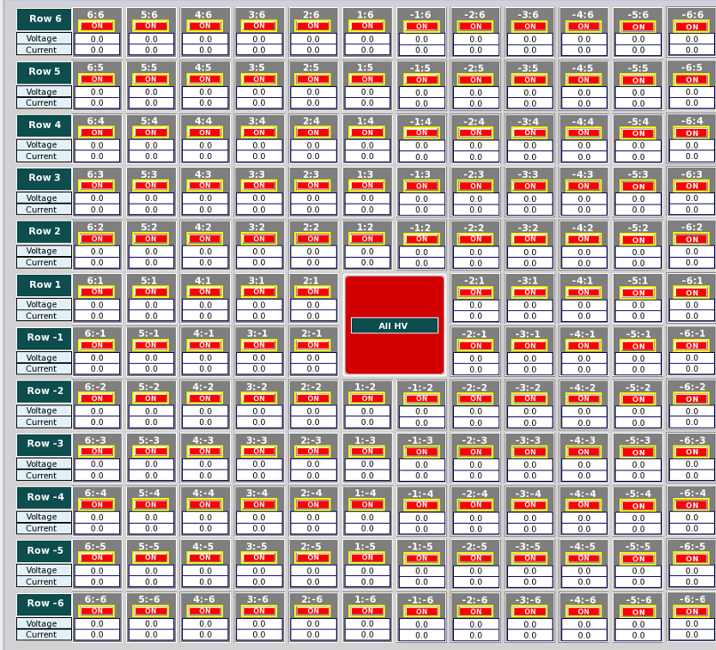
Test Modified Active Base with the Bypassed Amplifier
Install 9 PMT bases with
the bypassed amplifier
two bases with the reduced gain:
gain 3 and 6
<number>

Slide 41
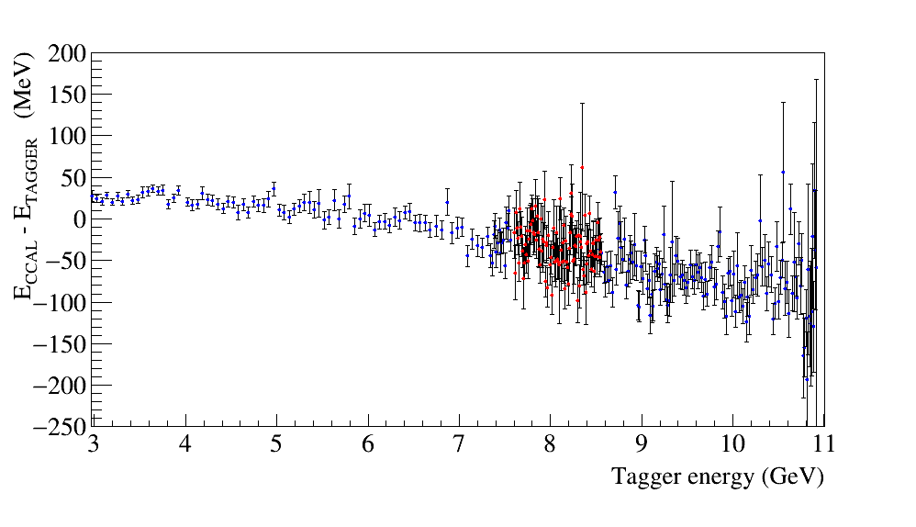
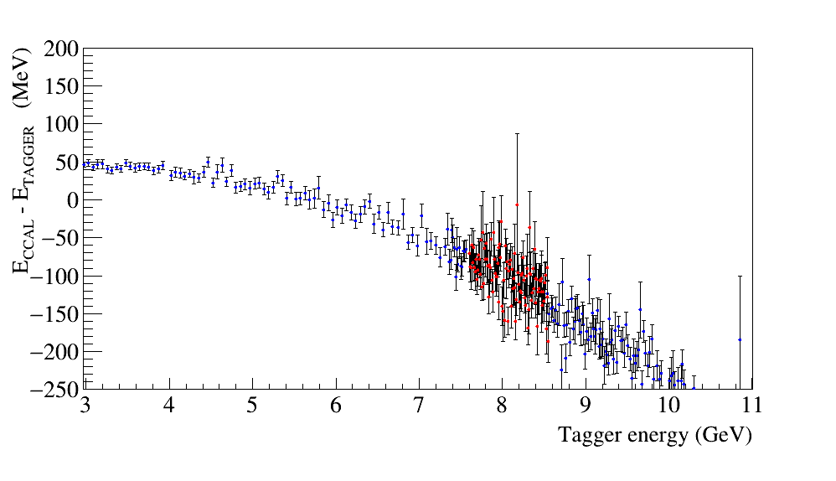
Linearity: ADC Peak Amplitude
Cell 4, 4
Cell 4, 4
Cell 4, 4
Cell 4, 4
Divider limitations
CCAL Spring 2019, gain 24
750 V
2 V range
Bypassed amplifier
810 V
0.5 V range
Bypassed amplifier
960 V
2 V range
Vpeak = 1.7 V (3501 cnt)
Vpeak = 0.4 V ( 3474 cnt)
Vpeak = 1.6 V (3228 cnt)
Cell -5, 4
Cell -5, 5
gain 3
850 V
2 V range
gain 6
800 V
2 V range
Vpeak = 1.2 V ( 2480 cnt)
Vpeak = 1.6 V ( 3359 cnt)

Slide 42
Hall D Compton Calorimeter
V. Berdnikov, T. Horn,
H. Voskonyan, H. Mkrtchyan
Collaboration between Hall D and Hall C (NPS prototype)
Array of 12x12 PbWO₄ crystals
Beam hole: 2 x 2 crystals
Tungsten absorber covers the inner
most layer (taken from HyCal)
Water cooling (minimum 5° C),
nitrogen purge
LED-based gain monitoring system
Positioned on X-Y movable platform
Hamamatsu R4125 PMT
HV dividers with amplifiers, designed by Vlad Popov
Notes:
<number>

Slide 43
Calorimeter Fabrication
Cooling Plates
PMT housing
<number>

Slide 44
Light Monitoring System
Two reference PMTs are installed to monitor LED stability
Each PMT receives light from the LED fiber and YAP:CE Am light source
LED and Alpha-source triggers are used during data taking (special trigger types)
Reference PMT FADC amplitudes
PMT1
PMT2
<number>

Slide 45
Rate per Counter (PrimEx D Conditions)
Maximum rate per counter
is 250 kHz
(at ∼30 MeV threshold)
Rates are in a good agreement with the simulation for PrimEx D
250 kHz
FADC scalers
<number>

Slide 46
Linearity: ADC Peak Amplitude
(Bypassed amplifier, 1000 V, 2 V range, Spring 2019)
Cell 4, 4
Better linearity at small amplitudes
Negative non-linearity at large amplitudes

