Slide 1
Crystal Ready for Shipment
A. Liu, B. Liu, A. Somov, V. Berdnikov, H. Voskanyan, A. Asaturyan
October 12, 2023
1

Slide 2
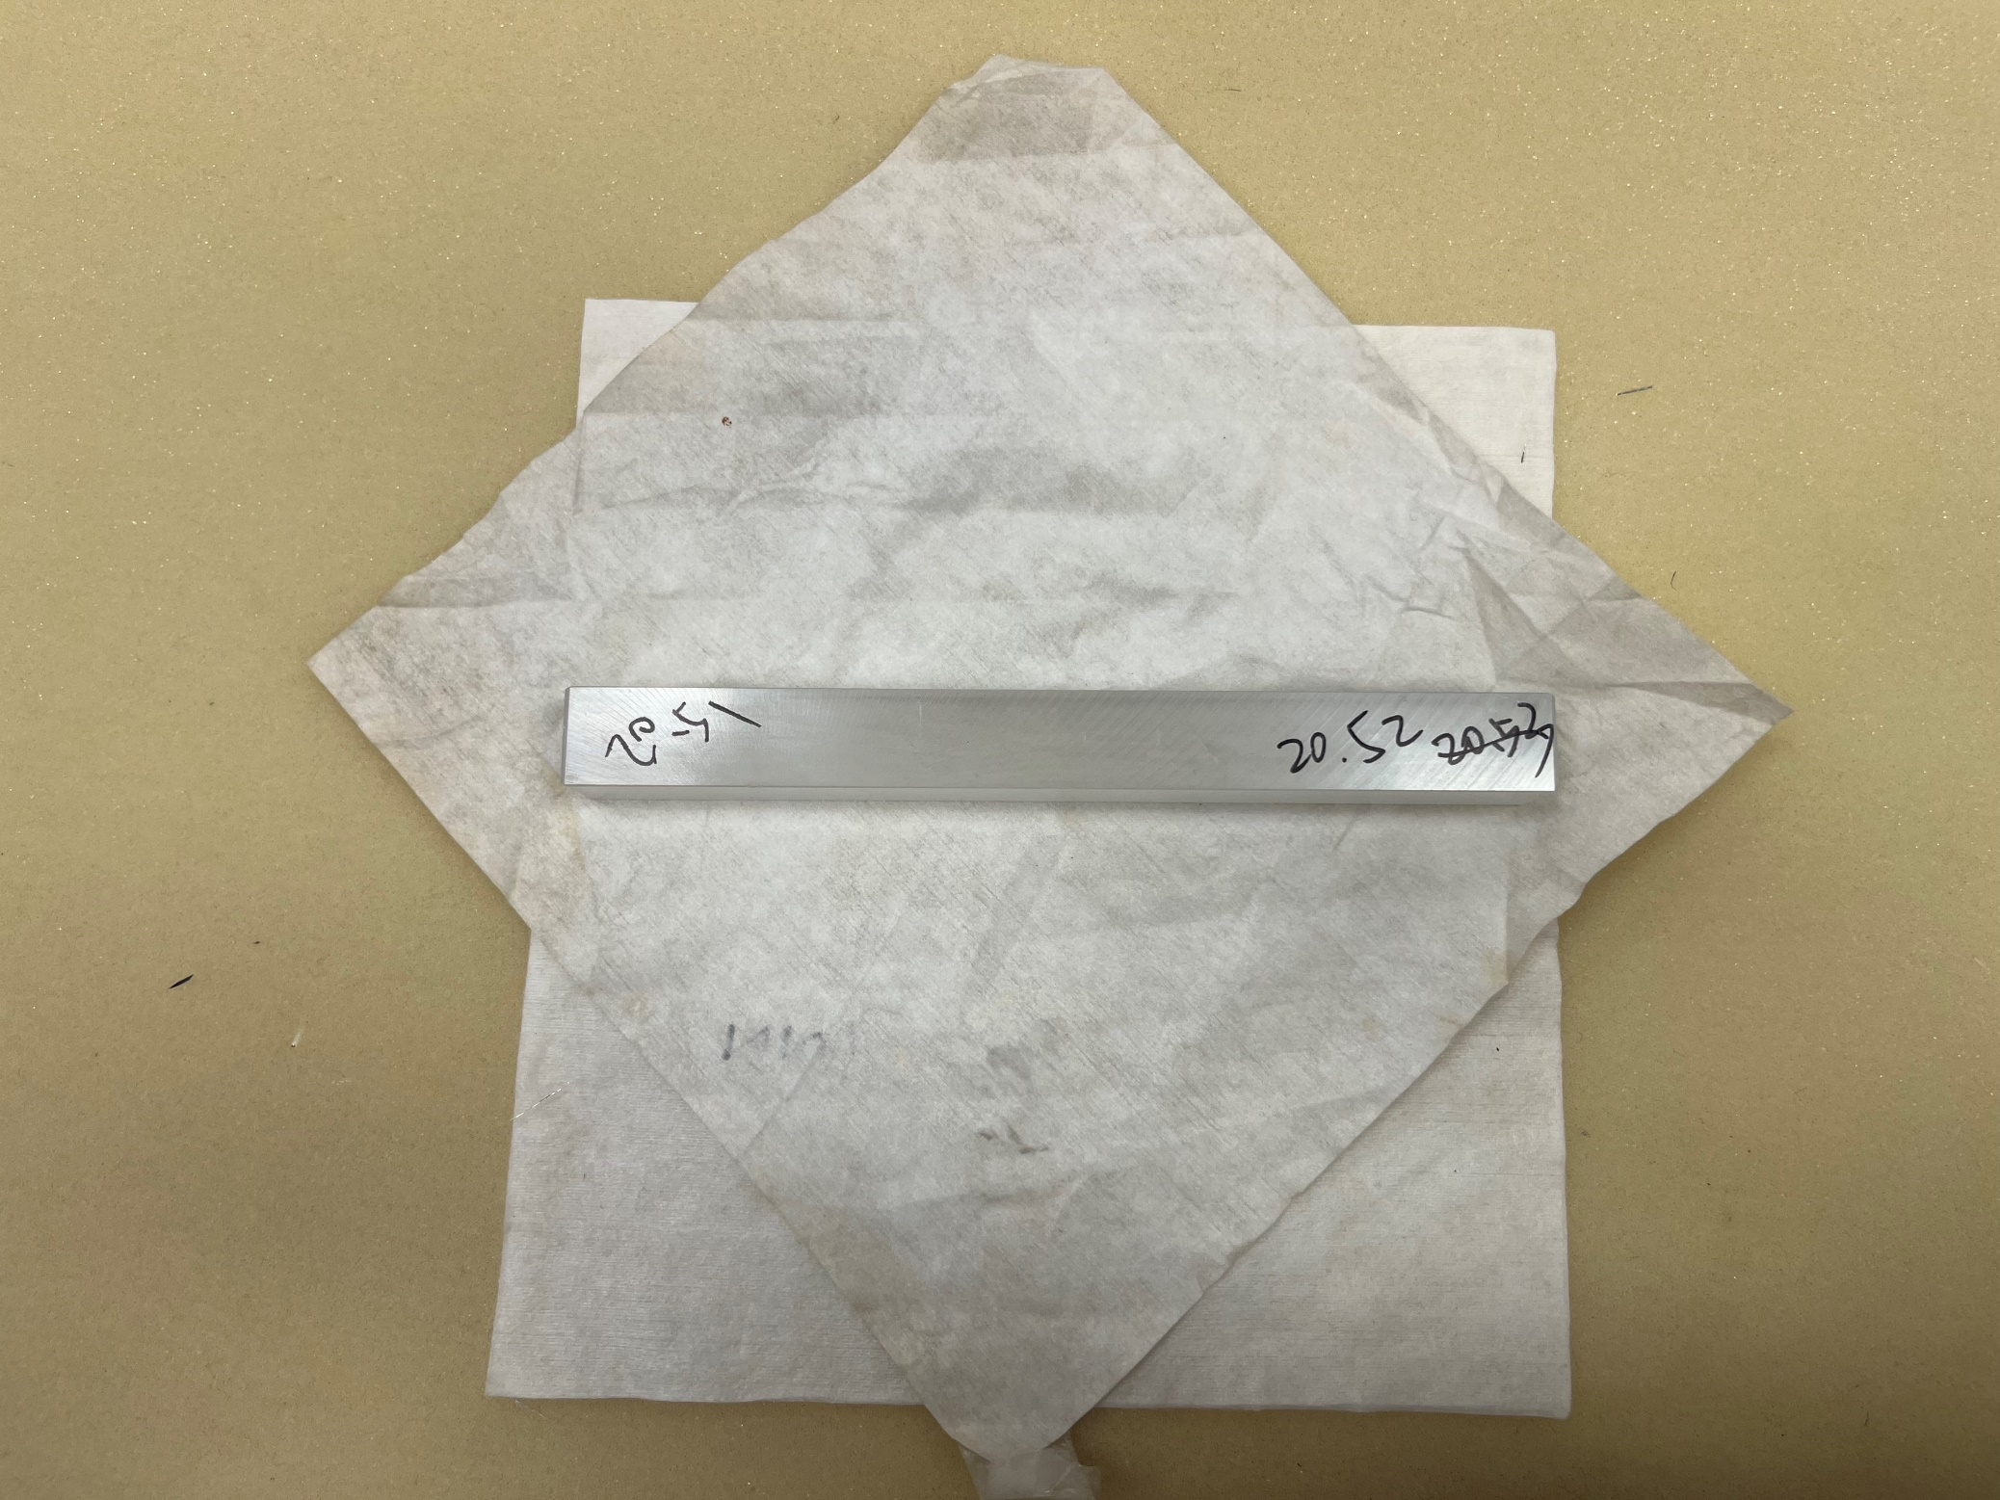
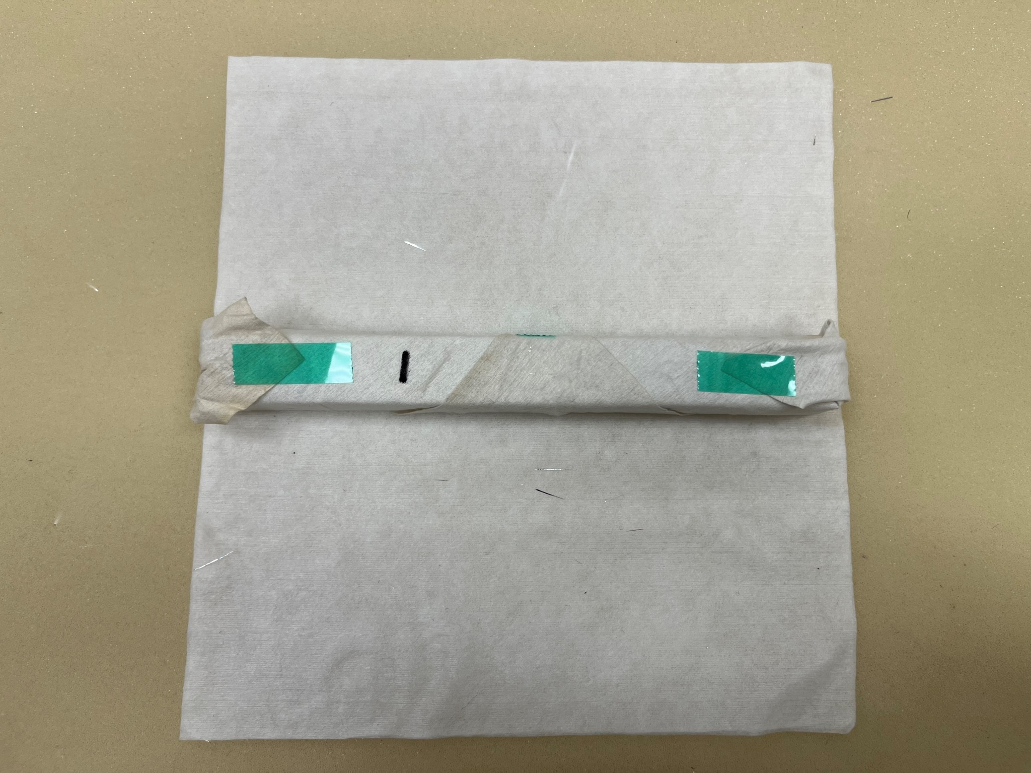
Unpolished-1
All Faces Unpolished
Chips inside
2

Slide 3
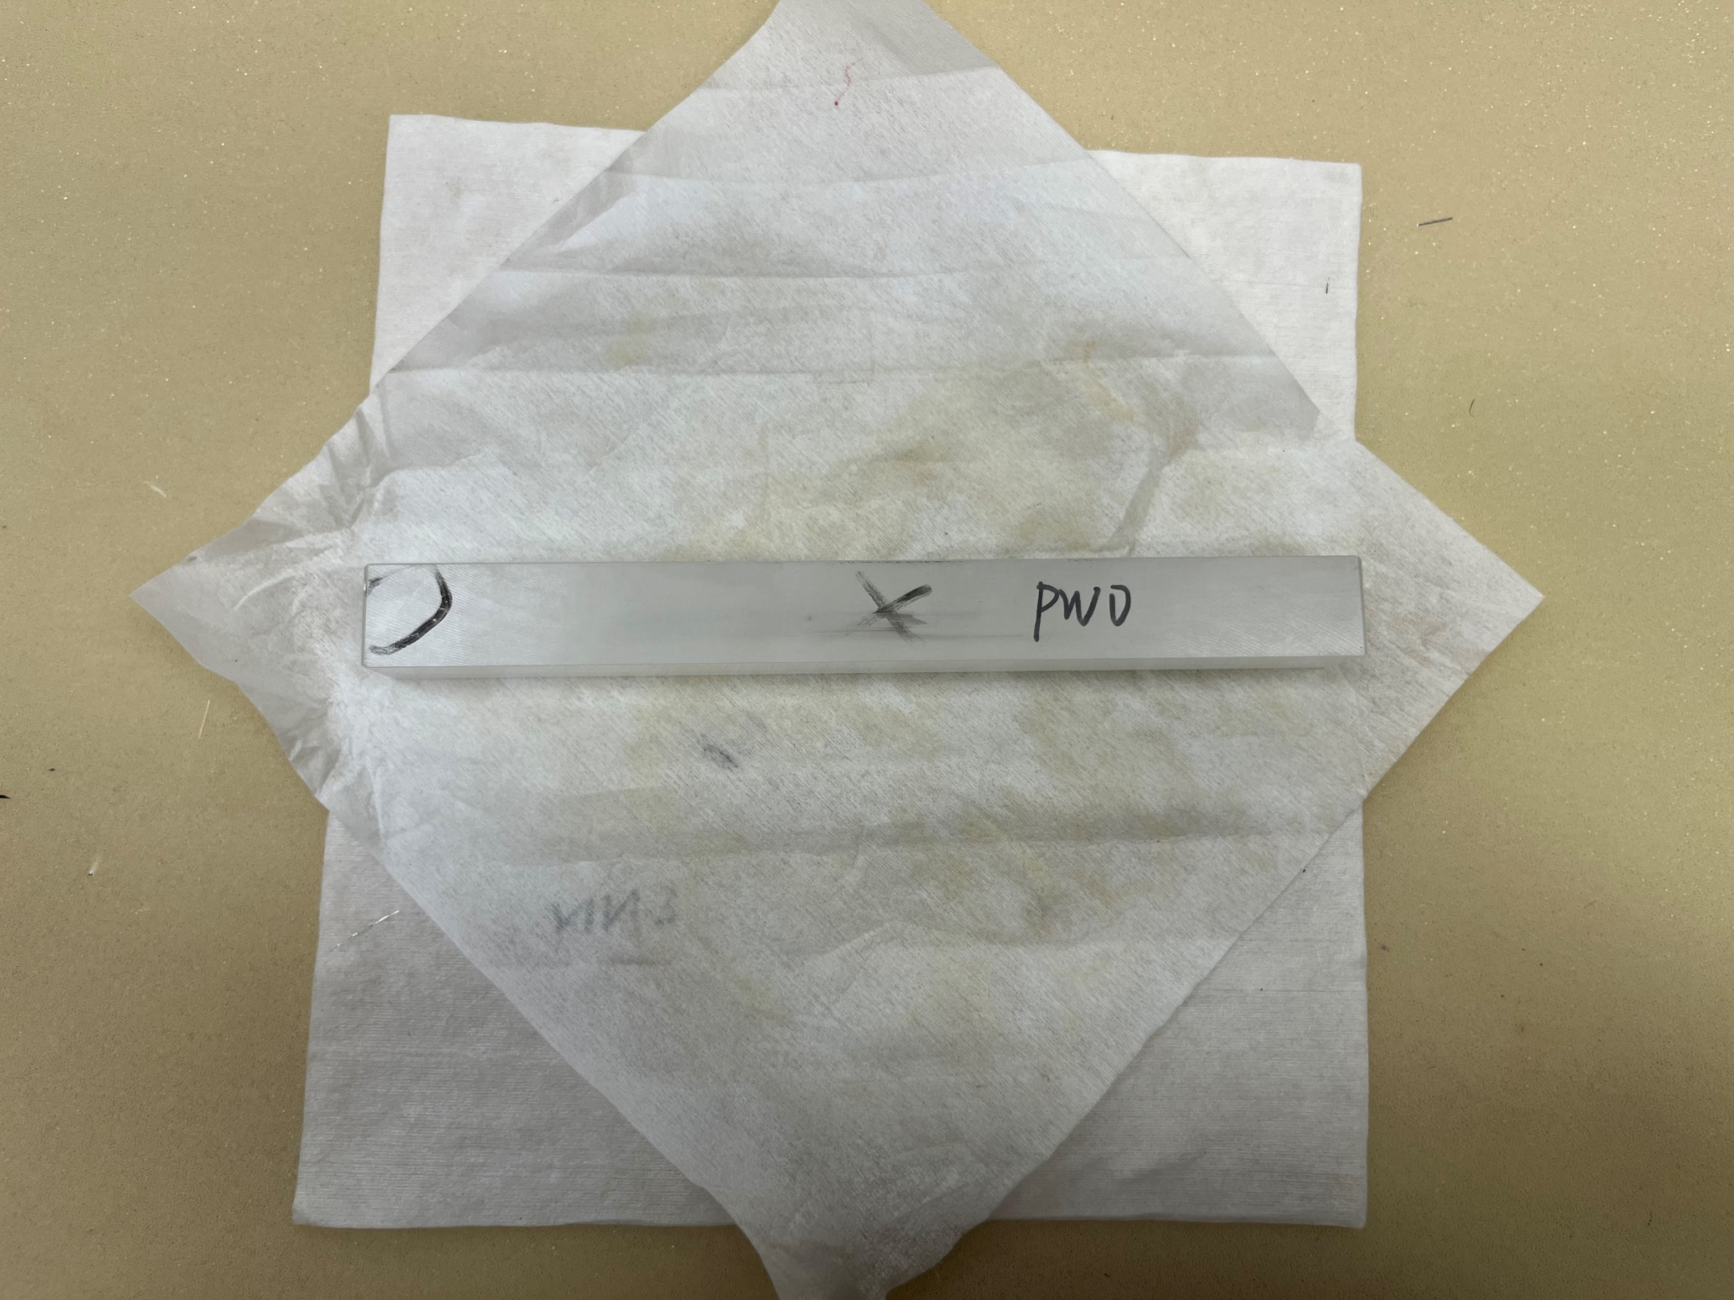
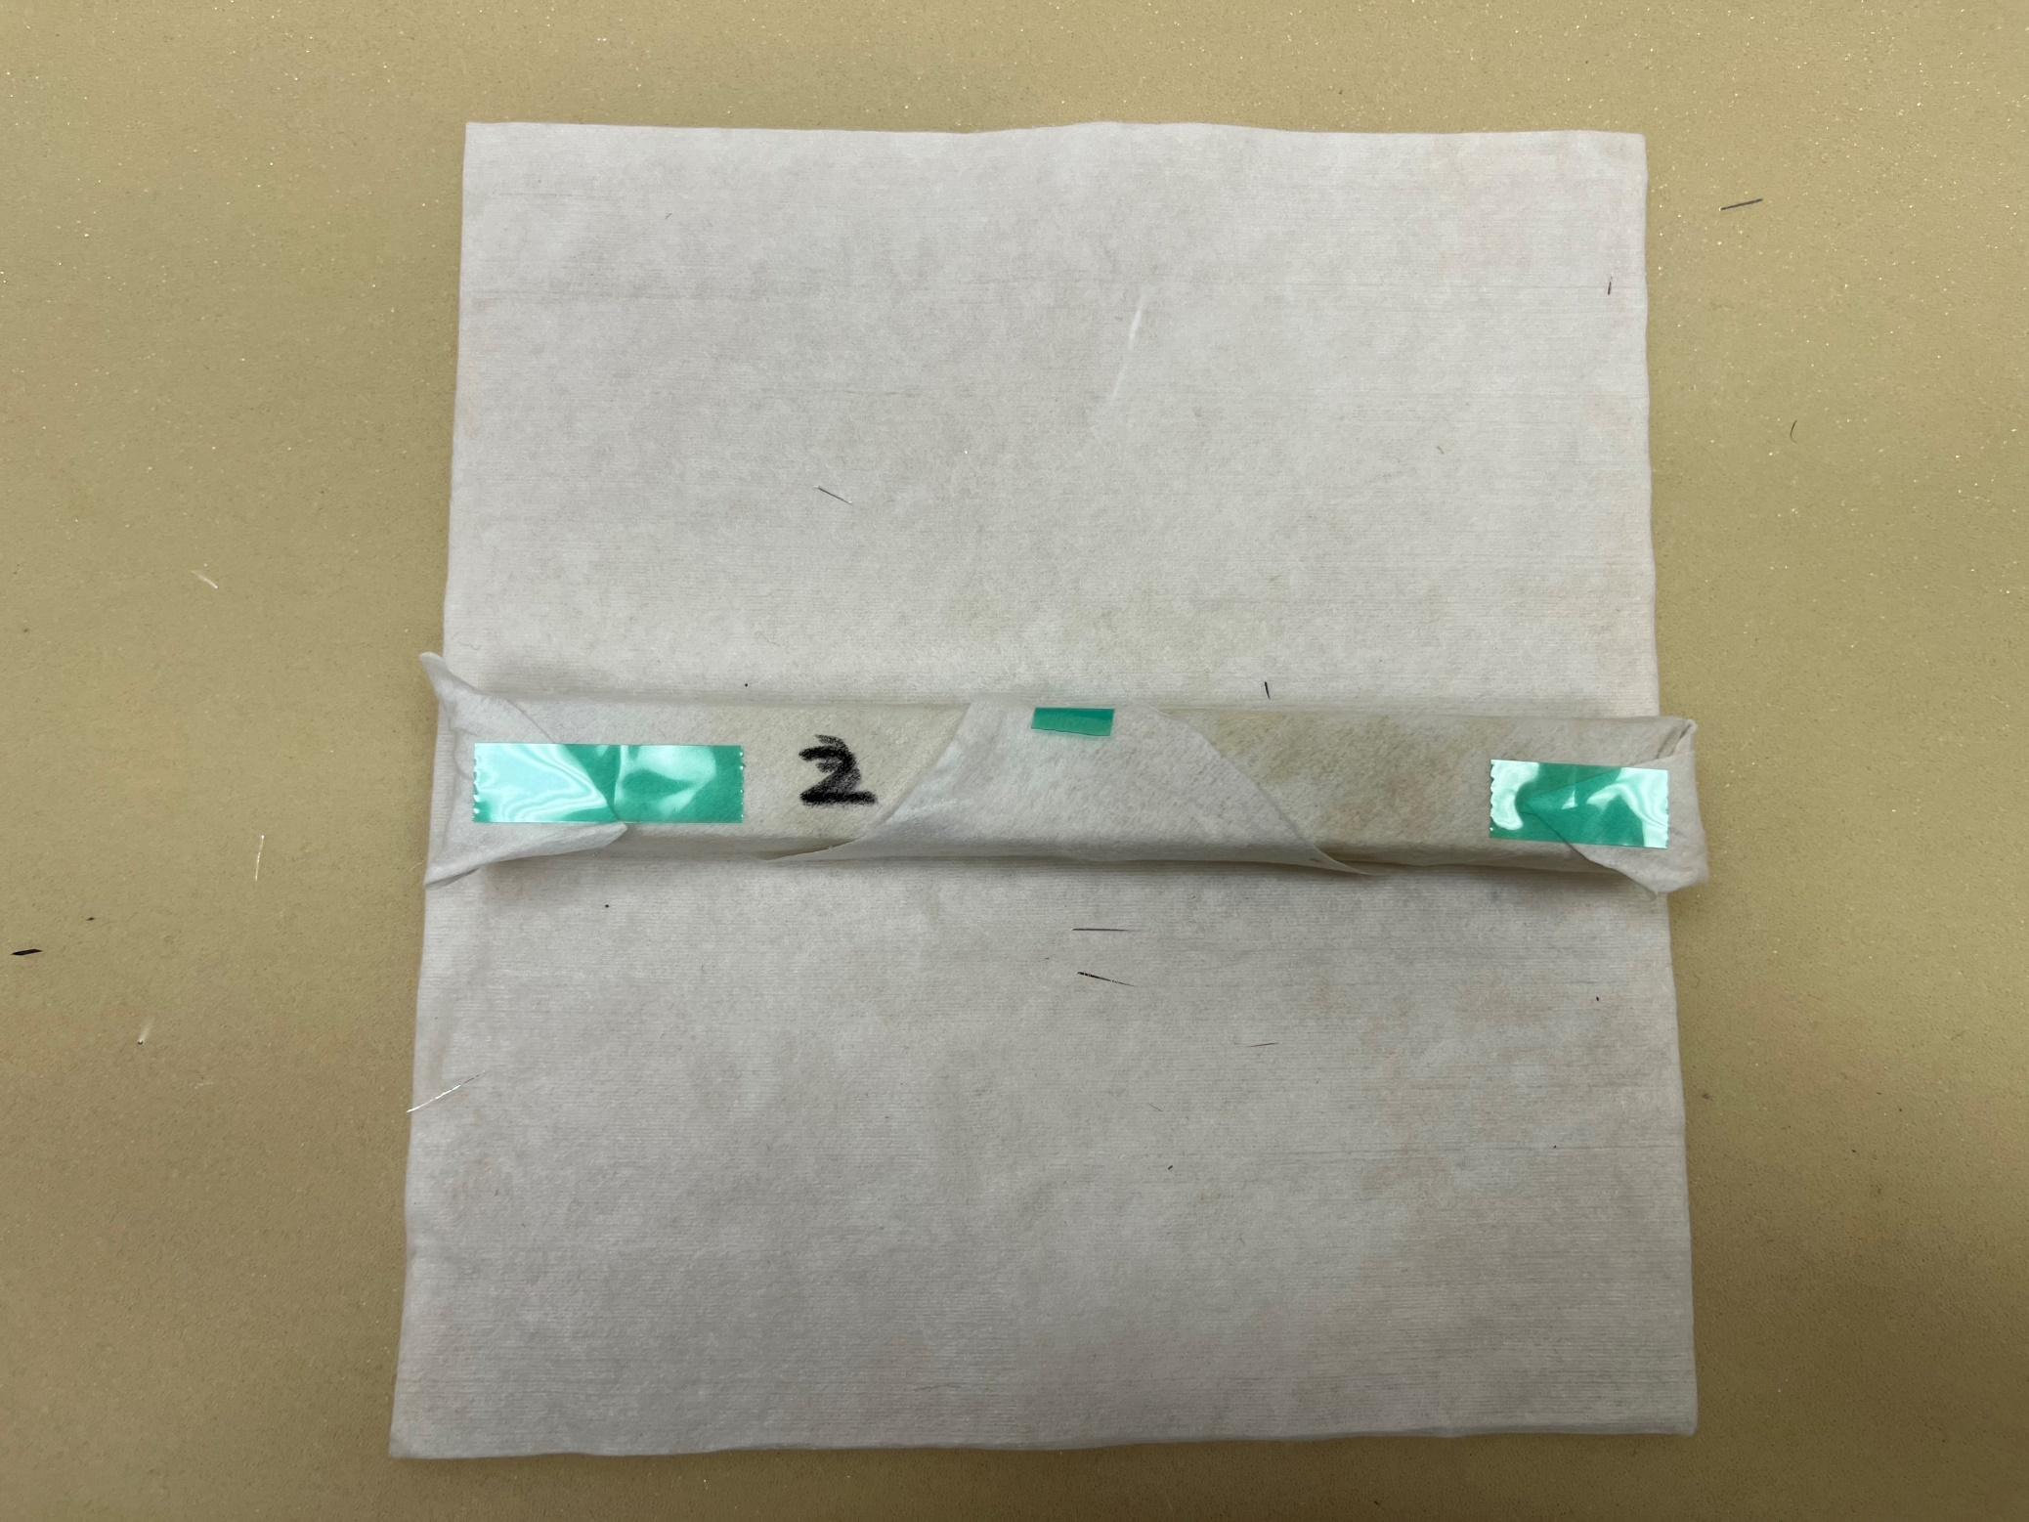
Unpolished-2
All Faces Unpolished
Chips inside
3

Slide 4
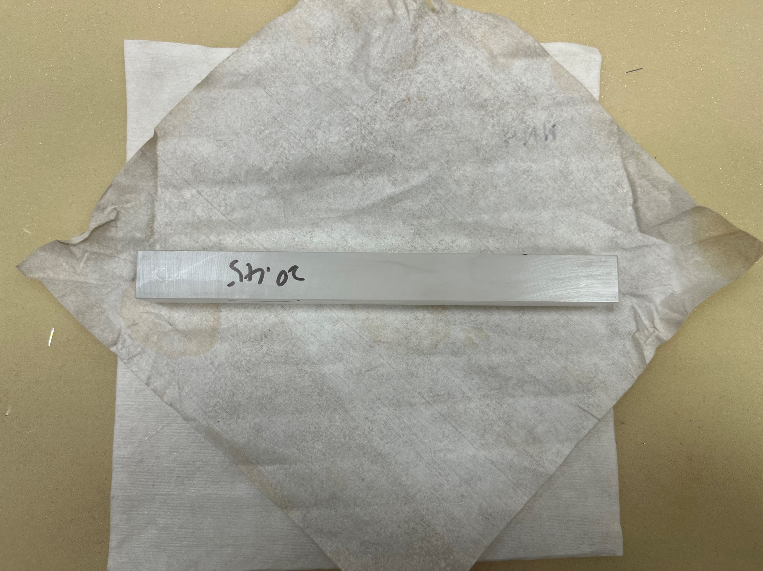
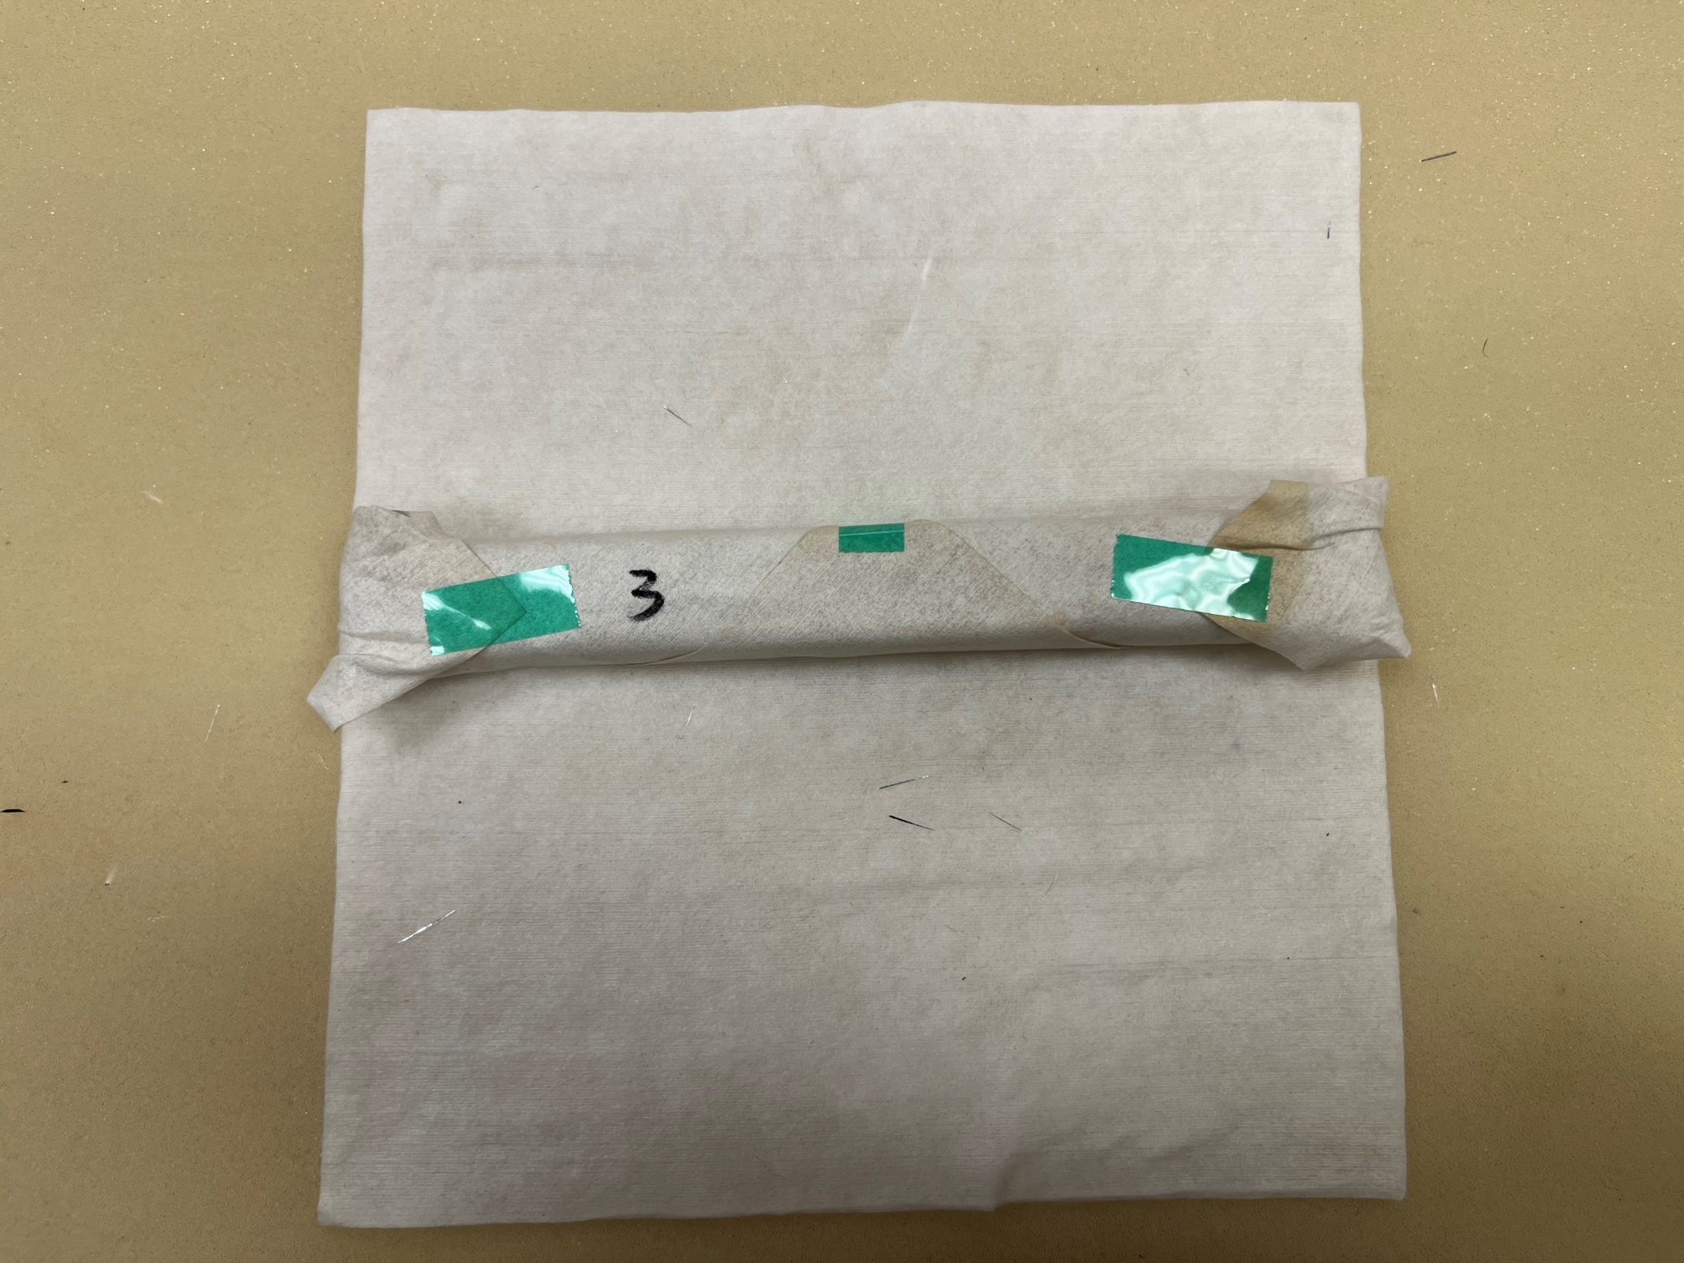
Unpolished-3
All Faces Unpolished
Chips inside
4

Slide 5
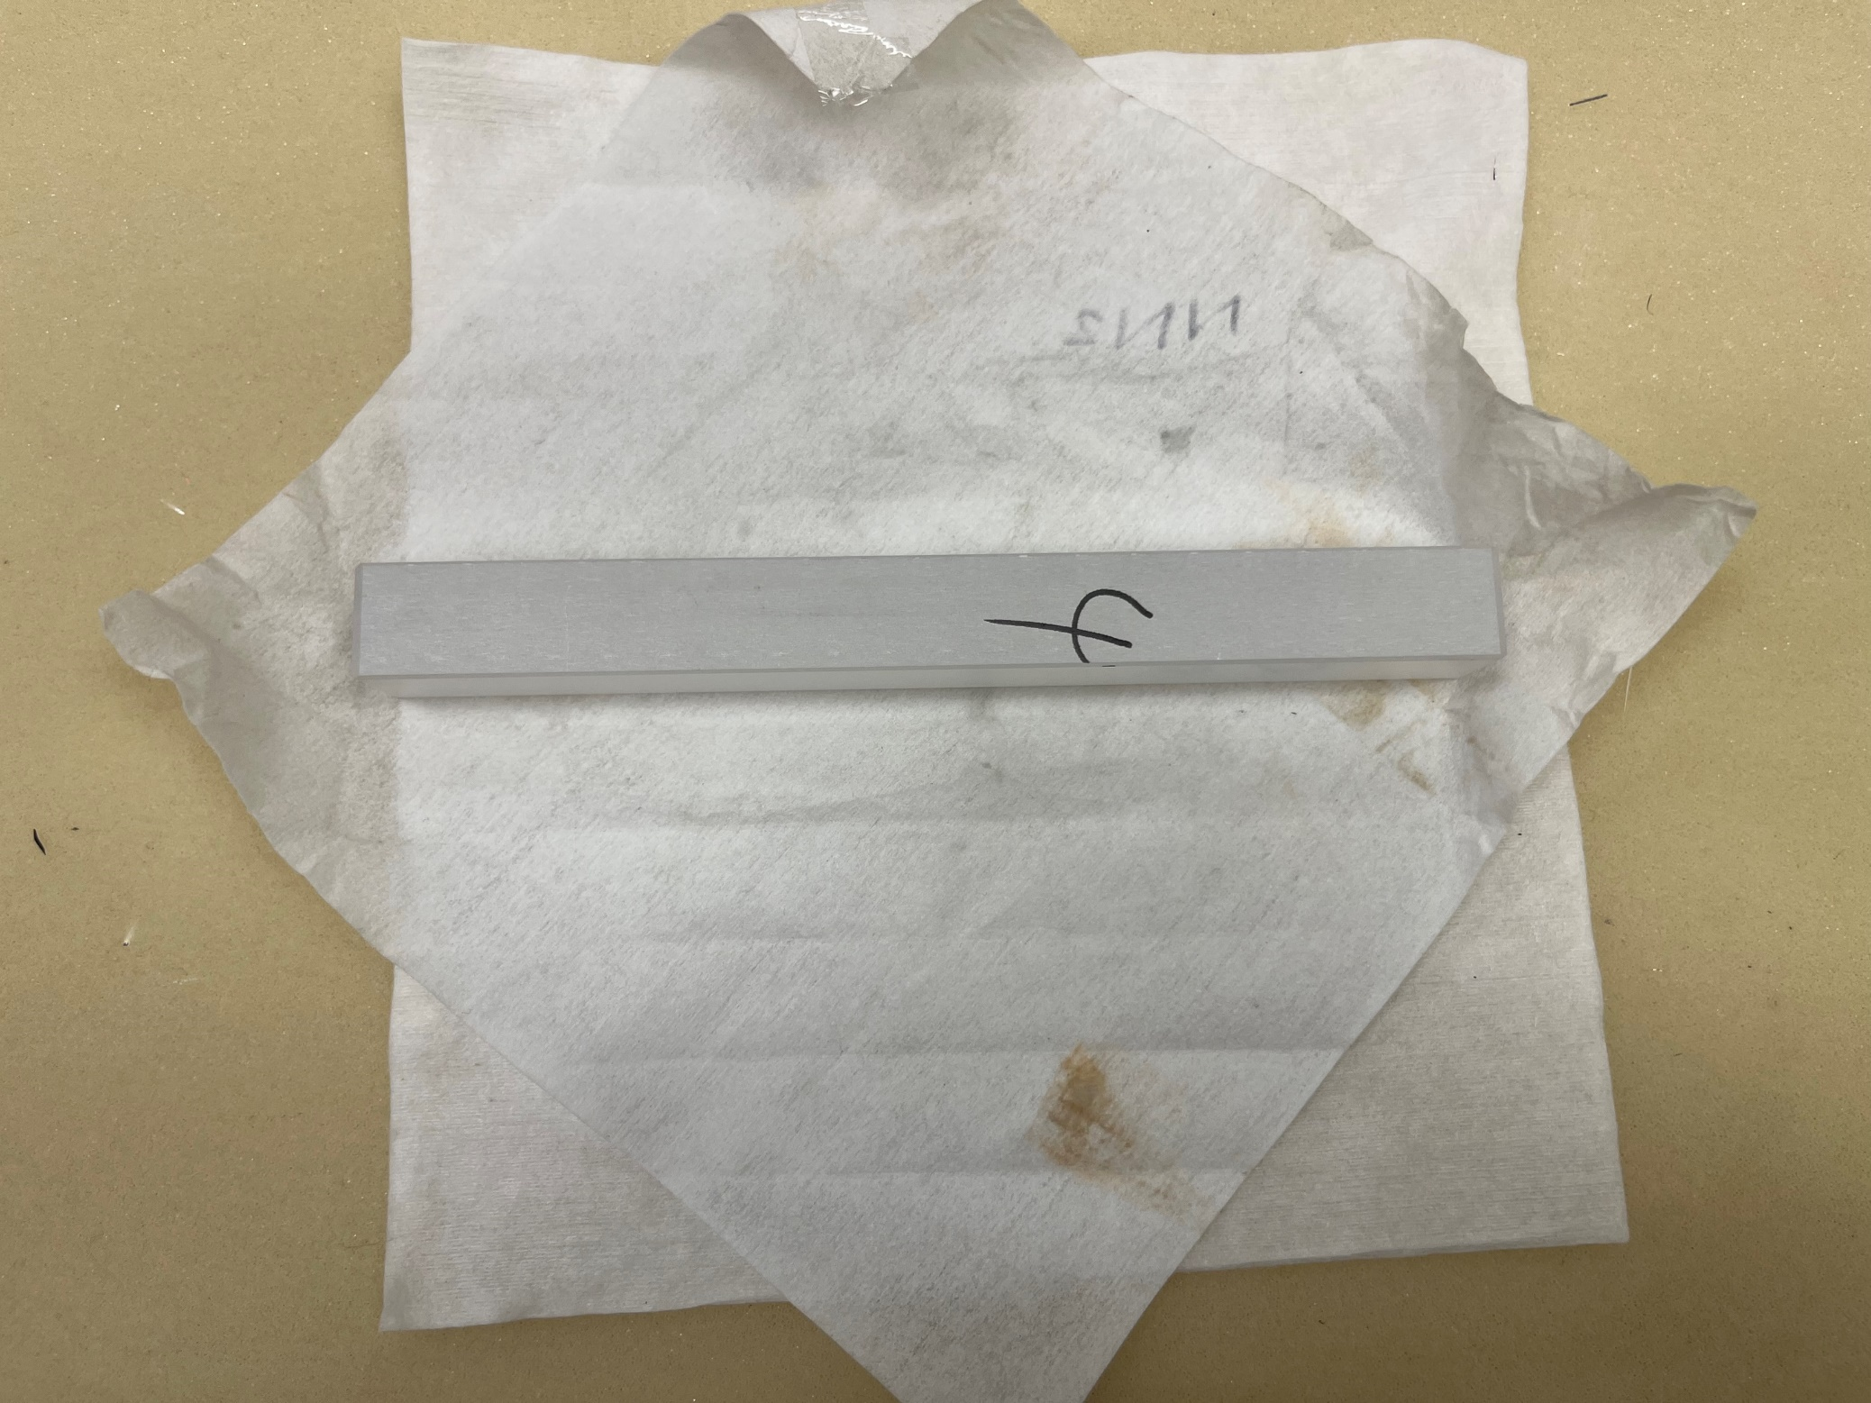
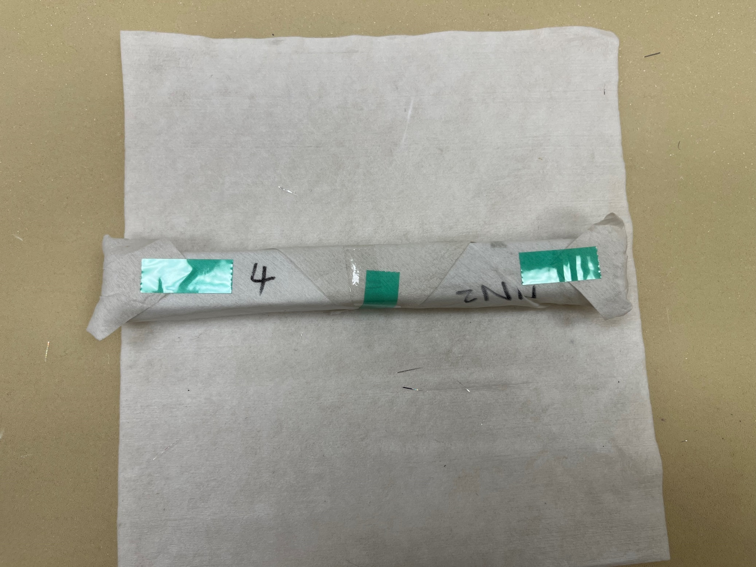
Unpolished-4
All Faces Unpolished
Chips inside and on chamfers
5

Slide 6
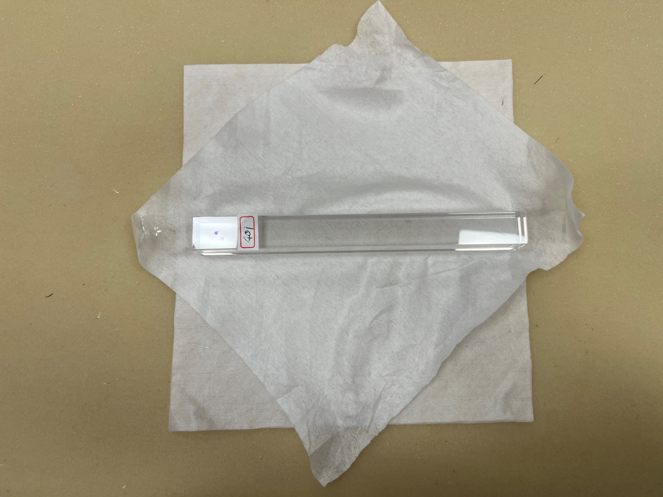
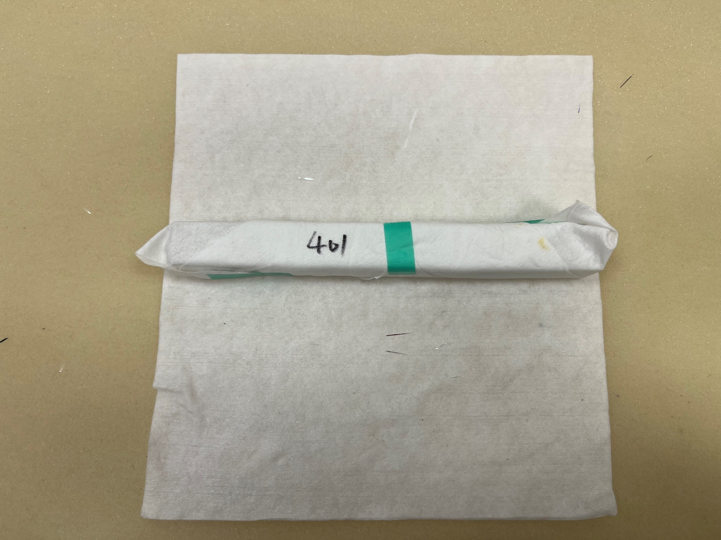
No. 401
Big chips on faces
Scratch
6

Slide 7
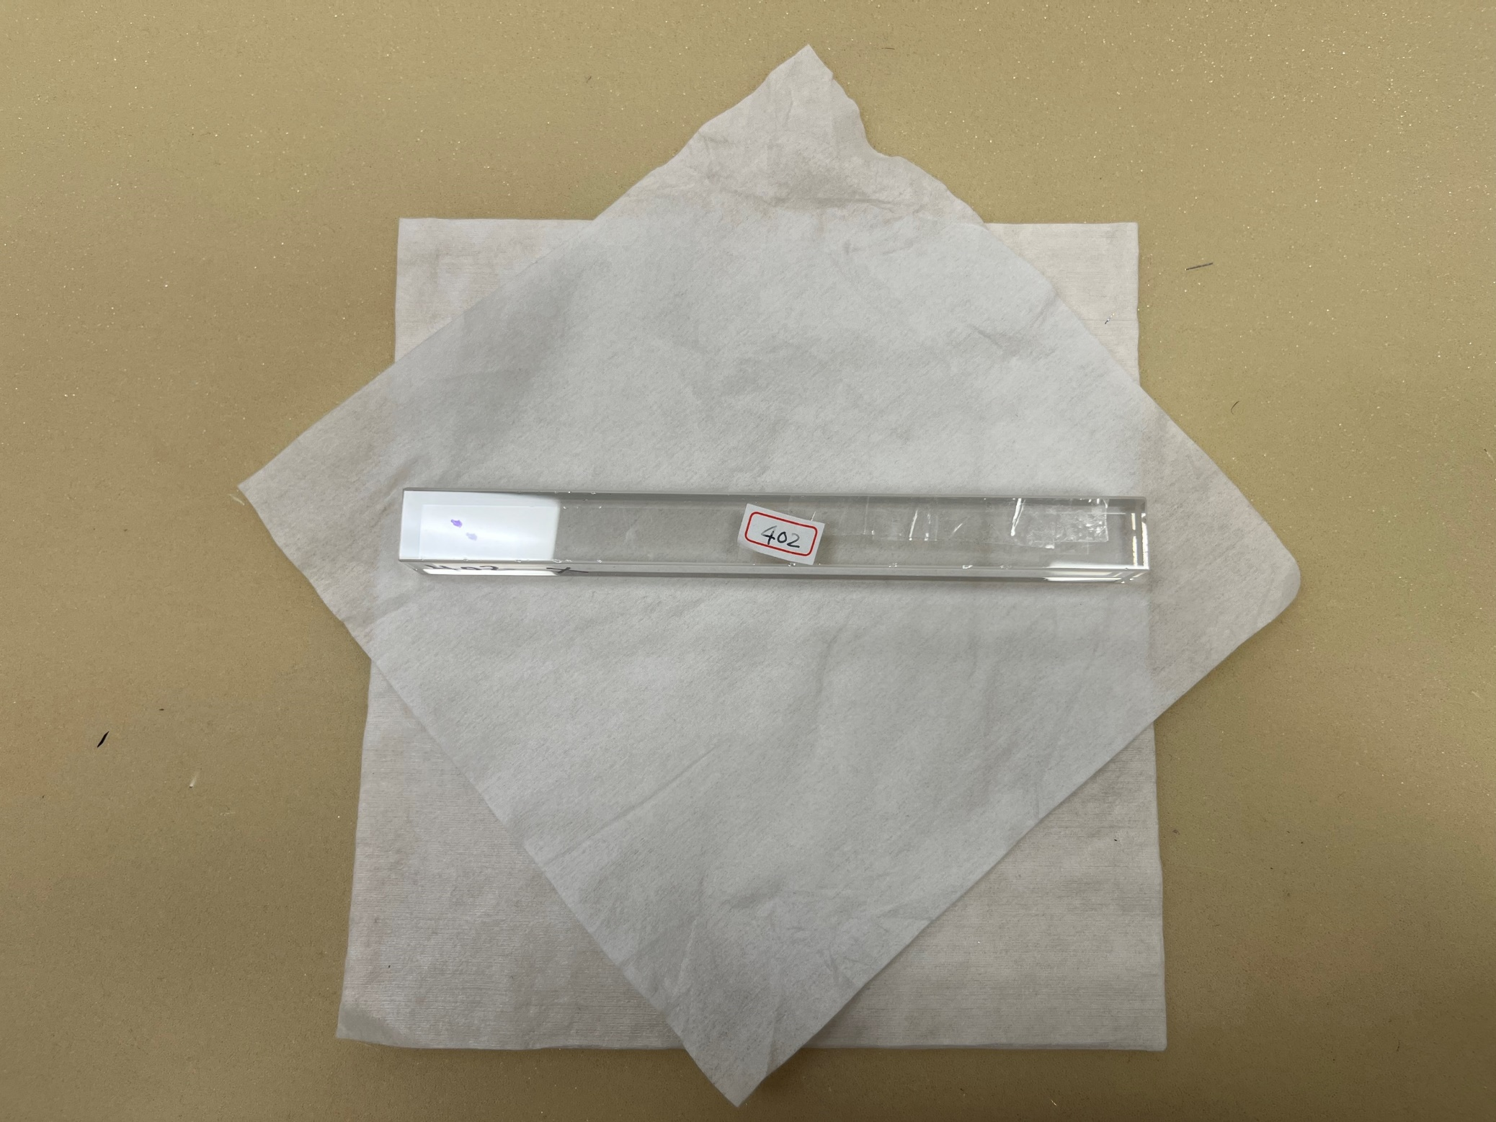
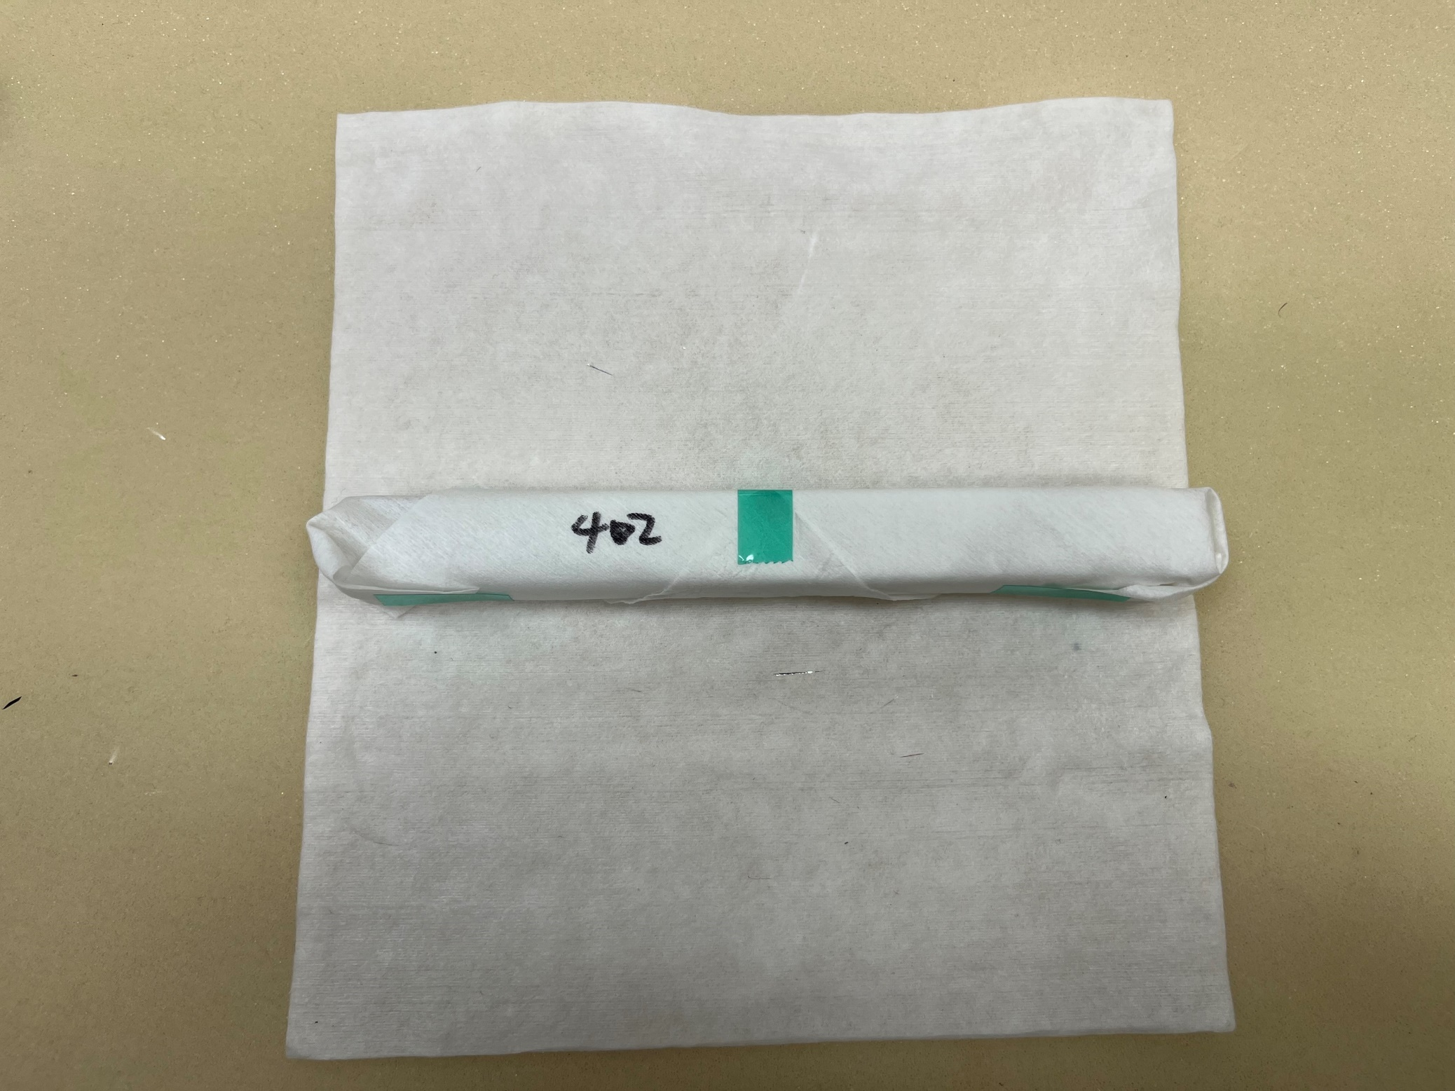
No. 402
Too many chips on chamfers
7

Slide 8
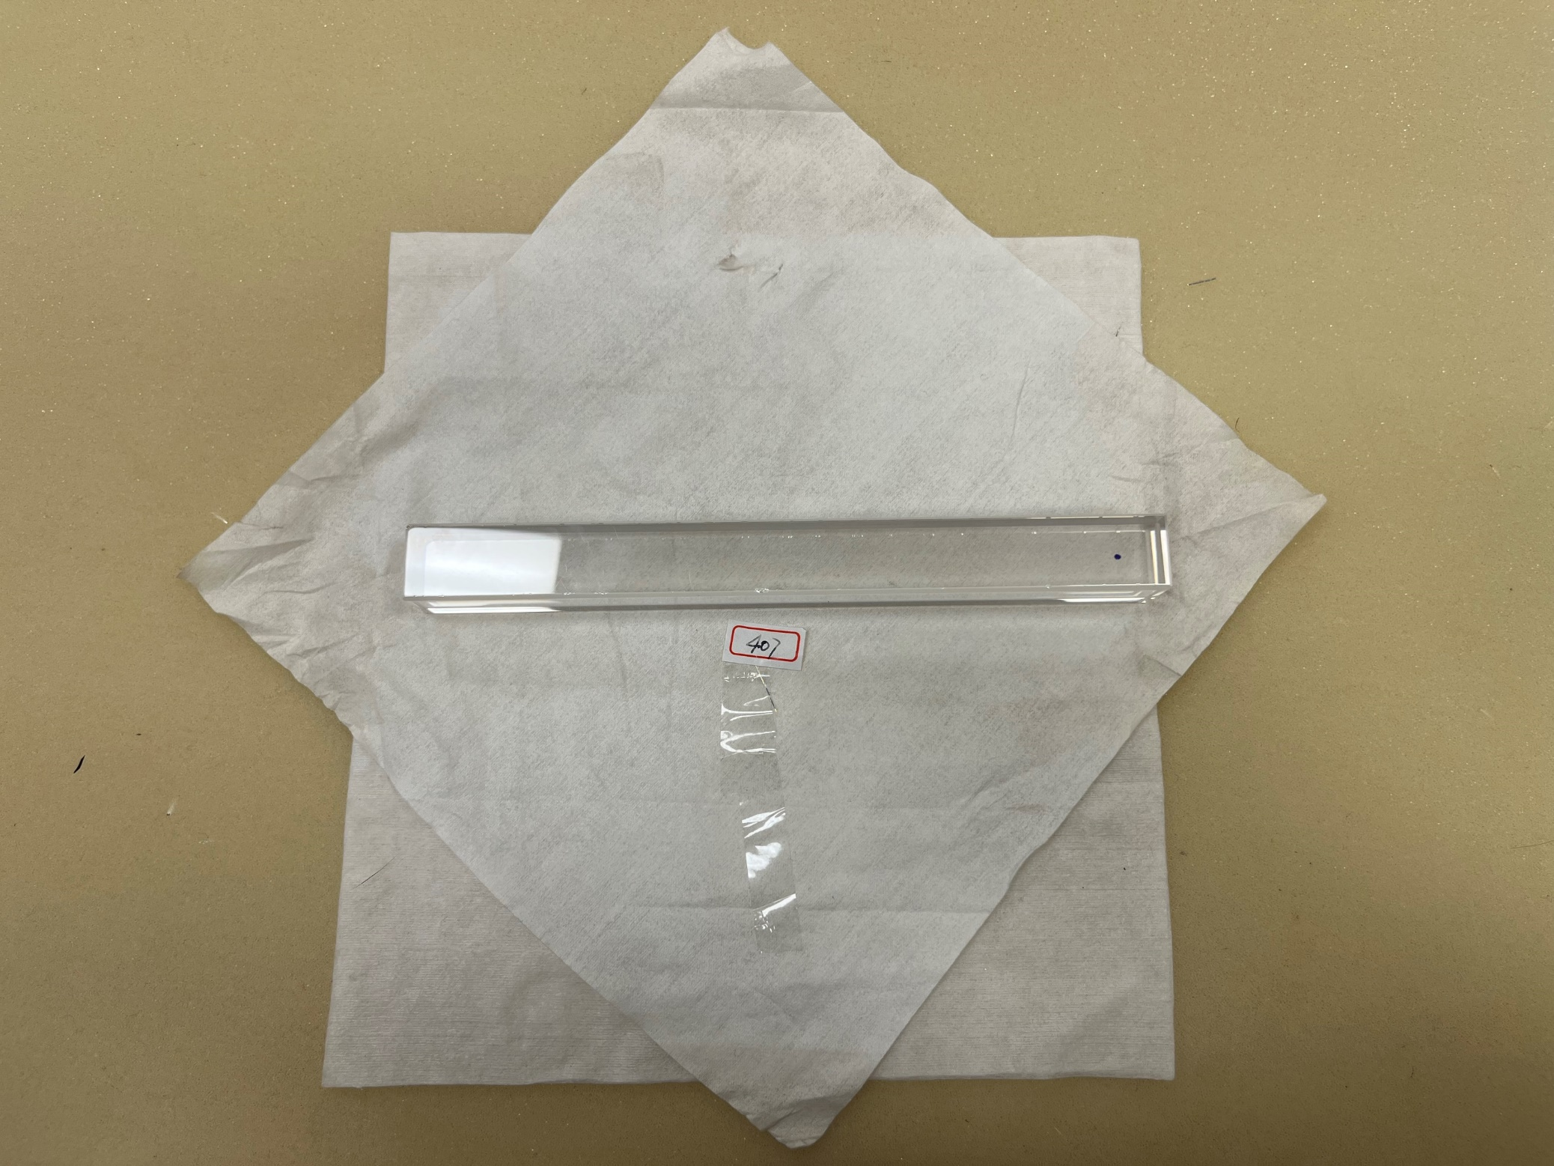
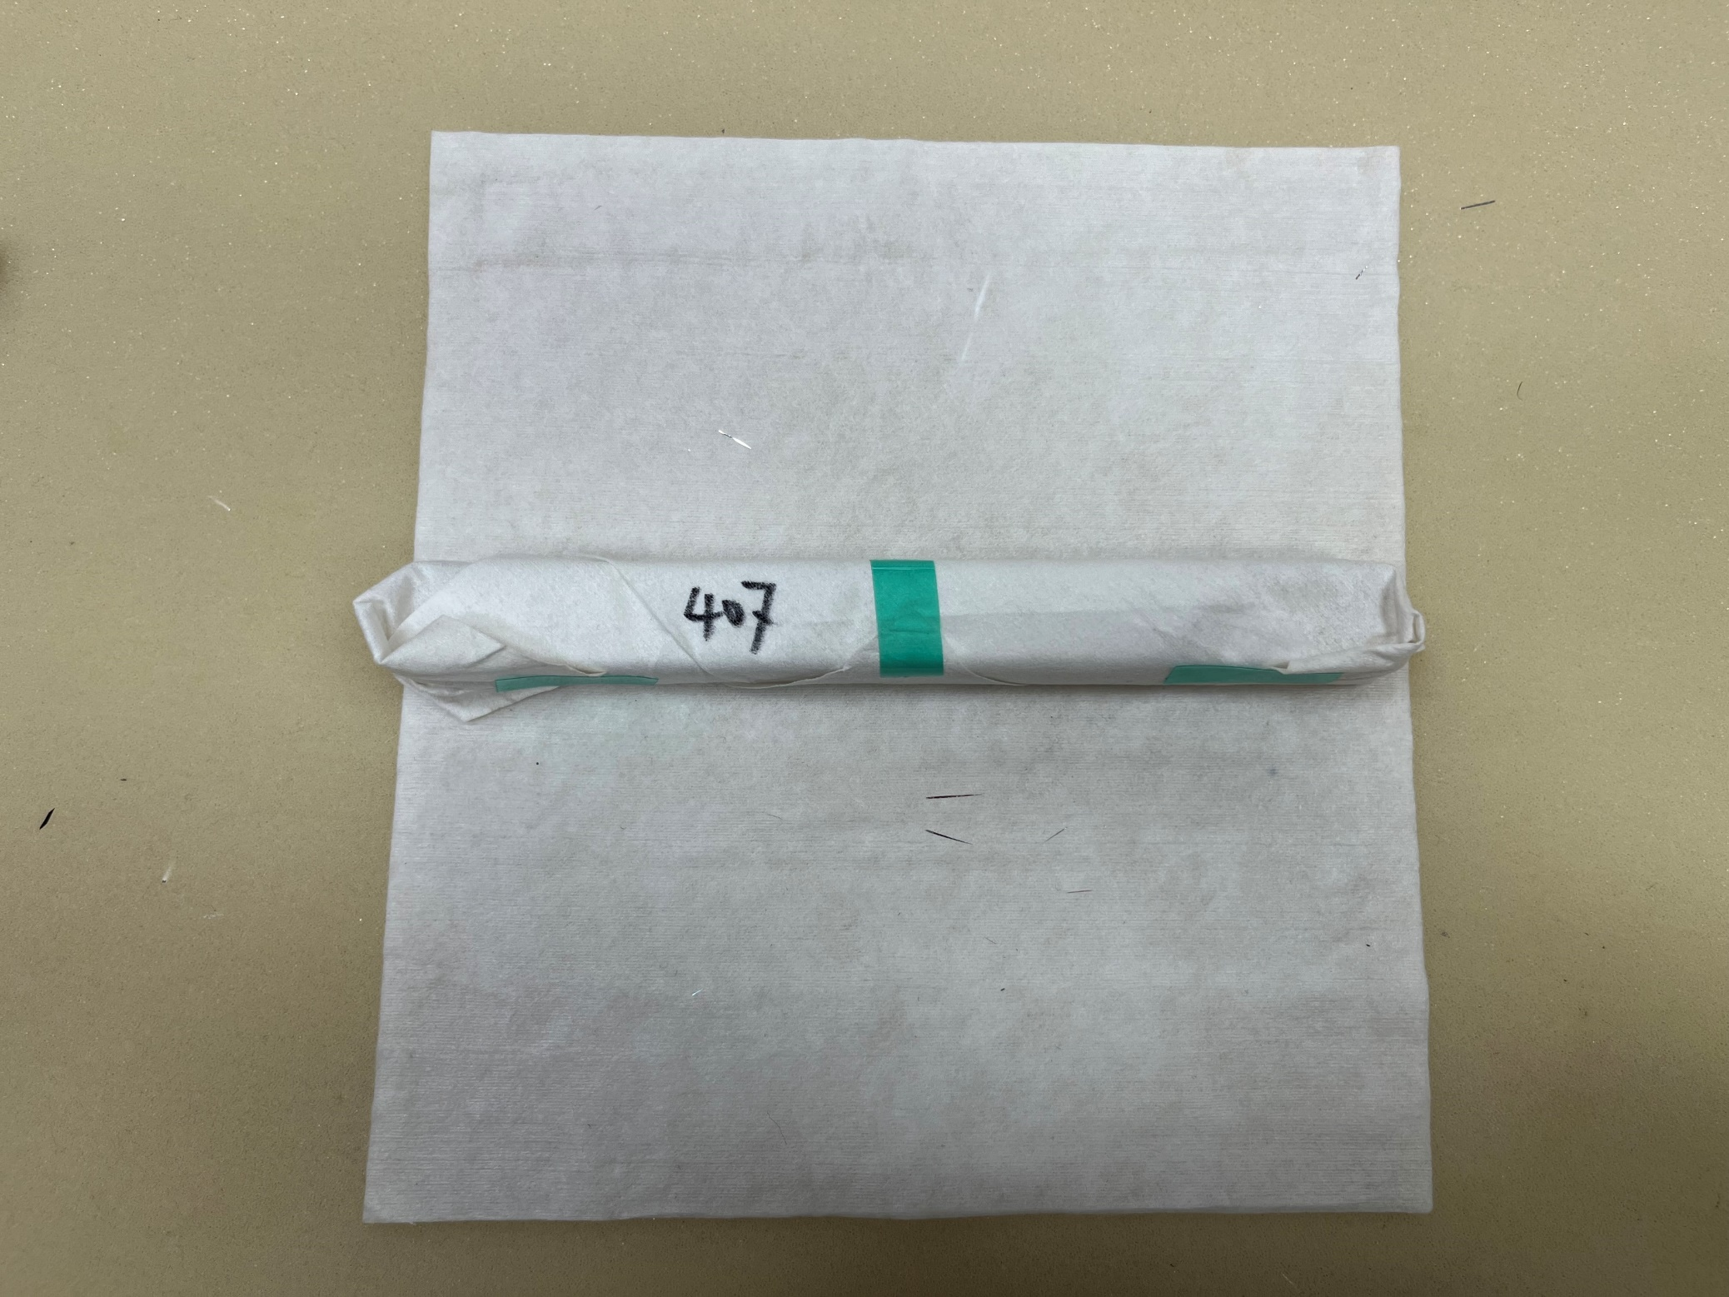
No. 407
Too many chips on chamfers
8

Slide 9
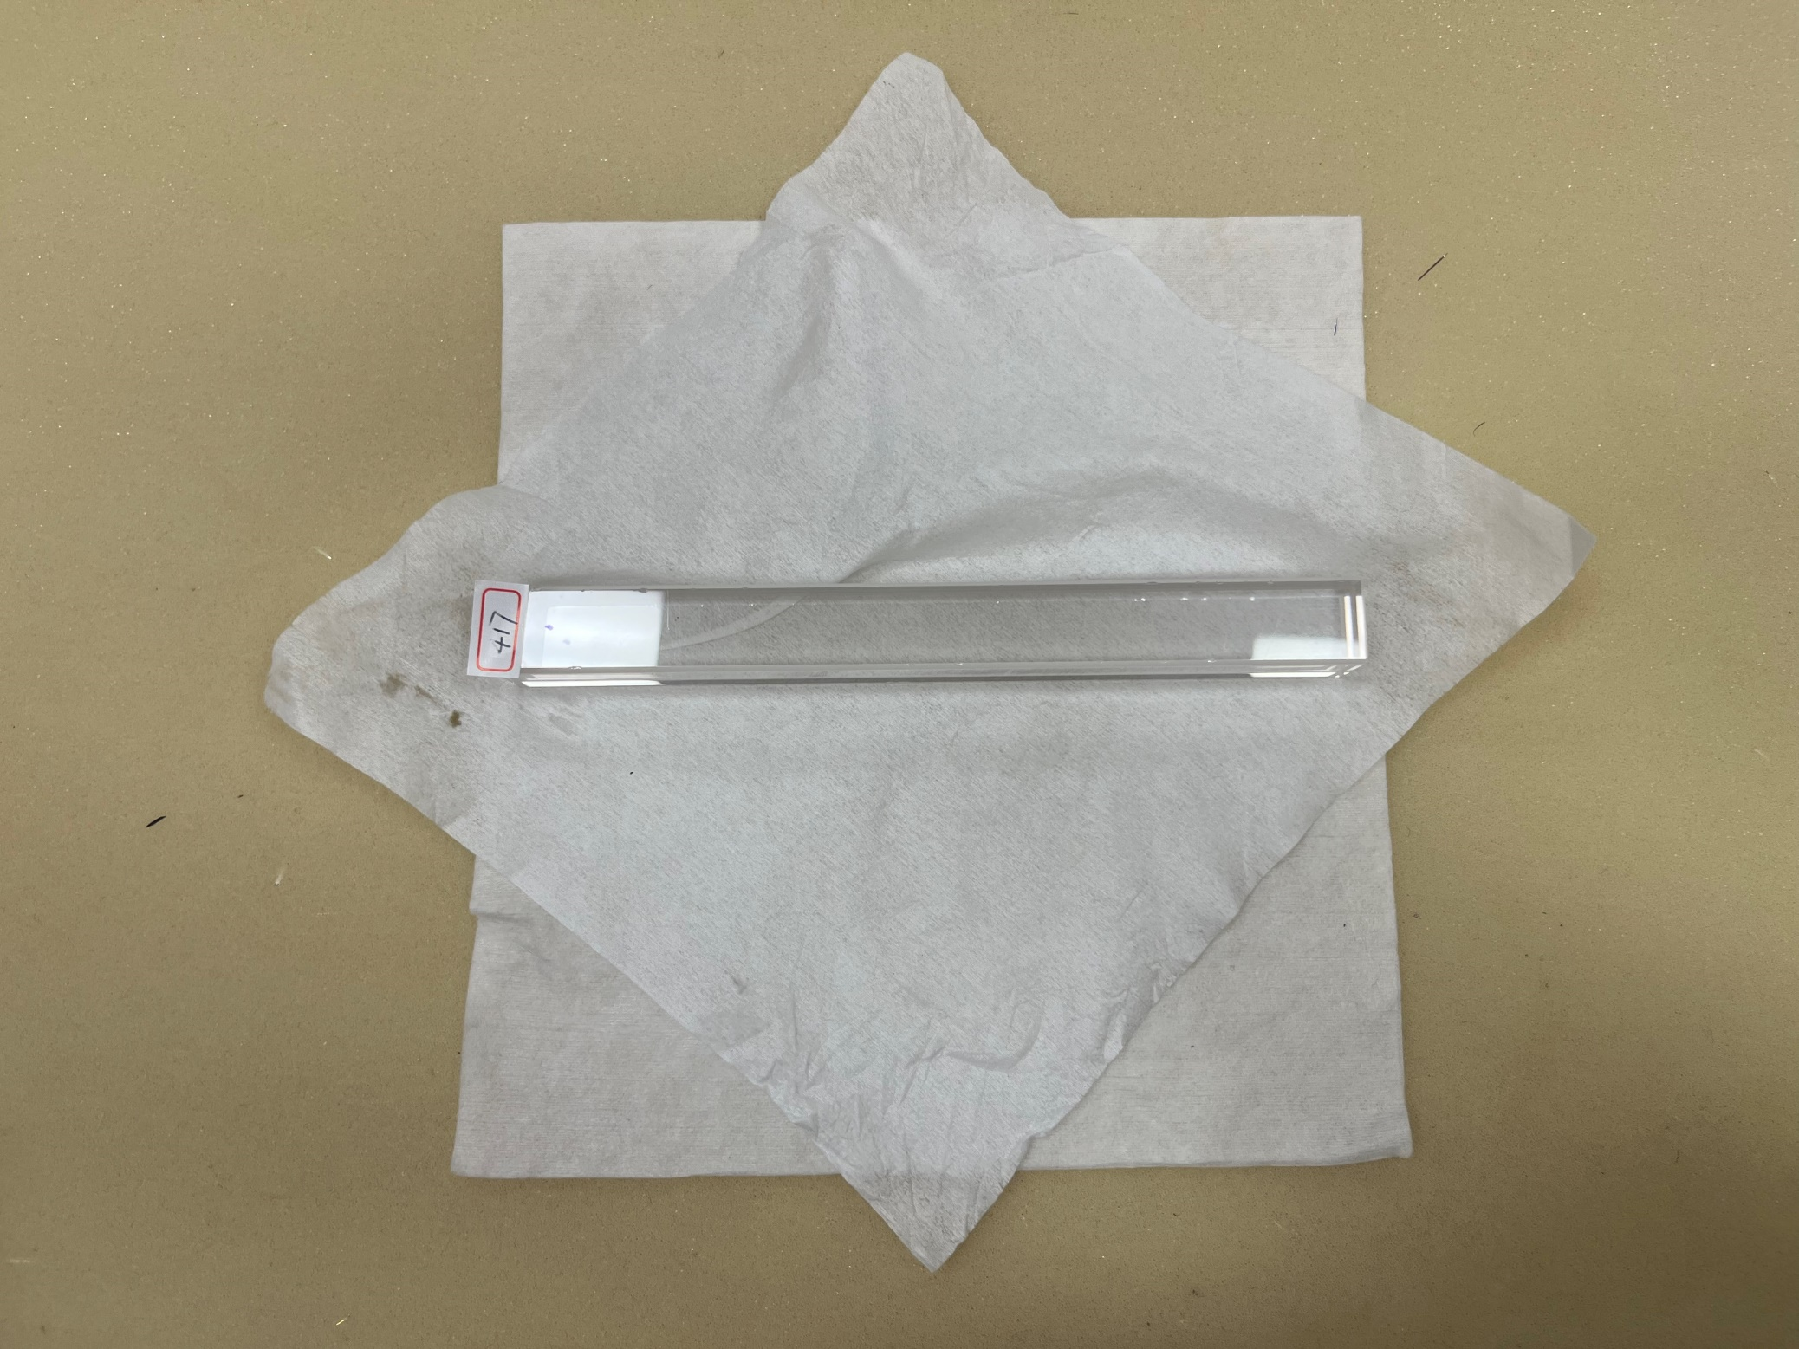
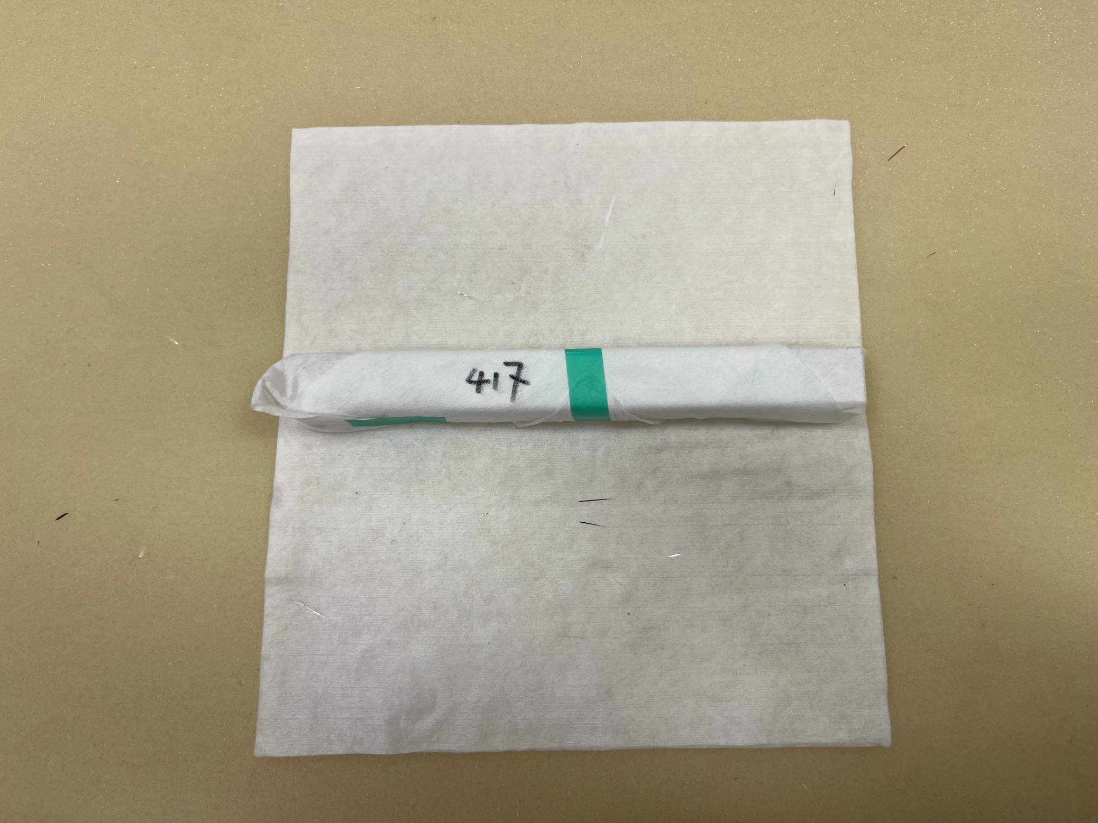
No. 417
Too many chips on chamfers
Scratches on faces
Big chamfers

Slide 10
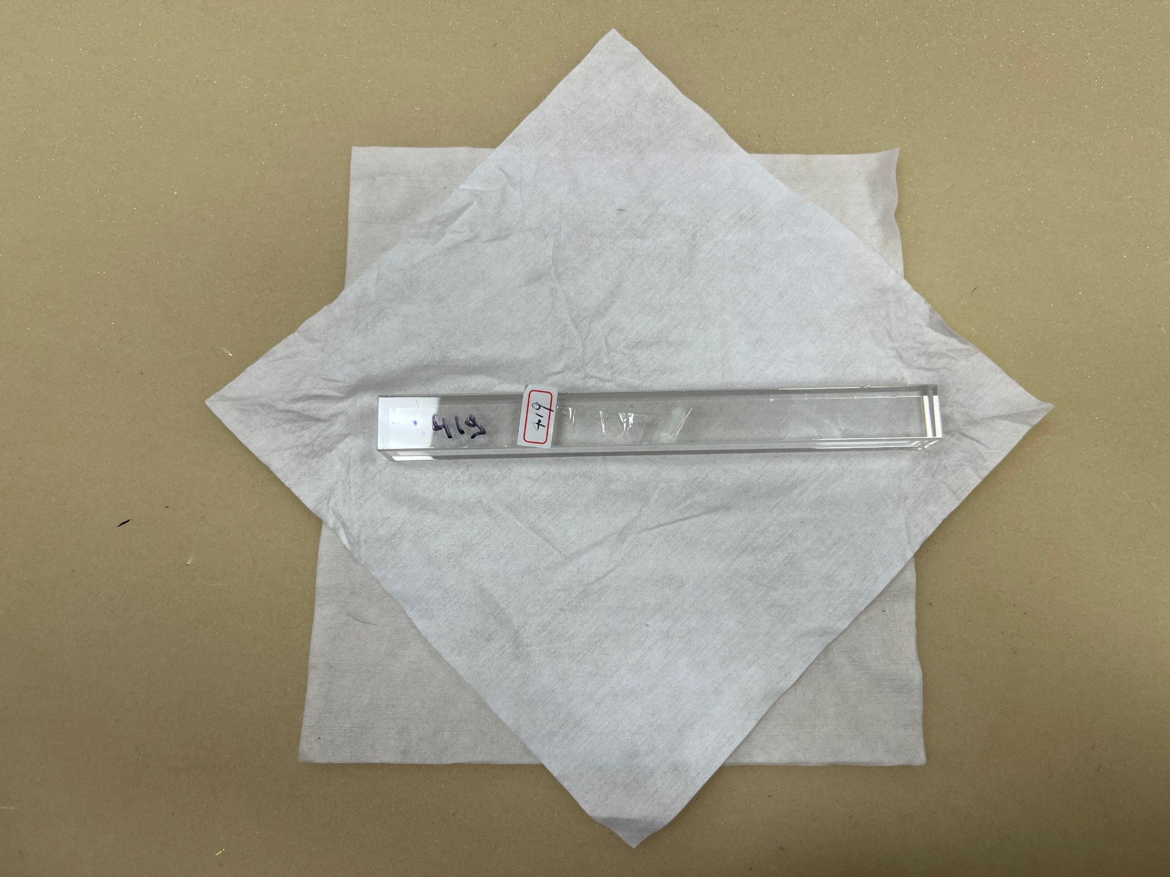
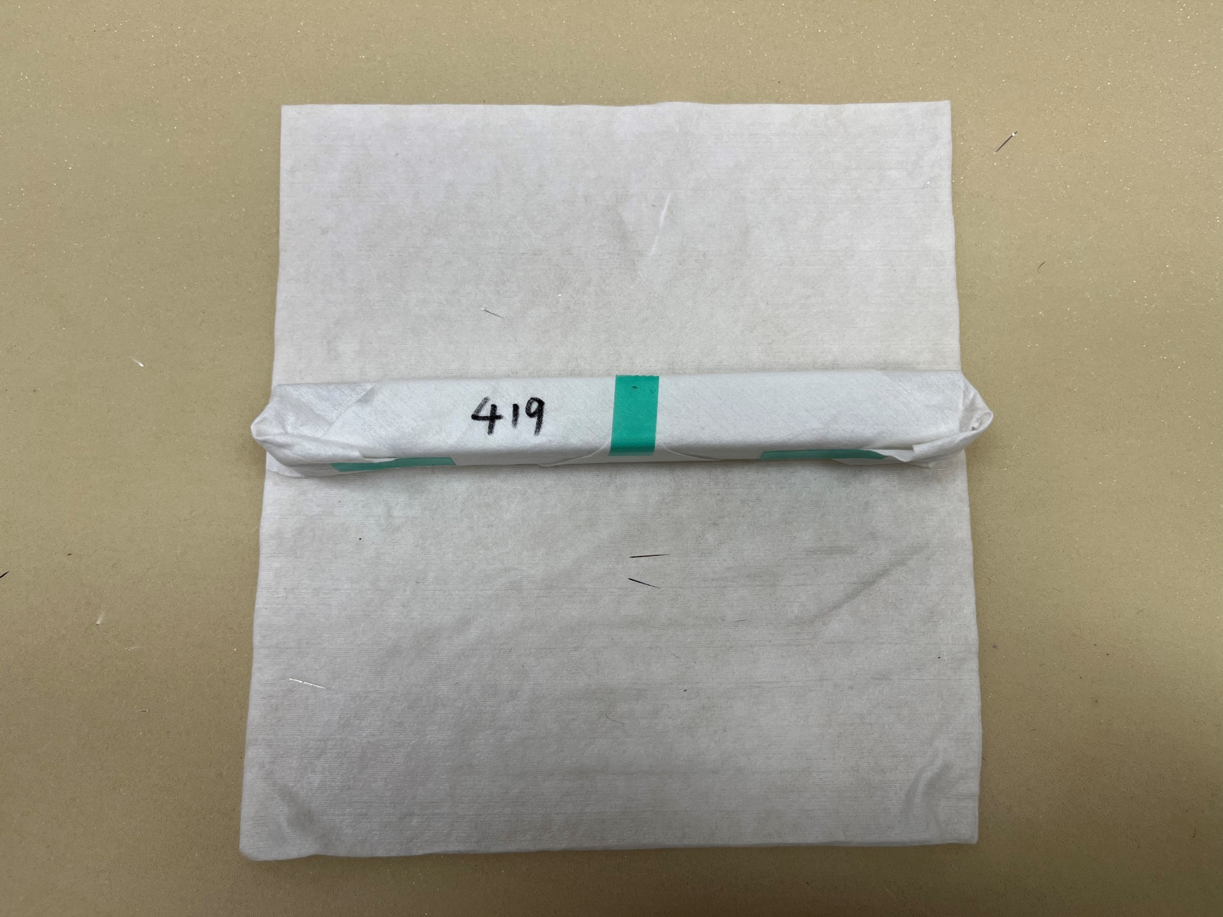
No. 419
Too many chips on chamfers
Scratches on faces
10

Slide 11
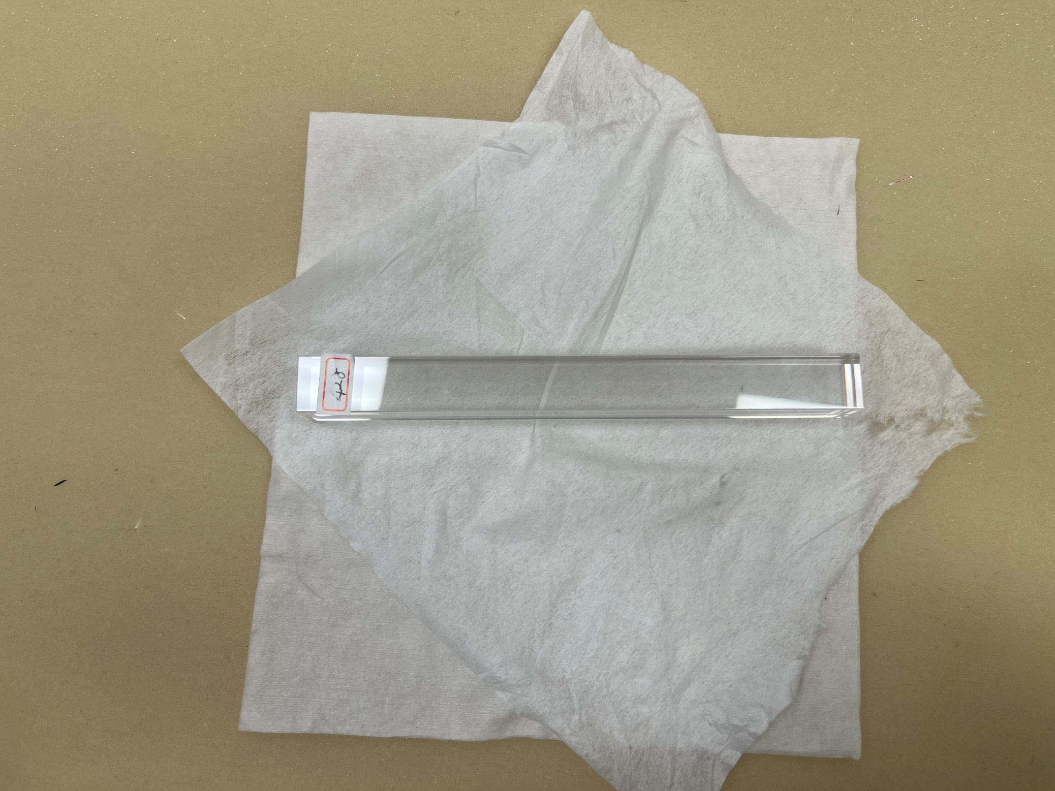
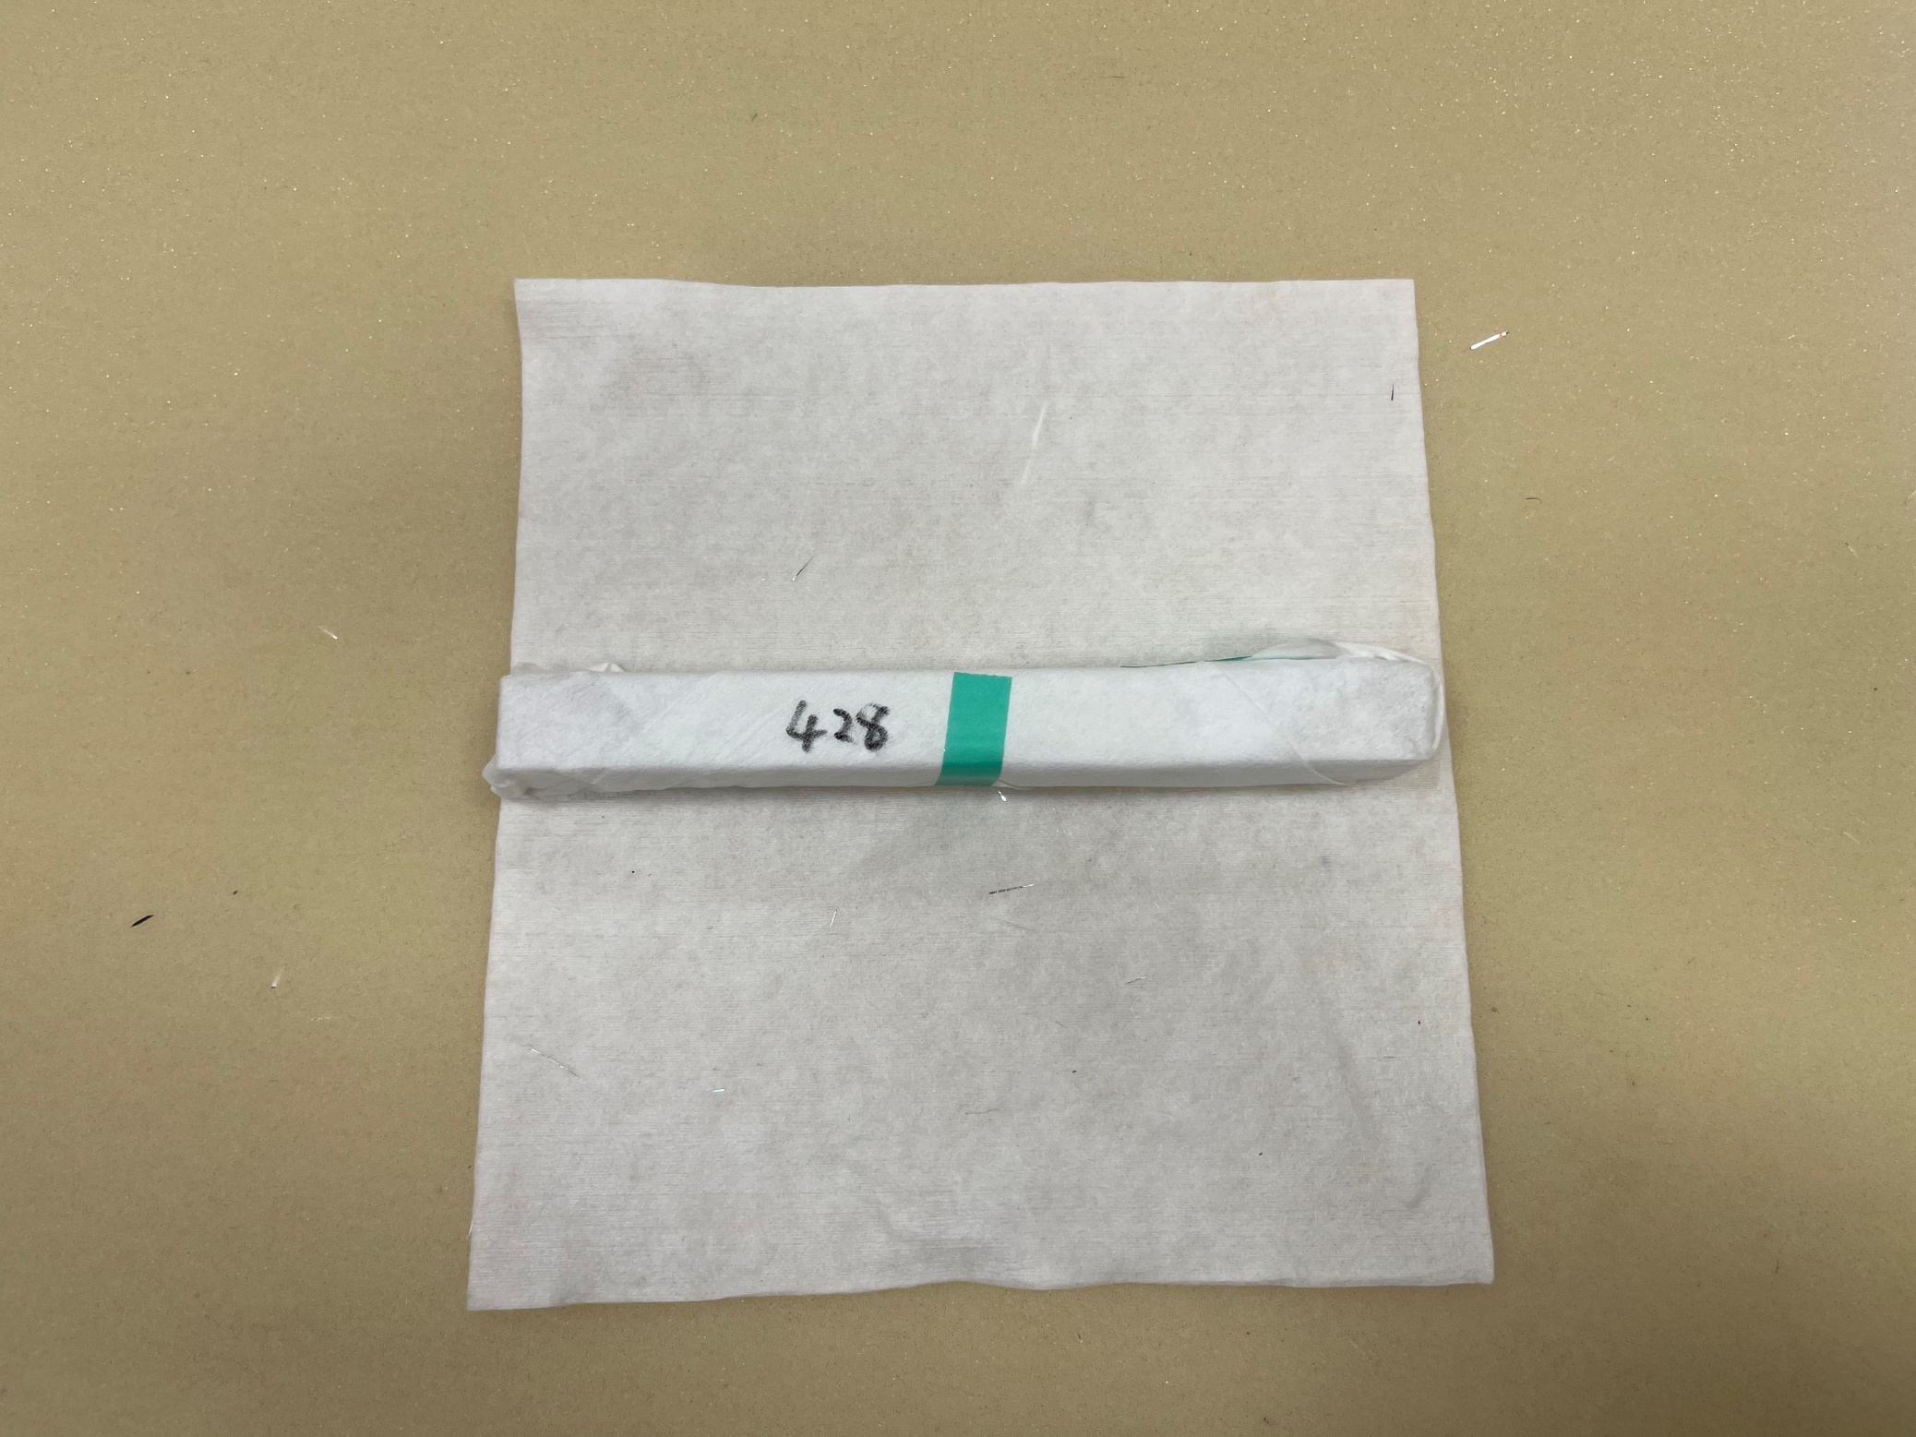
No. 428
Cloudy Region Inside
11

Slide 12
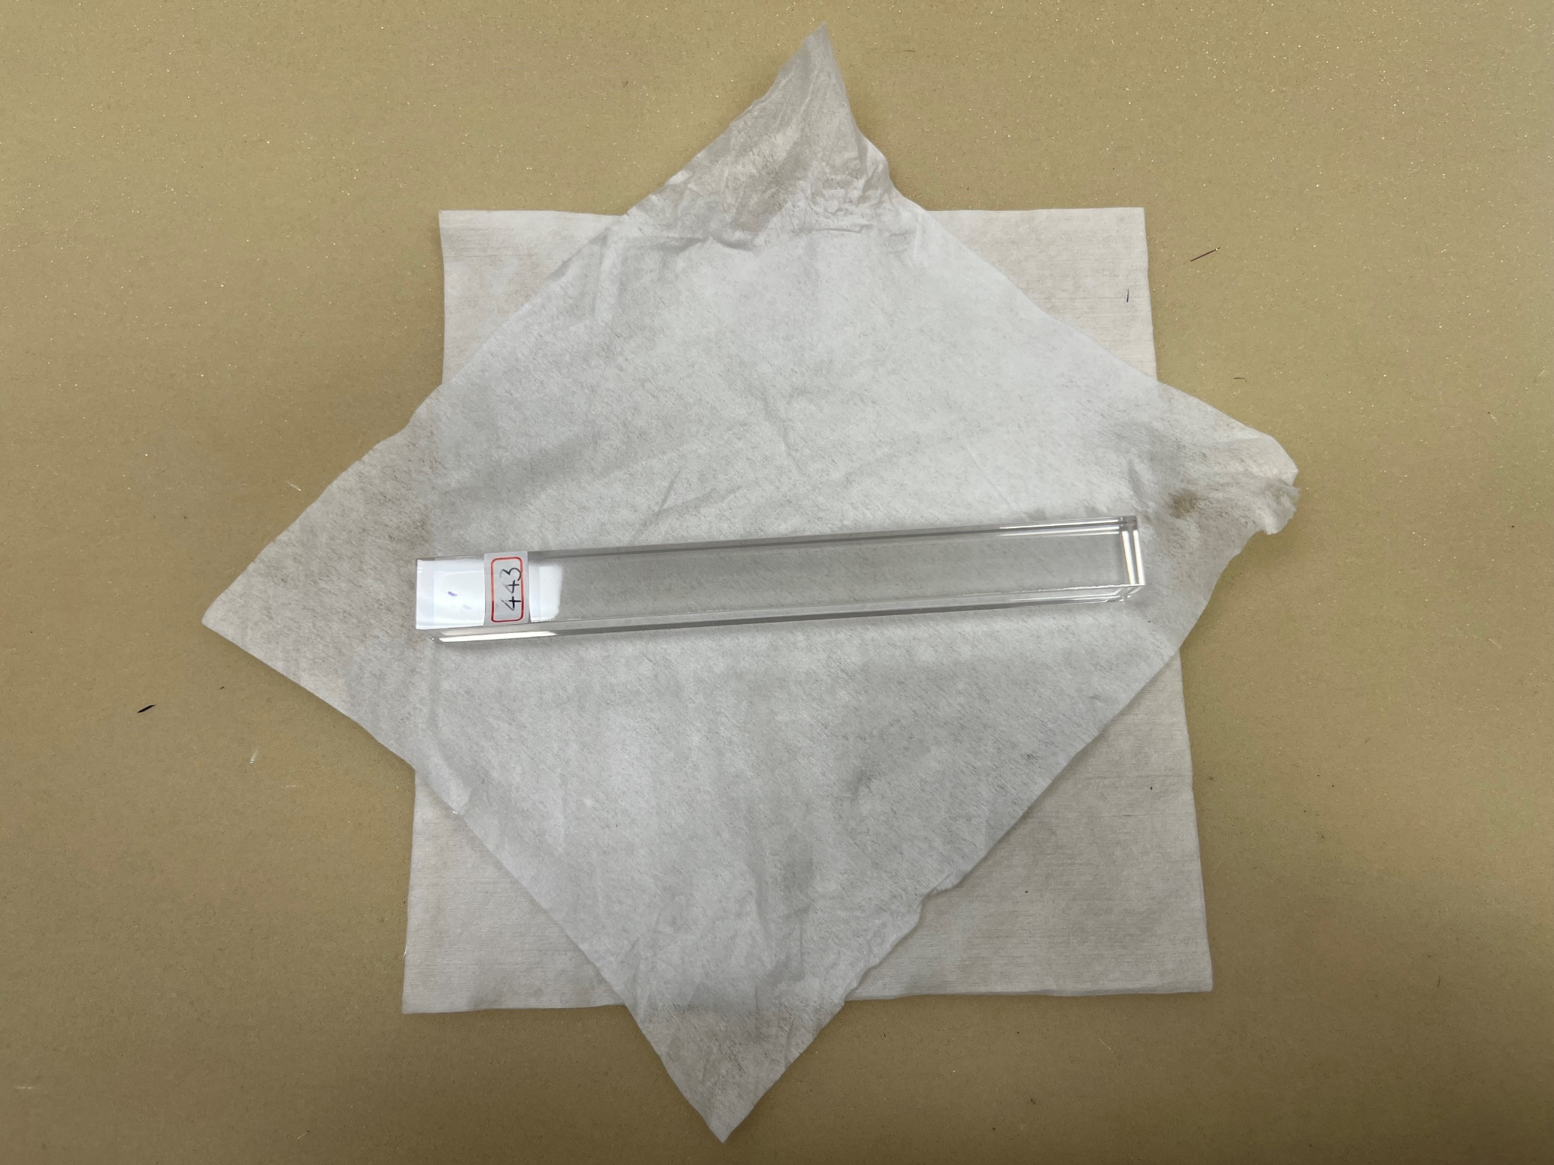
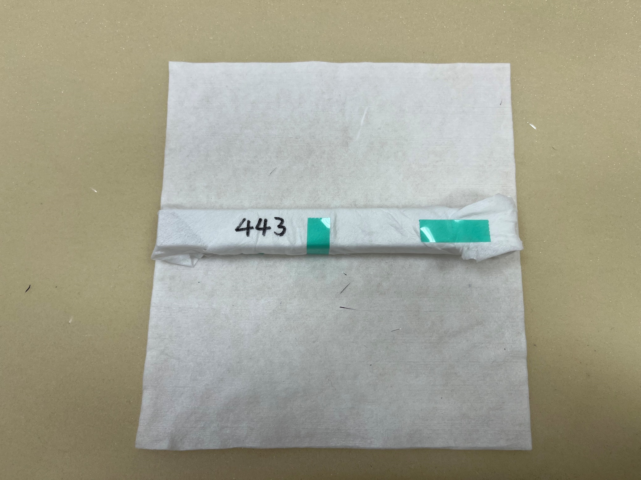
No. 443
Cloudy Layer Inside
12

Slide 13
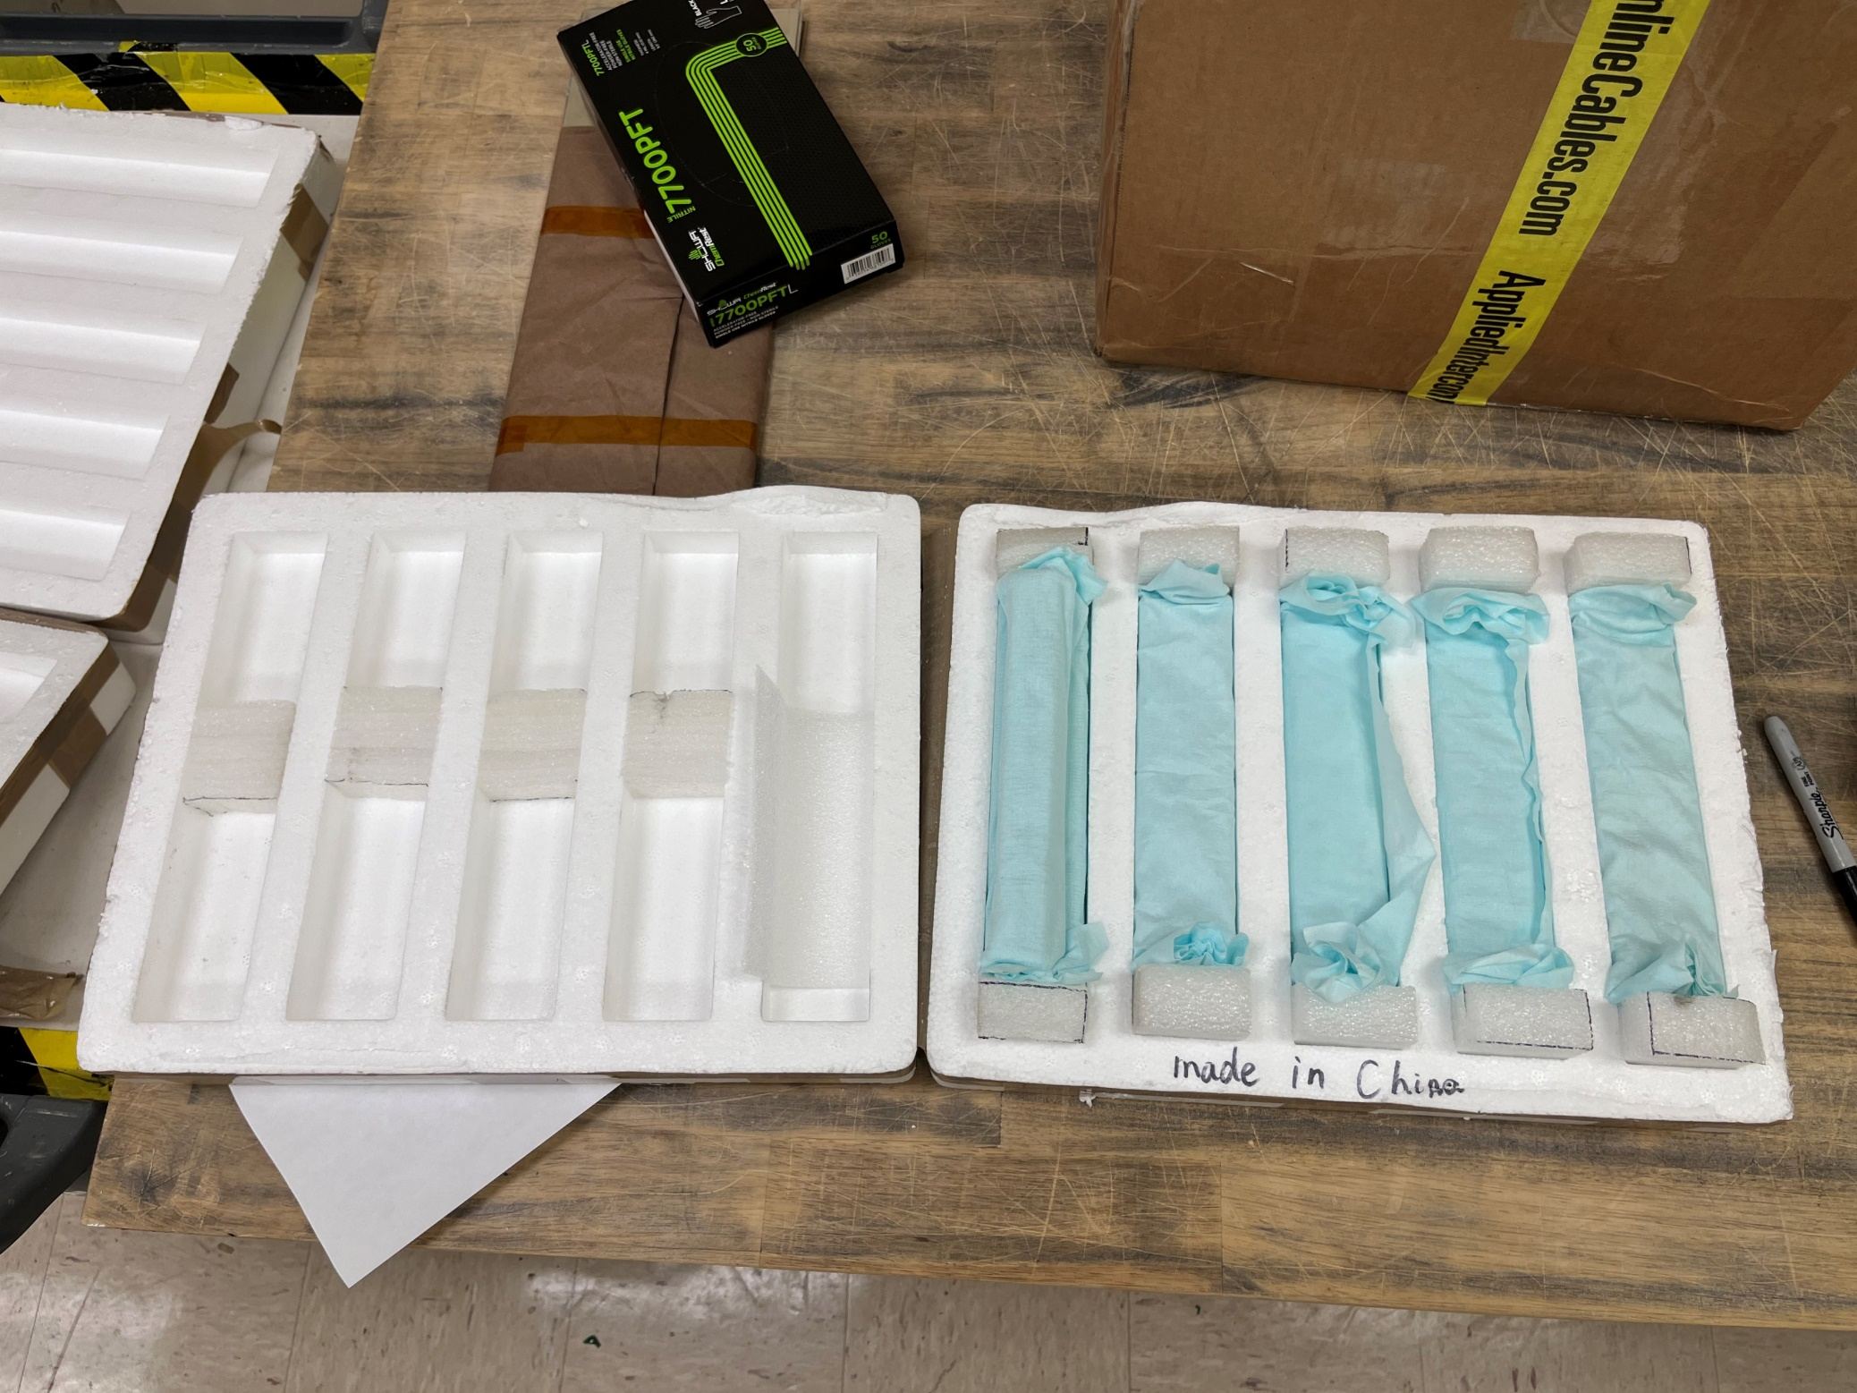
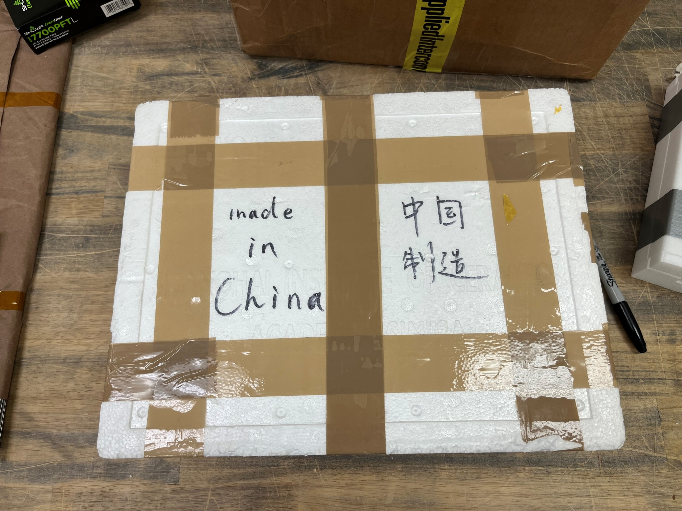
Final Look
13

