Slide 1
Crystal Quality Test (70 crystals recently received from SICCAS)
A. Somov, V. Berdnikov, H. Voskanyan, A. Asaturyan, A. Liu, B. Liu
September 22, 2023
1

Slide 2
Overview
19 problematic crystals in total
11 of them shown here
Main problems
- unpolished faces
- big chips inside the crystals
- big chips on face
- too many chips on chamfers
- cloudy region inside
- big chamfers & scratches on face
2

Slide 3
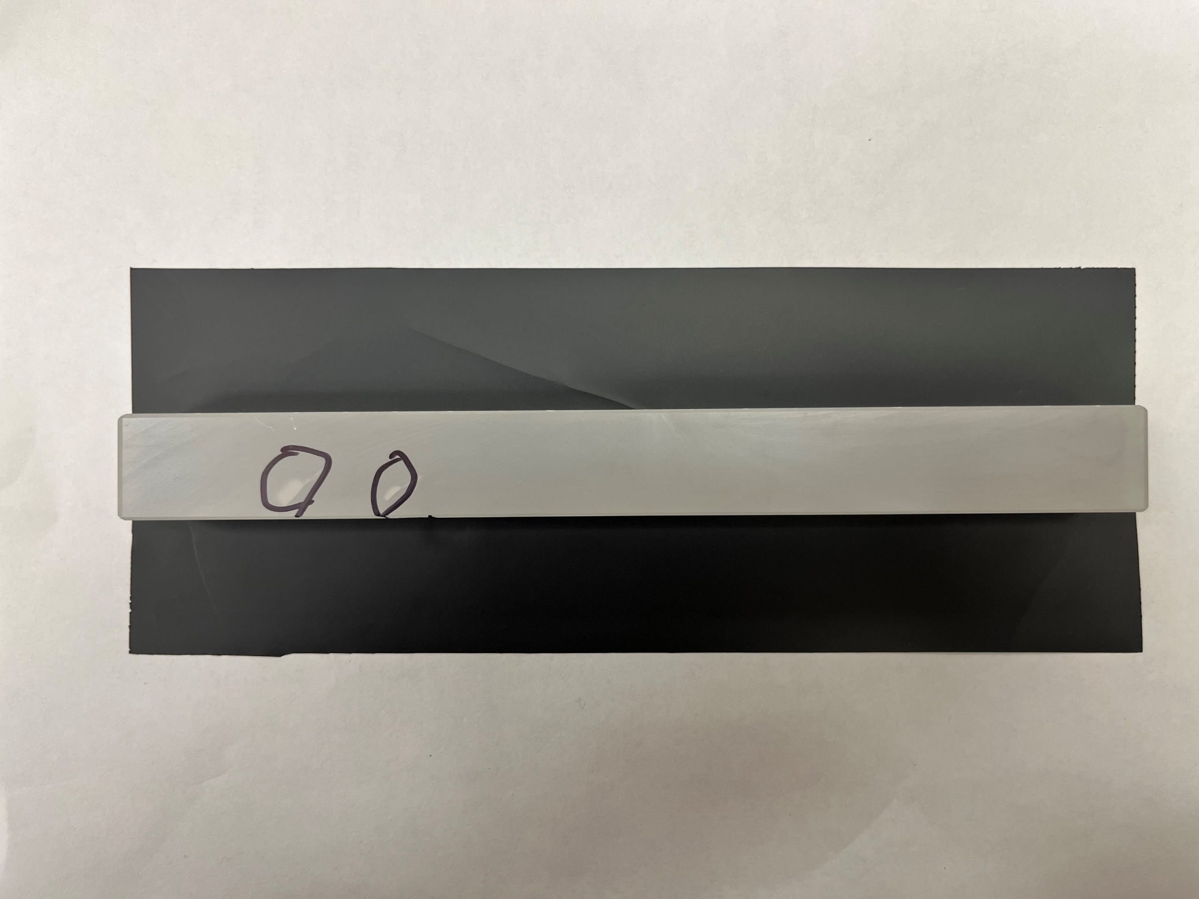
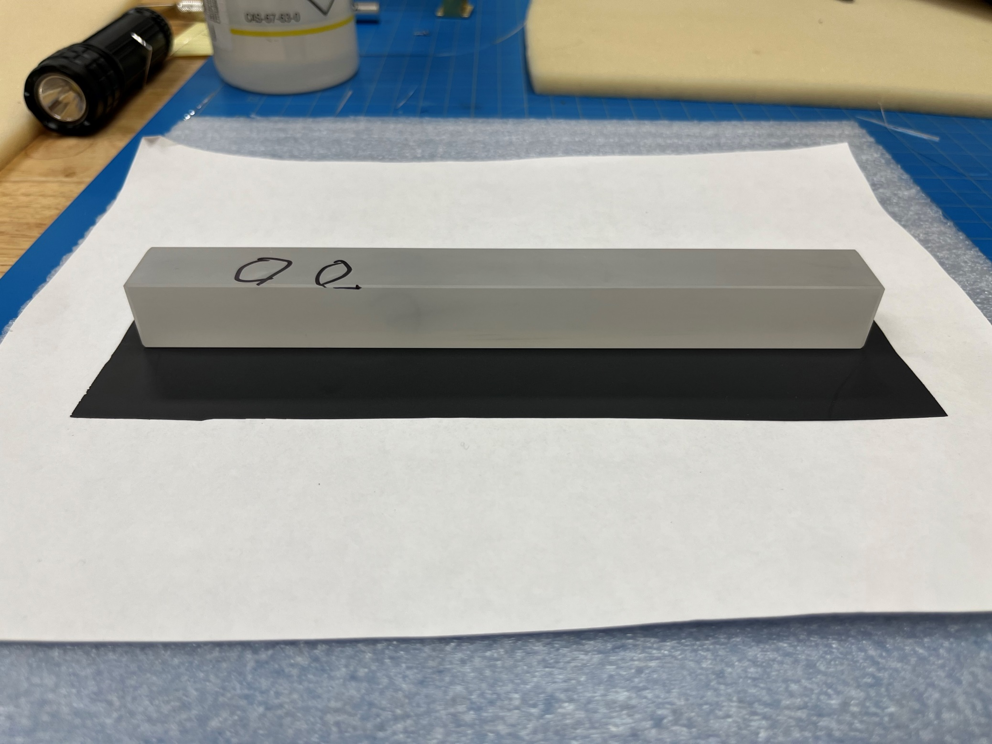
Unpolished-1
All Faces Unpolished
Chips inside
3

Slide 4
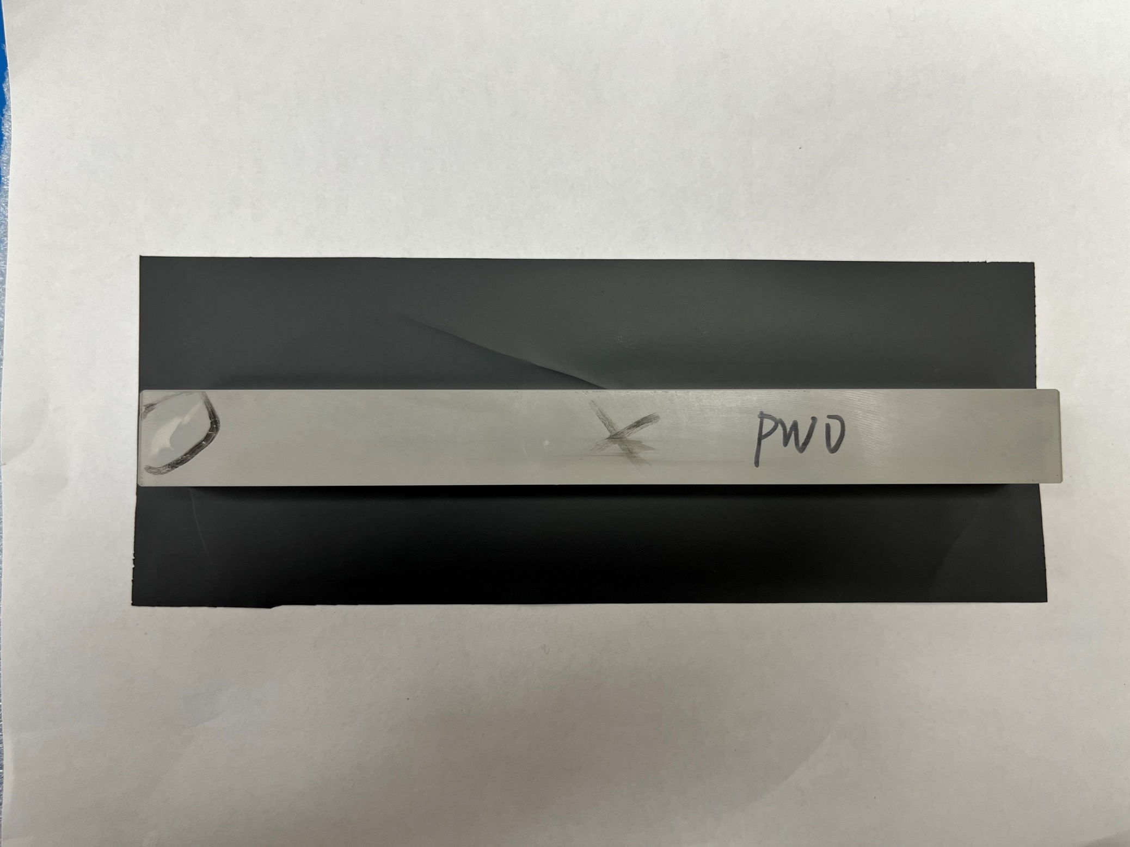
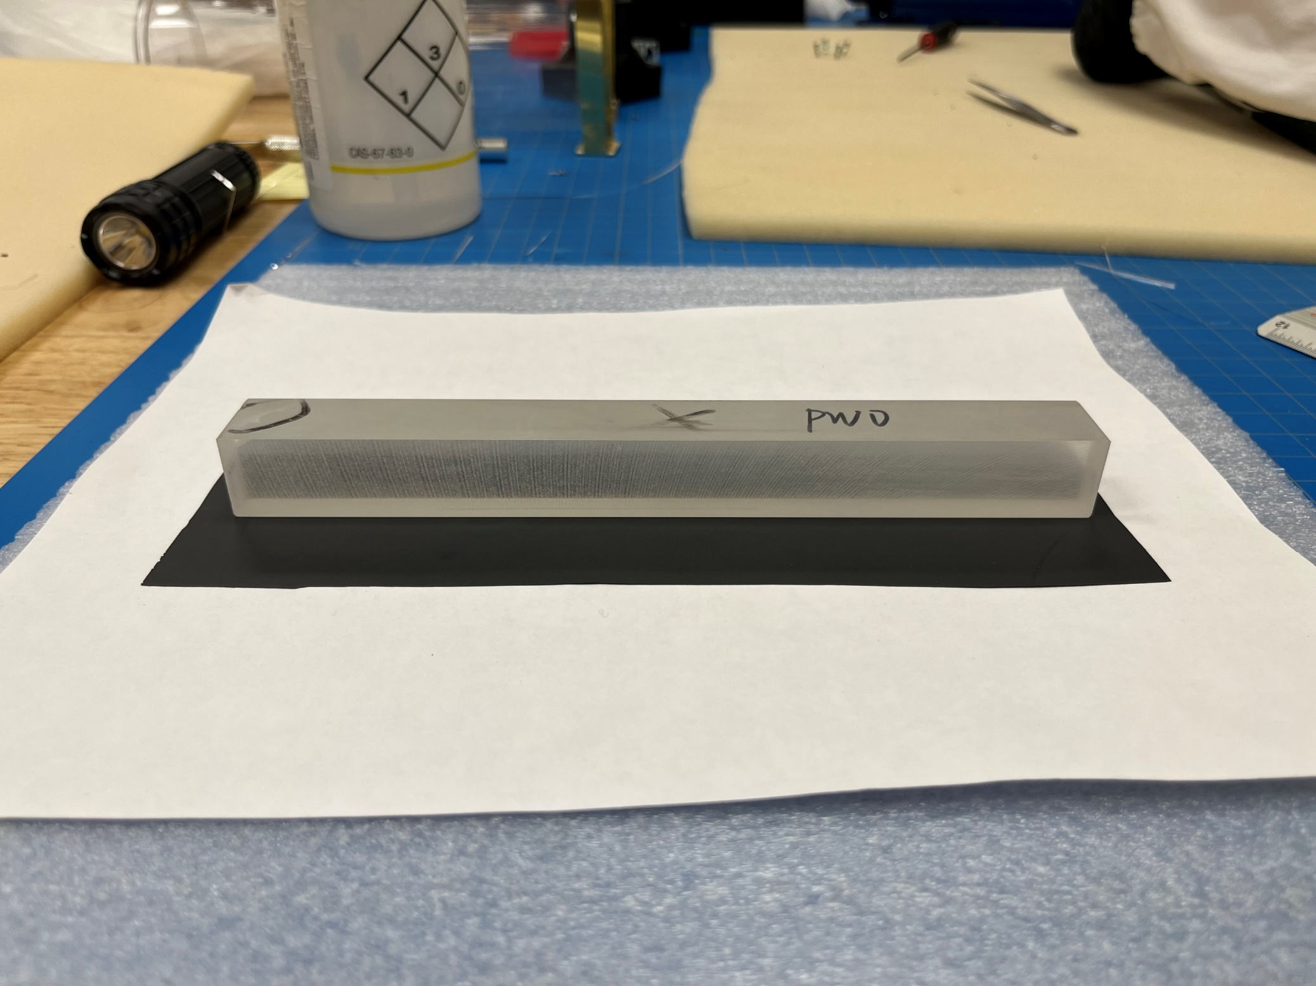
Unpolished-2
All Faces Unpolished
Chips inside
4

Slide 5
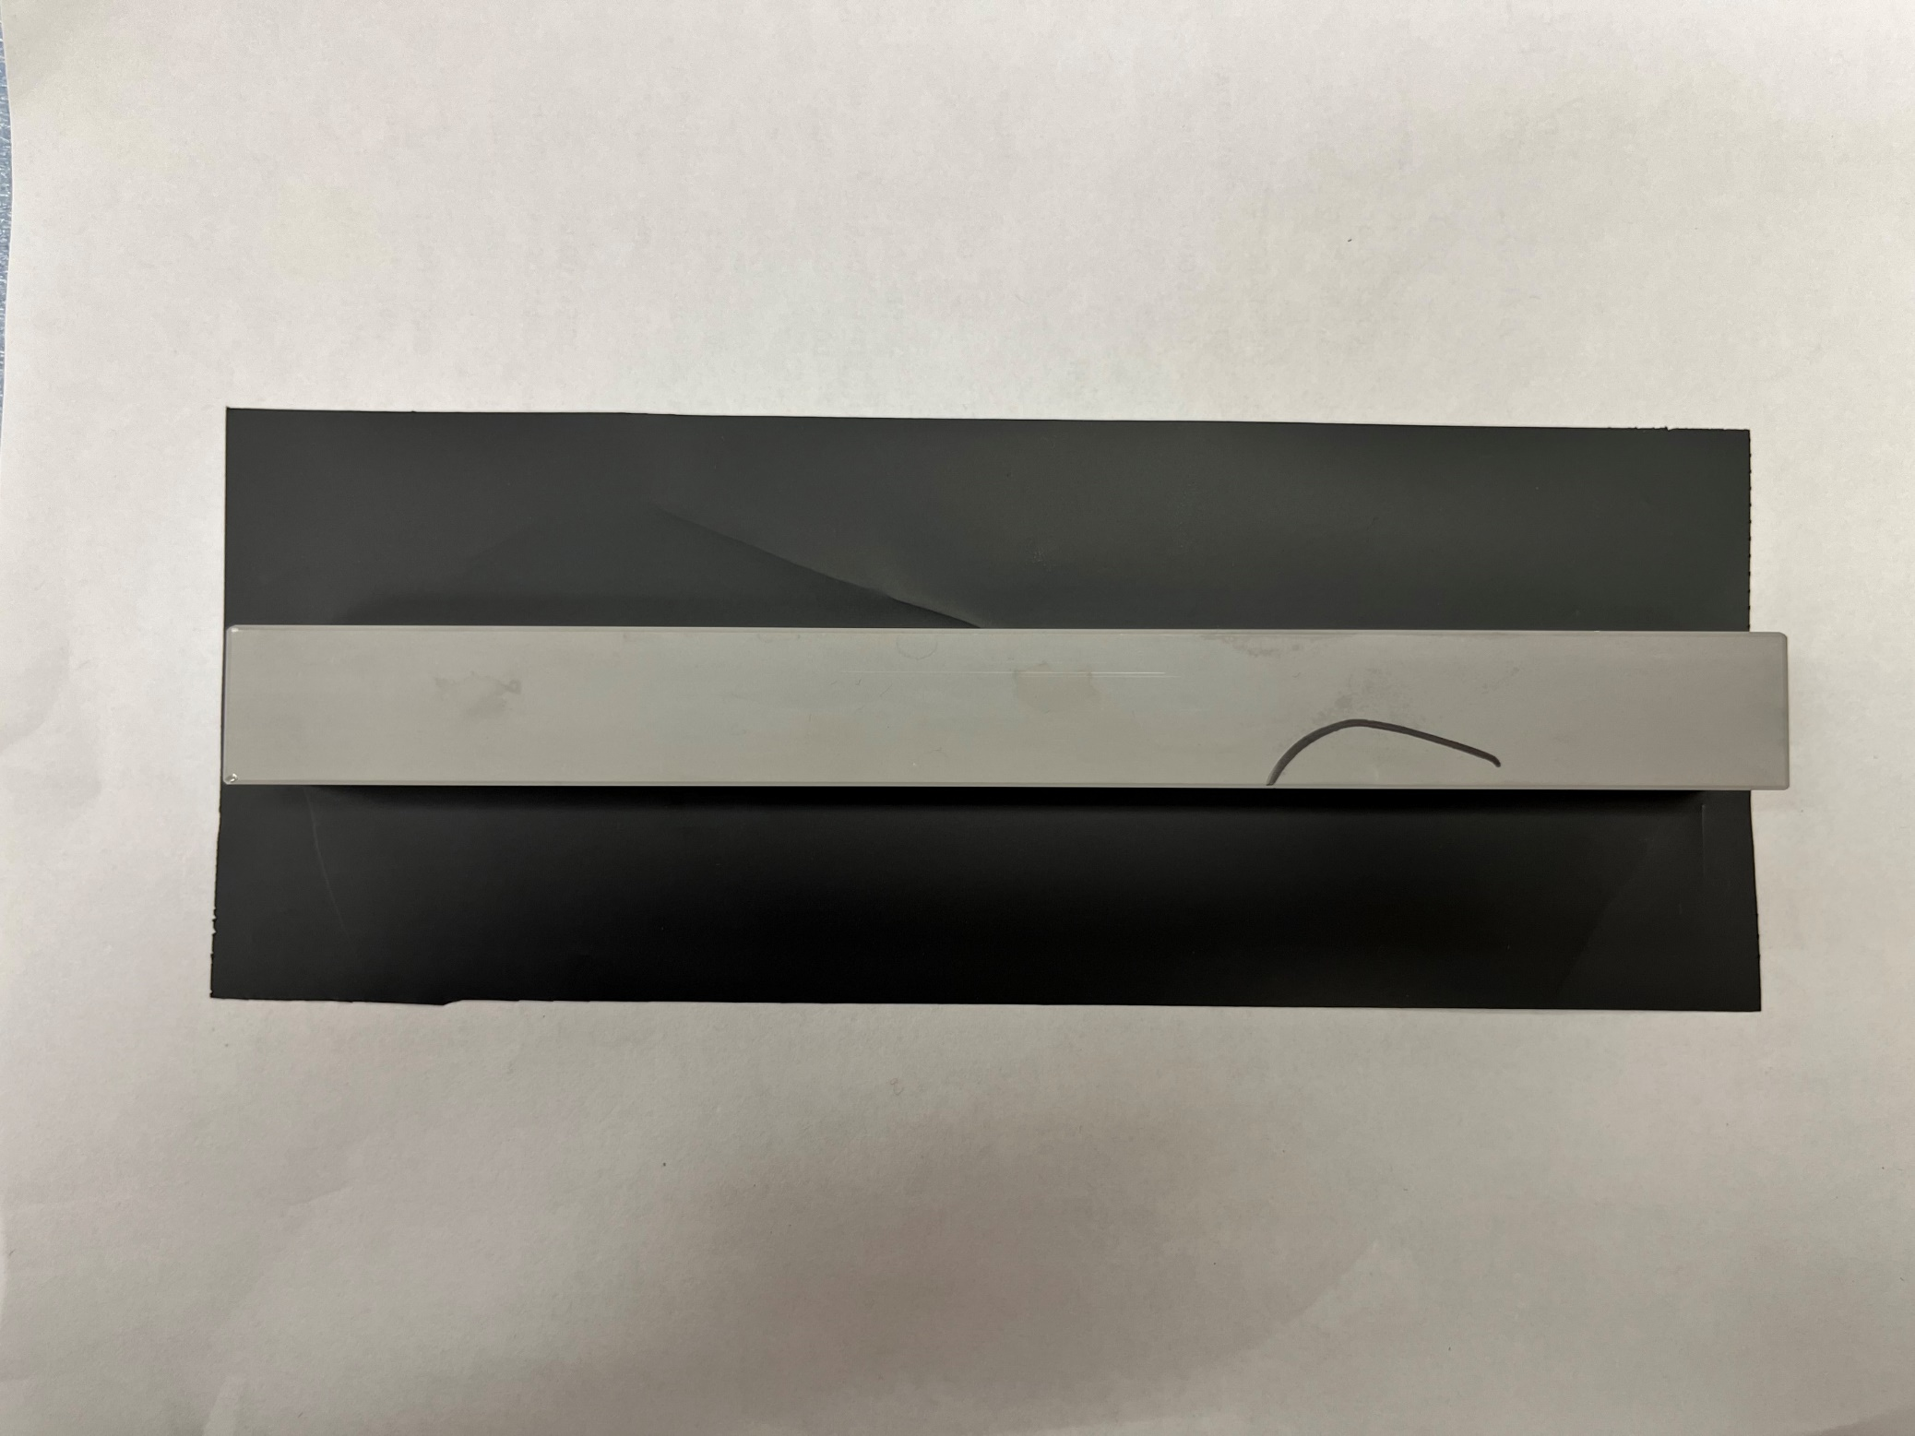
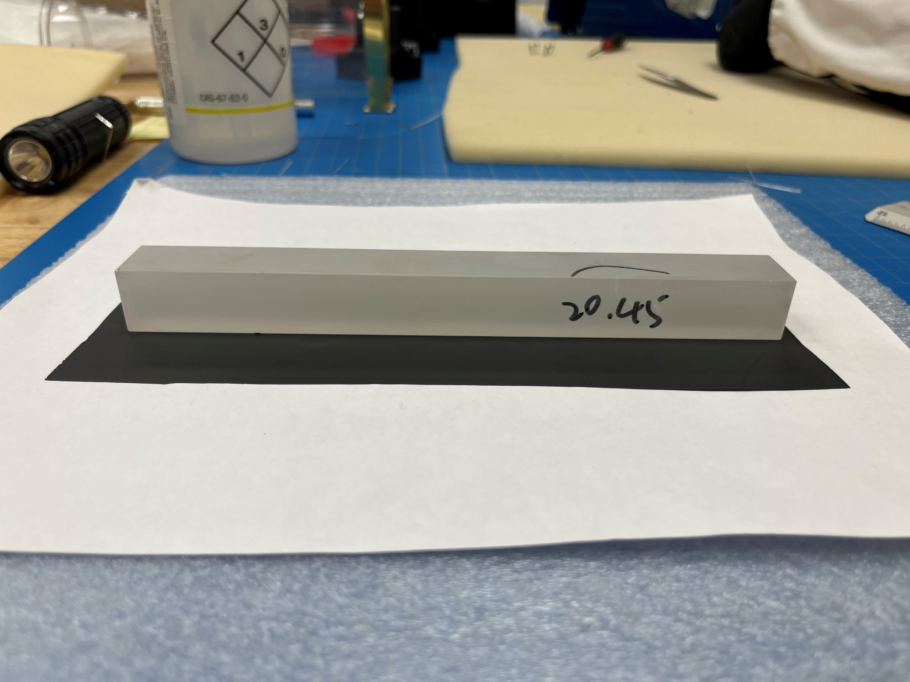
Unpolished-3
All Faces Unpolished
Chips inside
5

Slide 6
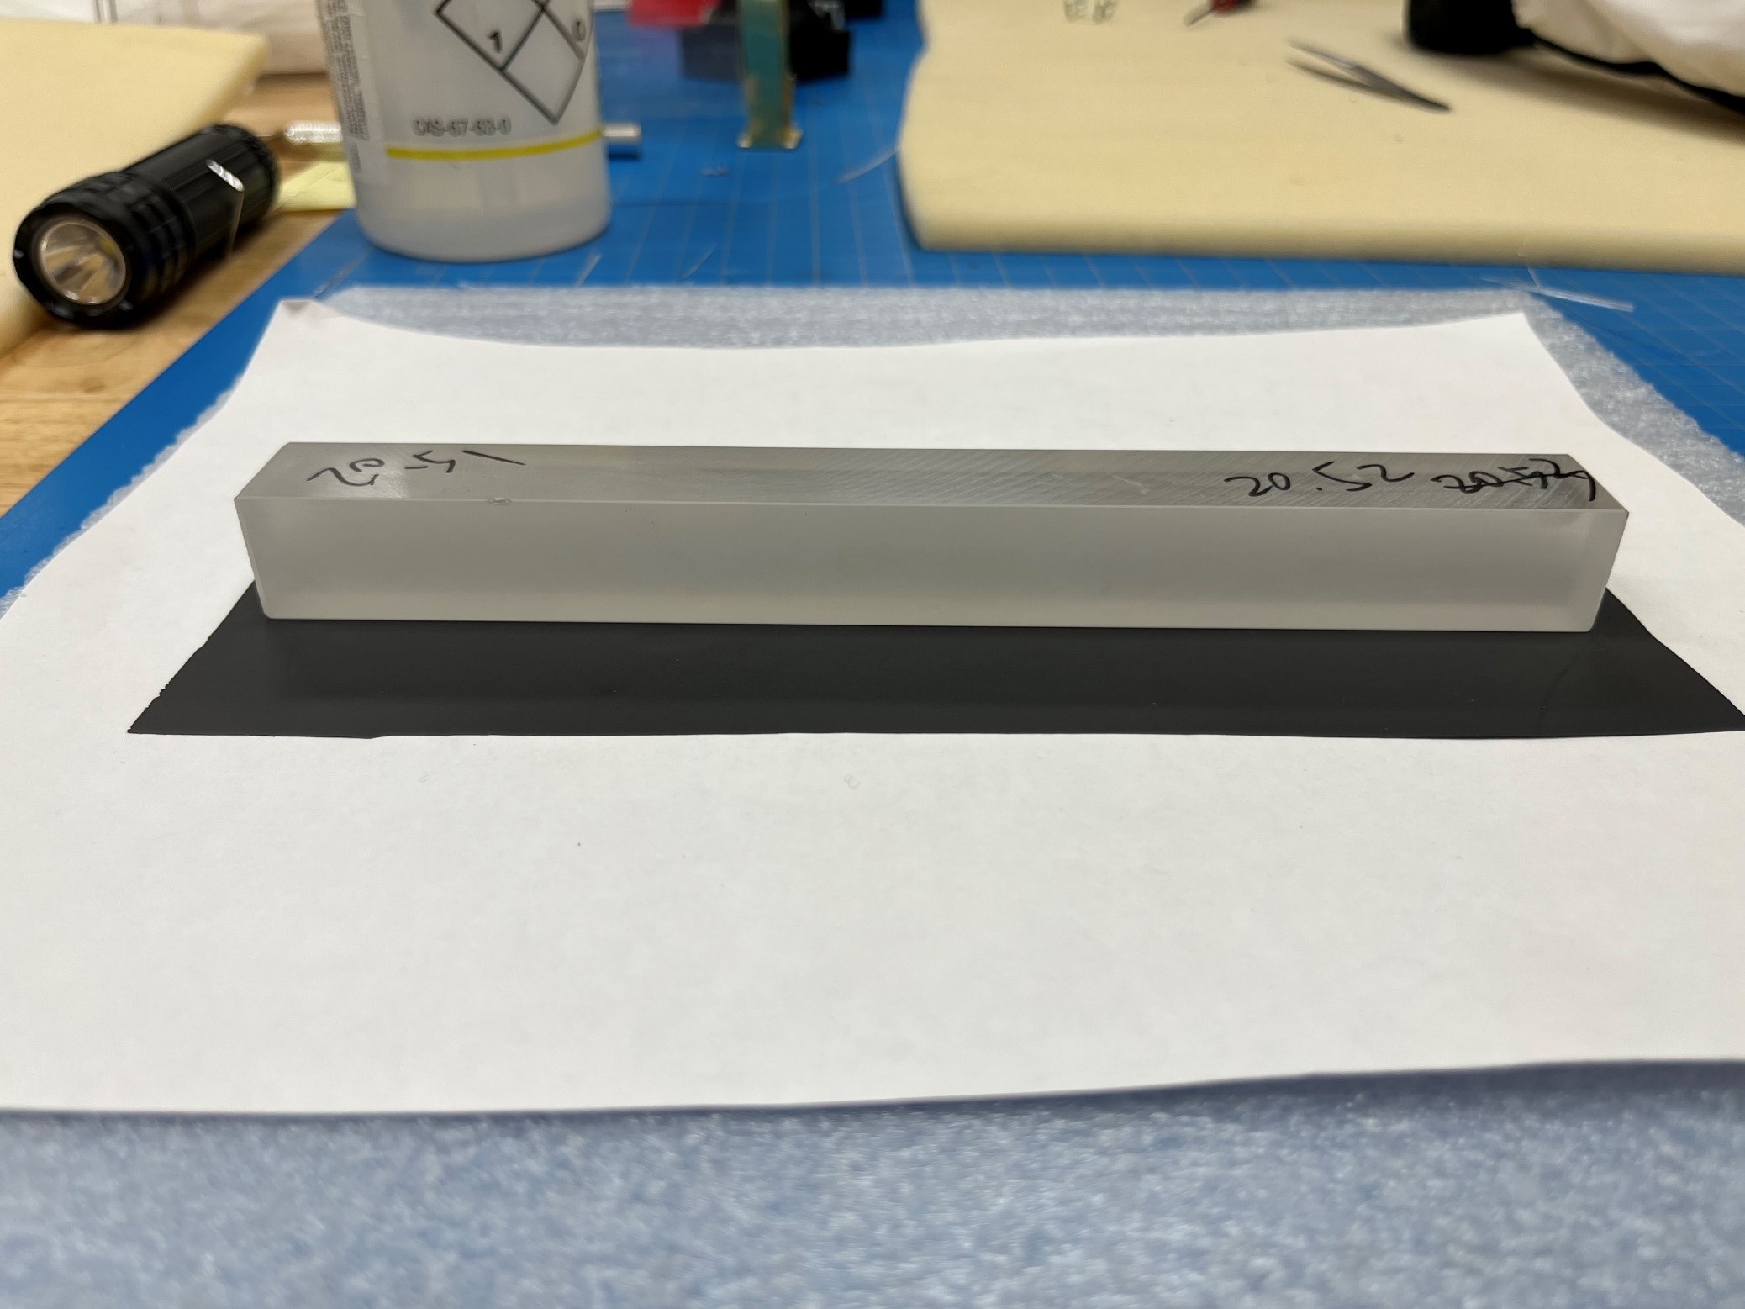
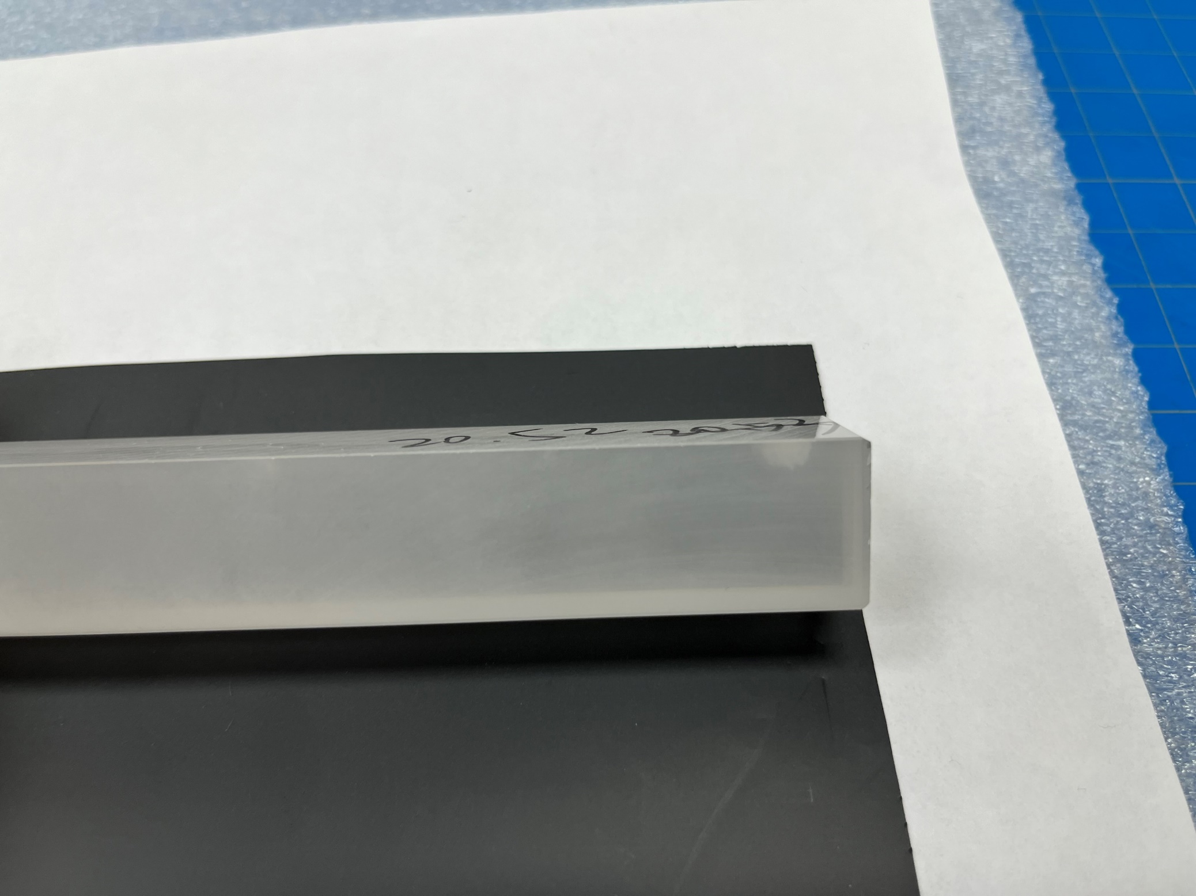
Unpolished-4
All Faces Unpolished
Chips inside and on chamfers
6

Slide 7
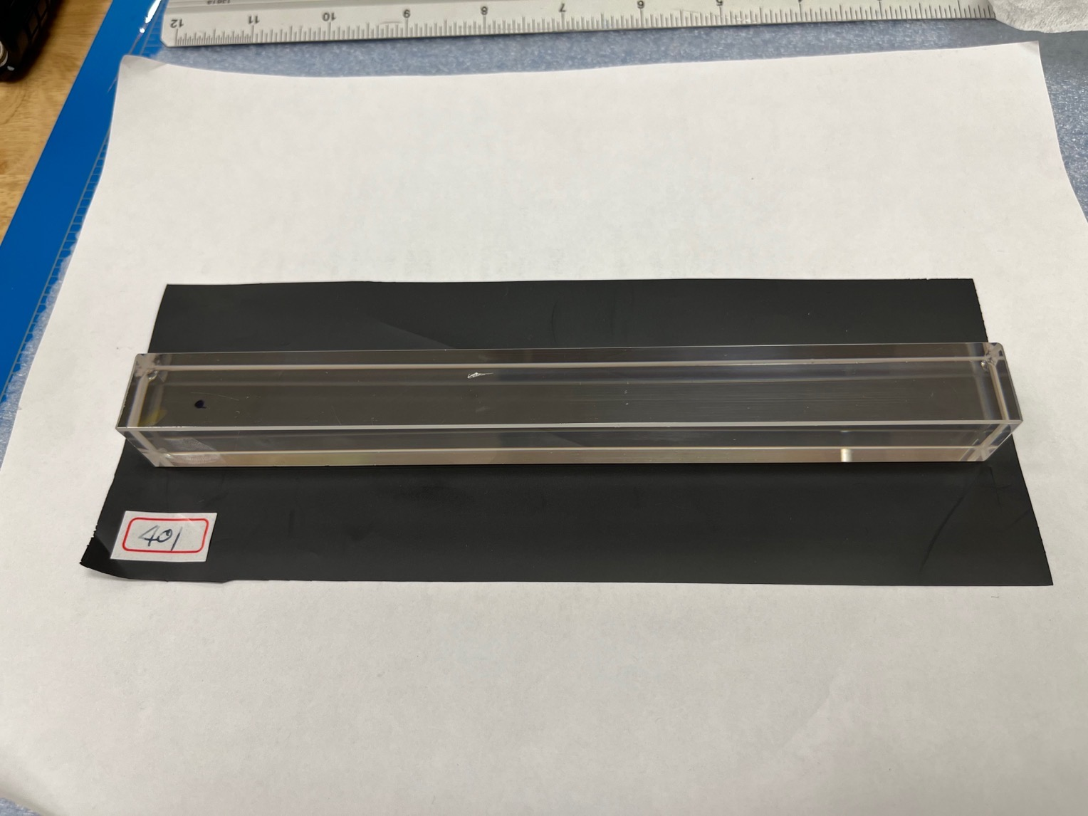
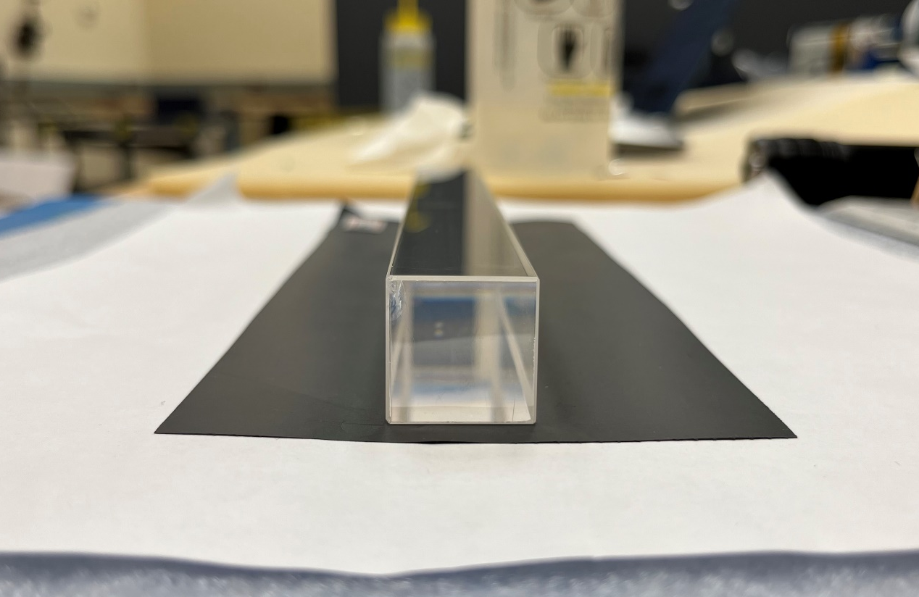
No. 401
Big chips (~ 5 mm) on faces
Scratch
7

Slide 8
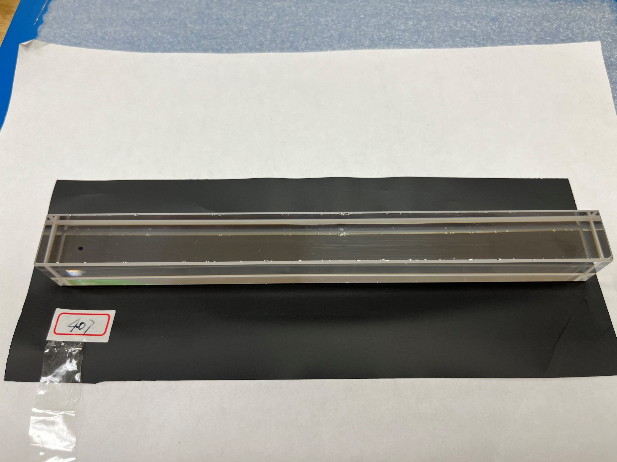
No. 407
Too many chips on chamfers
(more than 30)
8

Slide 9
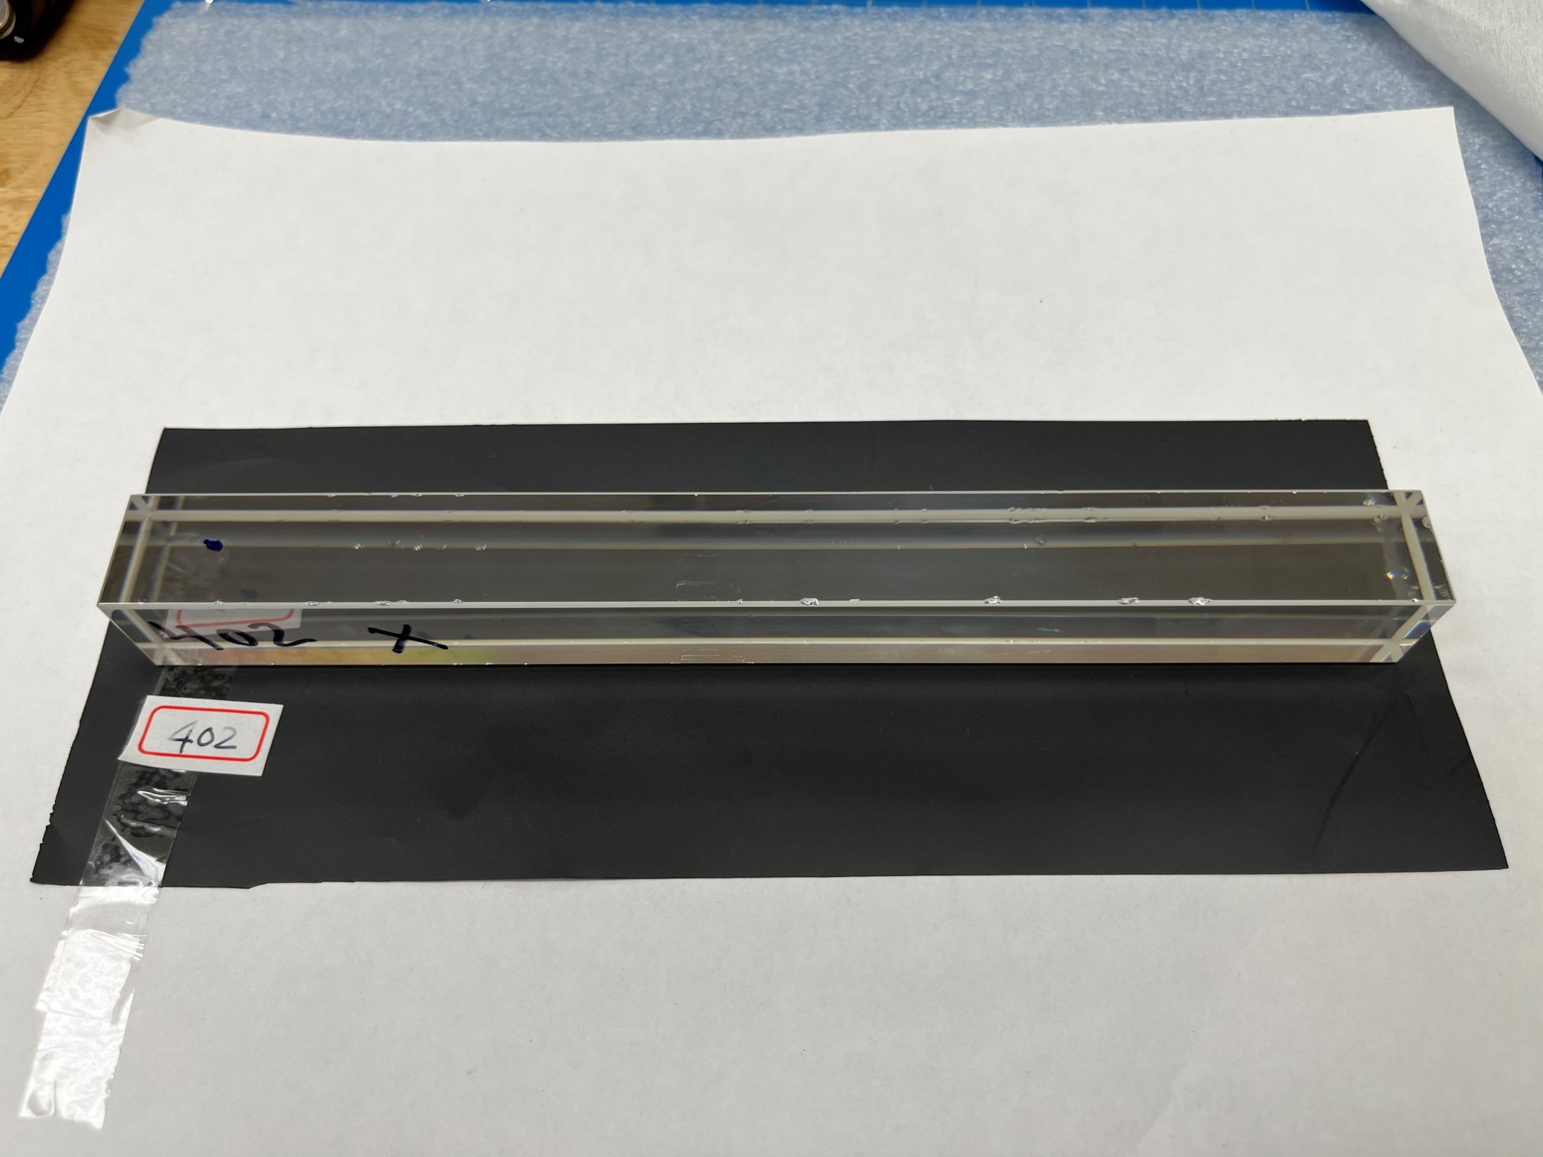
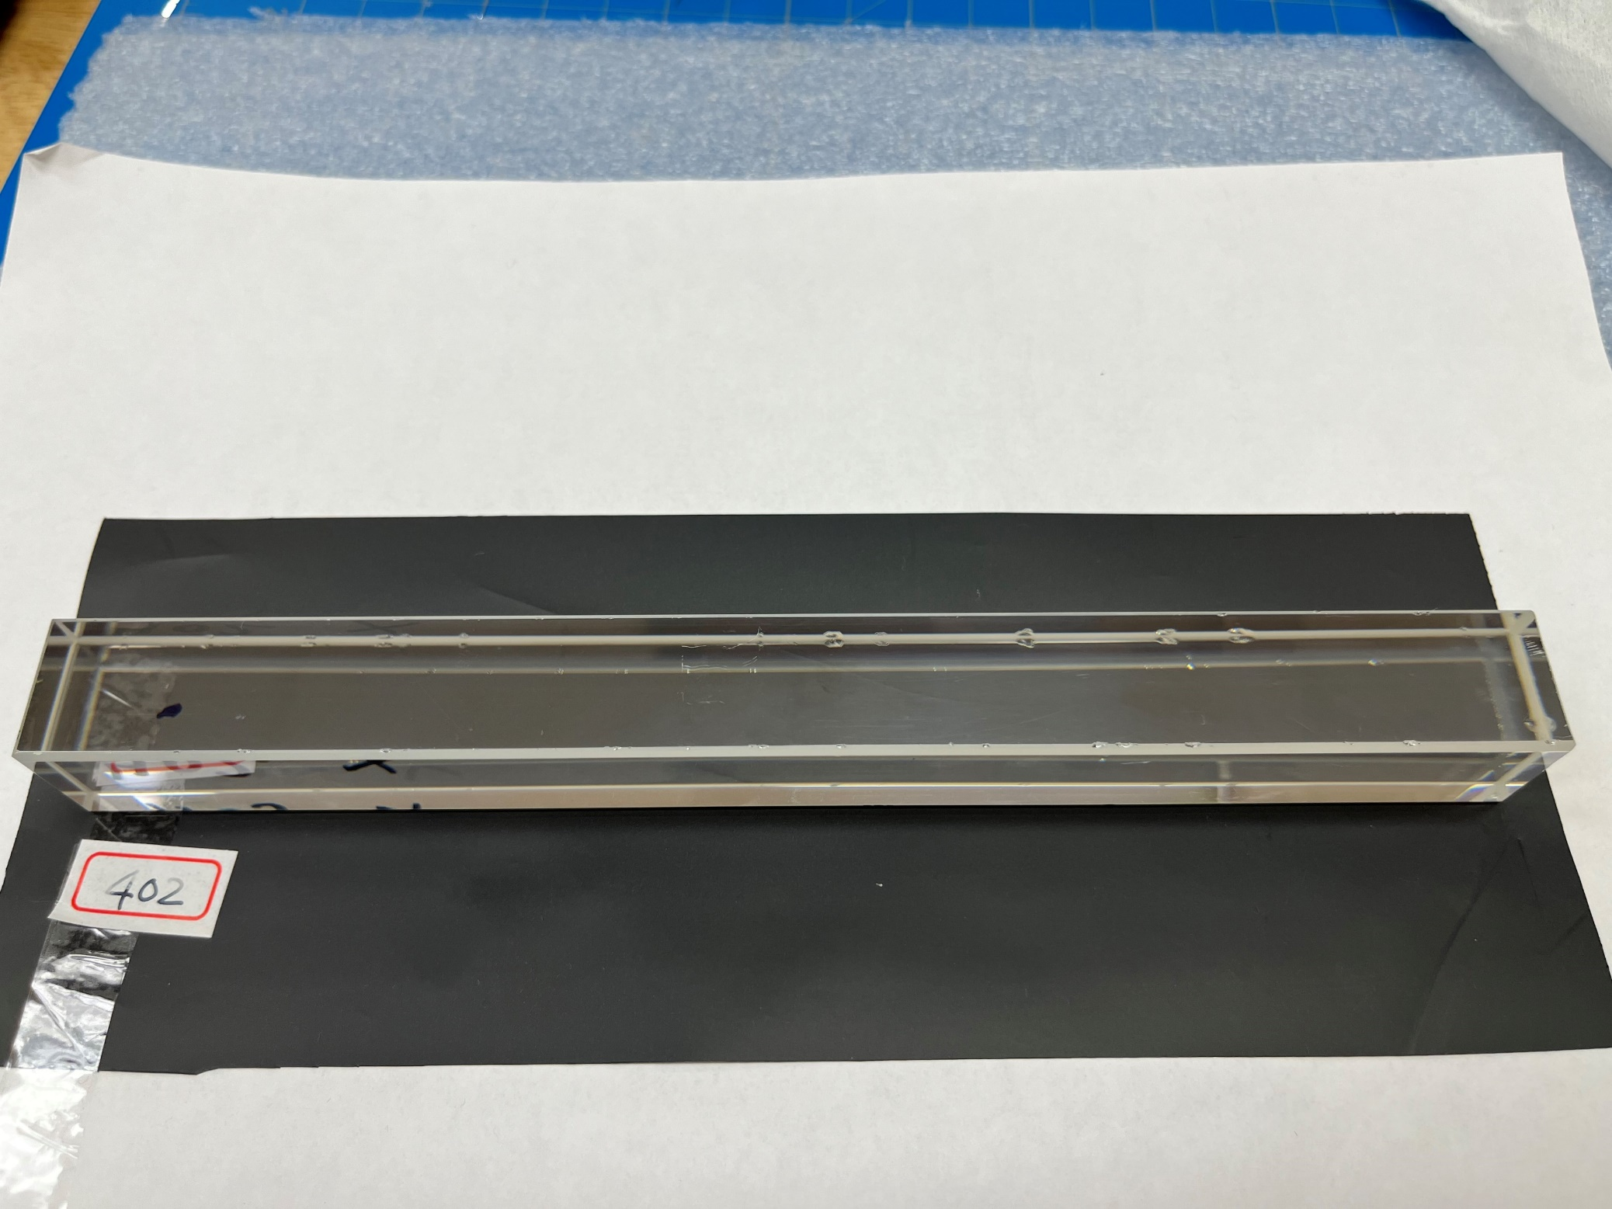
No. 402
Too many chips on chamfers
(the same as in 407)
9

Slide 10
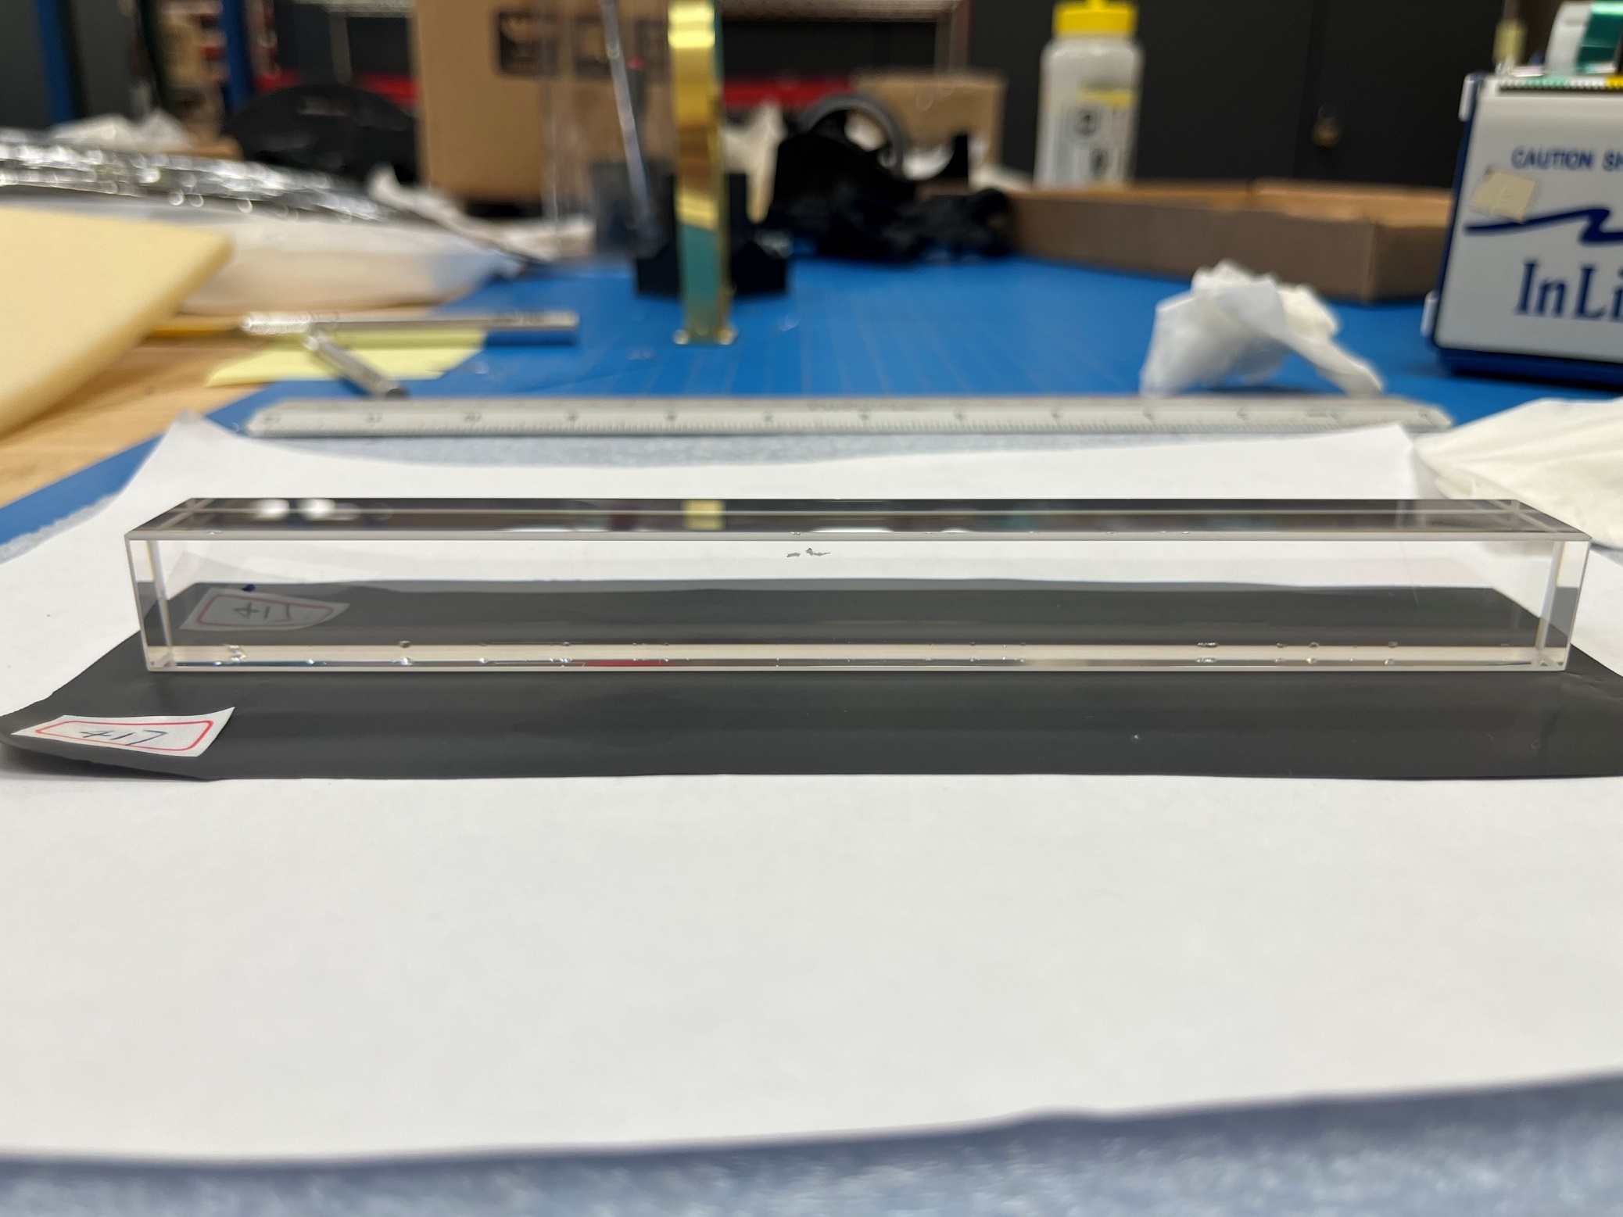
No. 417
Too many chips on chamfers
Scratches on faces
Big chamfers
10

Slide 11
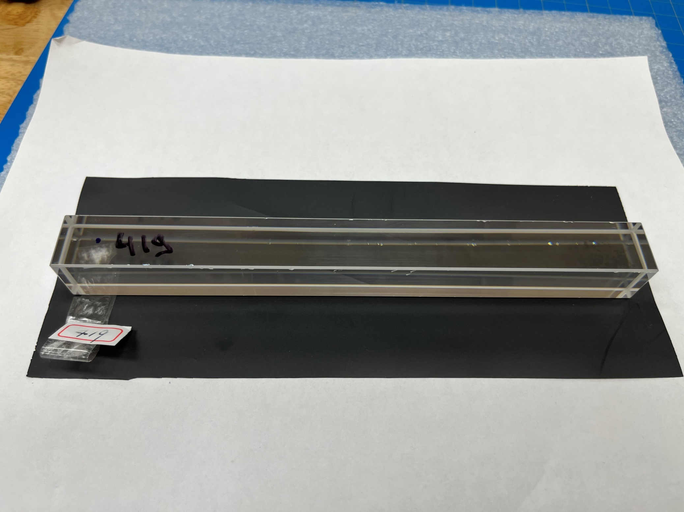
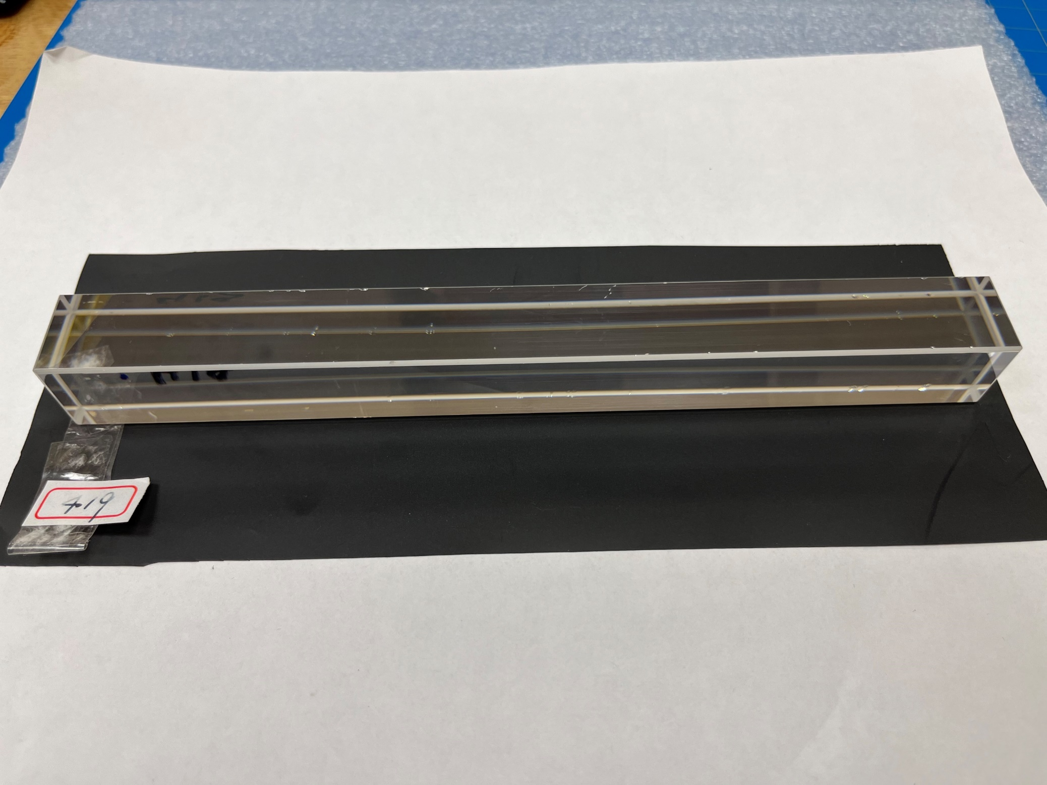
No. 419
Too many chips on chamfers
Scratches on faces
11

Slide 12
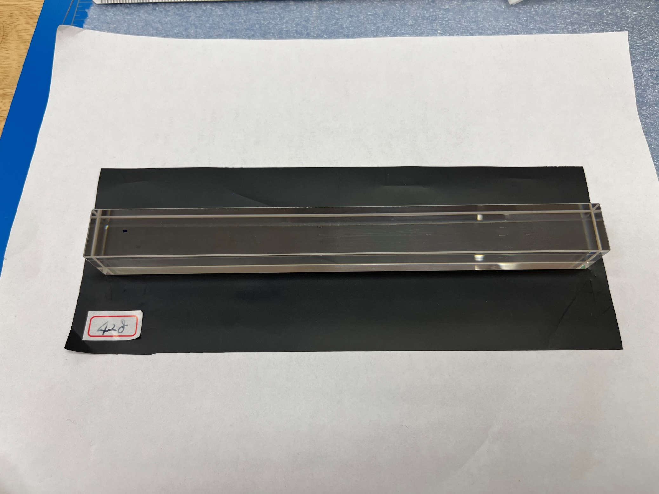
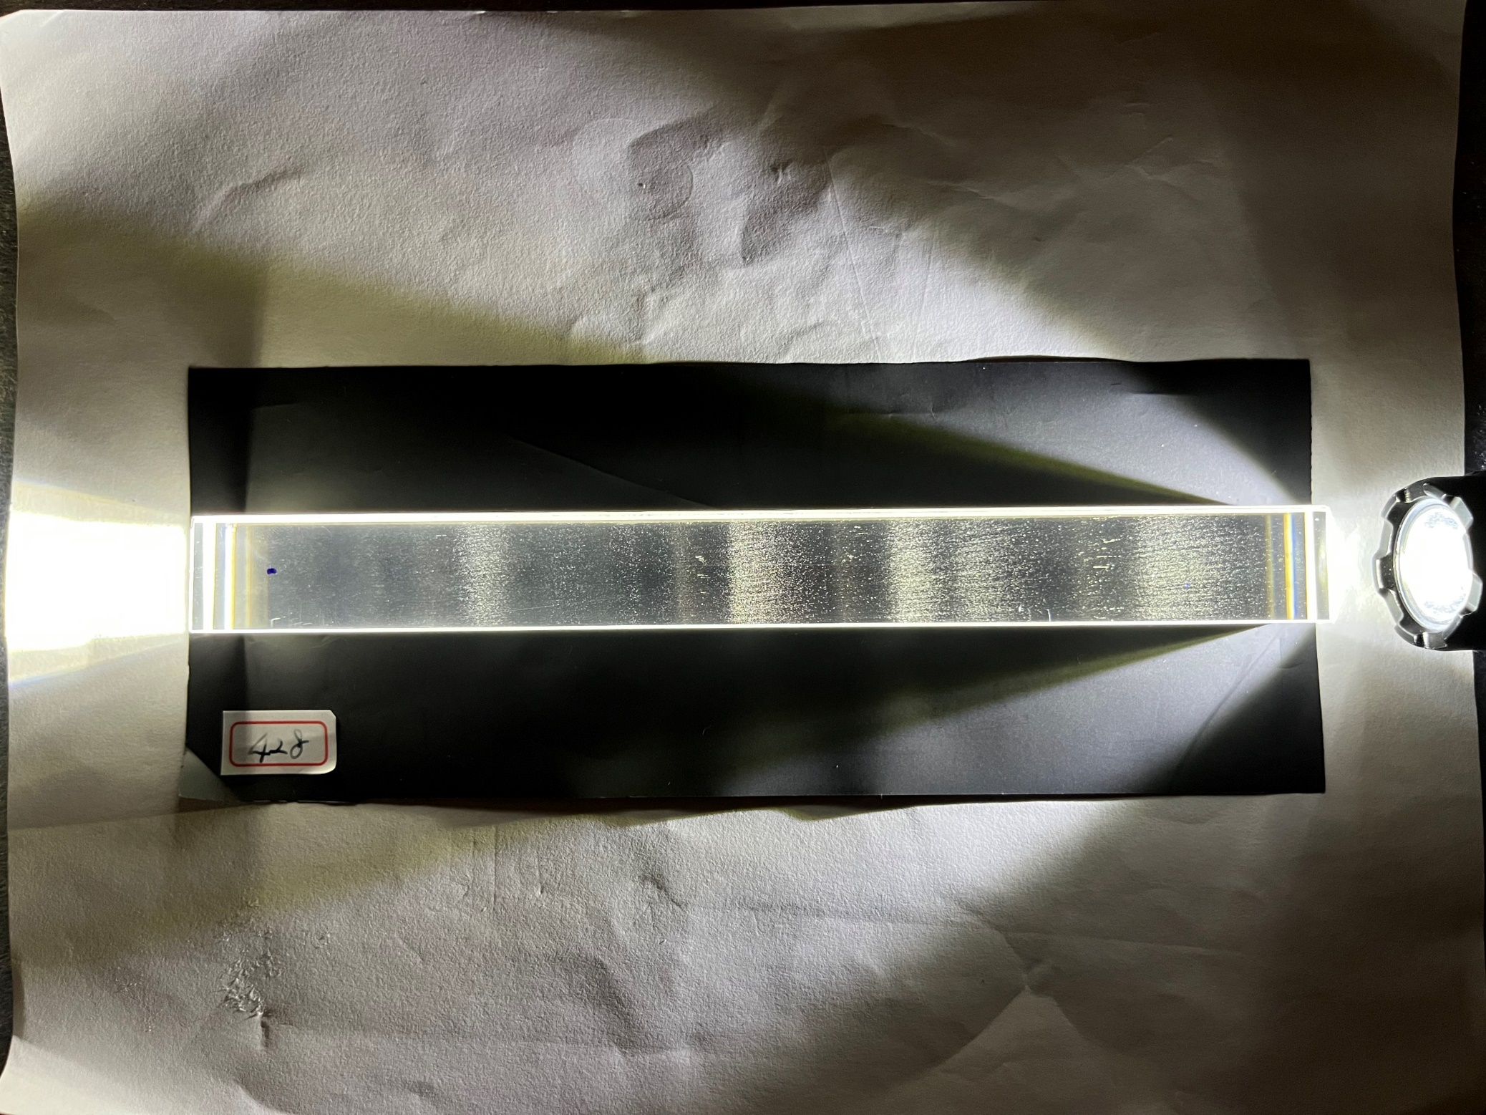
No. 428
Cloudy Region Inside
12

Slide 13
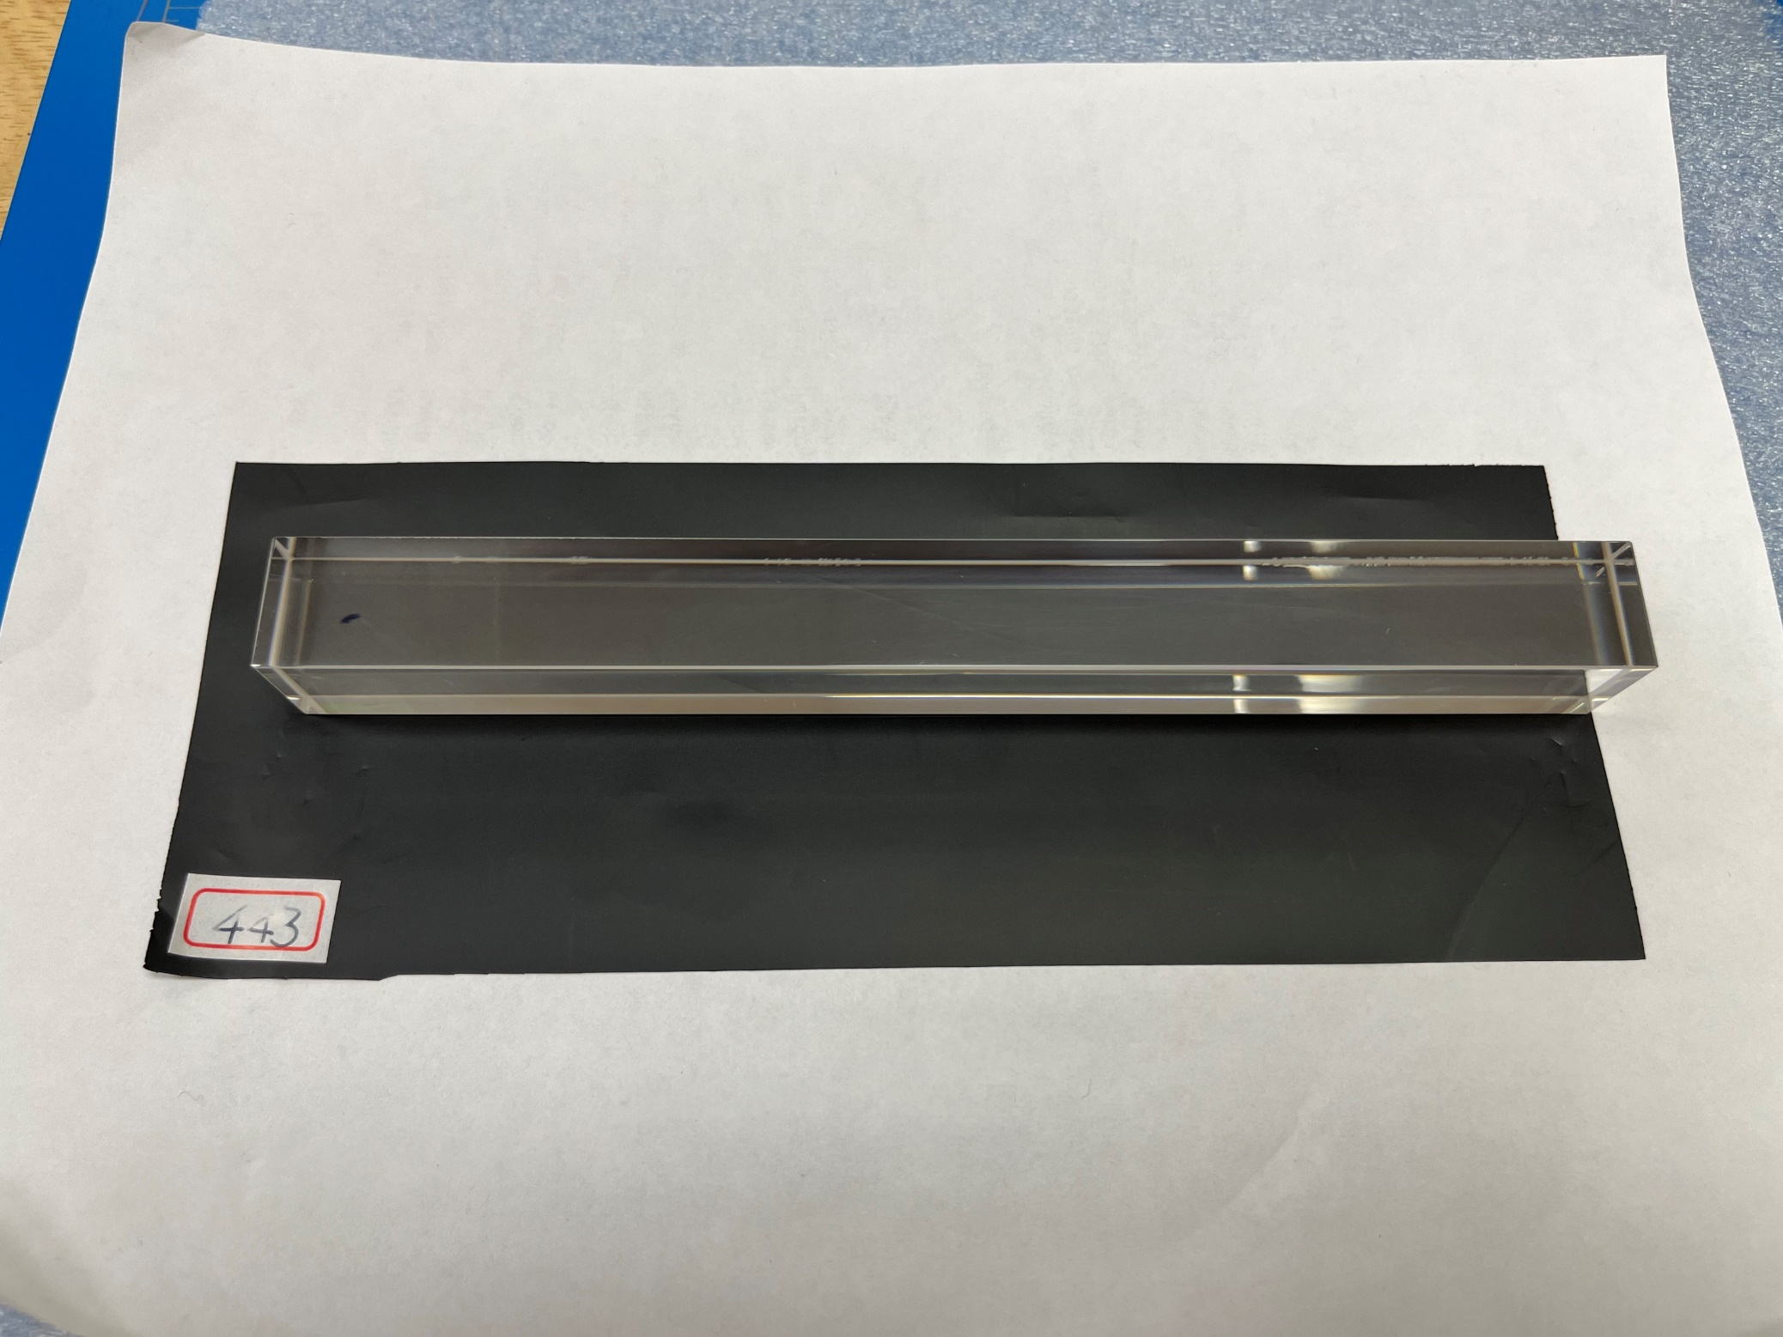
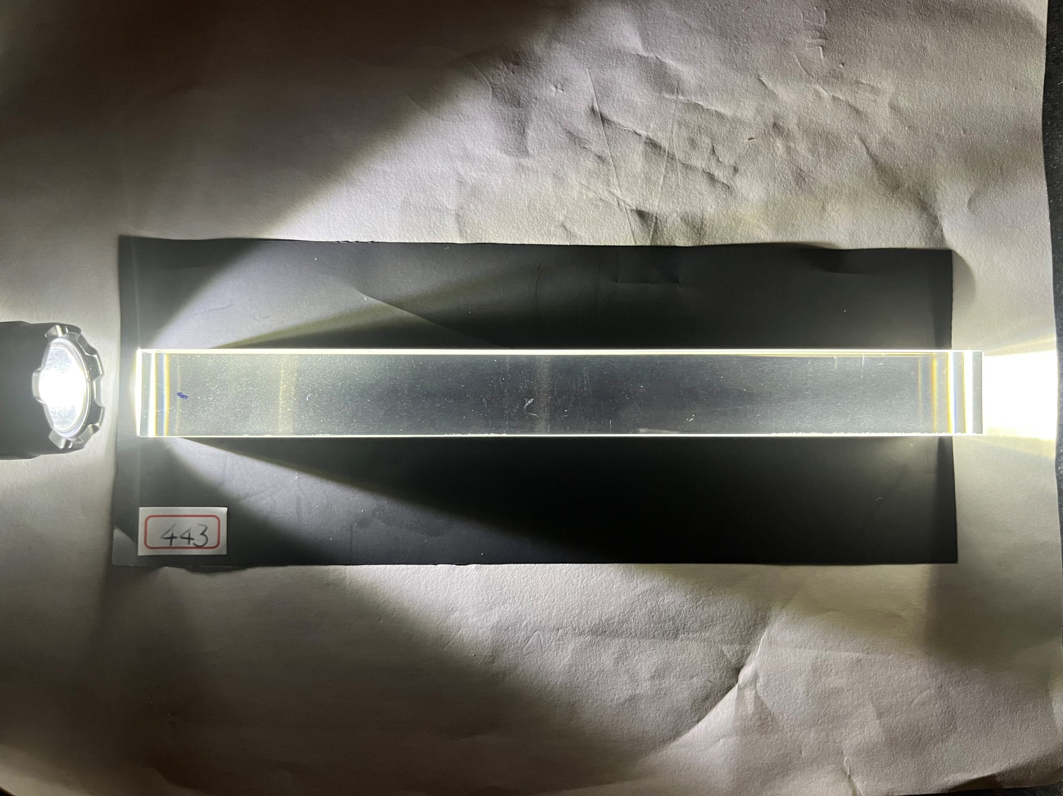
No. 443
Cloudy Layers Inside
13

