Slide 1
Divider Test Guides
A. Liu, B. Liu, A. Somov, V. Berdnikov, H. Voskanyan
October 19, 2023

Slide 2
Make sure the black box is well installed and the HV isolator works well (Fig. 1).
Make sure the LED pulse and power supply are power on and well connected (Fig. 2).
Shift the HV off (Fig. 9). Disconnect the HV connector outside the box (Fig. 8), and then open the box. Pull out the divider with PMT attached (Fig. 3).
Disconnect the divider and PMT. Unplug the low voltage wire (Fig. 4), high voltage wire and signal wire (Fig. 5).
Change the divider and plug the low voltage wire, high voltage wire and signal wire (Fig. 4 and Fig. 5).

Slide 3
Put the divider with PMT attached on the rank, and slightly push it to the end, see Fig. 1.
Close the box and connect the HV wire outside the box (Fig. 8).
Turn the HV on. Read the current value and save the image showed on Oscilloscope. (Fig. 9 and Fig. 10)

Slide 4
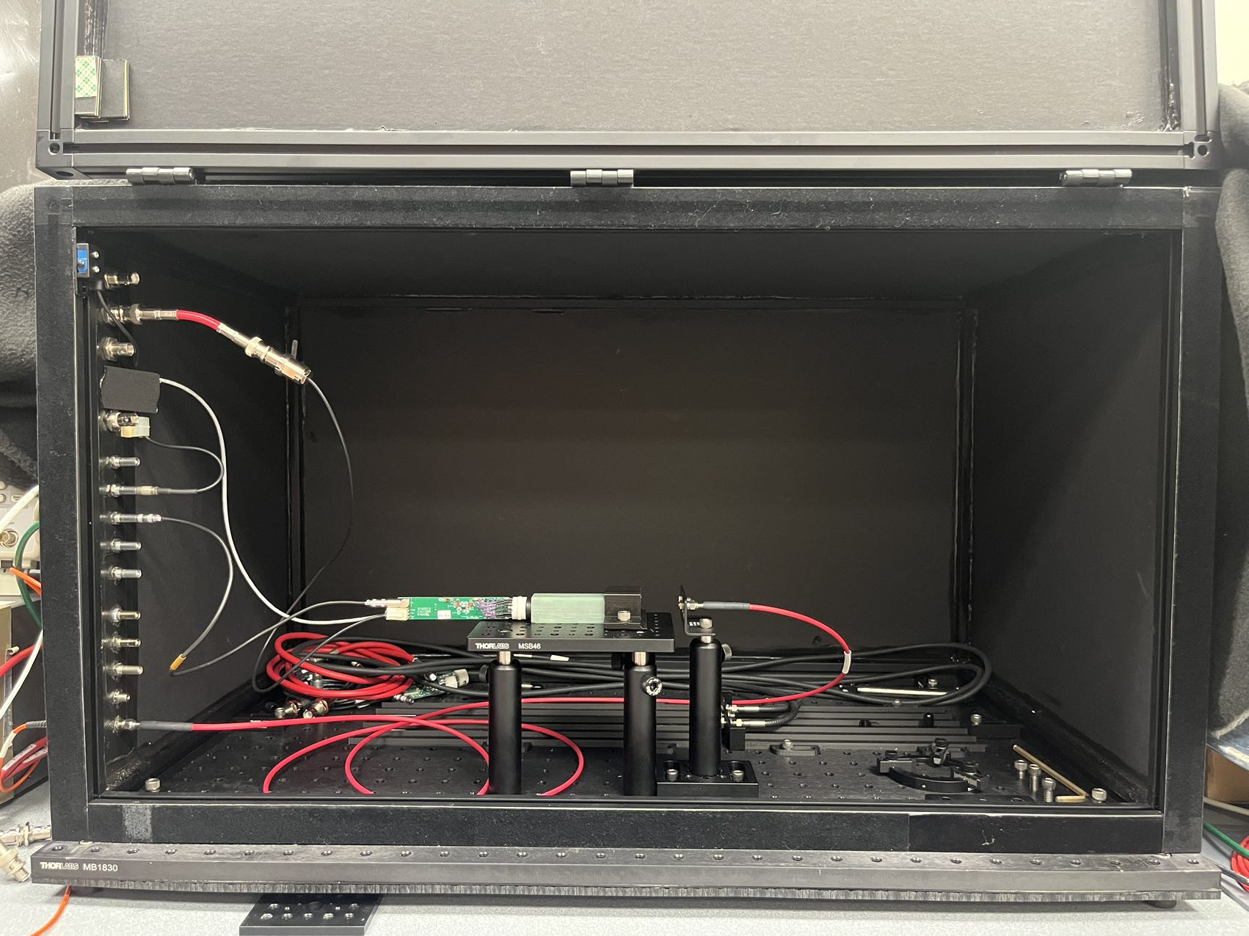
Fig. 1 Whole look inside the black box

Slide 5
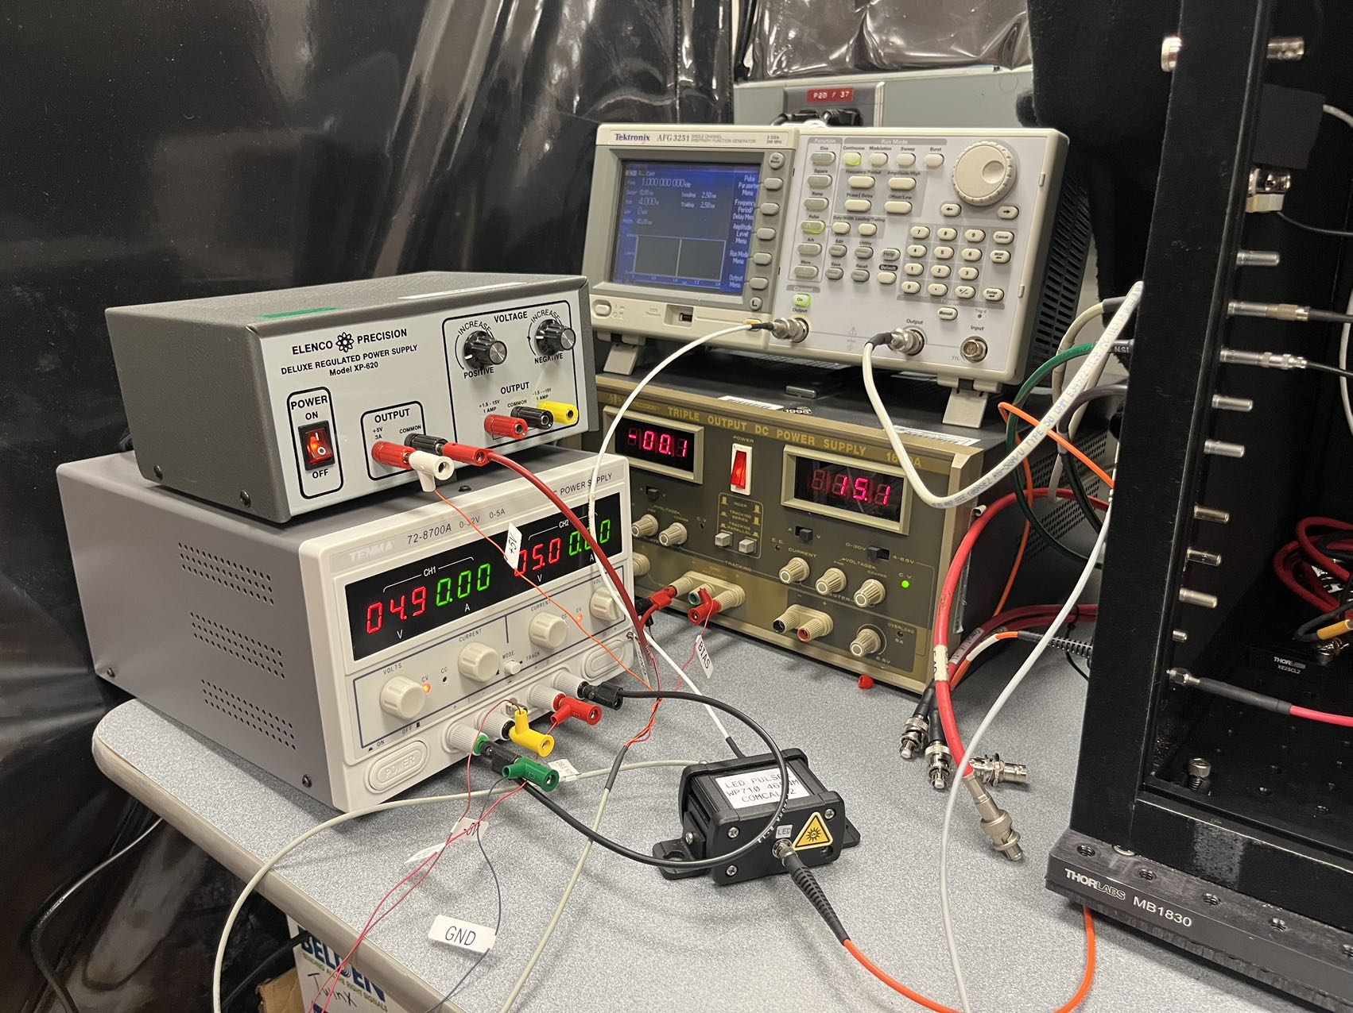
Fig. 2 LED Pulse and power supply

Slide 6
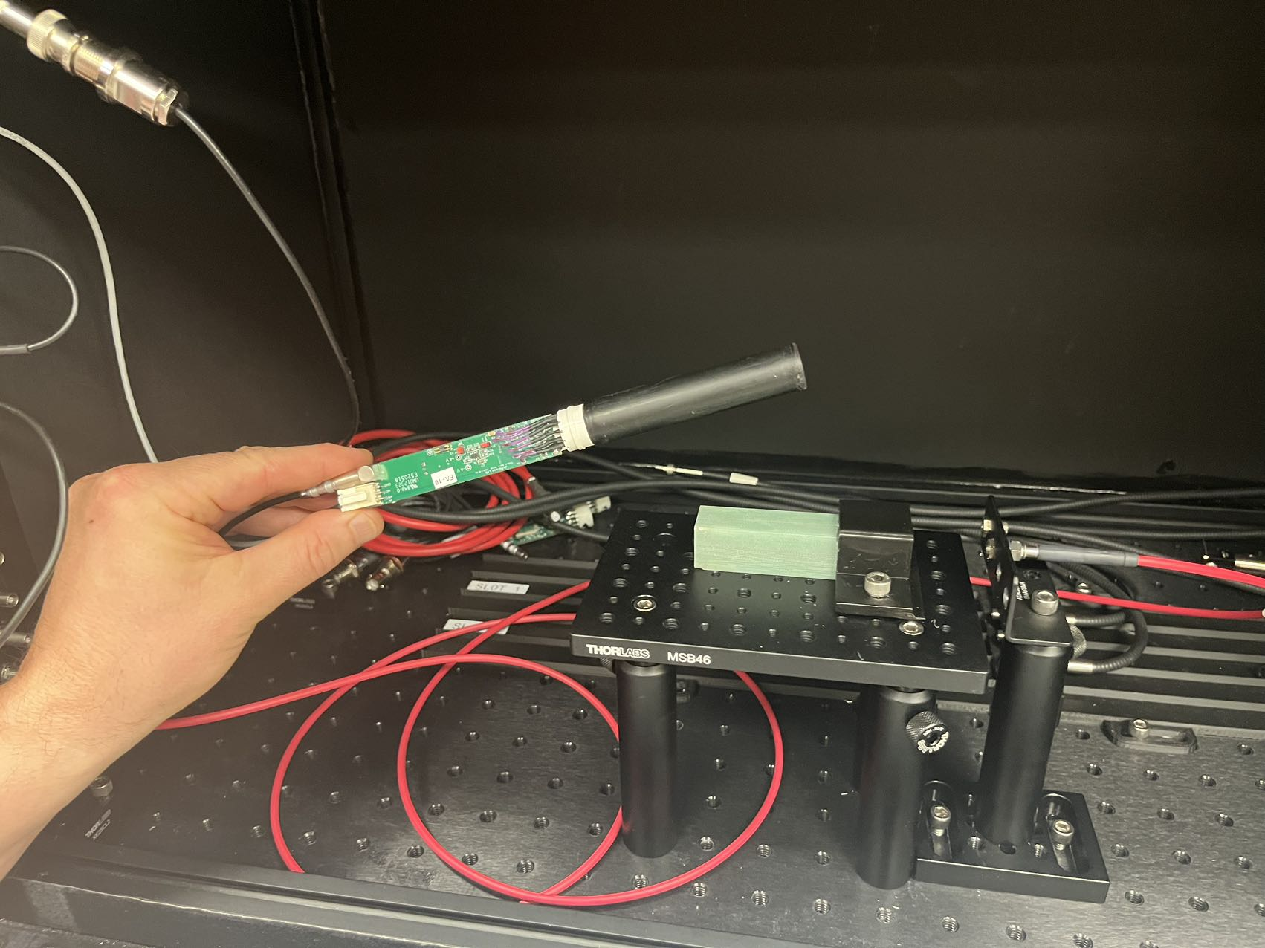
Fig. 3 Divider with PMT attached

Slide 7
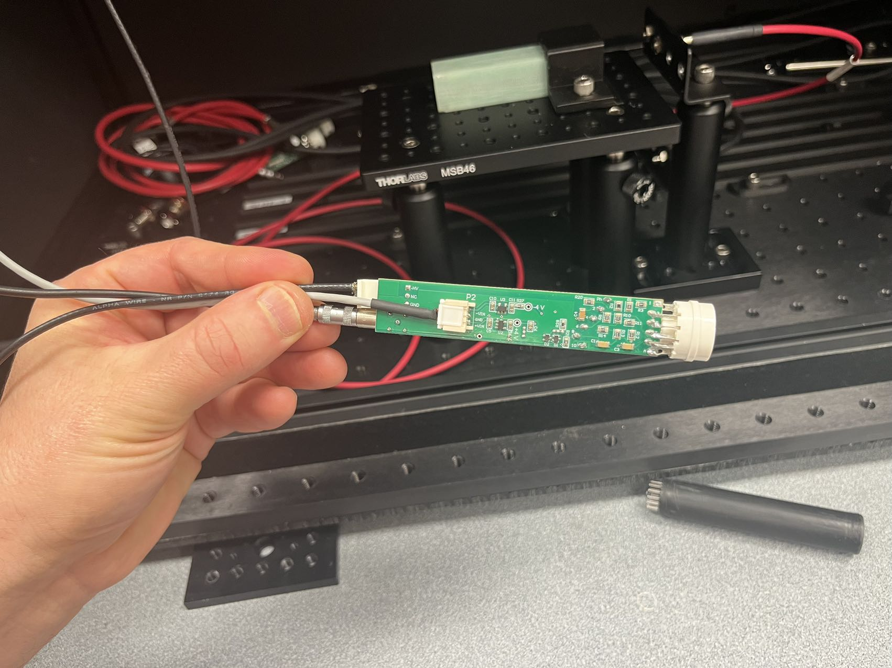
Fig. 4 Low voltage connector

Slide 8
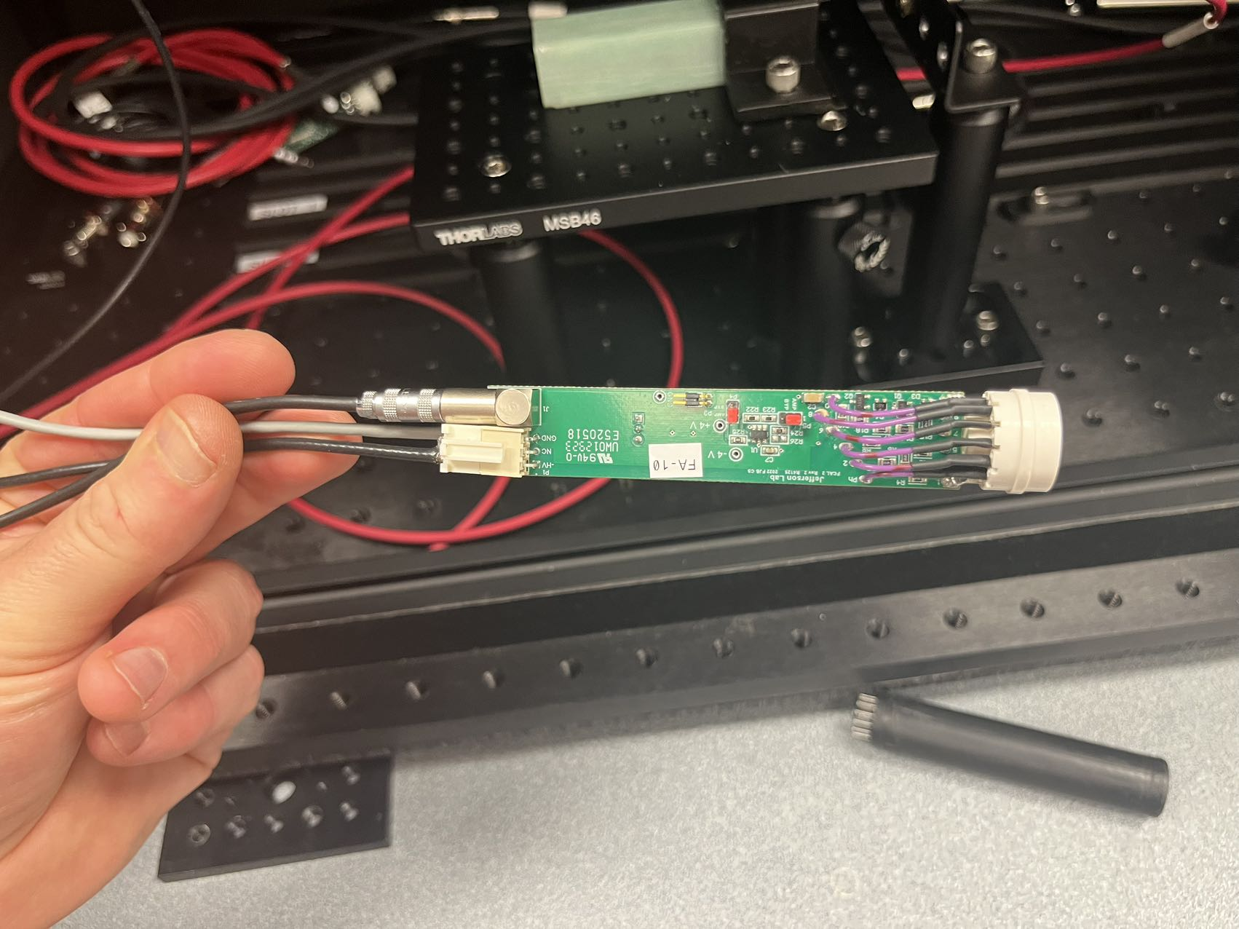
Fig. 5 High voltage and signal connectors

Slide 9
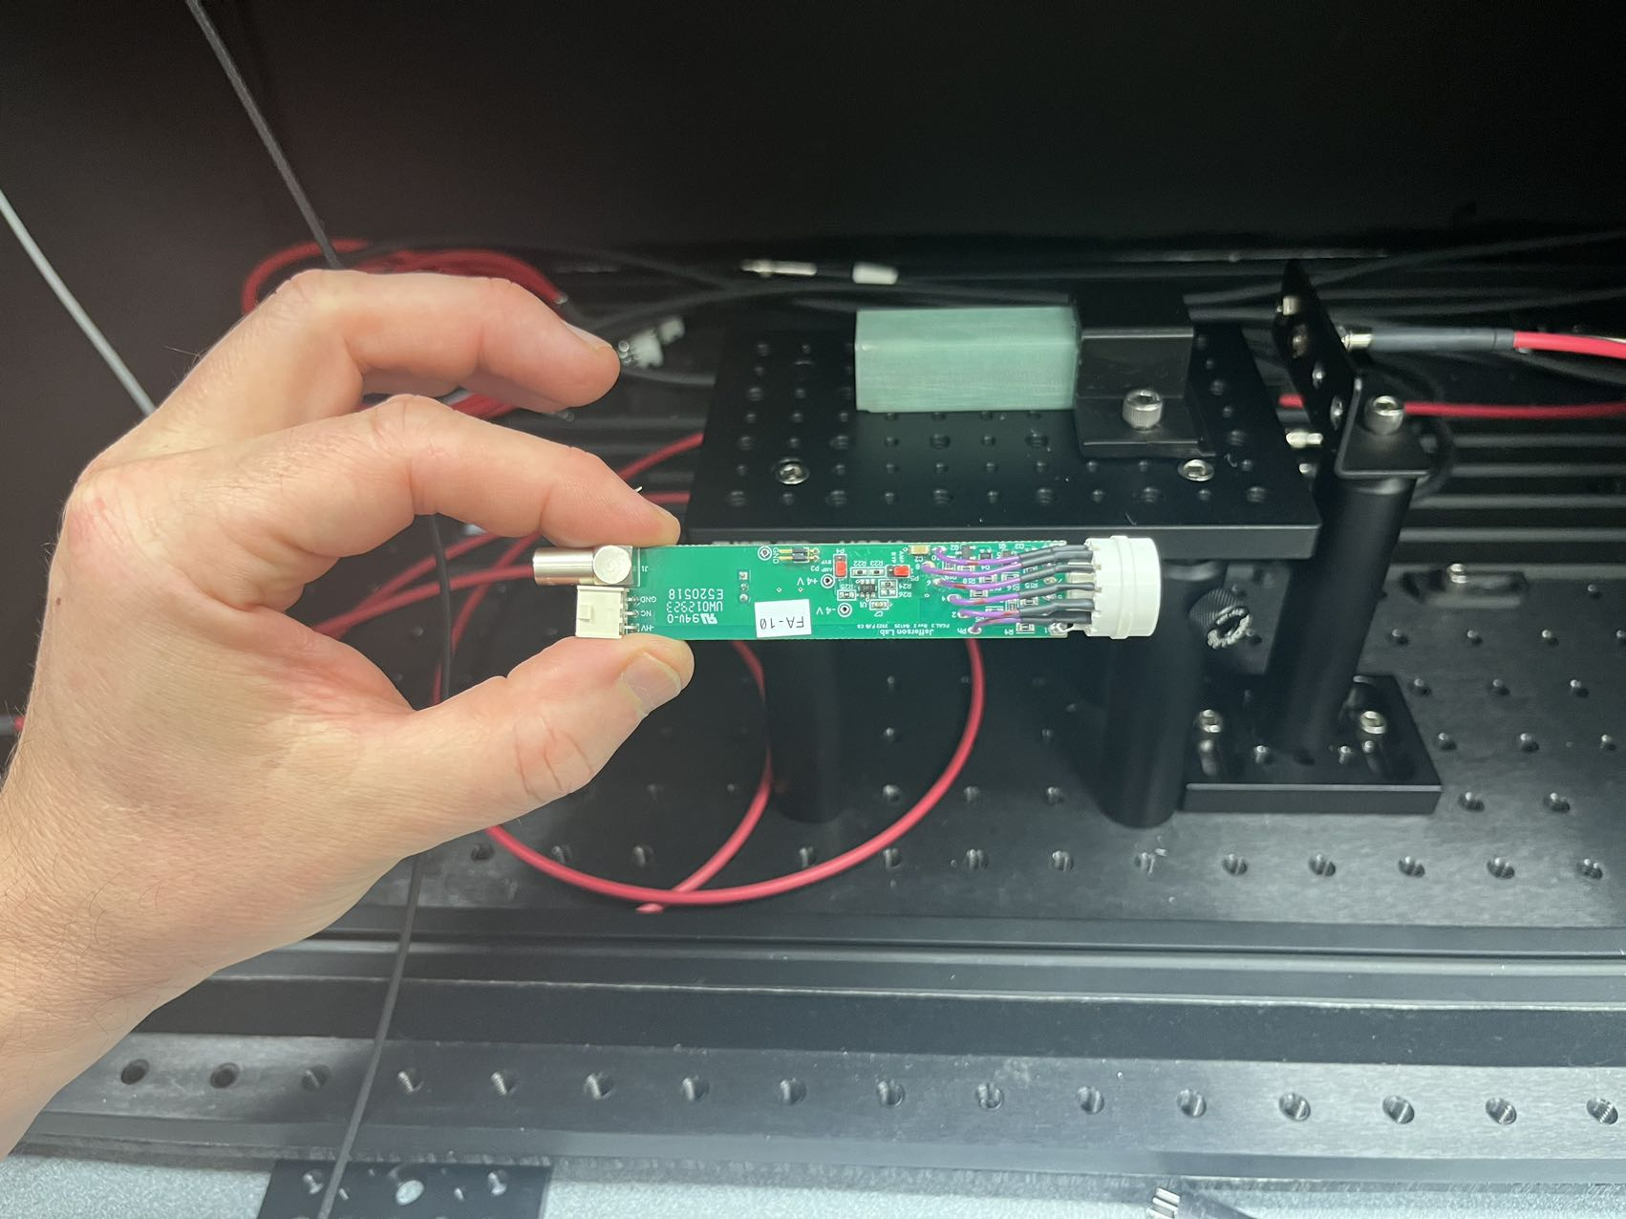
Fig. 7 Divider

Slide 10
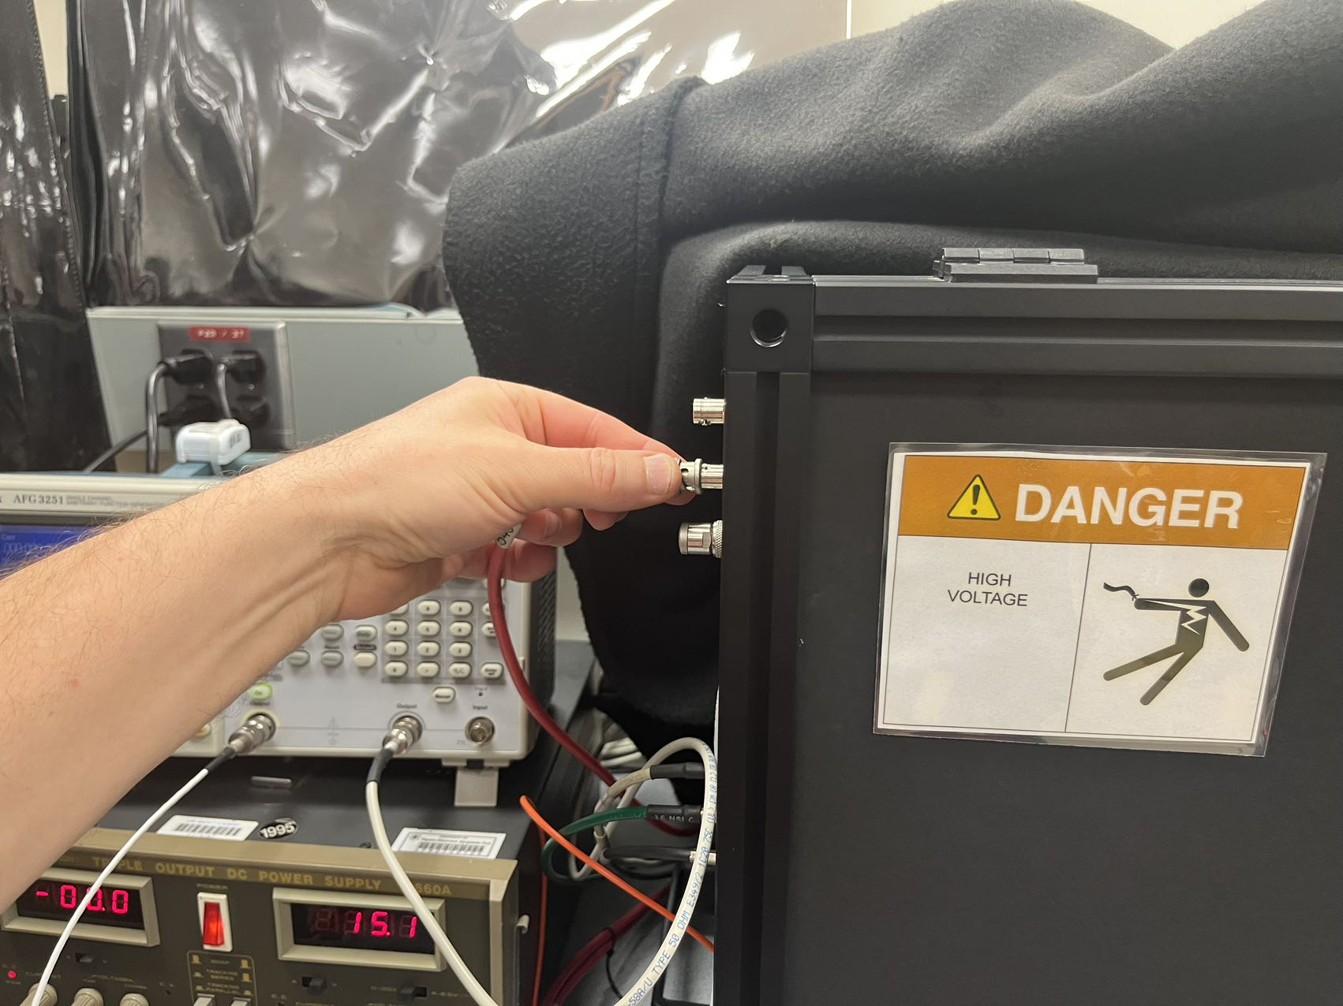
Fig. 8 High voltage connector outside the box

Slide 11
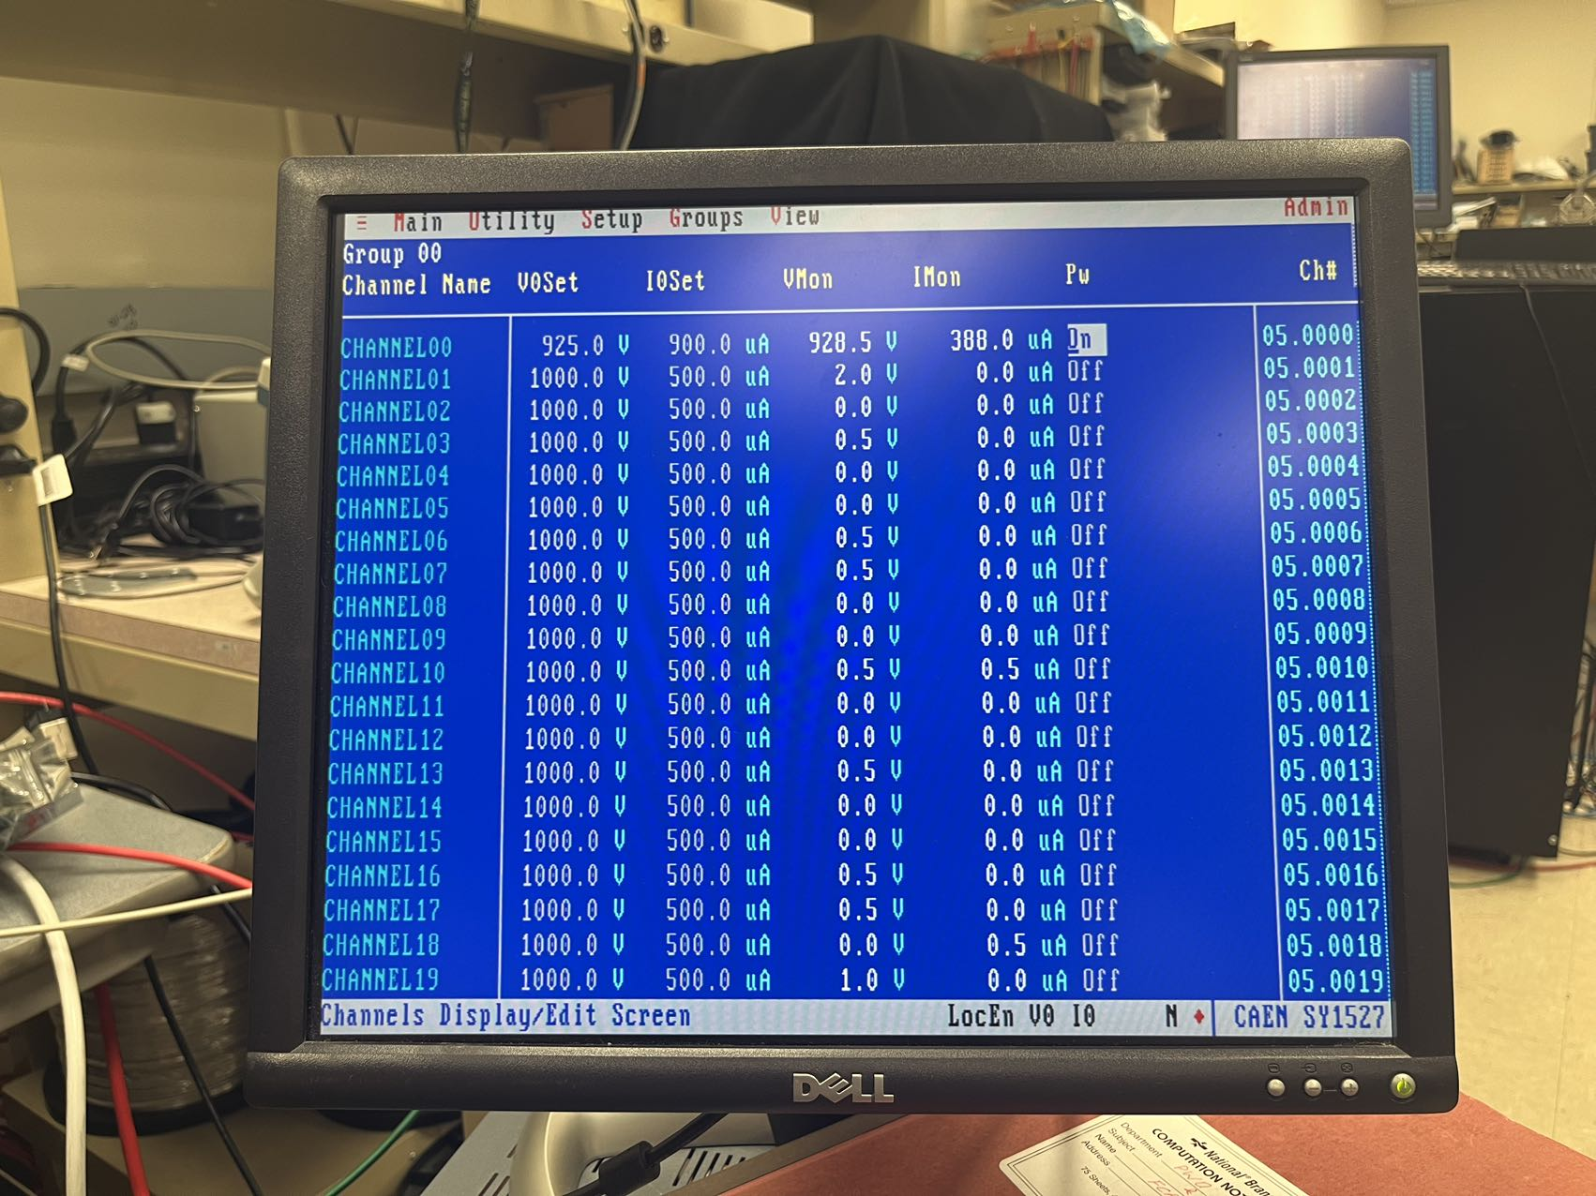
Fig. 9 HV manipulation and data reading

Slide 12
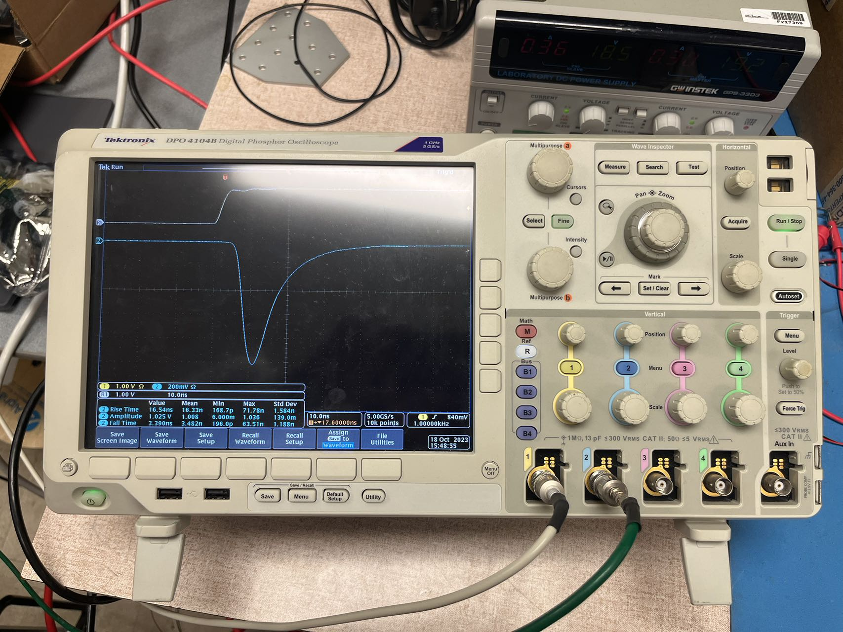
Fig. 10 Oscilloscope image display and picture saving

