Slide 1
Update on FCAL II
June 16, 2023
By Vadim D. Murakhovskiy

Slide 2
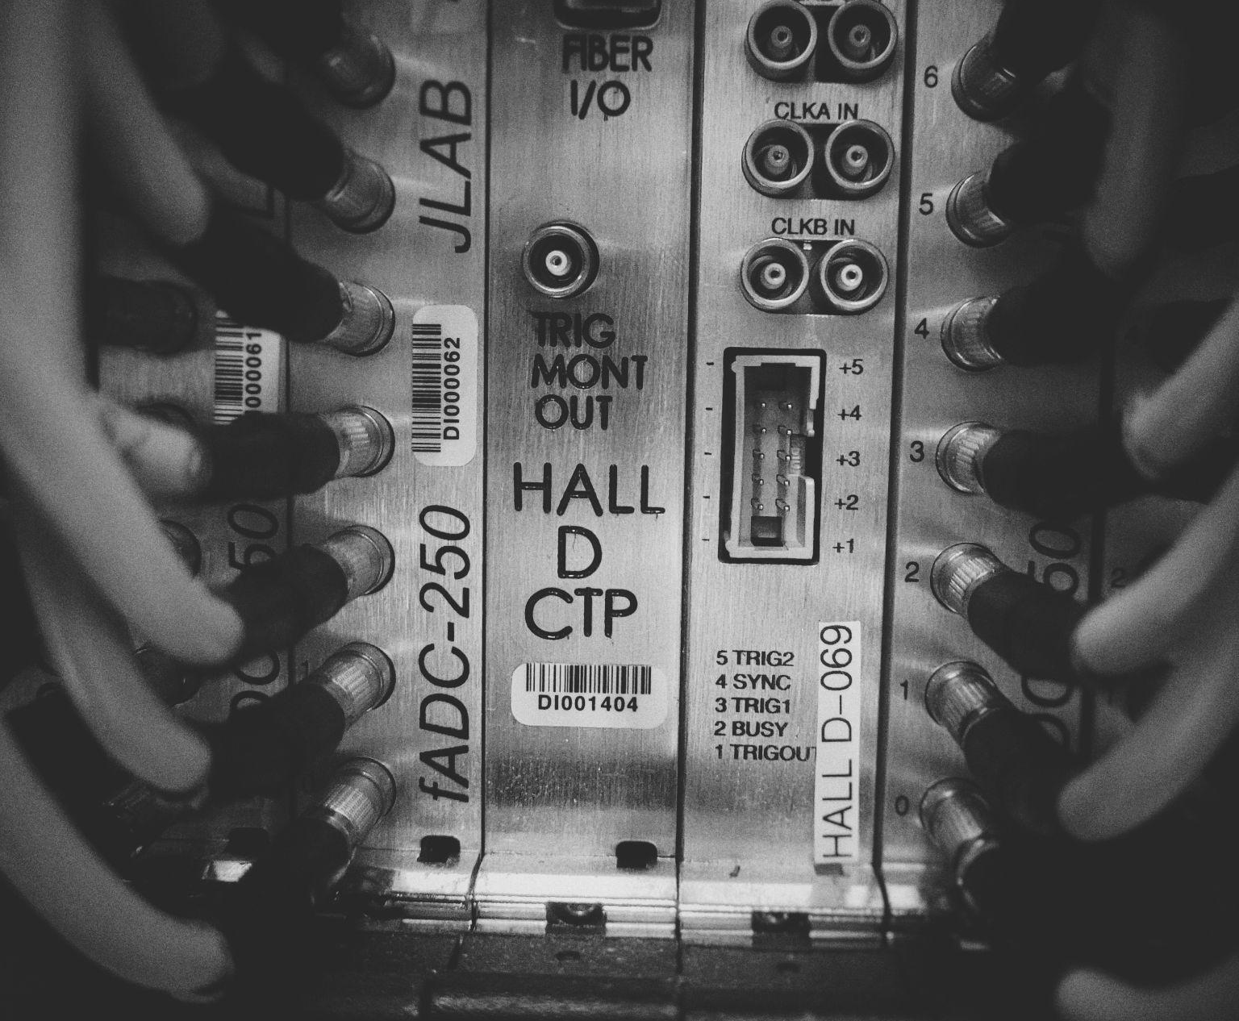
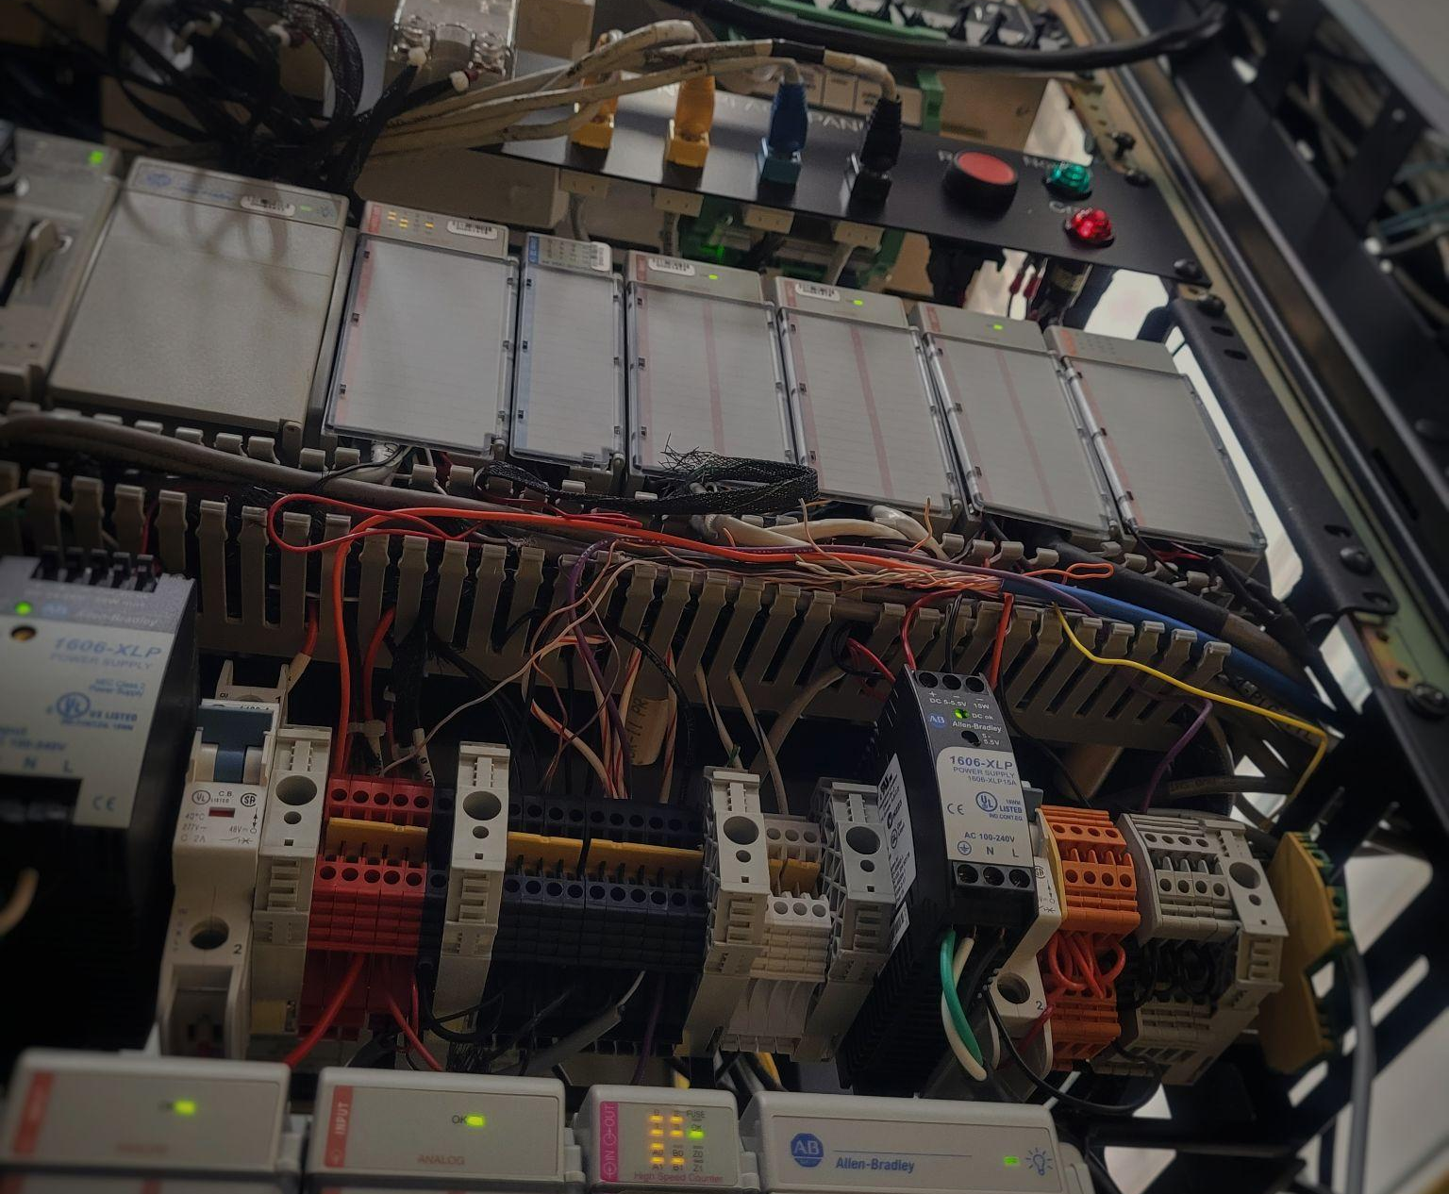
Hall D Group
Labeling
Removing
and
Connecting

Slide 3
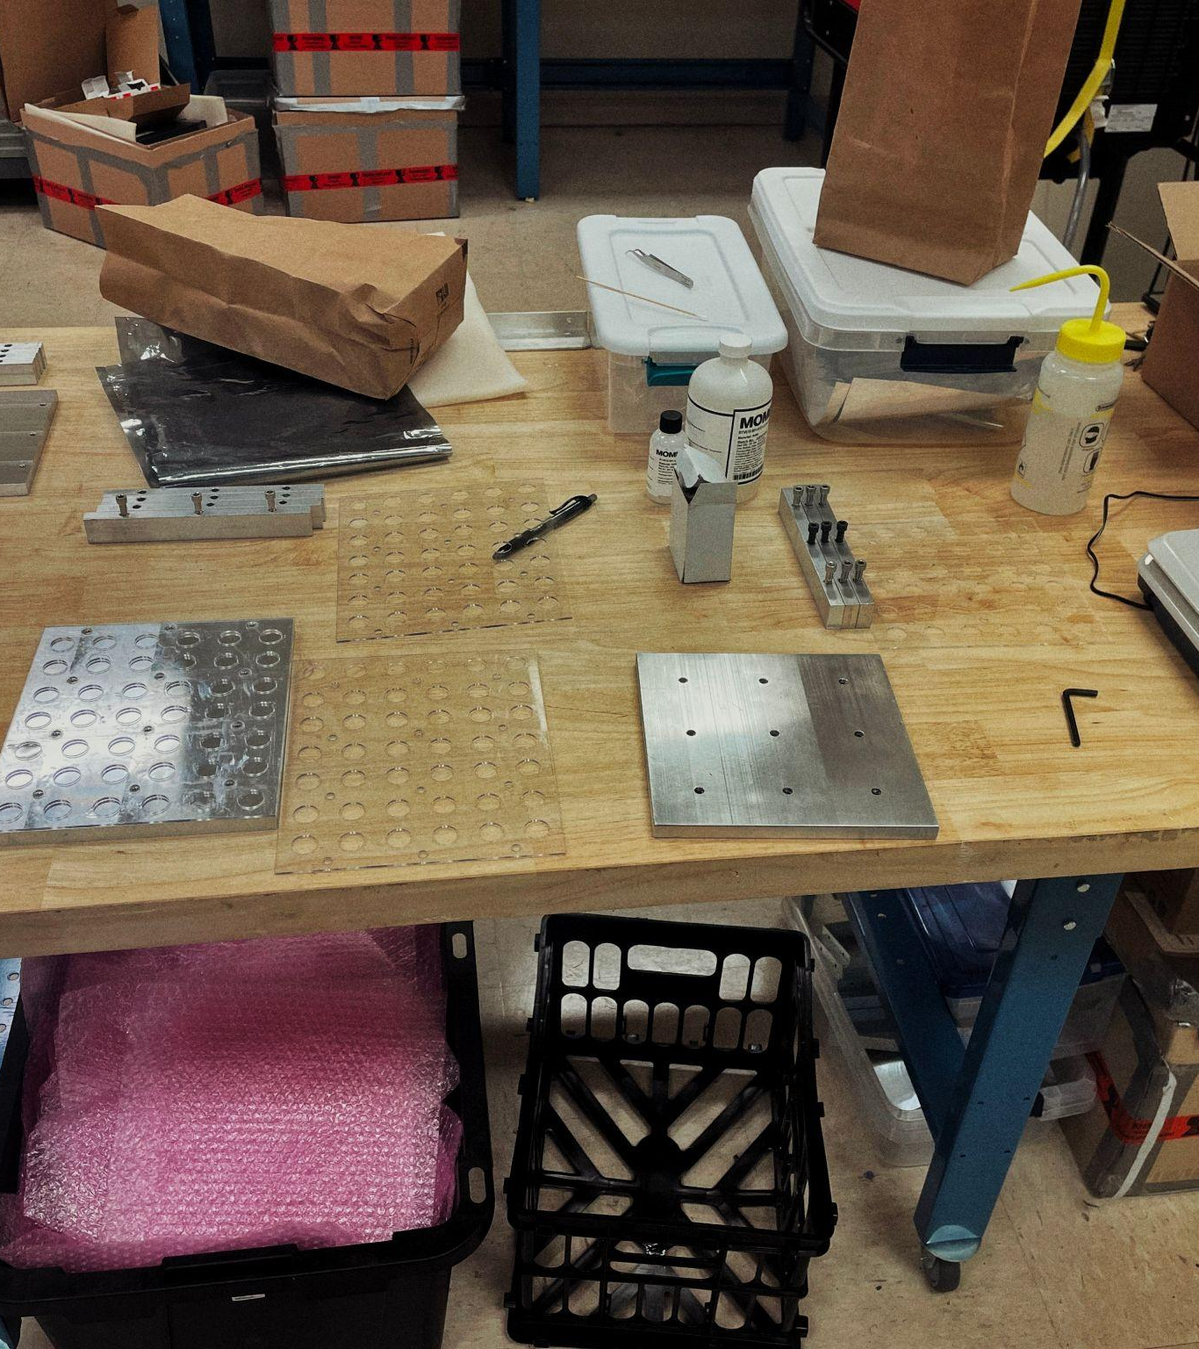
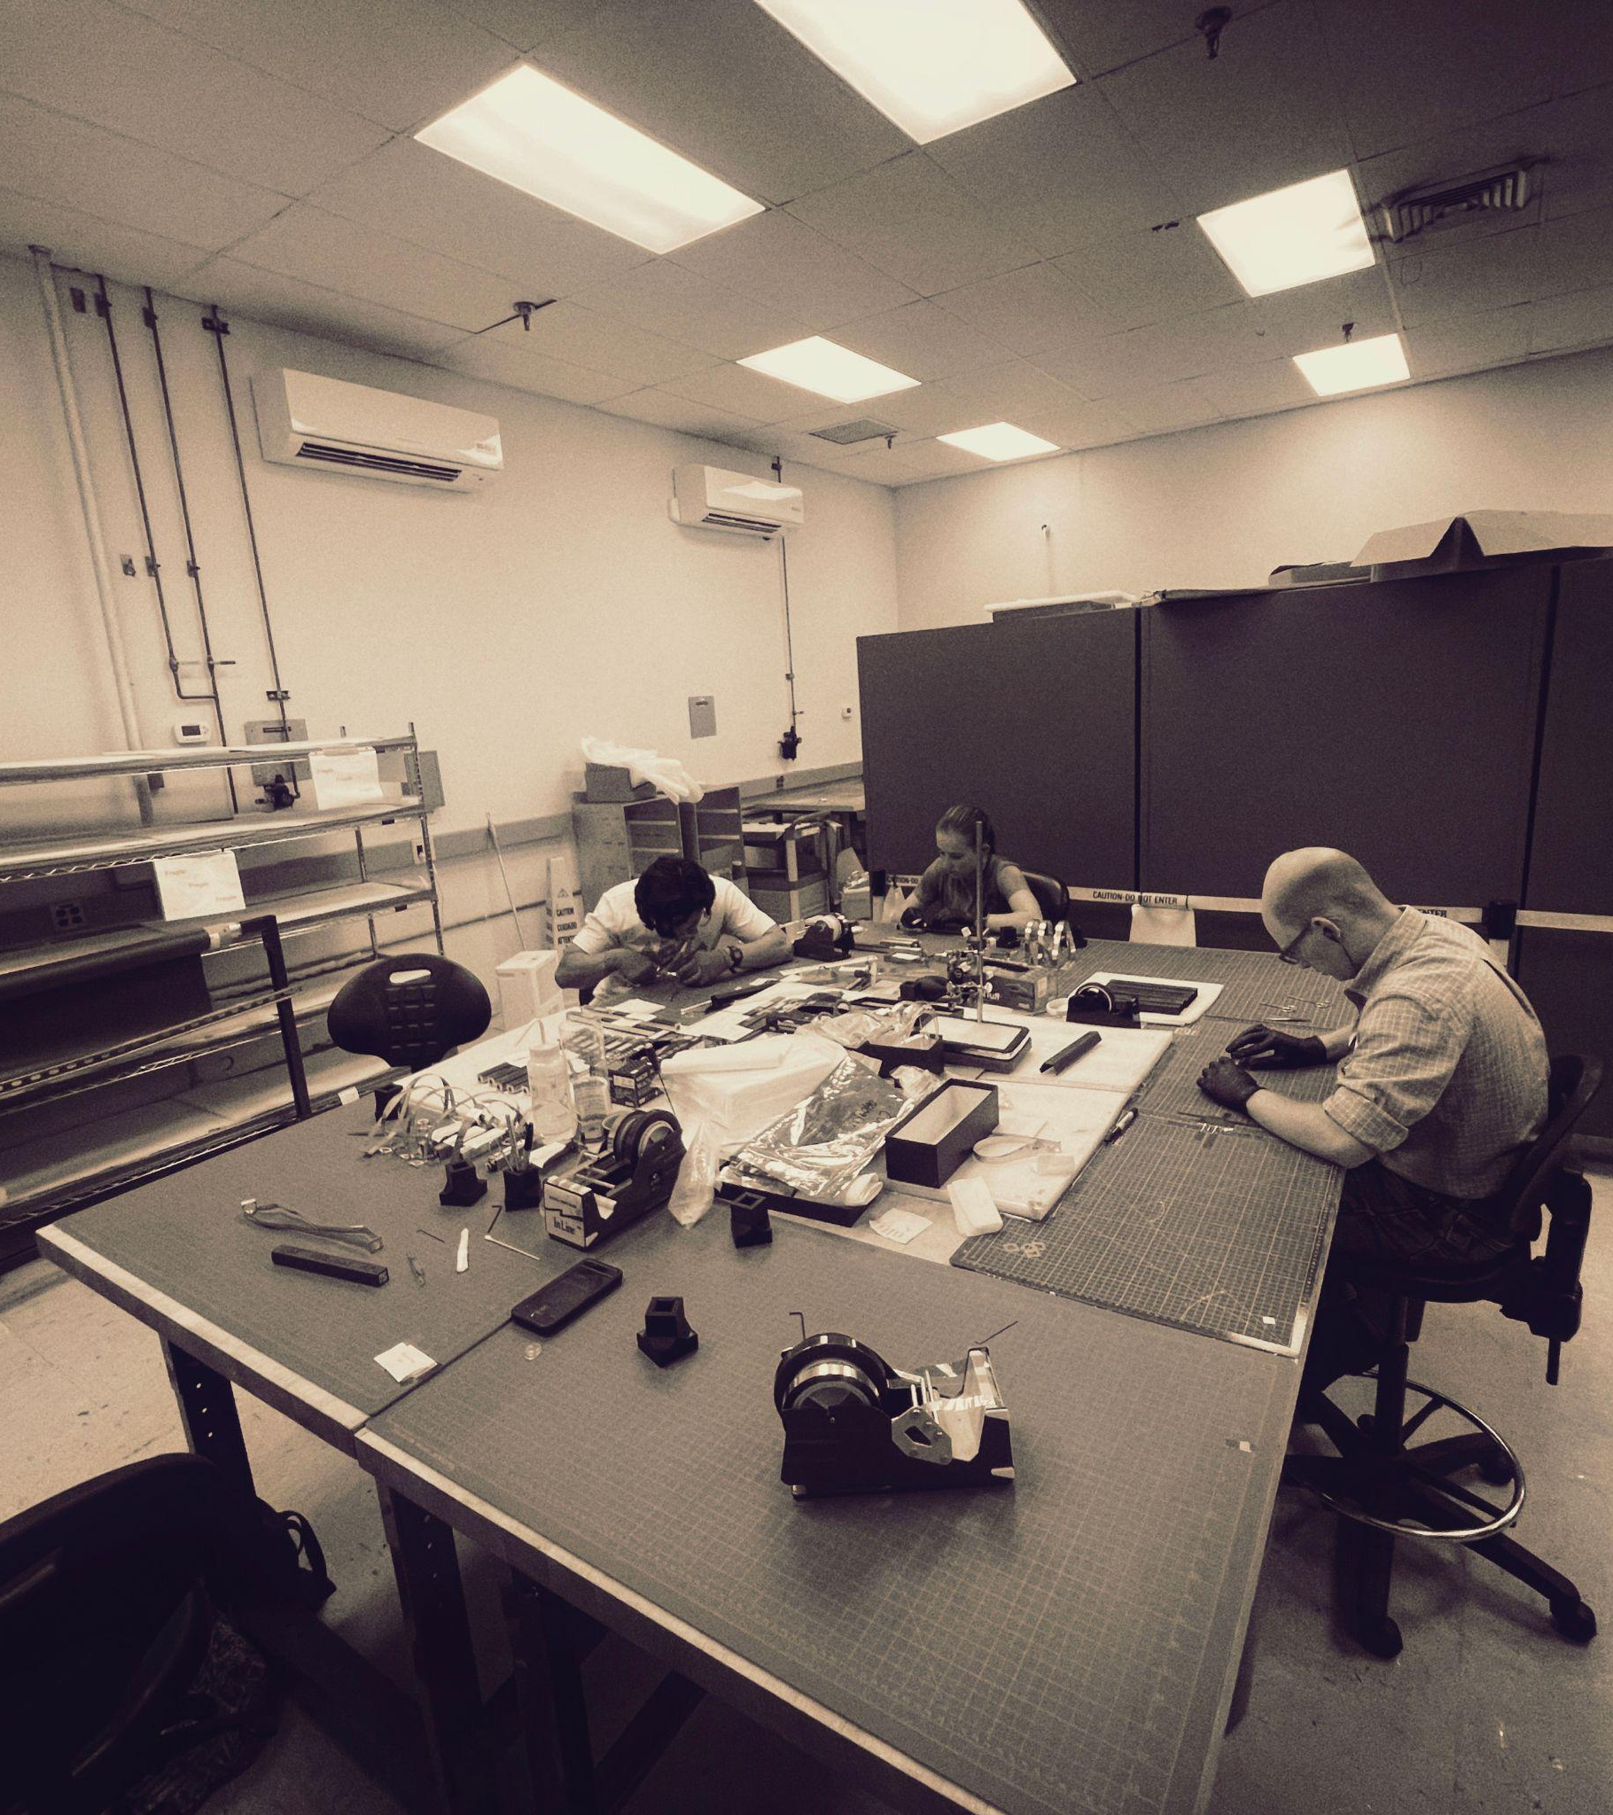
EEL Group
Fabricating
Organizing
Inspecting

