Slide 1
Intern update (6/19 - 6/23)
By Payton Sanford

Slide 2
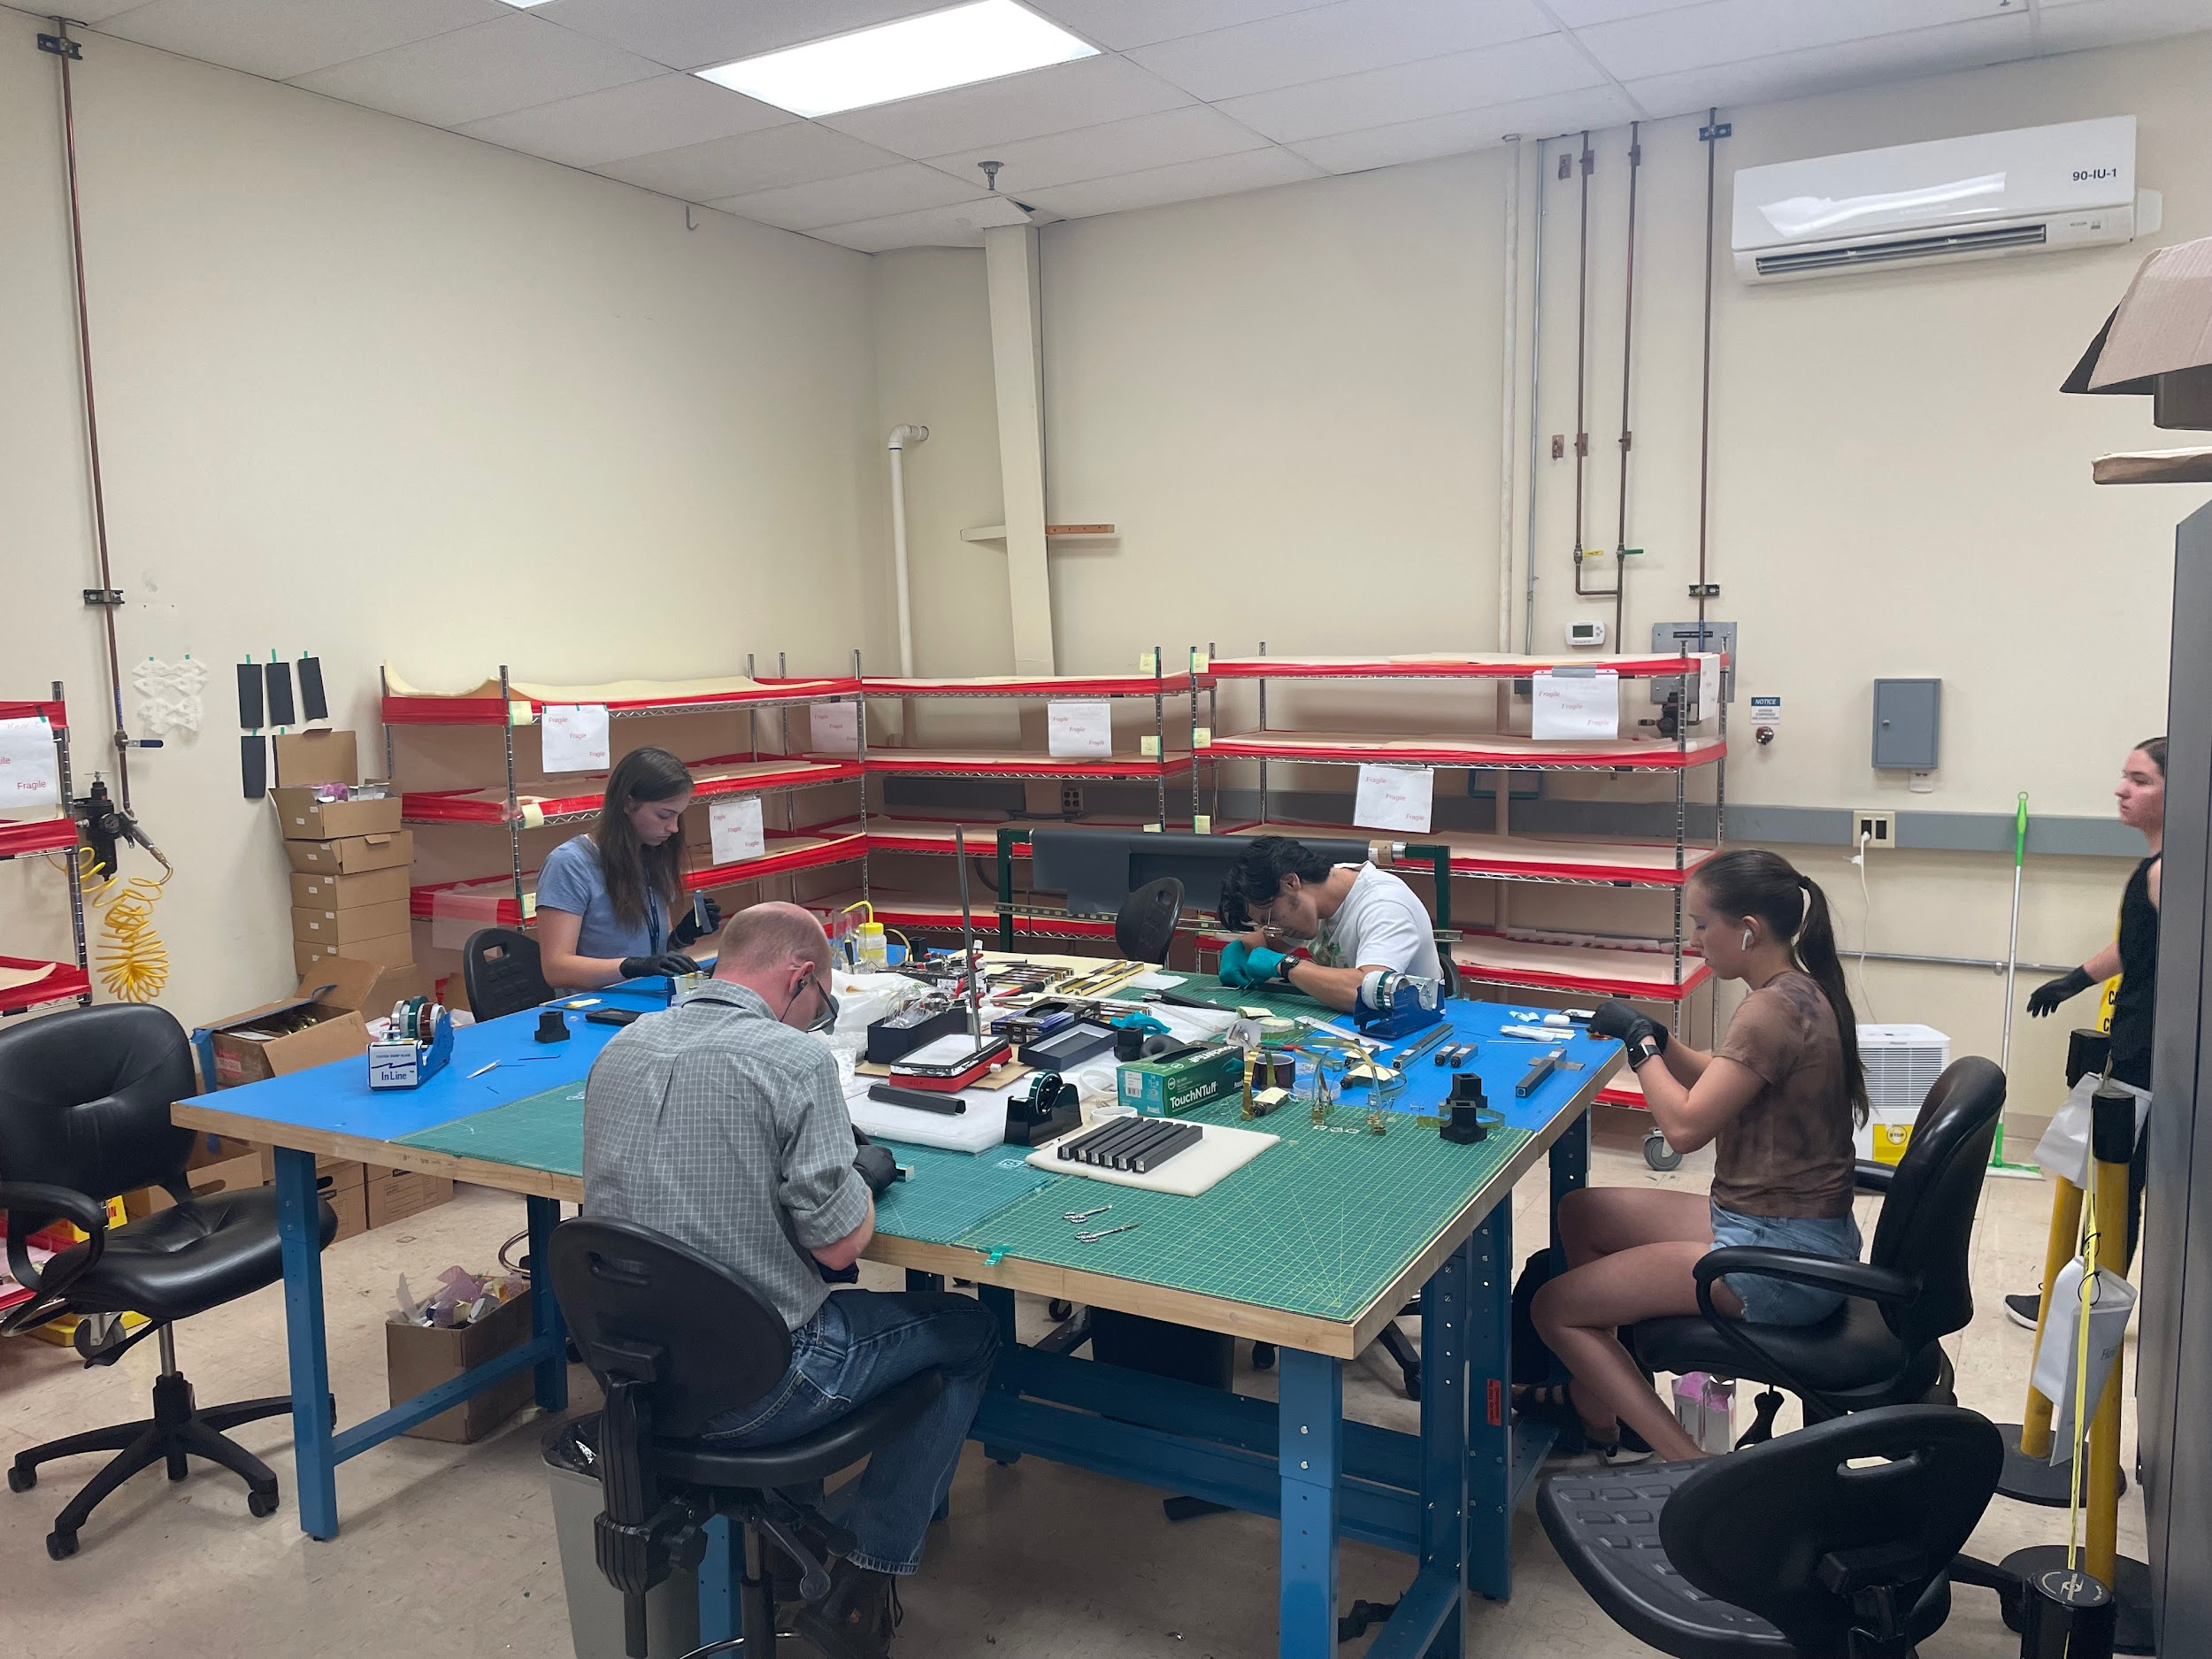
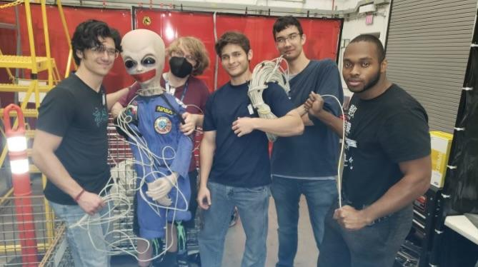
Cable Crew
Split into two teams
Inspection Crew

Slide 3
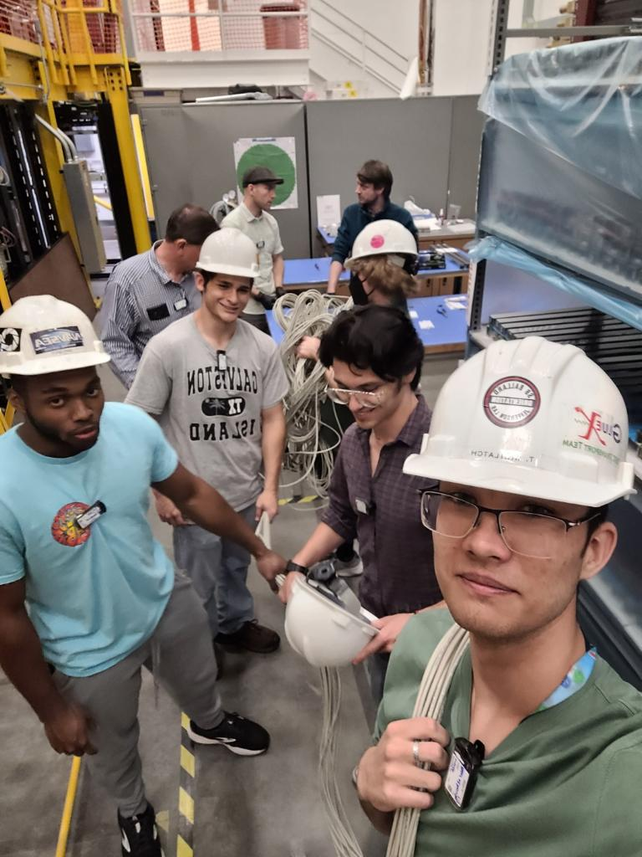
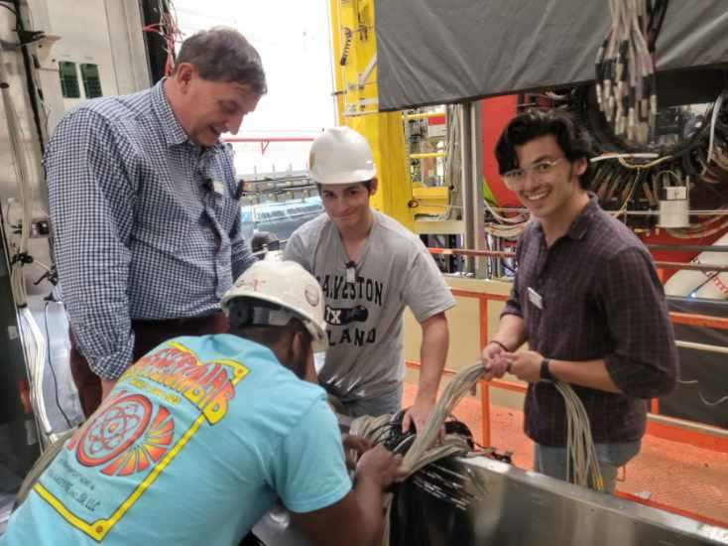
Cable Crew
Task:
Stretch and wrap relabeled cables to the FCAL
Clean Up Area

Slide 4
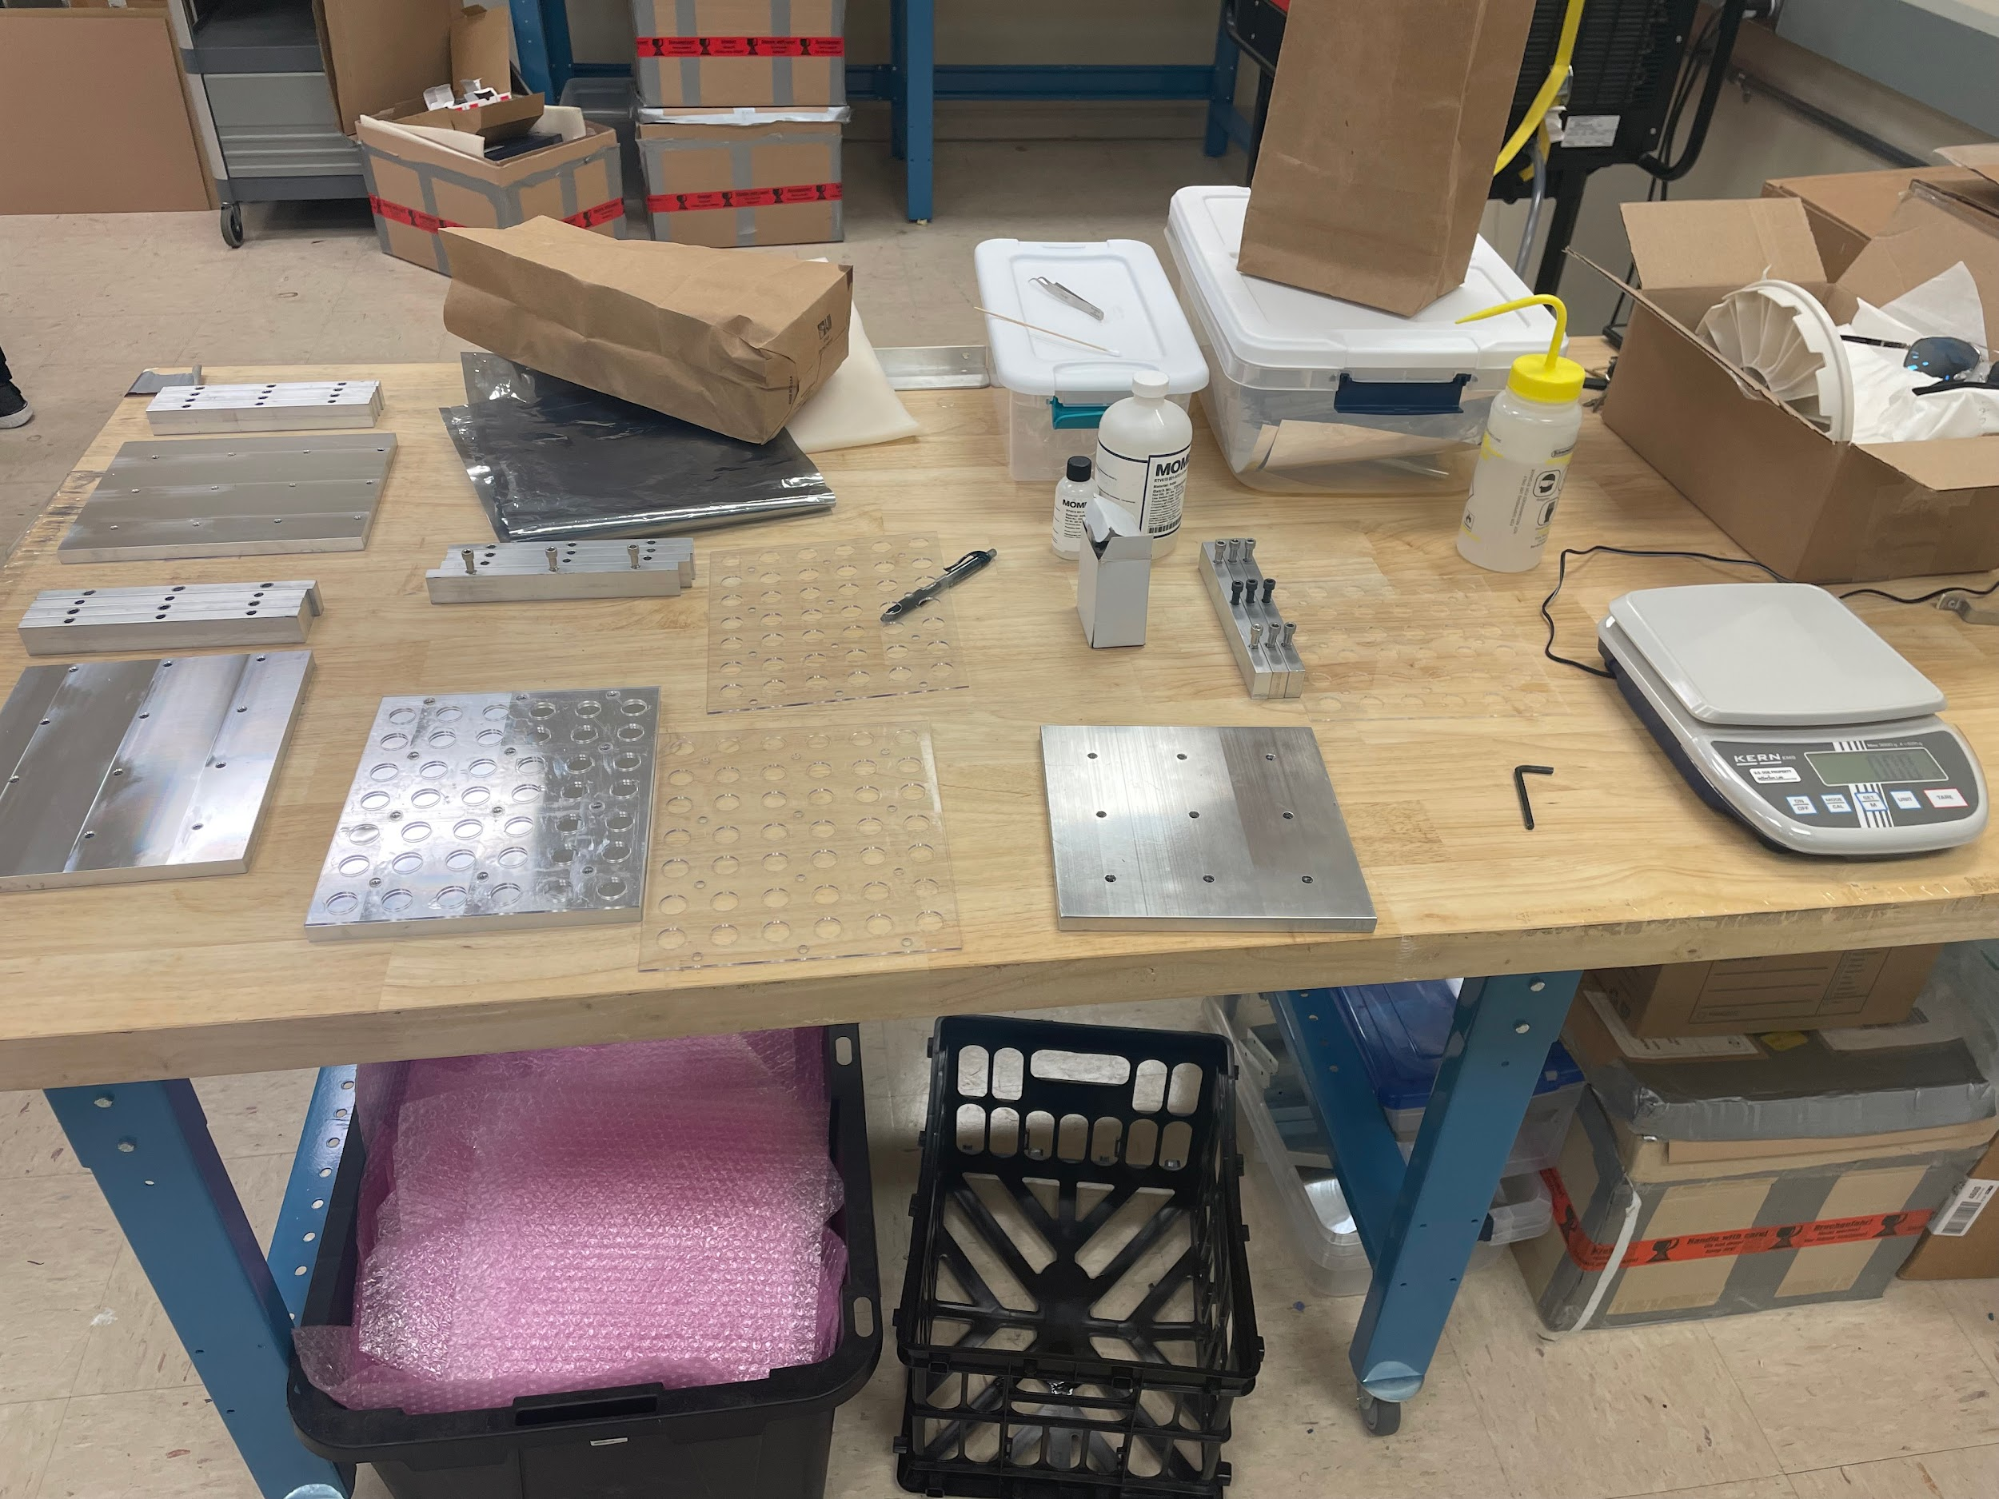
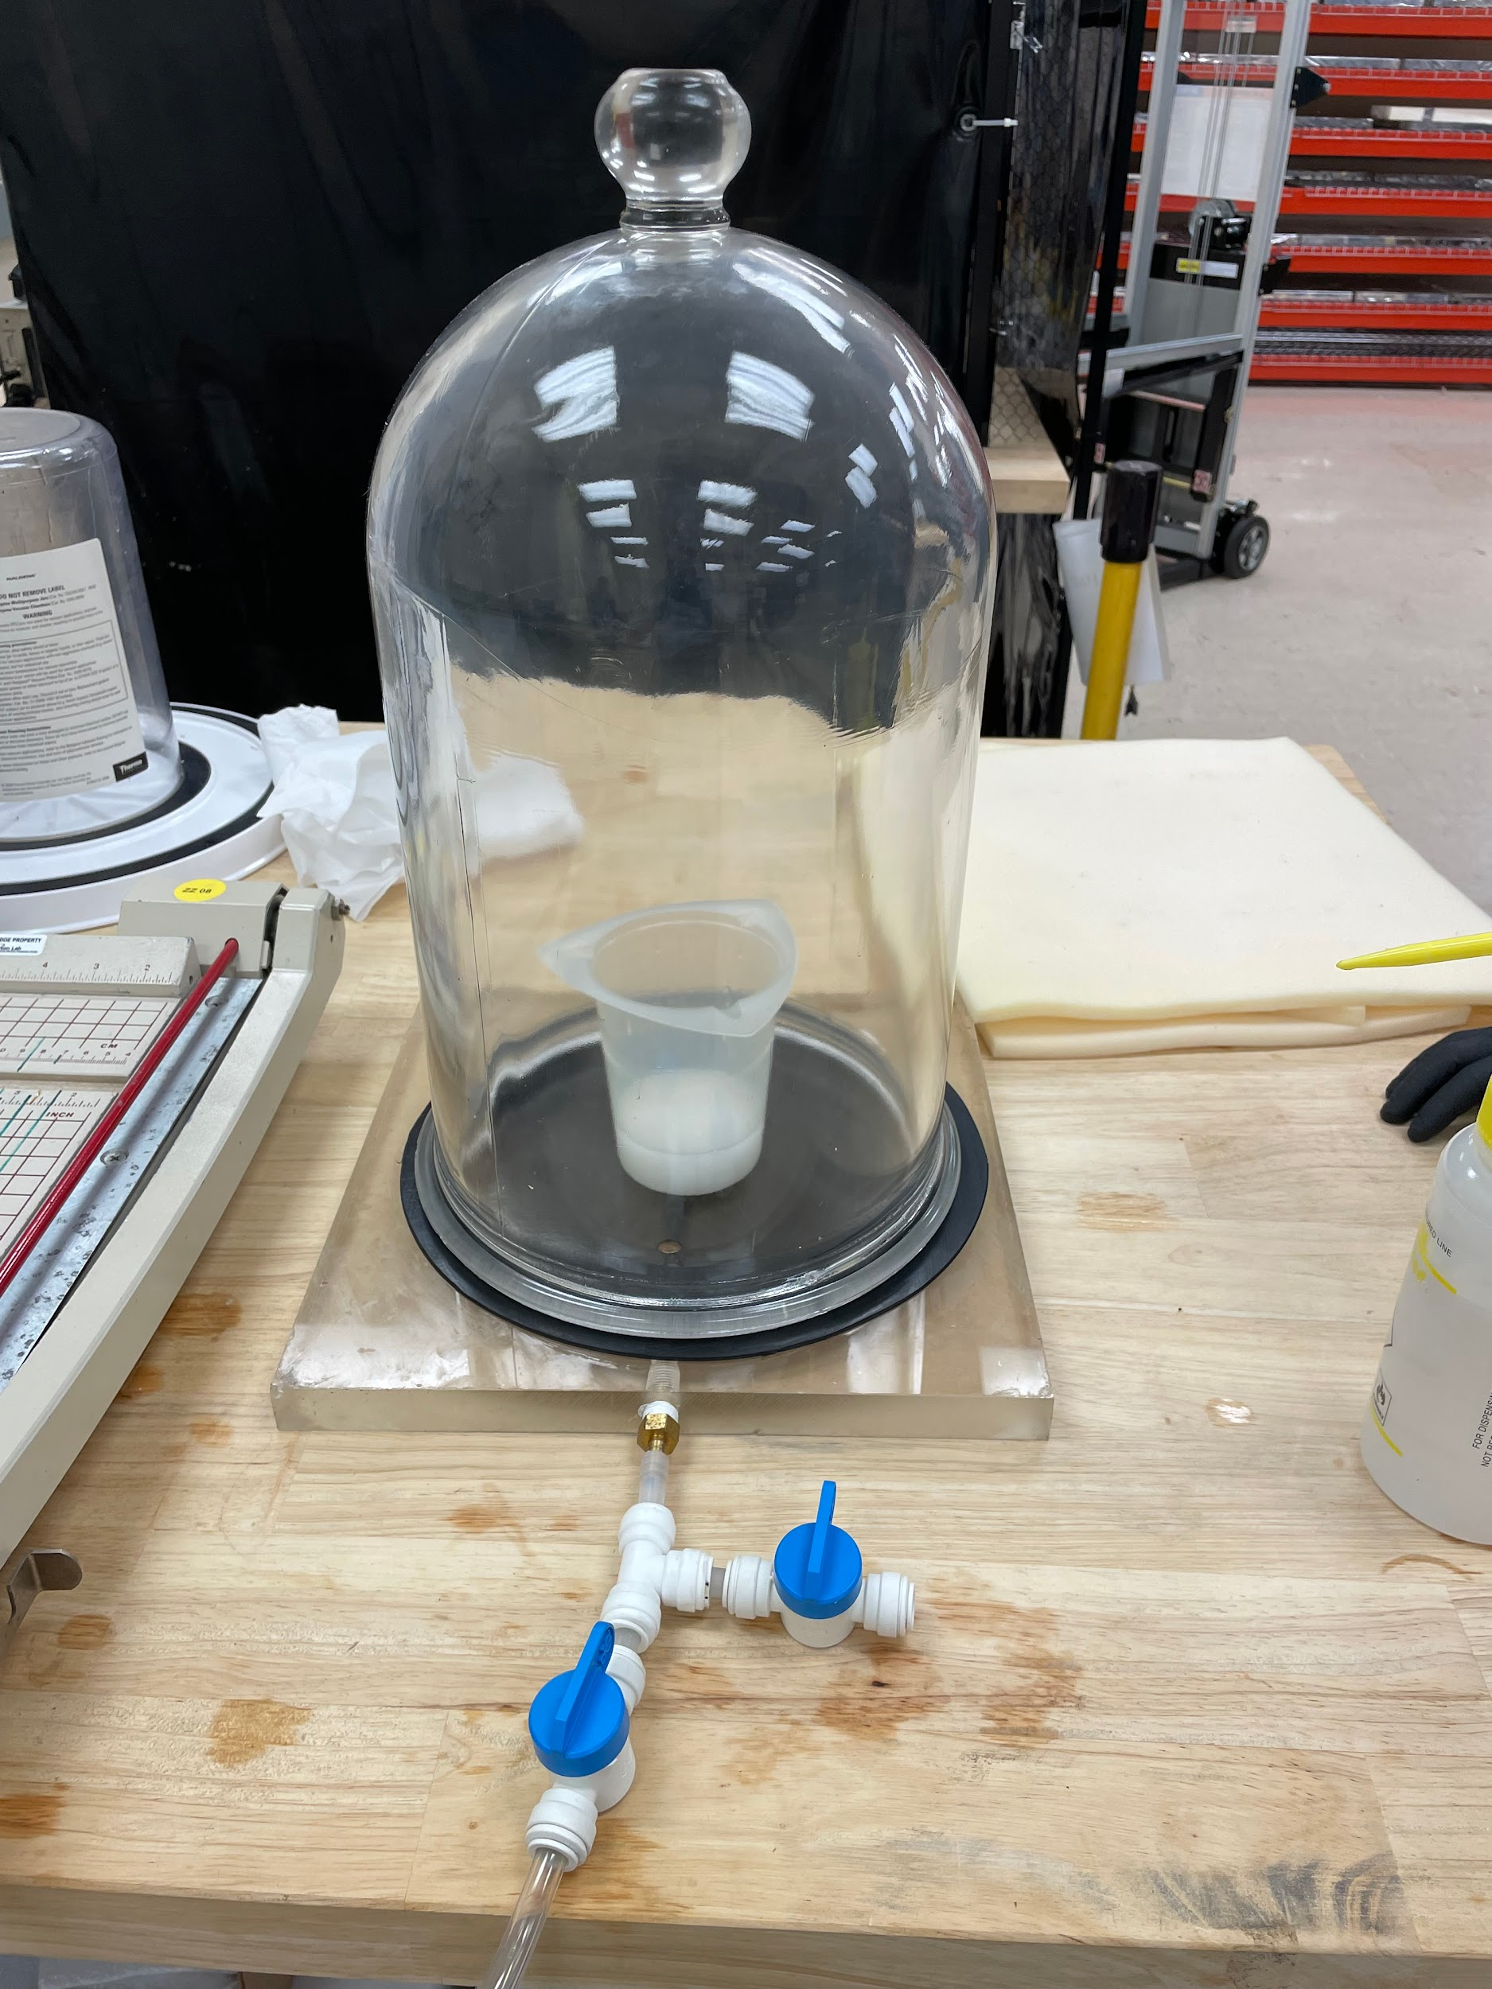
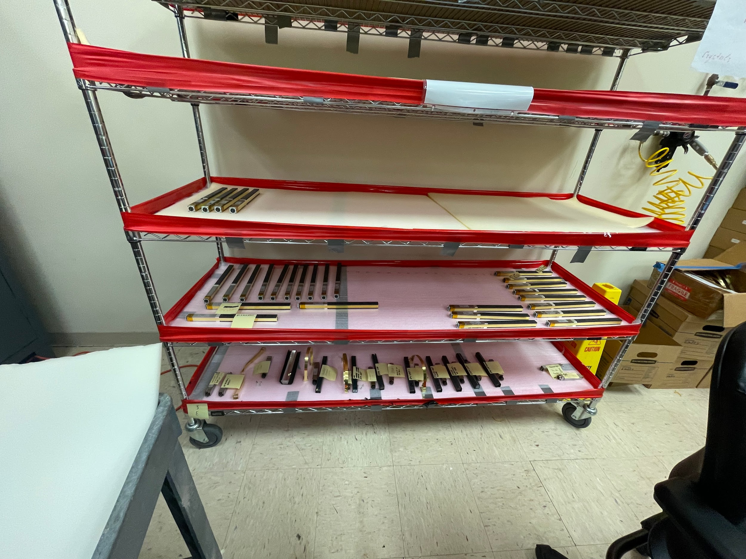
Inspection Crew
Task:
Inspect crystals
Make Cookies
Glue plastic cups to optical fibers

