Slide 1
Update on FCAL-II Project
1 July 2022
By Vadim Murakhovskiy

Slide 2
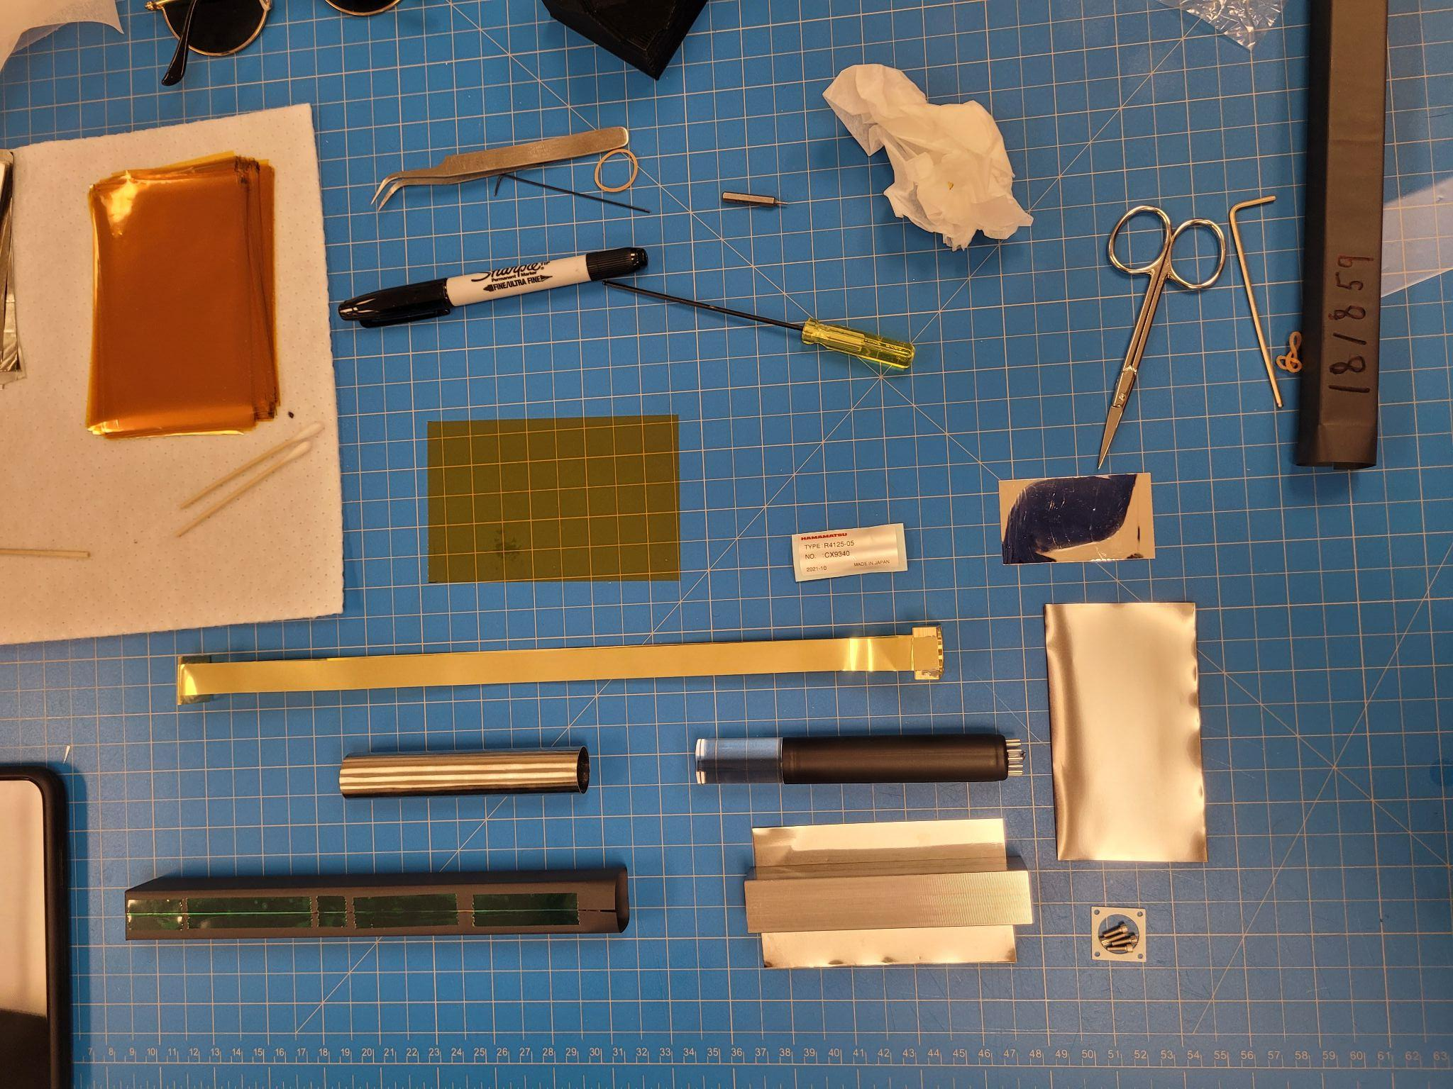
Wrapped/Fabricated Crystal Output
June 27th
June 27th
June 28th
June 28th
June 29th
20 Wrapped Crystals
31 Fabricated Crystals
29 Wrapped Crystals
33 Fabricated Crystals
34 Fabricated Crystals

Slide 3
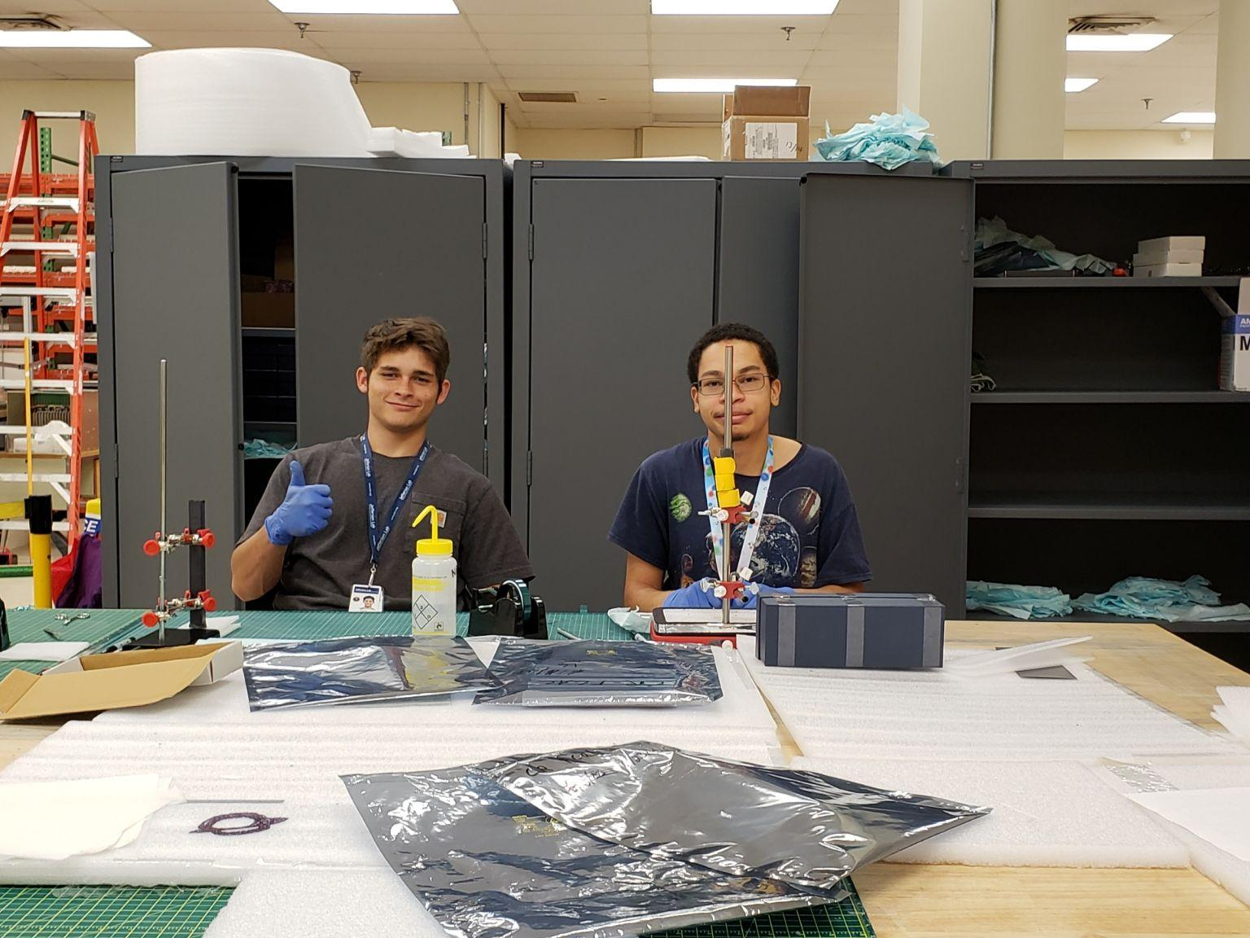
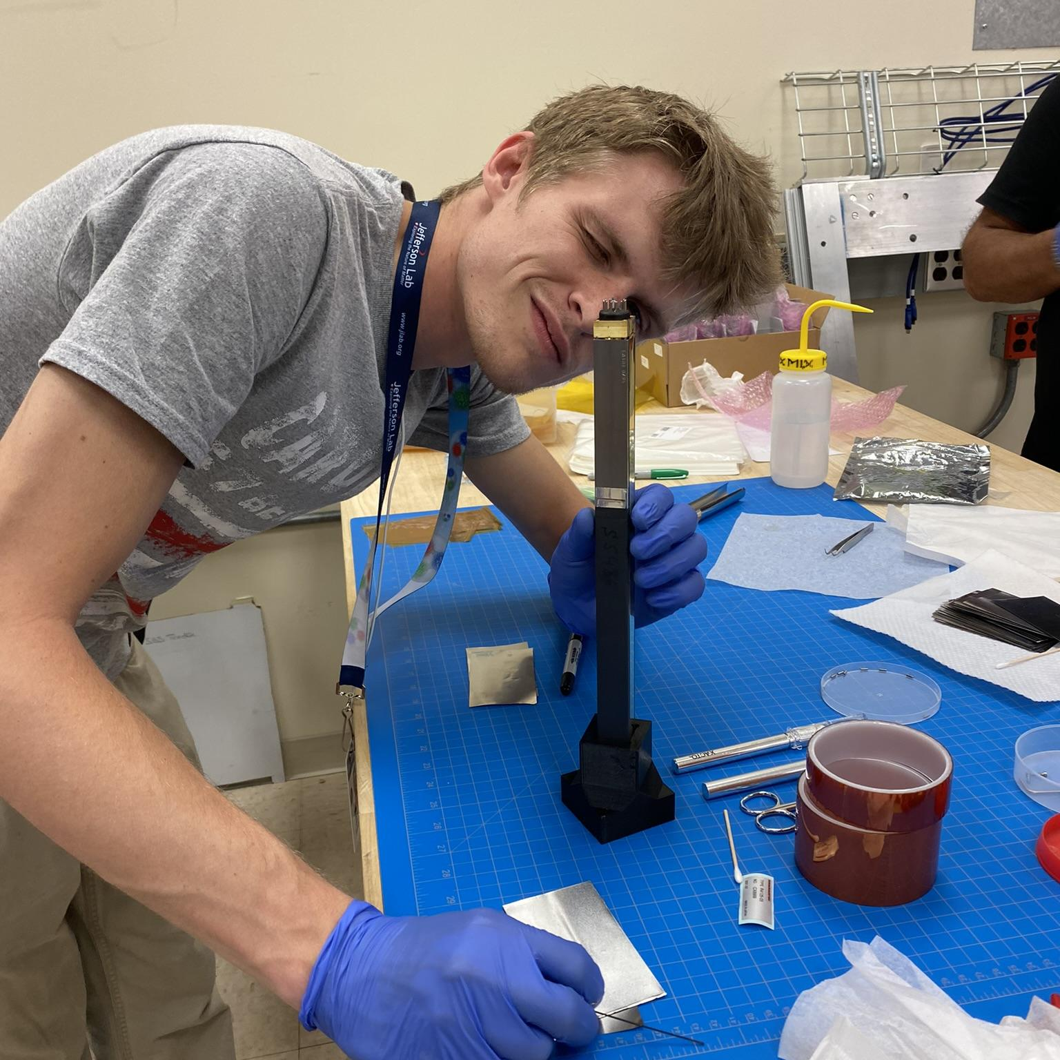
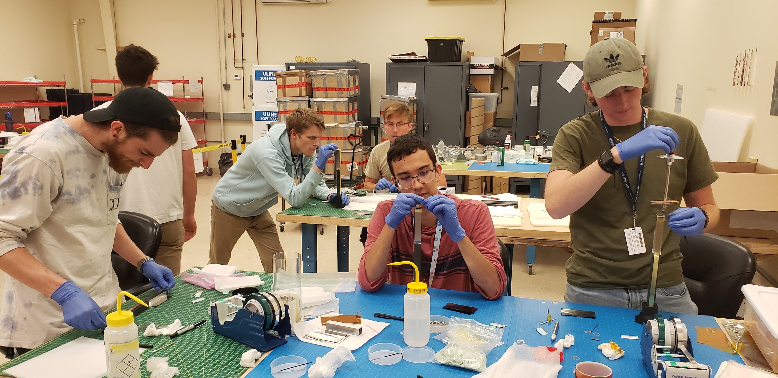

Slide 4
106
78+
Leaving Student
Jaden Wrapped 106 total Crystals and Fabricated 78
(Data Taken on 6/29)

