Slide 1
Intern Update
August 11

Slide 2
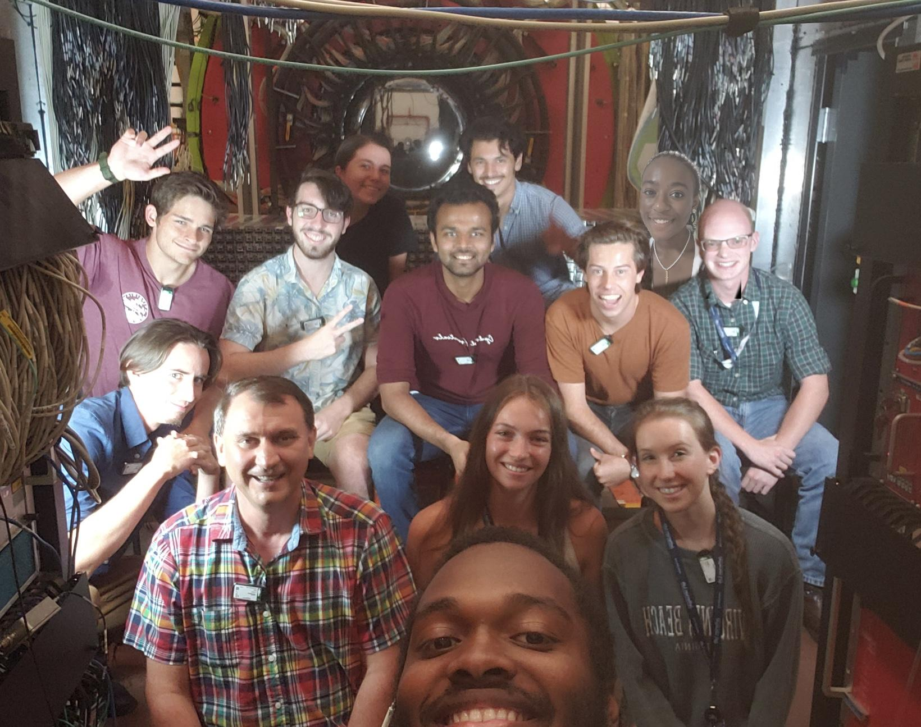
The Team

Slide 3
The Team
X
X
X
X
X
X
X
X

Slide 4
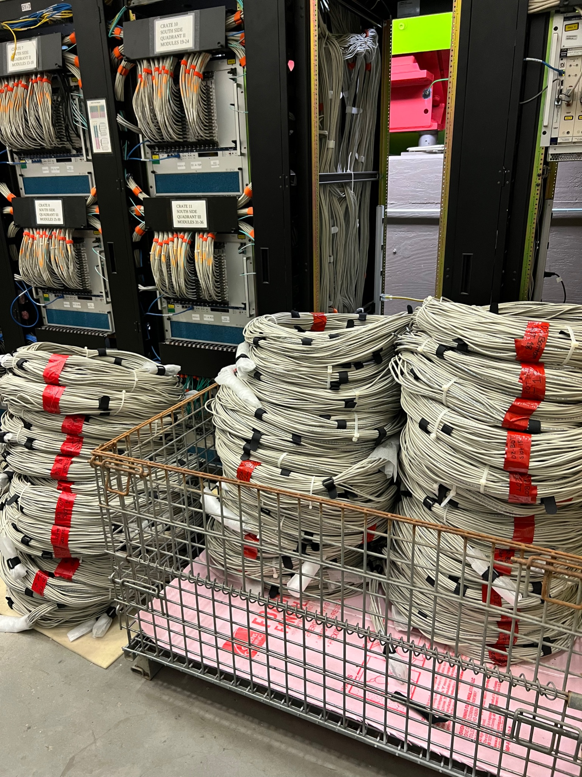
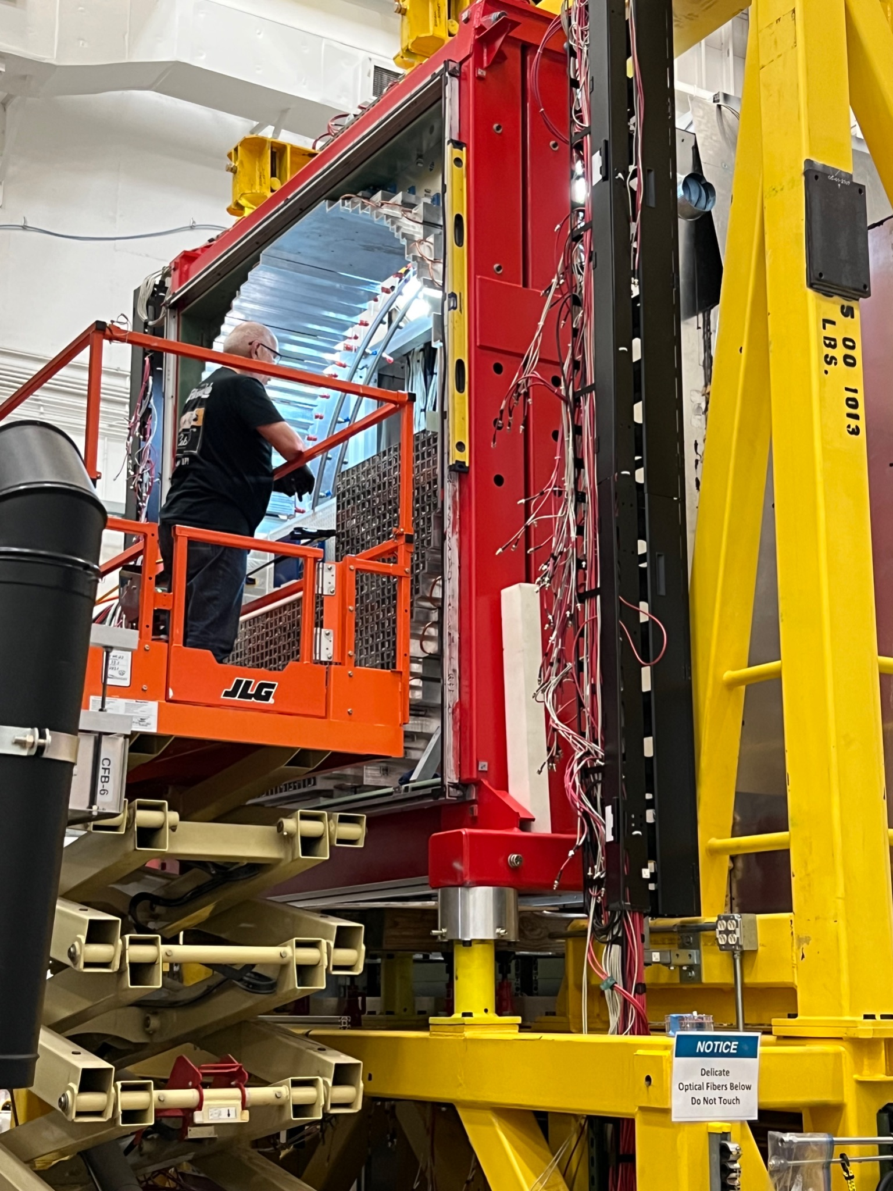
Hall D: Cables and Stacking

Slide 5
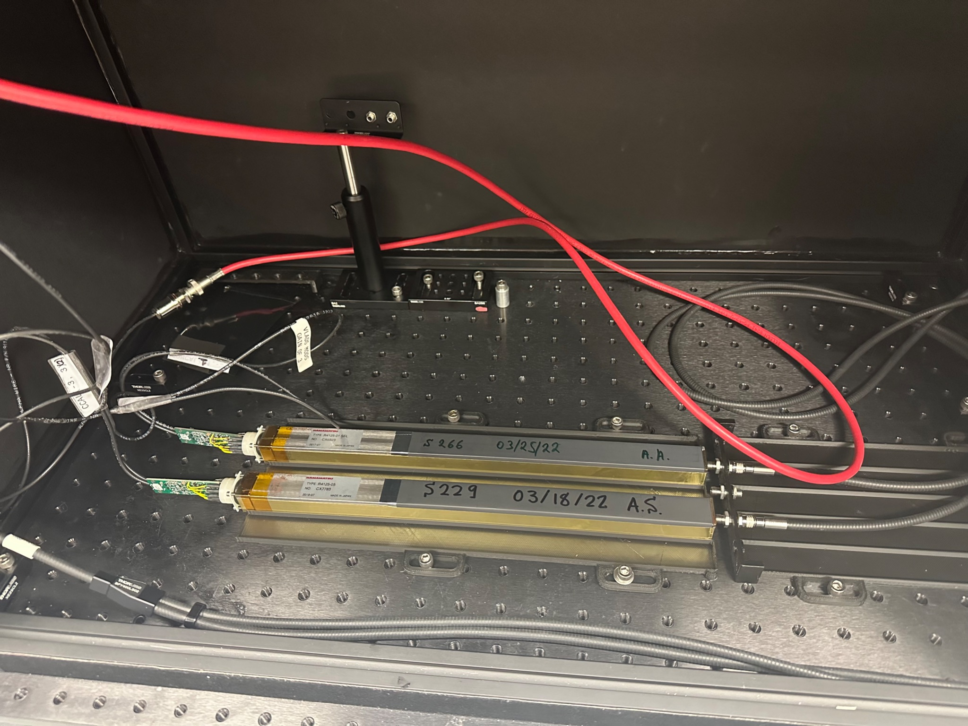
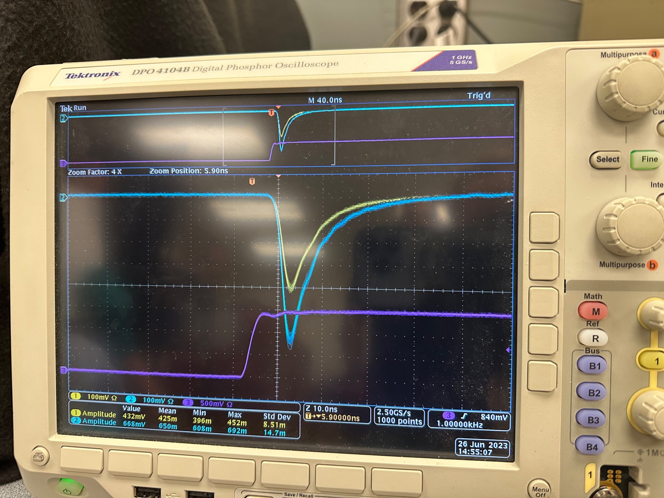
EEL: Testing PMTs (~1300)

