Slide 1
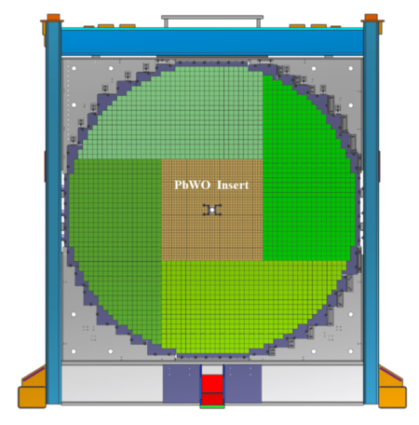
FCAL 2 in Hall D
Sasha, 11/3/22
Replace the inner part of the lead glass calorimeter with high-granularity high-resolution PbWO crystals
- Number of FCAL lead glass blocks: 2800
- Replace: 432 lead glass modules from the inner section by
1600 PbWO – based modules
lead glass size: 4 cm x 4 cm x 45 cm
PbWO crystal size: 2 cm x 2 cm x 20 cm
Timeline:
- fabricate 1600 (+spares) PbWO modules by March 2023
- start disassembling FCAL2 in Hall D in May 2023
- start installing lead glass and PbWO modules in the end of June 2023

Slide 2
Status of the FCAL 2 Module Construction
Number of fabricated modules: 1318 (need to fabricate 282 modules)
Wrapped crystals (Mindy, some students in summer): 576 (SICCAS) + 742 (CRYTUR) = 1318
Preshaped ESR films ( George ): 900 (SICCAS) + 890 (CRYTUR)
All done including spares !
Continue wrapping crystals (Mindy):
- About 80 crystals are available
- We’ll need to rewrap 140 CCAL modules (currently used by the PrimEx experiment,
will be available in January 2023 )

Slide 3
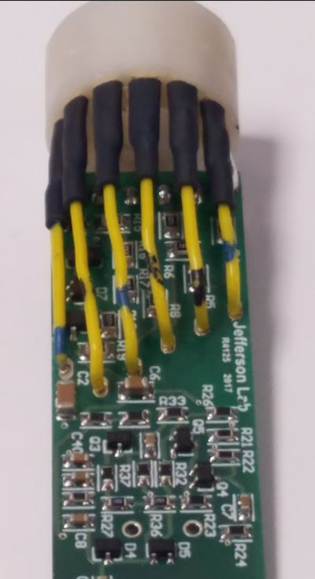
Possible Tasks During FCAL2 Module Fabrication
(before May 2023)
- Continue wrapping crystals (Mindy):
- Prepare PMT sockets for installation
(available 1600 sockets now)
Wires added to pins 6 through 11
- Check of PMT active bases (they will be ordered
in November). Expect to get some in Feb 2023

Slide 4
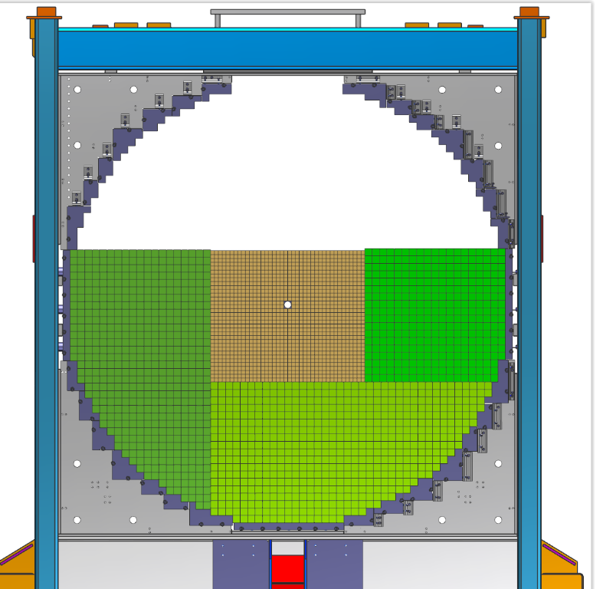
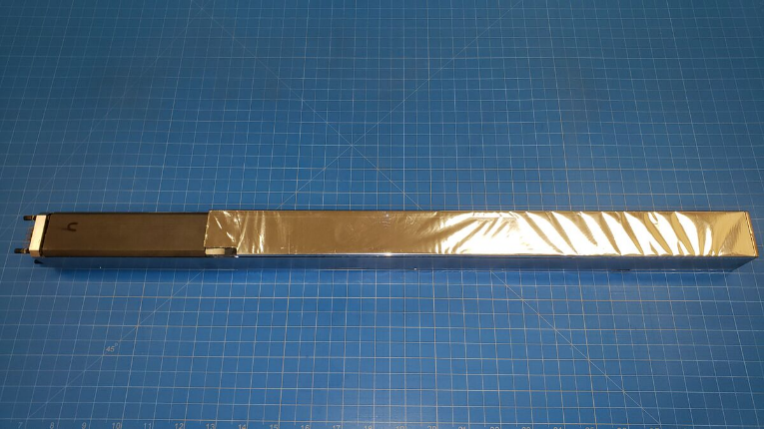
Possible Tasks During FCAL2 Installation
(after May 2023)
Help to disassemble FCAL modules. Help to install lead glass and lead
tungstate modules (some students will be involved)
- start disassembling detector in May 2023.
- start installing modules in the end of June
Perform visual inspection of uninstalled lead glass modules
(coordinate student’s activities)
https://halldweb.jlab.org/wiki/index.php/FCAL_Installation
Repairing lead glass modules (if needed), fix wrapping, etc.
- A few students will be available, coordinate activities

Slide 5
Possible Tasks During FCAL2 Installation
Help to Install cables:
Short cables in the FCAL dark room going from patch panels to
PMT dividers, connect to the divider (LV, HV, signal, 1600 of each time)
Cables connecting VSX readout and HV / LV crates
Any help with these tasks is very appreciated !

