Slide 1
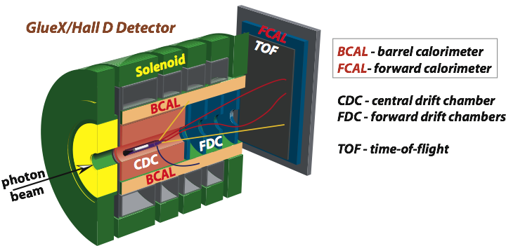
Experimental Studies of Hadrons in Nuclear
Matter with the GlueX Detector
A. Somov (Jefferson Lab)
The Nature of Hadron Mass and Quark-Gluon Confinement from JLab Experiments
in the 12-GeV Era, July 3 , 2018, Pohang, Korea
GlueX detector and physics program
Proposed experiments with the GlueX detector
- Study color transparency in photoproduction
- Study Photoproduction of vector mesons off nuclei

Slide 2
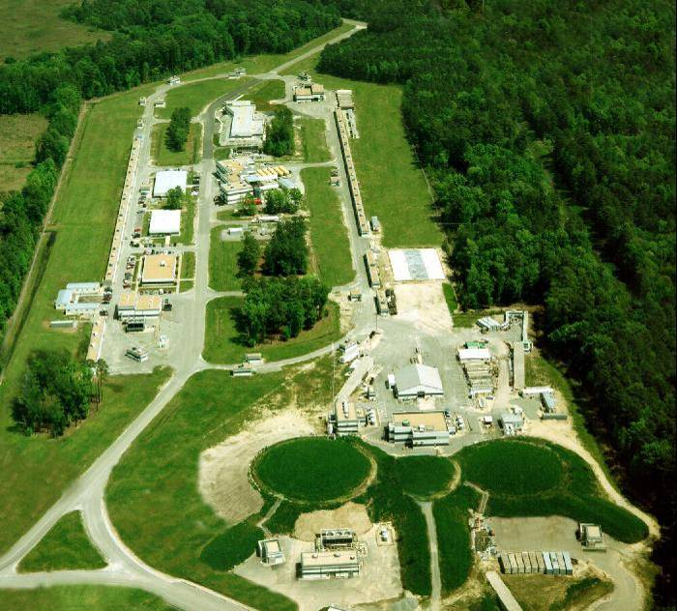
The GlueX Experiment in Hall D at JLab
Hall D
Newly constructed experimental Hall D
with the GlueX detector
- Photon beam produced by CEBAF 12 GeV
electrons in thin radiator via bremsstrahlung
process
- Linear polarization of beam photons
Over 125 collaborators from more than
25 institutions
A
B
C

Slide 3
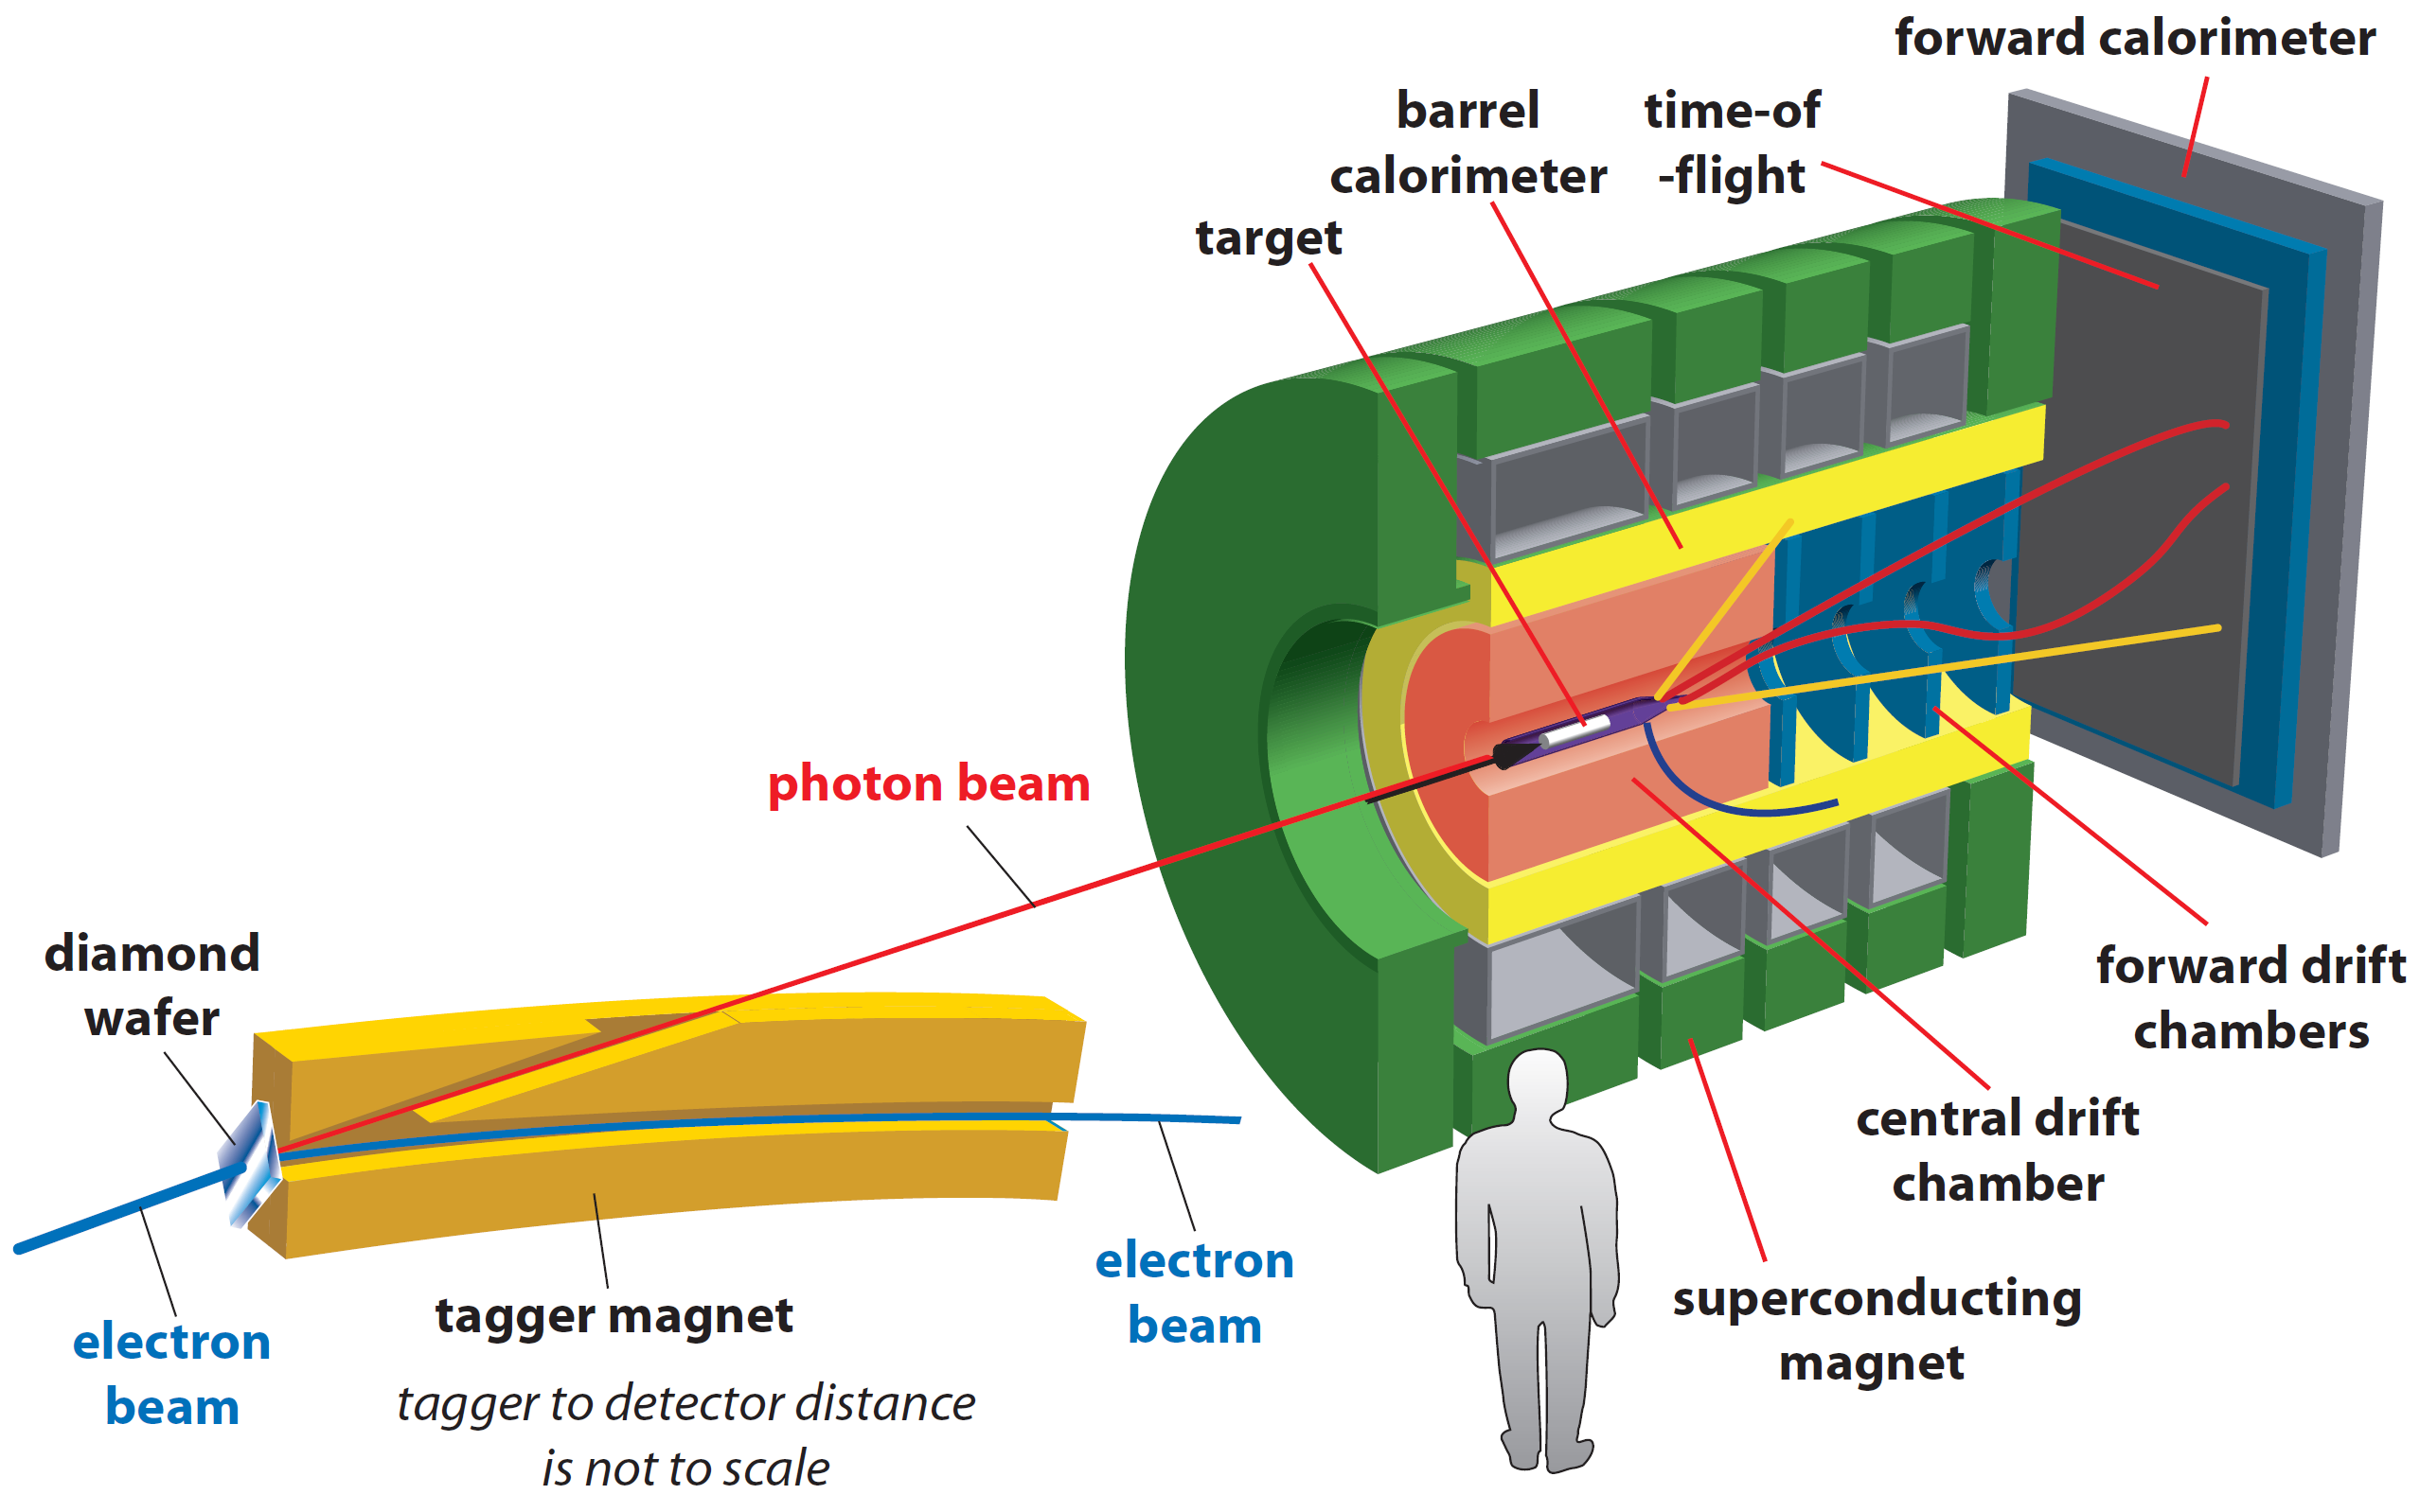
GlueX Detector
• Optimized to detect multi-particle final states
• Hermetic, large/uniform acceptance for
charged and neutral particles, good energy
and momentum resolution
Tracks: σ_{p} / p ~ 2 – 5 %
Photons: σ_{E} / E = 6 % /√E ⊕ 1.6 %
Acceptance: 1° < θ < 120°
Target: liquid hydrogen
new PID (k/π)
Newly proposed experiments:
- install nuclear targets
- no modifications to the
existing detector

Slide 4
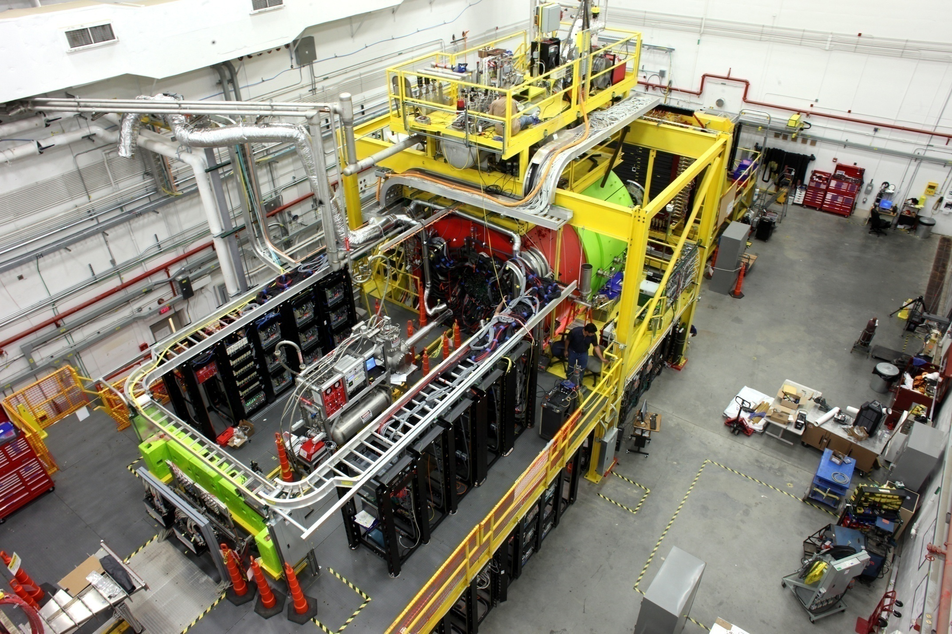
GlueX Detector

Slide 5
Hall D Physics Program: Approved Experiments
Experiment | Name | Days | Condition | Target
E12-06-102 | Mapping the spectrum of light quark mesons and gluonic excitations with Linearly polarized photons | 120 |  | LH₂
E12-12-002 E12-13-003 | A study of meson and baryon decays to strange final states with GlueX in Hall D | 220 (200) | PID | LH₂
E12-10-011 | A precision measurement of the η radiative decay width via the Primakoff effect | 79 |  | LH₂ LHe₄
E12-13-008 | Measuring the charged pion polarizability in the γγ → π⁺π⁻ reaction | 25 |  | Sn
C12-14-004 | Eta decays with emphasis on rare neutral modes: The JLab Eta Factory experiment (JEF) |  | Upgrade Forward calorim. | LH₂
see talk by Elton Smith

Slide 6
Hall D Physics Program: New Proposals
Proposal | Name | Target
PR12-17-001 | Physics with secondary K_{L} beam | LH₂, A
PR12-17-007 | Probing QCD in the nuclear medium with real photons and nuclear targets at GlueX (Color Transparency and SRC) | LH₂, A
PR12-17-010 | Production of vector mesons on nuclei with GlueX | A
Experiments in GlueX using nuclear targets
Working group:
Gasparan (NCAT), L.Gan (UNCW), S. Gevorkyan (JINR),
I. Larin (UMAS), O. Hen (MIT), H. Gao (Duke), M. Patsyuk (MIT),
D. Dutta (MSS), L. Weinstein (ODU), E. Piasetzky (TAU), and
GlueX Collaboration

Slide 7
Color Transparency
PR12-17-007
At high transfer momenta |t| photon couples to a qq configuration with a
small transverse size
The small-size configuration interacts less with the nuclear medium
(fundamental predictions of QCD)
Observables:
- Increase of the medium nuclear transparency T = σ _{A} / A ⋅σ _{N}
T
Color transparency
Glauber
|t|

Slide 8
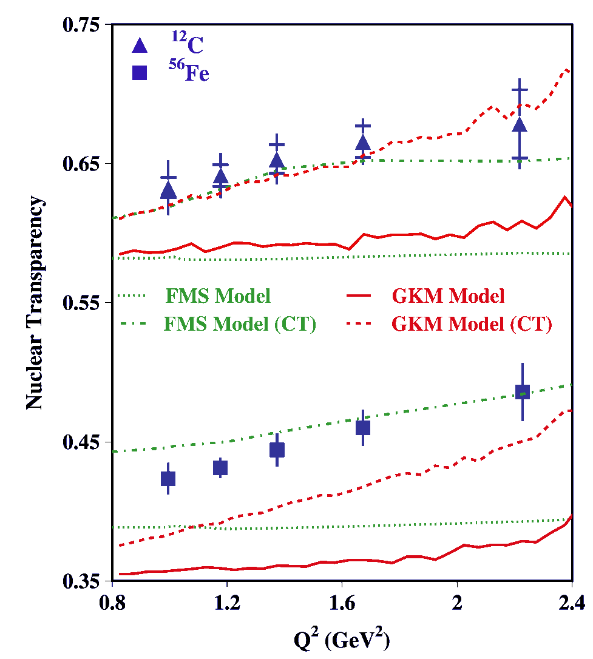
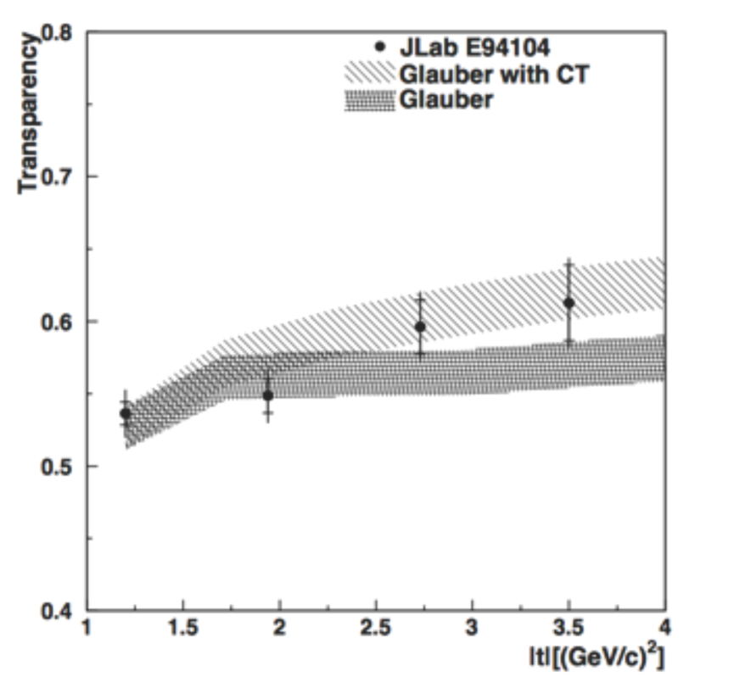
Measurement of Color Transparency
A (e,e′ ρ⁰)
γ + n → π ⁻ + p
Dutta et al., PRC 68, 021001R (2012)
L. El Fassi et al., PLB 712, 326 (2012)

Slide 9
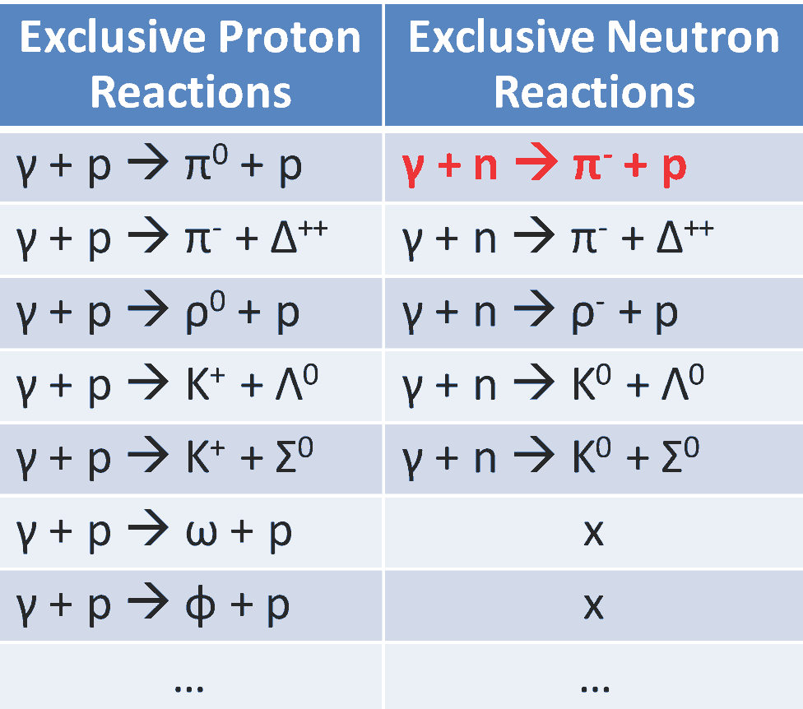
Proposed CT Measurements at GlueX
Measure nuclear transparency using nuclear targets:
D, ⁴He, ¹²C, ⁴⁰C
Reconstruct several final states
Large range of |t _{max}|
from 3 GeV² to about 10 GeV²
- Previous measurement:
|t| < 3.5 GeV²

Slide 10
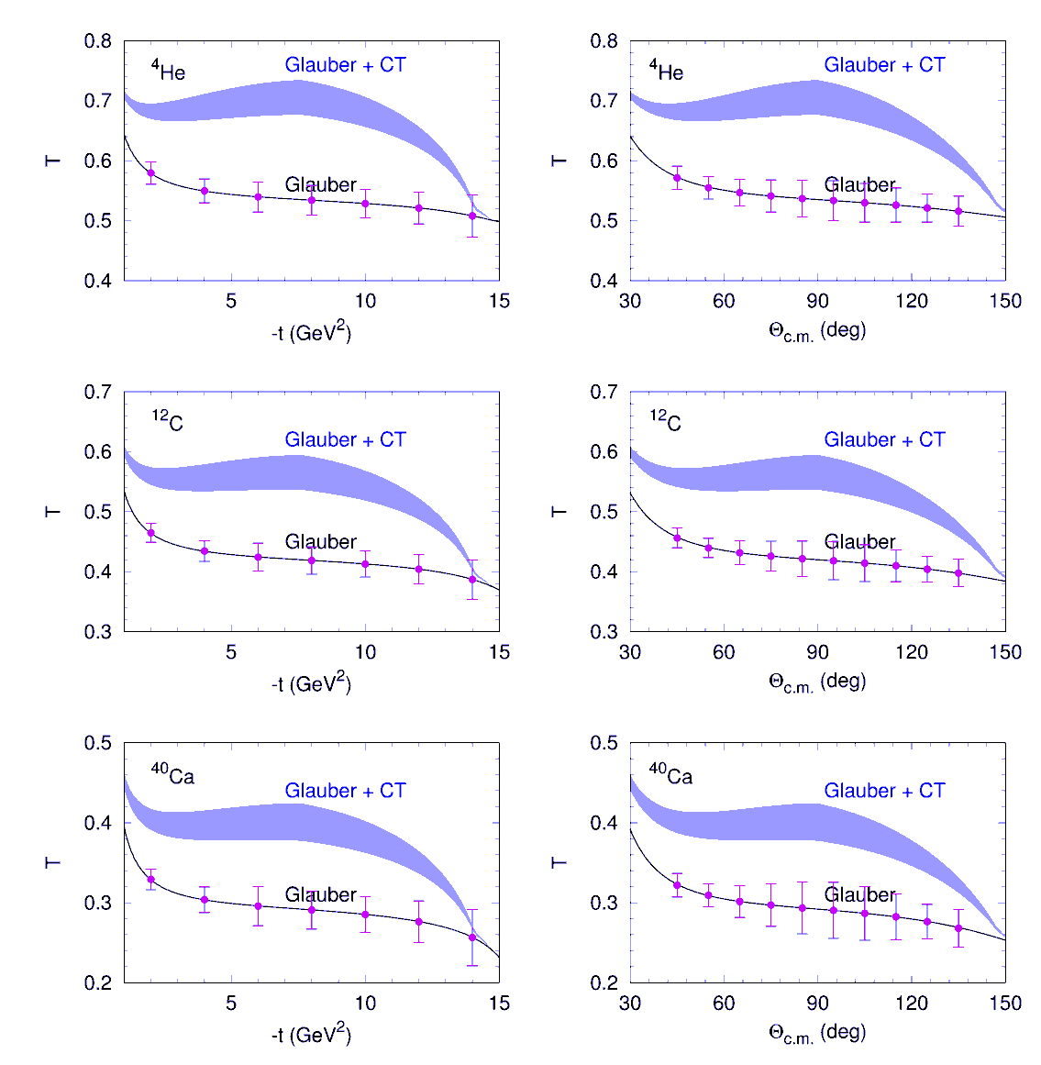
Expected Sensitivity
γ + n → π ⁻ + p
Theoretical calculations for GlueX
by I. Larionov and M. Strikman
Phys.Lett. B, 760, 753 (2016)
Number of reconstructed events
 | γ + n → π ⁻ + p | γ + n → ρ ⁻ + ρ ⁺
D | 13,600 | 57,000
⁴He | 13,000 | 54,000
¹²C | 7,400 | 31,000
⁴⁰Ca | 2,600 | 13,600
Smallest yield for γ + n → π ⁻ + p

Slide 11
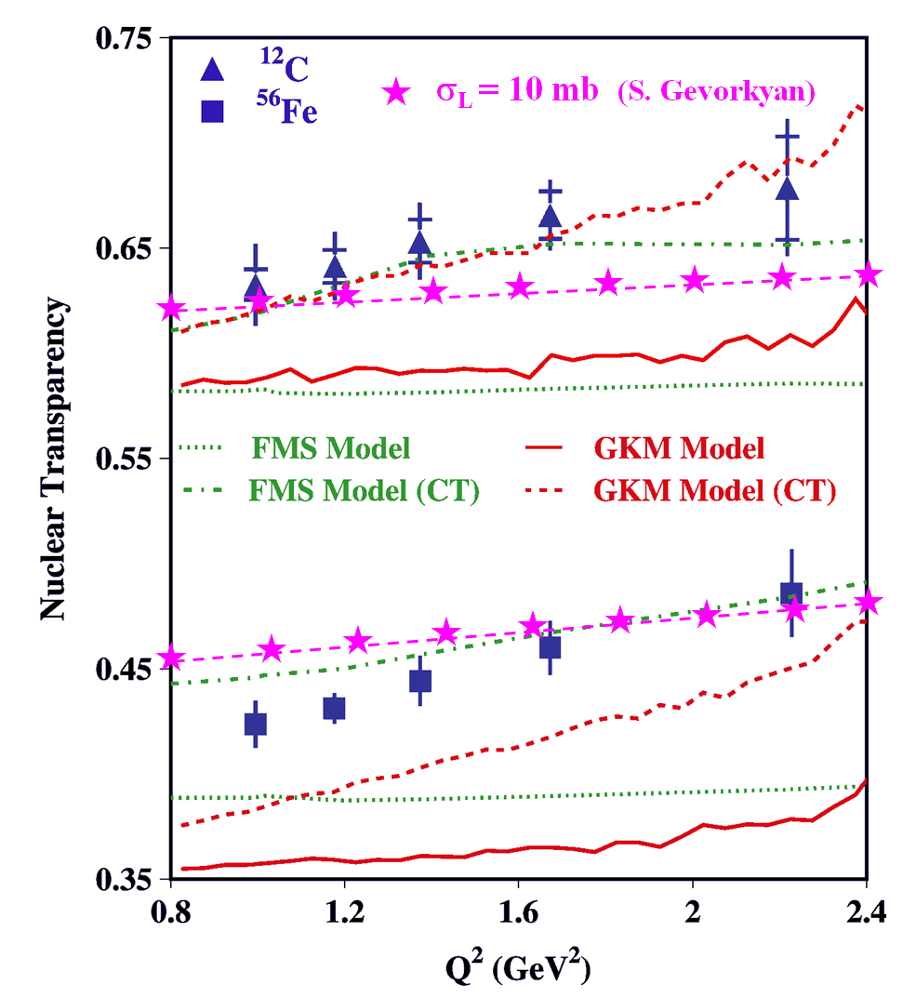
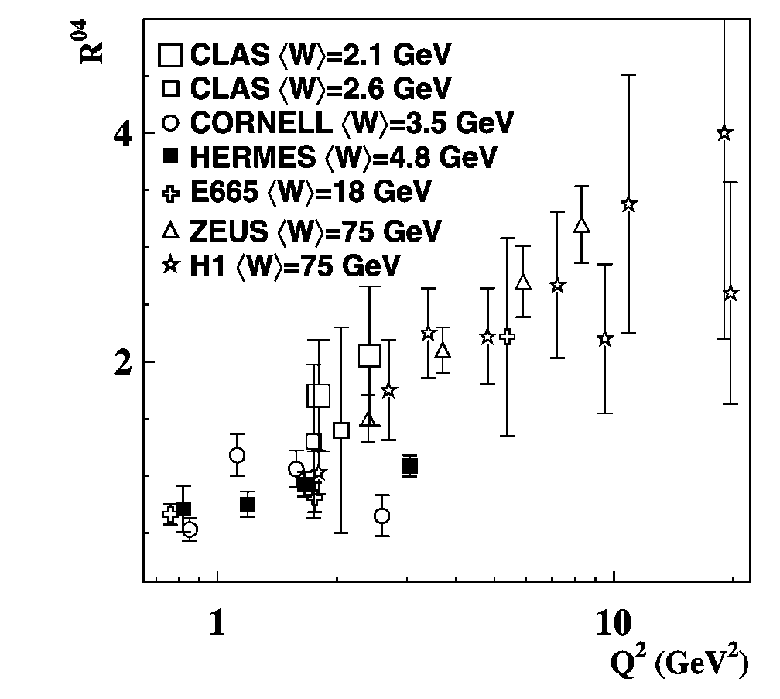
Impact of σ_{L,T} (VN) on Color Transparency
CT measurements at CLAS
Q² dependence of the longitudinal-to-
transverse cross section ratio for ρ mesons
- Larger fraction of longitudinally polarized ρ mesons produced at larger Q²
Nuclear transparency depends on the polarization of the meson
The Color Transparency effect is ‘screened ‘
if σ_{T} (VN) >> σ_{L} (VN)
Propose to measure meson-N cross sections of longitudinally and transversely polarized mesons

Slide 12
Proposed Experiment: Photoproduction of Vector
Mesons on Nuclei with GlueX
Measure photoproduction cross sections of vector mesons ω, ρ, and φ
on C, Si, Sn and Pb targets in the energy range of 6-9 GeV with the
GlueX detector
Extract nuclear transparency T = σ_{A} / A ⋅ σ _{N} at different energies
Extract spin density matrix elements
Extract cross section σ_{L} (ω N) with two methods
- nuclear transparency A_{eff}
- spin density matrix element ρ^{A}₀₀

Slide 13
Why is it Important ?
There are experimental indications that σ_{L} (VN) < σ_{T} (VN), but there
have been no direct measurements of σ_{L} (VN) so far. Measurements
of σ_{L} are important for the interpretation of the color transparency in
vector meson electroproduction and comparison between different
theoretical approaches
Disagreement between existing experimental data and theoretical
predictions for nuclear transparency

Slide 14
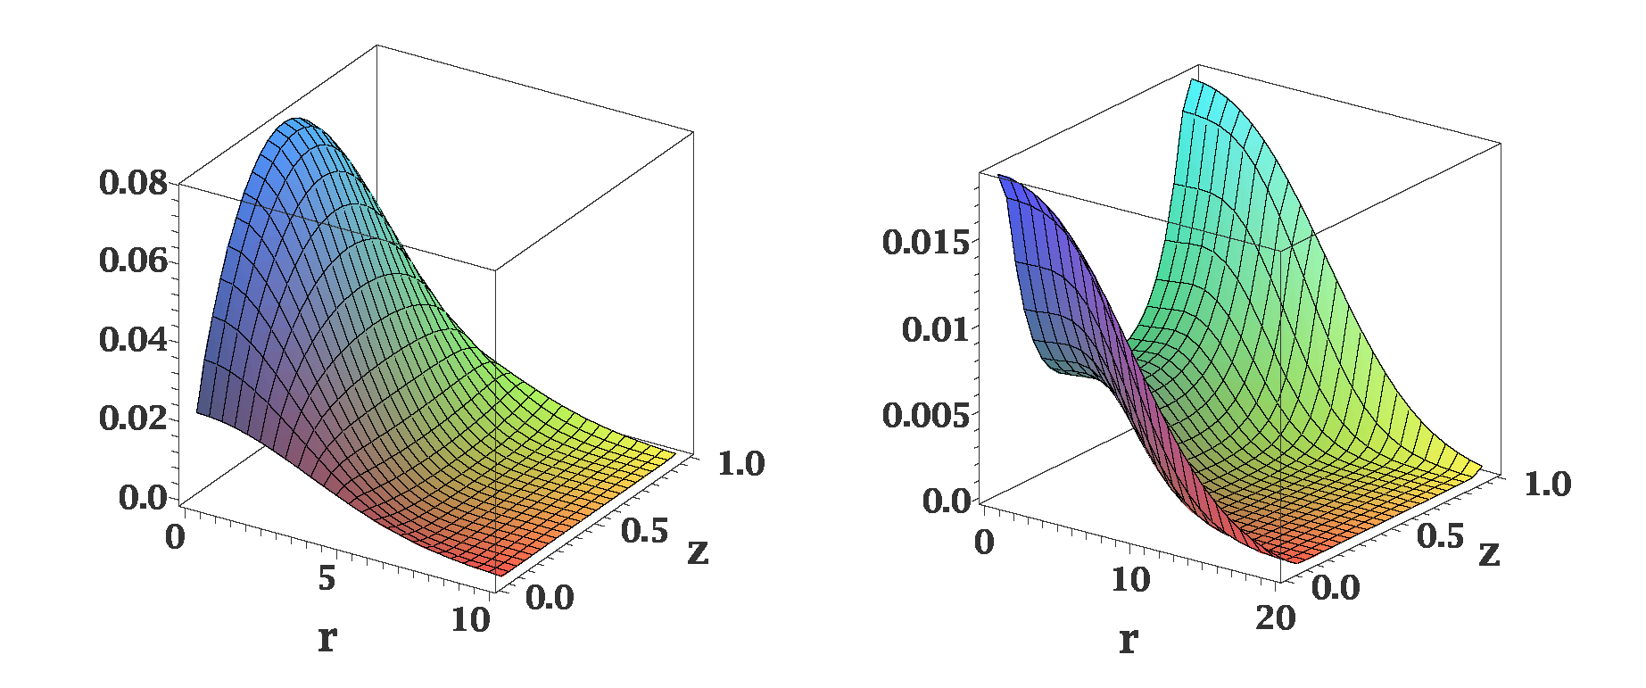
Distribution of Quarks in Vector Meson
Different distributions of quarks in the transversely and longitudinally polarized
mesons
ρ_{L}
ρ_{T}
In AdS/QCD (Brodsky & G.Teramond)
light-cone wave functions depend on
meson polarization
Light-cone wave functions for ρ mesons:
J.Forshaw and R.Sandapen
Phys.Rev. Lett. 109,081601,2012
Color dipole model of strong interaction
different cross sections for interactions of transversely and longitudinally
polarized mesons

Slide 15
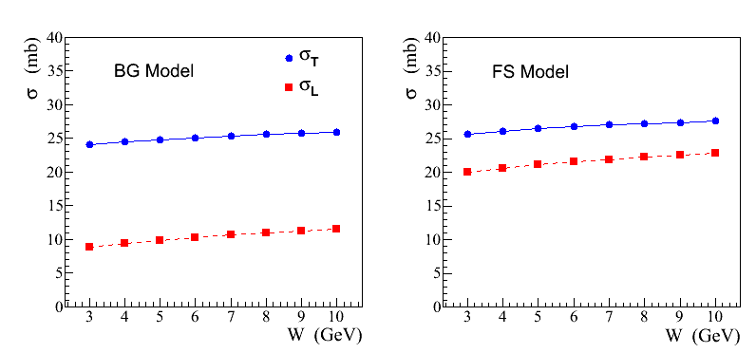
Recent Theoretical Calculations
S. Gevorkyan, paper in
preparation
σ_{L,T} (ρ N) cross sections predicted in a color dipole model using different
parameterizations of wave functions:
AdS / QCD holographic wave function (FS)
J.Forshaw and R. Sandopen,
Phys.Rev.Let. 109, 2012
Boosted Gaussian (BG) wave function
B.Kopeliovich et al., Phys.Rev. C65, 2002
FS model
BG model

Slide 16
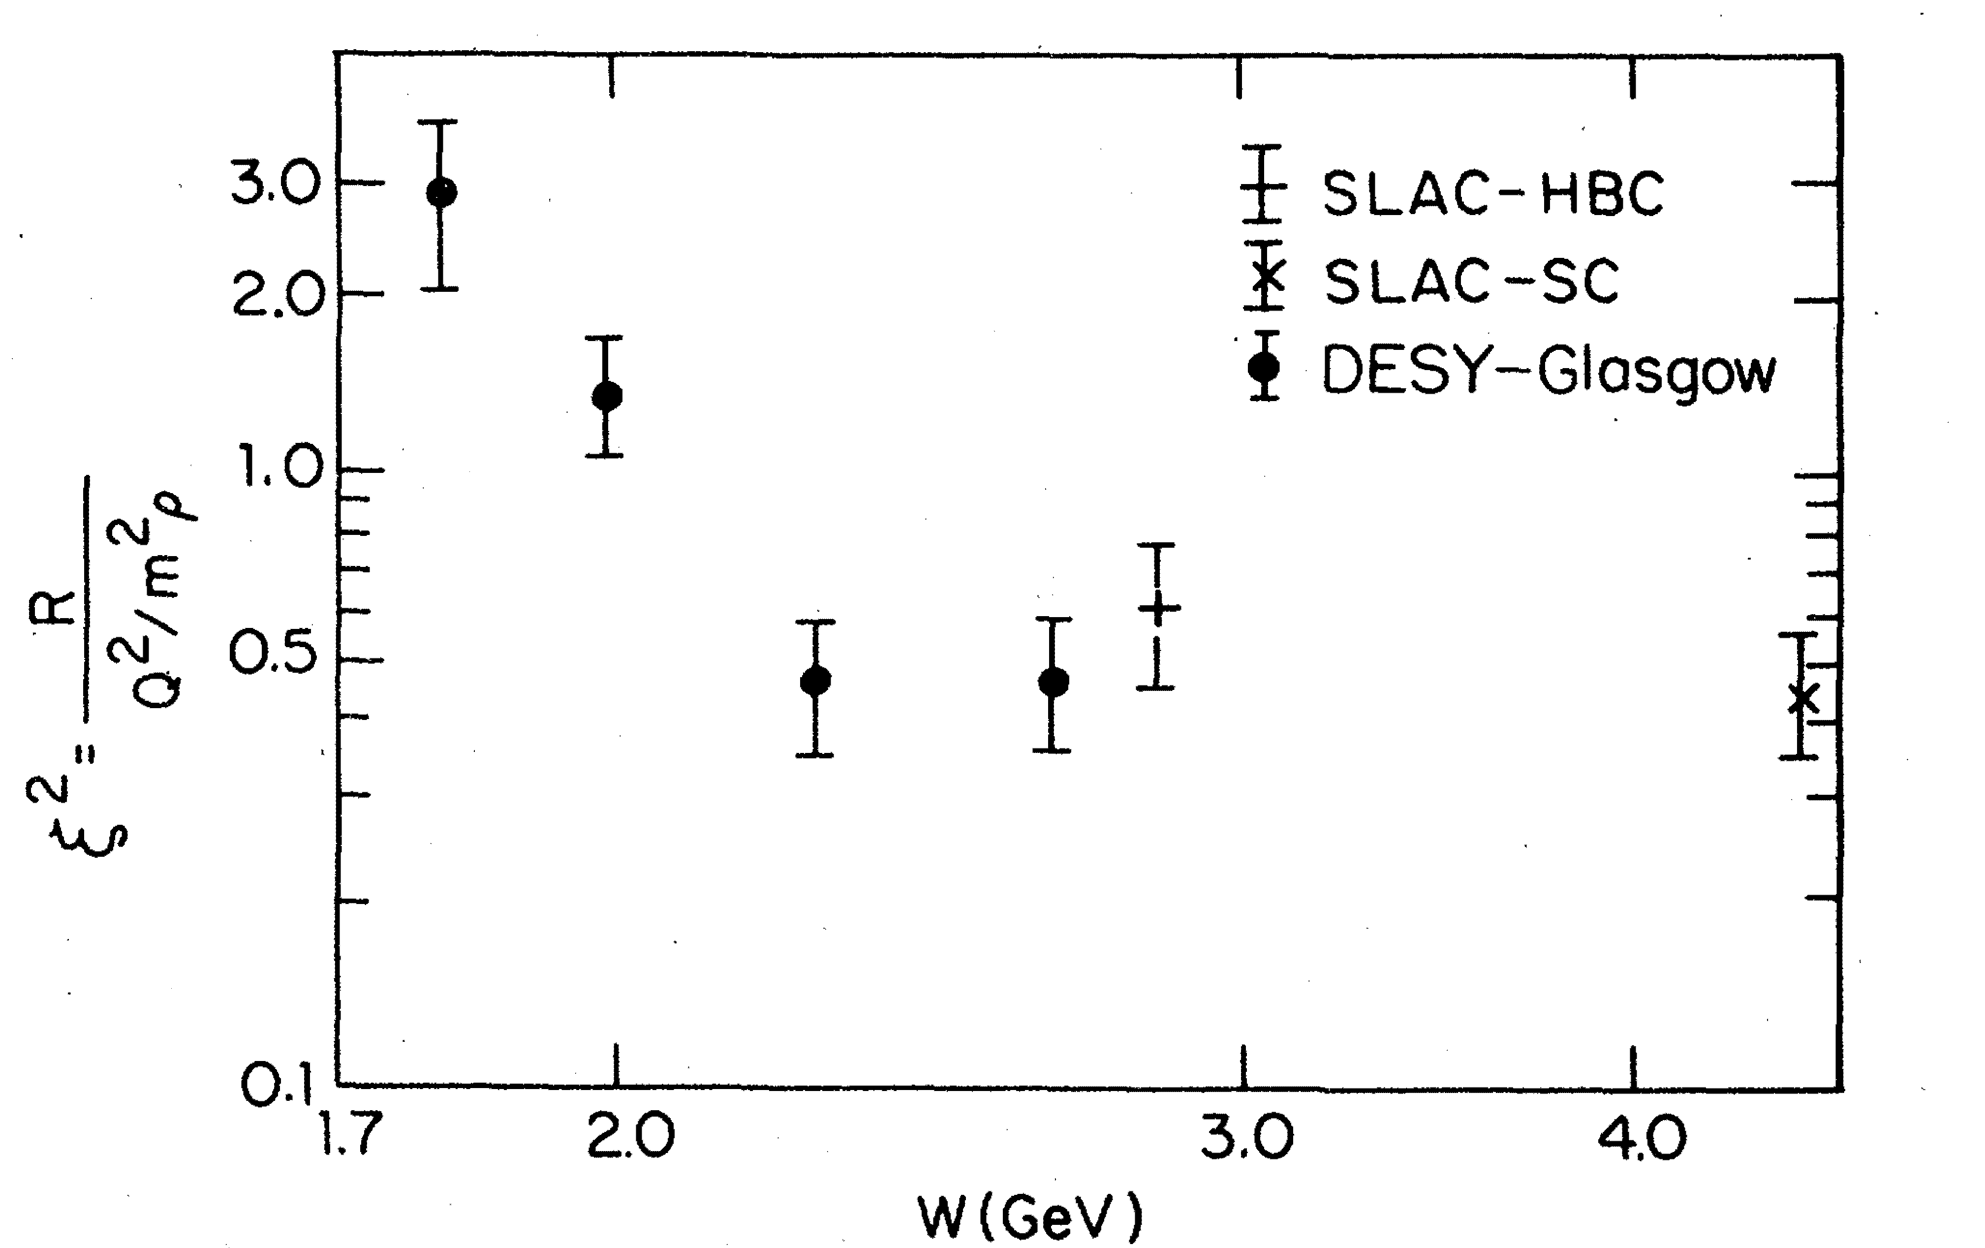
Polarization-Dependent Interactions: Experimental Observations
Hints from the electroproduction of vector mesons:
where
ρ mesons: ξ ~ 0.7 Nucl. Phys. B113, 53 (1976)
φ mesons: ξ² ~ 0.33 Phys. Rev. Let. 39, 516 (1977)
Similar observations of the polarization-dependent
interactions of deuterons with Carbon targer
- measured in Dubna and Juelich
Phys. Part. Nucl. Lett. 7, 27, 2010 Phys. Rev. Lett. 104, 2010
Measurements in the charge exchange process at Argonne:
π⁺ + Ne → ρ + Ne′
Nucl. Phys. B67, 333 (1973)
Propose to measure σ_{L} (VN) using photoproduction on nuclei

Slide 17
Photoproduction of ω Mesons
In the coherent γ + A → ω + A production at JLab energies the essential
contribution of pion exchange cancels out. From the absorption of ω’s one
can extract σ_{T} (ω N)
- it has been measured by several experiments (σ_{T} ~ 26 mb)
In the incoherent process γ + A → ω + A′ the cross section is given by
- N (0, σ_{L}) and N (E, σ_{T}) are absorptions of the longitudinally and transversely
polarized mesons predicted by theoretical models
- ρ₀₀ is the spin density matrix element measured in γ p → ω p reaction
Why ω measons ?
- Some fraction of ω mesons is longitudinally polarized at GlueX energies,
ρ₀₀ measured by SLAC is 0.2 ± 0.07

Slide 18
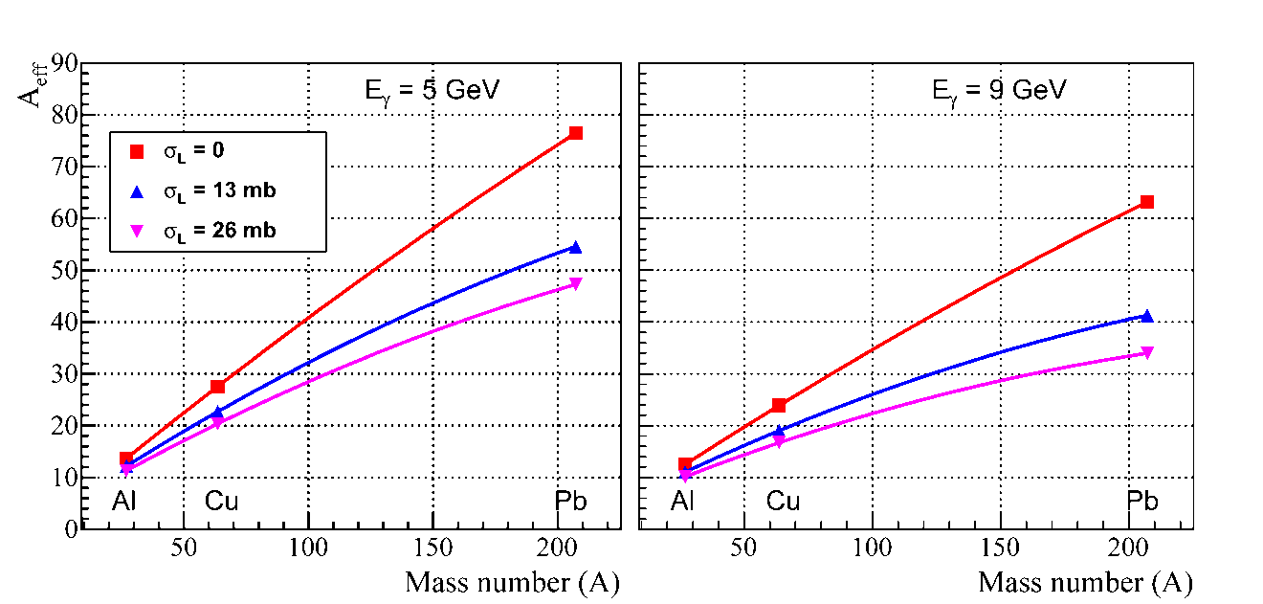
How to Extract σ_{L} (ωN) ?
σ_{L} (ωN) can be extracted from the measurements of:
Method 1: Nuclear transparency ( A_{eff} )
Method 2: Spin density matrix element (ρ^{A}₀₀ )
Method 1
Calculations by S. Gevorkyan for GlueX Phys. Rev. C 93, 015203 (2016)
Predictions for A_{eff}
Measure A_{eff} for each target
A_{eff} depends on σ_{L} (see plot)
N (0, σ_{L}) and N (E, σ_{T}) are
predicted by theoretical models.
N (E, σ_{T}) will be independently
measured for ρ mesons
A_{eff} will be normalized to Carbon data: some systematic uncertainties will cancel out
(σ_{N,} Br, some reconstruction efficiencies, )

Slide 19
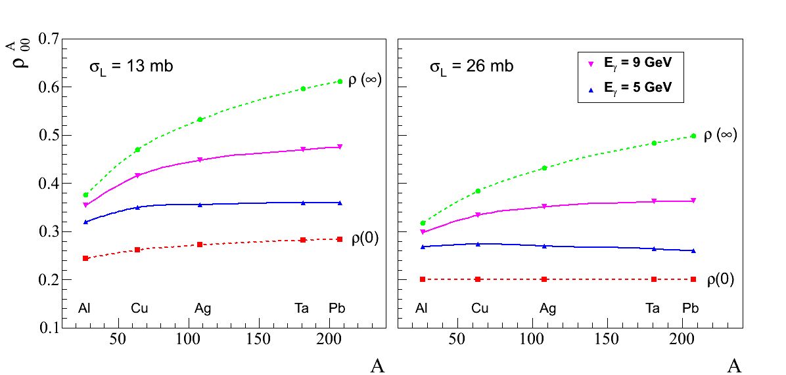
How to Extract σ_{L} (ωN) ?
Method 2
Measure ρ^{A}₀₀ for each target from the
fit to the ω decay angular distribution
ρ^{A}₀₀ depends on σ_{L}
- extract σ_{L}
ρ₀₀ is measured in the
γ p → ω p reaction
Predictions for ρ^{A}₀₀ Phys. Rev. C 93, 015203 (2016)
A-dependence of the spin
density matrix elements ρ^{A}₀₀

Slide 20
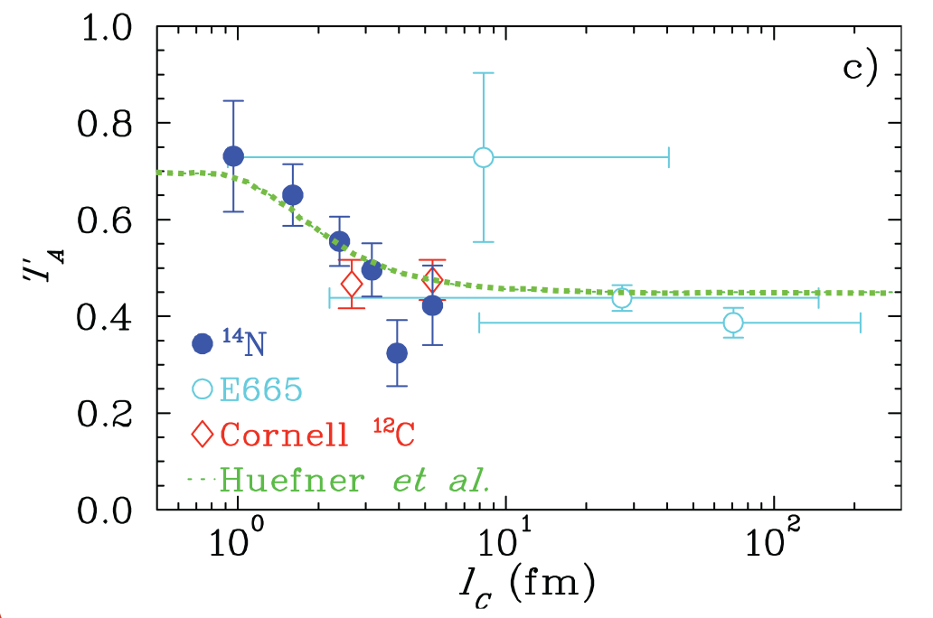
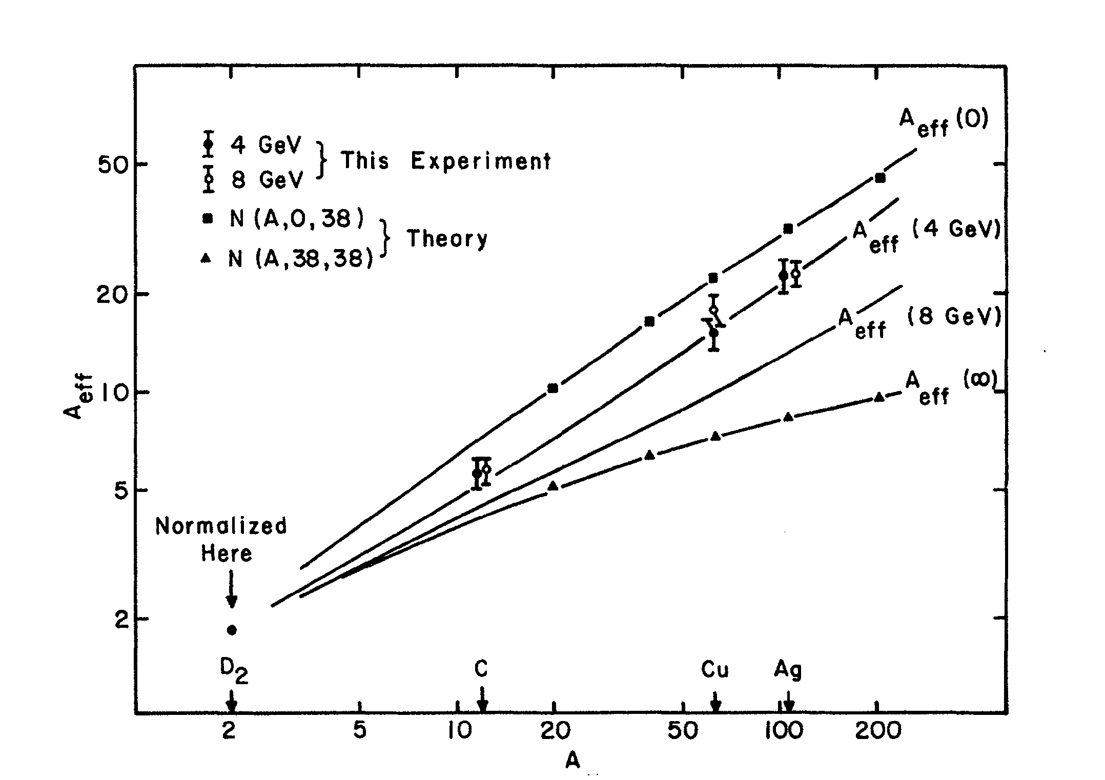
Energy Dependence of Nuclear Transparency
Energy dependence of the nuclear transparency due to the interference of amplitudes
in the production of mesons on nuclei
- dependence of the incoherent cross section on energy ν via the
coherence length
Predicted for both electroproduction and photoproduction
Measured in the electroptoduction
not observed in ρ photoproduction
A_{eff}
T_{A} = A_{eff} / A
G. McClellan, et al. Phys. Rev. Let. 23, 10, 1969

Slide 21
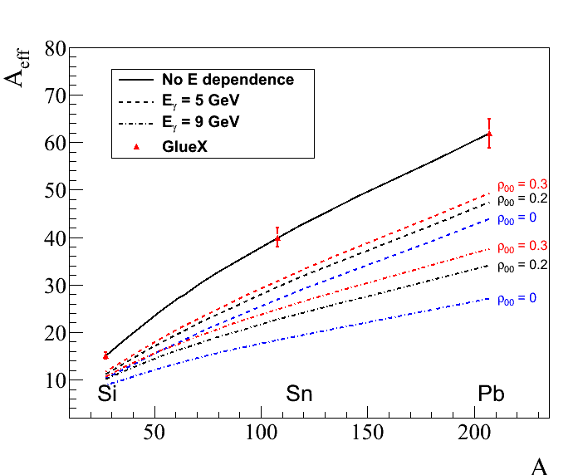
Energy Dependence Predicted for GlueX
Predicted energy dependence of the nuclear transparency for ω mesons
similar dependence for
ρ-mesons ( ρ₀₀ = 0 )
5 GeV
9 GeV

Slide 22
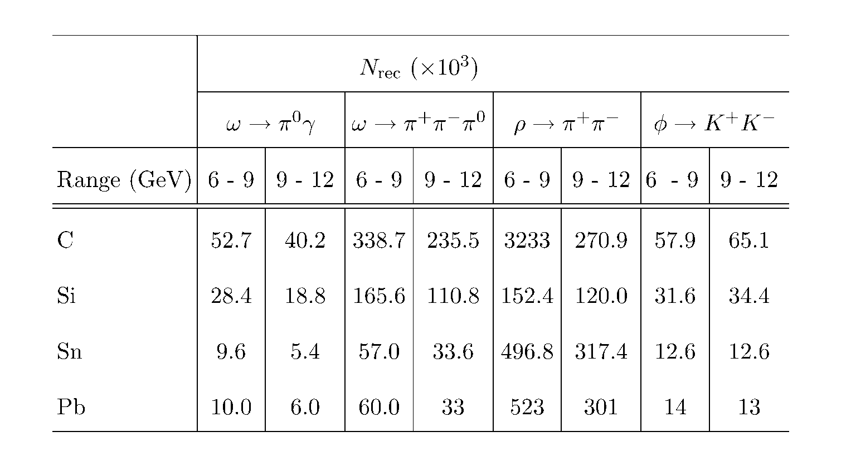
Reconstruction of Vector Mesons and Yield
Expected number of reconstructed ω, ρ, and φ mesons

Slide 23
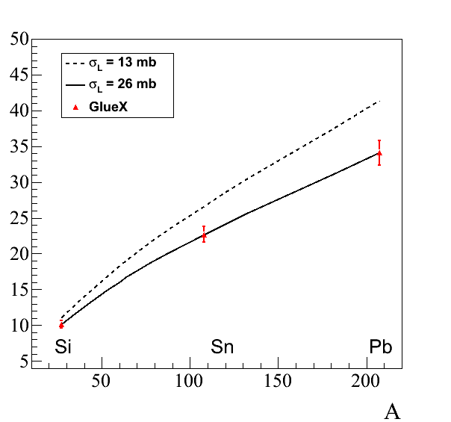
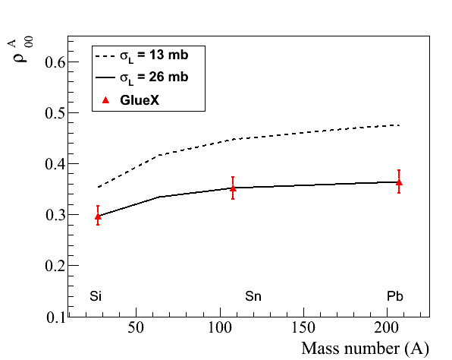
Projected Errors: A_{eff} and ρ^{A}₀₀
Projected errors on measurements of A_{eff} and ρ^{A}₀₀ for ω → π⁰ γ decays
(input values: σ_{T} = 26 mb, ρ₀₀ = 0.2)
A_{eff}
ρ^{A}₀₀
9 GeV
9 GeV

Slide 24
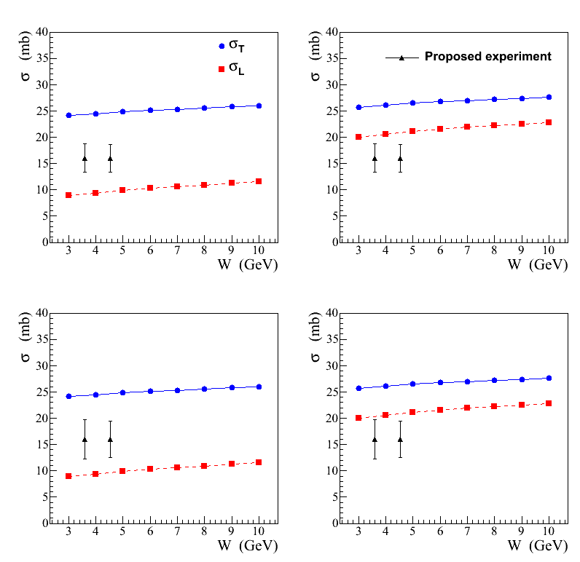
Projected Errors on σ_{L} (ωN)
ρ₀₀ = 0.2
Combined measurements
using ω → π⁰ γ and
ω → π⁺ π⁻ π⁰ decays
ρ₀₀ = 0.14

Slide 25
Summary
We propose to use the GlueX detector to study photoproduction of light mesons
on nuclear targets: C, Si, Sn, and Pb in the large beam energy range between
6 GeV and 12 GeV. The primary goal is:
Measure nuclear transparency and the SDME for omega mesons in incoherent
photoproduction and extract the total cross section of the longitudinally
polarized ω mesons with nucleon. Measurements are important in interpreting
color transparency effects.
Measure nuclear transparency of light mesons such as ρ, ω, ϕ. Study the
dependency of the nuclear transparency on the beam energy, predicted by
theoretical models.
Data sample acquired on nuclear target will allow to study other physics topics,
like production of mesons at larger t, etc.
The expected length of the experiment is 28 days of taking data. The detector
will be operated at small luminosity. No modifications of the GlueX detector
is required

Slide 26
Backup Slides

Slide 27
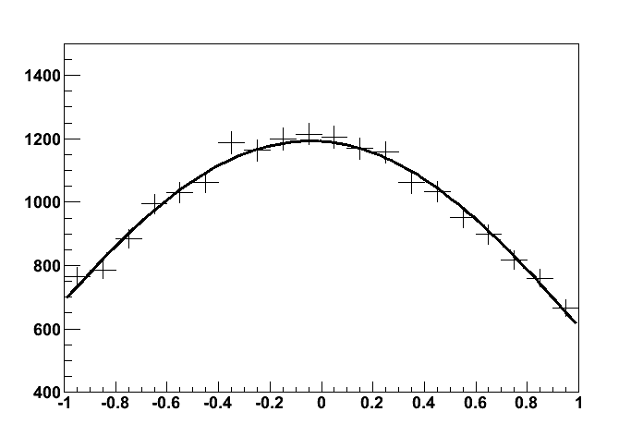
Errors on Measurements of ρ^{A}₀₀ and Extraction of σ_{L} (ωN)
Obtain ρ^{A}₀₀ from the fit to the decay angular distribution in the helicity frame
Statistical errors : σ(ρ^{A}₀₀ ) = 0.011 (6 – 9 GeV)
(from the fit) = 0.014 (9 -12 GeV)
→ π⁺ π⁻ π⁰ ( 6 – 9 GeV )
Signal + BG, realistic acceptance
(input ρ₀₀ = 0.2 )
cos θ
systematic uncertainties on ρ^{A}₀₀
σ_{L} is computed according to the predicted
dependence of ρ^{A}₀₀ on σ_{L}
Signal yield (bg subtraction) | 2.6 %
Acceptance determination | 3.9 %
Dependence on ρ₀₀ | 3.7 %
Total | 5.9 %
σ_{L} (26 mb) ±1.4 (stat) ±2.1 (syst) mb
6 – 9 GeV
σ_{L} (26 mb) ±1.6 (stat) ±2.3 (syst) mb
9 – 12 GeV

Slide 28
Errors on Measurements of A_{eff} and Extraction of σ_{L} (ωN)
Systematic uncertainties dominate
- smallest data sample of ω → π⁰γ reconstructed decays (16 K per target)
- conservatively assume that S/B = 1
- measure the ratio of cross section σ_{A} / σ_{N} some uncertainties related to
reconstruction efficiencies will be canceled out
systematic uncertainties on A_{eff}
Statistical errors on A_{eff}
δ (A_{eff}) / A_{eff} = 1.4 % (6 – 9 GeV)
= 1.8 % (9 -12 GeV)
Target thickness | 1.2 %
Photon flux determination | 1.6 %
Signal yield (bg subtraction) and event selection | 3.7 %
Total measured | 4.3 %
Dependence on input value of ρ₀₀ | 1.2 %
σ_{L} is computed according to the
predicted dependence of A_{eff} on σ_{L}
Polarization of | Error on σ_{L} (26 mb) (mb)
ω mesons | 6 – 9 GeV | 9 – 12 GeV
ρ₀₀ = 0.2 | 1.1 (stat) 3.5 (syst) | 1.1(stat) 2.7 (syst)
ρ₀₀ = 0.1 | 2.1 (stat) 6.6 (syst) | 2.0 (stat) 5.0 (syst)
Measued by
SLAC

Slide 29
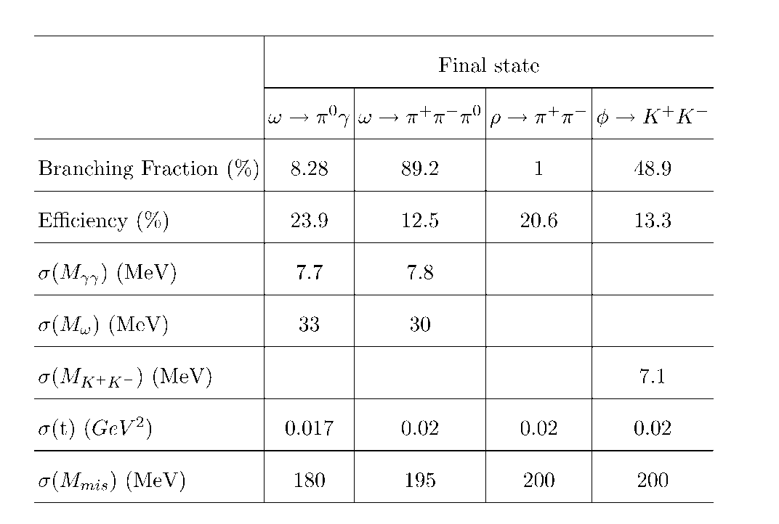
Reconstruction Efficiencies and Yields
Reconstruction properties of
ω, ρ, and φ mesons
Expected number of
reconstructed ω, ρ, and φ
mesons

Slide 30
Monte Carlo Simulation
We studied reconstruction capabilities for ρ, ω, and φ mesons using detailed GlueX
detector simulation
Signal events were generated by Pythia (with the Fermi motion taken into account) in
the energy range between 6 GeV – 12 GeV
Momentum transfer t
Δ t = 0.017
ω → π⁰ γ
 | π⁰ γ | π⁺π ⁻π⁰
M _{γγ} (MeV) | 7.7 | 7.8
M _{ω} (MeV) | 33 | 30
Δ t (GeV²) | 0.017 | 0.02
γ γ invariant mas
3γ invariant mas
σ (m) - 7.7 MeV
σ (m) - 33 MeV
σ (M_{mis}) ~ 190 MeV

Slide 31
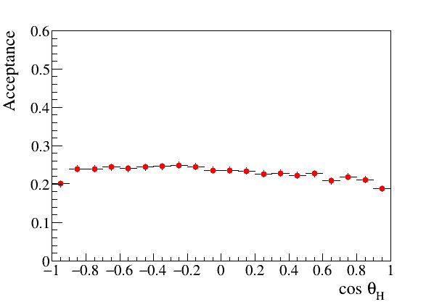
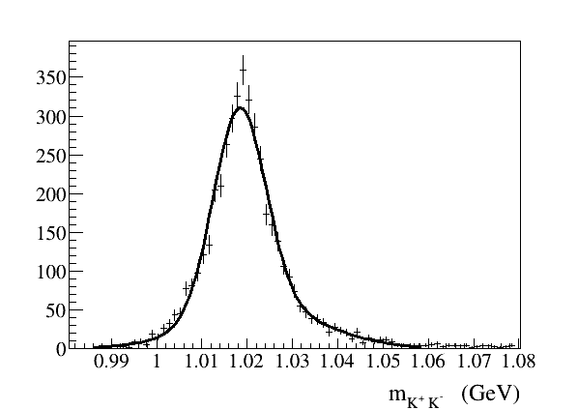
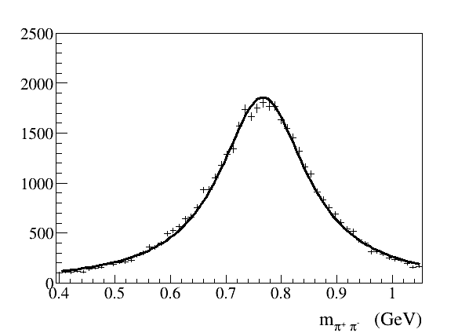
Monte Carlo Simulation
Angular acceptance for ω → π⁰ γ decays
(helicity frame)
Uniform angular acceptance
- important for polarization
measurements
Reconstruction of ρ → π⁺π⁻ and φ→ K⁺ K⁻
σ (m) - 7 MeV
σ (t) ~ 0.02 GeV²
σ (M_{mis}) ~ 200 MeV

Slide 32
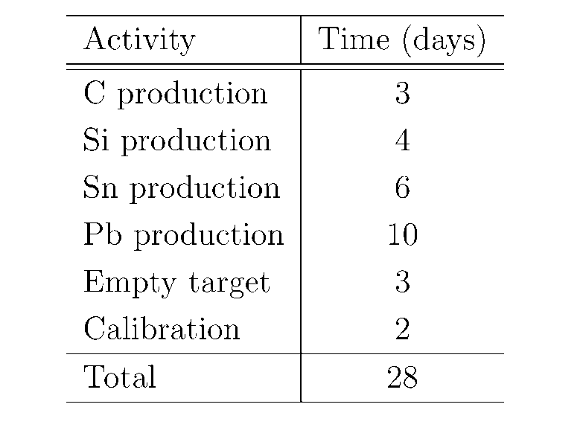
Beam Time Request
Propose to take data for 28 days
(one run)
No modifications of the GlueX
detector except for the target
installation
Compatibility with the PR12-17-007 Experiment (CT and SRC)
PR12-17-007: large lumi, small energy range, light targets (⁴⁰Ca the heaviest)
This proposal: smaller lumi, large energy range, 16 days on heavy targets (Sn, Pb)
we can use ⁴⁰Ca instead of Si
( accidental hits in tagger )
Take data at high and low lumi sequentially for C and Ca targets:
- minimize overhead for target installation and calibration runs
- simplify offline detector calibration and data analyses
Both experiments will benifit from additional data sets acquired on light heavy targets

Slide 33
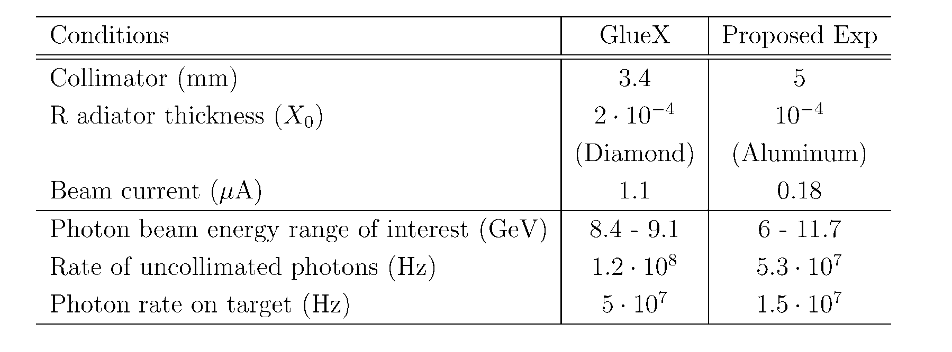
Beamline Conditions
Study meson production on the large energy range E_{γ} > 6 GeV
Use amorphous radiator (incoherent bremsstrahlung)
Decrease the flux of uncollimated photons by a factor of 12 compared with
the GlueX flux at high lumi
- rate of accidental hits in the tagging detectors is about 20 %

Slide 34
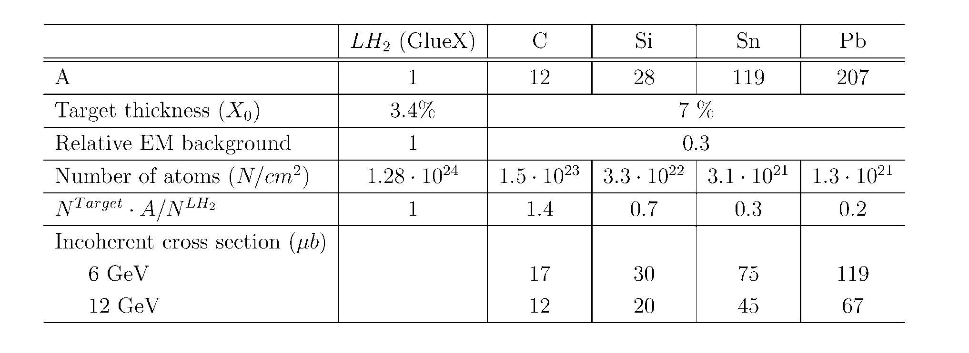
Nuclear Targets
Use four nuclear targets: C, SI, Sn, Pb with the thickness of 7 % R.L.
- small electromagnetic background compared with GlueX
- neutron background will not exceed the GlueX level
(JLAB-TN-11-005, 2011)

Slide 35
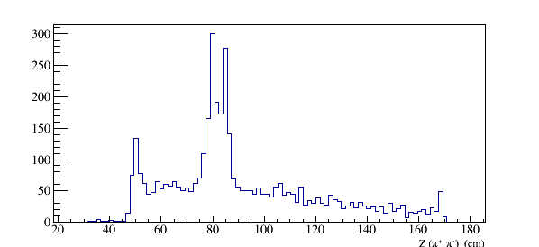
S/B Estimates
Estimate background using photoproduction on target walls
and air ( runs with empty target )
Production vertex for ω → π⁺ π⁻π⁰
Vacuum cell and window:
75 , 100 μm Kapton
Cold H₂ gas:
ρ = 1.8 ⋅10⁻³ g /cm³
Air:
ρ = 1.2 ⋅ 10⁻³ g /cm³
Target cell walls
Vacuum window
Air
Cold H₂ gas
Z (π⁺ π⁻) (cm)
Kapton
Kapton
Air

Slide 36
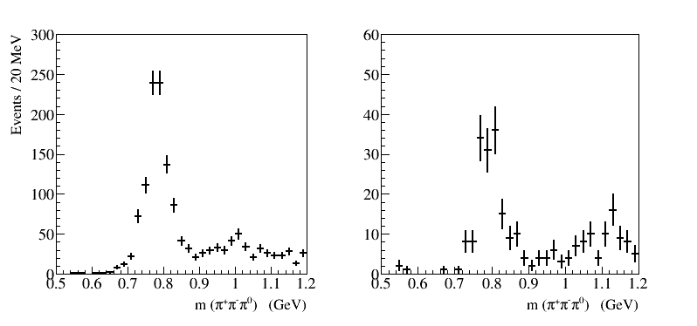
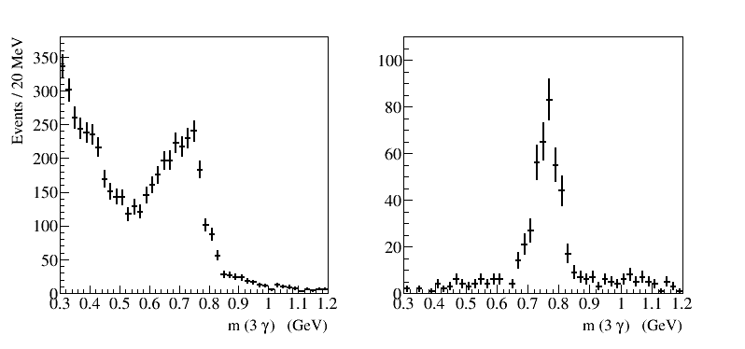
Runs with Empty Target
γ (p, A) → ω (X)
(require to reconstruct only ω)
γ (p, A) → p ω
ω → π⁺ π⁻ π⁰
Z vertex is unknown
(no shift for real target)
ω → π⁰ γ
Relatively small BG for both
ω decay channels

Slide 37
Projected errors on σ_{L} (ωN)
σ_{L} will be extracted for ω mesons using two measurements: A_{eff} and ρ^{A}₀₀
Expected errors on σ_{L} for ω→π⁰γ decays obtained from measurements on a Pb target:
( Input values of ρ₀₀ = 0.14 )
σ ( σ_{L} ) = 5.0 mb (6 – 9 GeV) ; 4.6 mb (9 – 12 GeV)
FS Model
BG Model
proposed
experiment
σ_{L} will be independently measured using ω → π⁺π⁻π⁰ decays

Slide 38
Timeline
Nuclear Photoproduction with GlueX Workshop, Jefferson Lab, April 28 - 29, 2016
https://www.jlab.org/conferences/photoproduction16/
- interesting discussions, motivated further theoretical studies
Photoprodiction of ω mesons of nuclei and impact of polarization on the
meson-nucleon interactions, Phys. Rev. C93, 1, 015203, 2016
Topic presented at several conferences / workshops

Slide 39
Sensitivity of A_{eff} and ρ^{A}₀₀ to ρ₀₀
I )
uncertainties of ρ₀₀ of ± 4 % affect A_{eff} by ± 1.2 %
total systematic error on A_{eff} = 4.7 %
I I )
uncertainties of ρ₀₀ of ± 4 % affect A_{eff} by ± 3.7 %
total systematic error on A_{eff} = 5.6 %
Extract from A_{eff}
Extract from ρ^{A}₀₀
σ_{L} (26 mb) ±1.1 (stat) ±3.5 (syst) mb
σ_{L} (26 mb) ±1.4 (stat) ±2.1 (syst) mb

Slide 40
S/B Estimates
Estimate background using photoproduction on target walls
and air ( runs with empty target )
Production vertex for ω → π⁺ π⁻π⁰
Vacuum cell and window:
75 , 100 μm Kapton
Cold H₂ gas:
ρ = 1.8 ⋅10⁻³ g /cm³
Air:
ρ = 1.2 ⋅ 10⁻³ g /cm³
Target cell walls
Vacuum window
Air
Cold H₂ gas
Z (π⁺ π⁻) (cm)
Kapton
Kapton
Air

Slide 41
Nuclear Targets
Use four nuclear targets: C, SI, Sn, Pb with the thickness of 7 % R.L.
- small electromagnetic background compared with GlueX
- neutron background will not exceed the GlueX level
(JLAB-TN-11-005, 2011)

Slide 42
Errors on Measurements of ρ^{A}₀₀ and Extraction of σ_{L} (ωN)
Obtain ρ^{A}₀₀ from the fit to the decay angular distribution in the helicity frame
Statistical errors : σ(ρ^{A}₀₀ ) = 0.011 (6 – 9 GeV)
(from the fit) = 0.014 (9 -12 GeV)
→ π⁰ γ ( 6 – 9 GeV )
Signal + BG, realistic acceptance
(input ρ₀₀ = 0.2 )
cos θ
systematic uncertainties on ρ^{A}₀₀
σ_{L} is computed according to the predicted
dependence of ρ^{A}₀₀ on σ_{L}
Signal yield (bg subtraction) and event selection | 1.0 %
Dependence on ρ₀₀ | 3.7 %
Acceptance determination | 3.0 %
Total | 5.6 %
σ_{L} (26 mb) ±1.4 (stat) ±2.1 (syst) mb
6 – 9 GeV
σ_{L} (26 mb) ±1.6 (stat) ±2.3 (syst) mb
9 – 12 GeV

