Slide 1
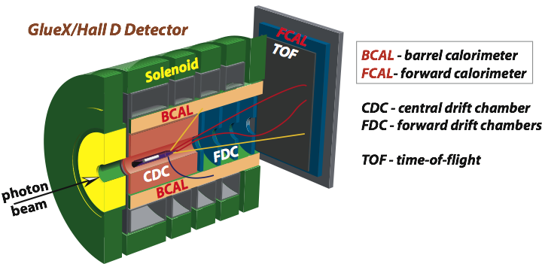
Photoproduction of Vector Mesons off Nuclei
A. Somov (JLab)
A. Gasparyan (NC A&T), L. Gan (UNCW), S. Gevorkyan (JINR), I. Larin (UMas, ITEP)
and GlueX Collaboration
PR 12 -18 -001
P AC 45, July 17, 2018
Physics motivation
Theoretical predictions
Reconstruction of vector mesons
Projected errors
Run conditions and beam request

Slide 2
PAC45
Response

Slide 3
Physics Goal
Measure photoproduction cross sections of vector mesons ω, ρ, and φ
on C, Si, Sn and Pb targets in the energy range of 6-9 GeV with the
GlueX detector
Extract nuclear transparency (A_{eff} = σ_{A} / σ_{N} ) at different energies
Extract spin density matrix elements
Extract cross section σ_{L} (ω N) with two methods
- nuclear transparency A_{eff}
- spin density matrix element ρ^{A}₀₀

Slide 4
Why is it Important ?
Disagreement between existing experimental data and theoretical
predictions about energy-dependence of the nuclear transparency
There are experimental indications that σ_{L} (VN) < σ_{T} (VN), but there
have been no direct measurements of σ_{L} (VN) so far. Measurements
of σ_{L} are important for the interpretation of the color transparency in
vector meson electroproduction and comparison between different
theoretical approaches

Slide 5
Energy Dependence of Nuclear Transparency
Interaction of a photon with hadrons
point –like interaction
- direct scattering process of a photon with target nucleons
- nucleus is transparent to the photon
interacts as a qq-system (photon shadowing)
- the qq is absorbed by the nuclear medium
- the lifetime of the qq fluctuation is characterized by the coherence length
- interactions of the qq system with nuclei depend on energy E
point-like interactions
photon shadowing
Nuclear transparency
Mass number A
Study energy dependence of the nuclear transparency provides information on hadronic part of photon
Energy dependence is predicted in both electroproduction and photoproduction

Slide 6
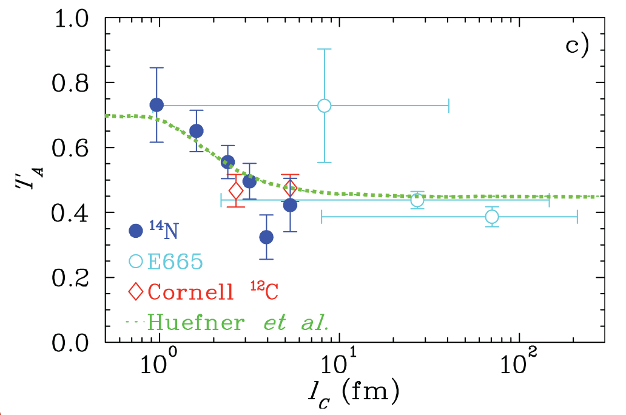
Hadronic Part of Photon: Dependence on the Coherence Length
K.Ackerstaff et al., Phys. Rev. Lett.,
82, 3025 (1999)
Dependence of the nuclear transparency on the
coherence length in electroproduction
Hermes
e
l_{c}
ρ
A_{eff} / A
e
N
N′
Significant contribution
from hadronic part of photon
Coherence length (fm)

Slide 7
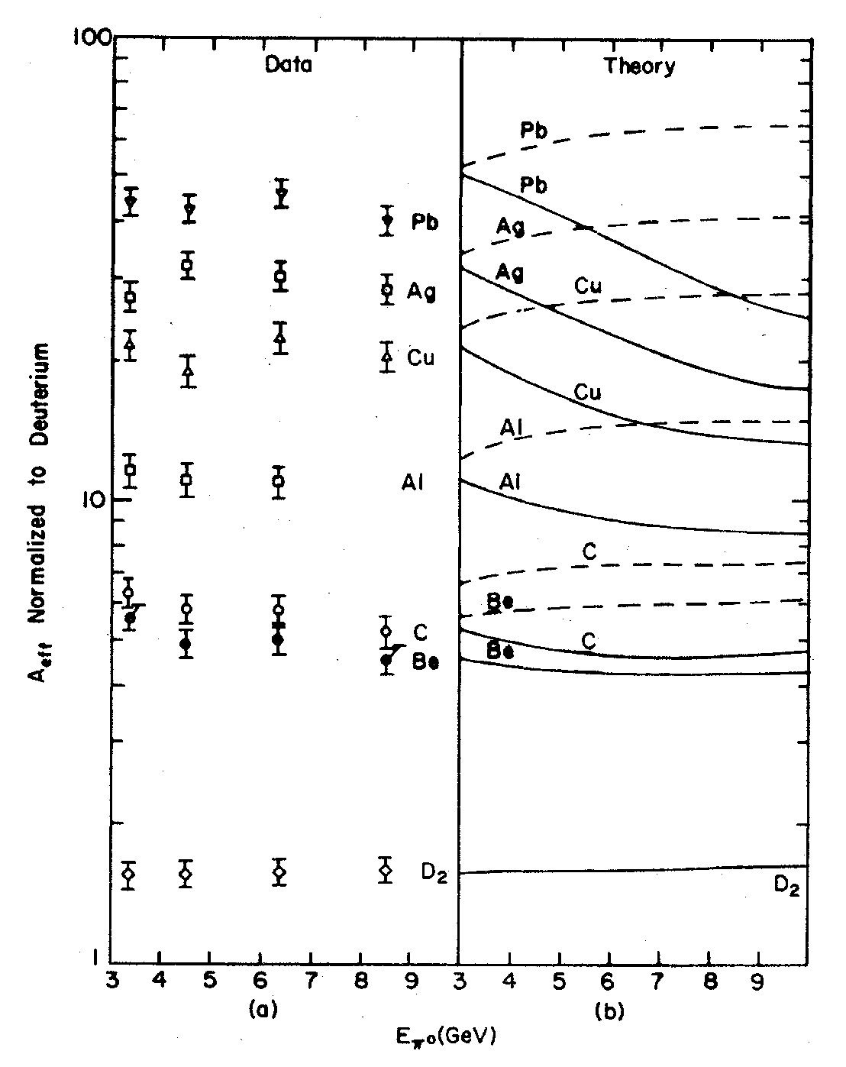
Energy Dependence: Photoproduction of π⁰ Mesons
Cornell experiment Meyer , et al. Phys. Rev. Let. 28, 1972
Data
Theory
Pb target, no photon shadowing
Pb target, VMD predictions
Incoherent production of π⁰ mesons
0.1 < | t | < 0.25 GeV²
A _{eff}
The data indicate shadowing
Very small energy dependence
(small contribution from photon shadowing)
E (π⁰) (GeV)

Slide 8
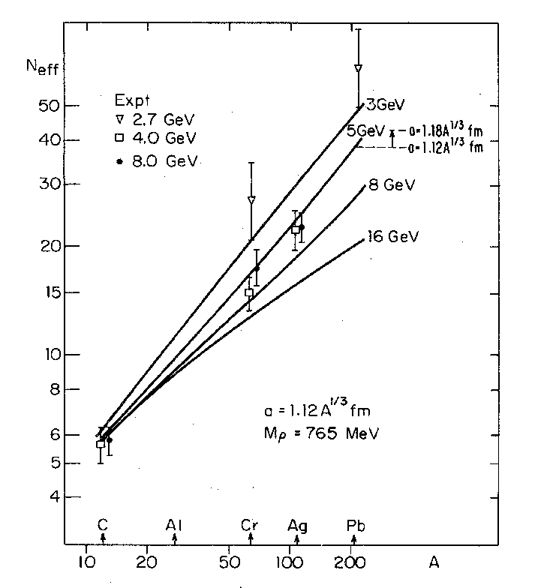
Energy Dependence: Photoproduction of ρ⁰ Mesons
Cornell: McClellan, et al. Phys. Rev. Let. 554, 1969
DESY: Asbury, et al. Phys. Rev. Let. 19, 1968
∇ 2.7 GeV
4.0 GeV
8.0 GeV
3 GeV
5 GeV
8 GeV
The data indicate shadowing
Small energy dependence
Small statistics
- need more data to study energy
dependence
16 GeV
A _{eff}
E (π⁰) (GeV)

Slide 9
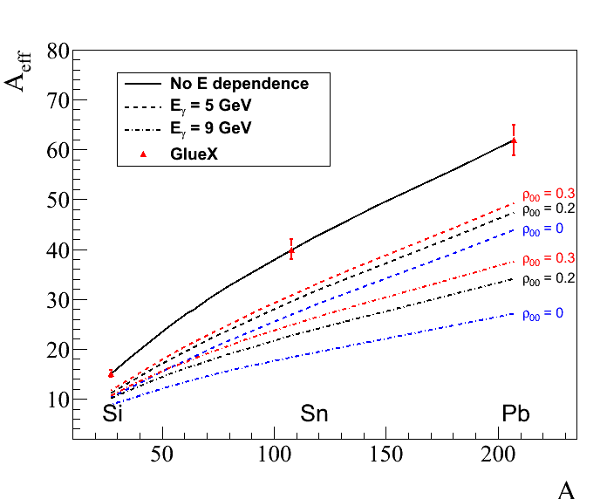
Measurements Proposed in GlueX
Predicted energy dependence of the nuclear transparency
for ρ and ω mesons Phys. Rev. C 93, 015203 (2016)
ρ-mesons ( ρ₀₀ = 0 )
Measure energy dependence
of the nuclear transparency for
ρ, ω,and φ mesons
on ¹²C, ²⁸Si, ¹²⁰Sn, and ²⁰⁸Pb
targets
5 GeV
9 GeV

Slide 10
Extraction of σ_{L} (ω N) from the Photoproduction
of ω Mesons

Slide 11
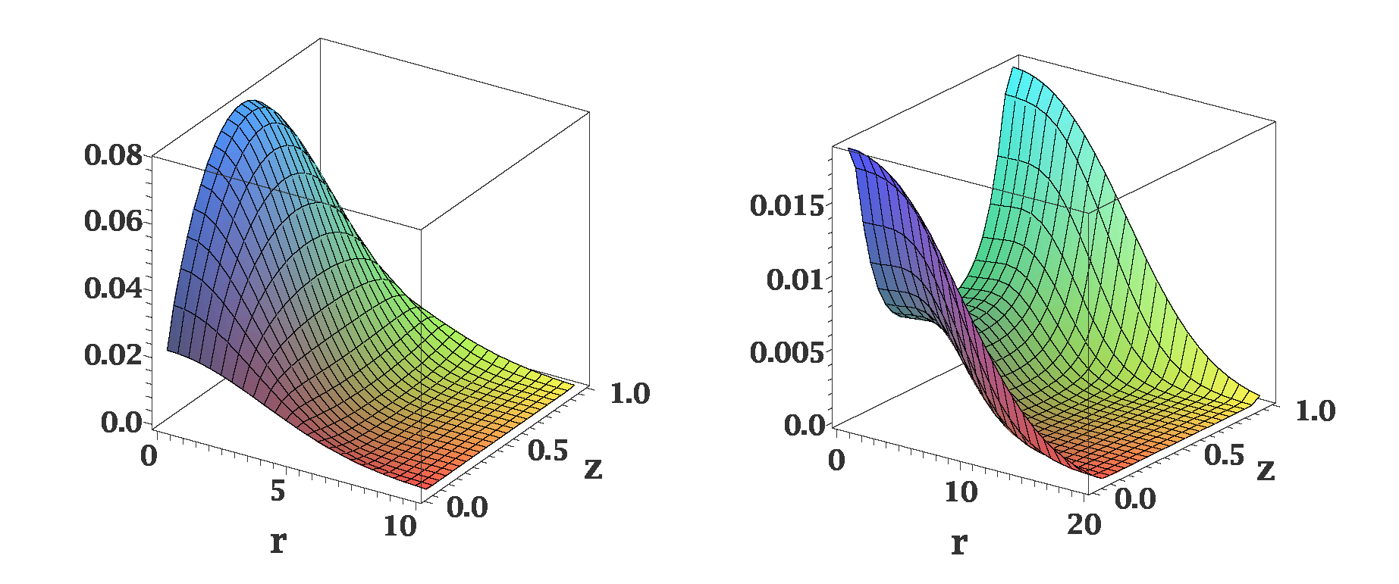
Distribution of Quarks in Vector Meson
Different distributions of quarks in the transversely and longitudinally polarized
mesons
ρ_{L}
ρ_{T}
In AdS/QCD (Brodsky & G.Teramond)
light-cone wave functions depend on
meson polarization
Light-cone wave functions for ρ mesons:
J.Forshaw and R.Sandapen
Phys.Rev. Lett. 109,081601,2012
Color dipole model of strong interaction
different cross sections for interactions of transversely and longitudinally
polarized mesons

Slide 12
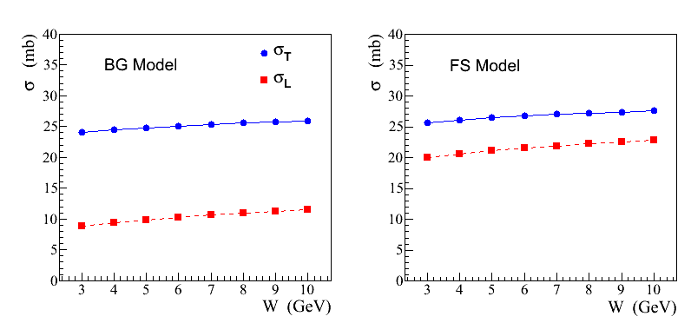
Recent Theoretical Calculations
S. Gevorkyan, paper in
preparation
σ_{L,T} (ρ N) cross sections predicted in a color dipole model using different
parameterizations of wave functions:
AdS / QCD holographic wave function (FS)
J.Forshaw and R. Sandopen,
Phys.Rev.Let. 109, 2012
Boosted Gaussian (BG) wave function
B.Kopeliovich et al., Phys.Rev. C65, 2002
FS model
BG model

Slide 13
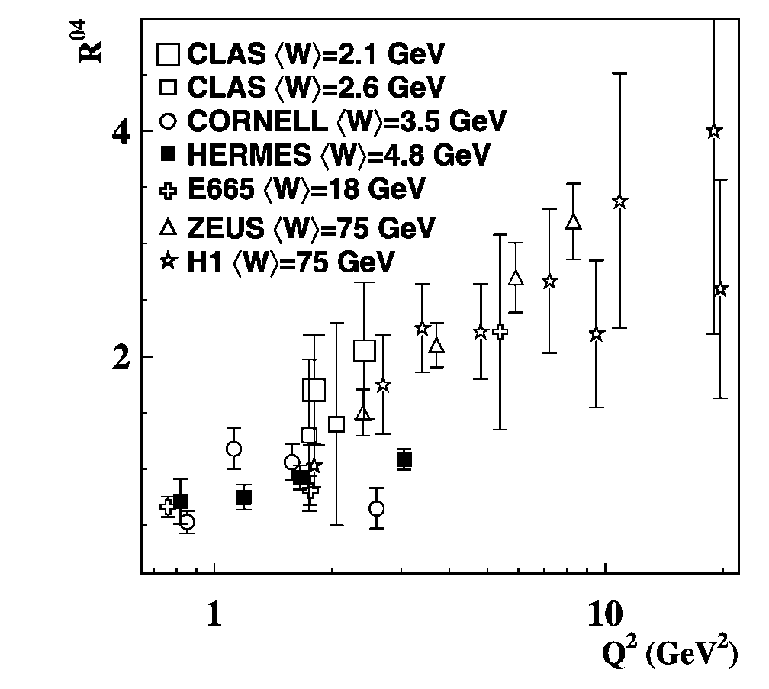
Impact of σ_{L,T} (VN) on Color Transparency
Q² dependence of the longitudinal-to-
transverse cross section ratio for ρ mesons
Eur. Phys. J. C 62, 659-695 (2009)
Larger fraction of longitudinally polarized ρ mesons produced at larger Q²

Slide 14
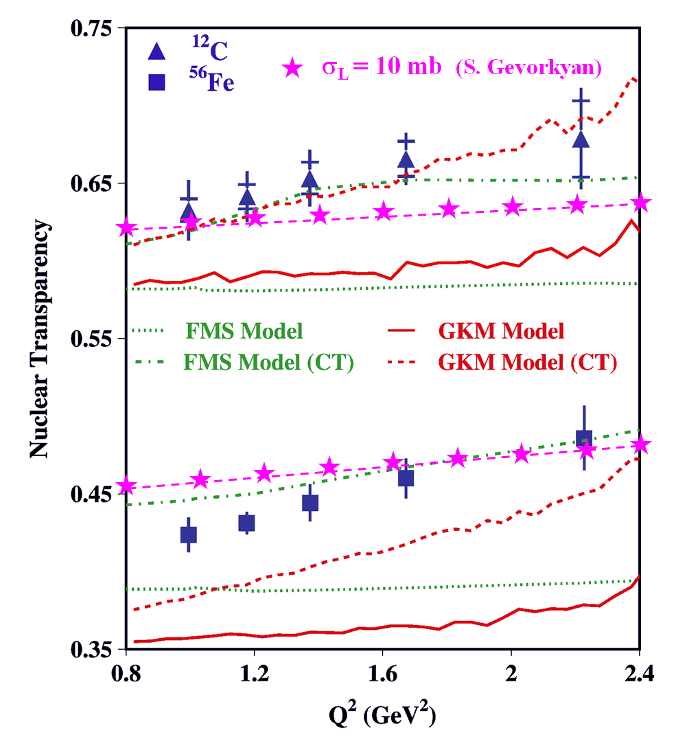
Impact of σ_{L,T} (VN) on Color Transparency
CT measurements at CLAS
Phys. Lett. B 712 (2012)
At large Q ² photon couples to a qq
configuration with a small transverse size
The small-size configuration interacts less
with the nuclear medium
Recent theoretical calculations
σ_{L} (VN) = 10 mb
Nuclear transparency depends on the polarization of the meson
- different absorption if σ_{L} (VN) ≠ σ _{T} (VN)
The Color Transparency effect is ‘screened ‘ if σ_{T} (VN) > σ_{L} (VN)

Slide 15
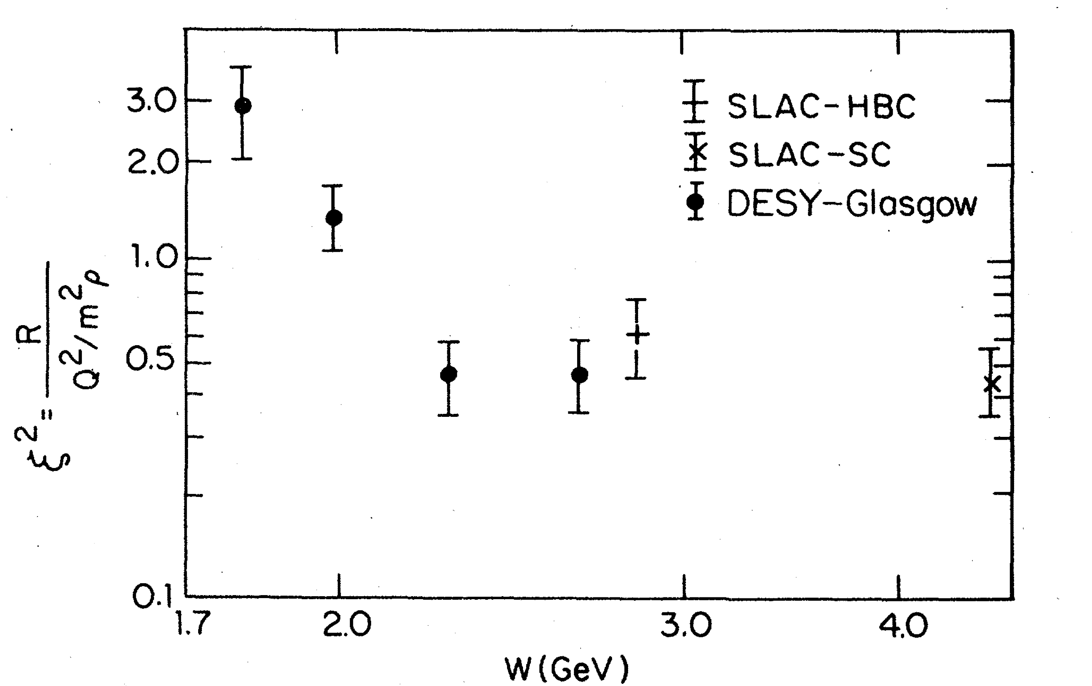
Polarization-Dependent Interactions: Experimental Observations
Hints from the electroproduction of vector mesons:
where
ρ mesons: ξ ~ 0.7 Nucl. Phys. B113, 53 (1976)
φ mesons: ξ² ~ 0.33 Phys. Rev. Let. 39, 516 (1977)
Similar observations of the polarization-dependent
interactions of deuterons with Carbon targer
- measured in Dubna and Juelich
Phys. Part. Nucl. Lett. 7, 27, 2010 Phys. Rev. Lett. 104, 2010
Measurements in the charge exchange process at Argonne:
π⁺ + Ne → ρ + Ne′
Nucl. Phys. B67, 333 (1973)
Propose to measure σ_{L} (VN) using photoproduction on nuclei

Slide 16
Coherent and Incoherent Production of ω Mesons
In the coherent γ + A → ω + A production at JLab energies the essential
contribution of pion exchange cancels out. From the absorption of ω’s one
can extract σ_{T} (ω N)
- it has been measured by several experiments (σ_{T} ~ 26 mb)
In the incoherent process γ + A → ω + A′ the cross section is given by
- N (0, σ_{L}) and N (E, σ_{T}) are absorptions of the longitudinally and transversely
polarized mesons predicted by theoretical models
- Sensitivity to σ_{L} through the absorption N (0, σ_{L})
- ρ₀₀ is the spin density matrix element measured in γ p → ω p reaction

Slide 17
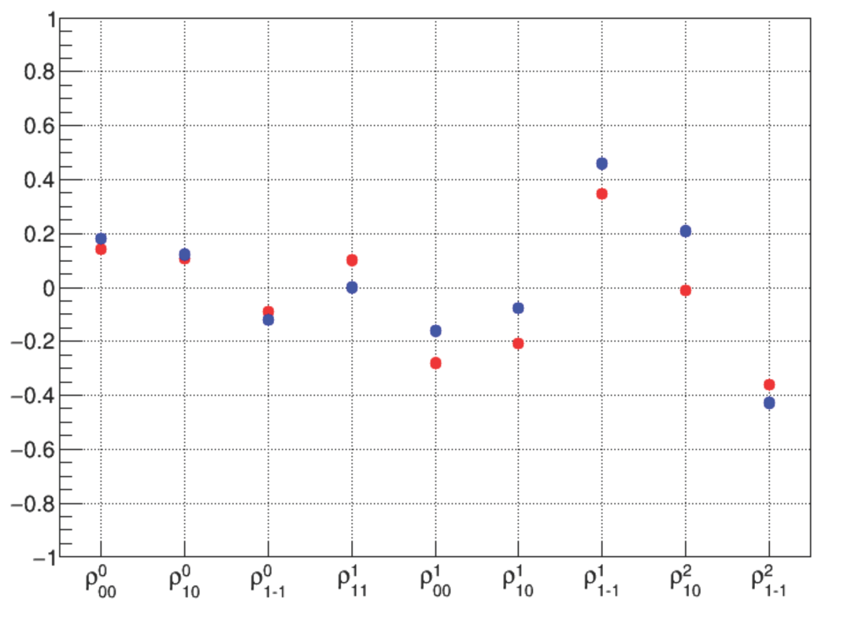
Why ω Mesons ?
Some fraction of ω mesons is longitudinally polarized at GlueX energies (9.3 GeV)
ρ₀₀ measured by SLAC is 0.2 ± 0.07
J.Ballam et al., Phys. Rev. D7, 3150 (1973)
Spin density matrix elements measured by
GlueX using a γp→ωp reaction
Preliminary GlueX results indicate
that ρ₀₀ is relatively large
GlueX preliminary
- measured in the energy range
8.4 – 9.1 GeV
- ρ₀₀ can be larger at smaller
energies (larger contribution
from pion exchange)
M. Staib, PhD tesis GlueX-doc-3357

Slide 18
How to Extract σ_{L} (ωN) ?
σ_{L} (ωN) can be extracted from the measurements of:
Method 1: Nuclear transparency ( A_{eff} )
Method 2: Spin density matrix element (ρ^{A}₀₀ )
Make use of the different absorption predicted for interactions of
longitudinally and transversely polarized mesons

Slide 19
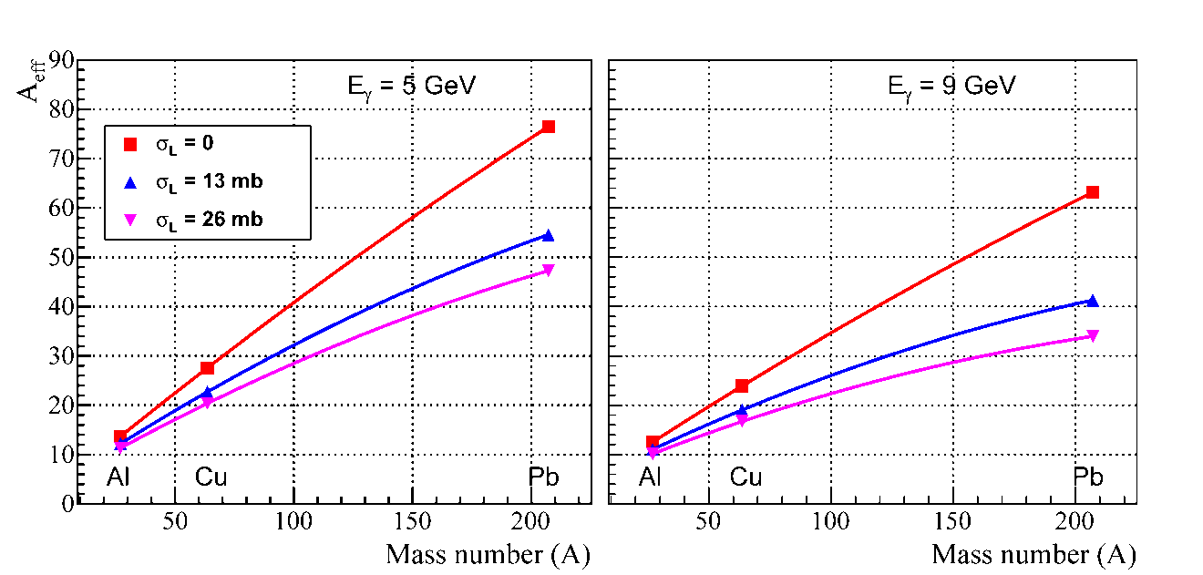
Extraction of σ_{L} (ωN): Method 1
Measure nuclear transparency A_{eff} for each nuclear target
A_{eff} depends on σ_{L} (see plot)
- N (0, σ_{L}) and N (E, σ_{T}) are predicted by theoretical models.
- N (E, σ_{T}) will be independently measured for ρ mesons
Predictions for A_{eff}
Calculations for GlueX
by S. Gevorkyan
Phys. Rev. C 93, 015203
(2016)

Slide 20
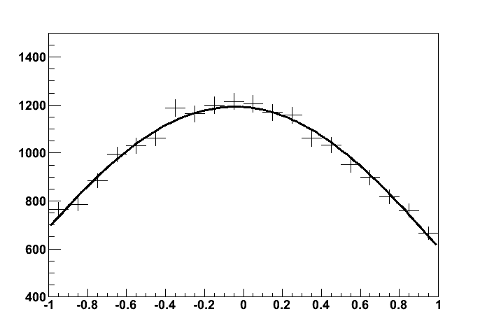
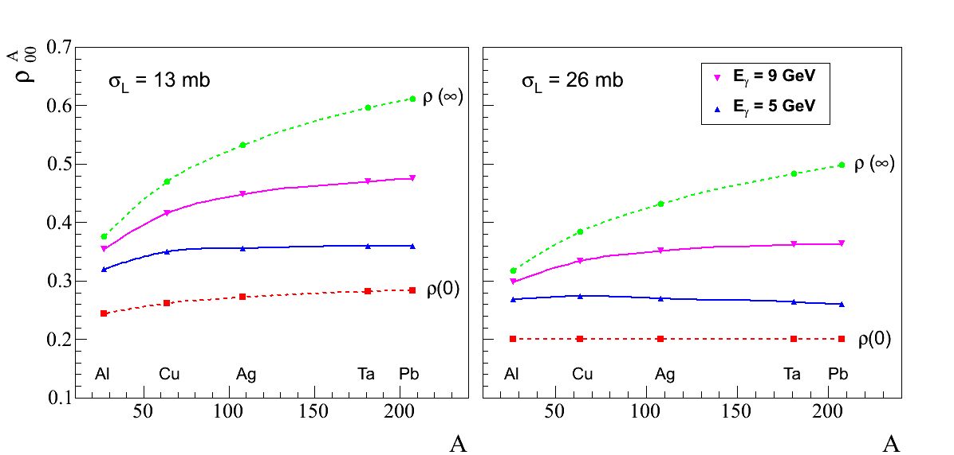
Extraction of σ_{L} (ωN): Method 2
Measure ρ^{A}₀₀ for each target from the
fit to the ω decay angular distribution
ρ^{A}₀₀ depends on σ_{L}
cos θ
- extract σ_{L}
Predictions for ρ^{A}₀₀
Phys. Rev. C 93, 015203 (2016)
Input value: ρ₀₀ = 0.2

Slide 21
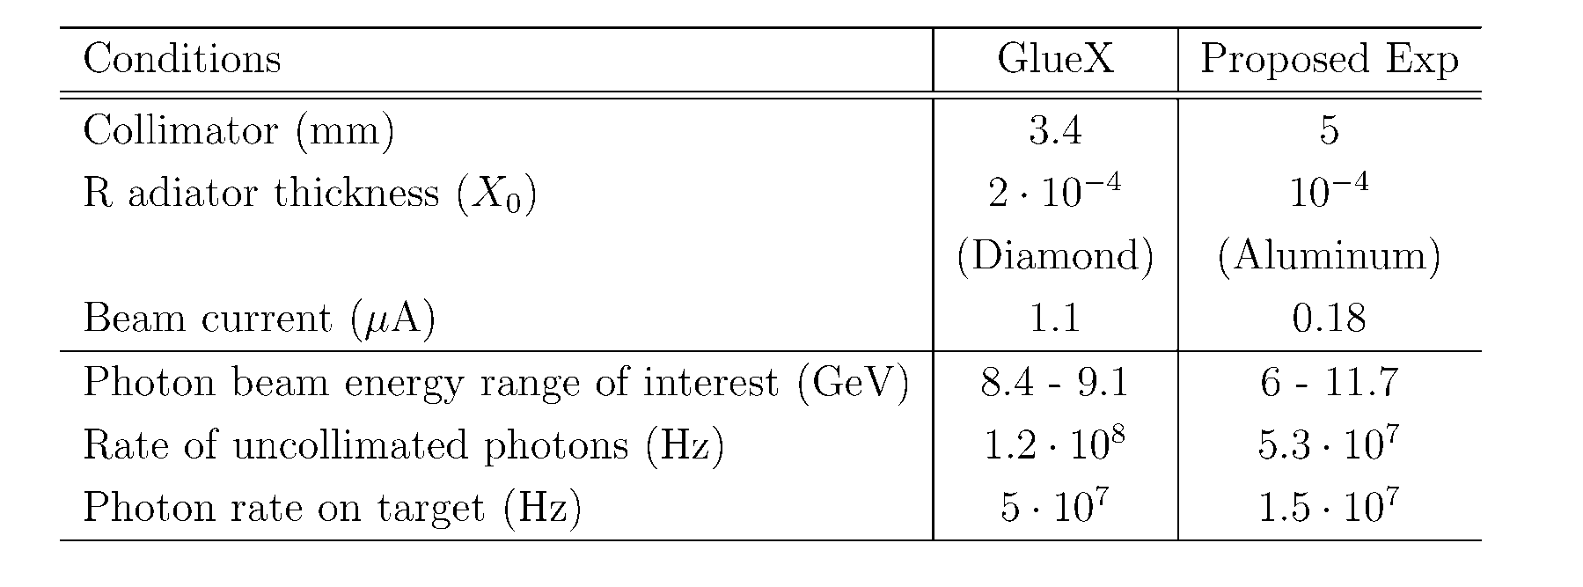
Beamline Conditions
Study meson production on the large energy range E_{γ} > 6 GeV
Use amorphous radiator (incoherent bremsstrahlung)
Decrease the flux of uncollimated photons by a factor of 12 compared with
the GlueX flux at high lumi
- rate of accidental hits in the tagging detectors is about 20 %

Slide 22
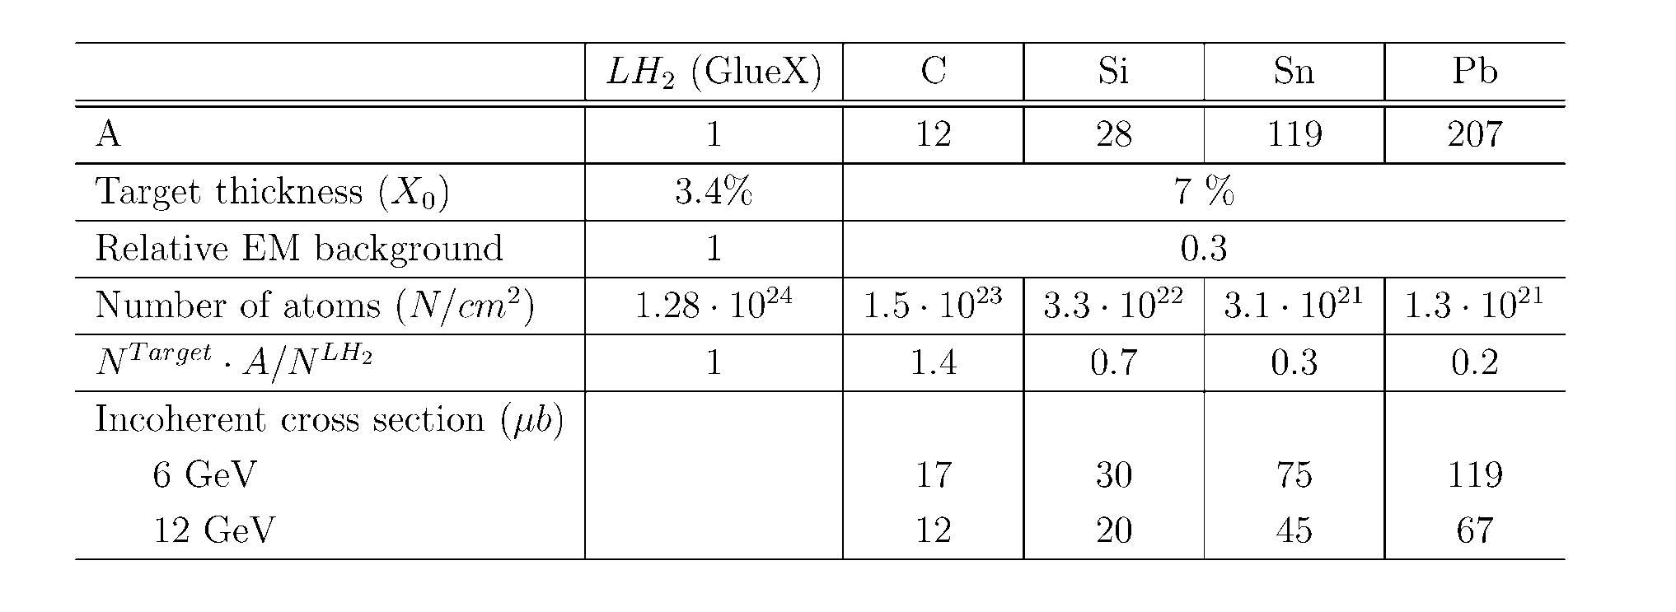
Nuclear Targets
Use four nuclear targets: C, SI, Sn, Pb with the thickness of 7 % R.L.
- small electromagnetic background compared with GlueX
- neutron background will not exceed the GlueX level
(JLAB-TN-11-005, 2011)

Slide 23
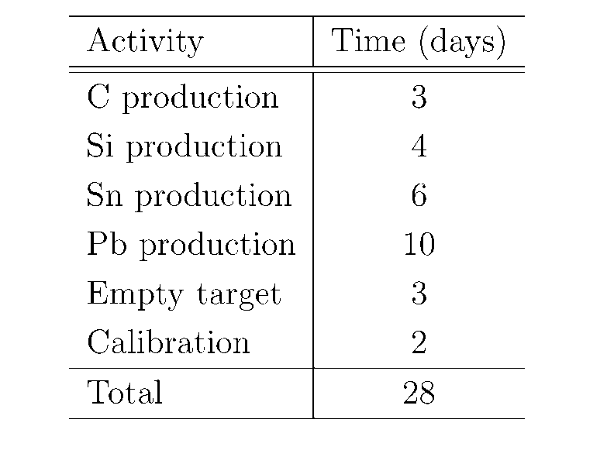
Beam Time Request
Propose to take data for 28 days
(one run)
No modifications of the GlueX
detector except for the target
installation

Slide 24
Reconstruction of Vector Mesons
We studied reconstruction capabilities for ρ, ω, and φ mesons using detailed GlueX
detector simulation
Signal events were generated by Pythia (with the Fermi motion taken into account) in
the energy range between 6 GeV – 12 GeV
Momentum transfer t
Δ t = 0.017
ω → π⁰ γ
 | π⁰ γ | π⁺π ⁻π⁰
M _{γγ} (MeV) | 7.7 | 7.8
M _{ω} (MeV) | 33 | 30
Δ t (GeV²) | 0.017 | 0.02
γ γ invariant mas
3γ invariant mas
σ (m) - 7.7 MeV
σ (m) - 33 MeV
σ (M_{mis}) ~ 190 MeV

Slide 25
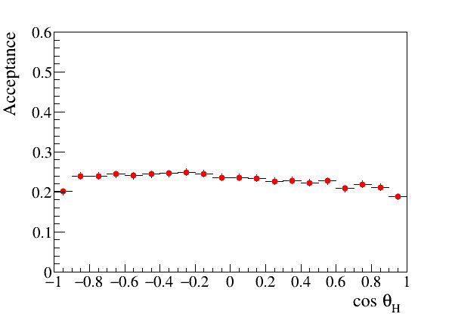
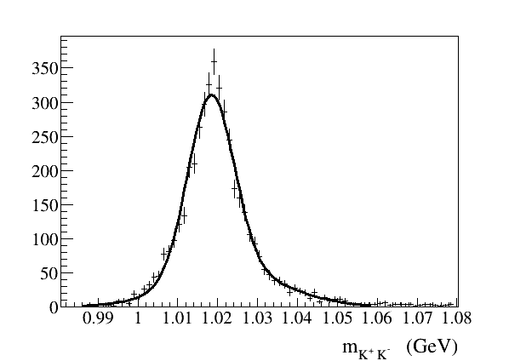
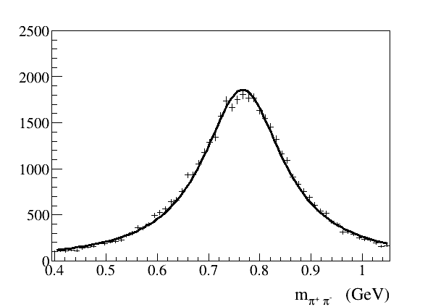
Reconstruction of Vector Mesons
Angular acceptance for ω → π⁰ γ decays
(helicity frame)
Uniform angular acceptance
- important for polarization
measurements
Reconstruction of ρ → π⁺π⁻ and φ→ K⁺ K⁻
σ (m) - 7 MeV
σ (t) ~ 0.02 GeV²
σ (M_{mis}) ~ 200 MeV

Slide 26
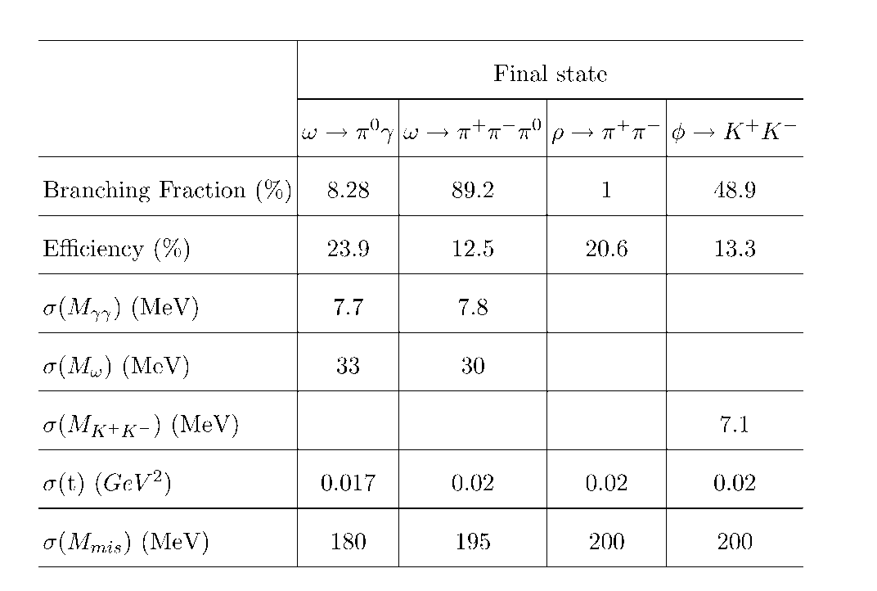
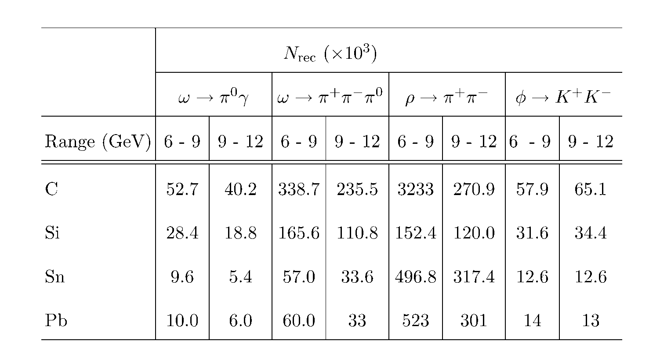
Reconstruction Efficiencies and Yields
Reconstruction properties of
ω, ρ, and φ mesons
Expected number of
reconstructed ω, ρ, and φ
mesons

Slide 27
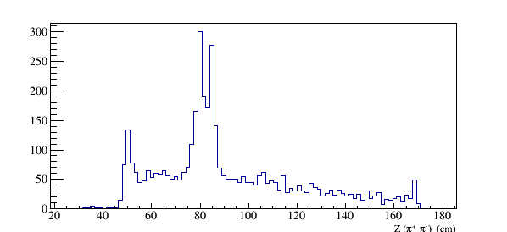
S/B Estimates
Estimate background using photoproduction on target walls
and air ( runs with empty target )
Production vertex for ω → π⁺ π⁻π⁰
Vacuum cell and window:
75 , 100 μm Kapton
Cold H₂ gas:
ρ = 1.8 ⋅10⁻³ g /cm³
Air:
ρ = 1.2 ⋅ 10⁻³ g /cm³
Target cell walls
Vacuum window
Air
Cold H₂ gas
Z (π⁺ π⁻) (cm)
Kapton
Kapton
Air

Slide 28
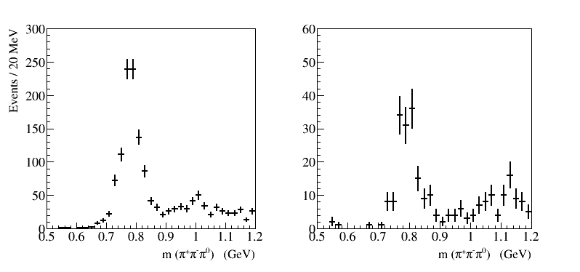
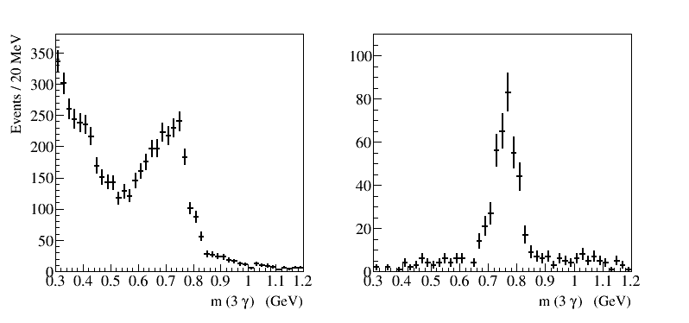
Runs with Empty Target
γ (p, A) → ω (X)
(require to reconstruct only ω)
γ (p, A) → p ω
ω → π⁺ π⁻ π⁰
Z vertex is unknown
(no shift for real target)
ω → π⁰ γ
Relatively small BG for both
ω decay channels

Slide 29
Uncertainties on Measurements of A_{eff} and Extraction of σ_{L} (ωN)
Systematic uncertainties dominate
- smallest data sample of ω → π⁰γ reconstructed decays (16 K per target)
- conservatively assume that S/B = 1
- measure the ratio of cross section σ_{A} / σ_{N} some uncertainties related to
reconstruction efficiencies will be canceled out
Statistical errors on A_{eff}
δ (A_{eff}) / A_{eff} = 1.4 % (6 – 9 GeV)
= 1.8 % (9 -12 GeV)
systematic uncertainties on A_{eff}
Target thickness | 1.2 %
Photon flux determination | 1.5 %
Signal yield (bg subtraction) | 5.0 %
Total measured | 5.4 %
Uncertainties on the extracted σ_{L}
(for σ_{L} = 16 mb)
Polarization of | Error on σ_{L} (mb)
ω mesons | 6 – 9 GeV | 9 – 12 GeV
ρ₀₀ = 0.2 | 0.9 (stat) 3.4 (syst) | 0.9 (stat) 3.1 (syst)
ρ₀₀ = 0.1 | 1.1 (stat) 4.6 (syst) | 1.1 (stat) 4.2 (syst)
Measued by
SLAC

Slide 30
Uncertainties on Measurements of ρ^{A}₀₀ and Extraction of σ_{L} (ωN)
Obtain ρ^{A}₀₀ from the fit to the decay angular distribution in the helicity frame
Statistical errors : σ(ρ^{A}₀₀ ) = 0.011 (6 – 9 GeV)
(from the fit) = 0.014 (9 -12 GeV)
→ π⁺ π⁻ π⁰ ( 6 – 9 GeV )
Signal + BG, realistic acceptance
(input ρ₀₀ = 0.2 )
cos θ
Uncertainties on the extracted σ_{L}
(for σ_{L} = 16 mb)
systematic uncertainties on ρ^{A}₀₀
Signal yield (bg subtraction) | 0.008
Acceptance determination | 0.019
Total | 0.02
Polarization | Error on σ_{L} (mb)
of ω mesons | 6 – 9 GeV | 9 – 12 GeV
ρ₀₀ = 0.2 | 3.4 | 3.3 (syst)
ρ₀₀ = 0.14 | 4.5 | 4.4 (syst)

Slide 31
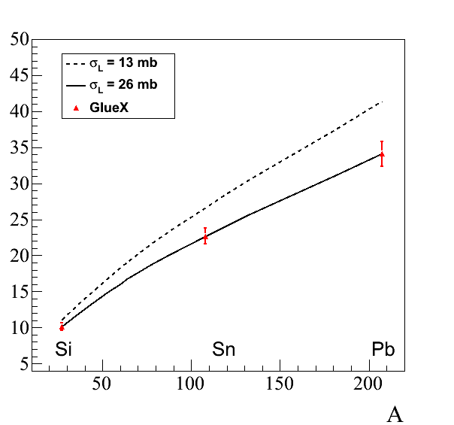
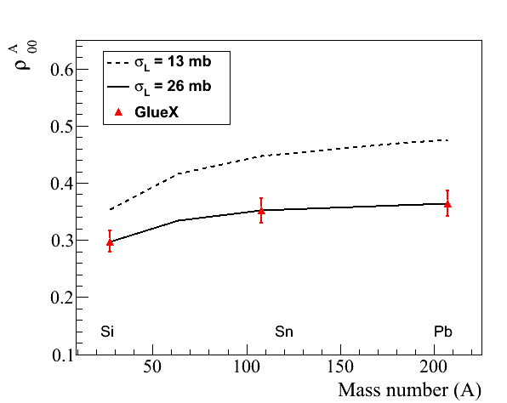
Projected Errors: A_{eff} and ρ^{A}₀₀
Projected errors on measurements of A_{eff} and ρ^{A}₀₀ for ω → π⁰ γ decays
(input values: σ_{T} = 26 mb, ρ₀₀ = 0.2)
A_{eff}
ρ^{A}₀₀
9 GeV
9 GeV

Slide 32
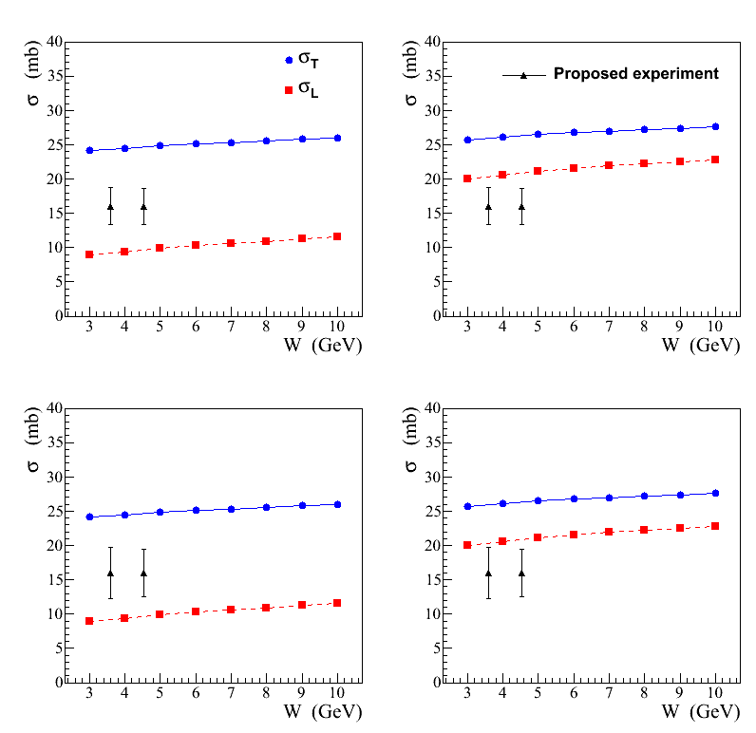
Projected Errors on σ_{L} (ωN)
FS model
BG model
ρ₀₀ = 0.2
σ_{L} extracted from the
measurement of A_{eff}
Combine measurements of A_{eff}
from two decay channels
ω → π⁰ γ and ω → π⁺ π⁻ π⁰
σ_{L} will be separately extracted
from the measuremnt of ρ^{A}₀₀
ρ₀₀ = 0.14

Slide 33
Summary
We propose to use the GlueX detector to study photoproduction of light mesons
on nuclear targets: C, Si, Sn, and Pb in the large beam energy range between
6 GeV and 12 GeV. The primary goal is:
Measure nuclear transparency and the SDME for omega mesons in incoherent
photoproduction and extract the total cross section of the longitudinally
polarized ω mesons with nucleon. Measurements are important in interpreting
color transparency effects.
Measure nuclear transparency of light mesons such as ρ, ω, ϕ. Study the
dependency of the nuclear transparency on the beam energy, predicted by
theoretical models.
Data sample acquired on nuclear target will allow to study other physics topics,
like production of mesons at larger t, etc.
The expected length of the experiment is 28 days of taking data. The detector
will be operated at small luminosity. No modifications of the GlueX detector
is required

Slide 34
Backup Slides

Slide 35
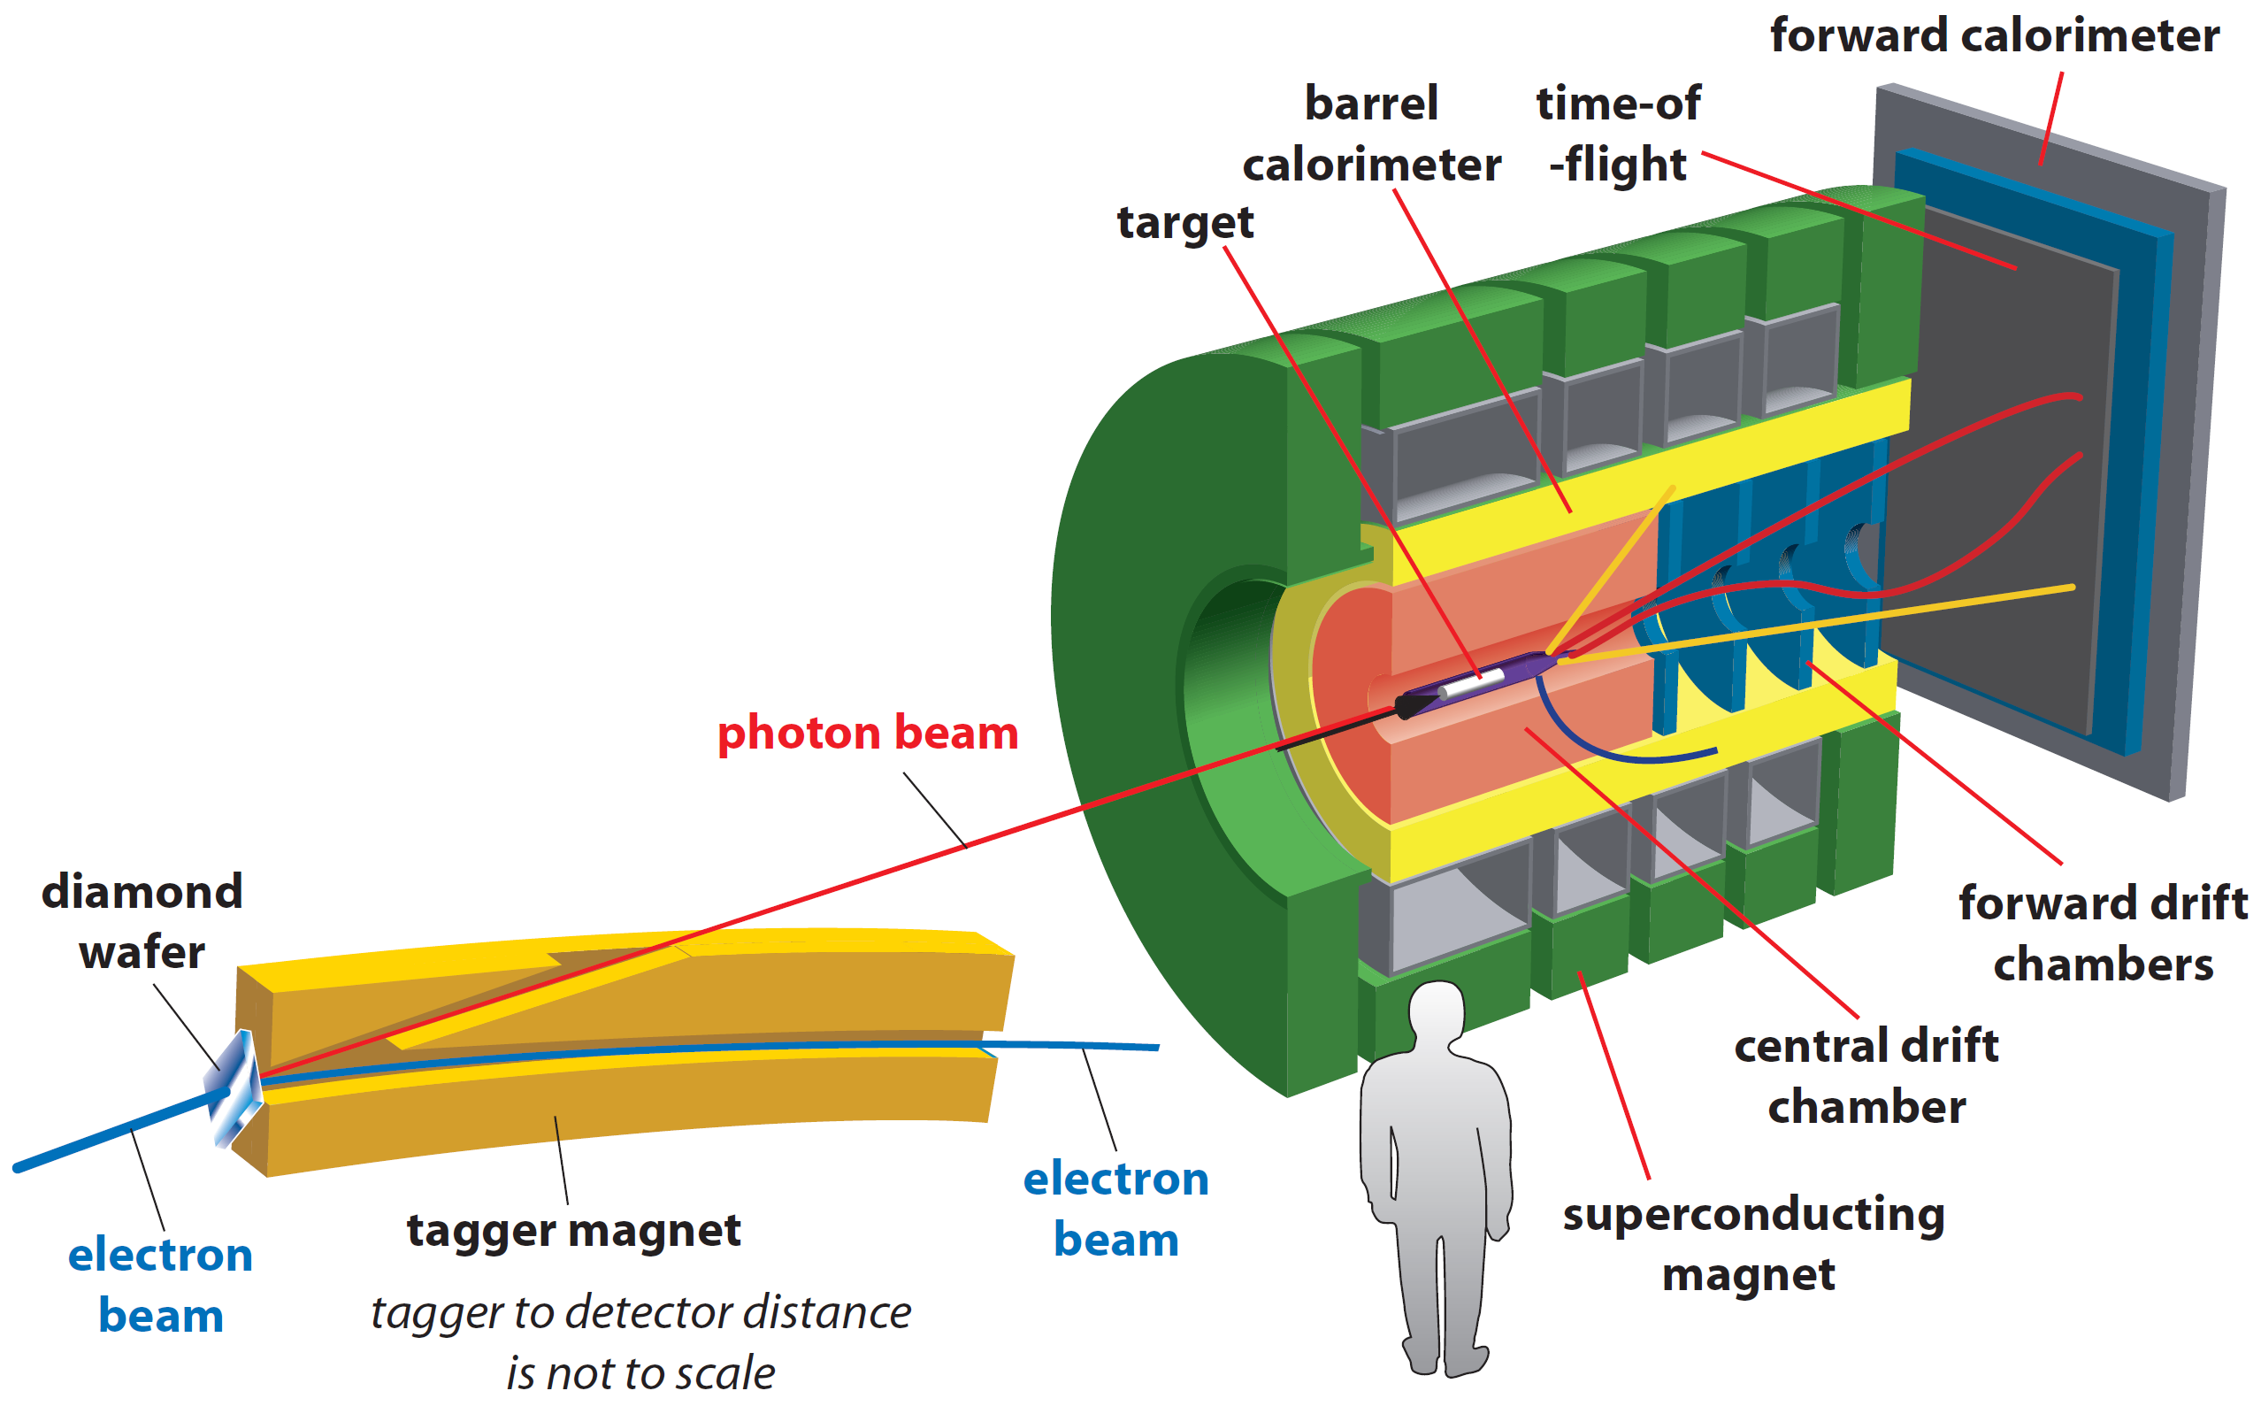
GlueX Spectrometer
• Optimized to detect multi-particle final states
• Hermetic, large/uniform acceptance for
charged and neutral particles, good energy
and momentum resolution
Tracks: σ_{p} / p ~ 2 – 5 %
Photons: σ_{E} / E = 6 % /√E ⊕ 1.6 %
Acceptance: 1° < θ < 120°
new PID (k/π)
Proposed experiment:
- install nuclear targets
- no modifications to the
existing detector

Slide 36
Projected errors on σ_{L} (ωN)
σ_{L} will be extracted for ω mesons using two measurements: A_{eff} and ρ^{A}₀₀
Expected errors on σ_{L} for ω→π⁰γ decays obtained from measurements on a Pb target:
( Input values of ρ₀₀ = 0.14 )
σ ( σ_{L} ) = 5.0 mb (6 – 9 GeV) ; 4.6 mb (9 – 12 GeV)
FS Model
BG Model
proposed
experiment
σ_{L} will be independently measured using ω → π⁺π⁻π⁰ decays

Slide 37
Timeline
Nuclear Photoproduction with GlueX Workshop, Jefferson Lab, April 28 - 29, 2016
https://www.jlab.org/conferences/photoproduction16/
- interesting discussions, motivated further theoretical studies
Photoprodiction of ω mesons of nuclei and impact of polarization on the
meson-nucleon interactions, Phys. Rev. C93, 1, 015203, 2016
Topic presented at several conferences / workshops

Slide 38
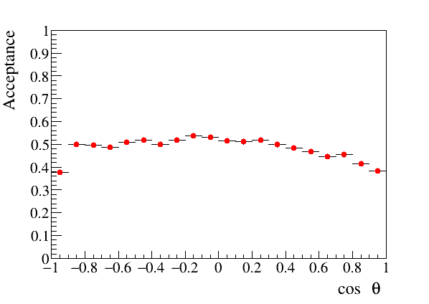
Measurement of ρ₀₀
Originally measured by SLAC in the γ p → ω p reaction: bubble chamber experiment, small
statistics ρ₀₀ = 0.2 ± 0.07 at 9.3 GeV [J.Ballam et. al. Phys.Rev. D7, 3150, 1973]
ρ₀₀ will be independently measured by the GlueX experiment in the γ p → ω p reaction
using a very large data sample of reconstructed ω mesons. ρ₀₀ will be extracted from the
fit to the ω decay angular distribution in the helicity frame (see page 11, Eq. 2 ) using
existing GlueX data
Based on the quality of the GlueX experimental data for ω → π⁰ γ decays, we expect the
dominant systematic error on the ρ₀₀ determination to be on the level of 4%
- the GlueX detector has a uniform angular acceptance for ω → π⁰ γ and ω → π⁺ π⁻ π⁰ decays
- relatively small background under reconstructed ω mesons
- angular acceptance for ω → π⁰ γ decays
(helicity frame)

Slide 39
Sensitivity of A_{eff} and ρ^{A}₀₀ to ρ₀₀
I )
uncertainties of ρ₀₀ of ± 4 % affect A_{eff} by ± 1.2 %
total systematic error on A_{eff} = 4.7 %
I I )
uncertainties of ρ₀₀ of ± 4 % affect A_{eff} by ± 3.7 %
total systematic error on A_{eff} = 5.6 %
Extract from A_{eff}
Extract from ρ^{A}₀₀
σ_{L} (26 mb) ±1.1 (stat) ±3.5 (syst) mb
σ_{L} (26 mb) ±1.4 (stat) ±2.1 (syst) mb

Slide 40
Effect of σ_{L} (VN) on Color Transparency
Q² dependence of the longitudinal-to-
transverse cross section ratio for ρ mesons
CT measurements at CLAS
- Larger fraction of longitudinally polarized
mesons produced at larger Q²
Nuclei become more transparent at large Q²
(color transparency effect)
screen CT if σ_{T} (VN) > σ_{L} (VN)

