Slide 1
Status of Tagger Energy Scale Calibration
and Lumi Determination for PrimEx D
A. Somov
Beamline meeting, May 29, 2019

Slide 2
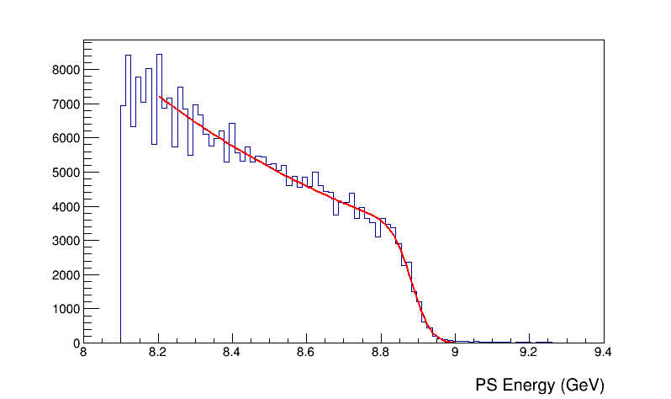
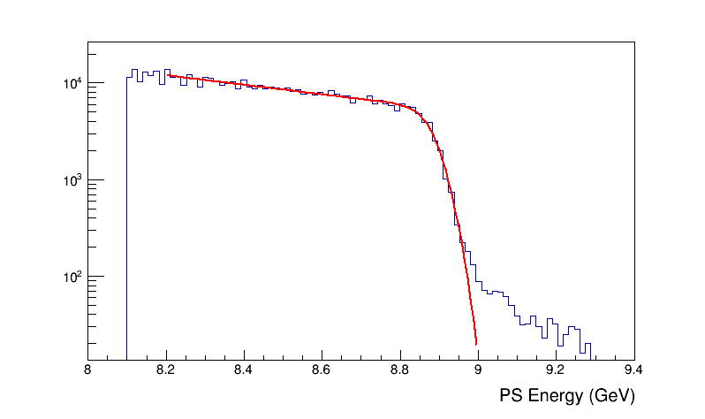
Pair Spectrometer Calibration using
Endpoint Energy
Energy endpoint of the Pair Spectrometer
PS energy scale was determined from MC simulation (realistic field map)
- use to calibrate PS energy scale (assume that the beam energy is known)

Slide 3
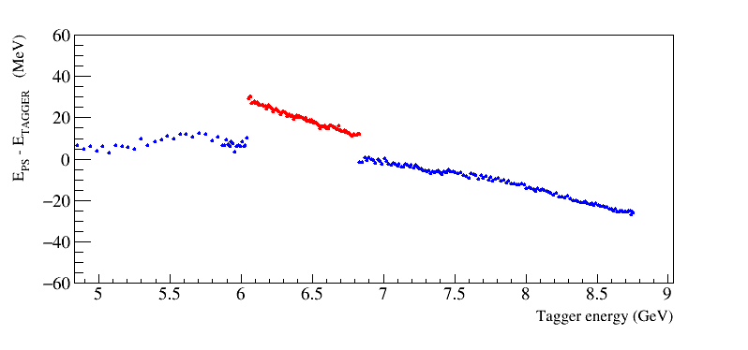
Unification of the Tagger & PS Energy Scales
Pair Spectrometer magnet is expected to be better mapped compared
with the tagger magnet
- PS can be used to calibrate tagger energy
run at 8.9 GeV beam energy
E _{PS} – E _{TAGGER}
Energy difference between
TAGH and PS is about
30 MeV
TAGM energy differs by
about 30 MeV from TAGH
Is this difference real ?

Slide 4
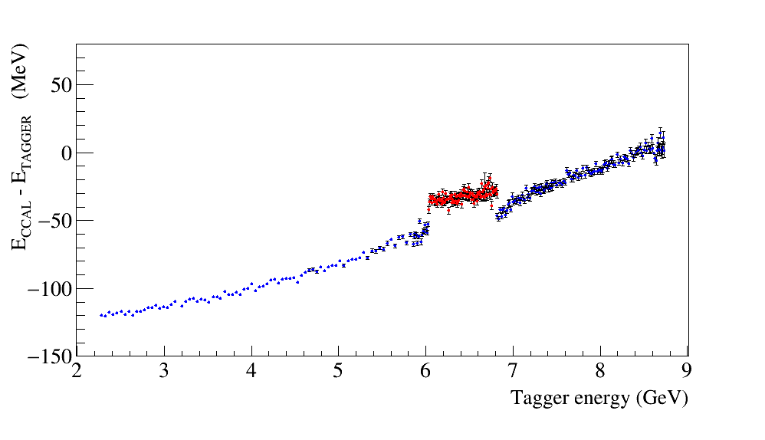
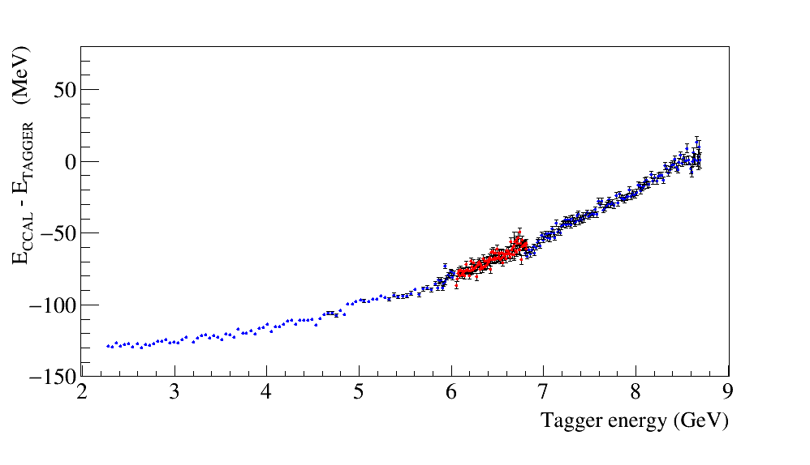
Unification of the Tagger & PS Energy Scales
Correct Tagger energy according to PS
E _{CCAL} – E T_{AGGER} before correction
E _{CCAL} – E _{TAGGER} after correction
PS Coverage
Slightly non-linear response of the CCAL

Slide 5
Calibration
Added beam energies to the CCDB (December – PrimEx runs)
Determined PS energy (scale) using energy endpoint
Corrected TAGH/M energy scale
Use updated DB tables scaled_energy_range (TAGH/TAGM)
and energy_range (PS) in the analysis (sqlite)
- energy scale also required for the CCAL calibration
- will update CCDB shortly

Slide 6
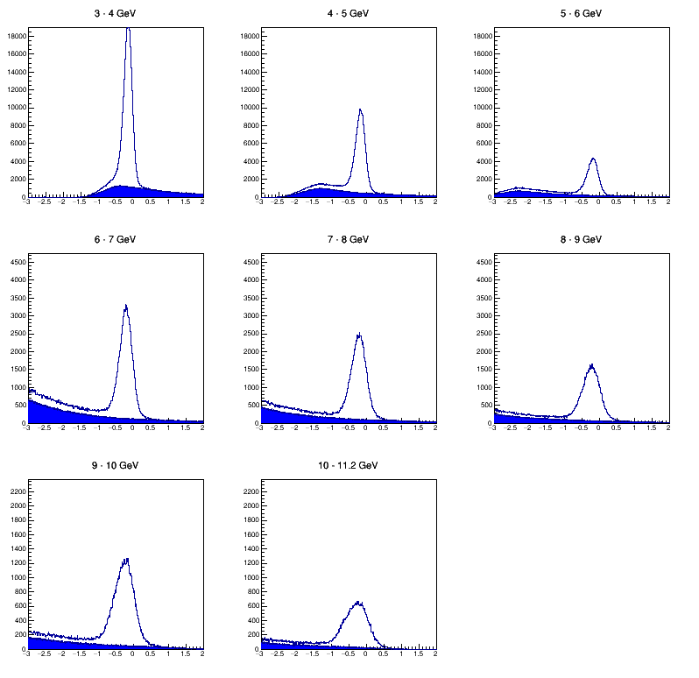
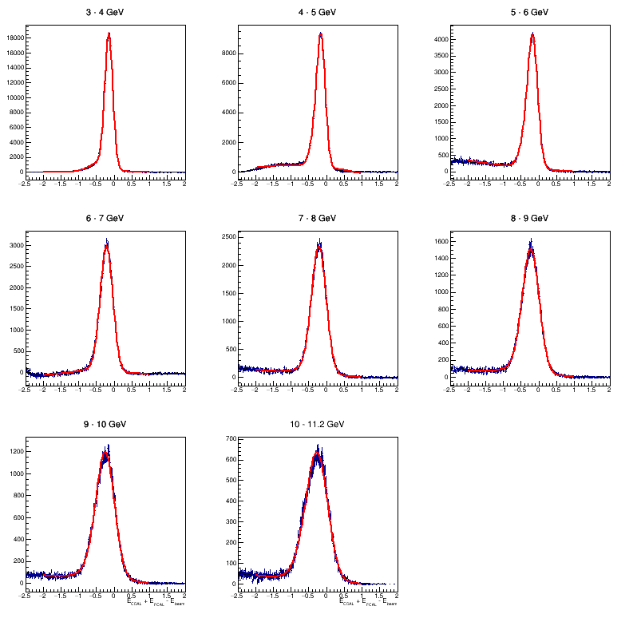
Di-Photon Events (PrimEx)
Subtract accidentals using evens from adjacent beam bunches
E_{CCAL}+ E_{FCAL} – E_{BEAM} (GeV)
E_{CCAL}+ E_{FCAL} – E_{BEAM} (GeV)

Slide 7
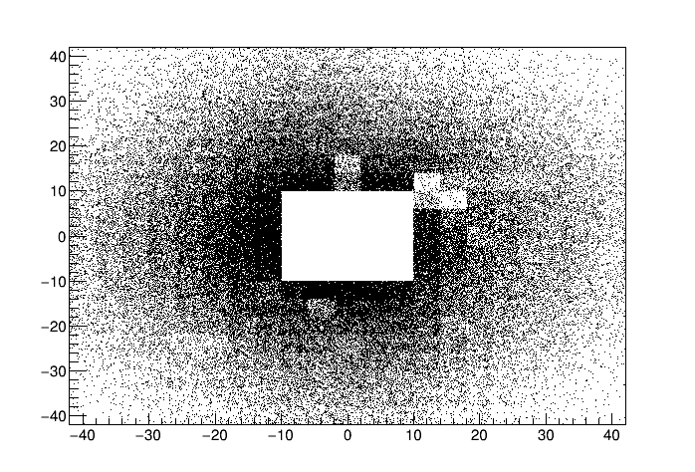
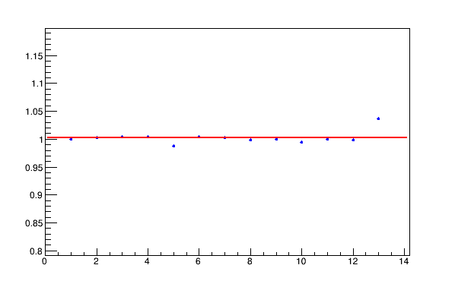
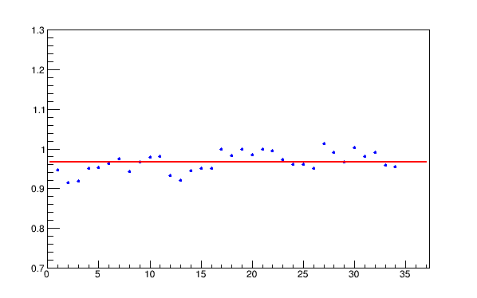
Di-photon Yield
FCAL XY of clusters
Compute tagged flux for all PrimEx production
runs (CCDB)
Flux normalized yield of di-photons
Run period: 1 day
Run period: 2 days
Relatively stable
performance
Problematic modules in FCAL
Runs
Runs

Slide 8
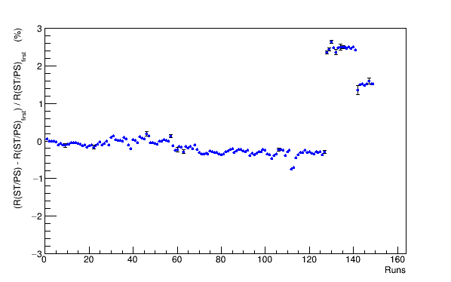
Target Density Monitoring (He target)
Normalize lumi stability using async scalers (PS, ST, TOF )
50 nA
100 nA
200 nA
Mart 26
April 14

