Slide 1
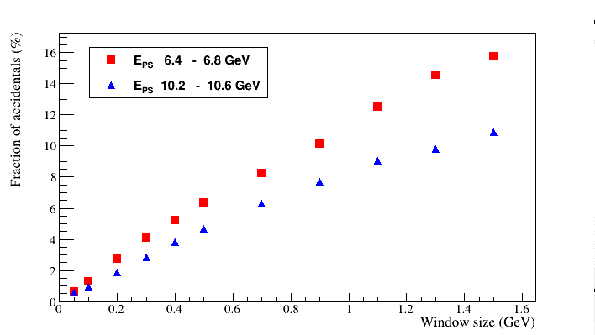
Accidentals in the Pair Spectrometer
Sascha, April 7, 2023

Slide 2
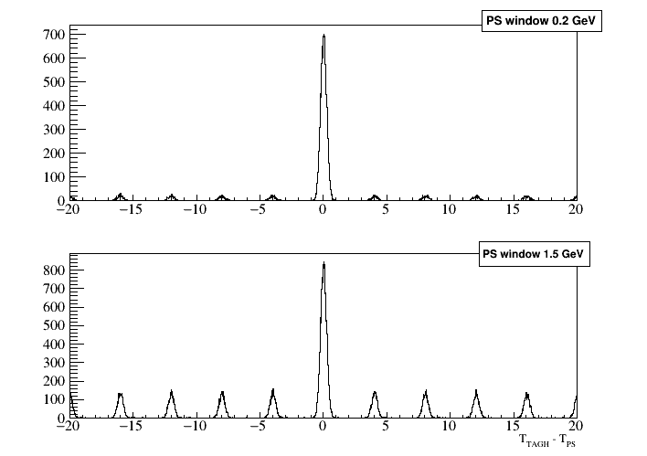
Accidentals: RF bunch structure (200 nA)

Slide 3
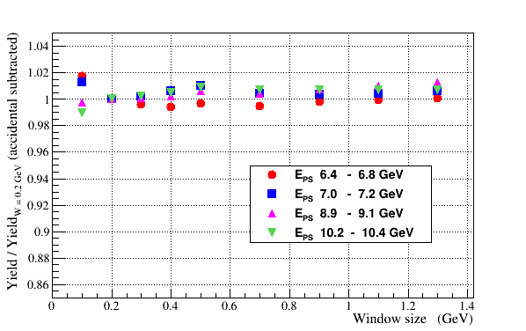
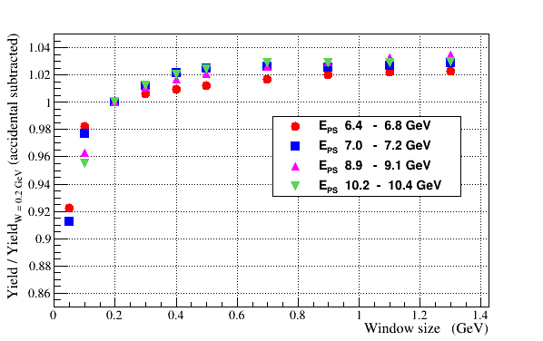
PS Yield as a Function of the Energy Window
Subtract accidentals using timing side band
Normalize PS yield to the yield obtained for | Δ E | < 0.2 GeV
50 nA (not corrected for PS acceptance)
50 nA (corrected for the PS acceptance)

Slide 4
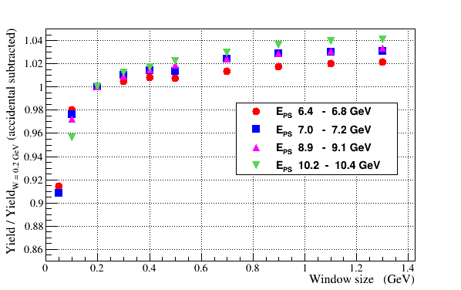
PS Yield as a Function of the Energy Window
Subtract accidentals using timing side band
Normalize PS yield to the yield obtained for | Δ E | < 0.2 GeV
50 nA (not corrected for the PS acceptance)
200 nA (not corrected for the PS acceptance

Slide 5
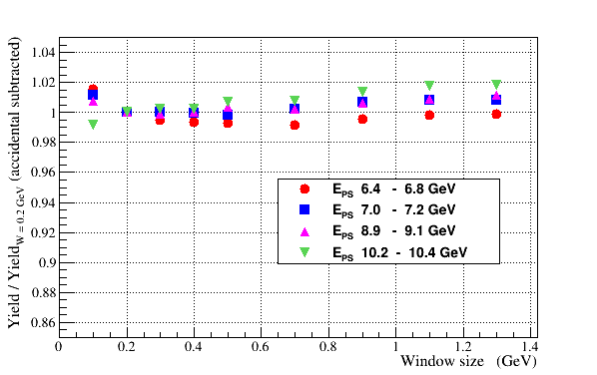
PS Yield as a Function of the Energy Window
50 nA (corrected for the PS acceptance)
200 nA (corrected for the PS acceptance)

Slide 6
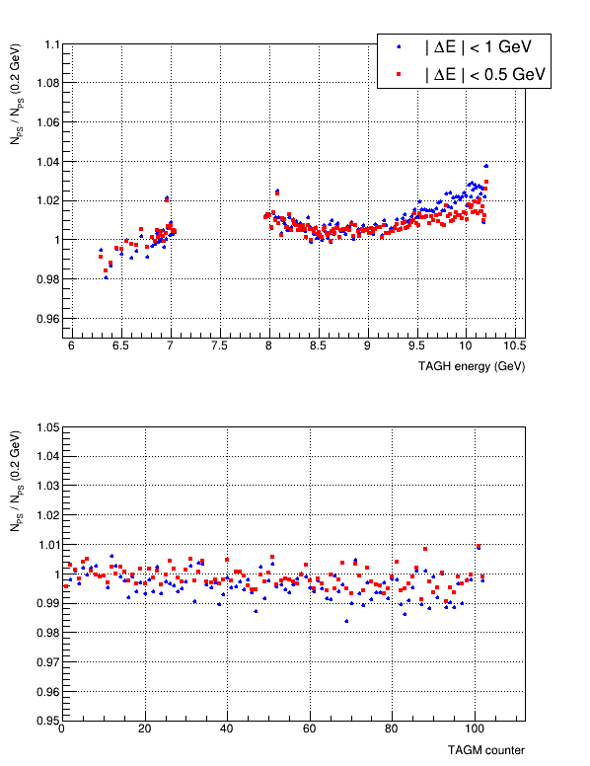
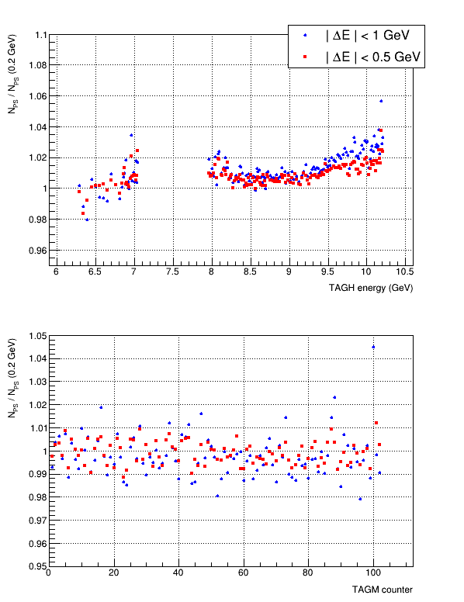
Normalized PS Yield
50 nA (run 81331)
200 nA (run 81376)

