Slide 1
Verification of the Pair Spectrometer Acceptance using
Compton events
(work progress)
Sasha, June 12, 2020

Slide 2
Comments Regarding MC Simulation
For MC simulation set JANA_CALIB_CONTEXT to “variation = mc”
(for data processing use “variation = default “)
- CCDB tables with variation “mc” will be used during in Geant and mcsmear
Assigned variation “MC” to the beam_spot Monte Carlo table. Added PS acceptance to the CCDB
Some minor issues with the latest version of Geant 3
(inconsistency between the old and new geometries in digitization hitFTOF,
temporary fixed, need to do more tests)

Slide 3
Compton Reconstruction
Start looking on runs with the smallest beam flux, 50 nA, He target
- uncertainties in the He target density (expected to be less that 5 %)
- small fraction of accidentals (in tagger and CCAL clusters). Try to check the shape of
Compton cross section
Event selection
- one cluster in the FCAL and one in the CCAL (Δ t = 8 ns ), Δ t (FCAL – RF) < 3 ns
- E_{CCAL} > 1 GeV, E_{FCAL} > 0.5 GeV
- fiducial cuts in calorimeters:
exclude fcal inner ring, -7 cm < X_{CCAL} < 9 cm, -9 cm < Y_{CCAL} < 9 cm

Slide 4
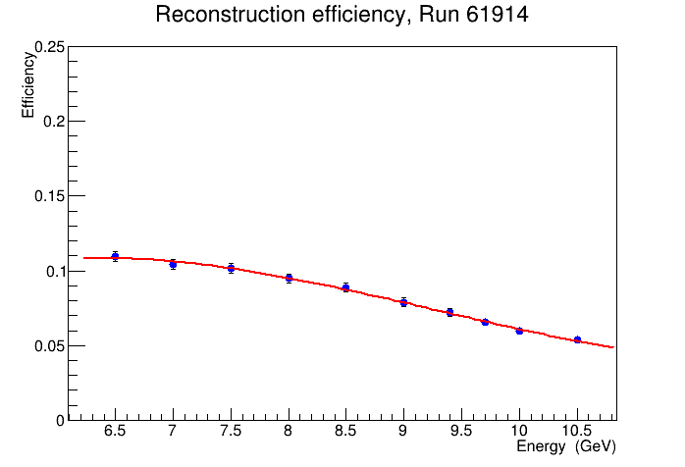
Monte Carlo Simulation: Compton Events
Monte Carlo samples generated by Igal using Pawel event generator
- Radiative corrections included
- Igal has implemented the generator to the GlueX framework (to be checked) !

Slide 5
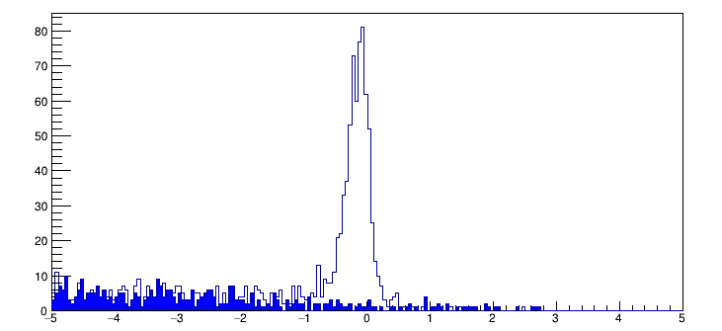
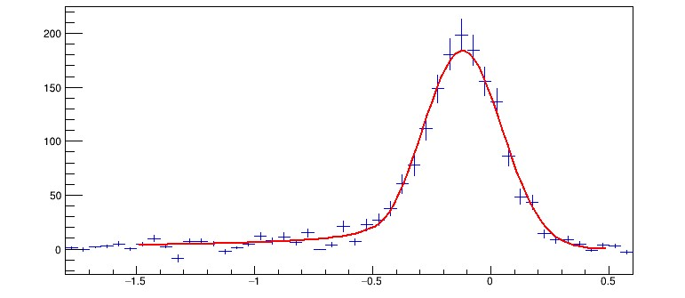
Compton Reconstruction
Run 61914
TAGM counter 33
(E ∼9 GeV)
Accidentals
Subtract accidentals
Subtract background using empty target runs
Fit for event yield using a Crystal Ball function
E_{FCAL} + E_{CCAL} - E_{BEAM} (GeV)
E_{FCAL} + E_{CCAL} - E_{BEAM} (GeV)

Slide 6
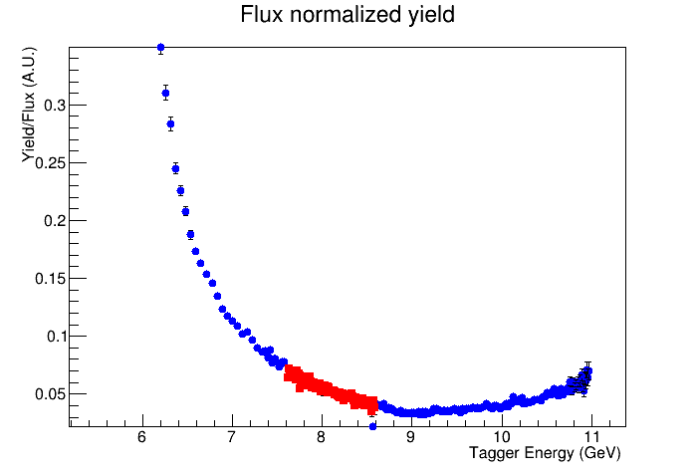
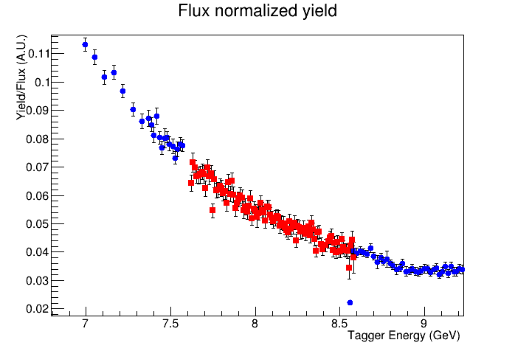
Flux Normalized Yield
Run 61914

Slide 7
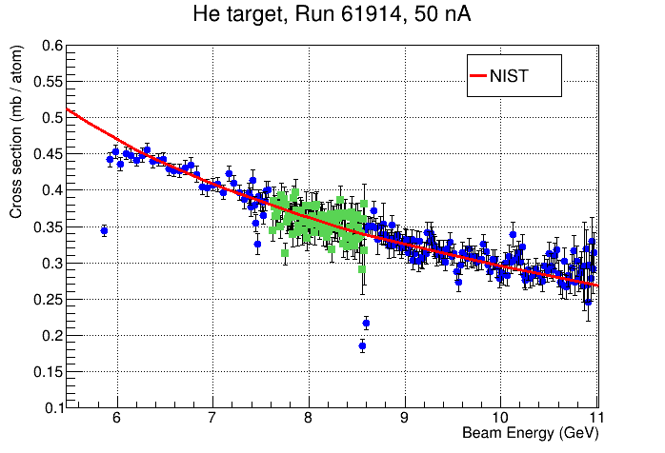
Compton Cross Section
Note: there are uncertainties
in He target density
Shape of the cross section is
in a relatively good agreement
with theoretical predictions
need to check with larger statistics

