Slide 1
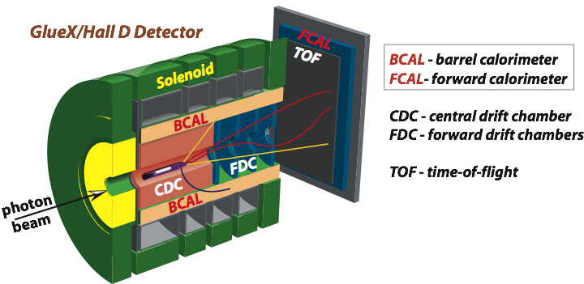
Calibration of the PS and TAGH Energy
A. Somov and V. Berdnikov
Beamline meeting, June 8, 2019

Slide 2
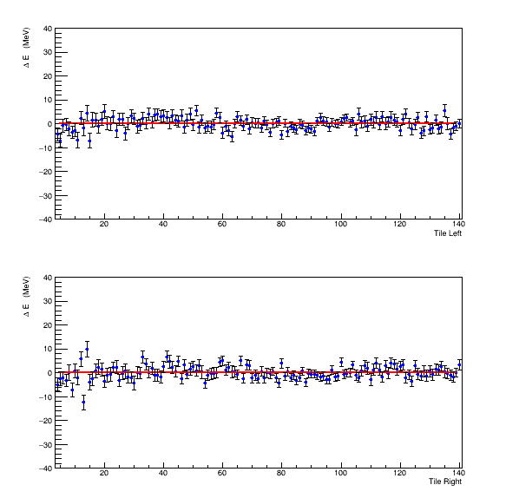
Corrections to the PS energy
TAGH counter 110
(E = 8.89 GeV)
Width of the PS detector
is well measured
Refine PS alignment:
four unknowns:
(Emin, Emax) _{L ,R}

Slide 3
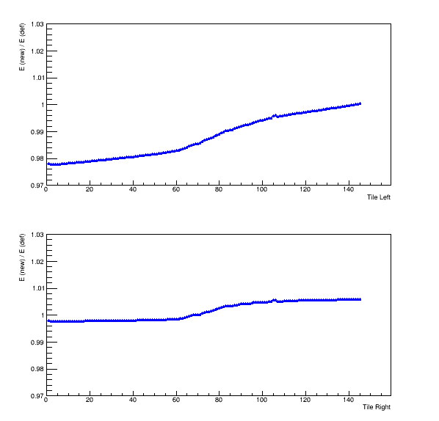
Corrections to the PS energy
Slightly shifted

Slide 4
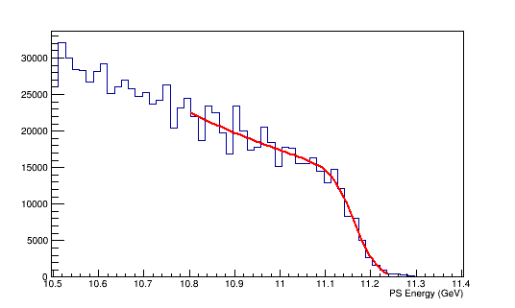
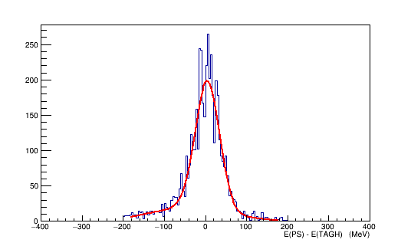
Consistency Check
TAGH 1
Set absolute PS energy according
to the beam energy
(fit to endpoint energy)
Ebeam = 11.167 GeV
Efit = 11.1658 +- 0.0004 GeV
E(PS) – E(TAGH) = 4.2 +- 0.7

Slide 5
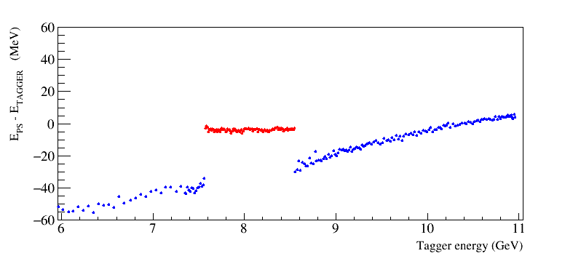
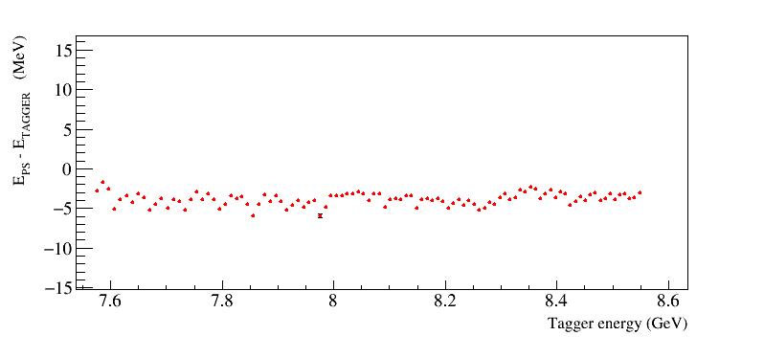
Energy Correction

