Slide 1
Sasha
SRC meeting, 3/7/22
Adjustment o f Tagger Time
Calibration of the RF time
Adjustment of global TAGH timing offsets
Time calibration of individual channels

Slide 2
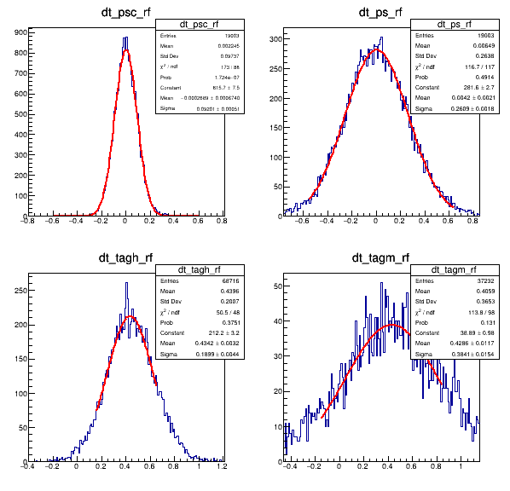
PS and Tagger Times
PSC FR
PSC
PS
PSC RF is used as reference
TAGH & TAGM are shifted by 0.4 ns
TAGH
TAGM
TAGM after time adjustment by Bo
T (DET) - T (RF)

Slide 3
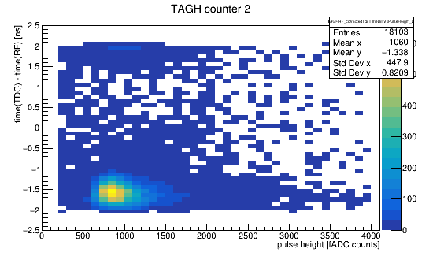
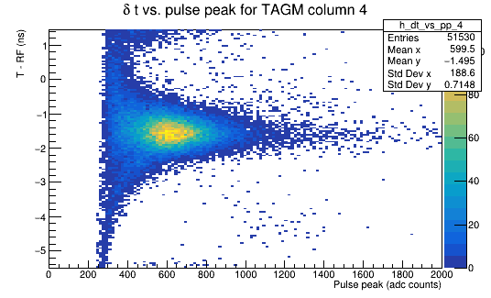
Tagger Times
Runs 90186 - 90195
TAGH FR
PS RF is used as reference
TAGH & TAGM are shifted by about 1.8 ns

Slide 4
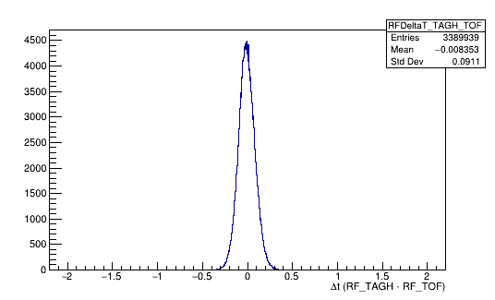
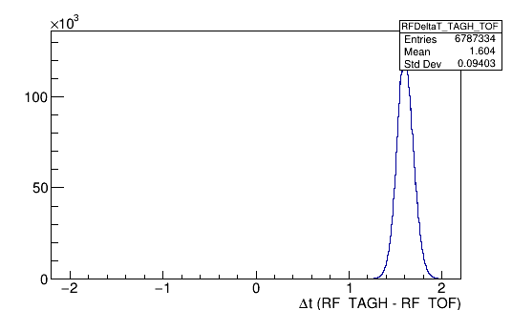
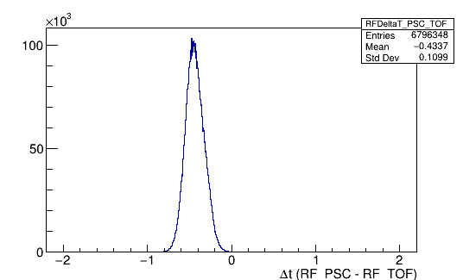
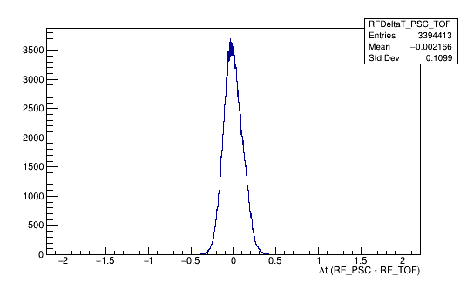
RF Times
Before Calibration
After Calibration
TAGH - TOF
Time shift ~1.7 ns
PSC - TOF
Time shift ~0.4 ns

Slide 5
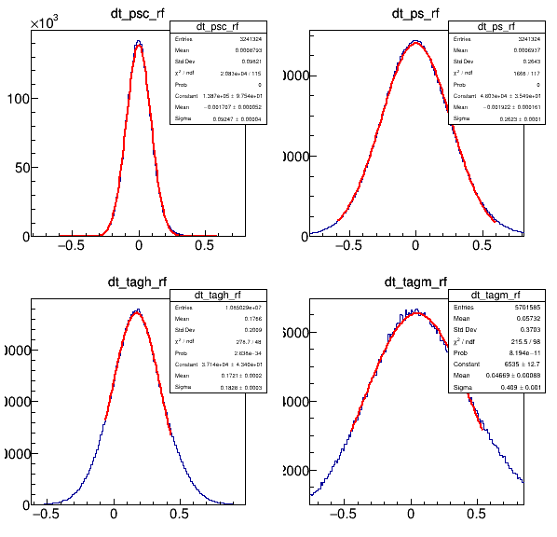
Adjustment of TAGH global time offsets
Run 90252
PSC FR
PS, PSC, and TAGM times are well aligned
TAGH time is shifted by
0.2 ns
TAGH
Shift by 0.2 ns

Slide 6
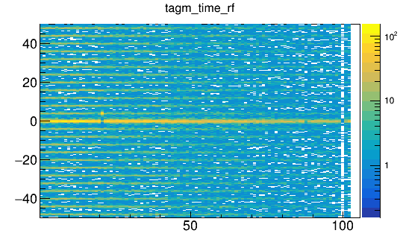
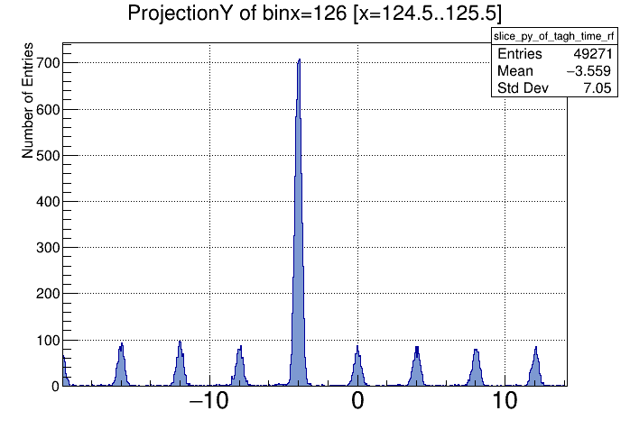
Individual Offsets
TAGH channels: 5 (8 ns), 125 (4 ns), 186 (4 ns)
TAGM channel 21 (4 ns)
T (TAGM) – T (RF) (ns)
T (TAGH) – T (RF) (ns)
Counter
Both ADC and TDC times are shifted
Time shift for almost all (491) SRC runs (corrected)

