Slide 1
Calibration database update
Dmitry Romanov
February 2, 2011

Slide 2
Unique ID
How to request particular data?
Jana interface don’t have time and other parameters
How to make it easy to understand?
Proposed solution is composit ID in string form
/name/path : run_number : variation : YYYY-MM-DD_hh_mm
Examples
/simple/constants : 101 : default : 2011-03
/simple/constants : : mc
/simple/constants : : : 2011-03-29

Slide 3
CCDB package overview
Versioning and branching
Full feature storage is DB (MySQL).
Interfaces JANA, plain C++, Python (and other)
Web interface and command line tools to manage the data.
Tools to browse, import, export data
Simple for user
C++ Users
Python Users
> Command line tools _
WEB
JANA Users
CCDB
Package

Slide 4
Overall package design
Interfaces
WEB
JANA Users
C++ Users
Python Users
> Command line tools _
Web engine
PHP
C++ CGI
JQuery
Calib. DB API
C++
SWIG
Python API (C++ API wrapping)
ROOT FIle Provider
MySQL Provider
File Provider
Ruby
Java
.NET
+
20 more
languages
.root
MySQL Server
Local DB Files

Slide 5
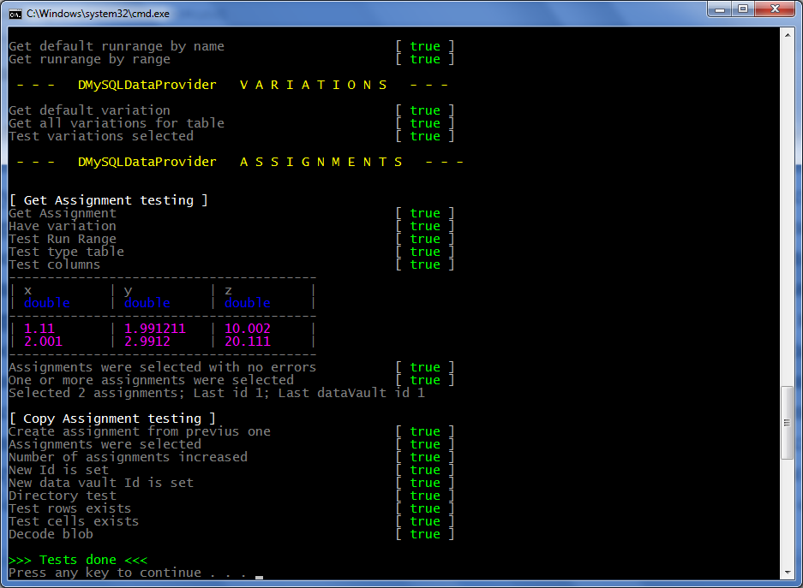
Unit testing

Slide 6
Dependencies summary
Concise overview
C++ API the only dependency is libmysql
Python wrapping is done by SWIG. No SWIG dependencies are needed for users.
Console tools are made by python 2.6+. No additional dependencies.
Web interface consists of two parts PHP and C++ CGI.
Web pages are driven by JQuery
Technologies overview
C++, STL
C API for MySQL
Python
SWIG
PHP
JQuery

Slide 7
Core API
Specifications are upgraded and released (Mark)
Core C++ API is done.
Unit tests done
Performance tests, basic stress tests, optimizations are done.
Storage file format specification is written.
Documentation (DOXYGEN) is done
SWIG interfaces (convert to 19 lang) done
Python core API wrapping done
Python documentation partly done
Dmitry Romanov romanov@jlab.org

Slide 8
User API
C++ multithreaded user API is mostly done (string ID implementation after will be accepted)
Multithreaded tests in progress
Thorough documentation in progress
JANA interface is done.
Convert from current Calib files to CCDB MySQL is mostly done (Thanks Mark)
Thus tests of running JANA with CCDB are in progress
Python user API is done.
Examples and documentation partly done

Slide 9
Management tools
Python command line tools mostly done
Python command line tools allow to do all basic managing operations.
Thorough documentation in progress
JANA interface is done.
Convert from current Calib files to CCDB MySQL is mostly done (Thanks Mark)
Web site prototype is done
Web site pages needs to be added
Examples and documentation partly done

Slide 10
Overall
CCDB is mostly ready for beta stage.
More documentation needed
More JANA tests needed

