Slide 1
Hall D Target Design Concept
Jim Fochtman
July 12, 2011

Slide 2
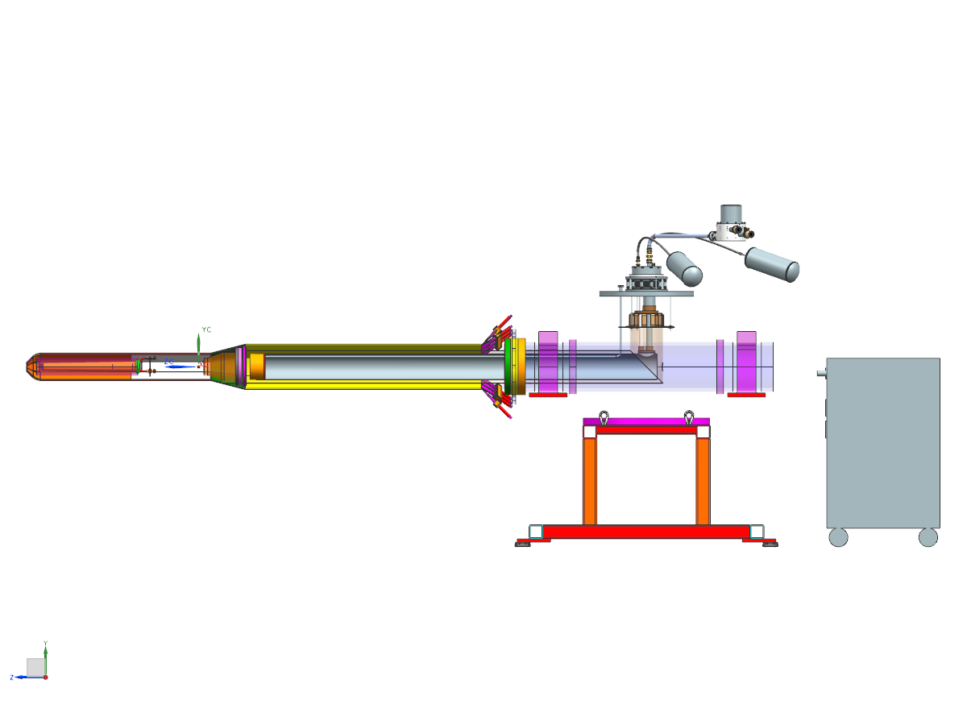
Target
Cold Head
1st stage driven radiation shield
Condenser
Cold Head Compressor
2nd stage thermal link to condenser

Slide 3
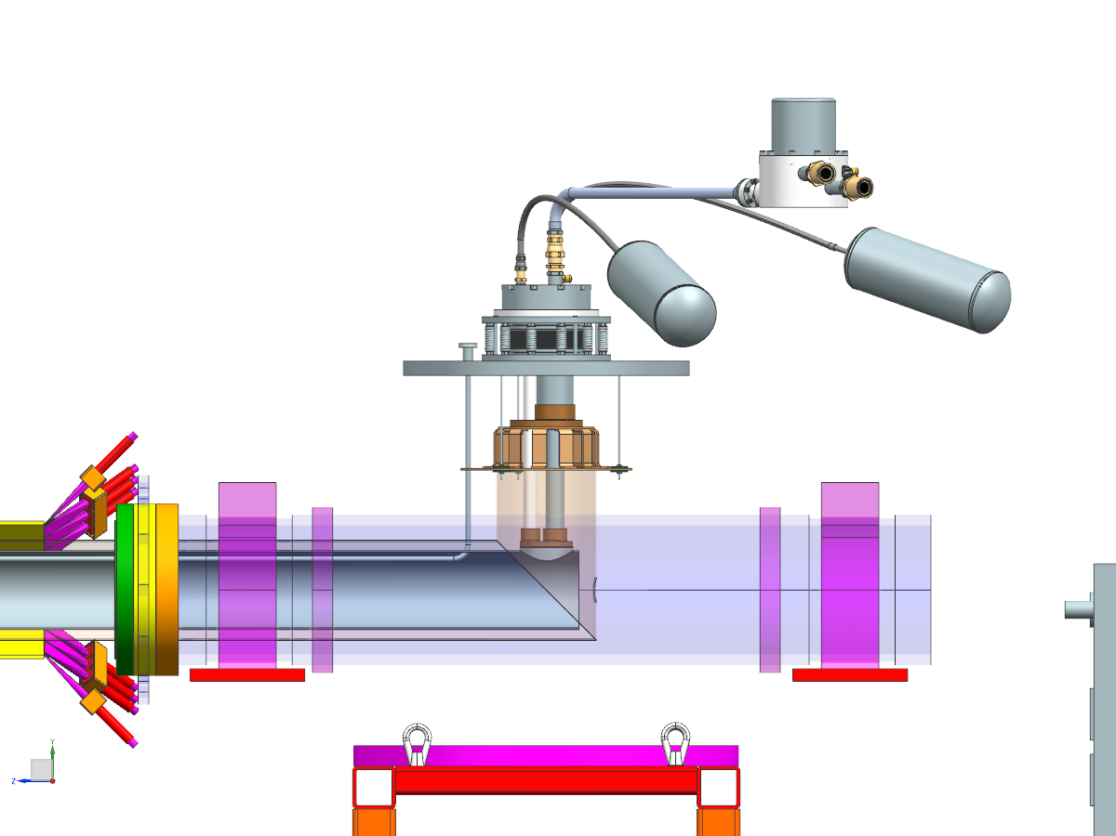

Slide 4
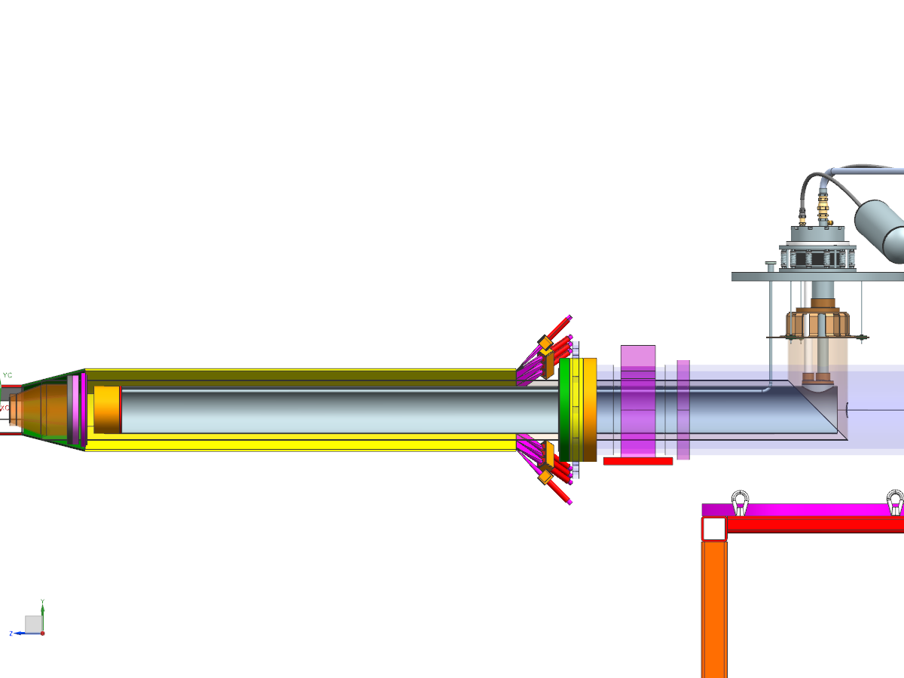

Slide 5
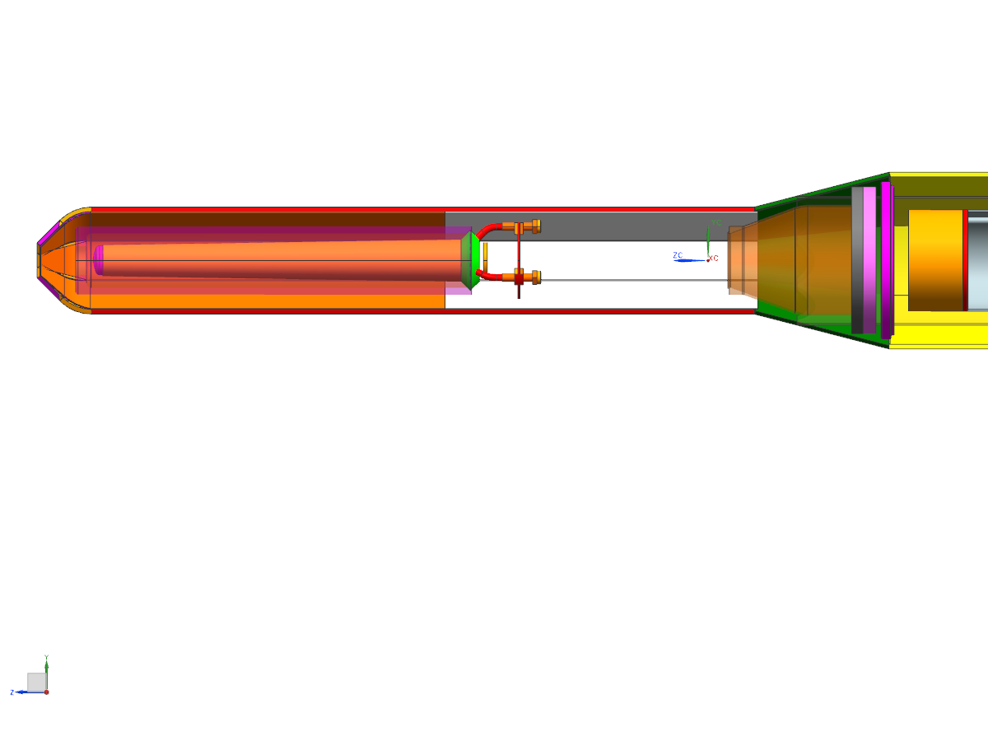
Thermal siphon set up from target to condenser due to natural convection and density changes of the liquefied gas.

