Slide 1
Hall D Target Design Status
Jim Fochtman- February 22, 2012

Slide 2
Quick Notes
The refrigeration system has arrived!
Hardware design about 90% complete. Detailing of some components has begun.
Some questions about instrumentation and assembly.

Slide 3
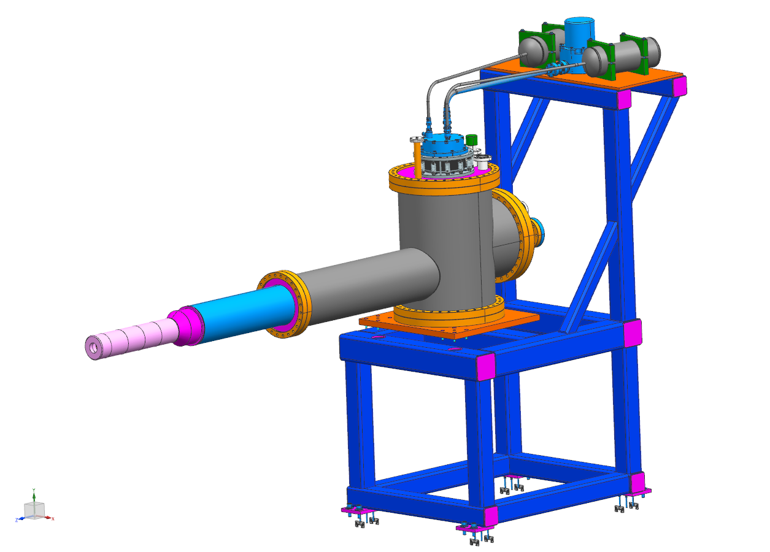
Current concept to align/position the target is to adjust the entire can.

Slide 4
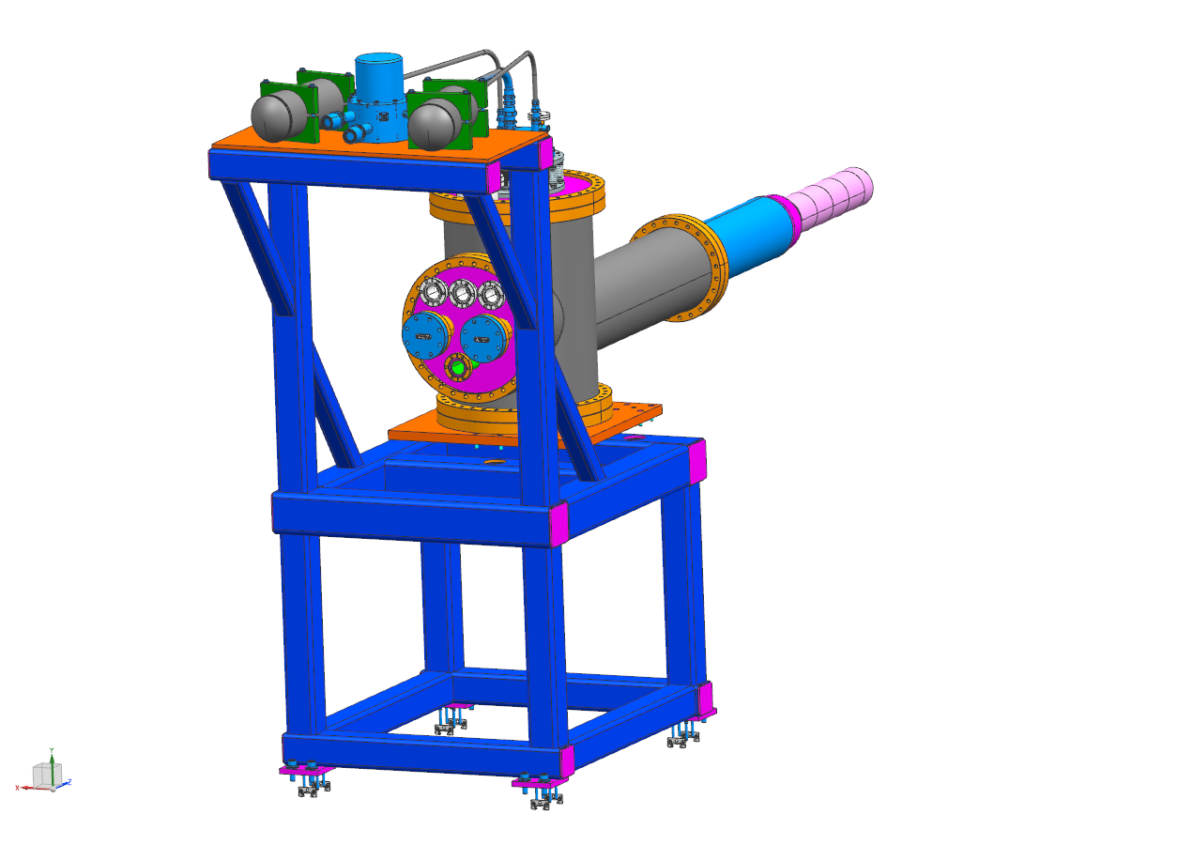
Any location preference for the gas and instrument connections?

Slide 5
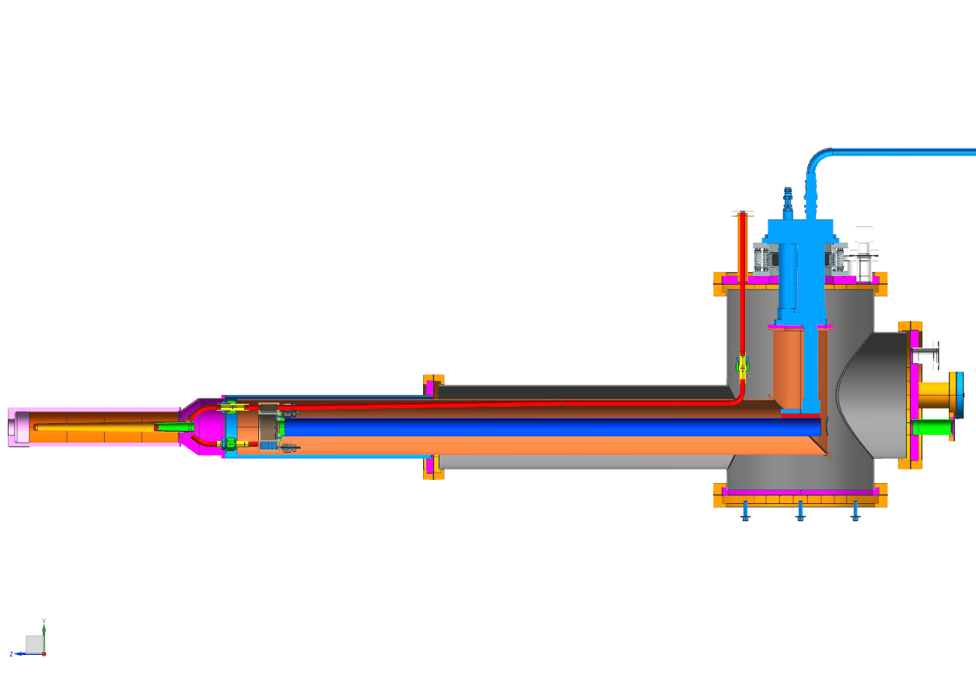
Current Concept- With cold head can and branch connections fabricated…
Insert the condenser, conductor and shield assembly through large port. Insert cover with cold head and vertical shield into can. Make gas, thermal and instrumentation connections. Attach the target and conductor assembly and then install the scattering chamber assembly.

Slide 6
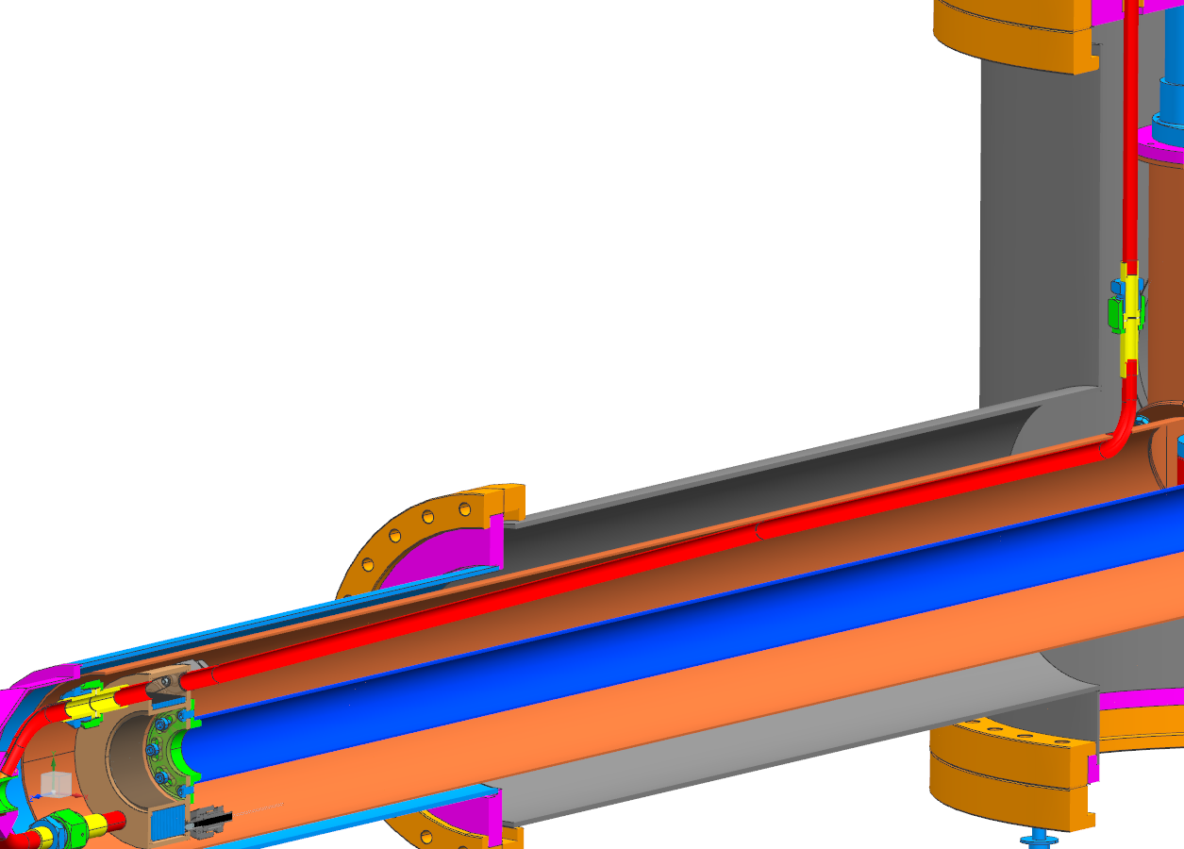
First 18” of gas tube thermally connected to the shield (stage 1 of the cold head) to pre cool gas.

Slide 7
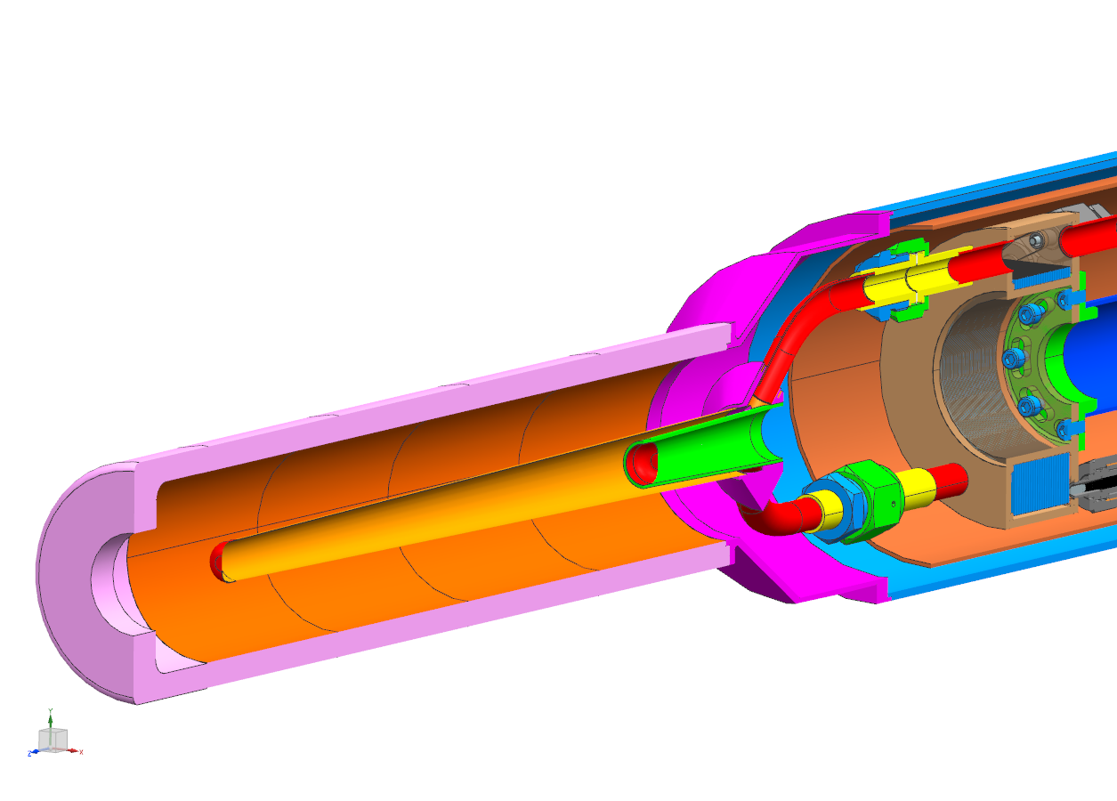
Condenser, conductor and shield assembly (target end). Target and conductor assembly installed and with the scattering chamber assembly.

Slide 8
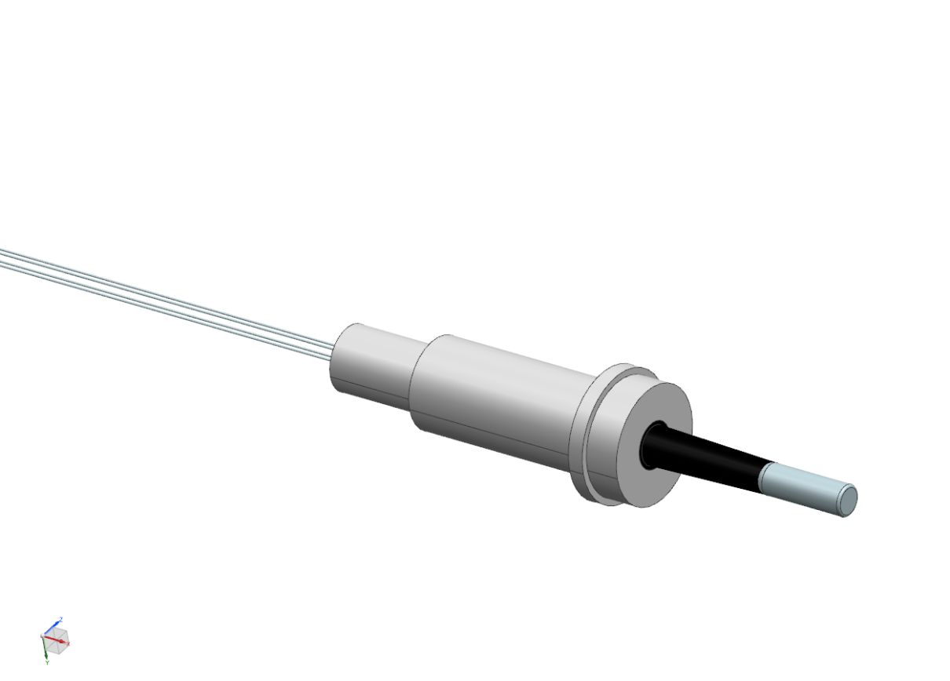
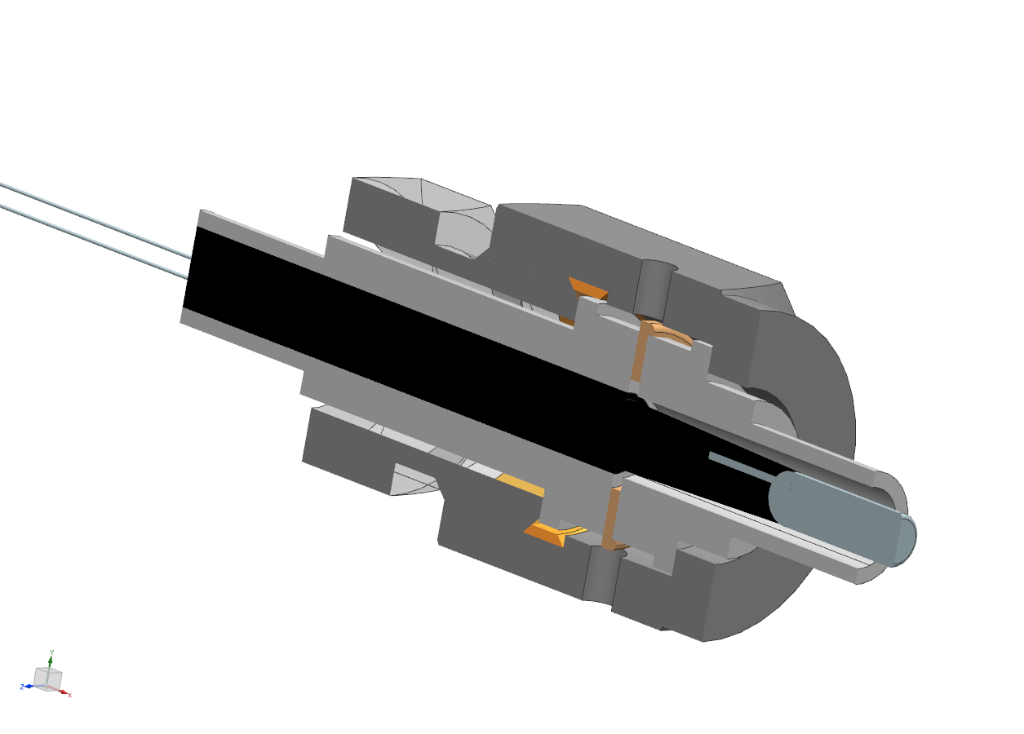
Lakeshore Cernox CC package potted into VCR gland allows for removal and calibration.
End of Swagelock VCR fitting brazed into condenser back plate.

Slide 9
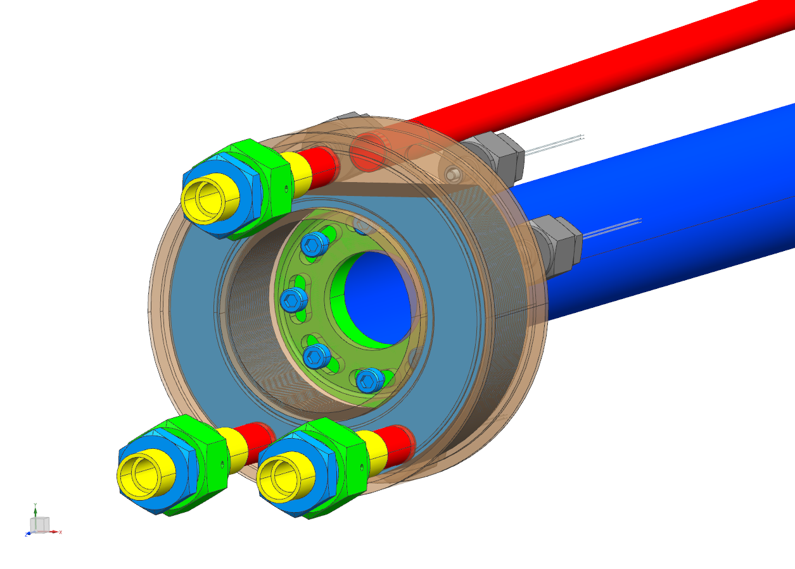

Slide 10
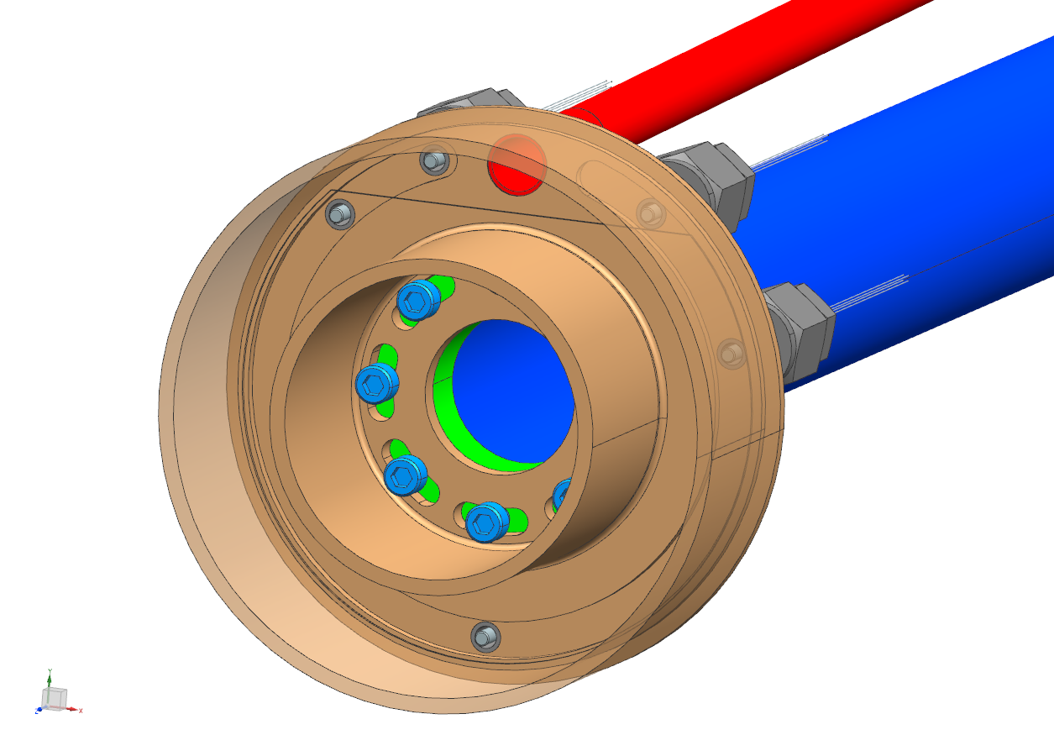
This sensor will feed through the condenser deep into the top feed tube.
This sensor used to detect top level (should not be submerged).
This sensor used to detect top level (should be submerged).
Initial fill detection
Backup?

Slide 11
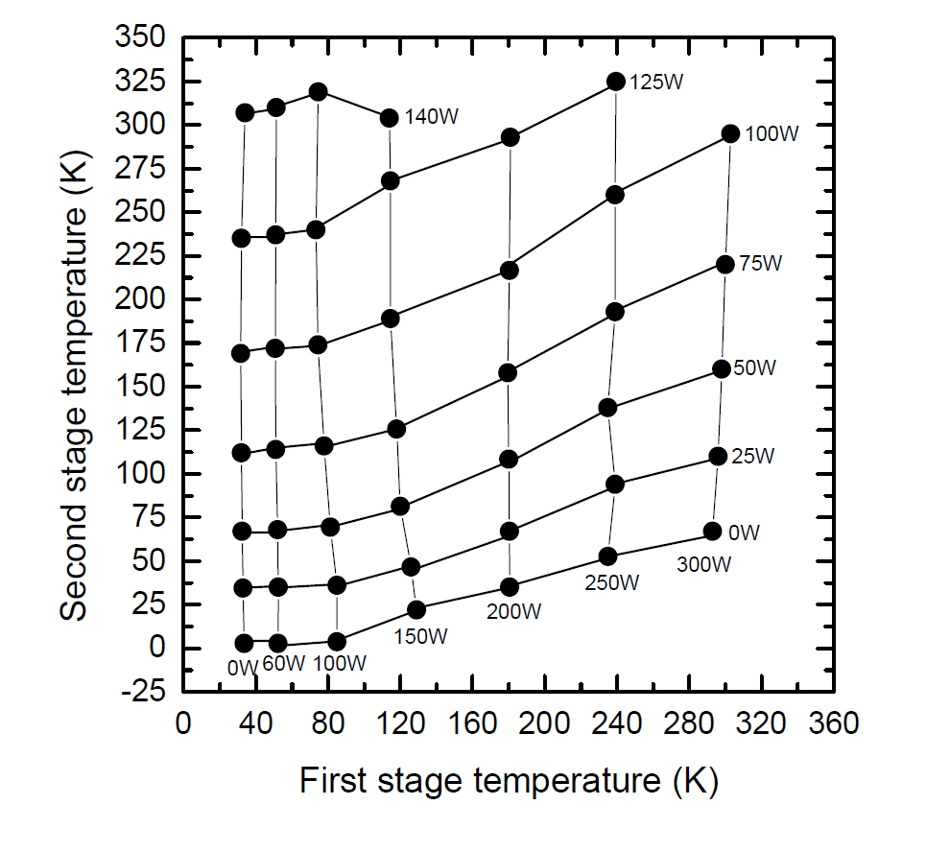
Cool Down Calculations
CryoMech only had cool down data from room temperature from the PT-410 cold head, not the PT-415 we have.
The graph shown here is the only information I received from CryoMech.

Slide 12
Cool Down Calculations- Method
Used Excel to match the graphs points.
The first stage power is nearly independent of the second stage temperature.
The second stage power, is very dependant on the first stage temperature.
Plotted into graph and line fit appropriate curves, and used fit lines to have a Power formula for cool down calculations.

Slide 13
Cool Down Calculations- Method
Used data from NIST and to be conservative selected RRR 50 copper (lowest conductivity) for conductivity and specific heat.
GASPAK ver. 3.31 Excel Add-In used for H₂ properties.

Slide 14
Cool Down Calculations- Method
Condensation rate was calculated using the formula
Where is modified based on the Jakob number.
The effective power of the stage 2 cold head at the condenser is ~10W.
This should condense the 0.4 liter target/condenser in about 30 minutes.
The system cool down considered a heat load of…
2W on Stage 1(~1.2W radiation, 0.5W spiders, 0.3W gas tube) from individual calculation
300mW on Stage 2 (200mW radiation target, 5mW radiation on shielded portion, 75mW spiders)
Values based on individual calculations including MLI.

Slide 15
Cool Down Calculations- Method
Assumptions
  Used PT-410 Power (PT-415 power should be 1.2 & 1.4 times for stage 1 & 2 respectively)
  Used 31g (0.4l of H₂ liquid) as mass from room temperature and condensation
  Fixed pressure (131.4kPa/1.3atm) used in GASPAK for H₂ specific heat
  Added fixed mass to compensate for CryoMech spec of first stage to 4K in less than 1 hour. Added appropriate mass for current design to stage 1 & 2
  Used linear interpolation between power bands and for heat loss from room temperature to cold
  Solved for T2 using equation

Slide 16
Cool Down Calculations- Results
Top graph uses stage 2 to cool the H₂ gas while the bottom graph shows the gas being cooled by stage 1
Using stage 1 to cool the gas is slightly faster, and is the design direction
With a small target, the difference between which stage cools the gas is small, the results would be more significant with a larger liquid volume

Slide 17
Cool Down Calculations- Results
Top graph uses stage 2 to cool the H₂ gas while the bottom graph shows the gas being cooled by stage 1
Both graphs show effective (90% of raw power – heat loss)

Slide 18
Back-Up Slides

Slide 19
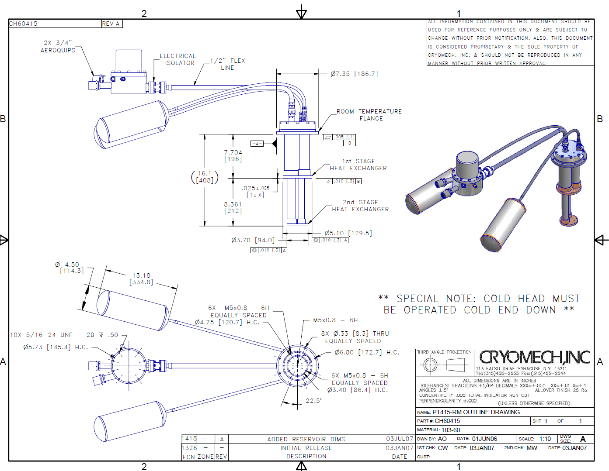

Slide 20
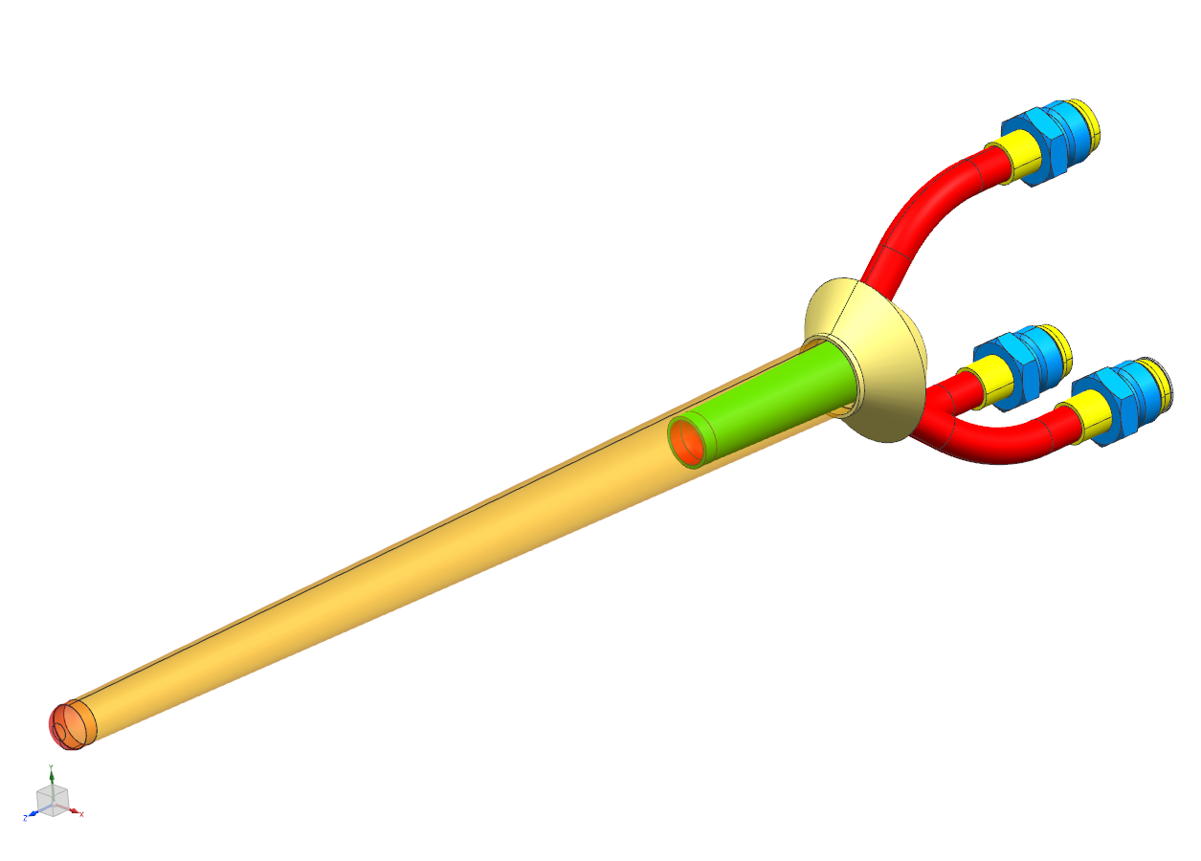
Close up of target assembly. What grade Torlon?

Slide 21
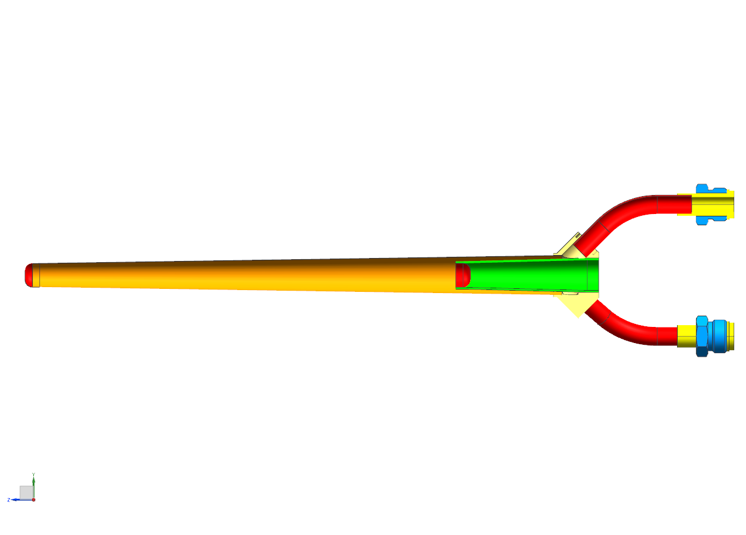
Glue Joints

Slide 22
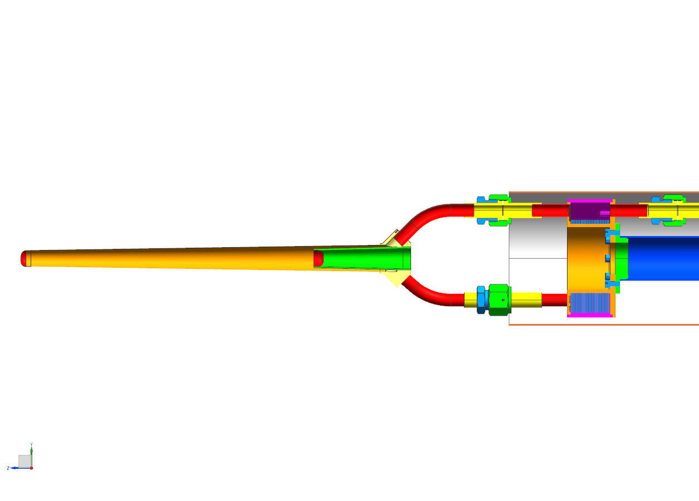
Two 1”x5.5” polyimide heaters capable of ~20 W each. Redundancy. Attachment to tube?
Cross section of condenser and target assembly. Fins of inside condenser show desired liquid level.

