Slide 1
PrimEx Experiments and the Prospects of Rare Meson Decays at GlueX
Liping Gan
University of North Carolina Wilmington
Outline
  Challenges in Physics
Precision tests of continuous symmetries in confinement QCD via PrimEx experiments
Testing discrete symmetries and searching for new physics via η rare decays
Summary

Slide 2
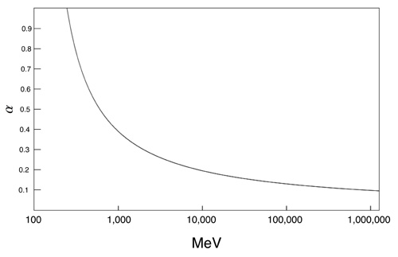
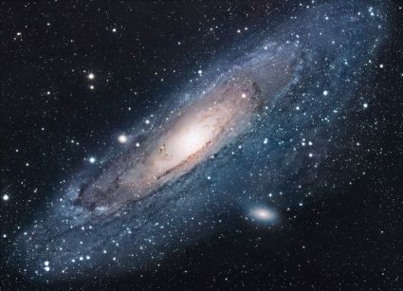
  Current Challenges in Physics
QCD at different energies
Confinement QCD
  Lattice QCD
  Chiral perturbation theory
New physics beyond the Standard Model (SM)
  New sources of symmetry violation
  Dark matter
  Dark energy

Slide 3
Continuous symmetries of QCD in the chiral limit
chiral limit: is the limit of vanishing quark masses m_{q}→ 0.
QCD Lagrangian with quark masses set to zero:
Large global symmetry group:

Slide 4
Fate of QCD symmetries

Slide 5
Lightest pseudoscalar mesons
Chiral SU_{L}(3)XSU_{R}(3) spontaneously broken
Goldstone mesons π⁰, η₈
Chiral anomalies
Mass of η₀
P→γγ
( P: π⁰, η, η׳)
Quark flavor SU(3) breaking
The mixing of π⁰, η and η׳
The π⁰, η and η’ system provides a rich laboratory to study the symmetry structure of QCD at low energy.

Slide 6
Primakoff Program at Jlab 6 & 12 GeV
Precision measurements of electromagnetic properties of π⁰, η, η′ via Primakoff effect.
Two-Photon Decay Widths:
      Γ(π⁰→γγ) @ 6 GeV
      Γ(η→γγ)
      Γ(η’→γγ)
Transition Form Factors at low
Q² (0.001-0.5 GeV²/c²):
F(γγ*→ π⁰), F(γγ* →η), F(γγ* →η′)
Input to Physics:
precision tests of Chiral
symmetry and anomalies
determination of light quark
mass ratio
η-η’ mixing angle
Input to Physics:
π⁰,η and η’ electromagnetic
interaction radii
is the η’ an approximate
Goldstone boson?

Slide 7
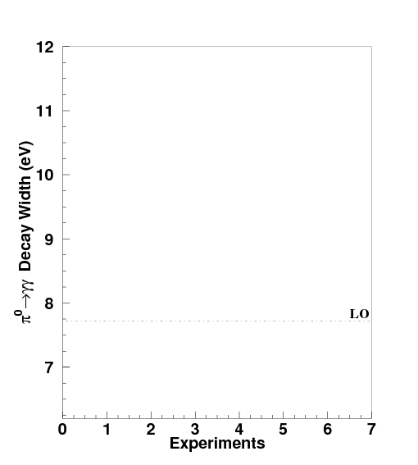
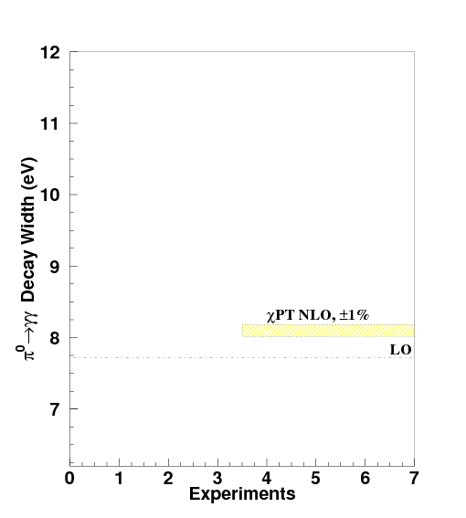
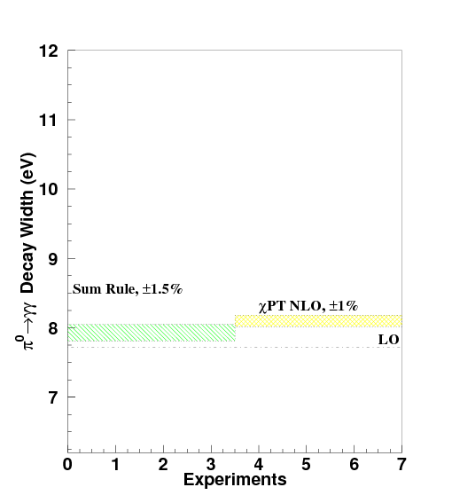
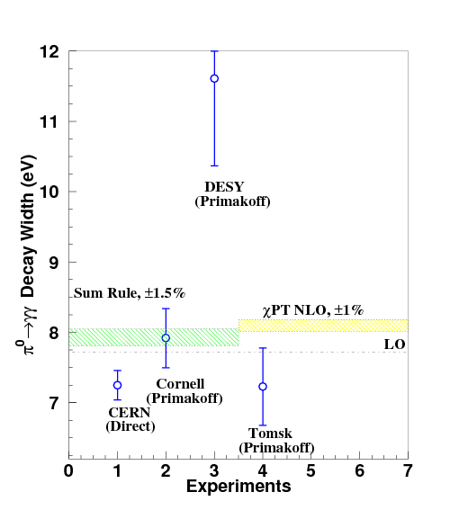
Γ(π⁰→γγ) Experiments @ 6 GeV
π⁰→γγ decay proceeds primarily via the chiral anomaly in QCD.
The chiral anomaly prediction is exact for massless quarks:
k₁
π
k₂
Γ(π⁰→γγ) is one of the few quantities in confinement region that QCD can
calculate precisely to higher orders!
Corrections to the chiral anomaly prediction:
  Calculations in NLO ChPT:
  Γ(π⁰→γγ) = 8.10eV ± 1.0%
  (J. Goity, et al. Phys. Rev. D66:076014, 2002)
  Γ(π⁰→γγ) = 8.06eV ± 1.0%
  (B. Ananthanarayan et al. JHEP 05:052, 2002)
  Calculations in NNLO SU(2) ChPT:
  Γ(π⁰→γγ) = 8.09eV ± 1.3%
  (K. Kampf et al. Phys. Rev. D79:076005, 2009)
Calculations in QCD sum rule:
  Γ(π⁰→γγ) = 7.93eV ± 1.5%
  (B.L. Ioffe, et al. Phys. Lett. B647, p. 389, 2007)
Precision measurements of Γ(π⁰→γγ) at the percent level will provide
a stringent test of a fundamental prediction of QCD.

Slide 8
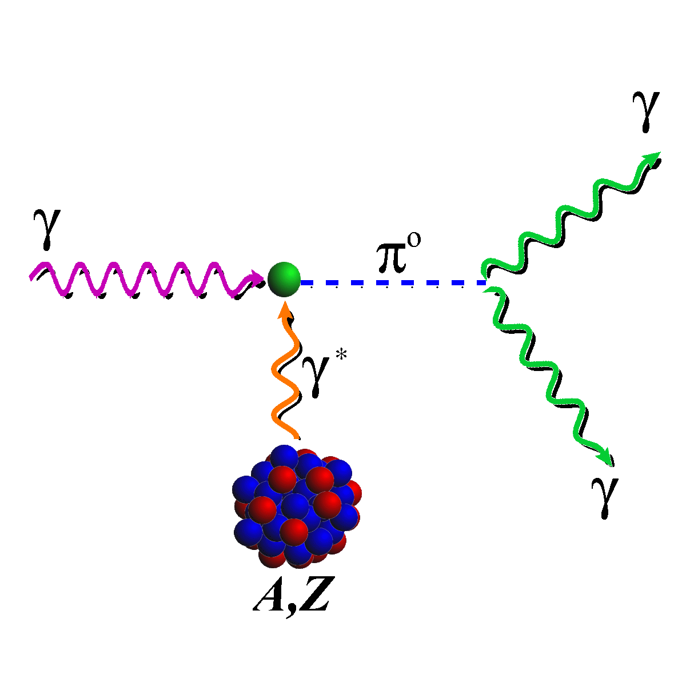
Primakoff Method
¹²C target
ρ,ω
Primakoff
Nucl. Coherent
Nucl. Incoh.
Interference
Challenge: Extract the Primakoff amplitude
Requirement:
Photon flux
Beam energy
π⁰ production Angular resolution
Features of Primakoff cross section:
Peaked at very small forward angle:
Beam energy sensitive:
Coherent process

Slide 9
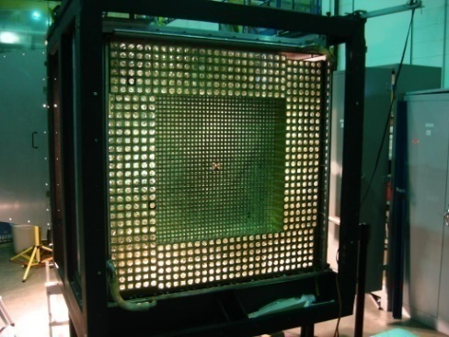
PrimEx-I (2004)
JLab Hall B high resolution,
high intensity photon tagging
facility
New pair spectrometer for
photon flux control at high
beam intensities
1% accuracy has been achieved
New high resolution hybrid
multi-channel calorimeter
(HyCal)

Slide 10
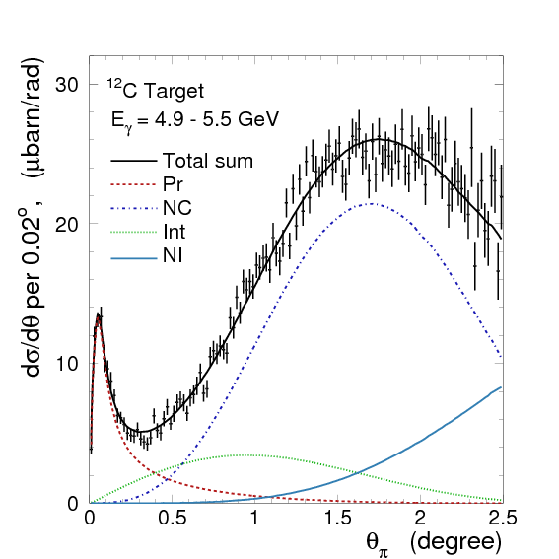
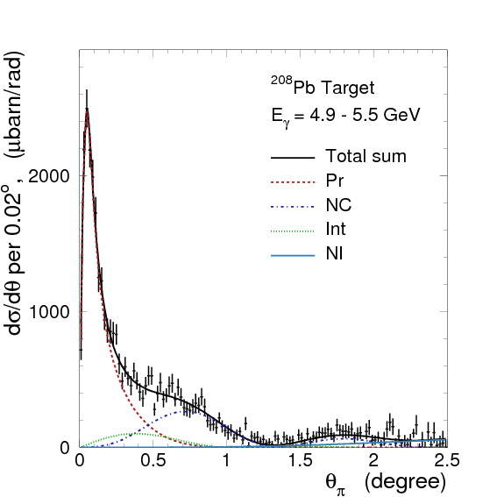
Fit Differential Cross Sections to Extract Γ(π⁰→γγ)
Theoretical angular distributions smeared with experimental resolutions are fit to the data on two nuclear targets:

Slide 11
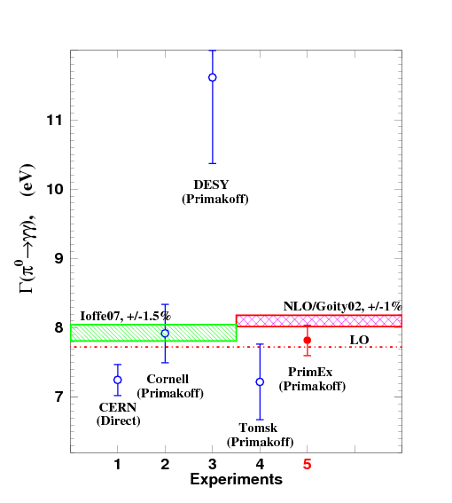
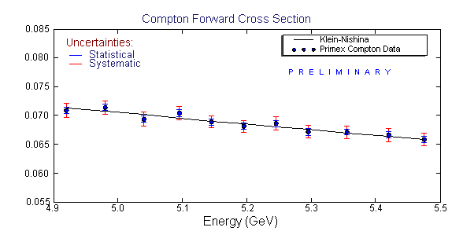
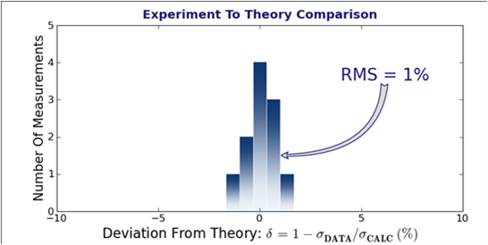
PrimEx-I Result
Systematical uncertainty verification:
Compton Cross Section Measurement
PRL 106, 162303 (2011)
Data with radiative corrections
Γ(π⁰→γγ) = 7.82±0.14(stat)±0.17(syst) eV
2.8% total uncertainty

Slide 12
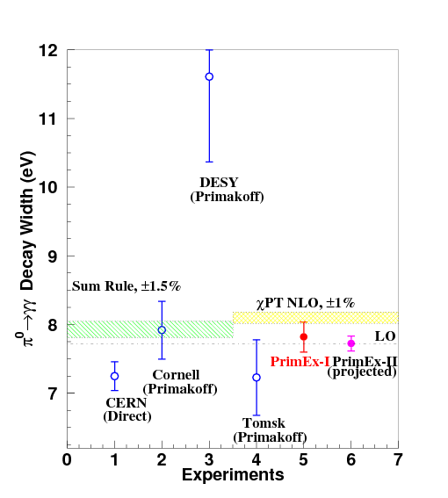
Goal for PrimEx-II (2010)
PrimEx-II
projected ±1.4%

Slide 13
PrimEx-II Experimental Yield (preliminary)
( Eγ = 4.4-5.3 GeV)
Primakoff
Primakoff
¹²C
²⁸Si
~8K Primakoff events
~20K Primakoff events

Slide 14
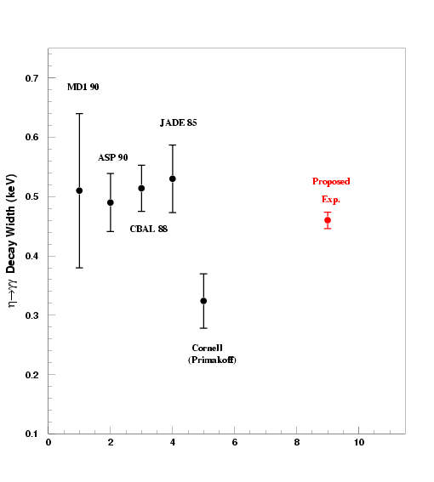
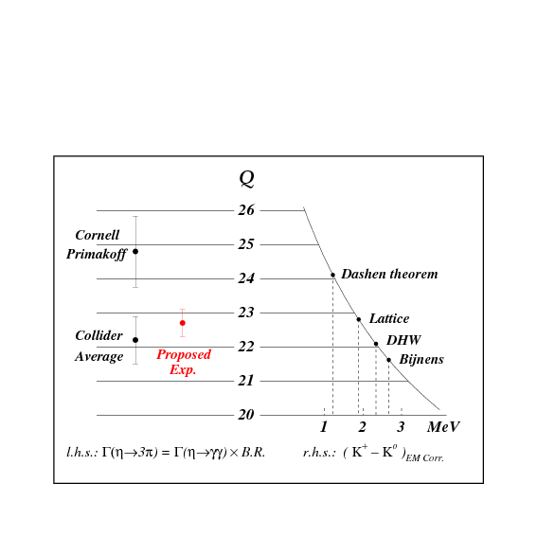
Outcomes from Γ(η→γγ) Experiment @ 12 GeV
Resolve long standing discrepancy between collider and Primakoff measurements:
Determine Light quark mass ratio:
      Γ(η→3π) ∝ |A|² ∝ Q⁻⁴
Extract η-η’mixing angle:
H. Leutwyler Phys. Lett., B378, 313 (1996)

Slide 15
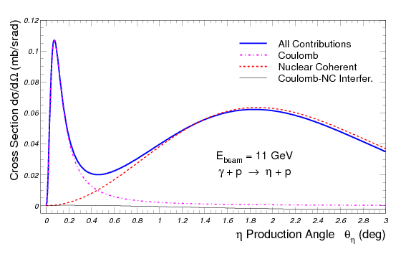
Challenges in the η→γγ Primakoff experiment
η
Hydrogen
⁴He targets
Compared to π⁰:
  η mass is a factor of 4 larger than π⁰ and has a smaller cross section
larger overlap between Primakoff and hadronic processes;
larger momentum transfer (coherency, form factors, FSI,…)

Slide 16
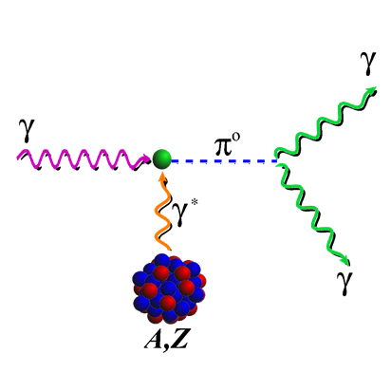
Measurement of Γ(η→γγ) in Hall D at 12 GeV
η
CompCal
FCAL
Incoherent tagged photon beam (~10.5-11.5 GeV)
Pair spectrometer and a TAC detector for the photon flux control
30 cm liquid Hydrogen and ⁴He targets (~3.6% r.l.)
Forward Calorimeter (FCAL) for η→γγ decay photons
CompCal and FCAL to measure well-known Compton scattering for control
of overall systematic uncertainties.
Solenoid detectors and forward tracking detectors (for background rejection)
16

Slide 17
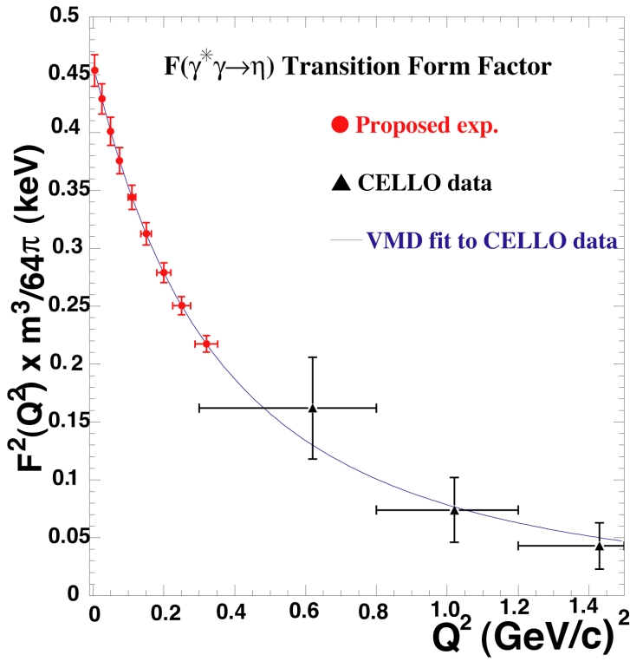
Transition Form Factors F(γγ*→p)
(at Low Q²)
Direct measurement of slopes
  Interaction radii:
  F_{γγ*P}(Q²)≈1-1/6▪<r²>_{P}Q²
  ChPT for large N_{c} predicts relation between the three slopes. Extraction of Ο(p⁶) low-energy constant in the chiral Lagrangian
Input for light-by-light scattering for muon (g-2) calculation
Test of future lattice calculations

Slide 18
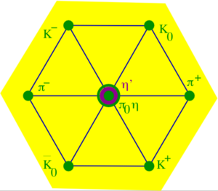

Why η is an unique probe for New physics ?
The most massive member in the octet of
pseudoscalar Goldstone mesons (547.9 MeV/c²)
Many open decay channels
Sensitive to QCD symmetry breakings
Due to the symmetries in the strong and EM interactions, the η
decay width Γ_{η} =1.3KeV is extremely narrow (relative to Γ_{ρ}=149MeV)
    The lowest orders of η decays are filtered out in the strong and EM interactions, enhancing the contributions from higher orders by a factor of ~100,000.
Eigenstate of P, C, CP, and G:
Study violations of discrete symmetries
The η decays are flavor-conserving reactions which are effectively
free of SM backgrounds for new physics search.
η decays is a unique probe to test SM and to search for new physics beyond SM: (1) test higher order χPTh and future lattice QCD predictions; (2) new sources of fundamental symmetry violations; (3) light dark matter.

Slide 19
η Neutral Rare Decay Channels
Mode | Branching Ratio (PDG) | Physics Highlight
π⁰ 2γ | ( 2.7 ± 0.5 ) × 10 ⁻ ⁴ | χPTh @ Ο(p⁶), Lattice QCD
2π⁰ | <3.5 × 10 ⁻⁴ | CP, P
3γ | <1.6 × 10 ⁻ ⁵ | C
π⁰ γ | <9 × 10 ⁻ ⁵ | C, L, gauge inv.
4γ | <2.8 × 10 ⁻⁴ | Suppressed (<10⁻¹¹)
π⁰ π⁰ γ | <5 × 10 ⁻ ⁴ | C
π⁰ π⁰ π⁰ γ | <6 × 10 ⁻ ⁵ | C
4π⁰ | <6.9 × 10 ⁻ ⁷ | CP, P

Slide 20
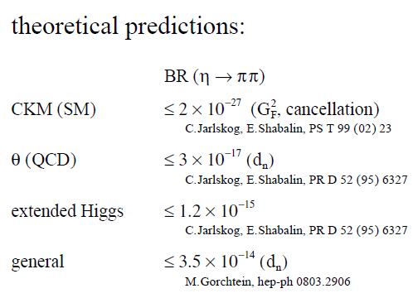


Status of η→π⁰ π⁰
Detection at any level would be signature of P and PC violations from new sources!

Slide 21
Strong CP Problem
A term in QCD Lagrangian violates P, T, CP. It only manifests in flavor-conserving phenomena.
When including electro-weak interaction in SM, the QCD vacuum angle becomes:
Current experimental constraint on θ came from neutron EDM: theory estimation
experimental limit
Such constraint is sensitive to the tree level and loop term cancellation (K. Ottnad, et al., Phys.Lett.,B687, 42 (2010)):
η→2π⁰ may shed light on the Strong CP problem:

Slide 22
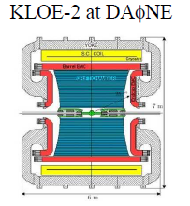
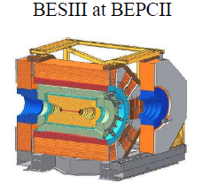
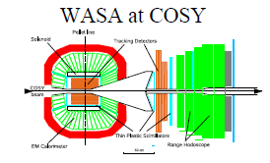

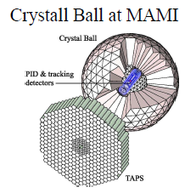
World competition in Rare η Decays
e⁺e⁻
Collider
Low energy
η-facilities
High energy η-facility
Fixed-target
CBELSA/TAPS at ELSA
JEF at Jlab

Slide 23
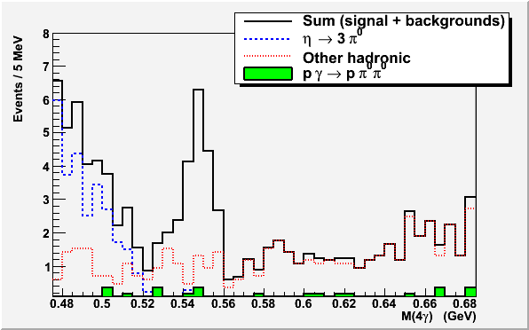
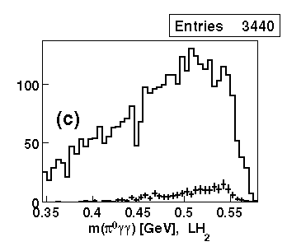
Filter Background with η Energy Boost
Jlab: high energy η production
(E_{γ} = 9-11.7 GeV)
Other competitors (CB, KLOE, BES-III,
WASA, CBELSA/TAPS) : low energy η production
Signal: η→π⁰γγ
η →π⁰π⁰π⁰
Note:
Statistics is normalized to 1
beam day.
BG will be further reduced by
requiring only one pair of γ’s
to have the π⁰ invariant mass.
S. Prakhov et al. Phy.Rev.,C78,015206 (2008)

Slide 24


Proposed JEF Experiment in Hall D
FCAL
118x118 cm²
Simultaneously measure the η→π⁰γγ, η →π⁰π⁰, η→3γ
η produced on LH₂ target with 9-11.7 GeV tagged photon beam: γ+p → η+p
Further reduce γp→ π⁰π⁰p and other background by detecting recoil p’s with GlueX detector
Upgraded Forward Calorimeter with PbWO₄ (FCAL-II) to detect multi-photons from the η decays
24

Slide 25
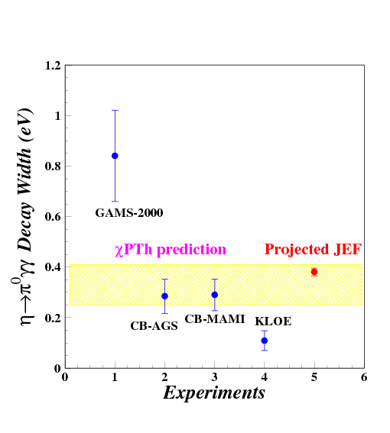
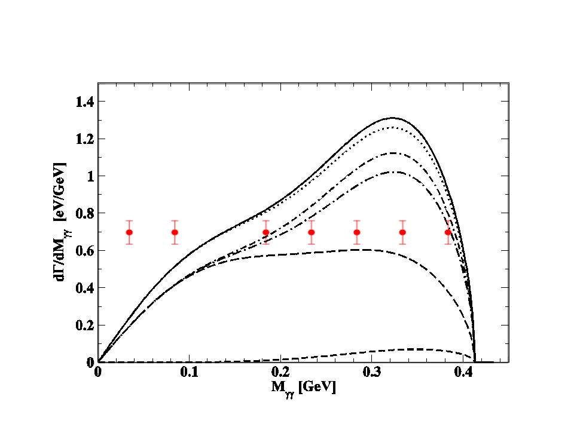
Projected JEF Measurement on η→π⁰2γ
100 days of beam time

Slide 26
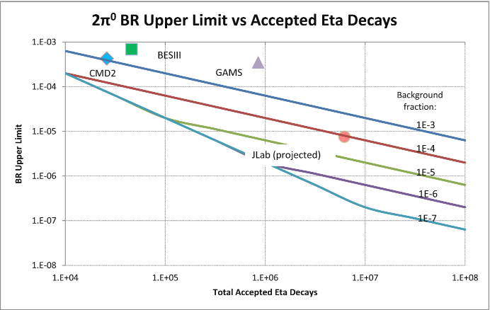
Improvement on SM Forbidden Channels
The upper limit for the branching ratio at ~90% CL is estimated by:
Improve the upper limits on the SM forbidden neutral decay channels by a factor of 1-1.5 orders of magnitude !

Slide 27
Neutral Vector U Boson (Dark Photon)
Dark photon, a_{u} of U(1)_{d,} couples to the SM photon by gauge kinetic mixing with U(1)_{Y} of the SM:
Dark photon, a_{u} of U(1)_{d,} coupling to SM weak currents is suppressed by
U(1)_{d}, is spontaneously broken, therefore U-boson has mass of

Slide 28
U in Meson Decays

Slide 29
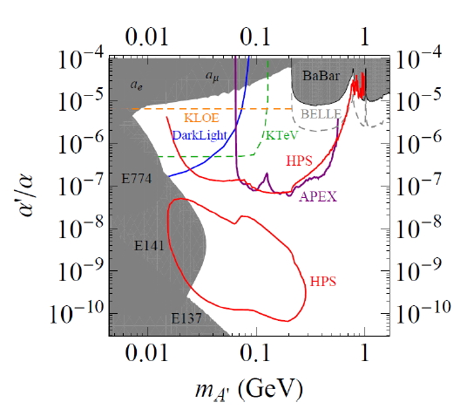
Experimental Sensitivity
Eta decay
(ε²)

Slide 30
Summary
Testing fundamental symmetries in the nature by study of light pseudoscalar meson decays will be a sensitive probe to understand fundamental issues in physics: confinement QCD and new physics beyond Standard Model.
The Primakoff effect provides a powerful experimental tool to test confinement QCD via the measurements of a wide range of low energy properties of hadron: radiative decay widths, transition form factors, hadron polarizabilities, neutral axial coupling of proton, ...
Precise measurements of various η rare decays will test SM and beyond: (1) test higher order χPTh and future lattice QCD predictions; (2) tighten the constrains on new sources of C, P and CP symmetry violations; (3) investigate the dark photon.

Slide 31
The End
Thanks you!

Slide 32
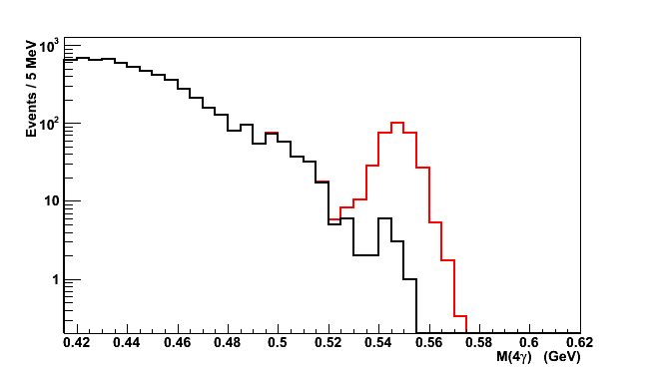
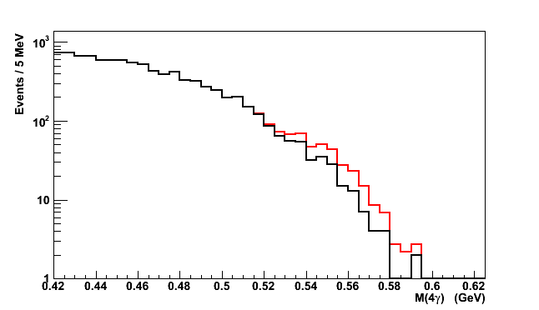
S/N Ratio vs. Calorimeter Types signal: , background:
FCAL-II
FCAL-I
S/N=10:1
S/N=0.1:1
Major improvement:
Granularity
Energy and position resolutions.
PWO
FCAL-II
Pb Glass
FCAL-I
Elasticity
Event selection
Elasticity=ΣE_{γ}/E_{tag-γ}
Invariant mass.
Elasticity
Invariant Mass of 4γ (GeV)
Invariant Mass of 4γ (GeV)

Slide 33
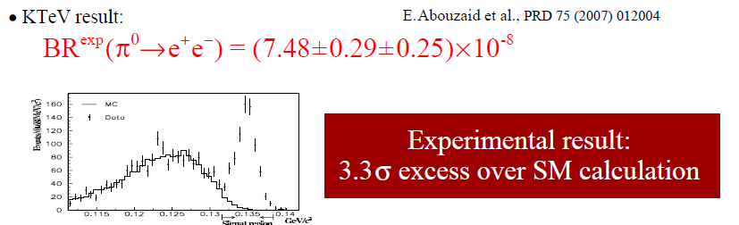
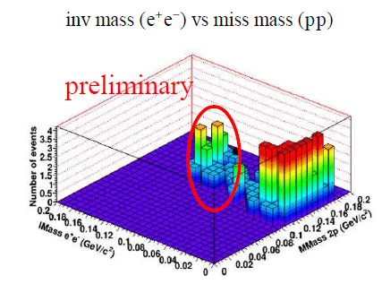
Experimental Glimpse
Preliminary result from WASA on π⁰ →e⁺ e⁻

Slide 34
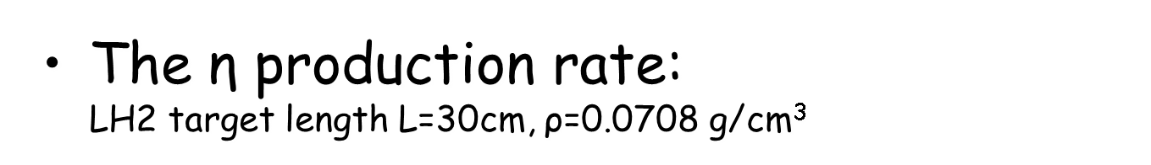
Rate Estimation
The γ+p→η+p cross section ~70 nb (θ_{η}=1-6º)
Photon beam intensity N_{γ}~4x10⁷ Hz (for E_{γ}~9-11.7 GeV)
100 days of beam time in Hall D will produce 3x10⁷ η’s.

Slide 35
Flavor-Conserving P and CP Violating in η→π⁰ π⁰
CP violation is described in SM by Kobayashi-Maskawa (KM) mechanism in Yukawa couplings (flavor-changing )→ a single complex phase in the CKM quark mixing matrix.
The KM mechanism fails by several orders of magnitude to explain the observed matter-antimatter asymmetry of the Universe. Almost all extensions of SM imply additional sources of CP violation. A new source of CP violation is also necessary for baryogenesis.
The flavor-changing processes have been intensively investigated in K, B and D meson decays, and no positive new source of CP violation has been discovered. The flavor-conserving regime remains much less explored.
The η→π⁰ π⁰ is one of the few available flavor-conserving reactions listed in PDG to test CP violation.
The flavor-conserving reactions are effectively free of SM backgrounds.

Slide 36
C Violating η→3γ
Forbidden by C invariance of EM interaction in the SM
Offers the most sensitive means to constrain C violation in the EM decay of a hadron.
Current PDG experimental limits: BR(η→3 γ ) < 1.6x10⁻⁵

Slide 37
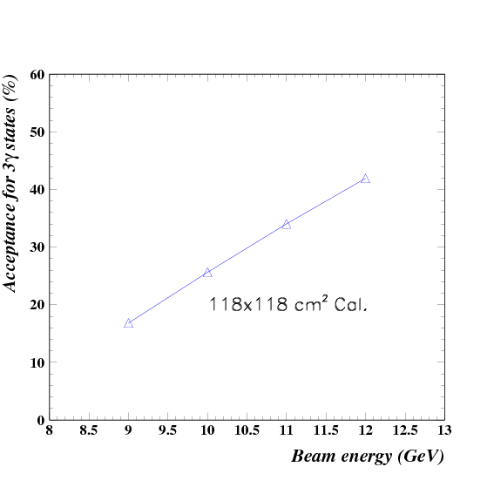
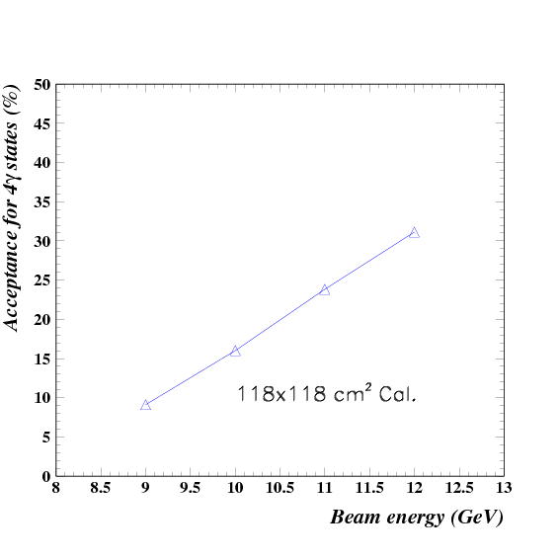
Acceptance of FCAL-II (118x118 cm²)
3γ final state
4γ final state
~30%
~20%

Slide 38
Rate Estimation
The γ+p→η+p cross section ~70 nb (θ_{η}=1-6º)
Photon beam intensity N_{γ}~4x10⁷ Hz (for E_{γ}~9-11.7 GeV)
Jlab Eta Factory (JEF)
The η→π⁰γγ detection rate:
  BR(η→π⁰γγ )~2.7x10⁻⁴
  Average geometrical acceptance is ~20% (118x118 cm² FCAL-II)
  Event selection efficiency ~60%

Slide 39
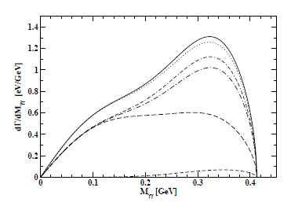
Allowed Rare Decay η→π⁰γγ
A stringent test of the χPTh prediction at Ο(p⁶) level
  Tree level amplitudes (both Ο(p²) and Ο(p⁴)) vanish;
  Ο(p⁴) loop terms involving kaons are suppressed by large mass of kaon
  Ο(p⁴) loop terms involving pions are suppressed by G parity
  The first sizable contribution comes at Ο(p⁶) level
Test future Lattice QCD calculations
A long history of large discrepancies exists between experimental results and theoretical predictions.
Current experimental value in PDG is: BR(η→π⁰γγ )=(2.7±0.5)x10⁻⁴
E. Oset et al., Phys. Rev. D77, 073001

Slide 40
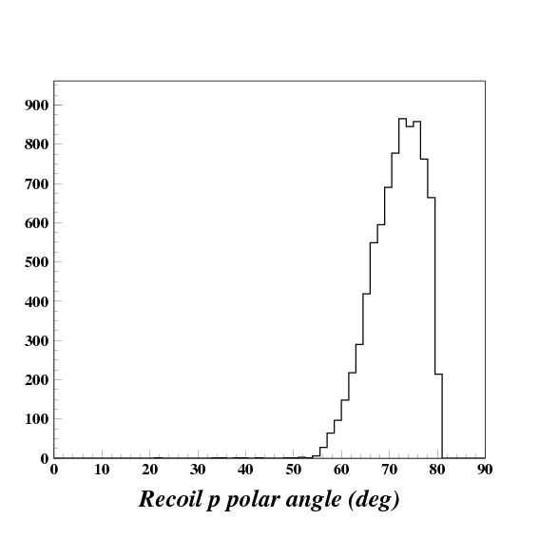
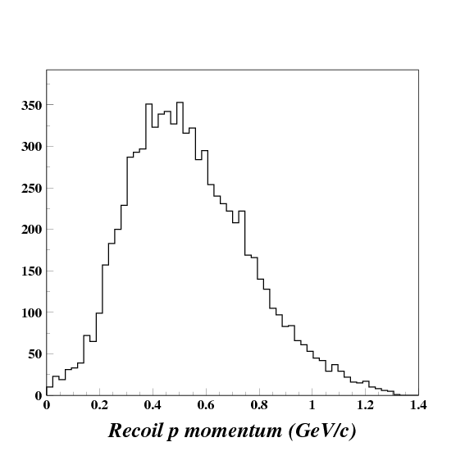
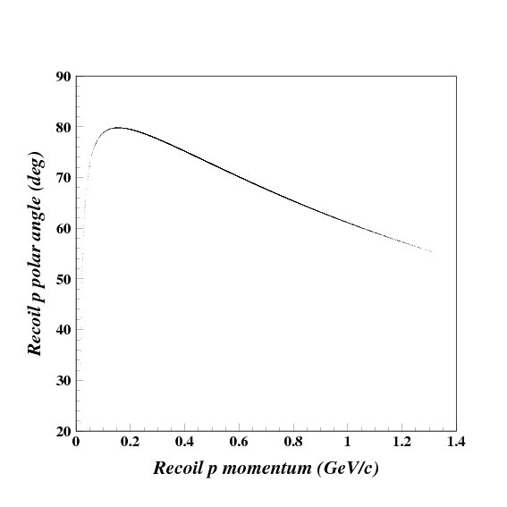
Detection of Recoil Proton with GlueX
Recoil proton kinematics
Polar angle ~55º-80º
Momentum ~200-1200 MeV/c

Slide 41
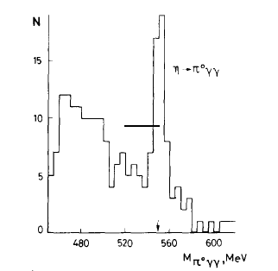
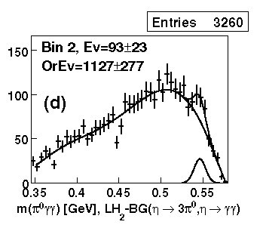
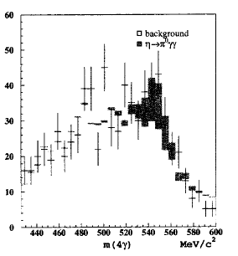
Advantages of Hall D
High energy tagged photon beam to reduce the background from η→ 3π⁰
  Lower relative threshold for γ-ray detection
  Improved missing energy resolution
Recoil proton detection to reduce non-coplanar backgrounds like non-resonant γp→π⁰π⁰p
High resolution, high granularity PbWO₄ Calorimeter
  improved invariant mass, energy and position resolutions
  fewer overlapping showers, thus reducing background from η→ 3π⁰
  Fast decay time (~20ns) and Flash ADCs → reduced pile-up
High statistics to provide a precision measurement of Dalitz plot
High energy η-production
Low energy η-production
GAMS
CB
KLOE

Slide 42

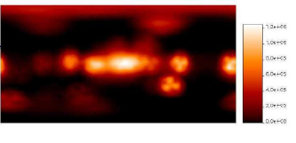

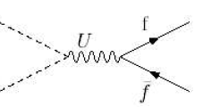
Light Dark Matter Particle
Postulate: neutral scalar dark matter particle χ with mass 1-10 MeV
Annihilation χχ→e⁺e⁻
Annihilation via neutral vector U boson (dark photon)
  m(U)~10-100 MeV
  Small couplings to SM fermions
χ
χ

Slide 43
Summary continue
Jlab experimental approach:
  12 GeV high intensity tagged photon beam to produce η through γ+p → η+p reaction.
  Further reduce the γp→ π⁰π⁰p and other backgrounds by detecting recoil p with GlueX detector
  Upgrade FCAL with PbWO₄ crystals
    High granularity calorimeter to reduce the η →π⁰π⁰π⁰ background due to overlapping showers.
    Fast decay time plus flash ADCs to reduce low energy pile-up clusters
    High energy and position resolutions to have precise invariant mass and elasticity spectrum for event selection
Less background compared to other competitor facilities.

Slide 44
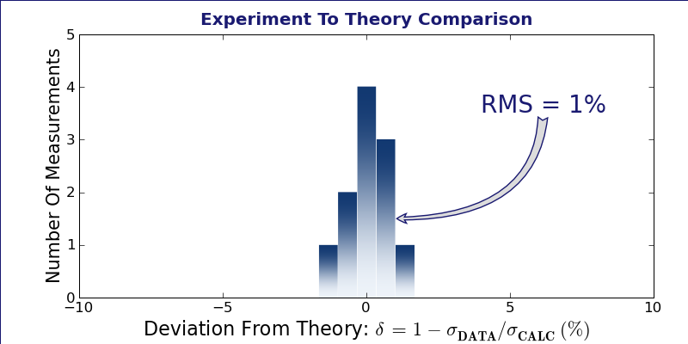
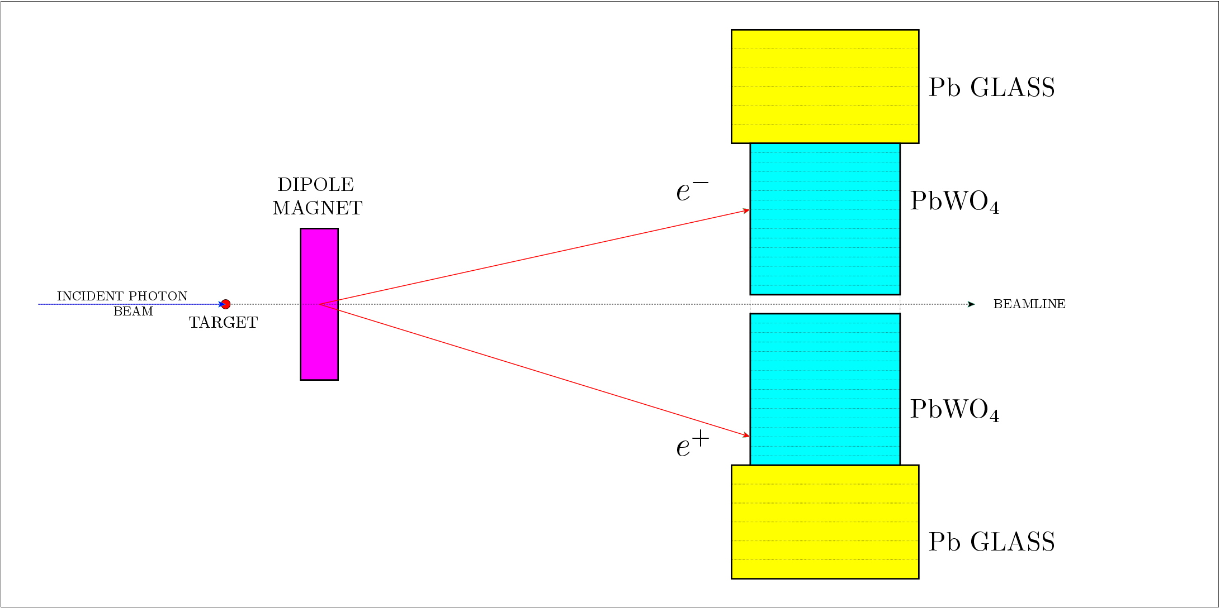
Verification of Overall Systematical Uncertainties
γ + e → γ +e Compton
cross section measurement
e⁺e⁻ pair-production cross
section measurement:
Systematic uncertainties on cross sections are controlled at 1.3% level.

Slide 45
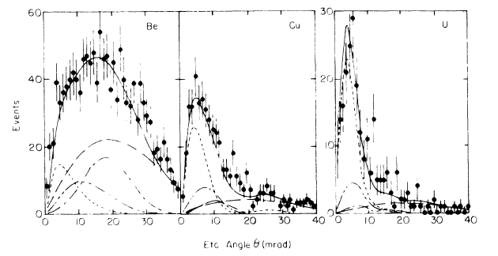
Cornell Primakoff Experiment
Cornell (PRL, 1974)
  untagged bremsstrahlung γ beam,
  E_{γ}=5.8, 9.0, 11.45 GeV
targets: Be, Al, Cu, Ag, U
conventional Pb-glass calorimeter
Result: Γ(η→γγ)=(0.324±0.046) keV (±14.2%)
As a result:
insufficient resolutions in
experimental parameters;
hard to resolve Primakoff
from hadronic contributions;
relatively large and
uncontrolled accidental
background over the nuclear
incoherent background.

Slide 46

Hadronic Backgrounds Reduction in 4γ States
Event Selection
Elasticity is
EL=ΣE_{γ}/ E_{tagged-γ}
Energy conservation
for γ+p → η+p reaction:
ΔE=E(η)+E(p)-E(beam)-M(p)
Co-planarity Δφ= φ(η)- φ(p)
Note:
Statistics is normalized to
1 beam day.
BG will be further reduced
by requiring that only one
pair of γ’s have the π⁰
invariant mass.
Signal: η→π⁰γγ

Slide 47

Estimated Error Budget
Systematical uncertainties (added quadratically):
Contributions | Estimated Error
Photon flux | 1.0%
Target thickness | 0.5%
Background subtraction | 2.0%
Event selection | 1.7%
Acceptance, misalignment | 0.5%
Beam energy | 0.2%
Detection efficiency | 0.5%
Branching ratio (PDG) | 0.66%
Total Systematic | 3.02%
Total uncertainty (added quadratically):
Statistical | 1.0%
Systematic | 3.02%
Total | 3.2%

Slide 48
Advantages of the Proposed Light Targets
Precision measurements require low A targets to control:
  coherency
  contributions from nuclear processes
Hydrogen:
  no inelastic hadronic contribution
  no nuclear final state interactions
  proton form factor is well known
  better separation between Primakoff
and nuclear processes
  new theoretical developments of Regge
description of hadronic processes
J.M. Laget, Phys. Rev. C72, (2005)
A. Sibirtsev, et al. arXiv:1001.0646, (2010)
⁴He:
  higher Primakoff cross section:
  the most compact nucleus
  form factor well known
  new theoretical developments for FSI
  S. Gevorkyan et al., Phys. Rev. C 80, (2009)
48

