Slide 1
Polishing and Testing
07/10/14

Slide 2
Previous Polishing Methods

Slide 3
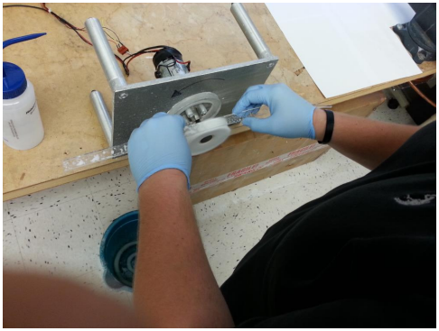
Previous Polishing Methods (Cont.)
Scintillator and buffing wheel are kept cool and wet at all times
Achieved with low buffing speeds (< 1500 rpms)
Polish in 20 minute intervals (~1000 rpms)
10 min in straight section -> 0.05 μm Buehler Alumina
10 min in bend and nose -> 0.05 μm Buehler Alumina
Polish both sides of scintillators with equal time and attention

Slide 4
Paddle 27 Results (Old Polishing Methods)
These data have not been corrected for the trigger (≈ 30 ps reduction)
Paddle 27 is one of the better bars in the lot of 50
Average Time Resolution
Unpolished: 361 ps
Trial 1: 332 ps
Trial 2: 339 ps
Trail 3: 334 ps
Polishing after 2 trials rid the surface of virtually all fine scratches
Possible to recover ≈ 25 – 40 ps with previous polishing methods

Slide 5
Current Polishing Methods
Same basic setup as before
Scintillator and buffing wheel are kept cool and wet at all times
Achieved with low buffing speeds (< 1500 rpms)
Polish in 1 hour intervals (~1000 rpms)
First polish with diluted 0.3 μm Allied Alumina
30 min in straight section
30 min in bend and nose
If Comet Tails (< 2 mm scratches incurred during the polishing procress) exist then 0.3 μm Alumina is applied to a glass cleaning cloth and polished by hand until the micro-scratches are removed
Second polish with diluted 0.05 μm Allied Alumina
30 min in straight section
30 min in bend and nose

Slide 6
Paddle 5 Results (New Polishing Methods)
These data have not been corrected for the trigger (≈ 30 ps reduction)
Paddle 5 is one of the worst bars seen to date
High density scratches in the nose and straight section
Numerous deep scratches along the entire length of scintillator
Average Time Resolution
Unpolished: 434 ps
0.3 μm Alumina: 409 ps
0.05 μm Alumina: 375 ps
Only scratches that remain on surface are the deep scratches that will most likely be unrecoverable
Possible to recover ≈ 25 – 75 ps with current polishing methods

Slide 7
Initial Tests of 30 Unpolished Paddles
These data have not been corrected for the trigger (≈ 30 ps reduction)
Large Spread of timing resolutions in the bend is due to varying magnitudes of high density scratches in the bend region
The nose region also suffers from a large spread in timing resolution
This is a direct result of the bend region
The nose section also suffers from a varying magnitude of scratch damage
Polishing the worst bar (paddle 5) has made it comparable to the performance of our best bars

Slide 8
Initial Tests (Cont.)
These data have not been corrected for the trigger (≈ 30 ps reduction)
Top: Max Time Resolution
Middle: Avg Time Resolution
Bottom: Min Time Resolution
These data allow us to easily determine the worst bars in the lot of 50
≈ 15 % (5) of the paddles are “unusable” to date
These bars will be used for polishing technique development
Once a technique is finalized:
Polish the good scintillators
Wrap them in AL Foil
Fully test each scintillator

