Slide 1
Start Counter Construction Update
Eric Pooser
08/21/2014

Slide 2
Current Status
The 30 best scintillators have been selected and fully tested
Rohacell support has been painted black and all gaps have been filled with black caulking
Shimming height has been determined (some materials are yet to be delivered)
We require approximately 30 mils (762 um) of shimming
Material is Kapton polyimide heavy duty film (type HN ρ = 1.42 g/cc)
All ST1 PCBs have been positioned so that all paddles require approximately the same shimming height of 30 mils (20 mil < shim < 40 mil)
Final construction of the Start Counter is underway

Slide 3
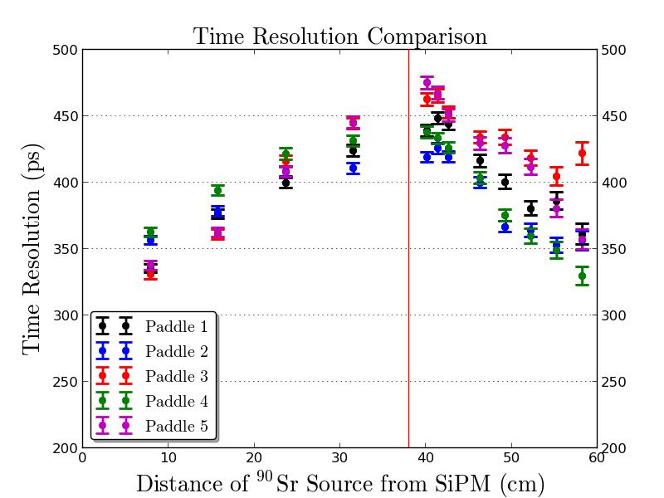
Wrapped Prototype Results

Slide 4
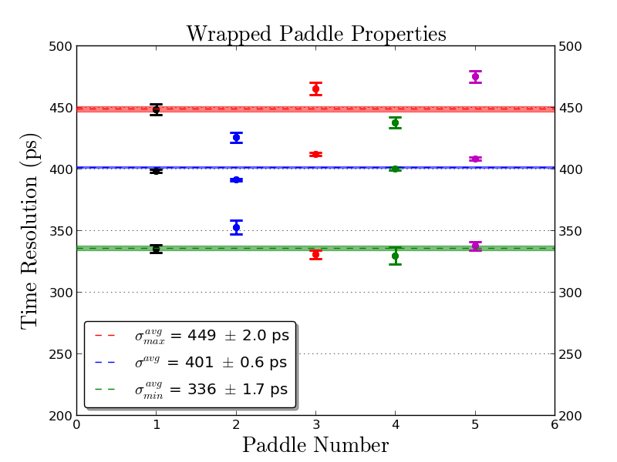
Wrapped Prototype Results (continued)

Slide 5
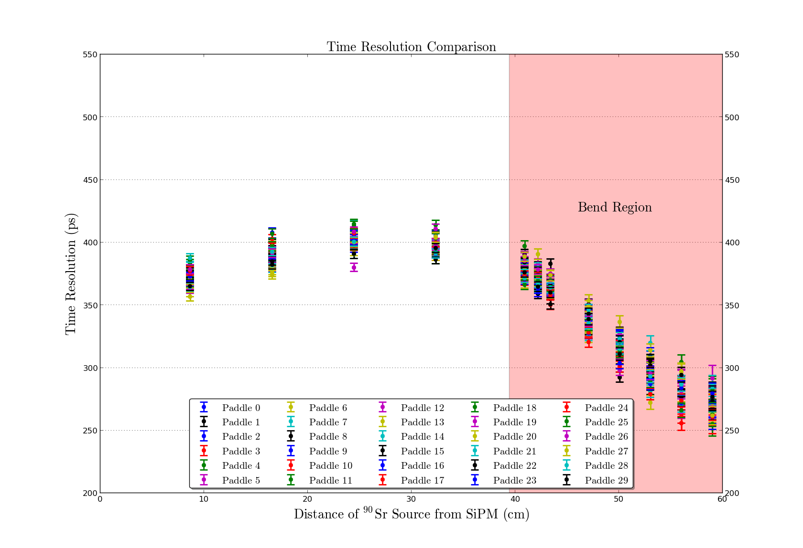
Results of Best 30 Paddles Wrapped

Slide 6
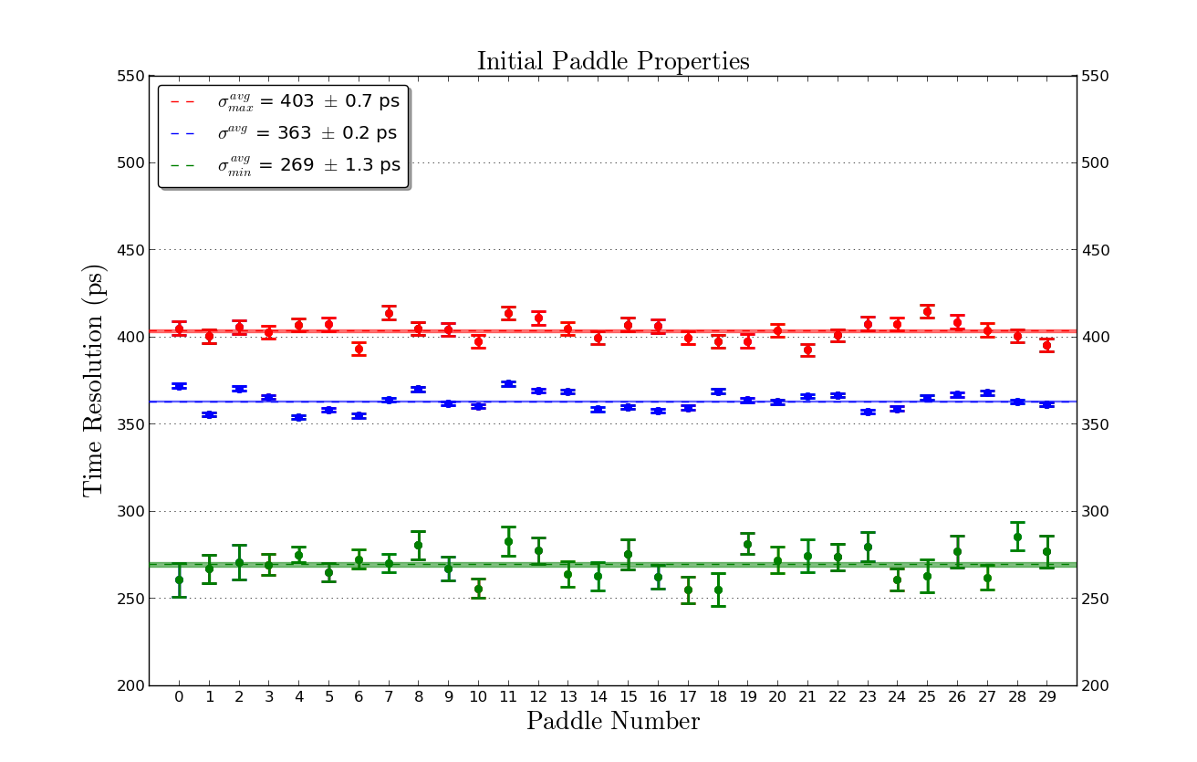
Results of Best 30 Paddles Wrapped (continued)

Slide 7
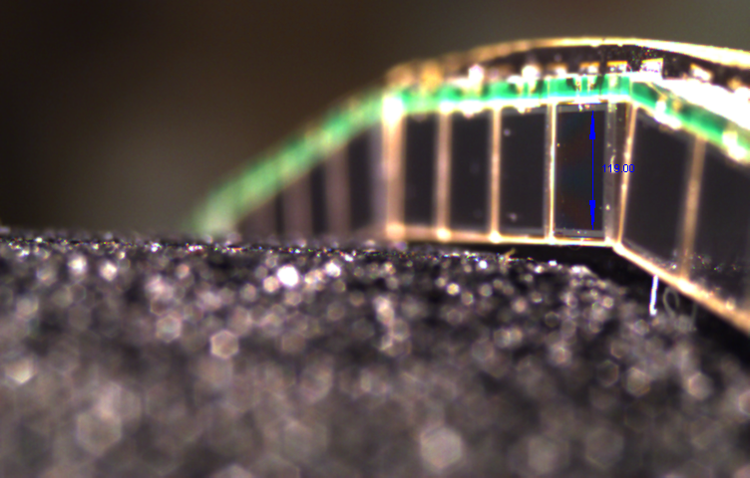
Calibration Measurement (3.02 mm)

Slide 8
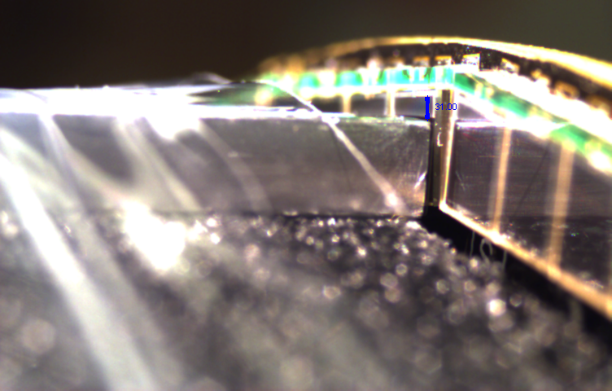
No Shimming (786 um)

Slide 9
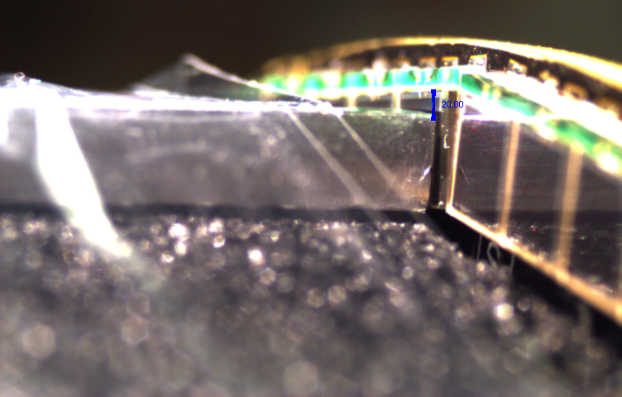
10 mil Shimming (507 um)

Slide 10
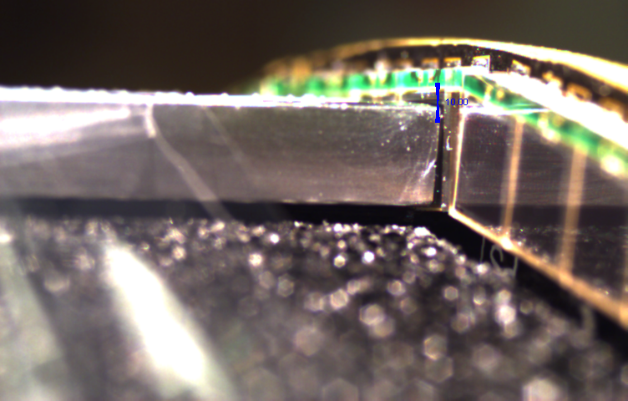
20 mil Shimming (254 um)

Slide 11
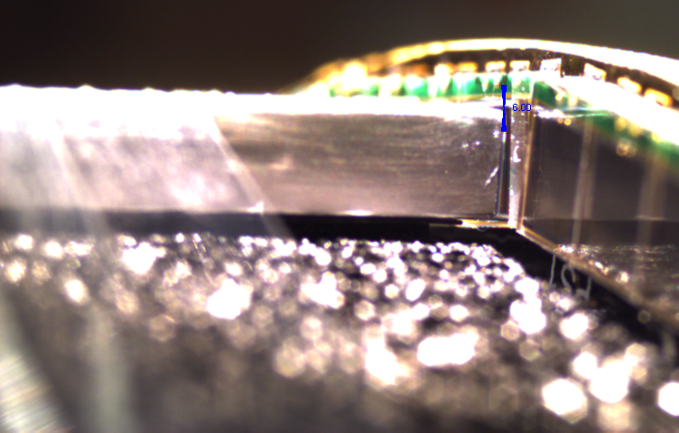
25 mil Shimming (152 um)

Slide 12
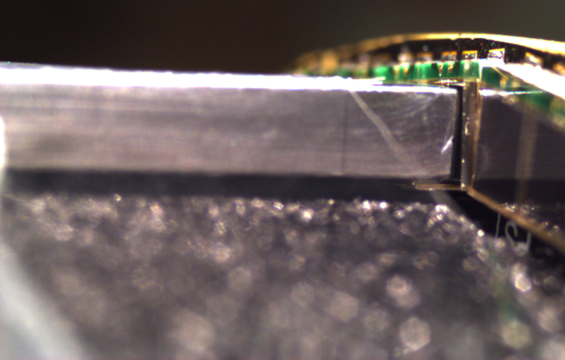
30 mil Shimming (Best Possible Alignment)

Slide 13
Future Plans
Fully Assemble Start Counter by Friday (08/22/2014)
This includes shimming and sub 200 um coupling
Next Week:
Wrap Start Counter with 80 gauge (0.8 mil) Bundling Wrap
Finalize Start Counter Construction
Verify all 30 channels are able to be read out
Use ⁹⁰Sr source to verify that all signal sizes are identical
Prepare Start Counter for transportation to Jlab
Ship MPOD, cables, and tools back to Nick
Deliver Start Counter to Jlab 09/02/2014

Slide 14
Topics for Discussion
Documentation for delivery of Start Counter
Schedule upon arrival at JLab (09/02/2014)
Light tightening
Testing of read out channels
Mounting to target
Survey & Alignment
Installation into Hall
Commissioning/Calibration

