Slide 1
ST Update Run 1556 (BCAL Trigger, 50k Events) 100 nA, 1x10-4 RL, I=1200A, 10 mm CH2
12/12/2014

Slide 2
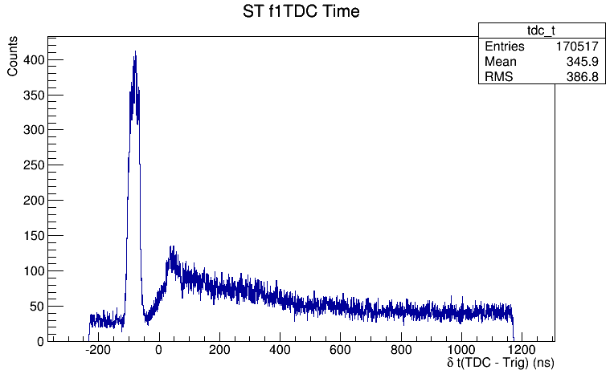
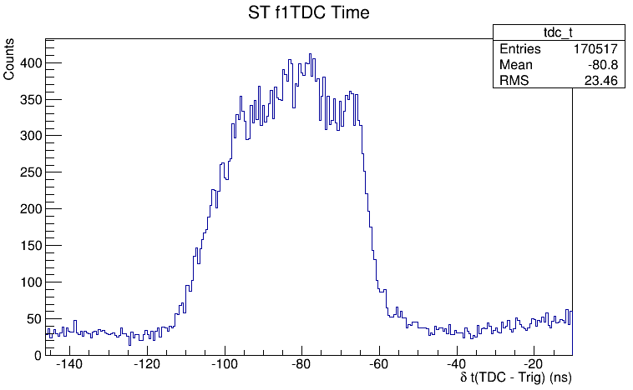
fTDC – Trig

Slide 3
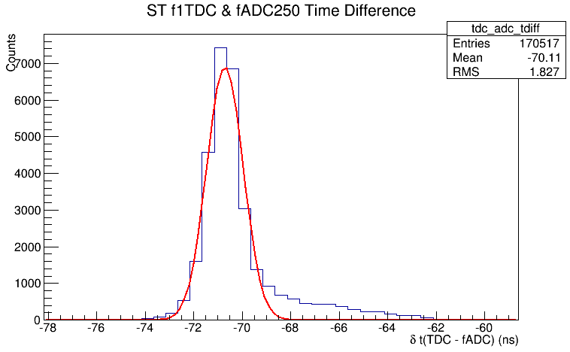
(fTDC – Trig) – fADC (750 ps)

Slide 4
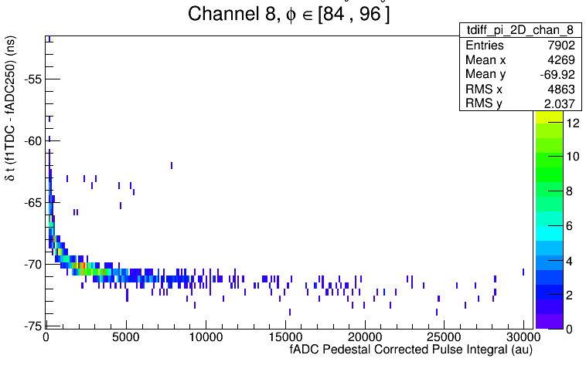
Ch 8 Time vs. Pulse Integral

Slide 5
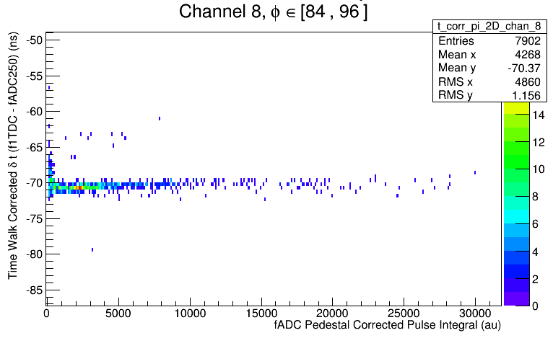
Ch 8 Time vs. Integral TW Corrected

Slide 6
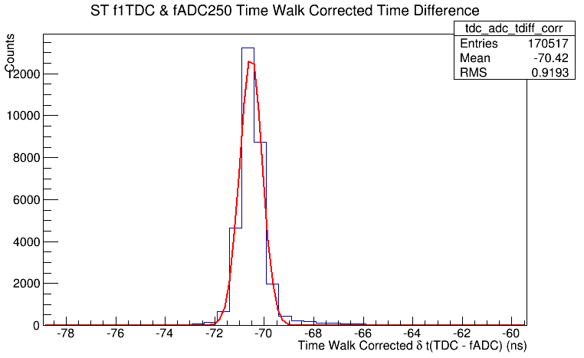
TW Corrected (fTDC – Trig) – fADC (450 ps)

Slide 7
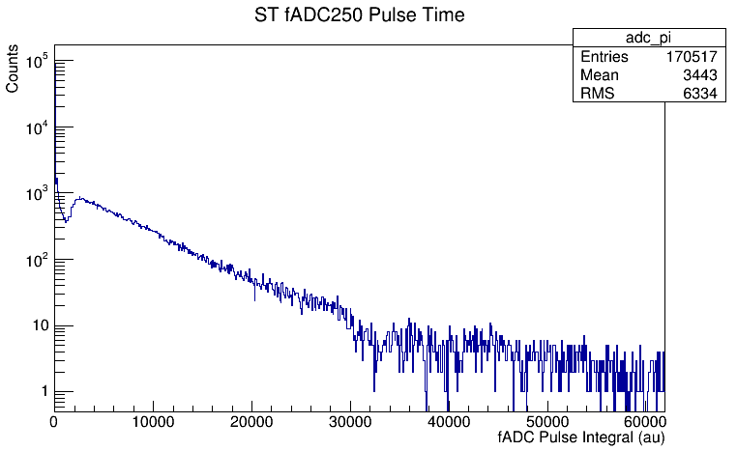
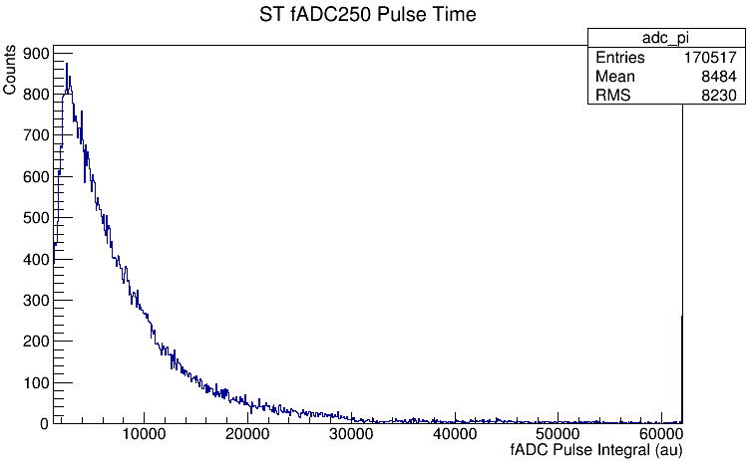
Pedestal Corrected fADC Pulse Integral

Slide 8
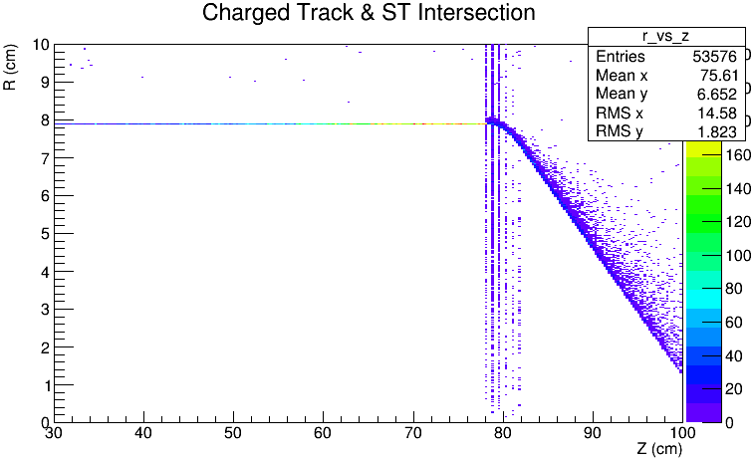
R vs. Z

Slide 9
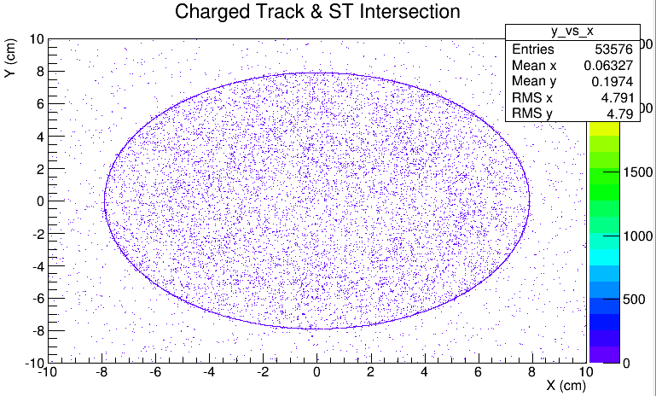
Y vs. X

Slide 10
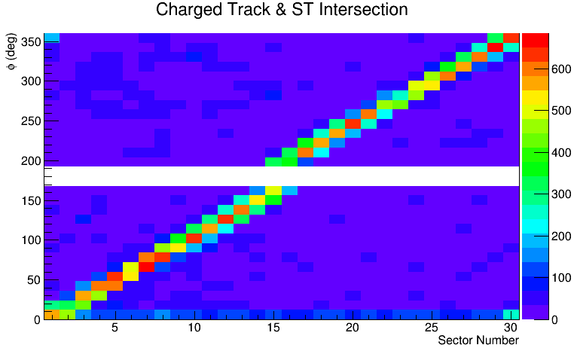
Phi vs. Sector

Slide 11
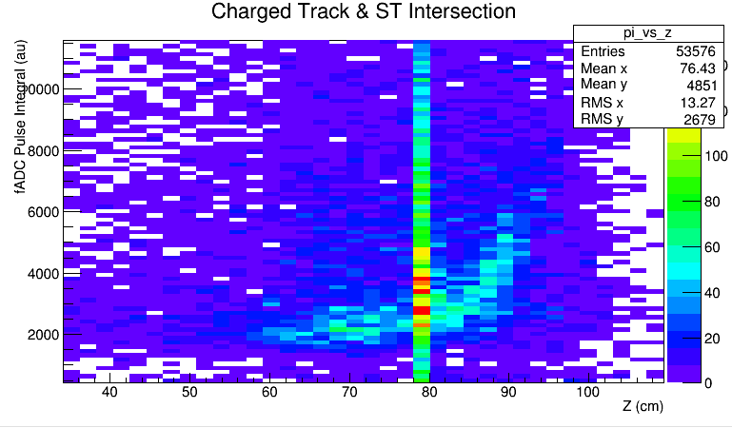
Pedestal Corrected Pulse Integral vs. Z

