Slide 1
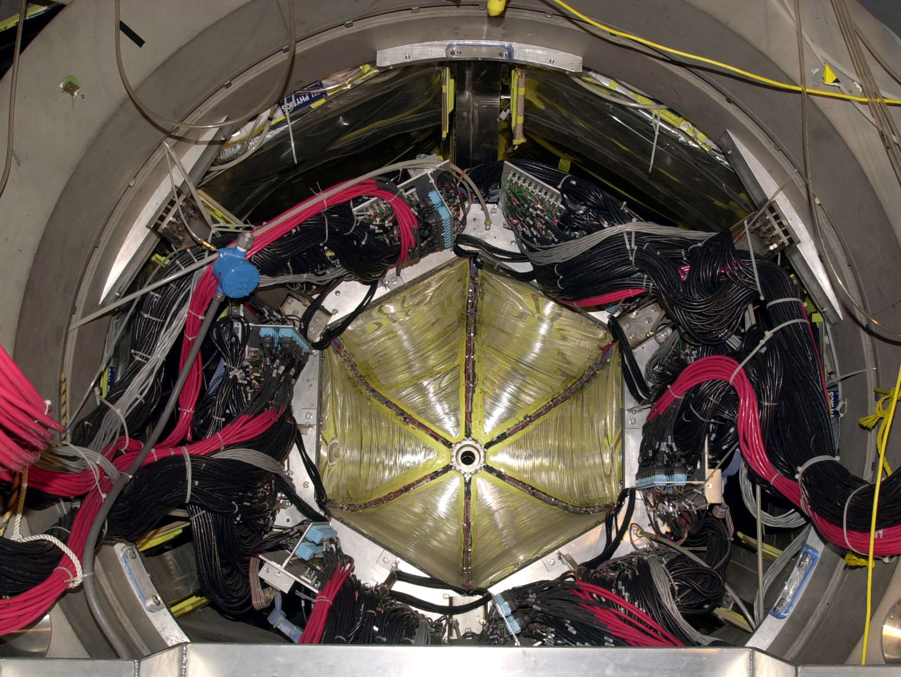

Meson photoproduction with CLAS
Nuclear Photoproduction with GlueX, Jlab, 28-29 March 2016
Hadron
Eugene Pasyuk
Jefferson Lab

Slide 2
Outline
Introduction
Some polarization formalism
Experimental tools
Selected Results
Outlook

Slide 3
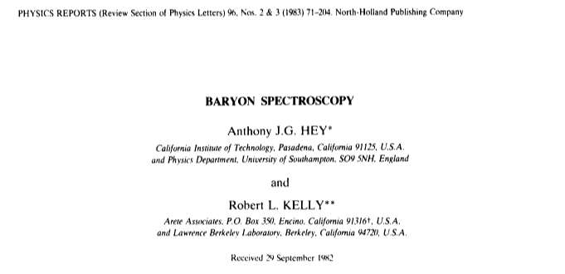
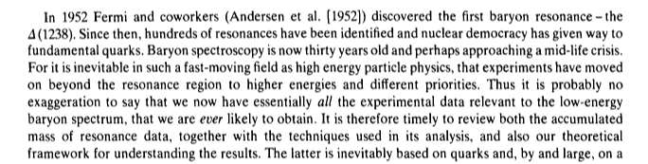
Baryon spectroscopy

Slide 4
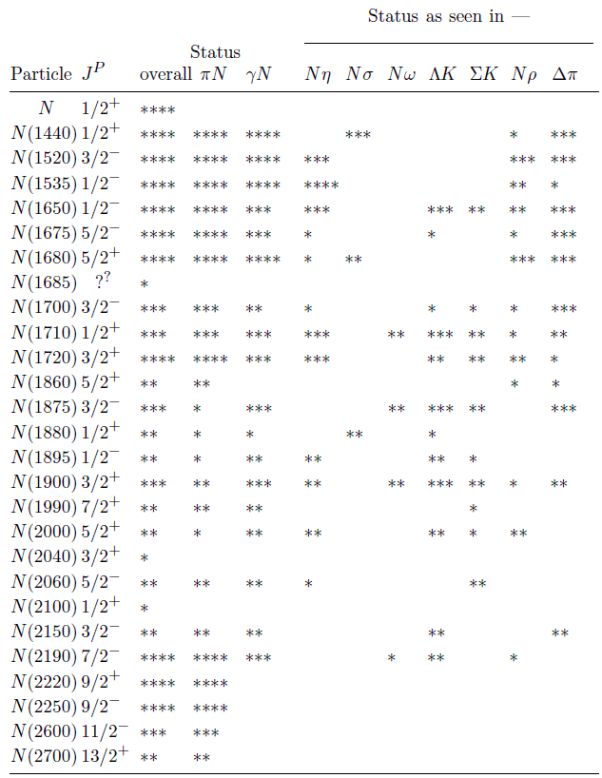
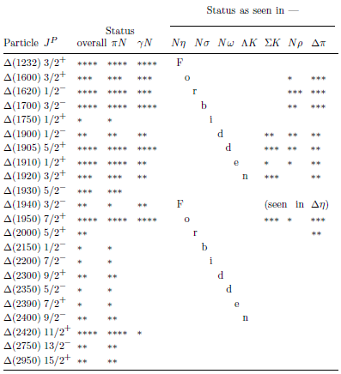
PDG summary table
22 Δ states:
•7 with ****
•3 with ***
•7 with **
•5 with *
26 N* states:
•10 with ****
• 5 with ***
• 8 with **
• 3 with *
Nearly half the states have only fair or poor evidence!
Most states need more work to learn details

Slide 5
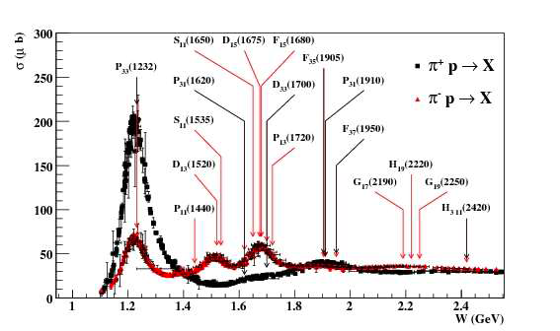
πN cross sections
Most of the information came πN scattering

Slide 6
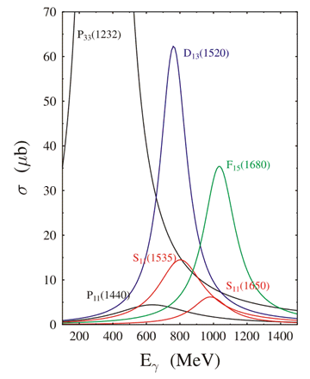
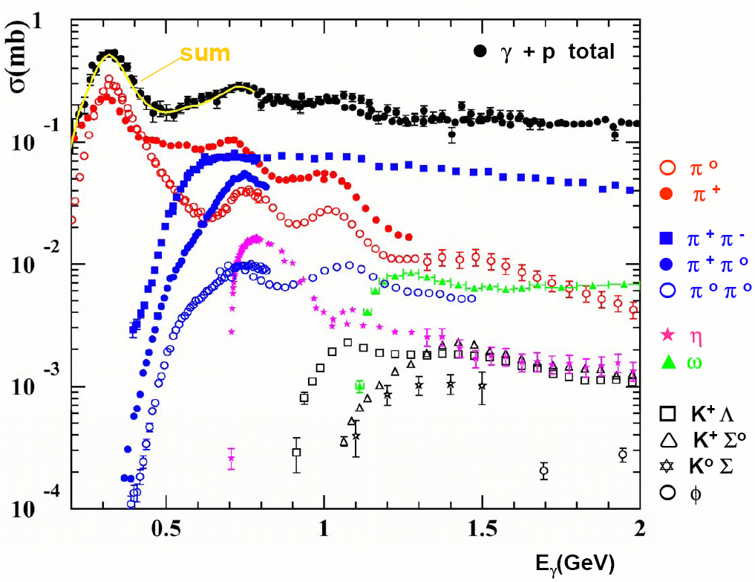
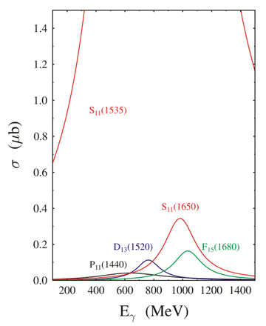
Photonuclear cross sections

Slide 7
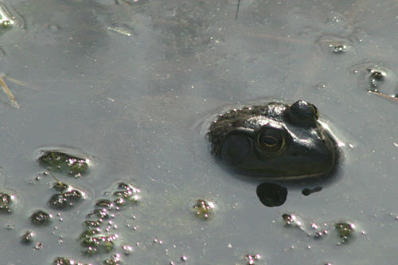
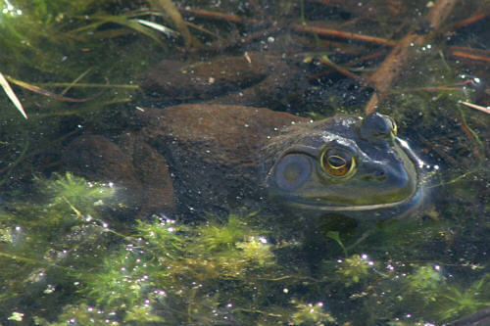
Importance of polarization
without polarizer
with polarizer

Slide 8
Some formalizm

Slide 9
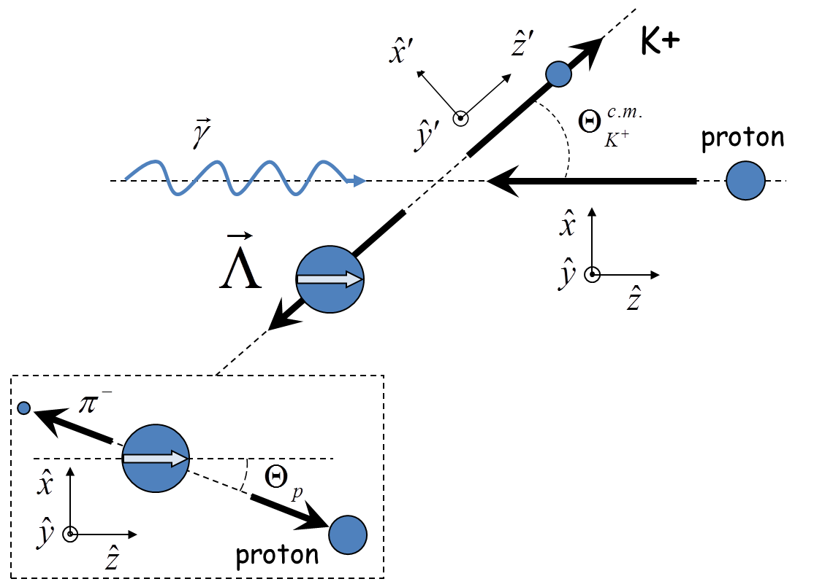
Kinematics

Slide 10
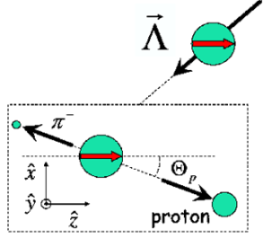
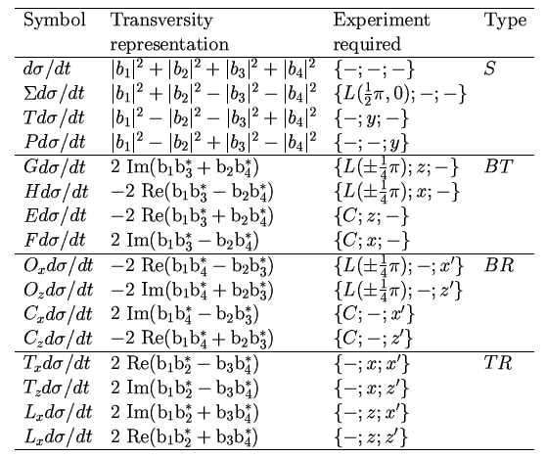
Polarization observables in pseudoscalar meson production
4 Complex amplitudes: 16 real polarization observables.
Complete measurement from 8 carefully chosen observables.
πN has large cross section but in KY recoil is self-analysing
☻
πN
KY
recoil targ γ
γ targ recoil
☻☻☻
☻☻☻
☻☻☻
☻☻☻
☻☻☻
☻☻☻
☻☻☻
☻☻☻
☻☻☻
I. S. Barker, A. Donnachie, J. K. Storrow, Nucl. Phys. B95 347 (1975).
circ polarized photons
longitudinally polarized target
linearly polarized photons
transversely polarized target

Slide 11
General cross section
single spin observables
Beam-Target
Beam-Recoil
Target-Recoil
A. M. Sandorfi, S. Hoblit, H. Kamano, T.-S. H. Lee J.Phys.G38:053001,2011

Slide 12
Oops!
There is no such thing as complete experiment!
Whatever we measure has uncertainties and they lead to ambiguities in extraction of amplitudes
“Uncertainty is an uncomfortable
position. But certainty is an
absurd one.”
― Voltaire

Slide 13
Fierz Identities

Slide 14
Intermediate Summary I
Beam |  | Target |  |  | Recoil |  |  | Target + Recoil
 |  |  |  |  | x’ | y’ | z’ | x’ | x’ | x’ | y’ | y’ | y’ | z’ | z’ | z’
 |  | x | y | z |  |  |  | x | y | z | x | y | z | x | y | z
unpolarized | dσ₀ |  | T |  |  | P |  | T_{x’} |  | L_{x’} |  | Σ |  | T_{z’} |  | L_{z’}
P_{L}^{γ} sin(2φ_{γ}) |  | H |  | G | O_{x’} |  | O_{z’} |  | C_{z’} |  | E |  | F |  | -C_{x’}
P_{L}^{γ} cos(2φ_{γ}) | Σ |  | -P |  |  | -T |  | -L_{x’} |  | T_{z’} |  | -dσ₀ |  | L_{x’} |  | -T_{x’}
circular P_{c}^{γ} | dσ₀ | F |  | -E | C_{x’} |  | C_{z’} |  | -O_{z’} |  | G |  | -H |  | O_{x’}
Every observable can be measured in at least in two different experiments.
It is important to measure both K⁺Λ and K⁺Σ⁰: Isospin filter
It is also important to do measurement on both proton and neutron target
There is no such things as redundant data!

Slide 15
Experimental apparatus

Slide 16
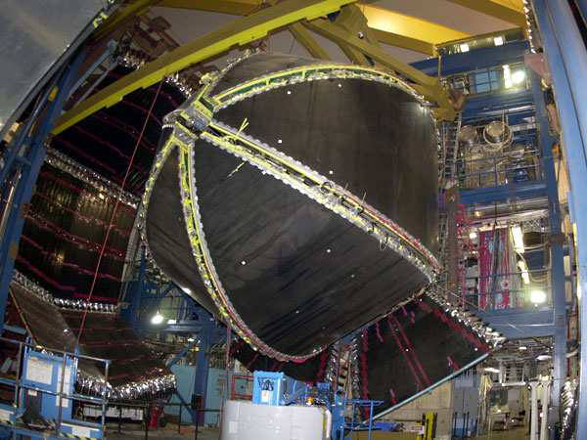
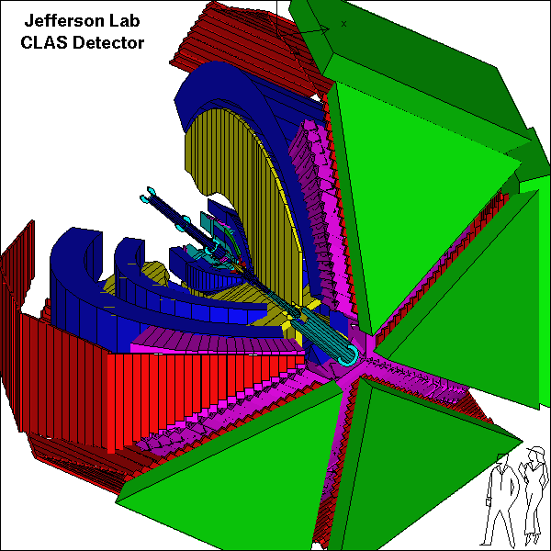
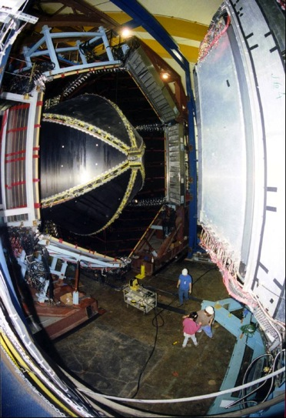
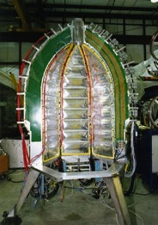
CEBAF Large Acceptance Spectrometer 1997-2012
Torus magnet
6 superconducting coils
Electromagnetic calorimeters
Lead/scintillator, 1296 photomultipliers
target + start counter
Drift chambers
35,000 cells
Time-of-flight counters
plastic scintillators, 684 photomultipliers
Gas Cherenkov counters
e/π separation, 256 PMTs

Slide 17
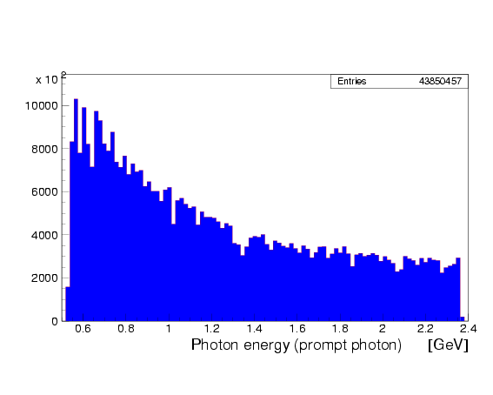
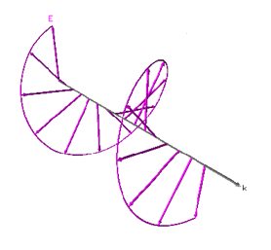
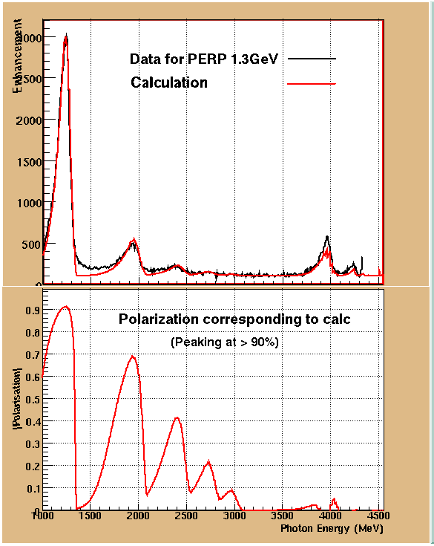
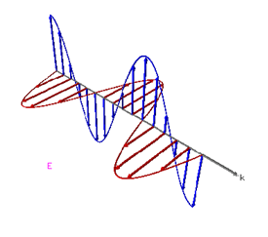
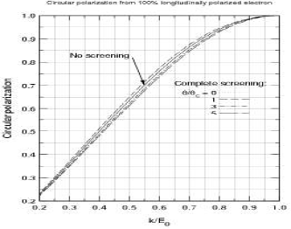
Polarized pohoton beam
Circular polarization from 100% polarized electron beam
Circular polarization
H. Olsen and L.C. Maximon, Phys. Rev. 114, 887 (1959)
Circularly polarized beam produced by longitudinally polarized electrons
Linearly polarized photons: coherent bremsstrahlung on oriented diamond crystal

Slide 18
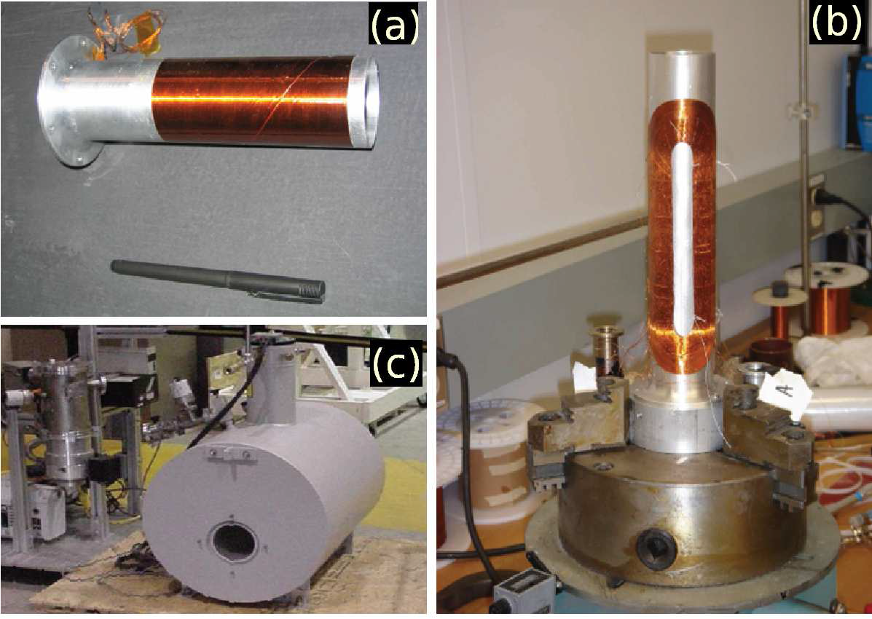
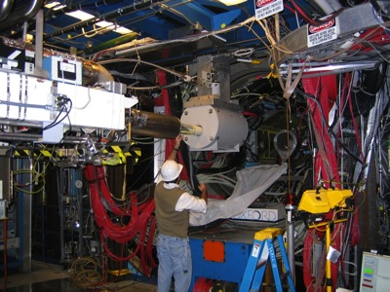
FROST

Slide 19
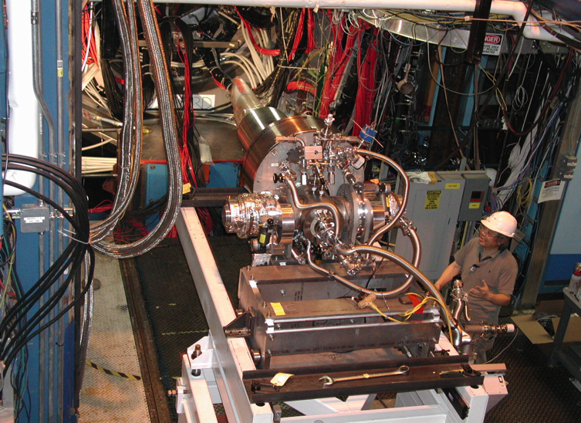
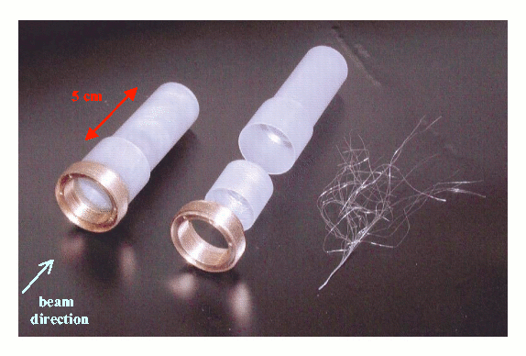
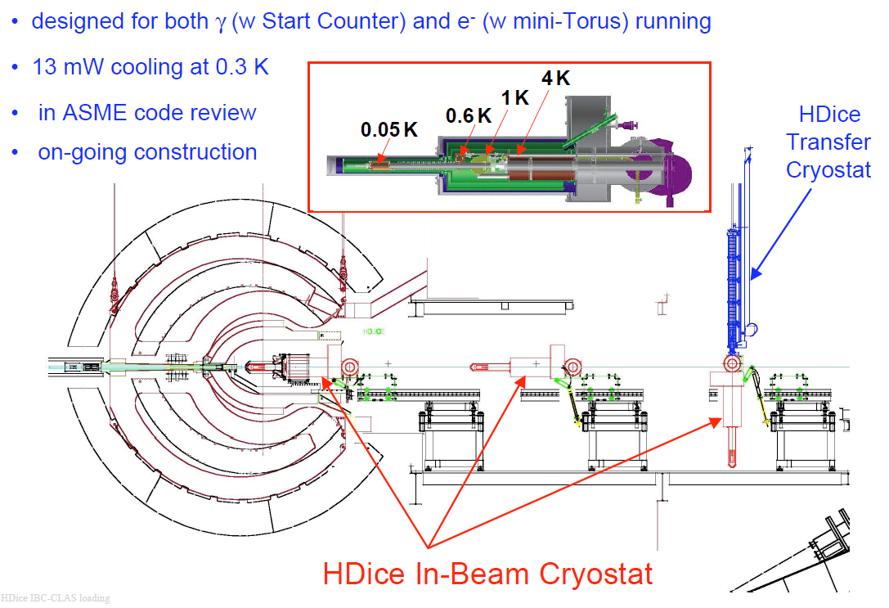
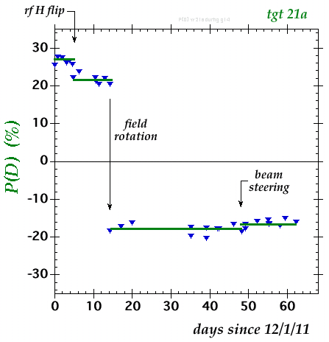
HDIce polarized target
Polarized at very high magnetic field and very low temperature
Transferred to in-beam cryostat
Spin can be moved between H and D with RF transitions
All material can be polarized with small background

Slide 20
Experimental results

Slide 21
What we measured with CLAS
γp→π⁰p, π⁺n
γp→ηp
γp→η’p
γp→KY (K⁺Λ, K⁺Σ⁰, K⁰Σ⁺)
γp→π⁺π⁻p ωp, ρp, ϕp
γn→π⁻p
γn→π⁺π⁻n
γn→Σ⁻K⁺ , ΛK⁰ …..

Slide 22
CLAS Experiments: g1c, g11
Beam |  | Target |  |  | Recoil |  |  | Target + Recoil
 |  |  |  |  | x’ | y’ | z’ | x’ | x’ | x’ | y’ | y’ | y’ | z’ | z’ | z’
 |  | x | y | z |  |  |  | x | y | z | x | y | z | x | y | z
unpolarized | dσ₀ |  | T |  |  | P |  | T_{x’} |  | L_{x’} |  | Σ |  | T_{z’} |  | L_{z’}
P_{L}^{γ} sin(2φ_{γ}) |  | H |  | G | O_{x’} |  | O_{z’} |  | C_{z’} |  | E |  | F |  | -C_{x’}
P_{L}^{γ} cos(2φ_{γ}) | Σ |  | -P |  |  | -T |  | -L_{x’} |  | T_{z’} |  | -dσ₀ |  | L_{x’} |  | -T_{x’}
circular P_{c}^{γ} | dσ₀ | F |  | -E | C_{x’} |  | C_{z’} |  | -O_{z’} |  | G |  | -H |  | O_{x’}
unpolarized target
g1c – circularly polarized beam
g11 – unpolarized beam, high statistics

Slide 23
CLAS Experiments: g8b
Beam |  | Target |  |  | Recoil |  |  | Target + Recoil
 |  |  |  |  | x’ | y’ | z’ | x’ | x’ | x’ | y’ | y’ | y’ | z’ | z’ | z’
 |  | x | y | z |  |  |  | x | y | z | x | y | z | x | y | z
unpolarized | dσ₀ |  | T |  |  | P |  | T_{x’} |  | L_{x’} |  | Σ |  | T_{z’} |  | L_{z’}
P_{L}^{γ} sin(2φ_{γ}) |  | H |  | G | O_{x’} |  | O_{z’} |  | C_{z’} |  | E |  | F |  | -C_{x’}
P_{L}^{γ} cos(2φ_{γ}) | Σ |  | -P |  |  | -T |  | -L_{x’} |  | T_{z’} |  | -dσ₀ |  | L_{x’} |  | -T_{x’}
circular P_{c}^{γ} | dσ₀ | F |  | -E | C_{x’} |  | C_{z’} |  | -O_{z’} |  | G |  | -H |  | O_{x’}
Linearly polarized beam
Unpolarized target

Slide 24
CLAS Experiments: g9a
Beam |  | Target |  |  | Recoil |  |  | Target + Recoil
 |  |  |  |  | x’ | y’ | z’ | x’ | x’ | x’ | y’ | y’ | y’ | z’ | z’ | z’
 |  | x | y | z |  |  |  | x | y | z | x | y | z | x | y | z
unpolarized | dσ₀ |  | T |  |  | P |  | T_{x’} |  | L_{x’} |  | Σ |  | T_{z’} |  | L_{z’}
P_{L}^{γ} sin(2φ_{γ}) |  | H |  | G | O_{x’} |  | O_{z’} |  | C_{z’} |  | E |  | F |  | -C_{x’}
P_{L}^{γ} cos(2φ_{γ}) | Σ |  | -P |  |  | -T |  | -L_{x’} |  | T_{z’} |  | -dσ₀ |  | L_{x’} |  | -T_{x’}
circular P_{c}^{γ} | dσ₀ | F |  | -E | C_{x’} |  | C_{z’} |  | -O_{z’} |  | G |  | -H |  | O_{x’}
Longitudinally polarized target
Linearly and circularly polarized photons

Slide 25
CLAS Experiments: g9b
Beam |  | Target |  |  | Recoil |  |  | Target + Recoil
 |  |  |  |  | x’ | y’ | z’ | x’ | x’ | x’ | y’ | y’ | y’ | z’ | z’ | z’
 |  | x | y | z |  |  |  | x | y | z | x | y | z | x | y | z
unpolarized | dσ₀ |  | T |  |  | P |  | T_{x’} |  | L_{x’} |  | Σ |  | T_{z’} |  | L_{z’}
P_{L}^{γ} sin(2φ_{γ}) |  | H |  | G | O_{x’} |  | O_{z’} |  | C_{z’} |  | E |  | F |  | -C_{x’}
P_{L}^{γ} cos(2φ_{γ}) | Σ |  | -P |  |  | -T |  | -L_{x’} |  | T_{z’} |  | -dσ₀ |  | L_{x’} |  | -T_{x’}
circular P_{c}^{γ} | dσ₀ | F |  | -E | C_{x’} |  | C_{z’} |  | -O_{z’} |  | G |  | -H |  | O_{x’}
Transversely polarized target
Linearly and circularly polarized target

Slide 26
CLAS Experiments: deuteron target
g10 unpolarized beam, unpolarized deuterium target
g13 circularly and linearly polarized beam on unpolarized deuterium target
g14 circularly and linearly polarized beam on longitudinally polarized HD target
final states with strangeness: K⁰Λ, K⁺Σ⁻

Slide 27
Bump?
SAPHIR data (1998) triggered discussionon “missing”D₁₃:
D₁₃(1890)?, P₁₁(1840)? D₁₃(1900)?... lots of other interpretations
CLAS got into the game
First CLAS measurements (g1c): dσ/dΩ, P, Cx, Cz
Confirmed bump around 1.9 GeV

Slide 28
g11 cross sections and P
CLAS g11 data
A.V. Anisovich et al. EPJ. A (2011) 47: 27

Slide 29
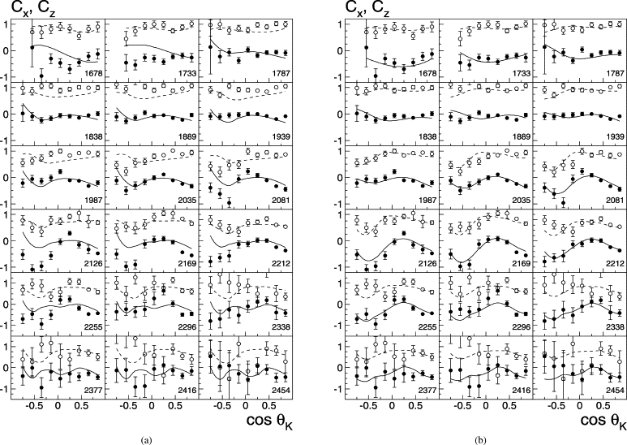
Polarization transfer C_{x} , C_{z}
without N(1900) 3/2⁺
with N(1900) 3/2⁺

Slide 30
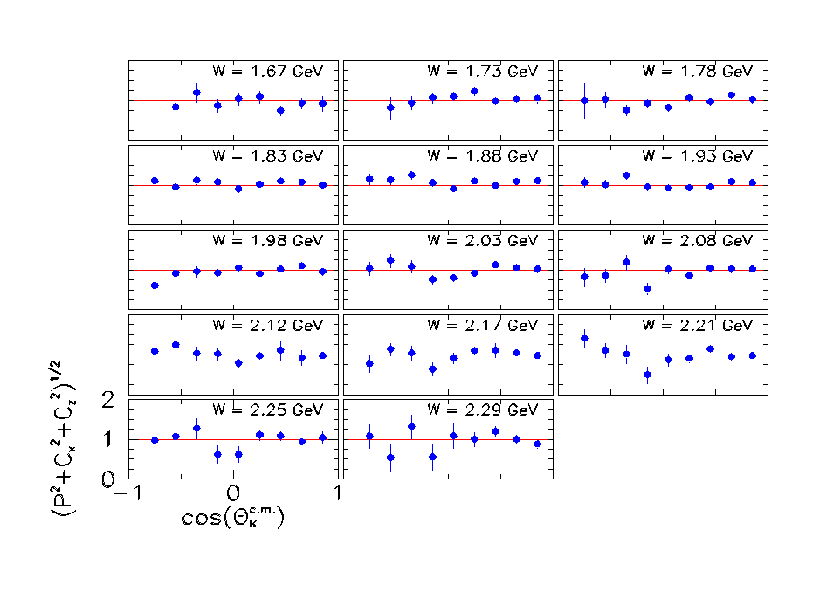
R Values for the Λ
The Λ appears 100% polarized when created with a fully polarized beam.

Slide 31
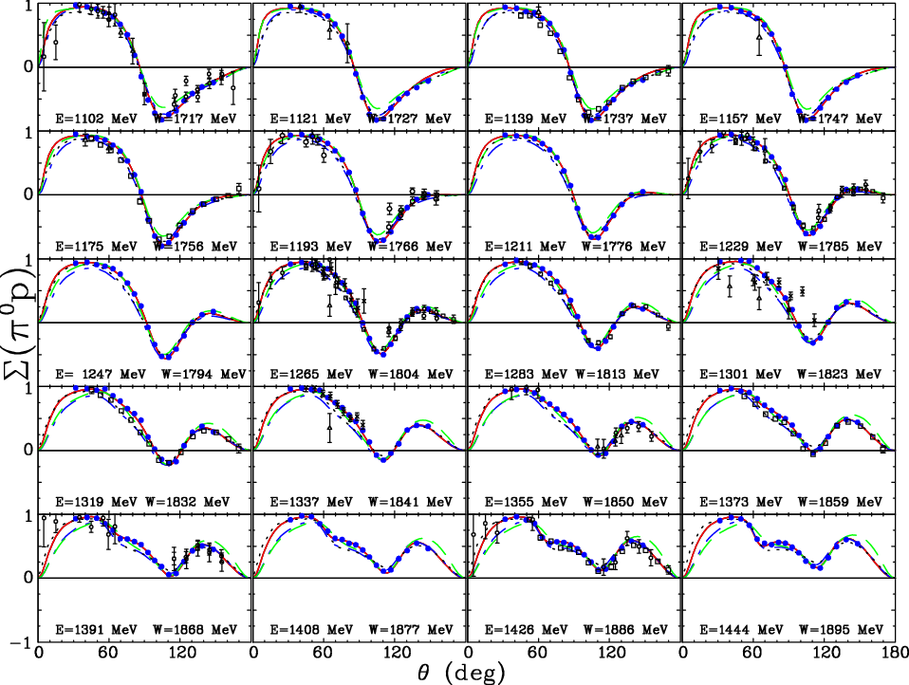
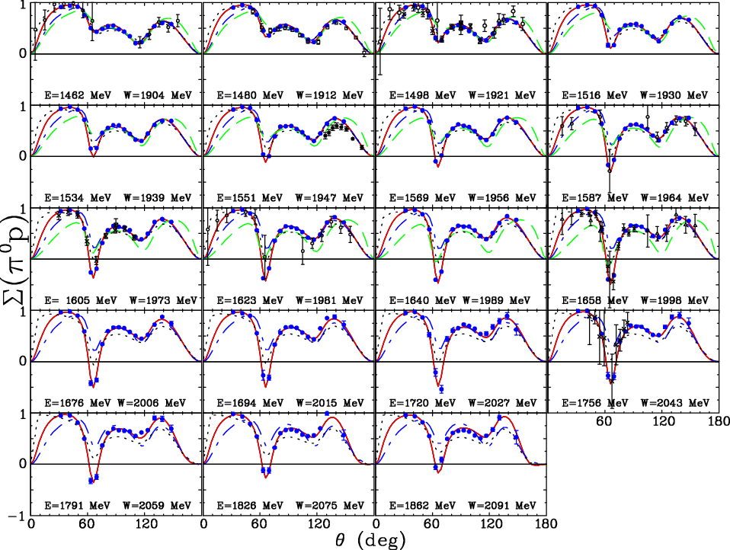
Σ for γ p → p π⁰
DU12
CM12
MAID
BbGa
M. Dugger et. al (CLAS Collaboration), Phys. Rev. C88, 065203 (2013)

Slide 32
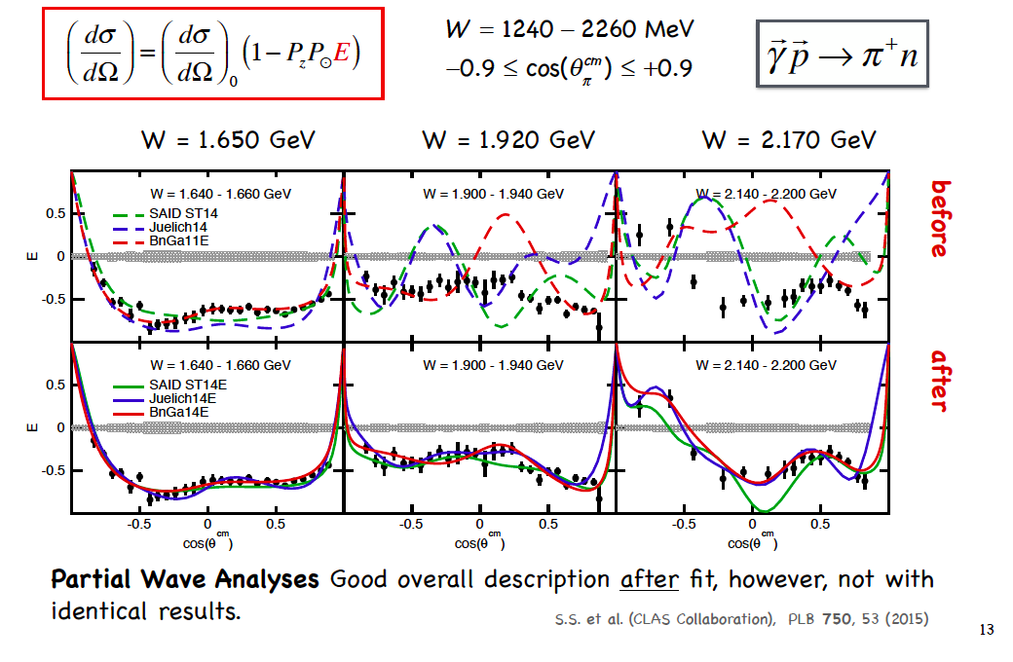
E asymmetry for γ p → n π⁺

Slide 33
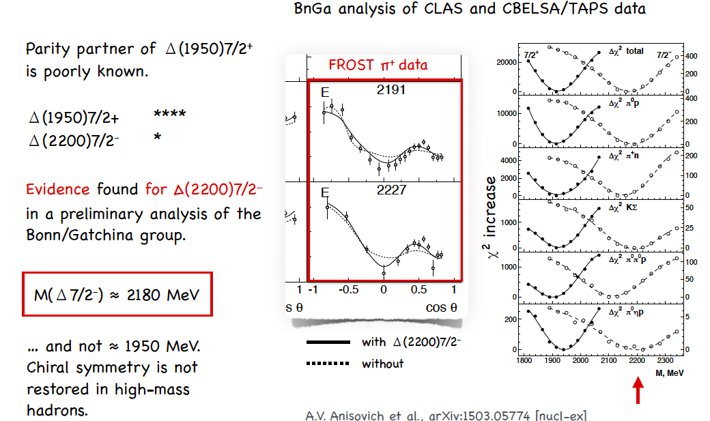
Partial restoration of chiral symmetry at high mass?

Slide 34
PDG
N* | J^{P}(L_{2I,2J}) | 2010 | 2012
N(1440) | 1/2⁺ (P11) | **** | ****
N(1520) | 3/2⁻ (D13) | **** | ****
N(1535) | 1/2⁻ (S11) | **** | ****
N(1650) | 1/2- (S11) | **** | ****
N(1675) | 5/2- (D15) | **** | ****
N(1680) | 5/2+ (F15) | **** | ****
N(1685) |  |  | *
N(1700) | 3/2- (D13) | *** | ***
N(1710) | 1/2+ (P11) | *** | ***
N(1720) | 3/2+ (P13) | **** | ****
N(1860) | 5/2+ |  | **
N(1875) | 3/2- |  | ***
N(1880) | 1/2+ |  | **
N(1895) | 1/2- |  | **
N(1900) | 3/2+ (P13) | ** | ***
N(1990) | 7/2+ (F17) | ** | **
N(2000) | 5/2+ (F15) | ** | **
N(2080) | D13 | **
N(2090) | S11 | *
N(2040) | 3/2+ |  | *
N(2060) | 5/2- |  | **
N(2100) | 1/2+ (P11) |  | *
N(2120) | 3/2- |  | **
N(2190) | 7/2- (G17)
N(2200) | D15 | **
N(2220) | 9/2+ (H19) | **** | ****
Major revision of the baryon table to large extent driven by new photoproducton data, particularly CLAS data.
The “bump” origin seems to be settled being attributed to N(1900) 3/2+
Other new states still require more confirmation

Slide 35
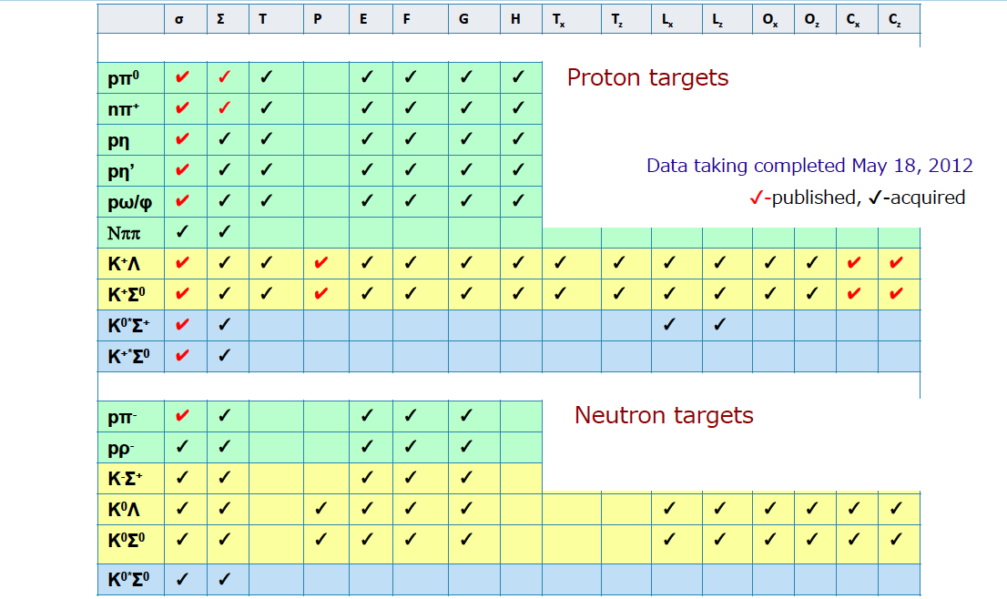
CLAS measurements

Slide 36
Intermediate Summary 2
Polarization measurements in photoproduction proved themselves to be a very important piece for understanding of the nucleon resonance spectrum.
There is no redundant data. Any data are useful.
Precision and consistency of the experimental data is of critical importance.
More interesting data are on the way for strange and non-strange meson production both on proton and deuteron targets.

Slide 37
Vector mesons

Slide 38
ω photoproduction
M. Williams et al., PRC 80, 065208, (2009)

Slide 39
ϕ photoproduction
B. Dey et al., PRC 89 055208, (2014)

Slide 40
For both ω and ϕ SDME ρ⁰ is not 0. What does it tell us?
  There is a spin flip, Helicity is not conserved

Slide 41
Outlook: What GlueX can do what CLAS has not done
SDME in vector meson production:
  extend energy range
  Use linearly and circularly polarized photons and possibly polarized target
  Extend studies to K* production
Study hyperon spectrum. There should be as many Λ and Σ states as N* and Δ
CLAS12 is planning to do some of it with quasi-real photons

Slide 42
Summary
Polarization measurements are critically important to understanding of the hadron spectrum.
Polarization measurements provide important information to understanding of the mechanisms of photoproduction of hadrons

Slide 43

Extras

Slide 44
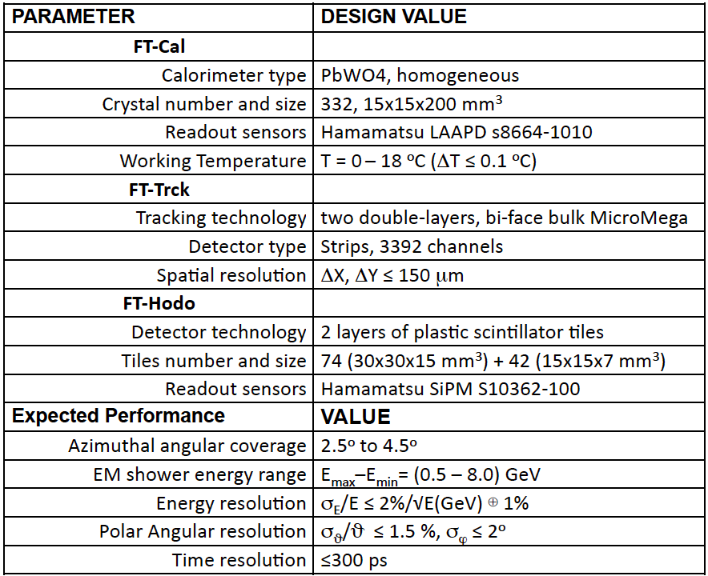
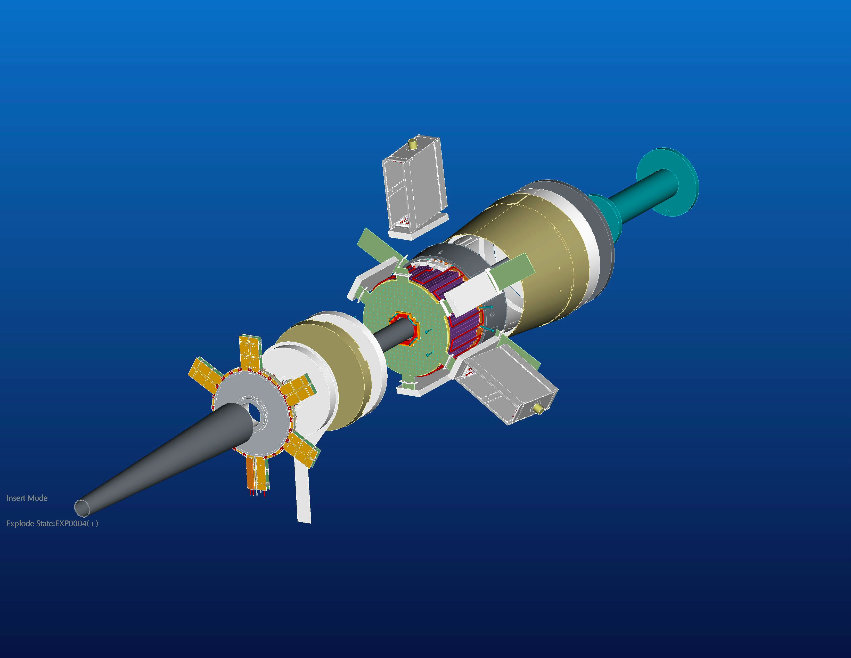
Forward tagger (FT)

