Slide 1
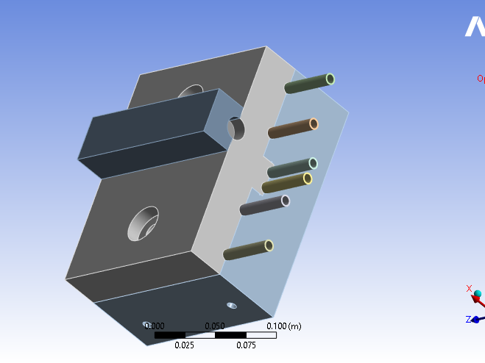

Slide 2
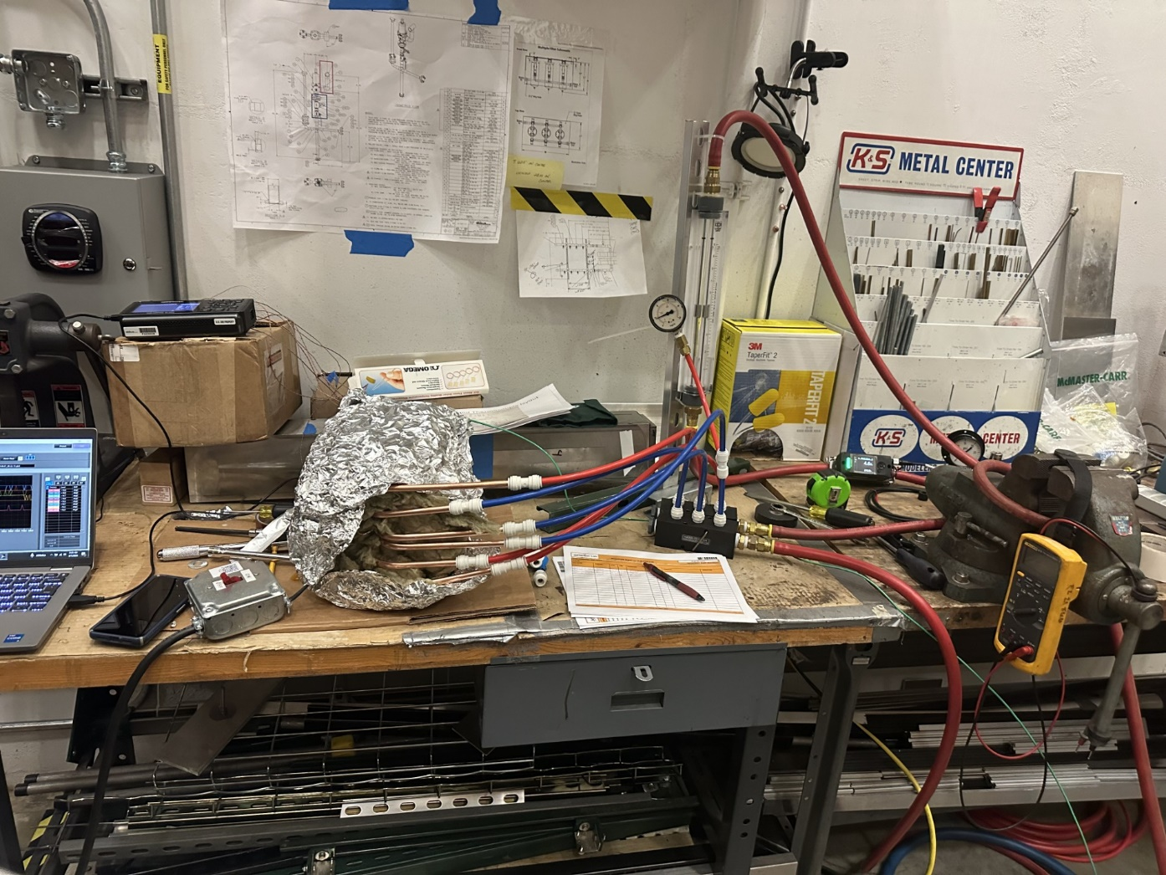

Slide 3
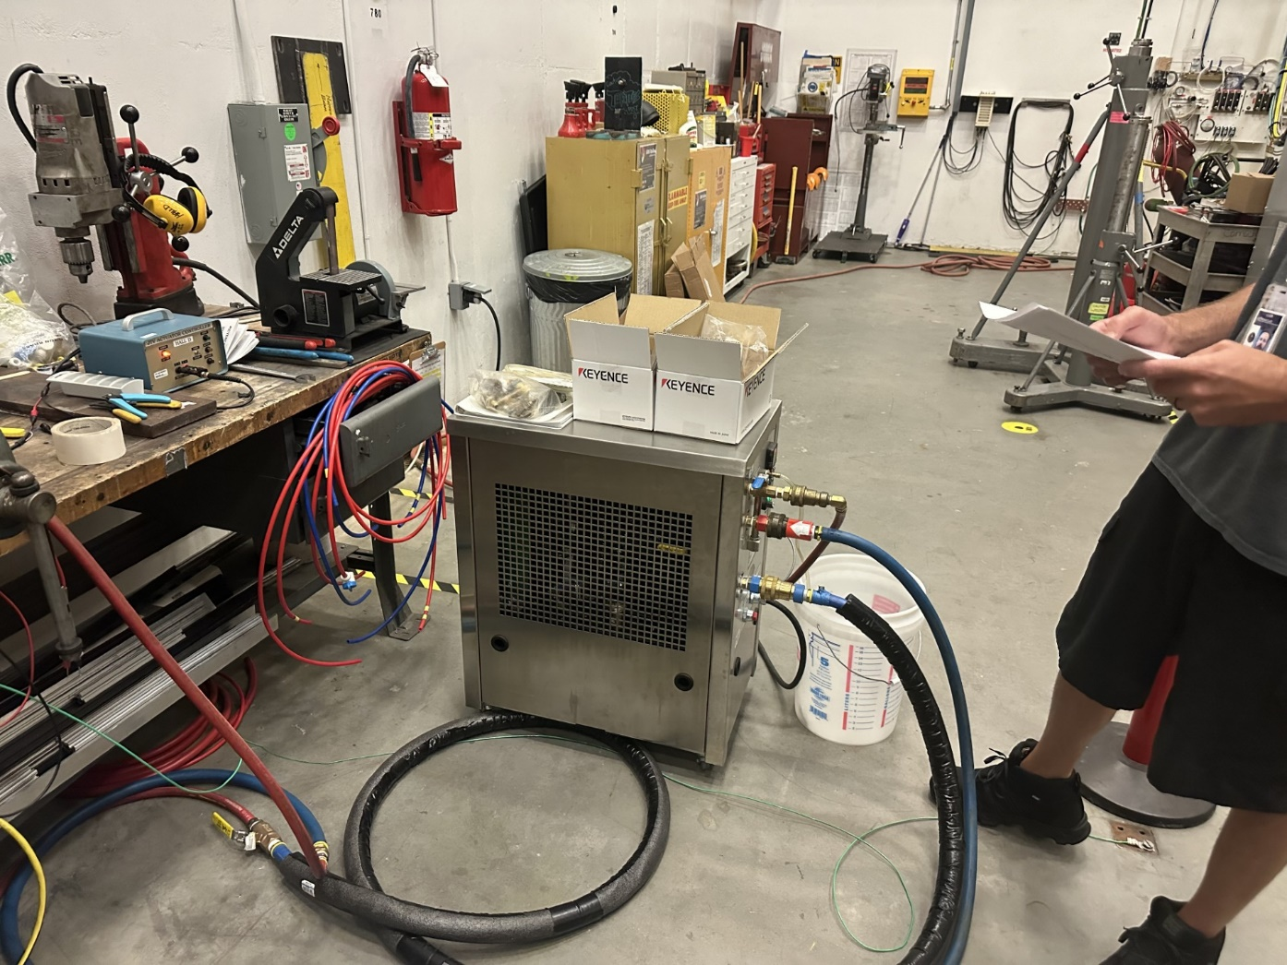

Slide 4
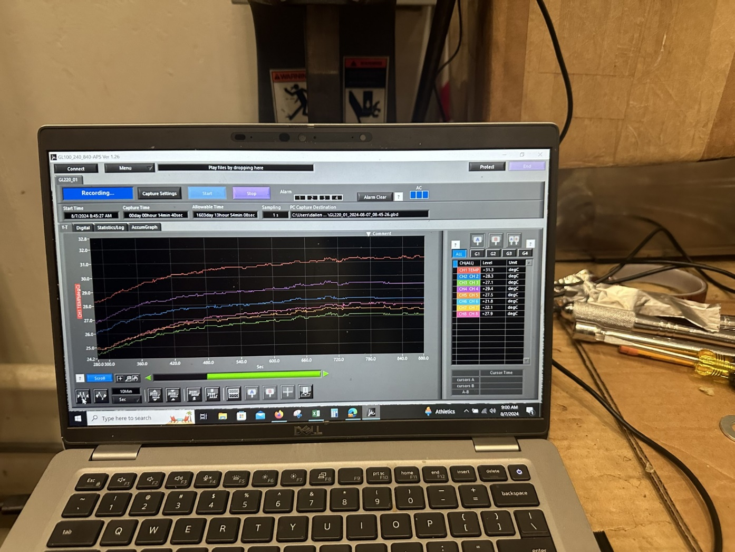

Slide 6
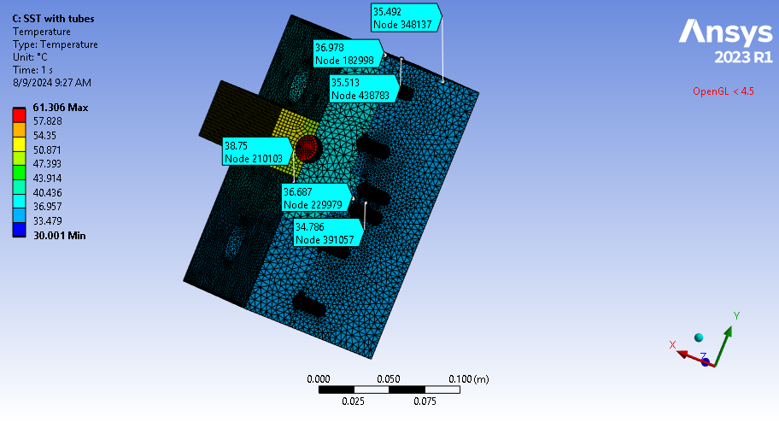
500 W tube heater
5um air gap at all contacts
9000w/mc convection on inner tube surface
36.5
38.1
36.2
39.7
37.1
35.8
39.7 37.1 35.8 38.1 36.2 30.9 31.1 36.5

Slide 7
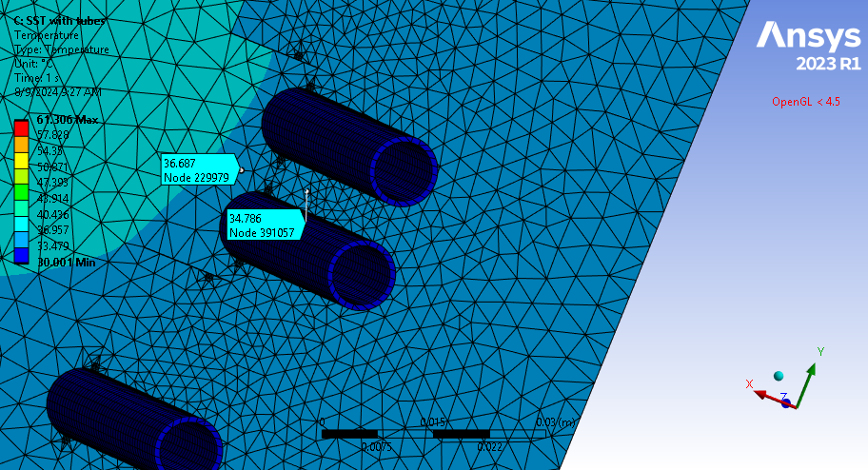

Slide 8
