Slide 1
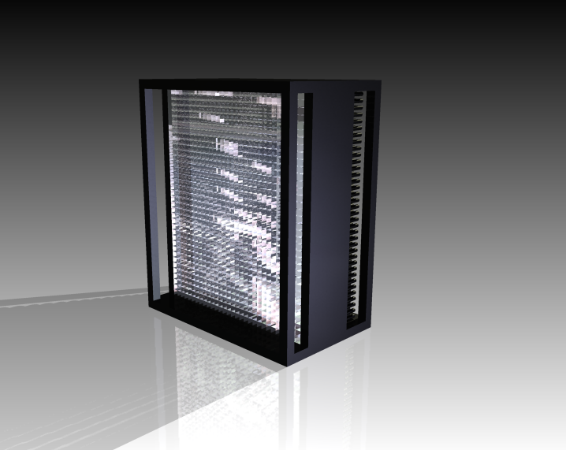
NPS project and future plans for EIC
Carlos Muñoz Camacho, IPN-Orsay
for the NPS Collaboration at Jefferson Lab
SICCAS, Shanghai, July 23 (2018)

Slide 2
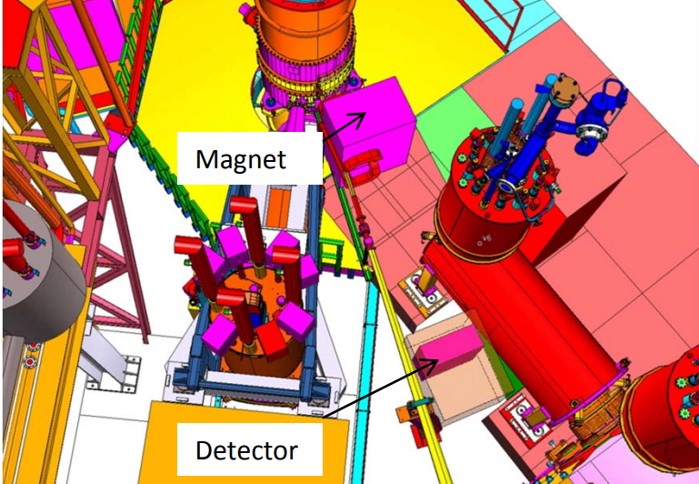
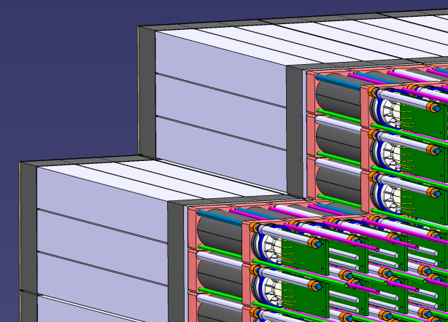
NPS project at JLab
Fully funded project
Several experiments approved
First experiment could run as soon as 2021-22
Experimental setup:
Design based on 2x2x20 cm PWO crystals optically coupled to PMTs

Slide 3
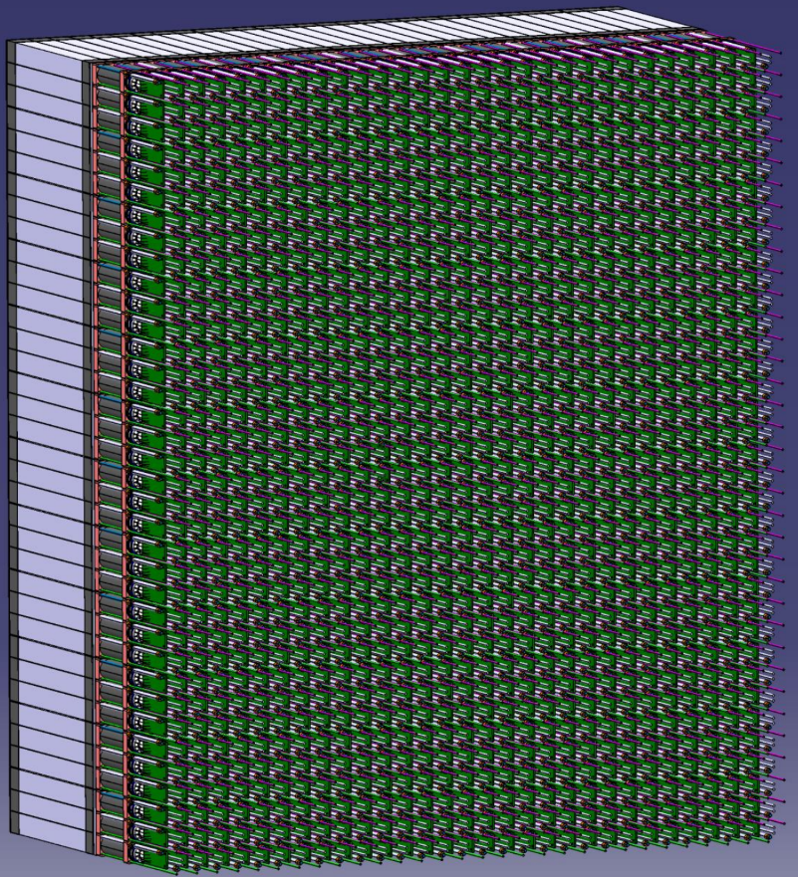
NPS calorimeter
A total of 36x30=
1080 PWO crystals needed
Critical requirements of the detector:
Energy resolution (light yield)
Radiation hardness
Uniformity:
- Crystal to crystal
- Along each individual crystal
36 rows
Timeline to procure all crystals:
end 2019
36 columns

Slide 4
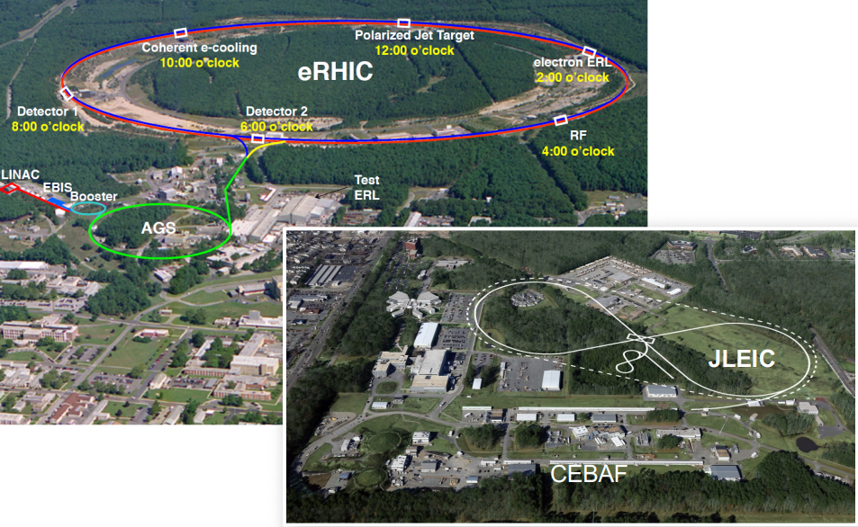
Longer term project: calorimeter for the US Electron Ion Collider
2 alternative designs: one at BNL (New York) and one at Jlab (Virginia)

Slide 5
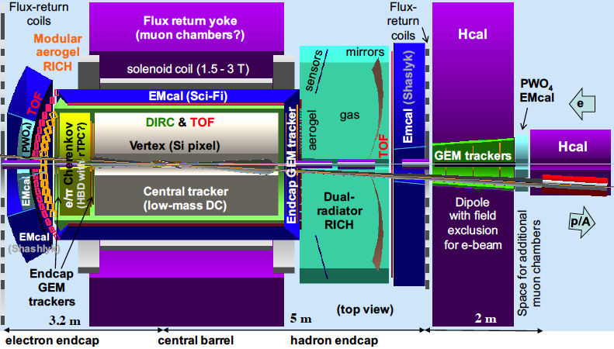
Calorimetry for the Electron Ion Collider
PID requirements in the electron endcap primarily driven by nearly real photo-production and semi-inclusive and exclusive processes
PID requirements in the ion endcap primarily driven by exclusive processes, e.g., DVCS (γ vs. photons from π⁰ decay) and to detect excitation in recoil baryons
Detection at very small angle is needed
Example: JLEIC detector

Slide 6
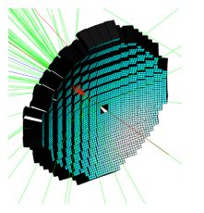
Tentative plans concerning PWO in EIC
Design still under study
Several thousands PWO crystals may be required
Specifications will be similar, but not exactly the same as for previous projects (still under study)
Tentative timeline:
Detector R&D ongoing
Accelerator and detectors construction 2020-2025+

