Slide 1
NSLS/BNL PLC Choice Elliott Wolin 6-Jan-2010
Following are a few slides from a much longer presentation
BNL chose Allen-Bradley
three month evaluation of four PLC vendors
many requirements not relevant to Hall D
BNL will use over 300 PLC’s and 600 PLC racks
got VERY good pricing!
Tight integration with IRMIS and EPICS
We should greatly benefit from their work
their plans are similar to ours
theirs is much larger scale
they will be in production before us
should be able to borrow a lot of software from them

Slide 2
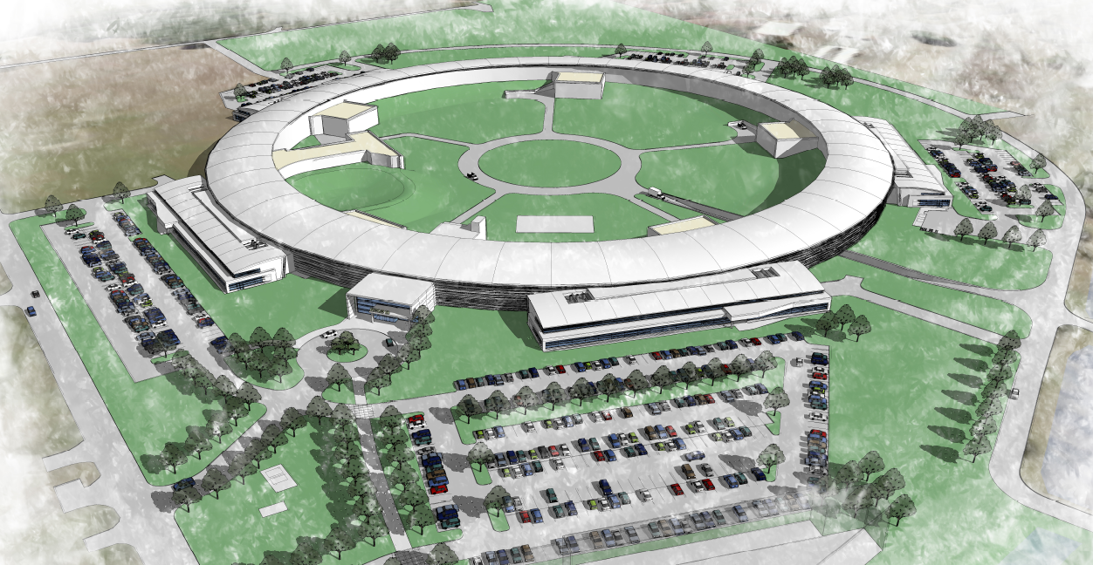
PLC Selection Criteria and Results
David Dudley
Sep 8, 2009

Slide 3
What are the PLC’s used for
Complete control of accelerator operations
Automatically manages control of machine operations under steady state conditions.
Controls access to accelerator facilities.
Provides the Personnel Protection System (PPS) which should prevent exposure to dangerous areas of facility.
Manages the Equipment Protection System (EPS) to prevent damage to equipment during operation.
Most actual control interfaces are linked through the PLC I/O systems.

Slide 4
What are the PLC’s used for (cont’d)
Slow and Moderate Speed I/O are linked through the PLC, which can acquire and time stamp data.
Automatic/semi-automatic or manual control of various subsystems used in the accelerator. These systems include:
Control and automatic operations of the Vacuum, RF, Power Supply, and other subsystems.
Almost all equipment monitoring.
Conventional Systems automatic control and monitoring.
HVAC monitoring.

Slide 5
What are the PLC’s used for (cont’d)
Provides secure, automatic shutdown in case of personnel intrusion into secure areas.
Protects the user from himself.
Prevents access to hazardous areas during operation.
Monitors radiation hazards in occupied areas. Should dangerous levels occur, takes protective action.
Provides for sequential systematic searching of secured areas before machine operation possible.
Enables machine to operate when all required areas are secured, and all interlocks satisfied.

Slide 6
Which PLC’s were on the short list, and why
Rockwell Automation (Allen Bradley) Control Logic and Compact Logic.
Handles Safety and Normal control systems
Fast, Compact Logix performs 1k boolean instructions in 0.08 ms, Control Logix (L63) in 0.04 ms. “Typical” instructions in 0.5ms/1k, 0.25ms/1k respectively.
Very popular in the US.
Full complement of functions.
Capable of loading/storing XML program descriptions.
Used by a great variety of customers

Slide 7
Requirements for PLC Integration
All IO is to be defined through the IRMIS system.
PLC programming software MUST be able to load and store files created through the IRMIS system that defines I/O and or logic.
PLC programming must be available over ethernet.
All IOC communications to the PLCs will take place over ethernet.

Slide 8
Allen Bradley Logic example

Slide 9
AB XML File Example

Slide 10
Results
Selection Criteria | Weight | Rockwell (A-B) | Siemens | Yokogawa | GE
Customer Support | 2 | + Yes | + Yes | + Yes | - Not known
Wide Hardware Selection | 3 | + Yes | + Yes | - Somewhat limited | + Yes
Safety Support | 3 | + Yes | + Yes | - No | + Yes
Ease of EPICS Interfacing | 3 | + Very, uses tagname accesses. | - Possible, uses data structure and PLC software | - Yes, register number based | - Yes, register number based
TEXT import File style | 3 | + XML defined structure | - Text file, very verbose | - Only form symbols and I/O addresses | - Unknown
Text Import of Tagnames and I/O Symbols | 3 | + Yes | + Yes | + Yes | - Unknown
Text Import of Program Logic | 2 | + Yes | + Yes, very detailed | - No | - Unknown
TEXT import form documented and supported | 2 | + Yes, is standard form for import/export | - Unknown | - Unknown | - Unknown
Ability to merge Input files | 2 | + Yes, supports partial merges as well. | - No | + Yes, for symbols and I/O addresses | - Unknown
Cost Comparison, Config #1 | 5 - 1 | 4 | 3 | 2+5 = 7 | 1
Cost Comparison, Config #2 | 5 - 1 | 4 | 2 | 3+5 = 8 | 1
US Company | 1 | + Yes | No | No | + Yes
Evaluation Totals | 34 | +32 | +18 | +22 | +9

