Slide 1
Status of the Pair Spectrometer
A. Somov, JLab

Slide 2
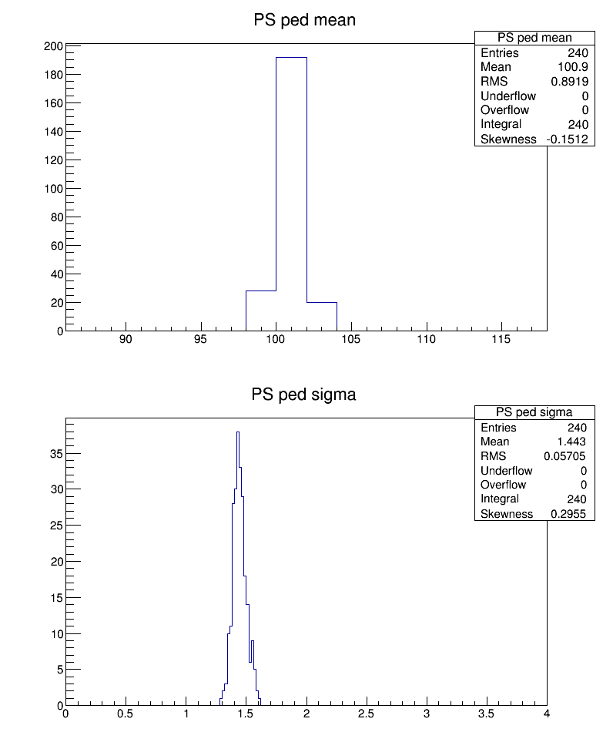
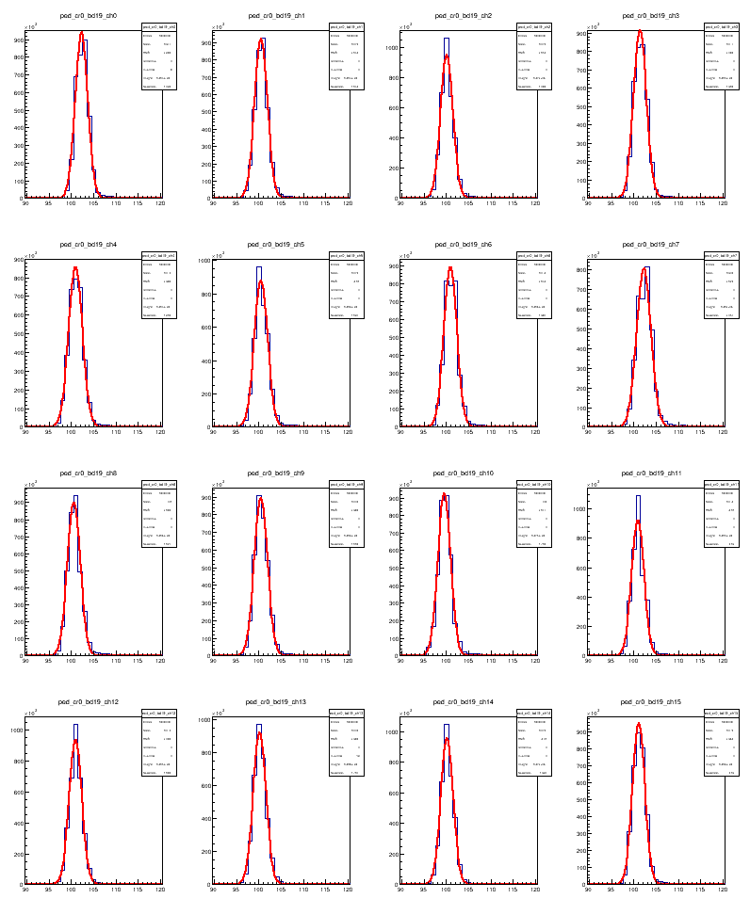
Pedestal Calibration
PS (rocps1)
Calibrated about one month ago; remain ‘stable’ since then

Slide 3
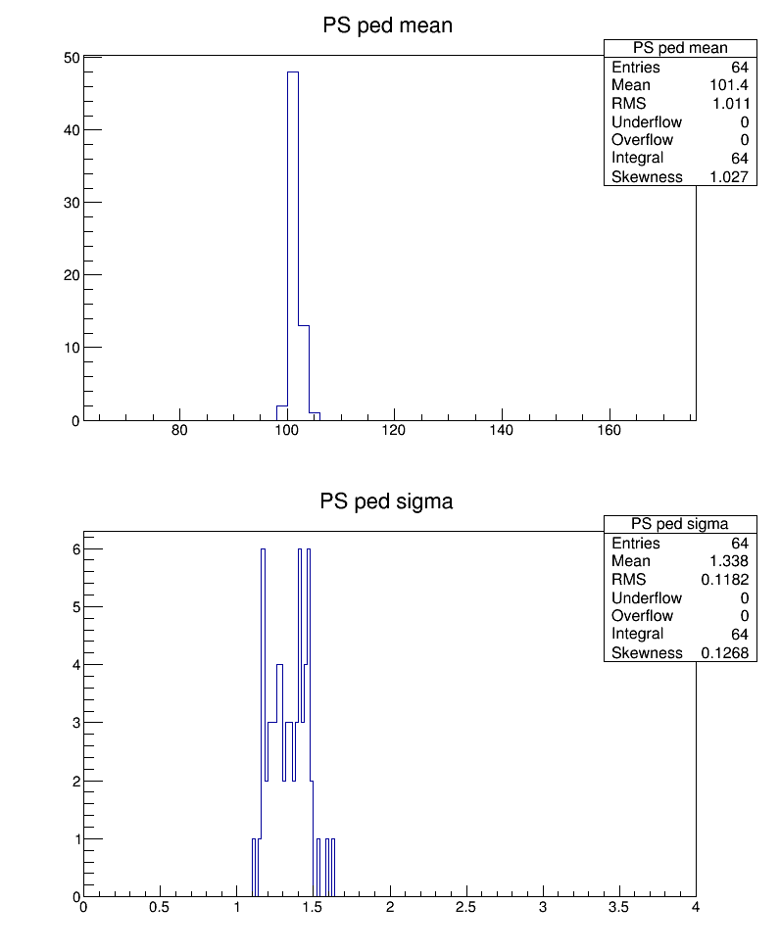
Pedestal Calibration
PS & PSC (rocps2)

Slide 4
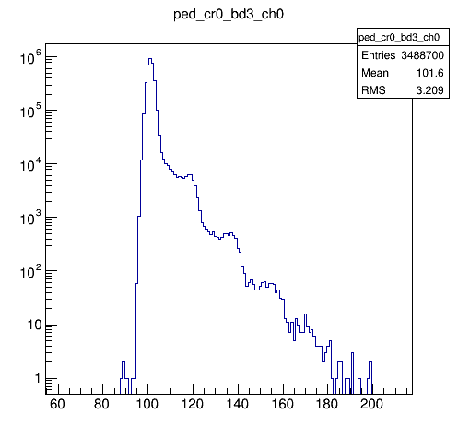
Pedestals
Single pixel

Slide 5
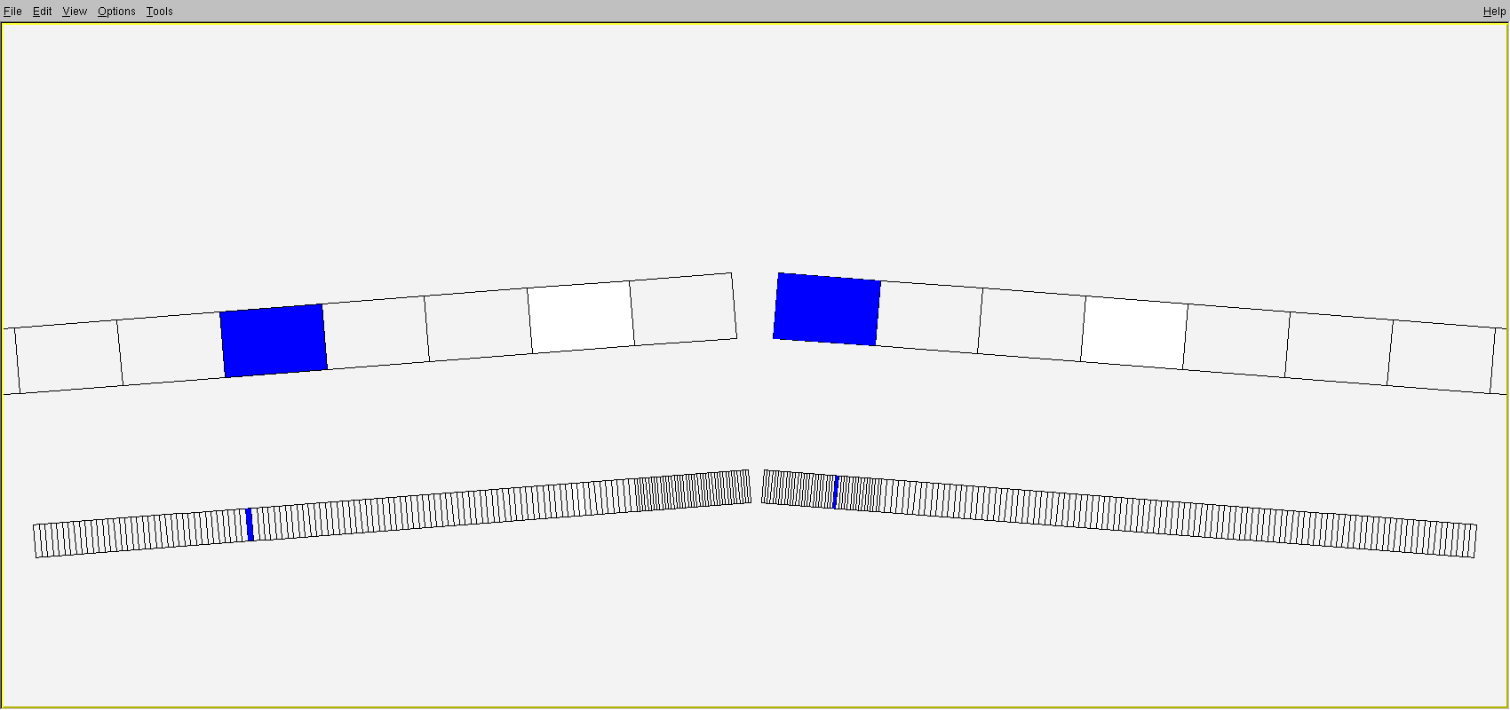
PS Viewer
PSC
PS

Slide 6
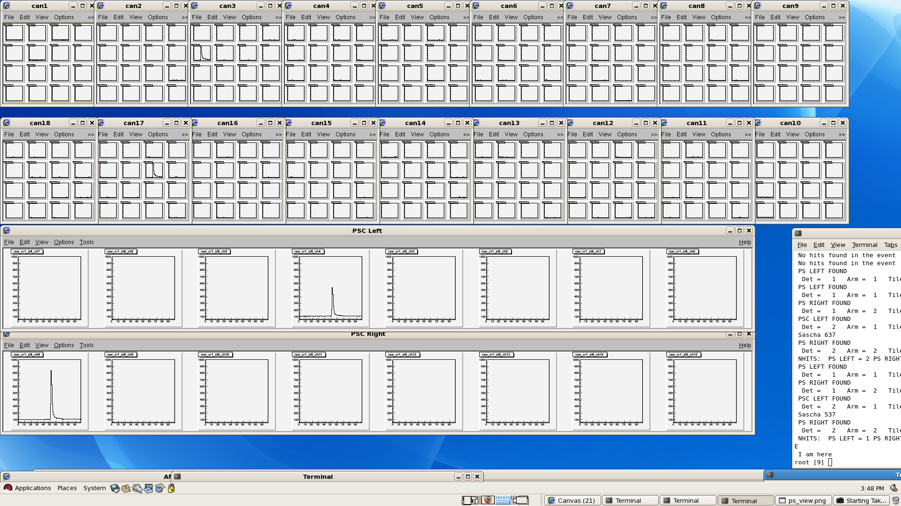
PS Viewer
PS Arm A
PS Arm B
PSC Arm A
PSC Arm B

Slide 7
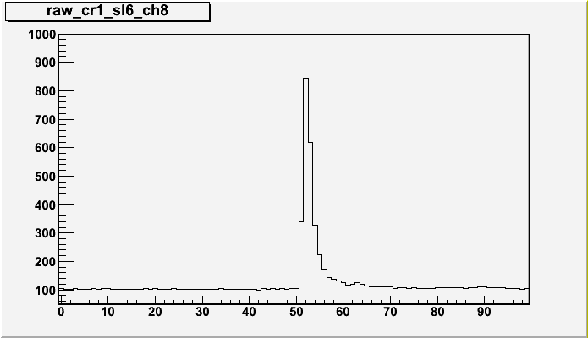
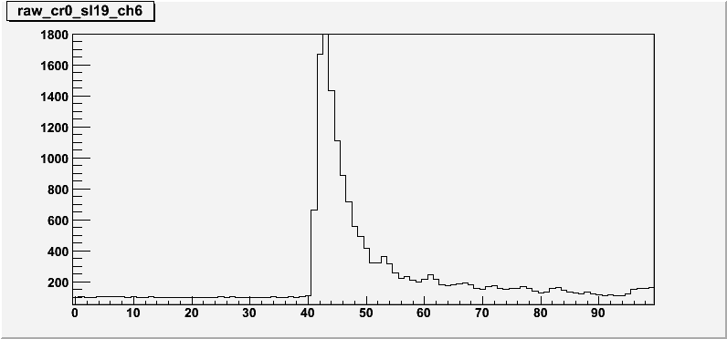
Pulse Shapes
PSC
PS

Slide 8
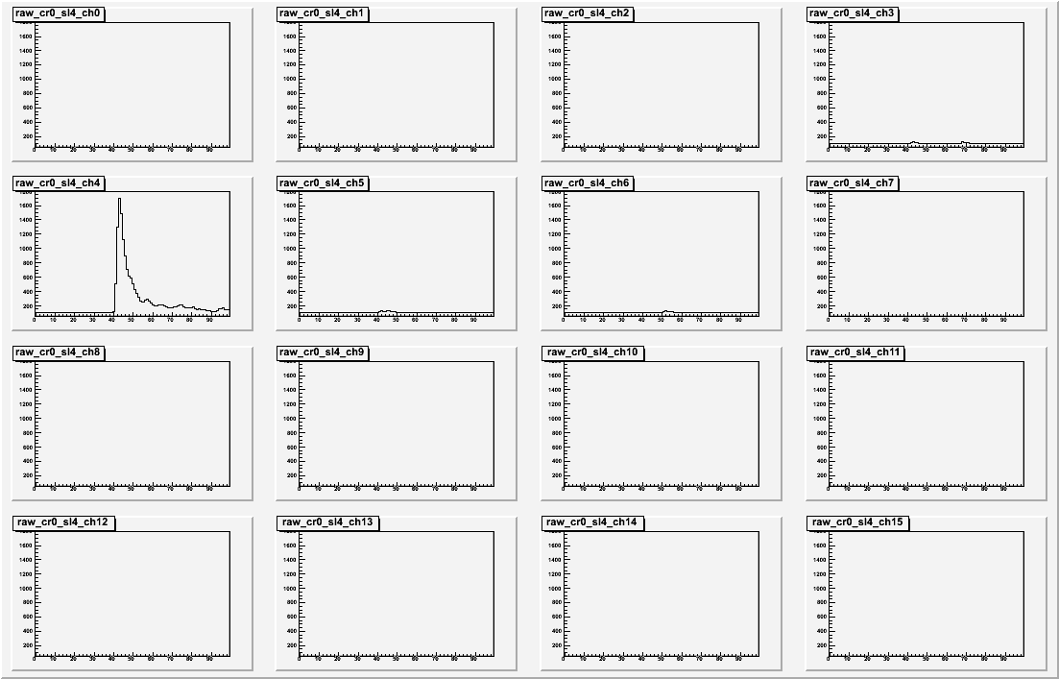
Pulse Shapes: PS

Slide 9
Maximum Amplitudes: PSC
400

Slide 10
Maximum Amplitudes: PS

Slide 11
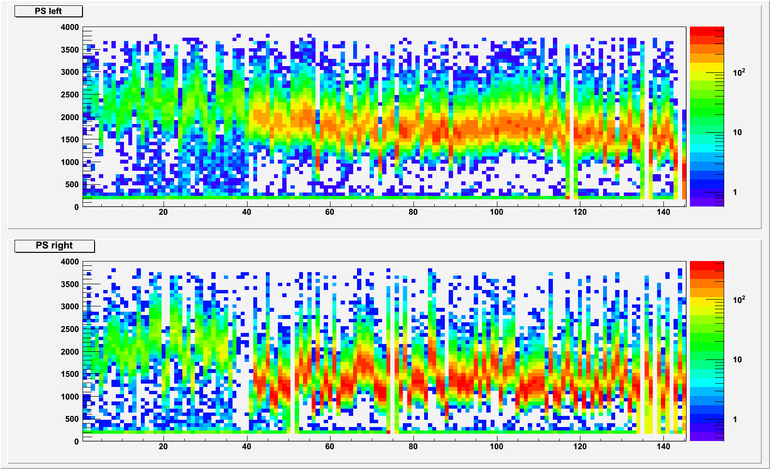
Maximum Amplitudes: PS

Slide 12
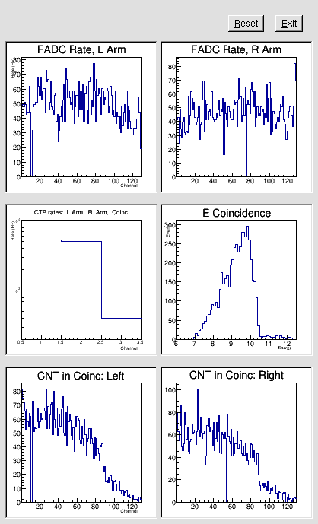
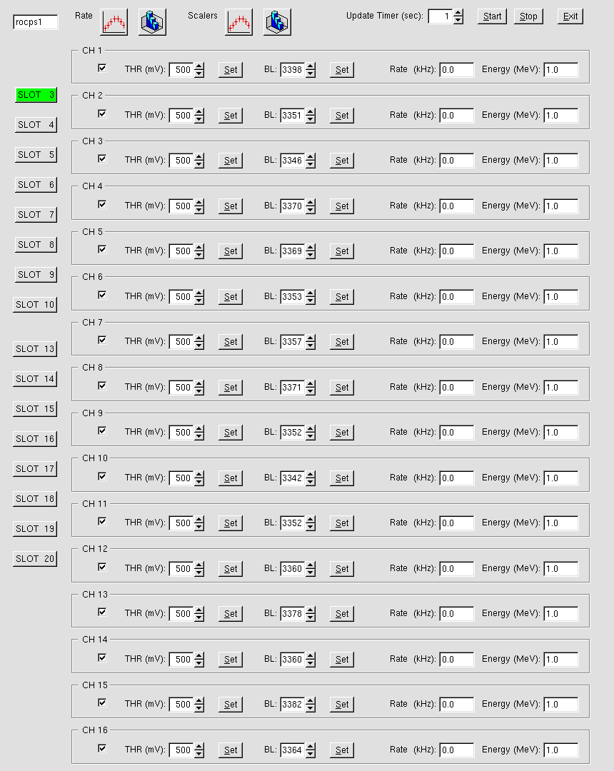
Online PS/PSC Monitor

Slide 13
PS Trigger

