Slide 1
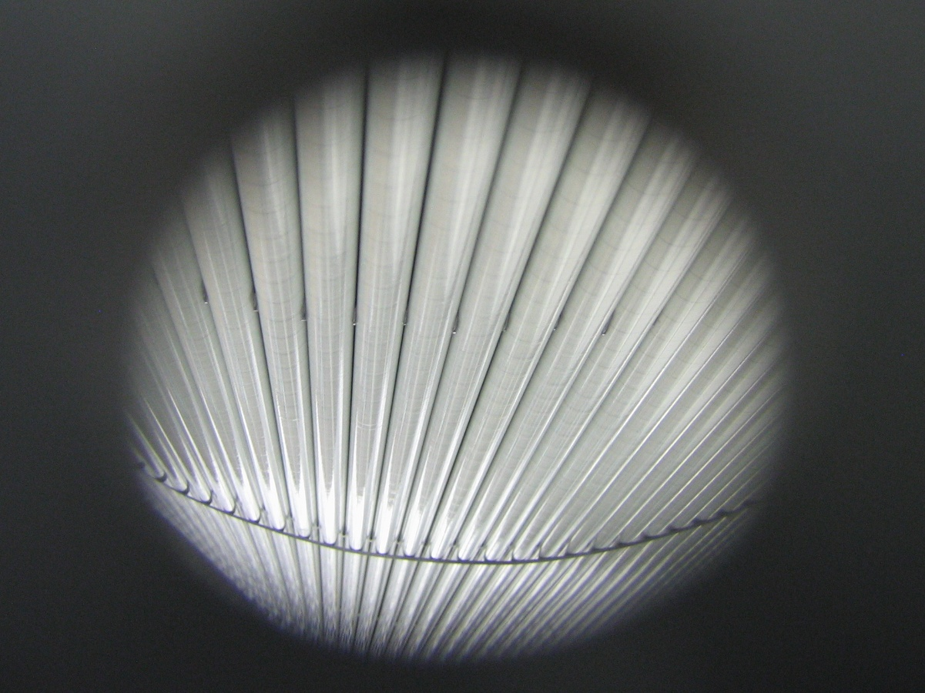
Central Drift Chamber Update
Naomi Jarvis
Carnegie Mellon University
GlueX Collaboration Meeting, Indiana University, May 2011

Slide 2
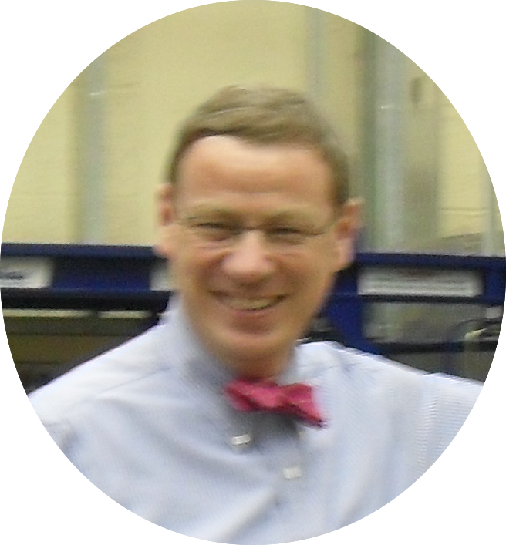
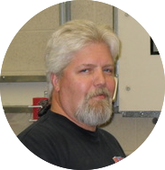
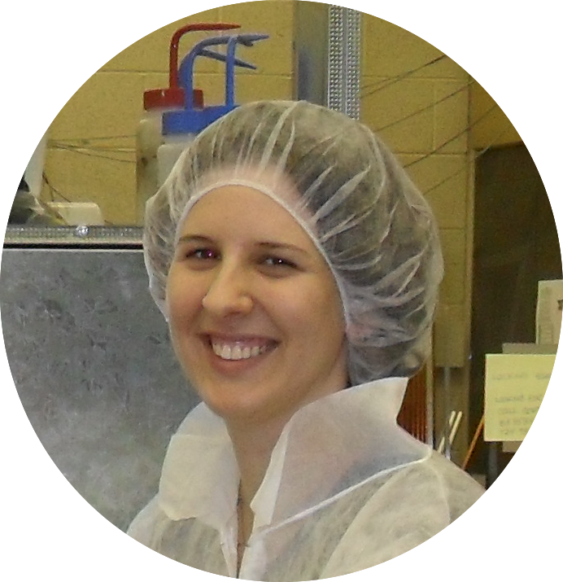
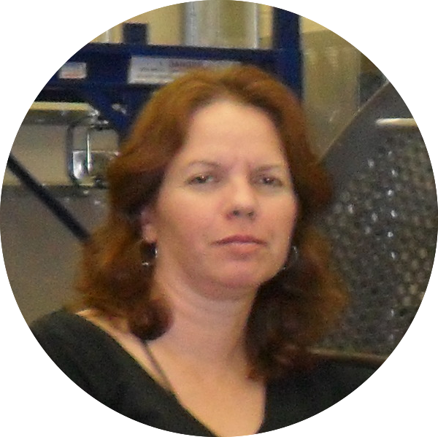
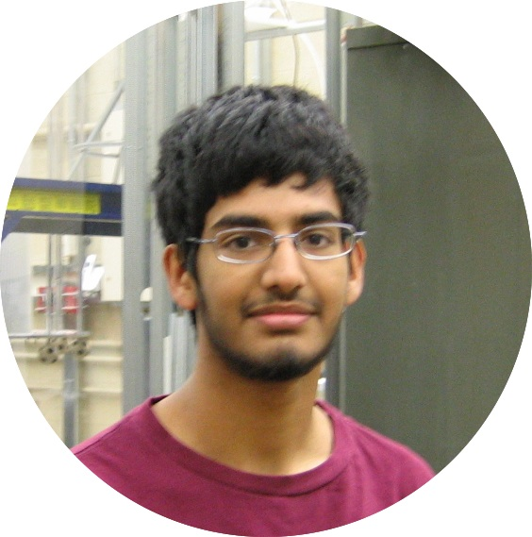
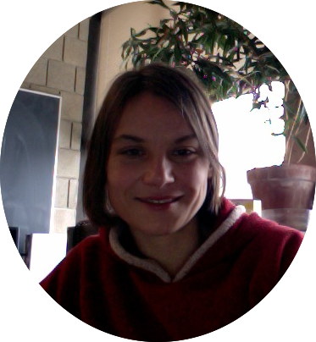
The CDC Team
CDC Update
Project Leader: Curtis Meyer
Project Scientist: Naomi Jarvis
Construction Manager: Gary Wilkin
Technicians: Amy Woodhall, Kaitlin Mueller
Undergraduate Students:
2011: Rahul Kurl, Maddi Brumbaugh
+ …

Slide 3
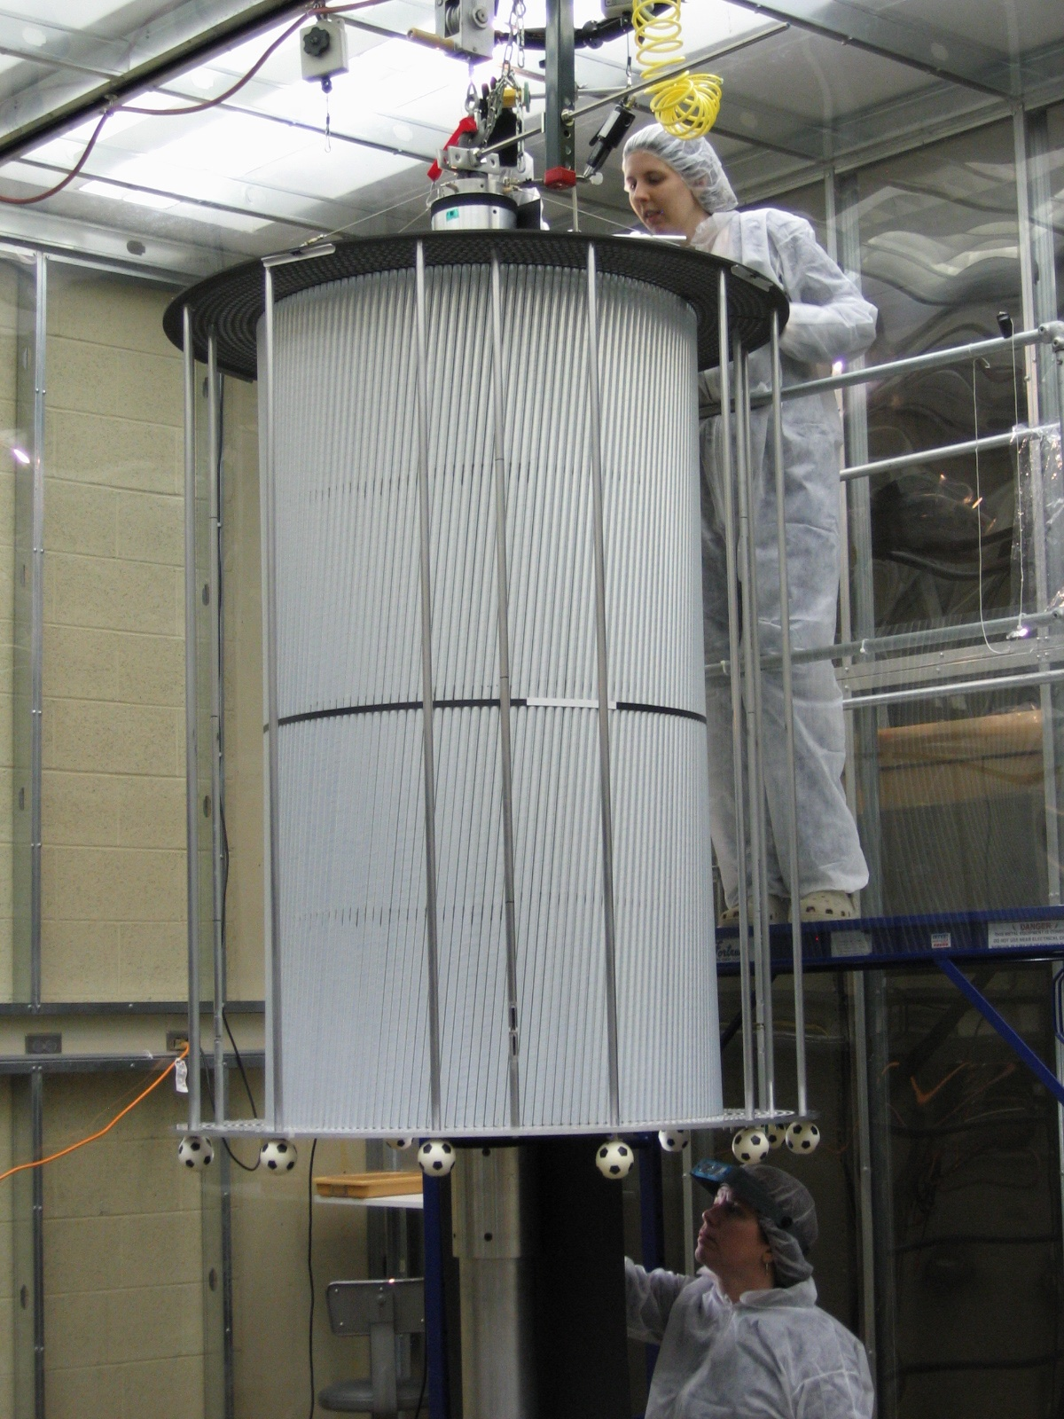
Outline
CDC Update
CDC Construction
Current status
Prep work for next stage
Prototype studies

Slide 4
CDC Construction: Current status
CDC Update
Phase 1: Mounting and Alignment of Endplates
complete
Phase 2: Installation of Straws (gas lines + outer shell)
Completed rows 1-19 of 28
Used up straws – rest expected soon
Phase 3: Wire Stringing
Started work on row 1

Slide 5
CDC Construction: Phase 2 Components
CDC Update
Component | Status | Acceptance
Straws (1900) | Checked, trimmed, installed | 82%
Straws (250) | Checked, trimmed, installed | 90%
Straws (rest) | Pending
Al donuts | Checked, cleaned, some installed | ~ 100%
Al feedthrus | Checked, cleaned, some installed | ~ 100%
Noryl donuts | Checked, cleaned, some installed | ~ 100%
Noryl feedthrus | Checked, cleaned, some installed | ~ 100%
Gas lines + steel nipples
Gas line glue widgets | To be made at CMU
Outer shell | Arrived at CMU 3rd May
Outer hub material
Tape for outer shell | Duct tape is at CMU; need Cu tape

Slide 6
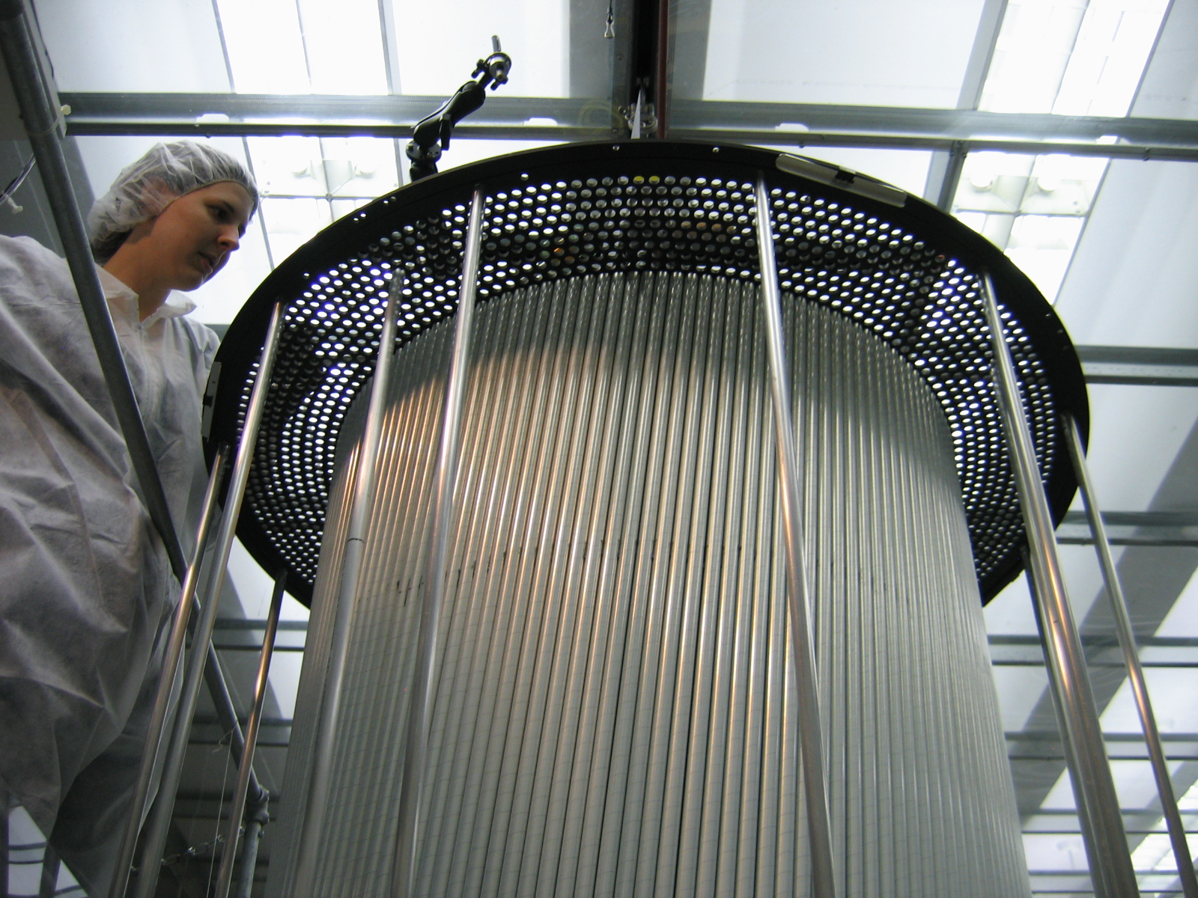
CDC Update

Slide 7
CDC Construction: Phase 3 Components
CDC Update
Component | Status | Acceptance
Pinholders | 85% checked, cleaned, some installed | So far all but 1
Crimp pins | Some in clean storage, some installed | 100%
Wire | Some in clean storage, some installed | 100%

Slide 8
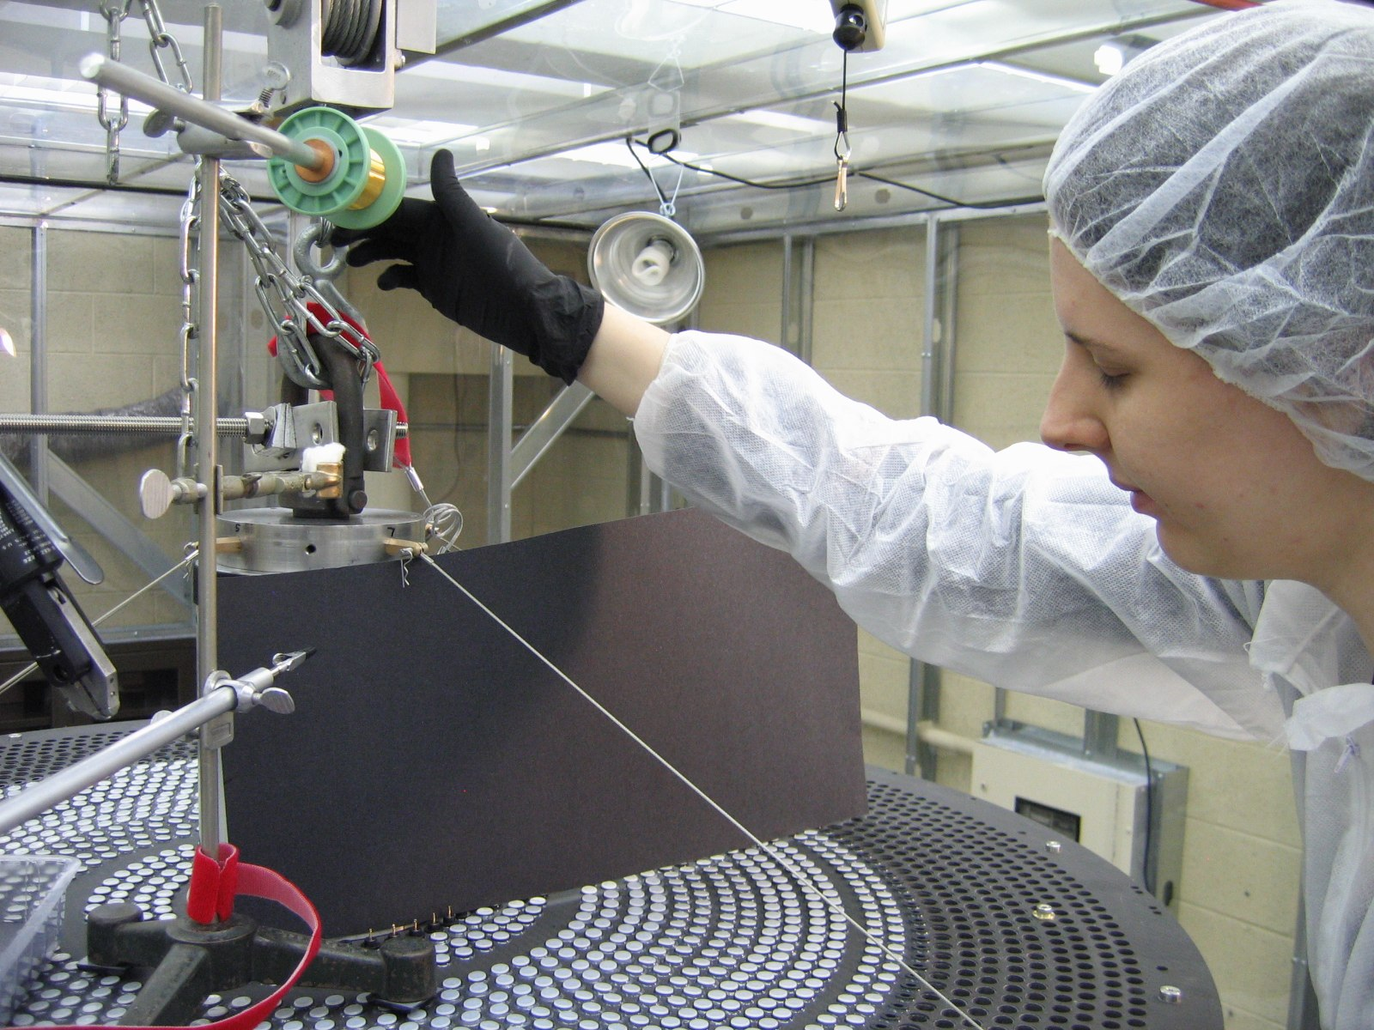
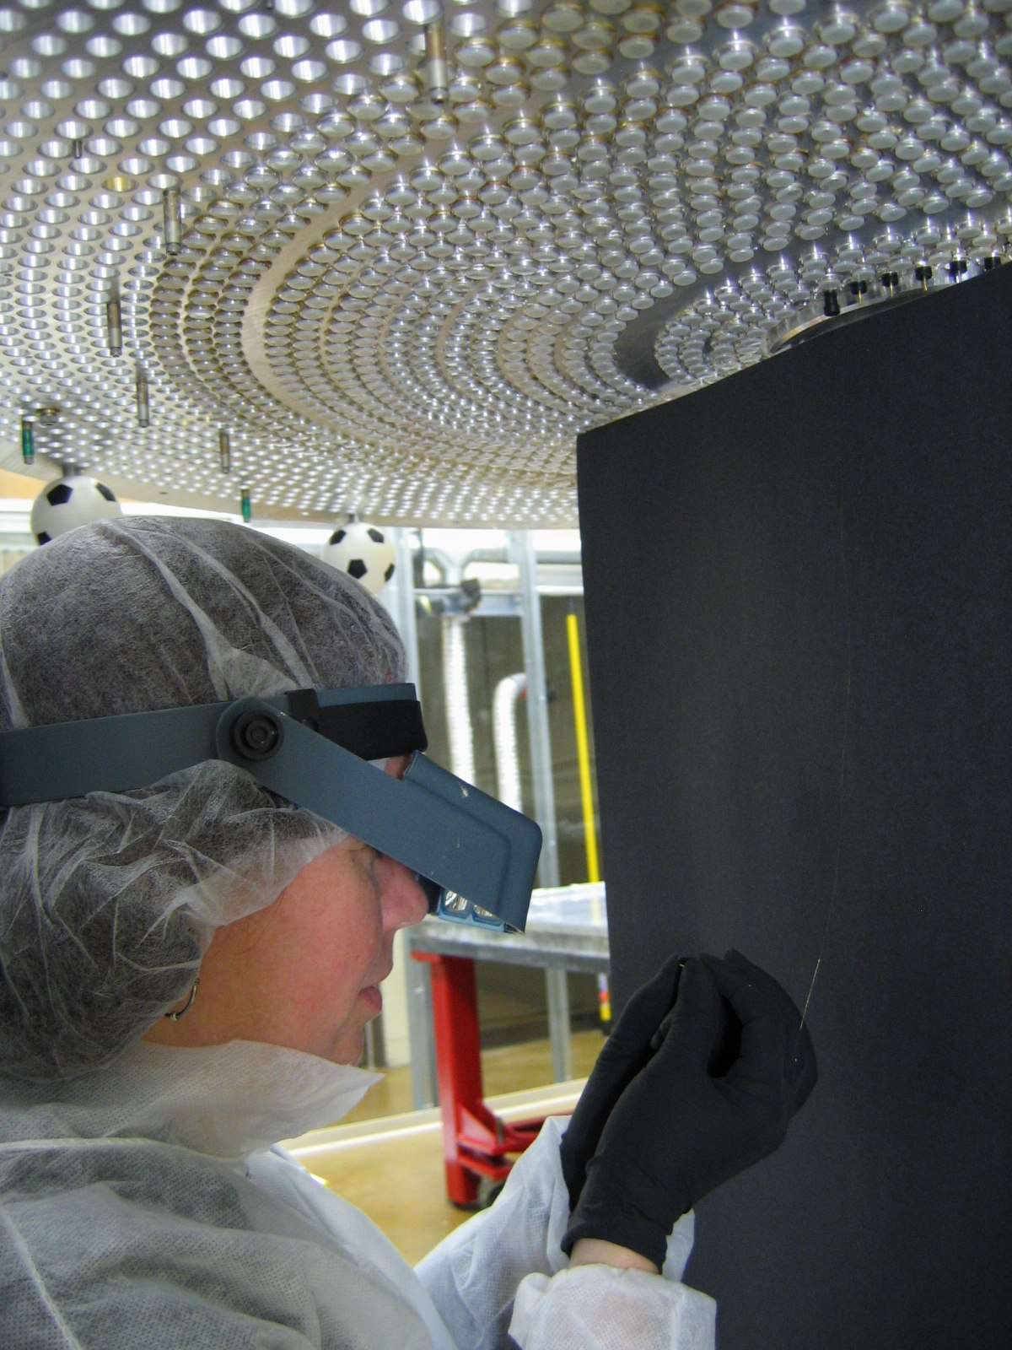
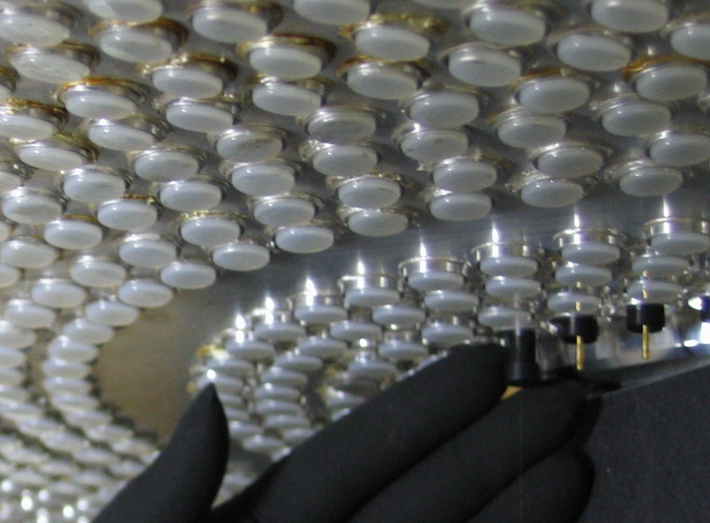
CDC Update

Slide 9
CDC Construction: Phase 4 Components
CDC Update
Component | Status | Acceptance
Threaded bushings | At CMU
O-rings | At CMU
Lugged ferrules | CMU have ordered these
Wire | At CMU | 100%
Silver balls | At CMU | 100%
Heatshrink | At CMU | 100%
Standoffs (3 types)
Standoff screws
HVBs

Slide 10
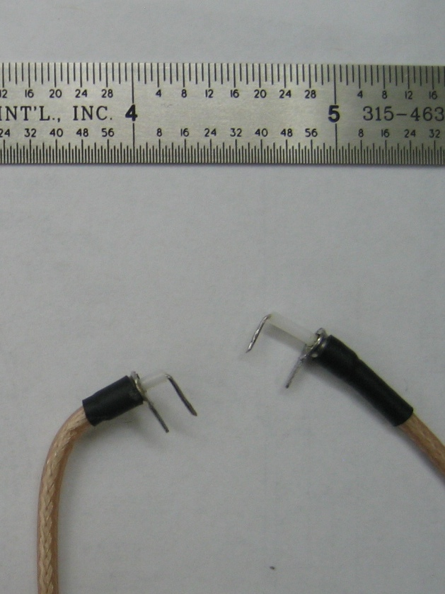
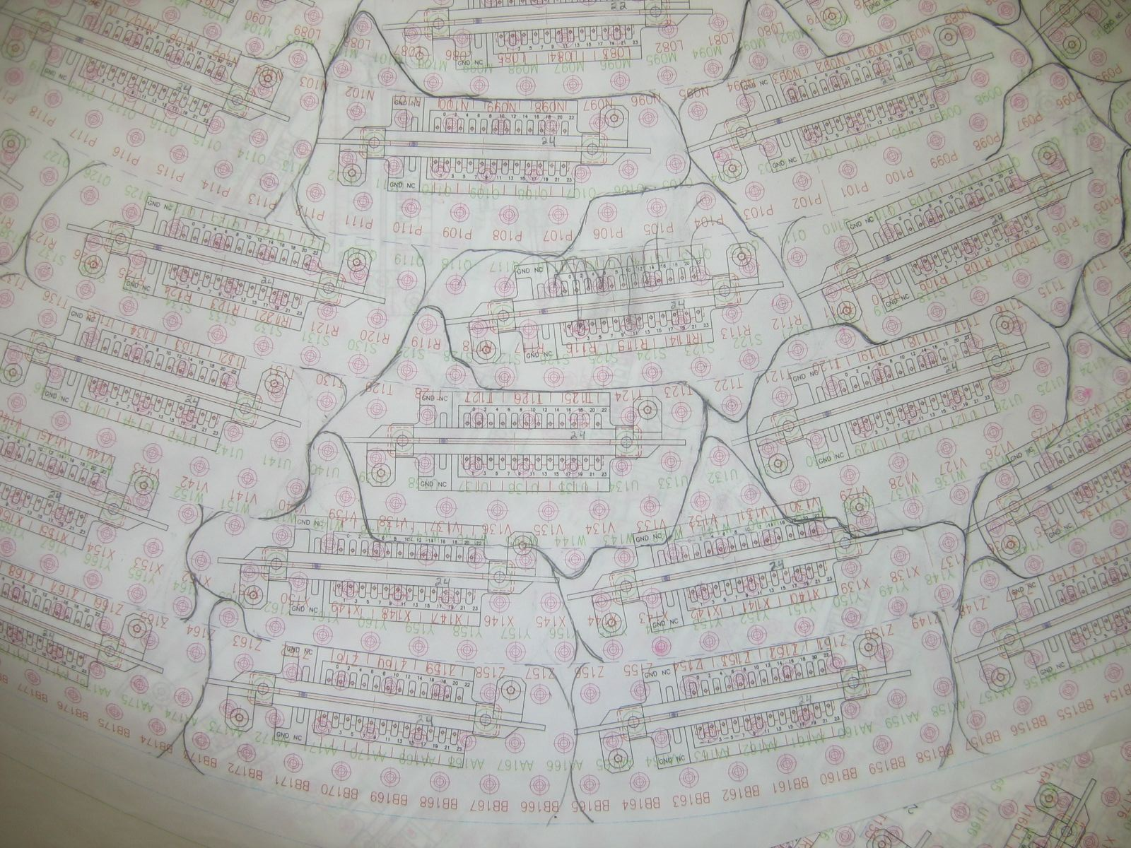
CDC Construction: Phase 4 Preparations
CDC Update
Hook-up wires
20% are half-made
HVB connection layout
Aim for shortest max wire lengths

Slide 11
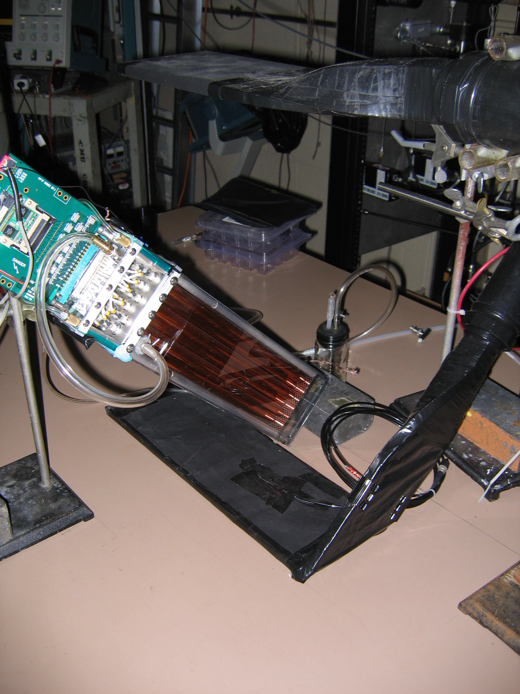
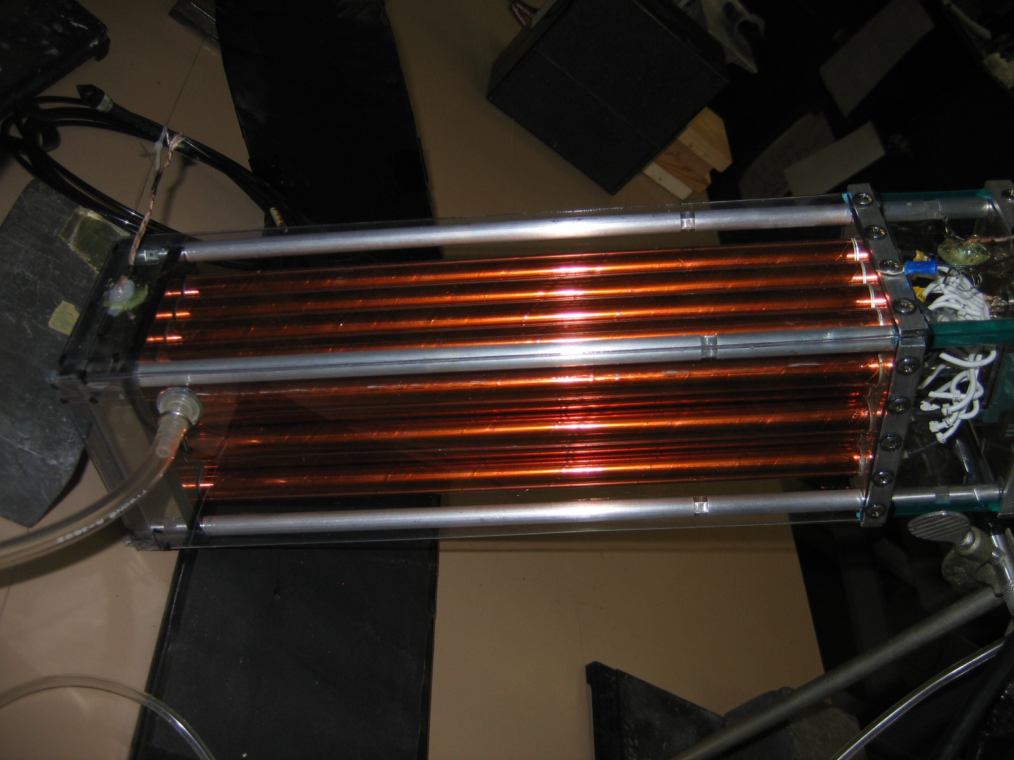
Prototype studies
CDC Update
New fADC125, preamp, plenum, gas MFCs
CODA 2.5, cosmic ray data, 50/50 Ar/CO₂

Slide 12
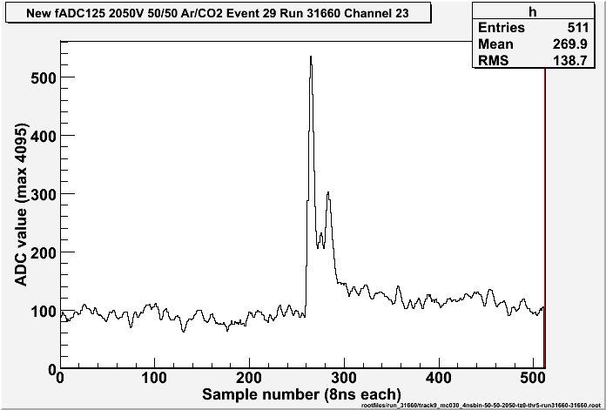
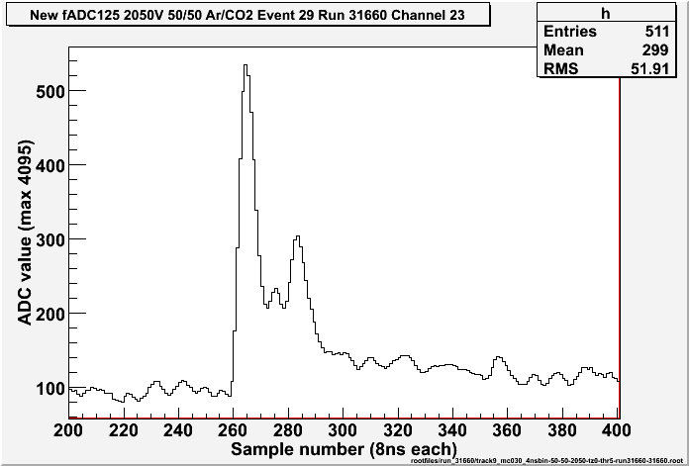
Event fADC data
CDC Update
Cosmic ray data with small prototype – event in one straw shown
Using 512 x 8ns samples and fADC range 0-4095
Noise is ~ 11 ADC values

Slide 13
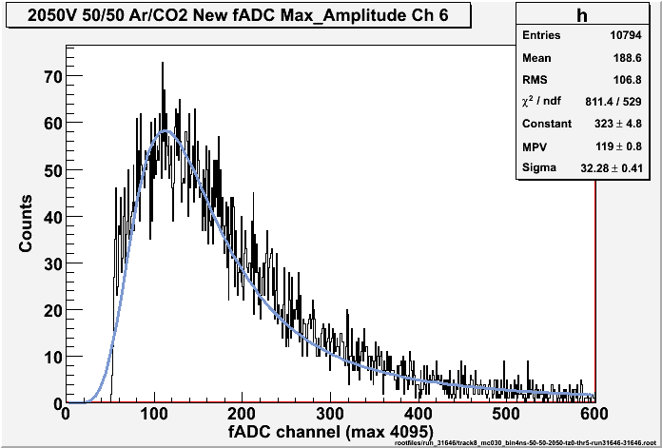
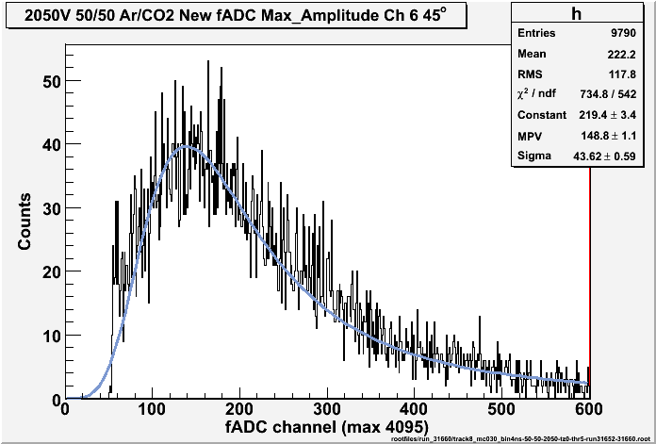
Amplitude histogram
CDC Update
Calculate mean pedestal for first 100 samples in each 100 events
Subtract pedestal from ADC values
Select event where ADC value rises above a threshold (5 sigma): hit
Histogram the first maximum in the ADC value after crossing the threshold

Slide 14
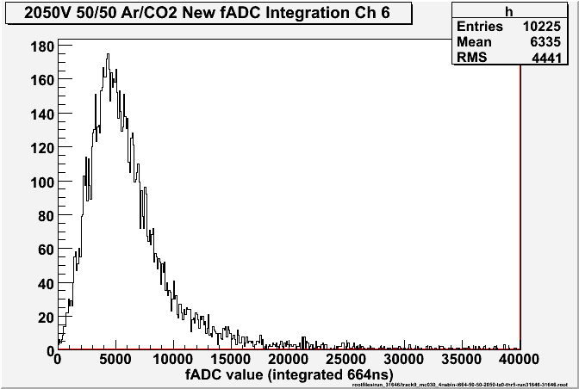
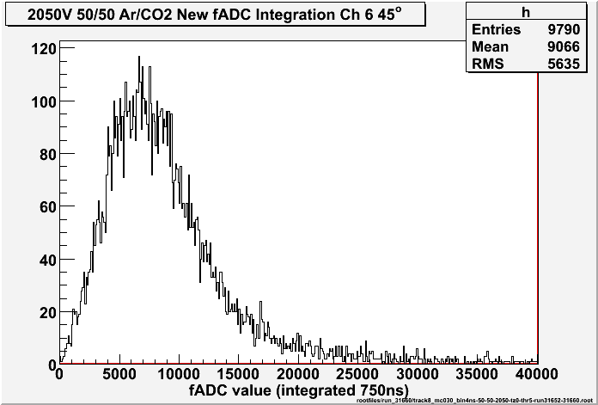
Integrated amplitude histogram
CDC Update
Subtract mean pedestal from ADC values
Select event where ADC value rises above a threshold (5 sigma): hits
Sum the ADC values from the threshold crossing point out to 664ns later

Slide 15
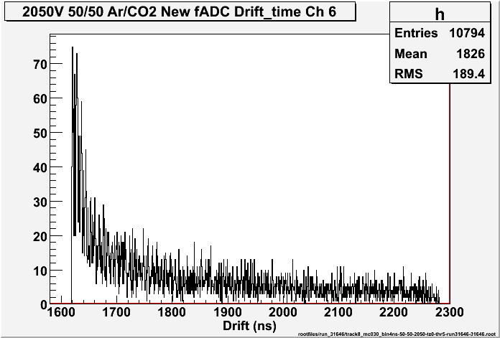
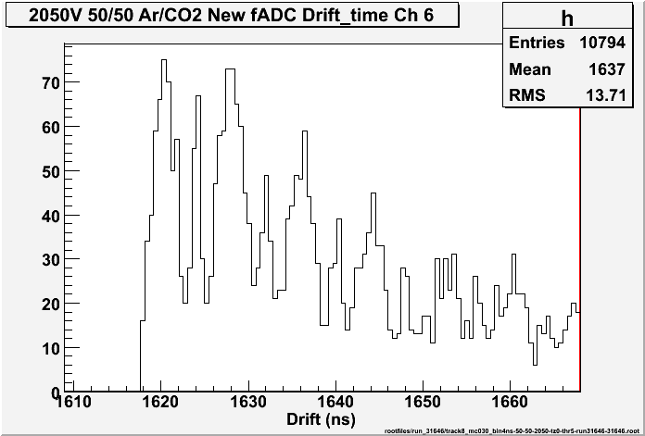
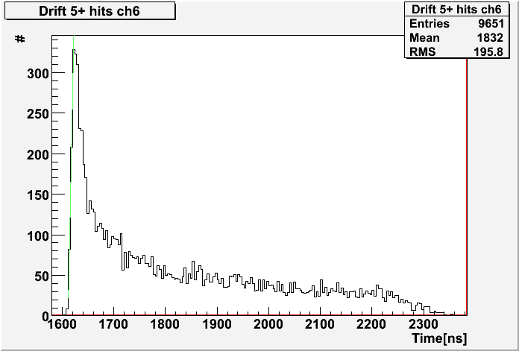
Drift-time histogram
CDC Update
Define leading edge in ADC data (bins with step > 0.3 x max step)
Extract time by DCOG (average of leading edge bins weighted by step size)
Select events with 5 or more hits
Histogram drift times and extract t-zero from histogram: fit leading edge/take point on edge

Slide 16
Tracking
CDC Update
Select events with 5+ hits
Use Garfield simulation to convert drift time into distance by interpolation
Find track – look at each pair of hits, calculate 2 possible straight line tracks, include other hits, find the most likely track
Fit track – send the most likely track to minuit to fit radius
Calculate residuals – distance between fitted track radius and interpolated driftdistance, and again after excluding the straw of interest from the fit
Adjust tzero? times < tzero are assigned to tzero

Slide 17
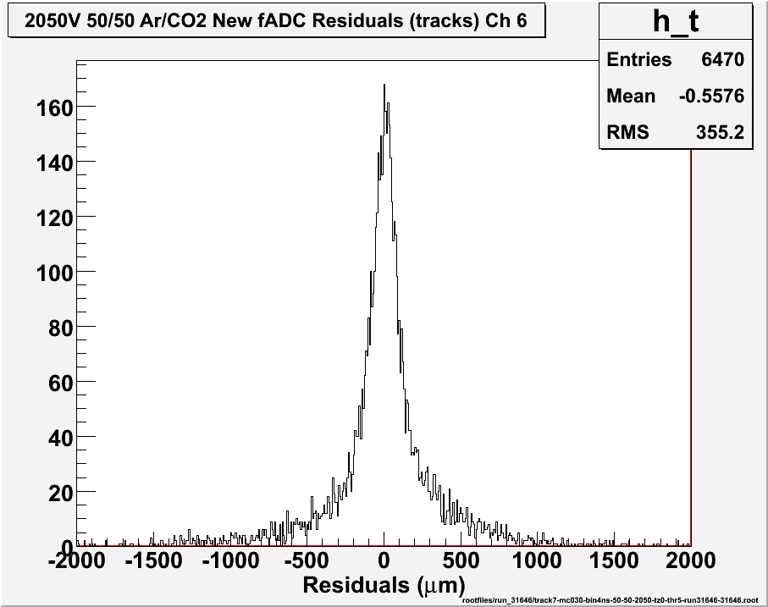
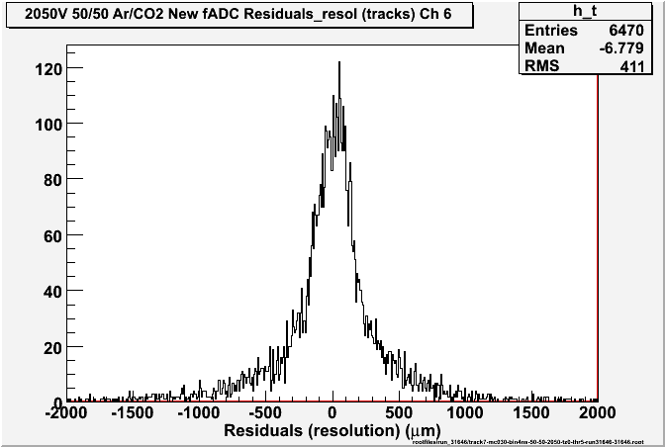
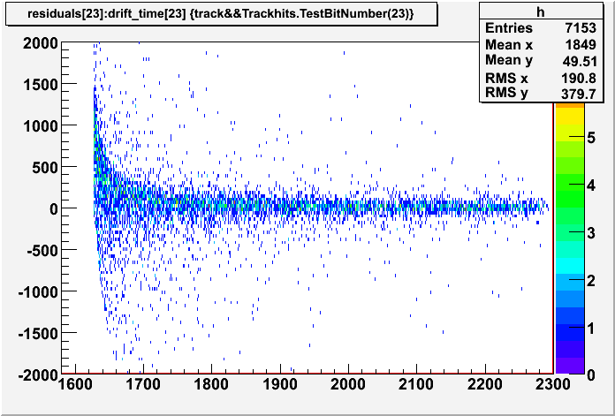
Resolution
CDC Update
Prototype horizontal, tzero = maximum bin in drift time histogram

Slide 18
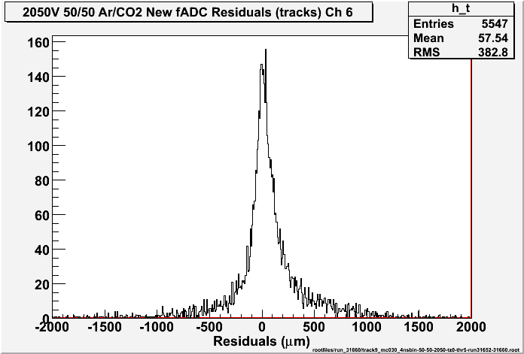
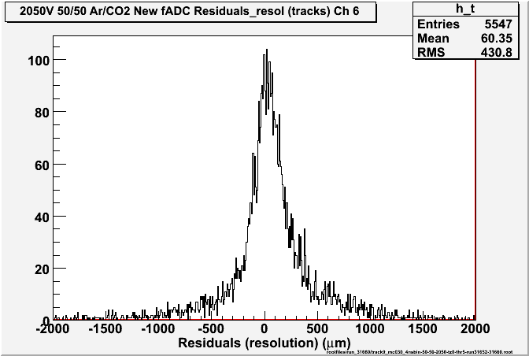
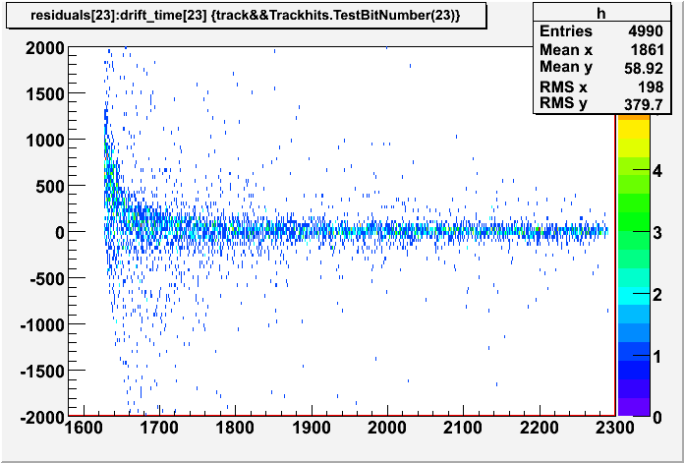
Resolution
CDC Update
Prototype 45°, tzero = maximum bin in drift time histogram

Slide 19
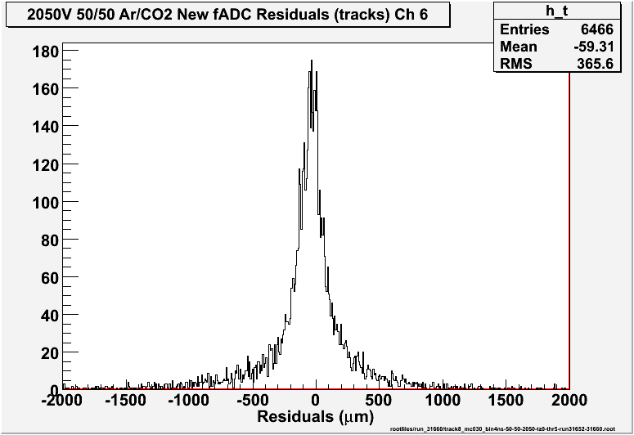
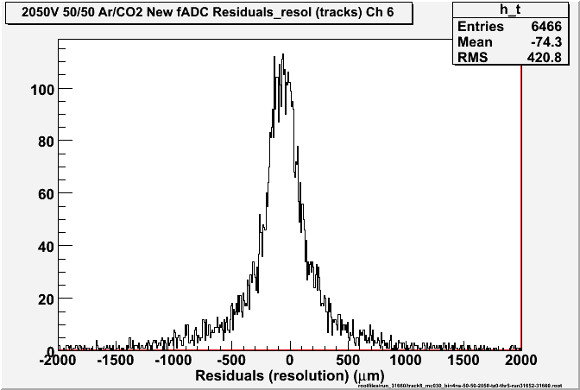
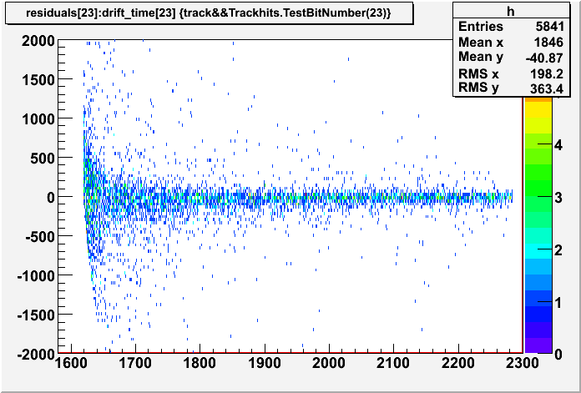
Resolution
CDC Update
Prototype 45°, tzero = half-way up leading edge of drift time histogram
Leading edge: counts>10% of max counts, fit to straight line, find start

Slide 20
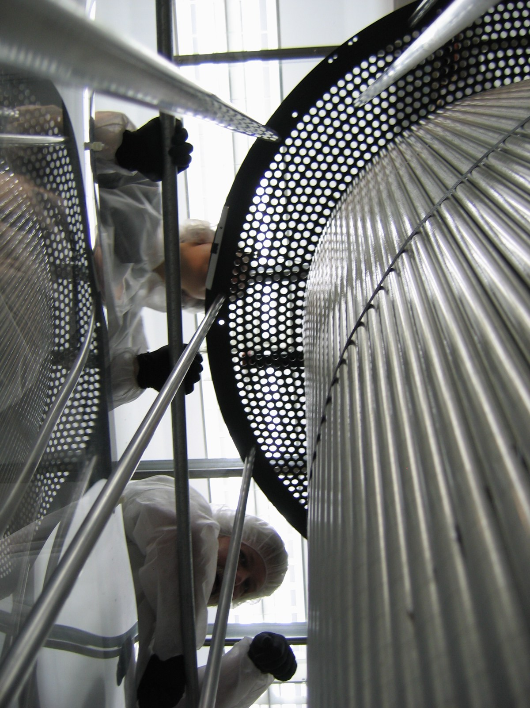
What next?
CDC Update
Prototype
Tune the timing methods
Put algorithm onto fADC
Revisit integration method
Revisit gas mix and flow rates
CDC Phase 2
Straw installation
Also need to install gas lines and shell.
Wire tension tests
Phase 3 Stringing (2011/2012)
Phase 4 Electrical hookup
Some details to be finalized
Remaining:
Operational testing, transport

