Slide 1
FDC/CDC Gas System Controls
P&I Diagram
Gas Room Controls
Gas Panels Controls in the Hall
GUI
Oxygen Sensor Cart

Slide 2
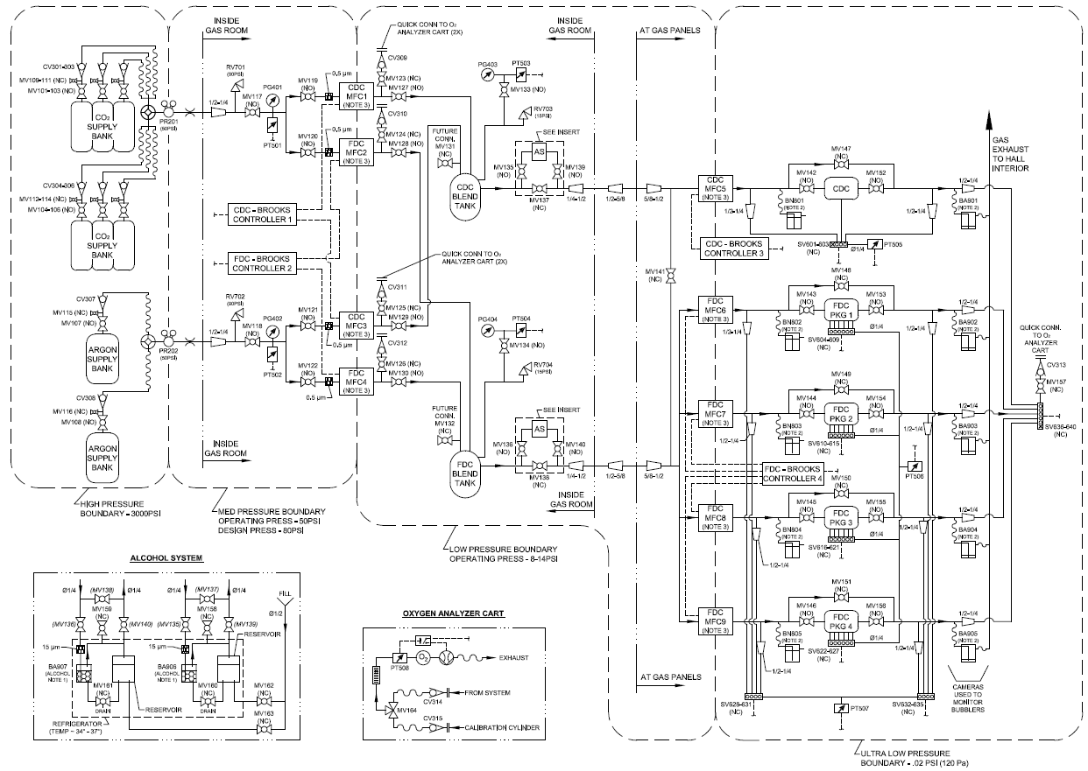

Slide 3
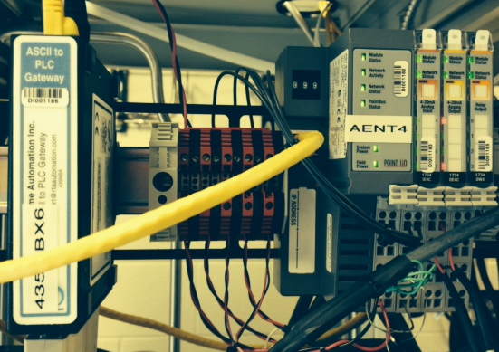
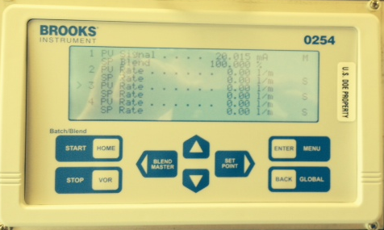
Gas Room
Brooks Controllers
Read Back the flow rate (Complete)
Send ON/OFF flow signal to Master channels (4-20mA signal from PLC). Triggered from the blend tank pressure, 12 psi is OFF and below 7 psi ON. (Complete)
Read back the flow Set Point (Working)
Set the flow Set Point (Working)
Pressure Monitor and Control
Read Back PT501 and PT502 (~50 psi +/- 2 psi)(Complete)
Read Back PT503 and PT504 to control Master Channels flow(Complete)
RS 232
4-20mA Master Signal

Slide 4
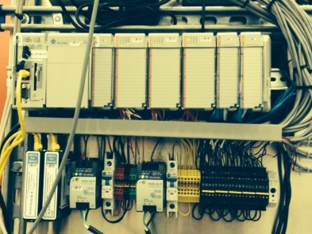
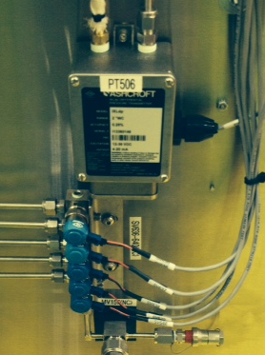
Gas Panel in the Hall
Brooks Controllers
Read Back the current flow rate (Complete)
Read back the current flow Set Point (Working)
Set the flow Set Point (Working)
Pressure Monitor and Control
Read Back PT505 , PT506 and PT506 (Complete)
Automatically cycle FDC/CDC Solenoid Valves to take Cell and Package pressure measurements (Complete)
Allow manual control of individual solenoid valves for troubleshooting and purge operations (Complete)
Initiate Alarms based on over or under pressure situations (Working)
RS 232
Pressure
Valve Control

Slide 5
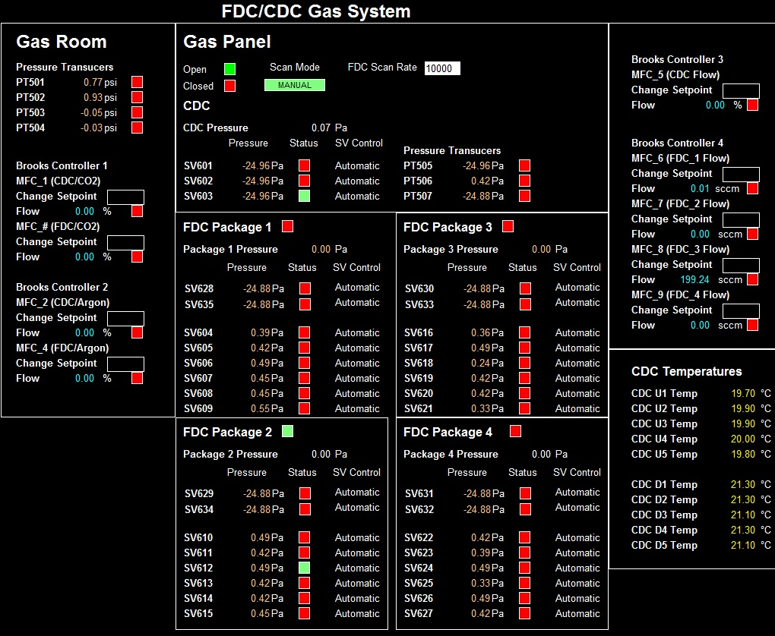
GUI

Slide 6
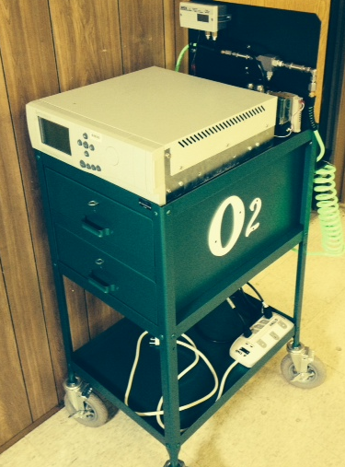
Oxygen Sensor Cart
Servomex
Determine frequency of testing required
Open solenoid valve for FDC/CDC testing (Not Started)
Read back oxygen content (Not Started)
Redundant code to shut valves if pressure drops below zero Pa (Not Started)
RS 232

