Slide 1
CDC Update
Run Coordination Meeting
December 12, 2014

Slide 2
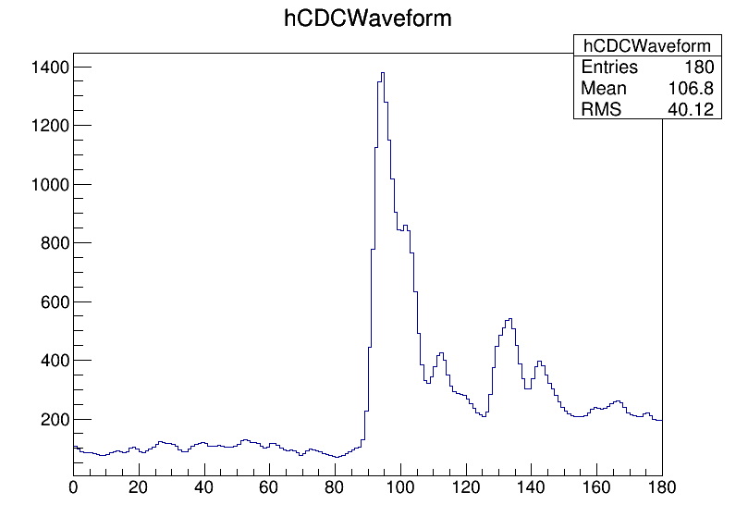
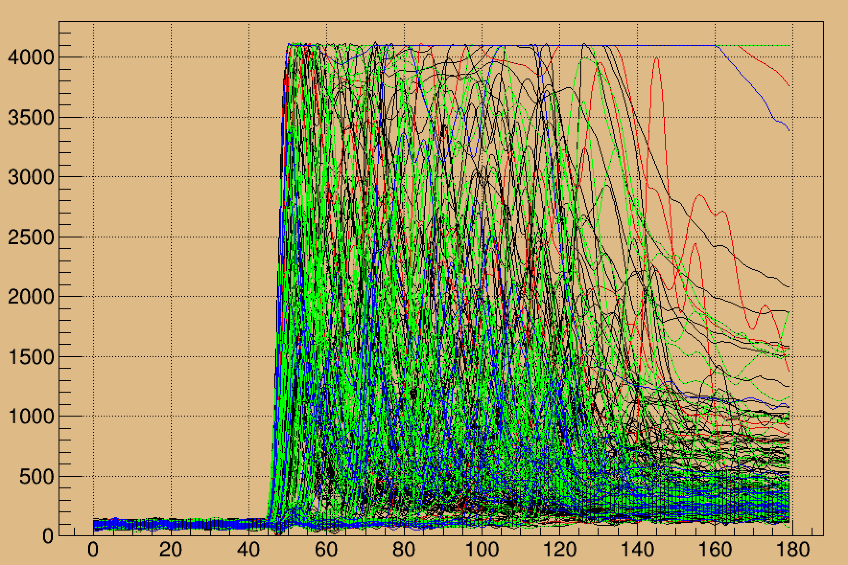
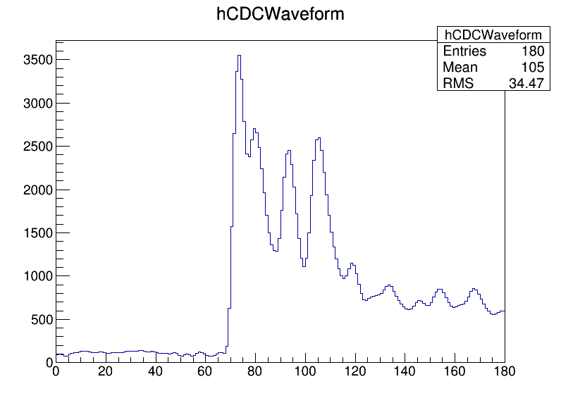
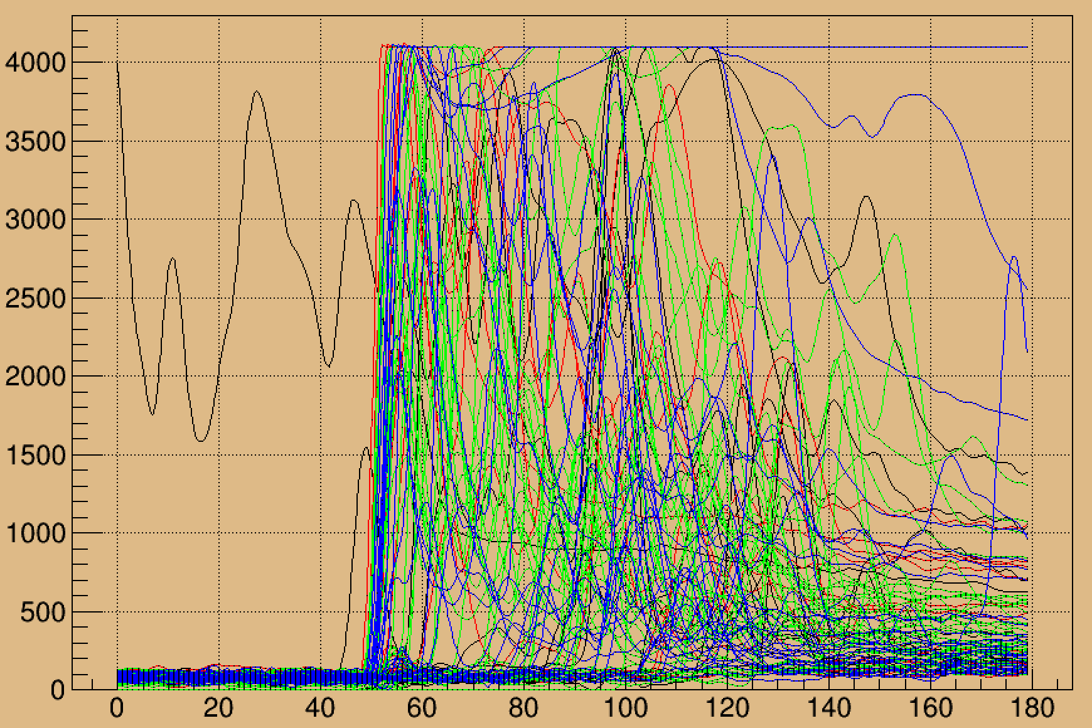
fADC125 Signals
“Tagged” pion from dE/dx
50nA 10⁻⁵ radiator (Run 1505)
“Tagged” proton from dE/dx
100nA 10⁻⁴ radiator (Run 1561)

Slide 3
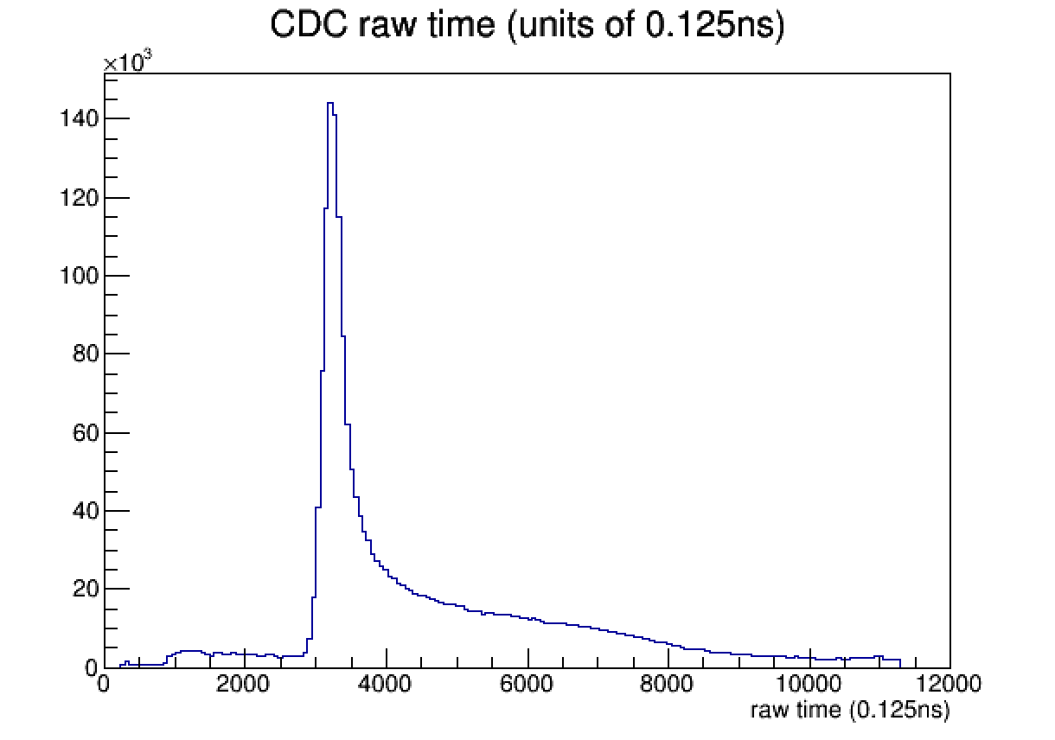
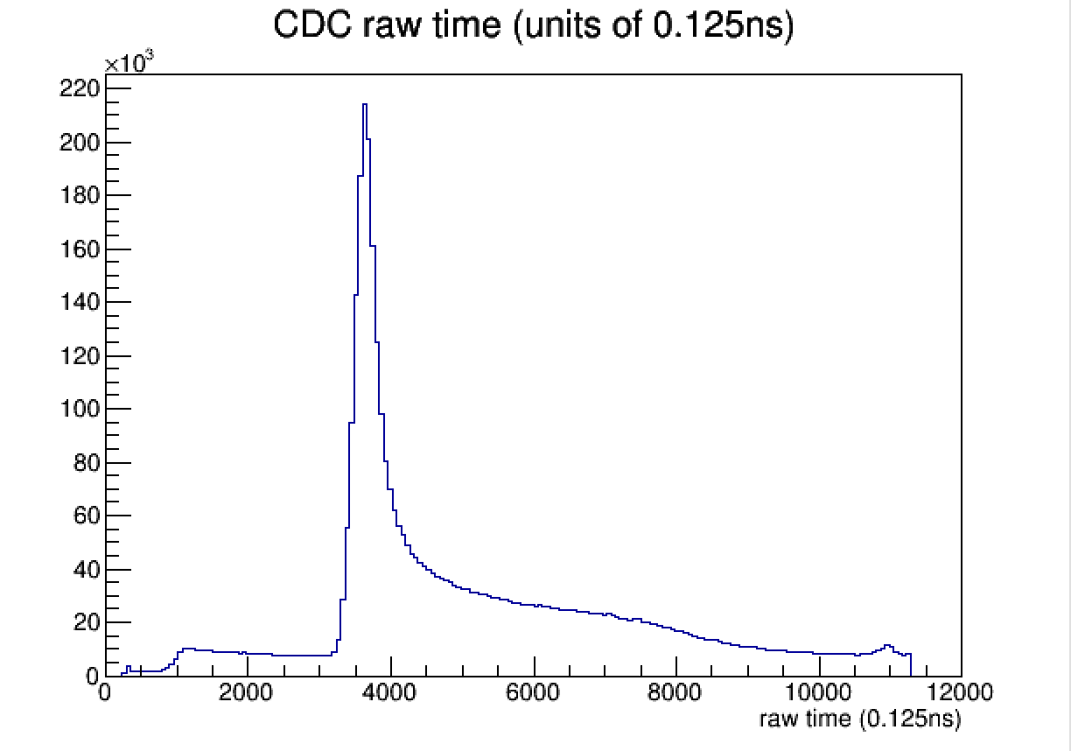
fADC125 Timing
50nA 10⁻⁵ radiator (Run 1505)
100nA 10⁻⁴ radiator (Run 1561)
The signals are within the window. We are capturing up to the maximum drift time.

Slide 4
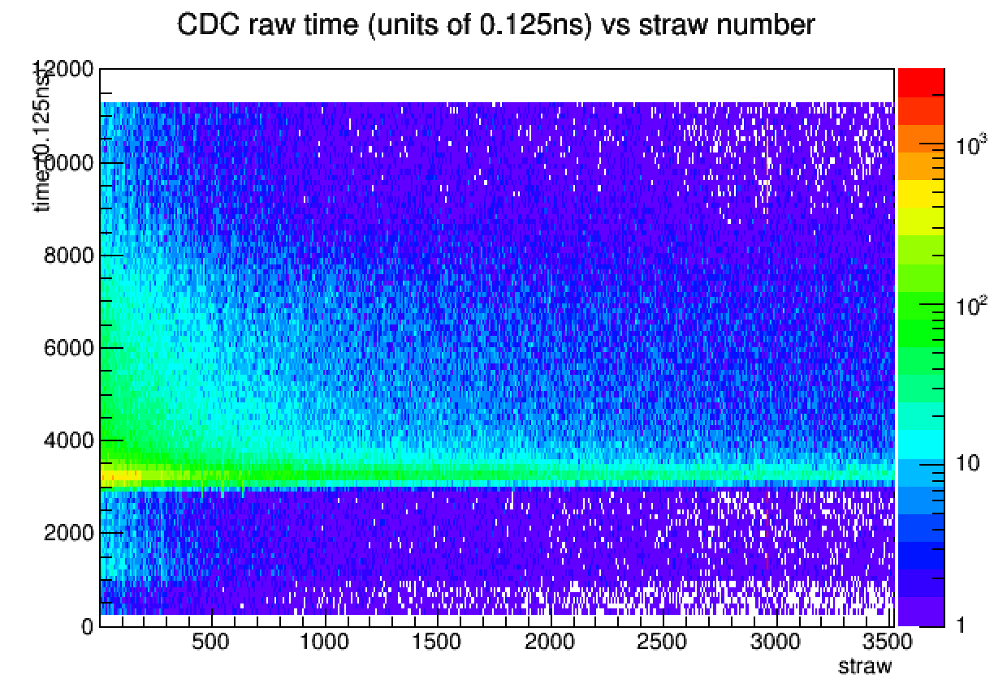
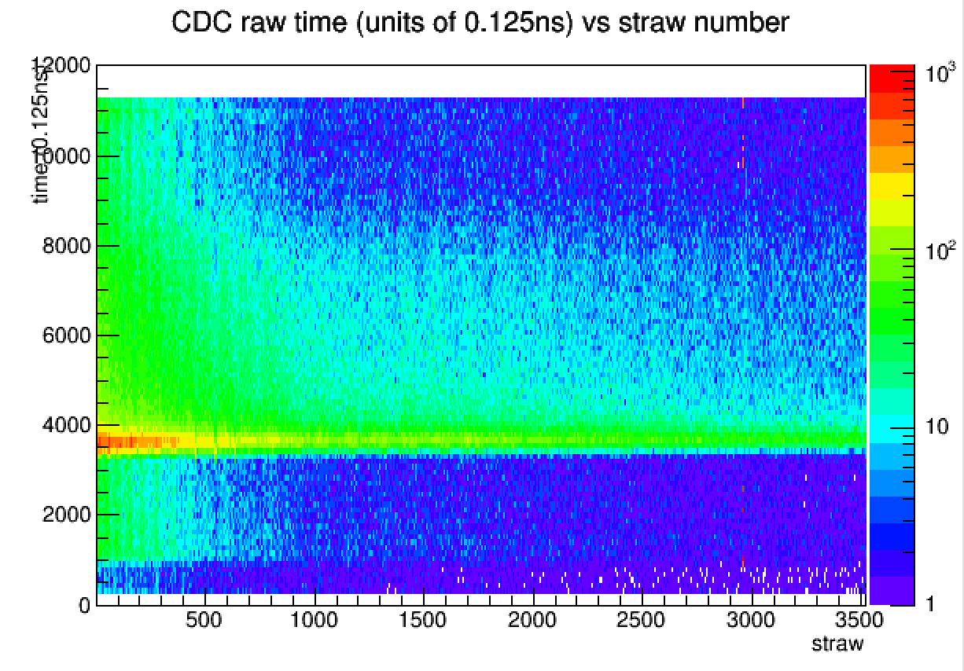
fADC125 Timing
50nA 10⁻⁵ radiator (Run 1505)
100nA 10⁻⁴ radiator (Run 1561)
Lots of noise in this measurement on the inner straws.

Slide 5
fADC125 Pulse Height
High voltage scan from 1975 to 2125 V in 25V steps
These values are higher than expected from earlier running with cosmics…

Slide 6
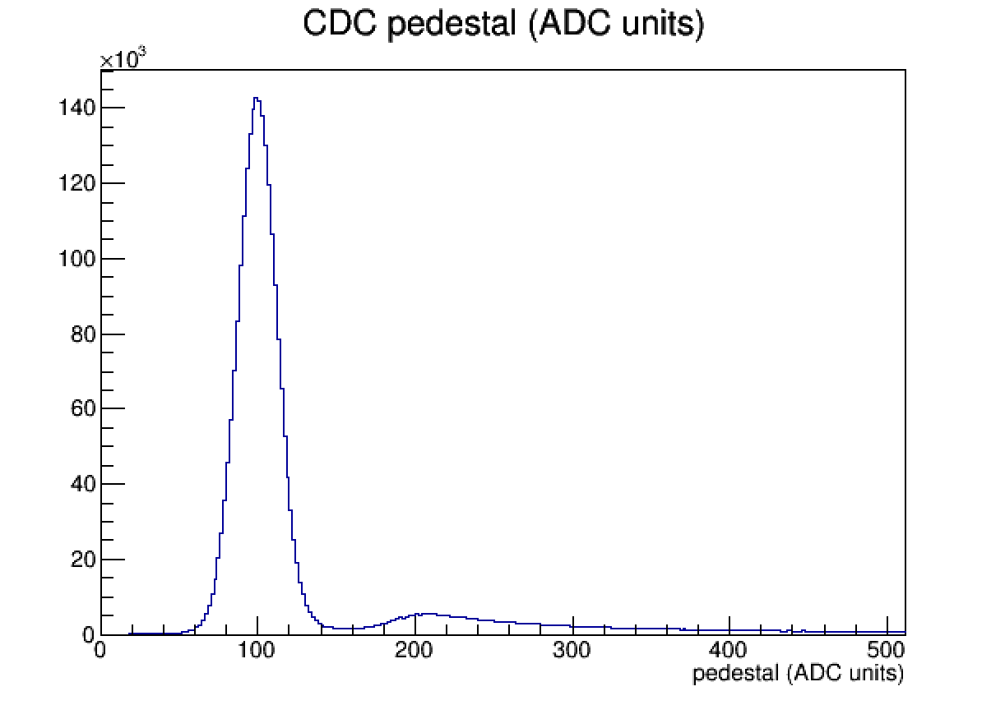
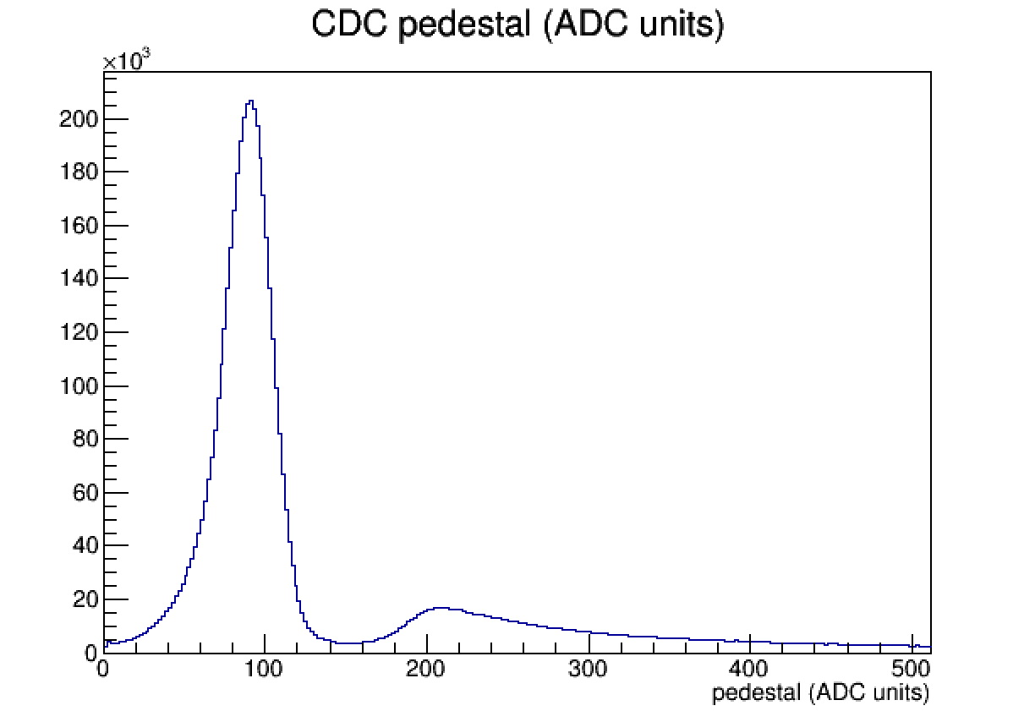
fADC125 Pedestals
50nA 10⁻⁵ radiator (Run 1505)
100nA 10⁻⁴ radiator (Run 1561)
Since our noise is so high, we are not as sensitive to small changes in the pedestal value as some other detectors. Pedestals were last set before Thanksgiving, have not drifted substantially. Weekly calibrations should be adequate, but pedestals should be monitored for outliers.
The sparsification threshold is currently set to 7x the baseline RMS per individual channel.

Slide 7
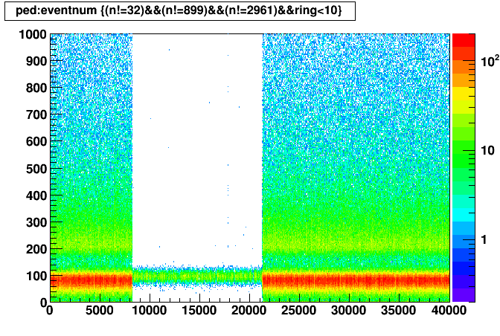
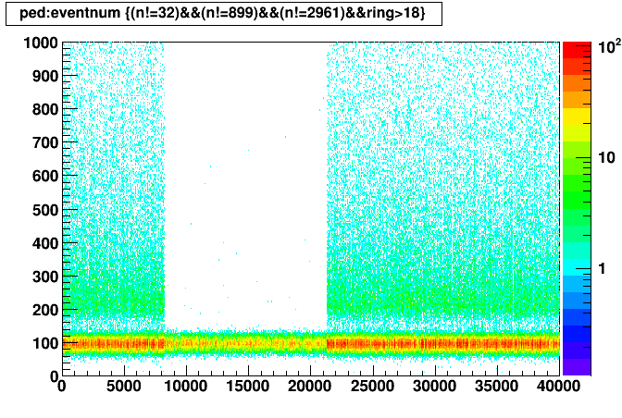
fADC125 Pedestals Run 1802-1843
fADC125 Pedestals Run 1602

Slide 8
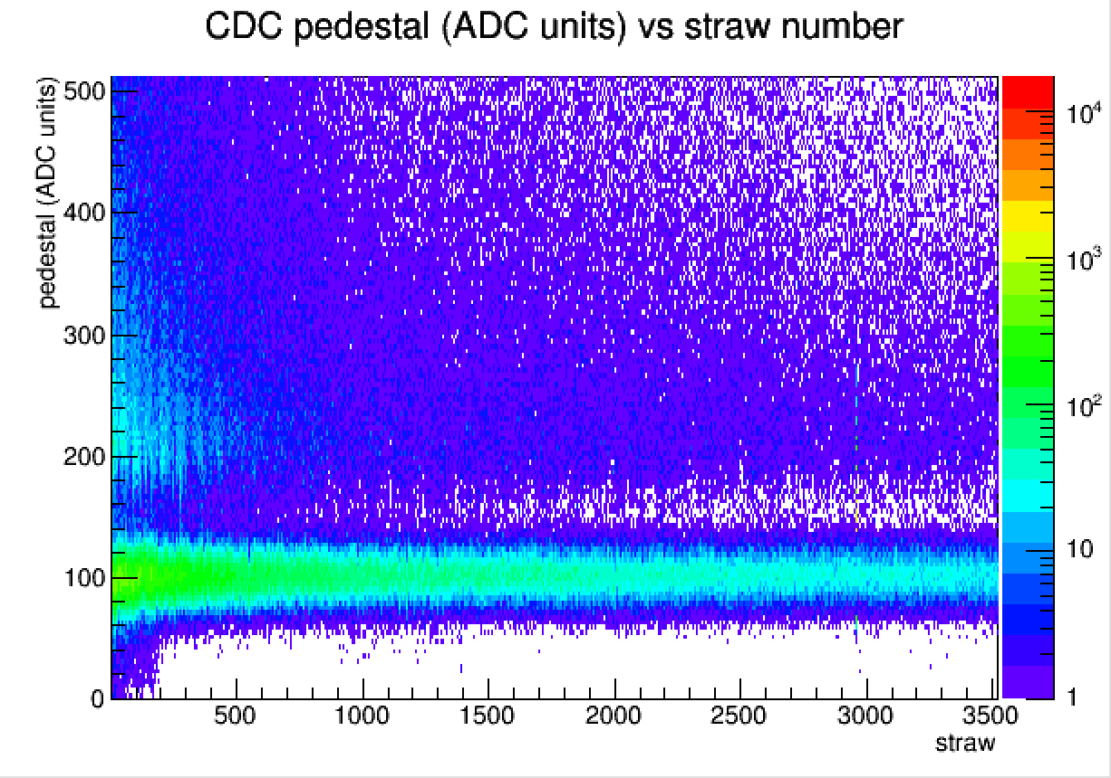
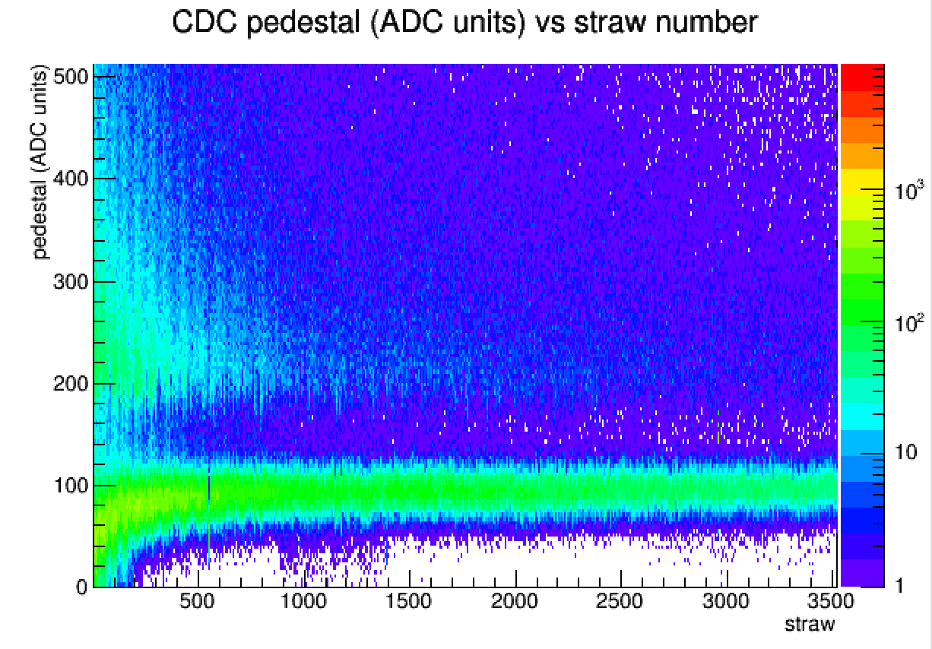
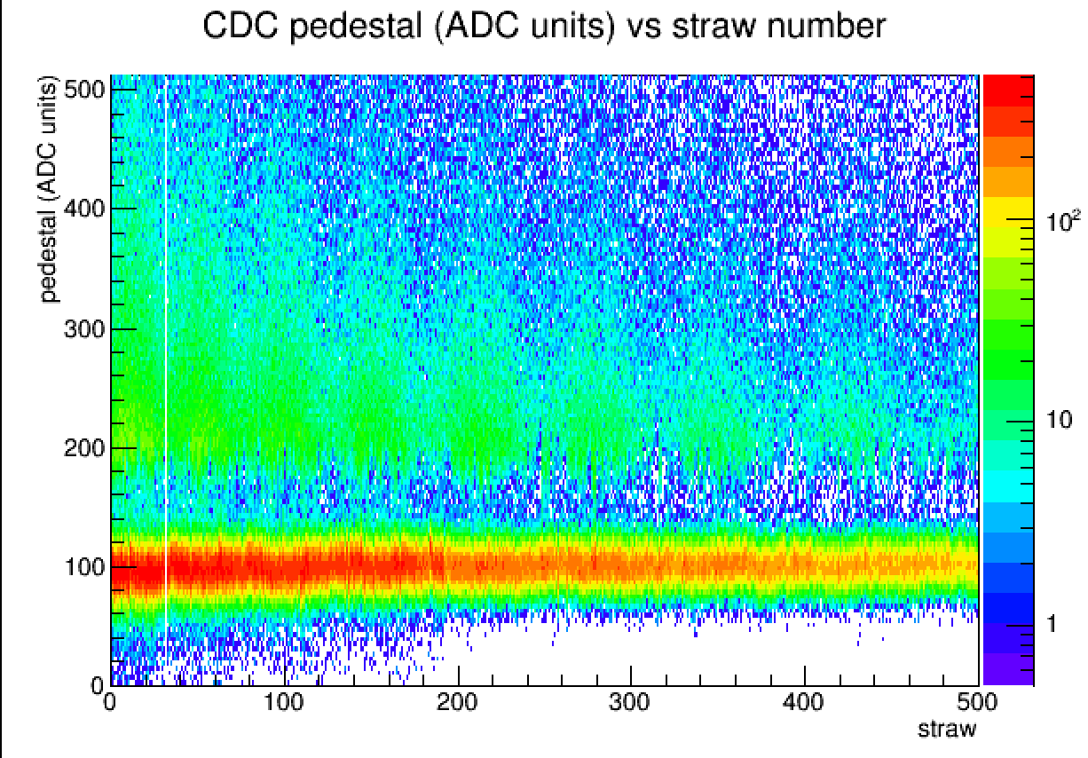
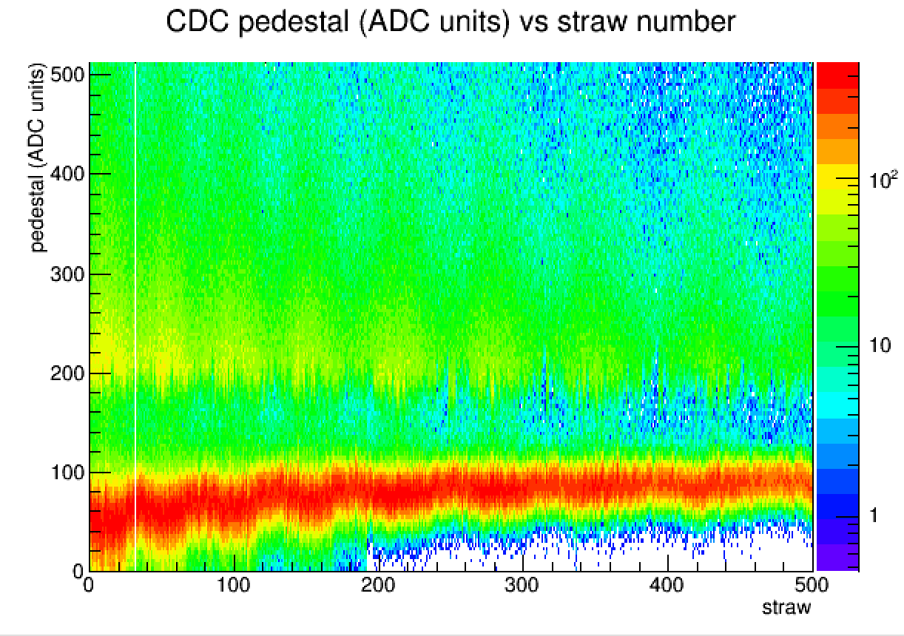
fADC125 Pedestals
50nA 10⁻⁵ radiator (Run 1505)
100nA 10⁻⁴ radiator (Run 1561)

Slide 9
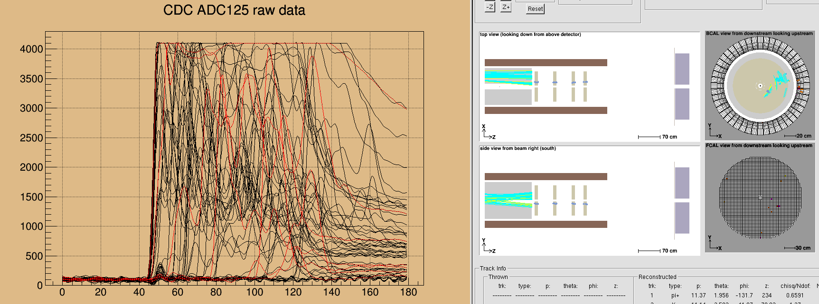
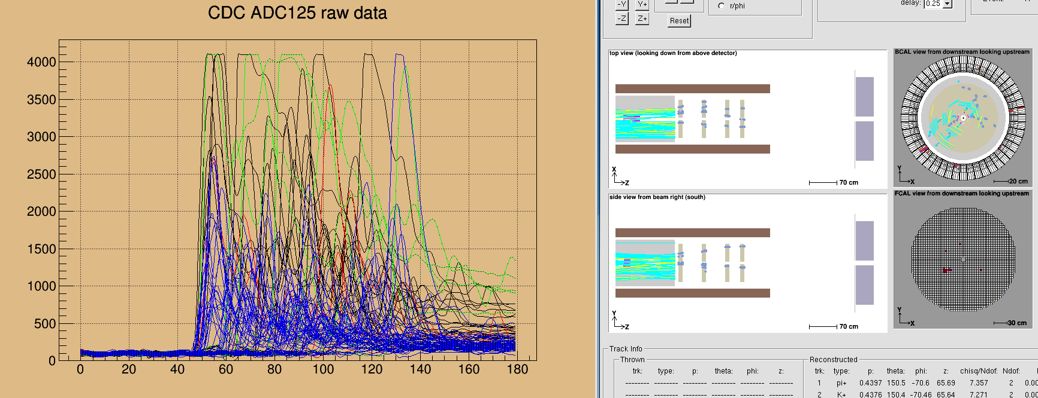

Slide 10
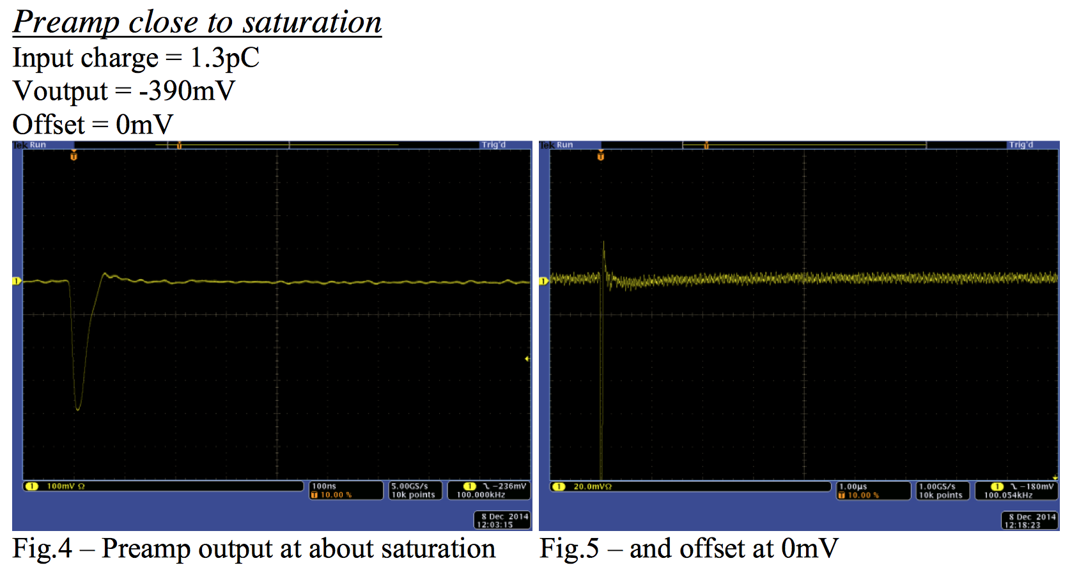
GlueX-doc-2616

Slide 11
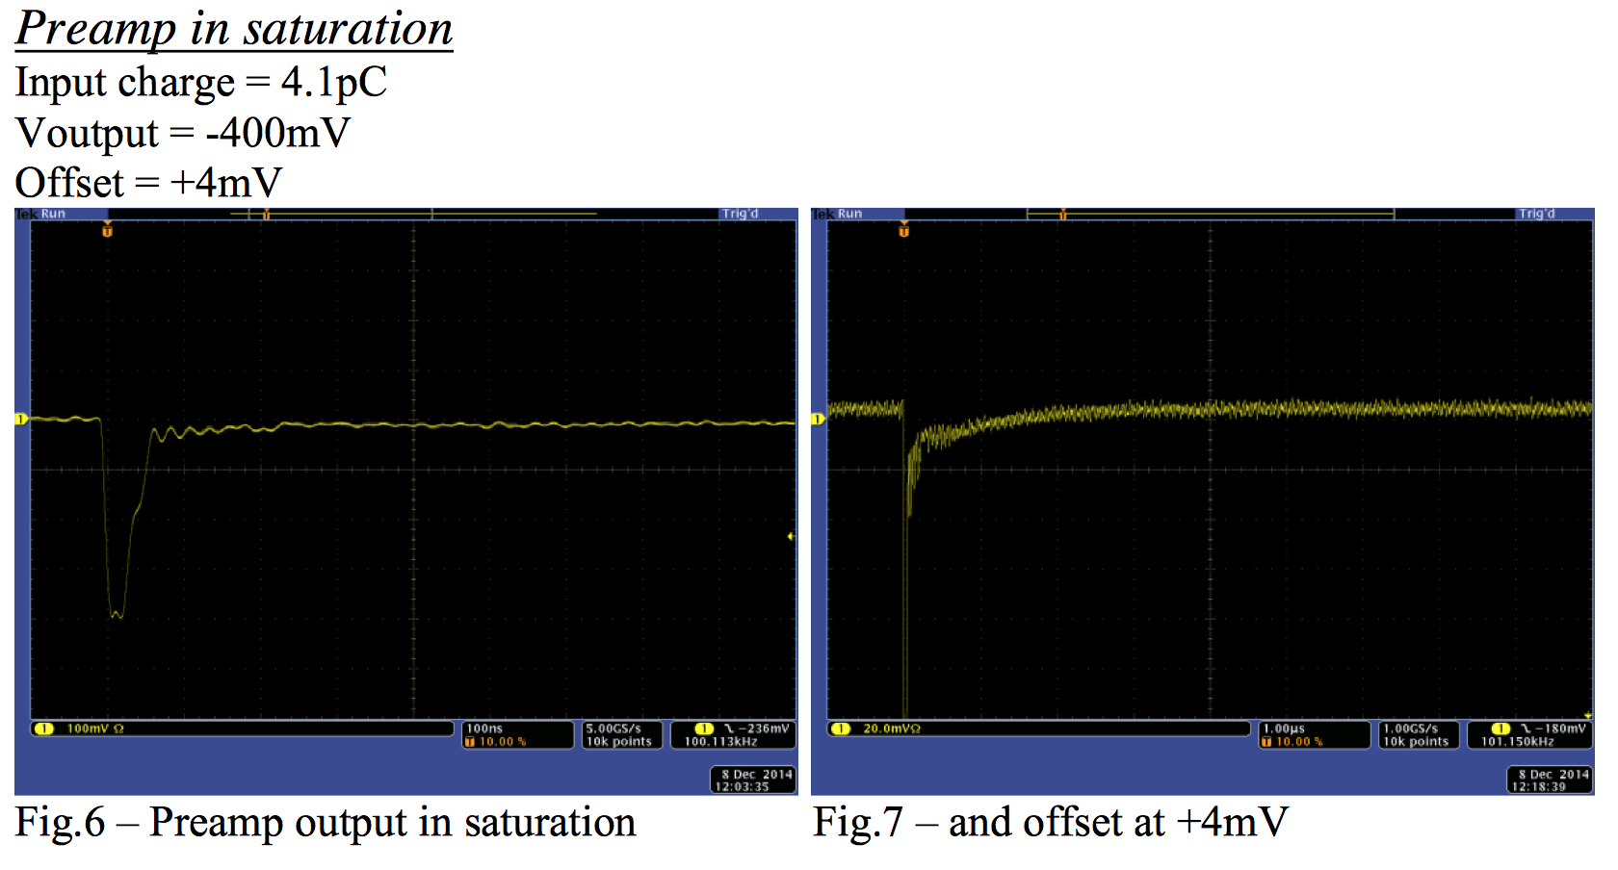
GlueX-doc-2616

Slide 12
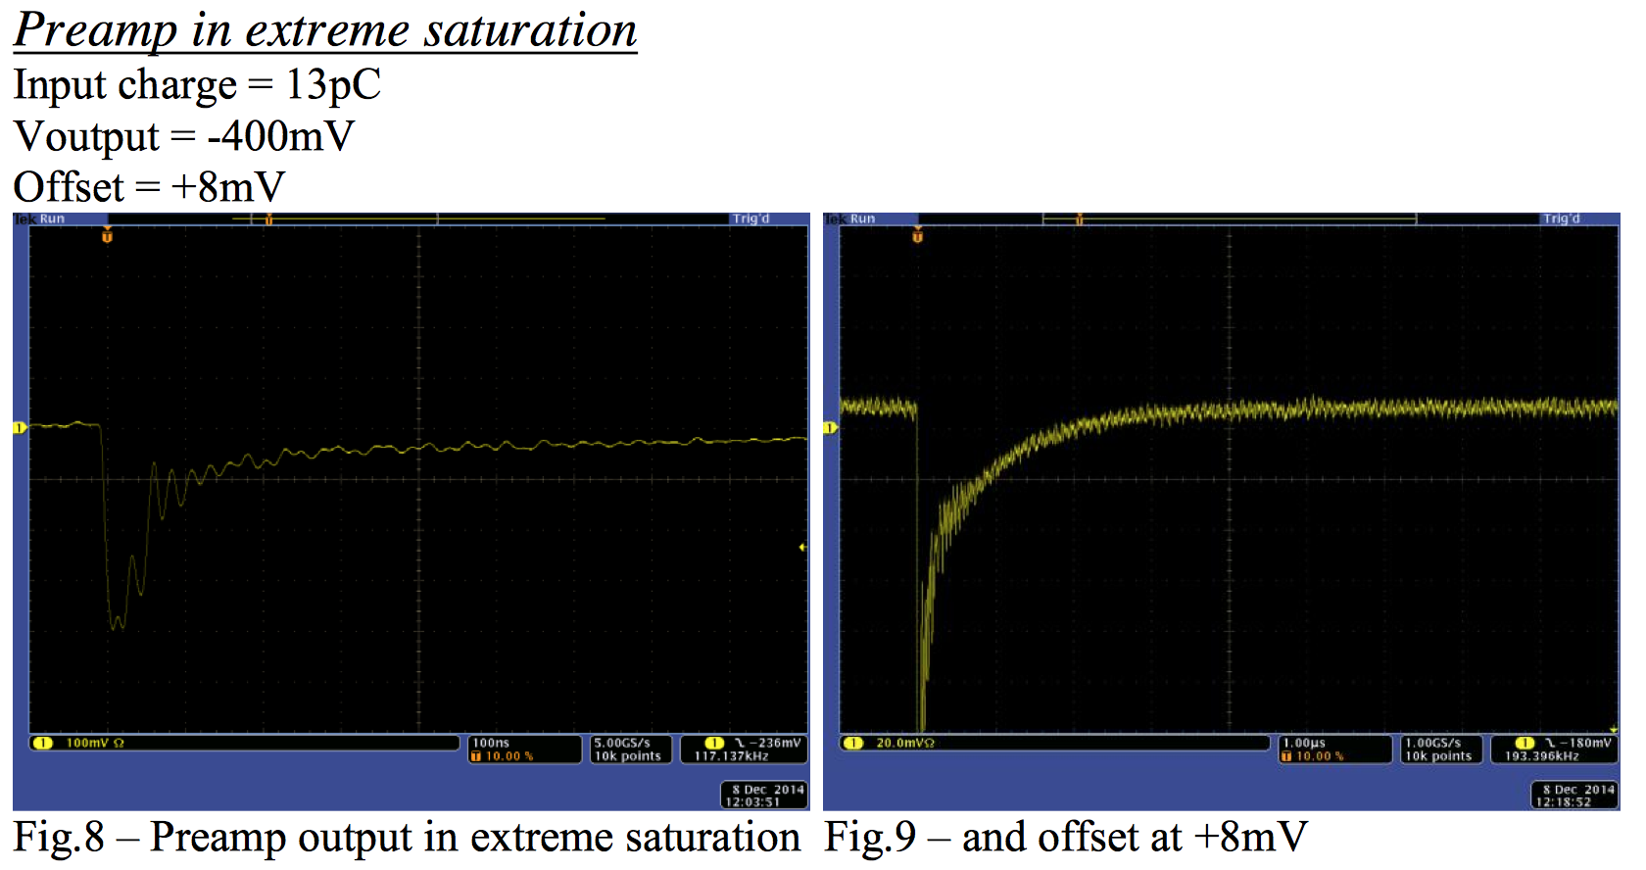
GlueX-doc-2616

Slide 13
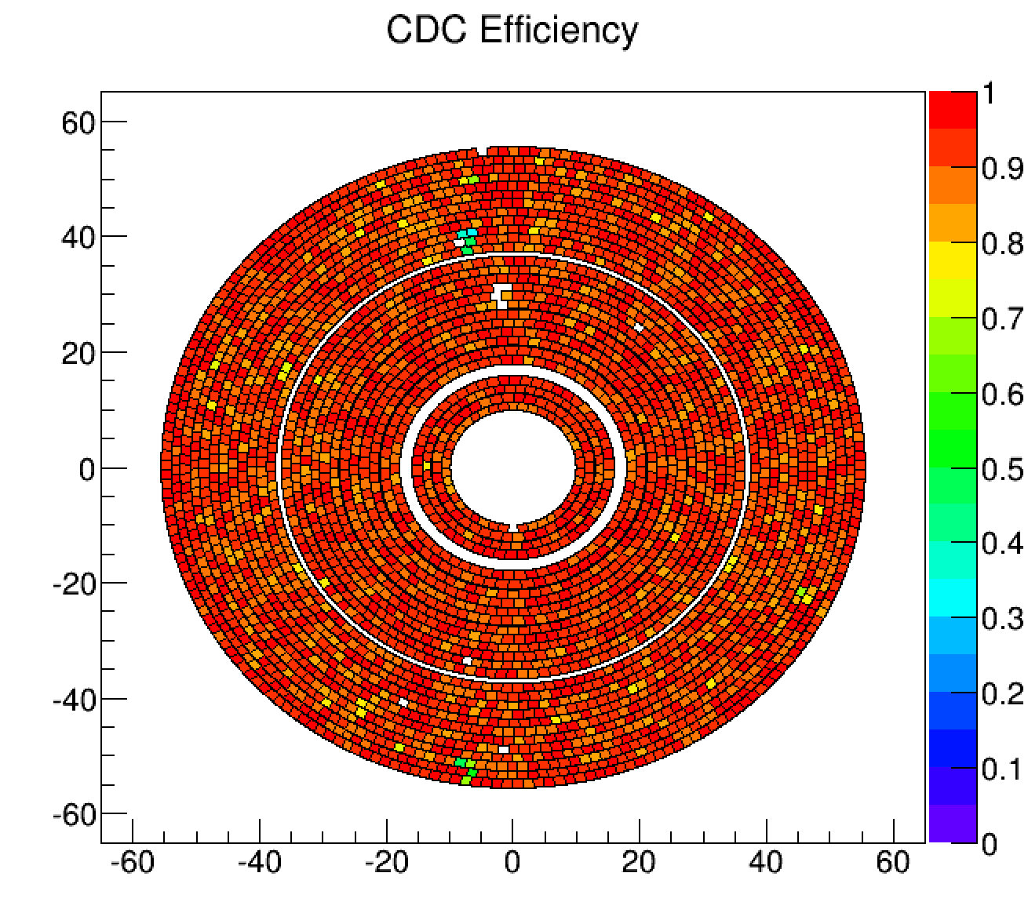
Things to take away from this talk…
CDC has been functioning well in beam thus far, timing distributions are reasonable, tracking finding and fitting is working, trips are low (but the current limit is high).
11 channels with no data due to readout issues which can be likely be fixed after this run period.
Noise in the chamber must be improved, and we need to minimize low angle particles reaching the CDC from upstream to avoid unwanted performance issues.
Pedestal calibrations are stable.
Energy scales need to be investigated.
Questions?

