Slide 1
PID using Boosted Decision Trees on Particle Gun Data
Ricky Dube
University of Connecticut
Department of Physics

Slide 2
Goal: Identify which particle left a track or shower
Identification typically requires cuts based on dE/dx, shower properties, TOF, DIRC, etc.
For higher energies, it is more difficult to obtain a positive ID based on these cuts
Can machine learning give a more accurate ID than manual methods?

Slide 3
Evaluating the potential of Machine Learning for PID
To determine how powerful Machine Learning can be, we can consider a sample of idealized events:
Particle Gun events- only one particle present
Only consider particles that left tracks/showers
Only consider particles that do not decay before creating a shower/track
Expect very high accuracy- this serves as an “upper bound” on accuracy for unfiltered data
Can a boosted decision tree produce similar or superior results to manual PID methods?

Slide 4
Purification of Particle Gun Data
Cuts on events:
Time of first vertex must be after the time of first shower/track
If particle is charged, must be at least one track in event
If particle is neutral, must be at least one shower in event
Cuts on dE/dx (CDC) and TOF (based on BCal shower time) in low energy samples
Truth information was not sufficient to purify the data, because nuclear interactions are not included. Thus cuts on dE/dx and TOF were used to remove tracks that correspond to particles that were not generated by the particle gun.
In high energy events, no cuts on any of the training parameters were made
Will affect accuracy, as it is more likely that the test data is misclassified

Slide 5
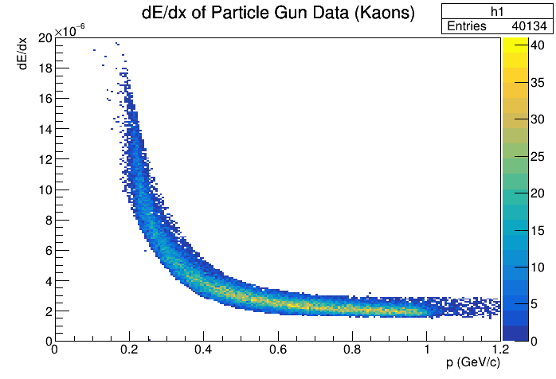
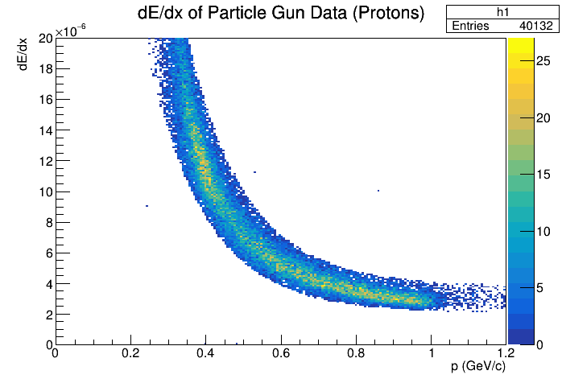
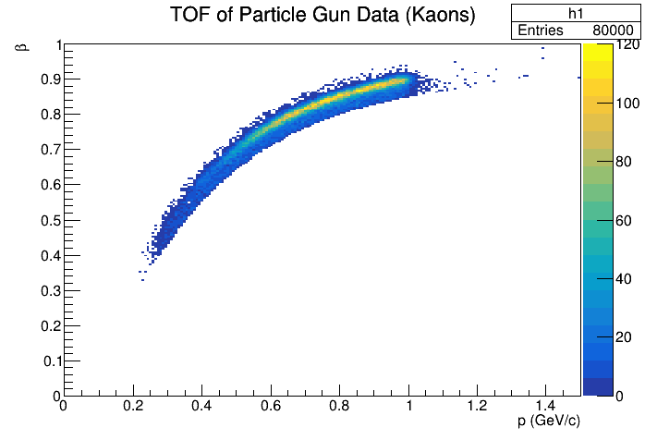
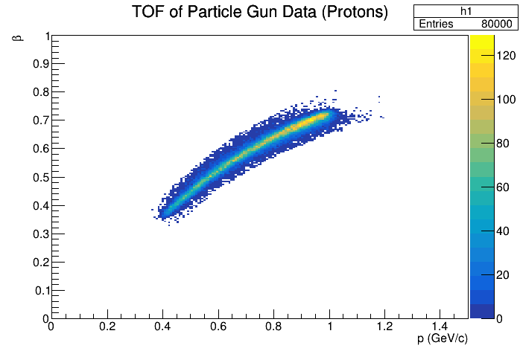

Slide 6
Boosted Decision Tree
Tensorflow Boosted Decision Tree with a maximum of 500 trees, each with a maximum depth of 12 nodes
Trained using 80k of each particle type
Photons, electrons, pions, kaons, protons, antiprotons, klong, neutrons
28 total parameters:
Track parameters: Charge, dE/dx, p
Shower parameters: Eshower, sigLong, sigTrans, sigTheta
SC, FTOF, DIRC parameters are included as well

Slide 7
Boosted Decision Tree: Identification Process
BDT
Prediction: Neutron
74% confidence
Shower

Slide 8
Boosted Decision Tree: Identification Process
Final ID: π (only prediction that matches hypothesis)
Hypothesis: e
BDT
Prediction: K
74% confidence
Hypothesis: π
Prediction: π
80% confidence
Track
Prediction: e
66% confidence
Hypothesis: K
Hypothesis: p
Prediction: K
84% confidence

Slide 9
Boosted Decision Tree: Identification Process
Final ID: π (highest confidence that matches hypothesis)
Hypothesis: e
BDT
Prediction: e
74% confidence
Hypothesis: π
Prediction: π
80% confidence
Track
Prediction: e
66% confidence
Hypothesis: K
Hypothesis: p
Prediction: K
84% confidence

Slide 10
Boosted Decision Tree: Identification Process
Final ID: no ID (No hypothesis matches prediction)
Hypothesis: e
BDT
Prediction: K
74% confidence
Hypothesis: π
Prediction: p
80% confidence
Track
Prediction: e
66% confidence
Hypothesis: K
Hypothesis: p
Prediction: K
84% confidence

Slide 11
Results
Model evaluated on similarly cut, but statistically independent sample
Low energy model (<1 GeV, particles fired in random direction):
88% average accuracy
“No ID” in under 3% of events
Able to correctly identify photons, electrons, protons, neutrons, pions in over 90% of events
Able to correctly identify K-longs, charged kaons in >70% of events

Slide 12
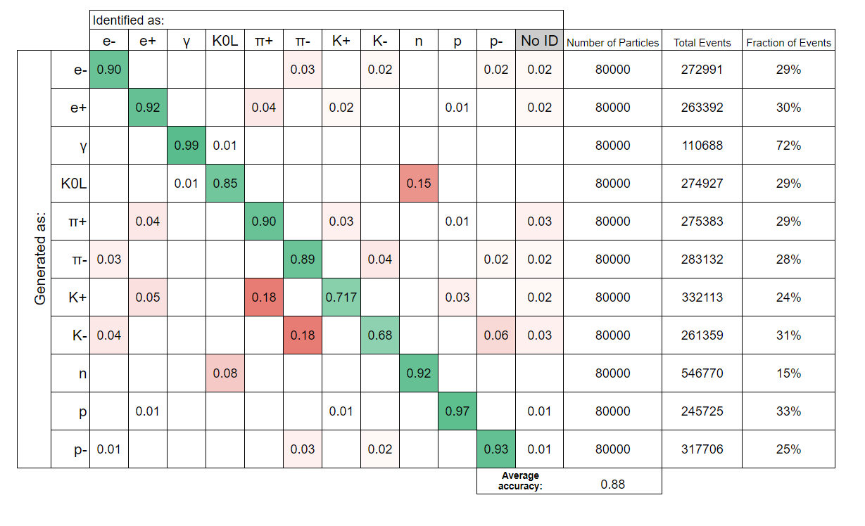

Slide 13
Results
High energy model (1-12 GeV, particles fired into acceptance of FCAL):
66% average accuracy
“No ID” in under 3% of events
Able to correctly identify
photons, electrons, in 98% of events
pions in 80% of events
Klong, protons, antiprotons, and neutrons in 50% of events
Kaons in 30% of events

Slide 14
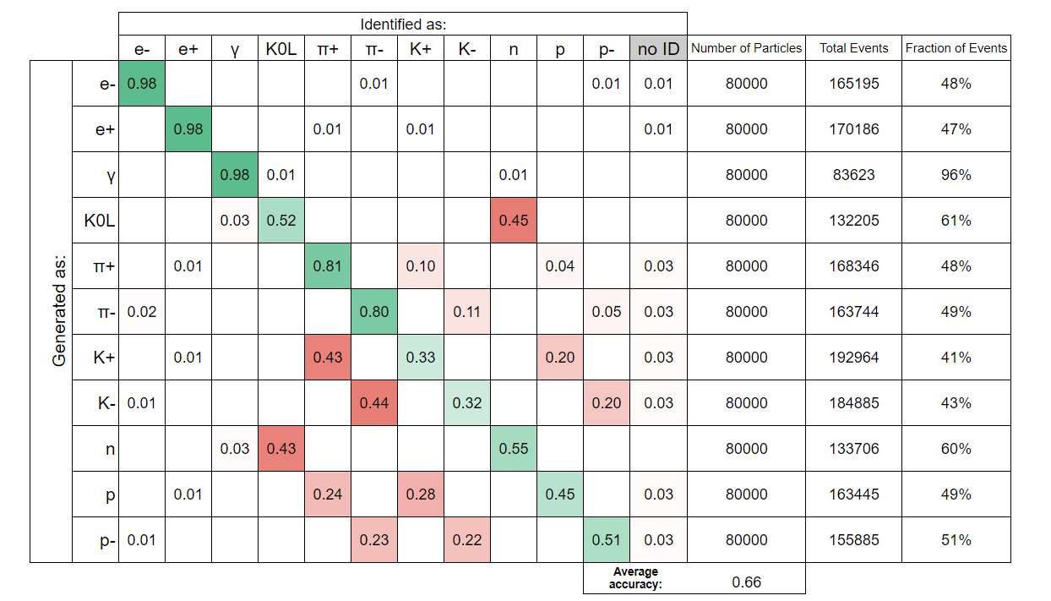

Slide 15
Best Classifiers of Particle Type:
Both models (0-1 GeV and 1-12 GeV) had these top classifiers:
Charge (did the particle leave a track or a shower?)
dEdx (CDC)
tShower
dEdx (start counter)
Eshower

Slide 16
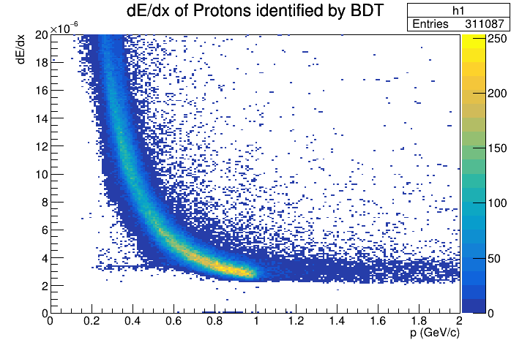

Slide 17
Observations and Next Steps:
Unexpectedly high Klong/Neutron separation
The model seems to be using Eshower and tShower to identify neutral particles, which may be some type of modified TOF. Further investigation is needed to ensure this is effective in events that include decays (or where the vertex timing is unknown).
The model is currently not making effective use of DIRC information
The particle gun data includes DIRC information that does not appear to adhere to experimental results, so a next step will be to investigate the simulation
Moving forward:
Test if increasing number of training events increases accuracy
Improve the labeling of training/test data to obtain a more accurate metric of model power
Find cuts to purify data that do not rely on truth information

Slide 18
Thank you!
Ricky Dube
University of Connecticut
Department of Physics

