Slide 1
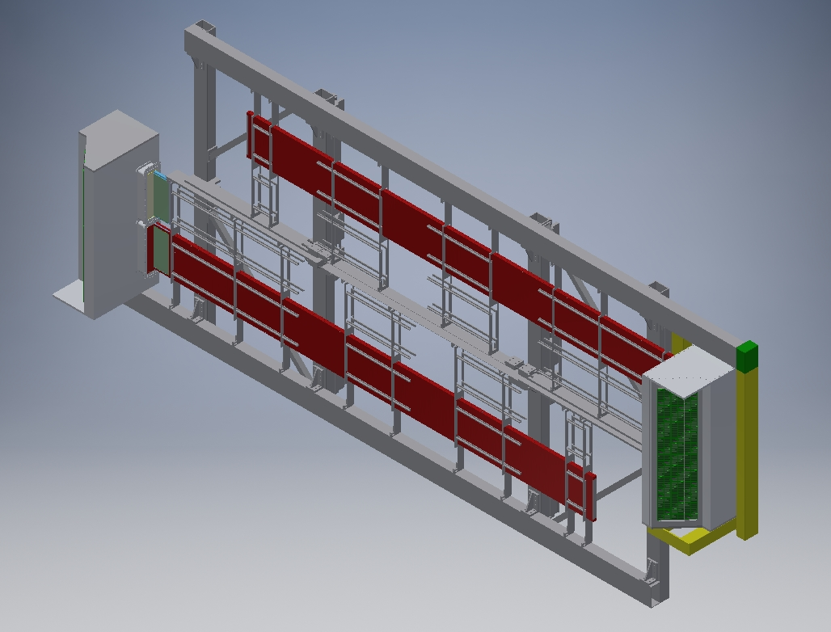
DOWNSTREAM VIEW
BEAM
READOUT BOX LOCATIONS WERE REVERSED TO PROVIDE WORKING ROOM ON NORTH SIDE OF HALL – THIN STRIP SECTION IN CENTER NOW REMOVABLE

Slide 2
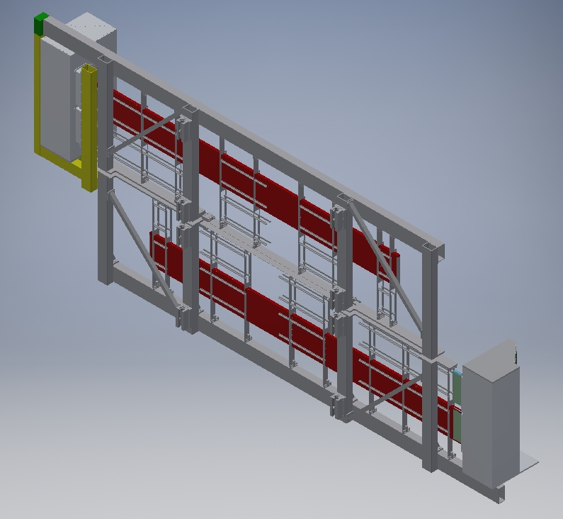
UPSTREAM
LINEAR BEARINGS ARE NOW LOCATED ON THE INNER VERTICAL TUBES

Slide 3
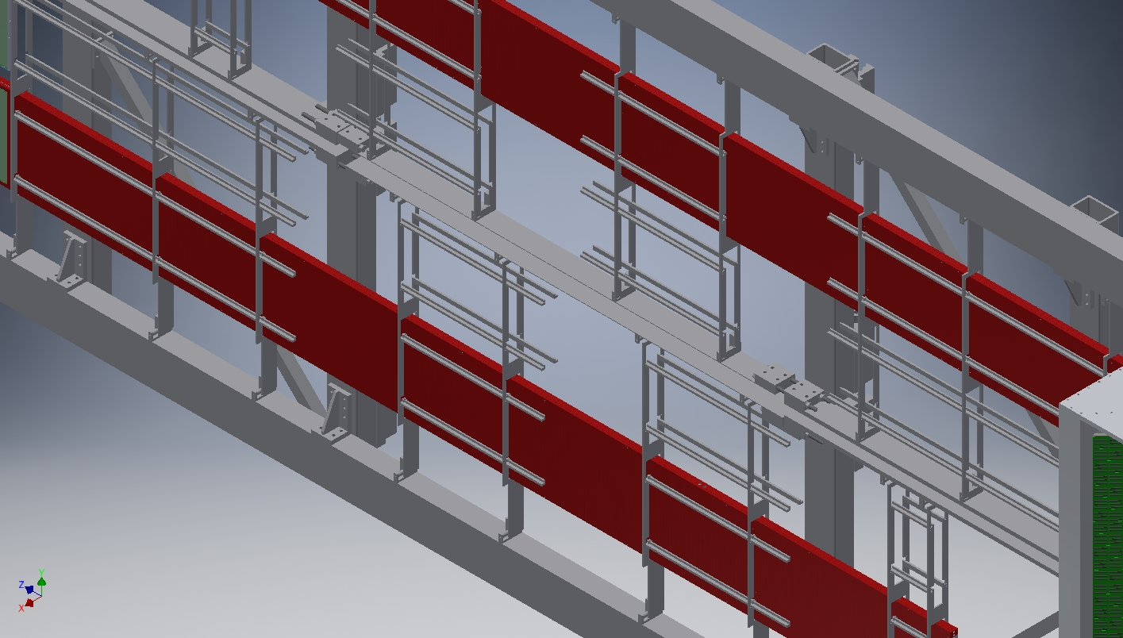
REMOVABLE STRIP DETAIL

Slide 4
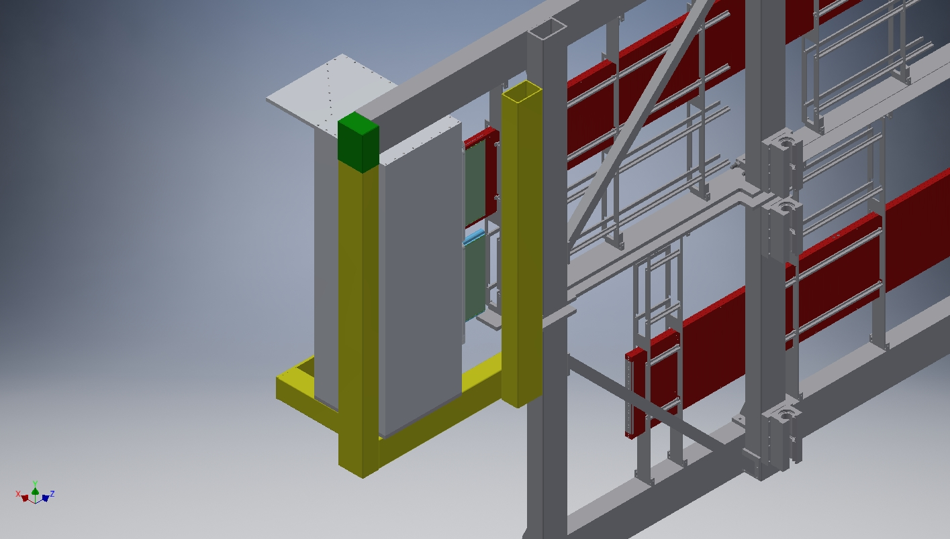
READOUT BOX SUPPORT
NEED TO RE-ENGAGE MIT GROUP, TO FINALIZE READOUT BOX DESIGN – DETERMINE FINAL OUTSIDE DIMENSIONS AND SUPPORT REQUIREMENTS

