Slide 1
Hall D Target System Review
Preliminary Design Work
J. Fochtman September 28,2011

Slide 2
Purpose of Concept Review
Review current concept and calculations
Discuss design challenges and concerns with current concept
Address these concerns in the final design

Slide 3
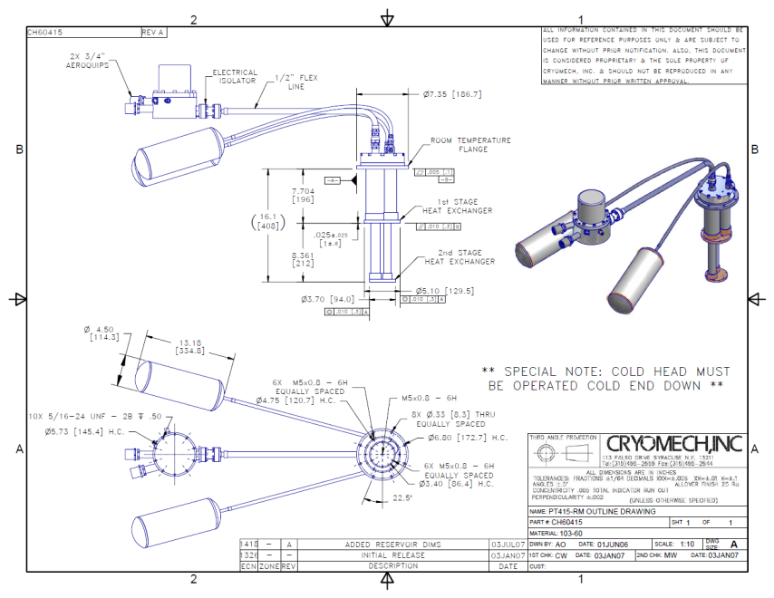
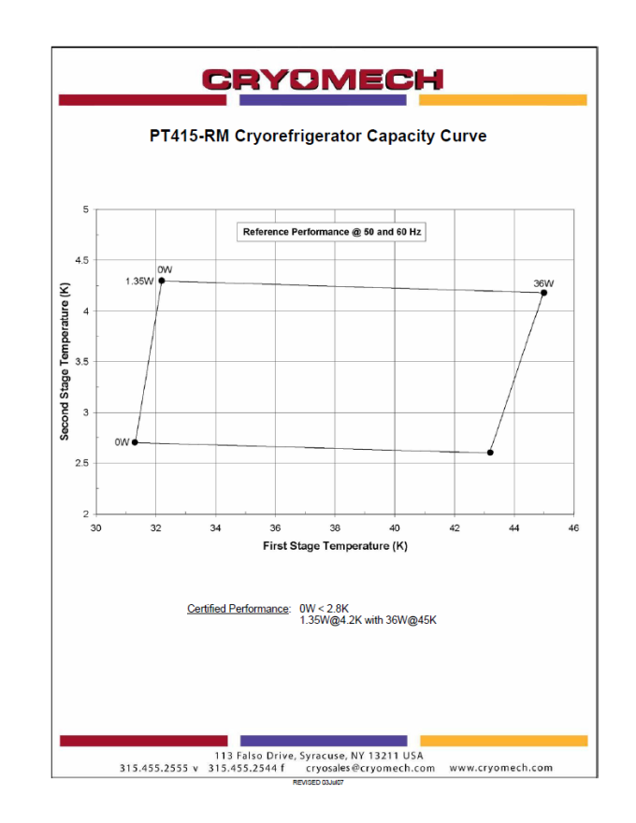
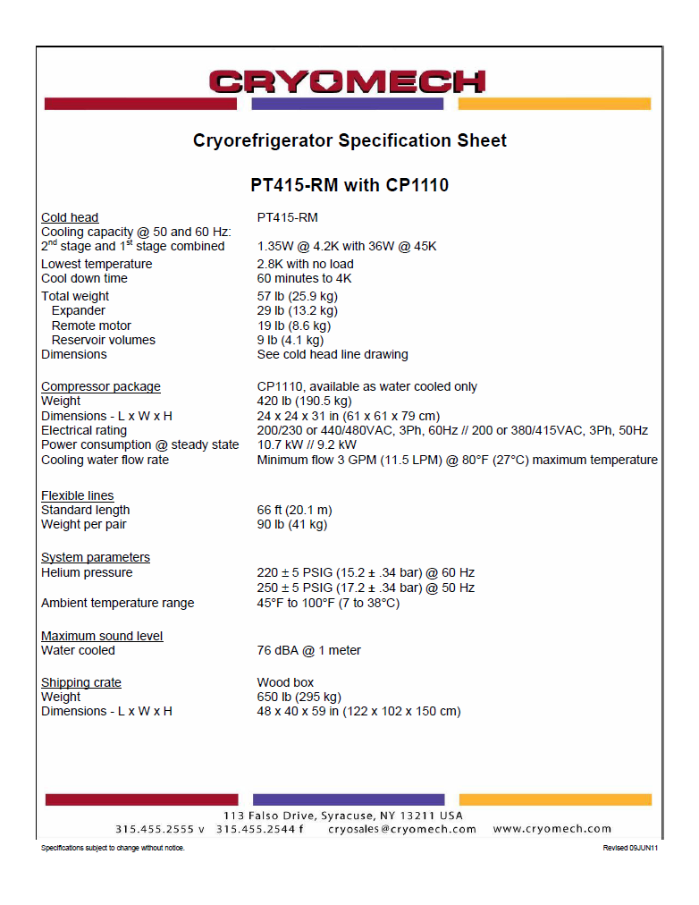
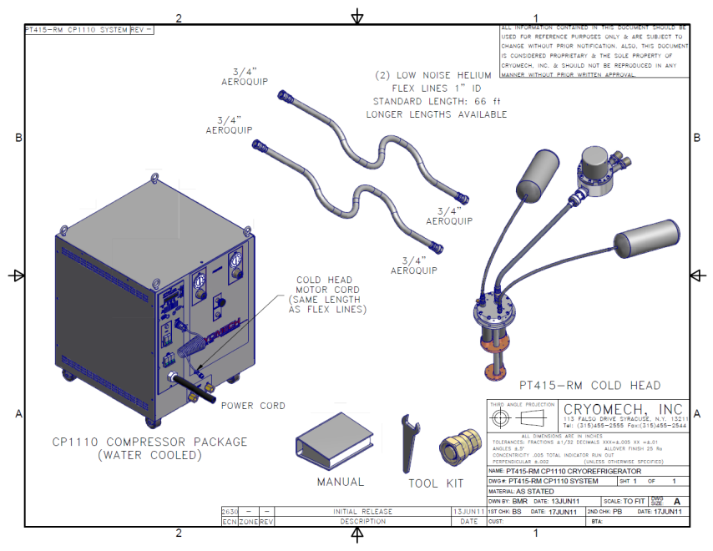
Hall D Target Refrigerator
PR Completed- Current ETA is Mid January 2011
Remote motor option reduces 2nd stage power by 15%. Reduces cold head vibration to ~1µm
Magnetic Field Limitations:
Remote Motor <500 Gauss
Cold Head <1T

Slide 4
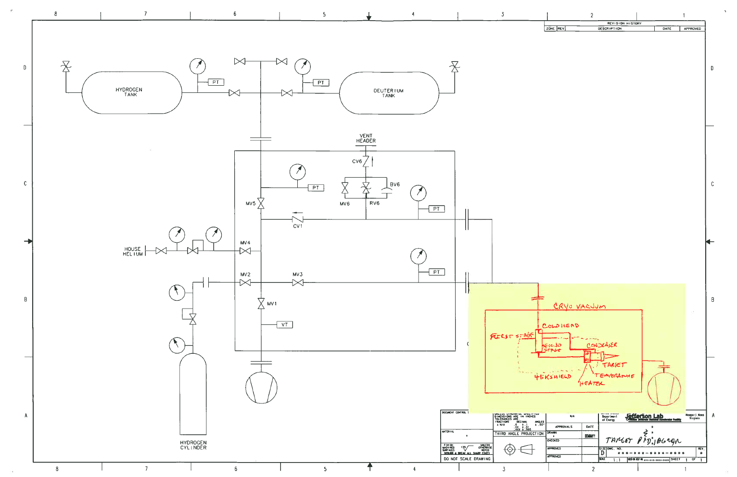
Preliminary P&I Diagram
Can these lines be combined if CV1 is removed?

Slide 5
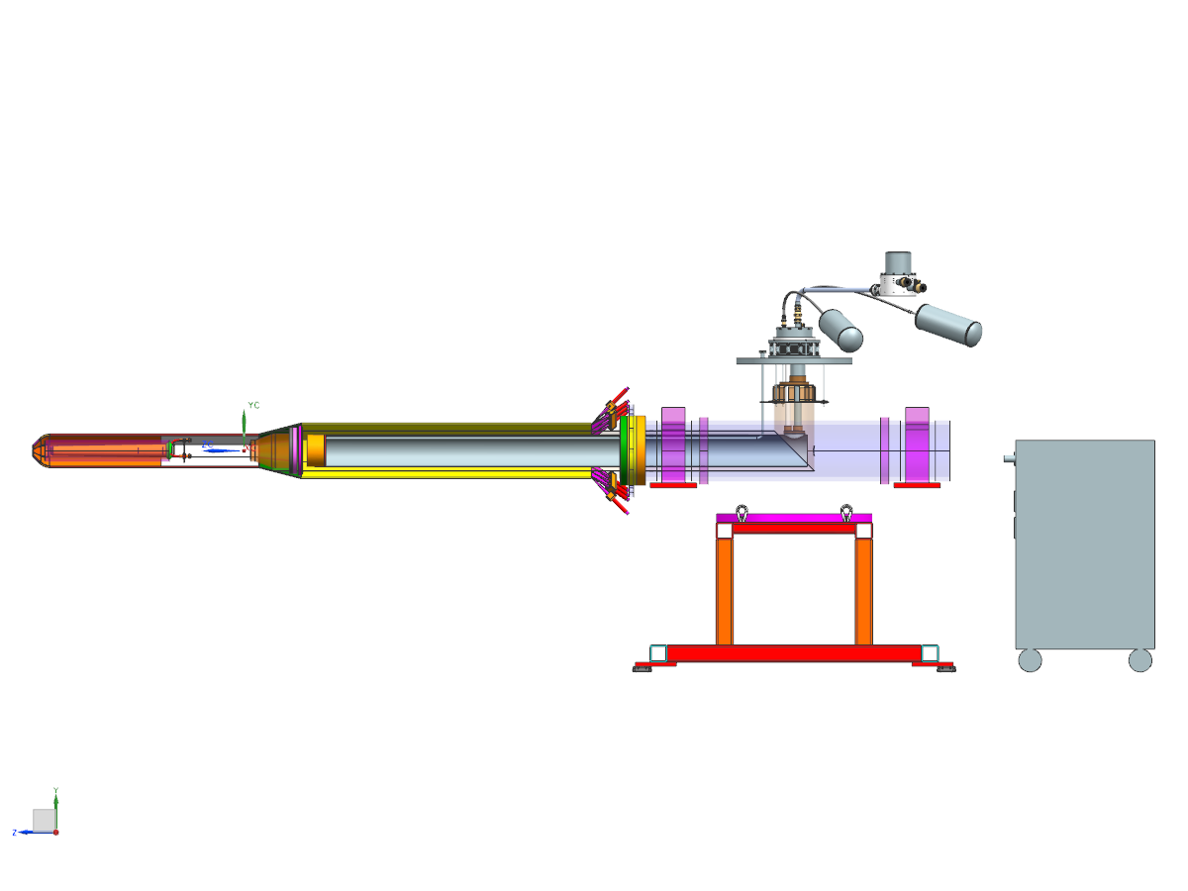
Conceptual System
Target
Cold Head
1st stage driven radiation shield
Condenser
Cold Head Compressor
2nd stage thermal link to condenser

Slide 6
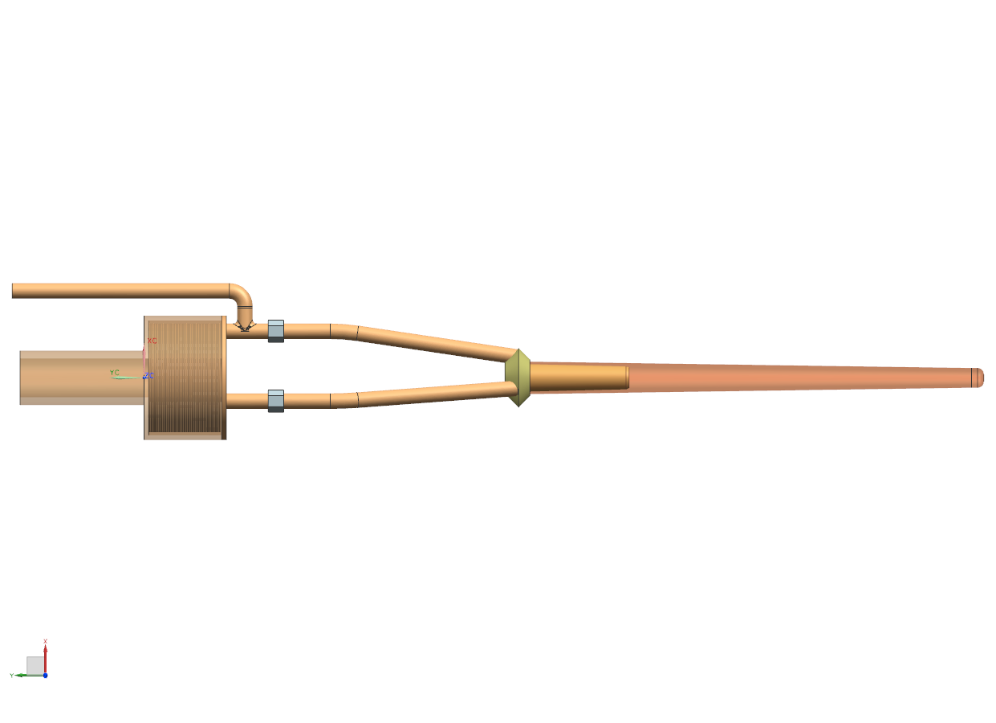
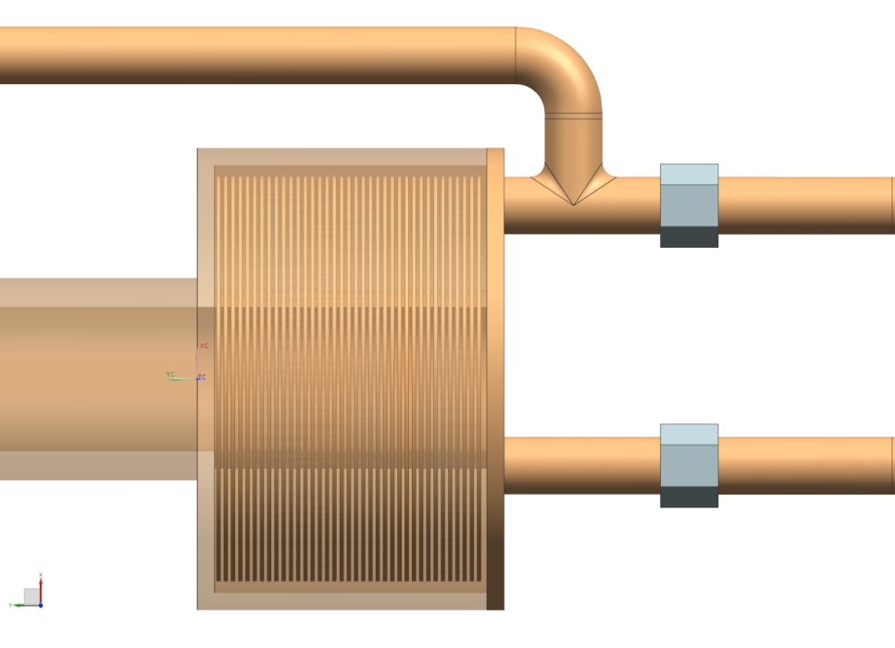
Conceptual Target & Condenser
Single target gas line, relief is central from target and condenser
Kapton film strip heater on this surface
3 radially positioned tubes allow thermal siphon between target and condenser
OFHC Copper pipe conducts thermal energy from 2nd stage
Thin OFHC Copper disks, soldered to inner condenser surface with narrow spacing

Slide 7
Cold Head Power & Cool Down Times
Second stage cooling power output is a function of the set* temperature (* this will be accomplished by using a Kapton ribbon heater)
  Based on my understanding, the second stage power will be linear between 4.2K (1.35 W)and 45K (36 W)
  Above 45K, the power output is considered to be 36 W.
7 kg (~15 lbs) is the current estimate for mass of OFHC Copper thermally connected to second stage (condenser and cold tubing)
Based on the above assumptions, cool down and condensing the gas in the current targets (He, H₂, D₂) will take ~14 hours

Slide 8
Hydrogen Target Details
Based on estimated piping volumes and known pressures, we need ~1000 liter accumulator.
Estimated mass of liquid H₂ is 0.03 Kg
Based on estimated target volumes and surface areas, the boiloff rates for a loss of vacuum (Q= 20 kW/m₂) is ~5 g/s

Slide 9
Hydrogen Target LOV Pressure Relief
Maximum pressure estimate inside the target is <26 psia

Slide 10
Deuterium Target Details
Based on estimated piping volumes and known pressures, we need ~1100 liter accumulator.
Estimated mass of liquid D₂ is 0.07 Kg
Based on estimated target volumes and surface areas, the boiloff rates for a loss of vacuum (Q= 20 kW/m₂) is ~7 g/s

Slide 11
Deuterium Target LOV Pressure Relief
Maximum pressure estimate inside the target is <26 psia

Slide 12
Helium Target Details
Based on estimated piping volumes and known pressures, we need ~800 liter accumulator.
Estimated mass of liquid He is 0.06 Kg
Based on estimated target volumes and surface areas, the boiloff rates for a loss of vacuum (Q= 20 kW/m₂) is ~100 g/s

Slide 13
Helium Target LOV Pressure Relief
Maximum pressure estimate inside the target is <26 psia
Maximum pressure estimate inside the target is <32 psia

Slide 14
ASME Pressure Relief
What is maximum design pressure of similar targets?
If the large flow area relief valve (needed for He) is used for Hydrogen and Deuterium, the valve is oversized. Would it be best to switch the relief valve based on the target gas?
Where will the vent exit the Hall?

Slide 15
Next Steps
Complete P&I diagram
Layout piping and refrigerator positions on into Hall D model
Finalize the design and calculations
Receive and test cold head
Build and test target

