Slide 1
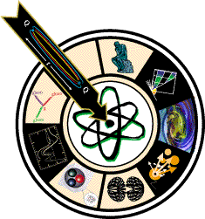


Daniel S. Carman
Jefferson Laboratory
N* Spectrum & Structure
Relevance of KY Data
CLAS γ_{v}p →KY Measurements
CLAS12 N* → KY Experiments
Concluding Remarks

Slide 2
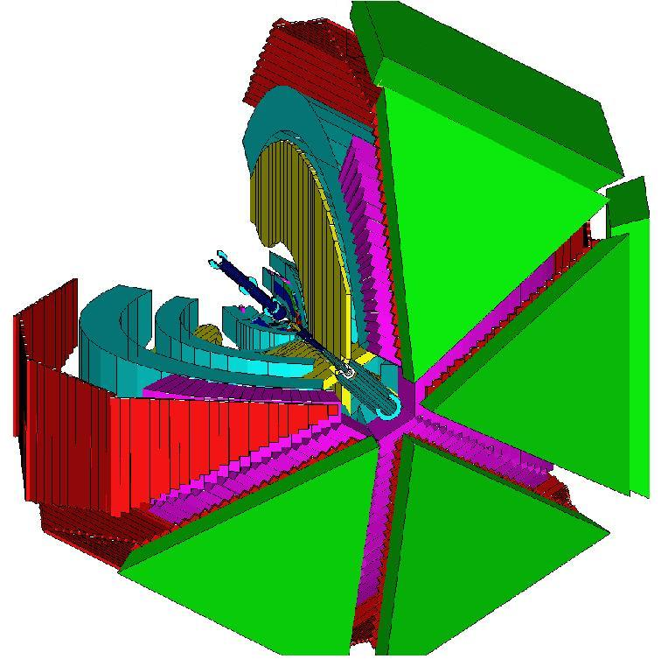

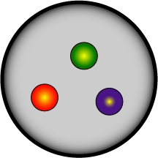
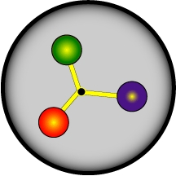
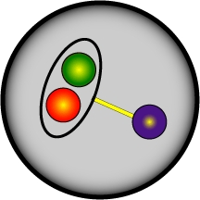

CLAS N* Program
The N* program is one of the key physics foundations of Hall B
CLAS was designed to measure γN and γ_{v}N cross sections and spin observables over a broad kinematic range for exclusive reaction channels
πN, ωN, φN, ηN, η’N, ππN
KY, K*Y, KY*
- Consistent interpretation of N* properties from different exclusive channels with different couplings and backgrounds offers model independent support for findings
The program goal is to probe the spectrum of states and their structure through studies of the Q² evolution of the γ_{v}NN* electrocouplings
- Probe the underlying degrees of freedom of the nucleon
- Study the non-perturbative strong interaction that generates N* of different quantum numbers from quark and gluons
?

Slide 3
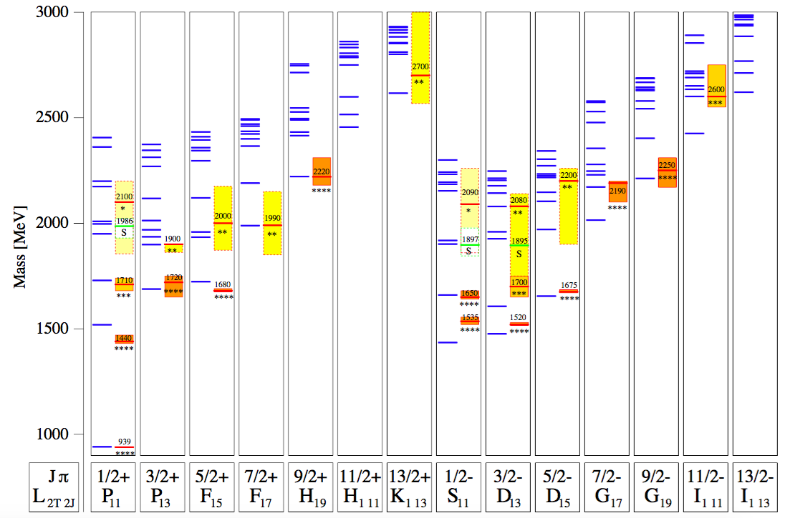
N* Spectrum
missing N* states
KY
sensitive to higher mass states
RCQM
[Löring, Metsch, Petry, Eur. Phys. J. A 10, 395 (2001)]
Most information on N* spectrum from πN elastic scattering
Coupling to inelastic channels gives new information
Recent LQCD predictions support CQM
[Dudek, Edwards, PRD 85, 054016 (2012)]

Slide 4
N*,Δ* → KY Landscape
Old
New
N* → KY |  |  |  | Δ* → KΣ
State | Rating | BR % (KΛ) | BR % (KΣ) | State | Rating | BR % (KΣ)
N*(1650) | **** | 3–11 | - | Δ*(1700) | **** | -
N*(1675) | **** | < 1 | - | Δ*(1750) | * | -
N*(1680) | **** | - | - | Δ*(1900) | ** | -
N*(1700) | *** | < 3 | - | Δ*(1905) | **** | -
N*(1710) | *** | 5–25 | - | Δ*(1910) | **** | 9
N*(1720) | *** | 1–15 | - | Δ*(1920) | *** | 2.1
N*(1875) | *** | - | - | Δ*(1930) | *** | -
N*(1900) | *** | 0-10 | 5 | Δ*(1940) | ** | -
N*(1990) | ** | - | - | Δ*(1950) | **** | -
N*(2000) | ** | - | - | Δ*(2000) | ** | -
N* → KY |  |  |  | Δ* → KΣ
State | Rating | BR % (KΛ) | BR % (KΣ) | State | Rating | BR % (KΣ)
N*(1650) | **** | 10±5 | - | Δ*(1620) | **** | -
N*(1675) | **** | - | - | Δ*(1700) | **** | -
N*(1680) | **** | - | - | Δ*(1750) | * | -
N*(1700) | *** | - | - | Δ*(1900) | ** | 5±3
N*(1710) | *** | 23±7 | - | Δ*(1905) | **** | -
N*(1720) | **** | - | - | Δ*(1910) | **** | 9±5
N*(1875) | *** | 4±2 | 15±8 | Δ*(1920) | *** | 4±2
N*(1880) | ** | 2±1 | 17±7 | Δ*(1930) | *** | -
N*(1895) | ** | 18±5 | 13±7 | Δ*(1940) | *** | -
N*(1900) | ** | 16±5 | 5±2 | Δ*(1950) | **** | 0.4±0.1
N*(1990) | ** | - | - | Δ*(2000) | ** | -
N*(2000) | ** | - | -
[Beringer et al. (PDG), PRD 86, 010001 (2012)]
[Anisovich et al., EPJ A 48, 15 (2012)]

Slide 5
Evidence for New N* in KY Final States
State N(mass)J^{P} | PDG pre-2010 | PDG 2016 | KΛ | KΣ | Nγ
N(1710)1/2⁺ | *** | **** | **** | ** | ****
N(1880)1/2⁺ |  | ** | ** |  | **
N(1895)1/2⁻ |  | ** | ** | * | **
N(1900)3/2⁺ | ** | *** | *** | ** | ***
N(1875)3/2⁻ |  | *** | *** | ** | ***
N(2150)3/2⁻ |  | ** | ** |  | **
N(2000)5/2⁺ | * | ** | ** | * | **
N(2060)5/2⁻ |  | ** |  | ** | **
Extend these studies to electroproduction and to higher masses

Slide 6
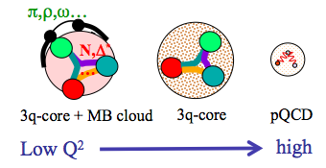
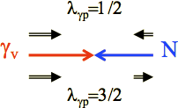
Excited Nucleon Structure
Nucleon structure is more complex than what can be described accounting for quark degrees of freedom only
  - Low Q²:
  High Q²:
  structure well described by adding an external M-B cloud to inner quark core
  quark core dominates; transition from confinement to pQCD regime
(Q² < 5 GeV²)
(Q² > 5 GeV²)
Electroproduction studies from low to high Q² probe the detailed structure of the N* states through the γ_{v}NN* electrocoupling amplitudes
Elucidate relevant degrees of freedom and their evolution with distance scale
- Only source of information on many facets of the non-perturbative strong interaction in the generation of N* states from quarks and gluons
e’
K
γ_{v}
e
N*,△*
Q²
N
Y
A_{1/2}, A_{3/2}, S_{1/2}
helicity amplitudes
A_{1/2} , A_{3/2} – transverse
S_{1/2} - longitudinal

Slide 7
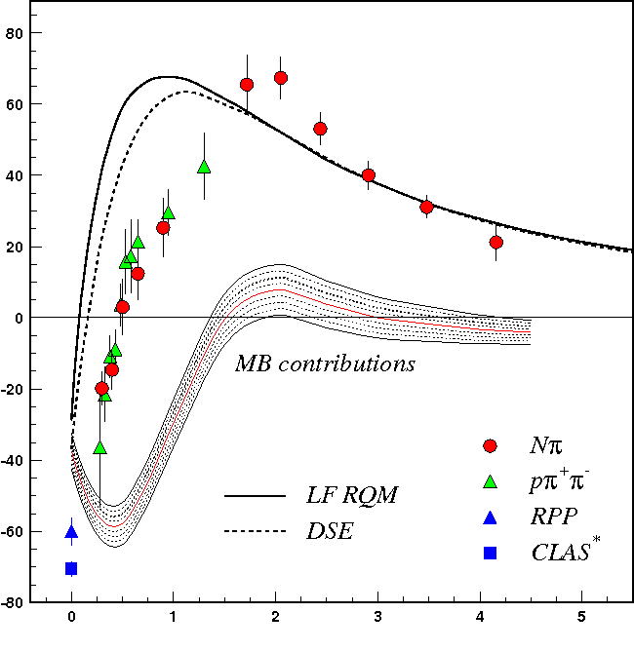
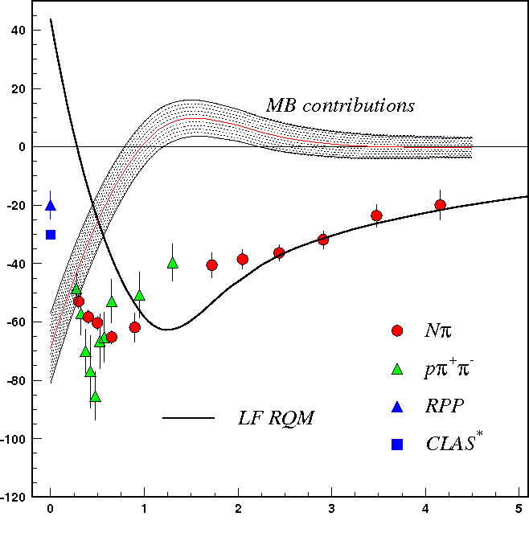
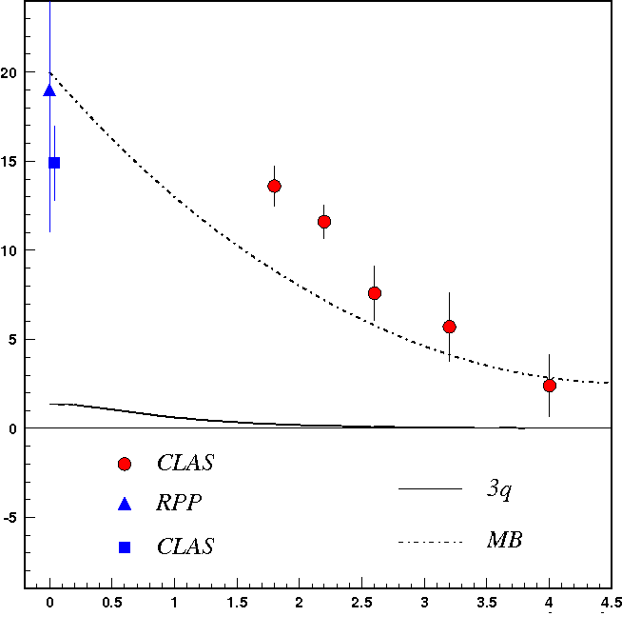
Lower-Lying N* States
A_{1/2}
N(1440)1/2⁺
A_{1/2}
N(1520)3/2⁻
A_{1/2}
N(1675)5/2⁻
Q² (GeV²)
Q² (GeV²)
Q² (GeV²)
Electrocouplings reveal different interplay between quark core and M-B cloud
Important to study different N* states vs. distance scale
Good agreement of the extracted N* electrocouplings from Nπ and Nππ
Compelling evidence for the reliability of the results
Channels have very different mechanisms for the non-resonant background
Structure studies of low-lying N* states have advanced due to agreement of results from independent analyses of the Nπ and Nππ final states

Slide 8
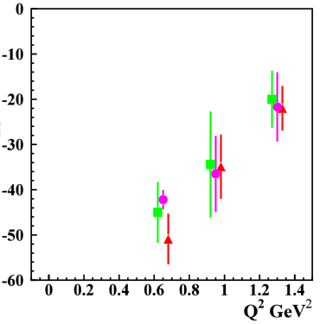
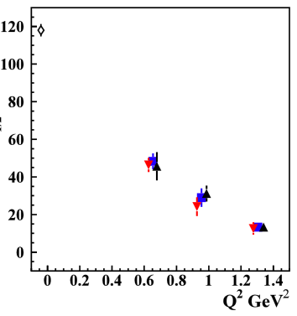
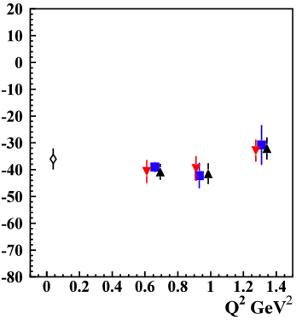
Higher-Lying N* States
Nππ channel gave first electrocoupling results on higher-lying states up to 1.7 GeV:
Δ(1620)1/2⁻, N(1650)1/2⁻, Δ(1700)3/2⁻, N(1720)3/2⁺
Note: Most high-lying N* states (M > 1.6 GeV) decay mainly to Nππ with much smaller strength to Nπ
Δ(1620)1/2⁻
Δ(1700)3/2⁻
N(1720)3/2⁺
1.61-1.71 GeV
1.66-1.76 GeV
1.71-1.81 GeV
1.46-1.56 GeV
1.56-1.66 GeV
1.61-1.71 GeV
S_{1/2}
A_{1/2}
A_{3/2}
[Mokeev, Aznauryan, Int. J. Mod. Phys. Conf. Ser. 26, 1460080 (2014)]
Data from the KY channels is critical to provide an independent
extraction of the electrocoupling amplitudes for the high-lying N* states

Slide 9

CLAS Strangeness Program
The initial thrust of the CLAS KY measurement program focused on exclusive production of ground-state Λ and Σ⁰ hyperons
Photo- and electroproduction experiments
W: 1.6 – 3.0 GeV
Q²: 0 – 4.5 GeV²
Provide extensive database of:
    Cross sections and separated structure functions
    Recoil and beam-recoil hyperon polarizations
            Program has grown to include studies of:
            vector meson production (K*Y)
            excited hyperon production (KY*)
            semi-inclusive hyperon processes (YX)
            complete experiments in photoproduction (γp, γn)
cos θ_{K}^{c.m.}: [-1: 1]
E_{b}: up to 6 GeV
CLAS: 1997 - 2012

Slide 10
CLAS KY Dataset Overview
# | Run | E_{b} (GeV) | Trig. (M)
1 | e1c | 2.567 | 900
2 | e1c | 4.056 | 370
3 | e1c | 4.247 | 620
4 | e1c | 4.462 | 420
5 | e1-6 | 5.754 | 4500
6 | e1f | 5.499 | 5000
Publications:
K⁺Λ beam-recoil pol. transfer
  W=1.6-2.15 GeV, Q²=0.3 – 1.5 GeV²
  [Carman et al., PRL 90, 131804 (2003)]
K⁺Λ σ_{L}/σ_{T} ratio
  W=1.72-1.98 GeV, Q²~0.7 GeV²
  [Raue & Carman, PRC 71, 065209 (2005)]
K⁺Λ, K⁺Σ⁰ separated structure functions
  W=thr-2.4 GeV, Q²=0.5-2.8 GeV²
  σ_{U}, σ_{LT}, σ_{TT}, σ_{L}, σ_{T} - K⁺Λ, K⁺Σ⁰
  [Ambrozewicz et al., PRC 75, 045203 (2007)]
  W=thr-2.6 GeV, Q²=1.4-3.9 GeV²
  σ_{U}, σ_{LT}, σ_{TT}, σ_{LT’} – K⁺Λ , K⁺Σ⁰
  [Carman et al., PRC 87, 025204 (2013)]
K⁺Λ fifth structure function σ_{LT’}
  W=1.6-2.1 GeV, Q²=0.65, 1.0 GeV²
  [Nasseripour et al., PRC 77, 065208 (2008)]
K⁺Λ, K⁺Σ⁰ beam-recoil pol. transfer
  W=thr-2.6 GeV, Q²=1.6-2.6 GeV²
  [Carman et al., PRC 79, 065205 (2009)]
K⁺Λ recoil pol.
  W=1.6-2.7 GeV, Q²=1.9 GeV²
  [Gabrielyan et al., PRC 90, 035202 (2014)]

Slide 11

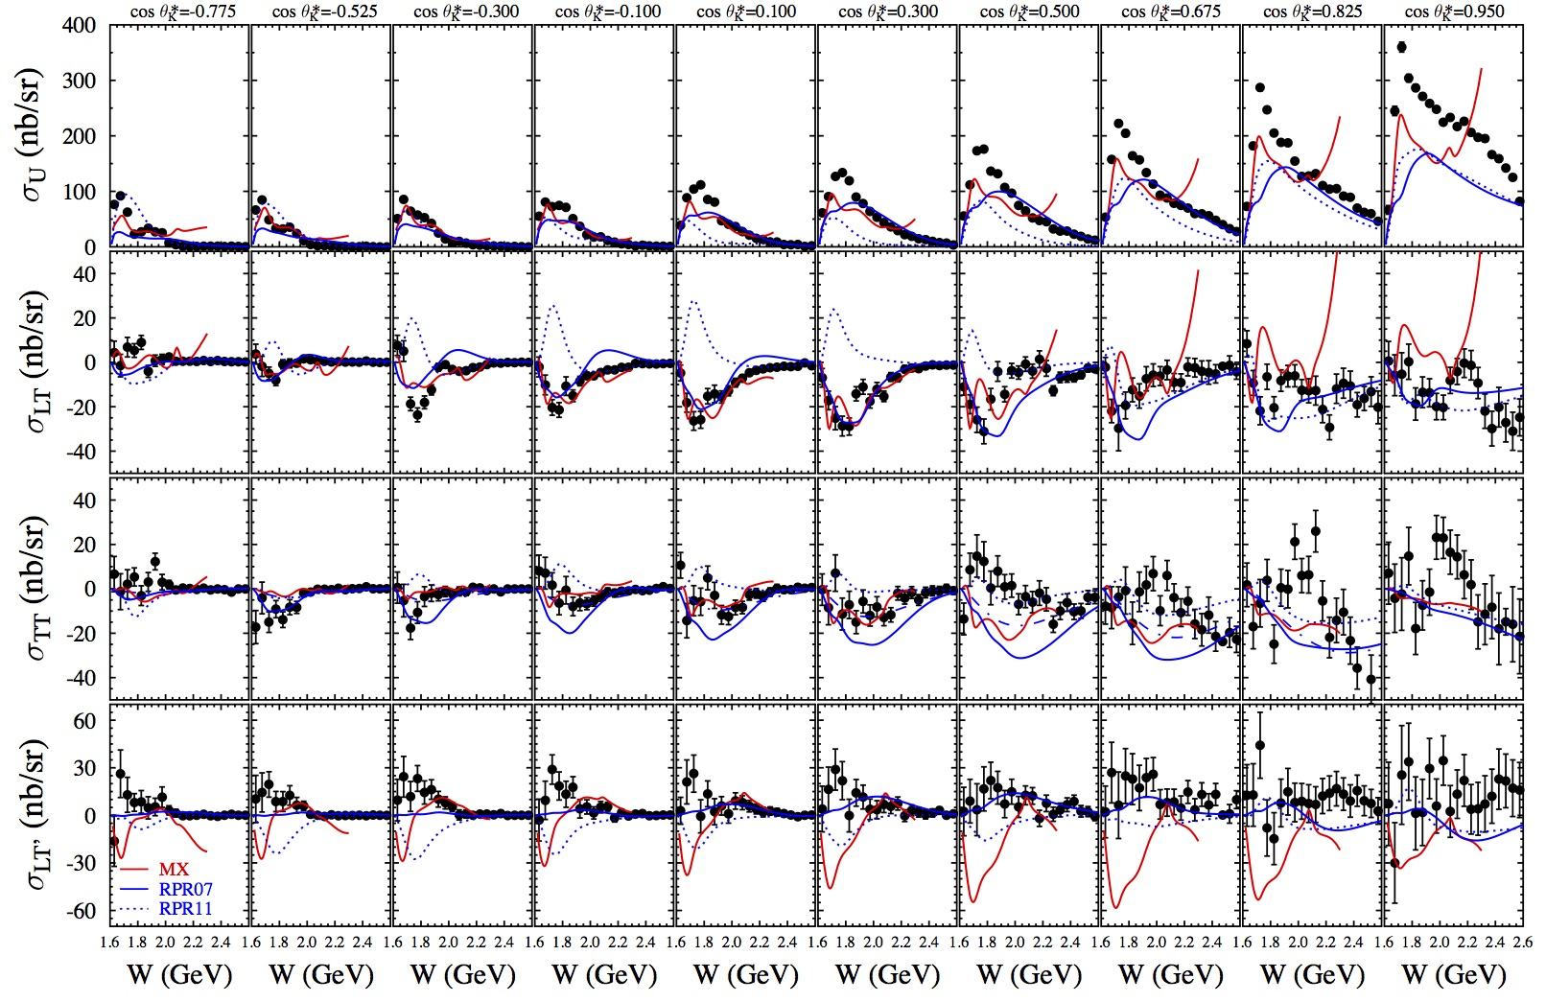
K⁺Λ Structure Functions
E = 5.5 GeV, W: thr – 2.6 GeV, Q² = 1.80, 2.60, 3.45 GeV²
[Carman et al., PRC 87, 025204 (2013)]

Slide 12
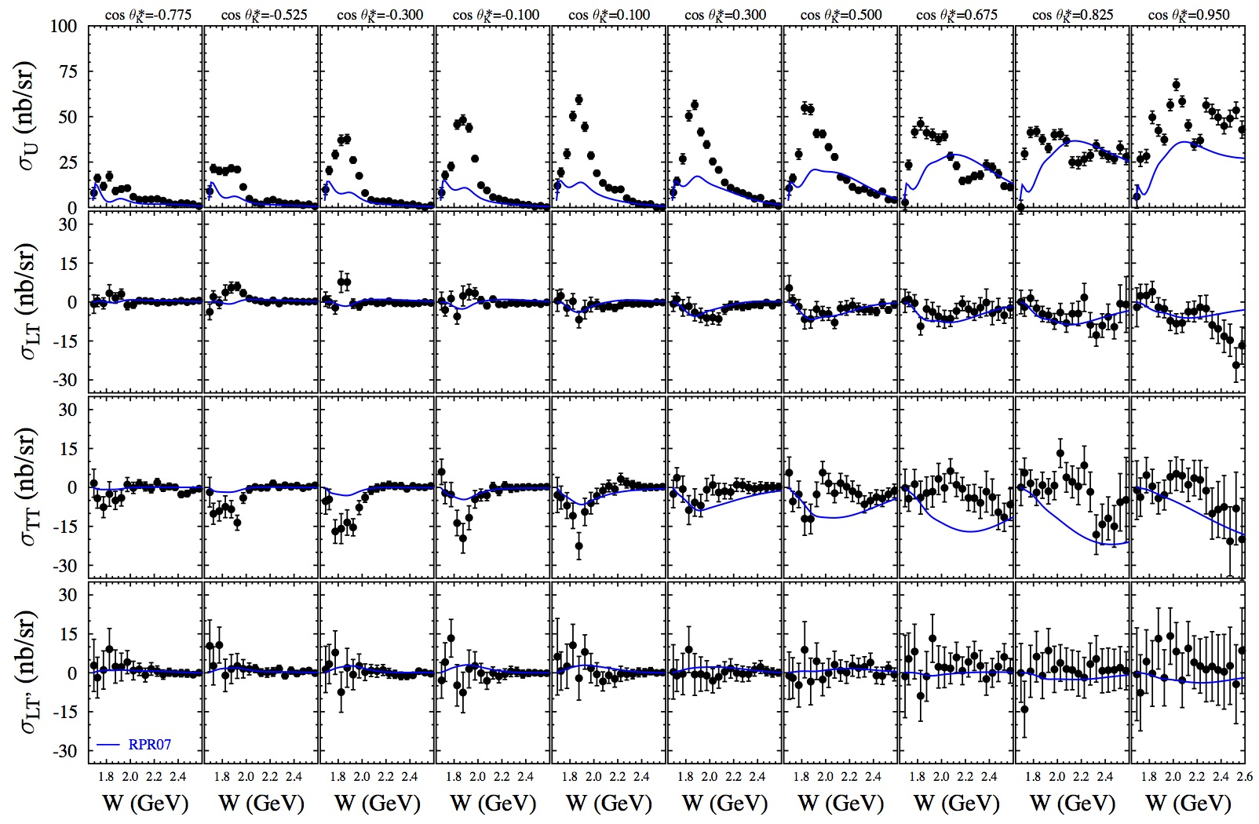
K⁺Σ⁰ Structure Functions
E = 5.5 GeV, W: thr – 2.6 GeV, Q² = 1.80, 2.60, 3.45 GeV²
[Carman et al., PRC 87, 025204 (2013)]

Slide 13
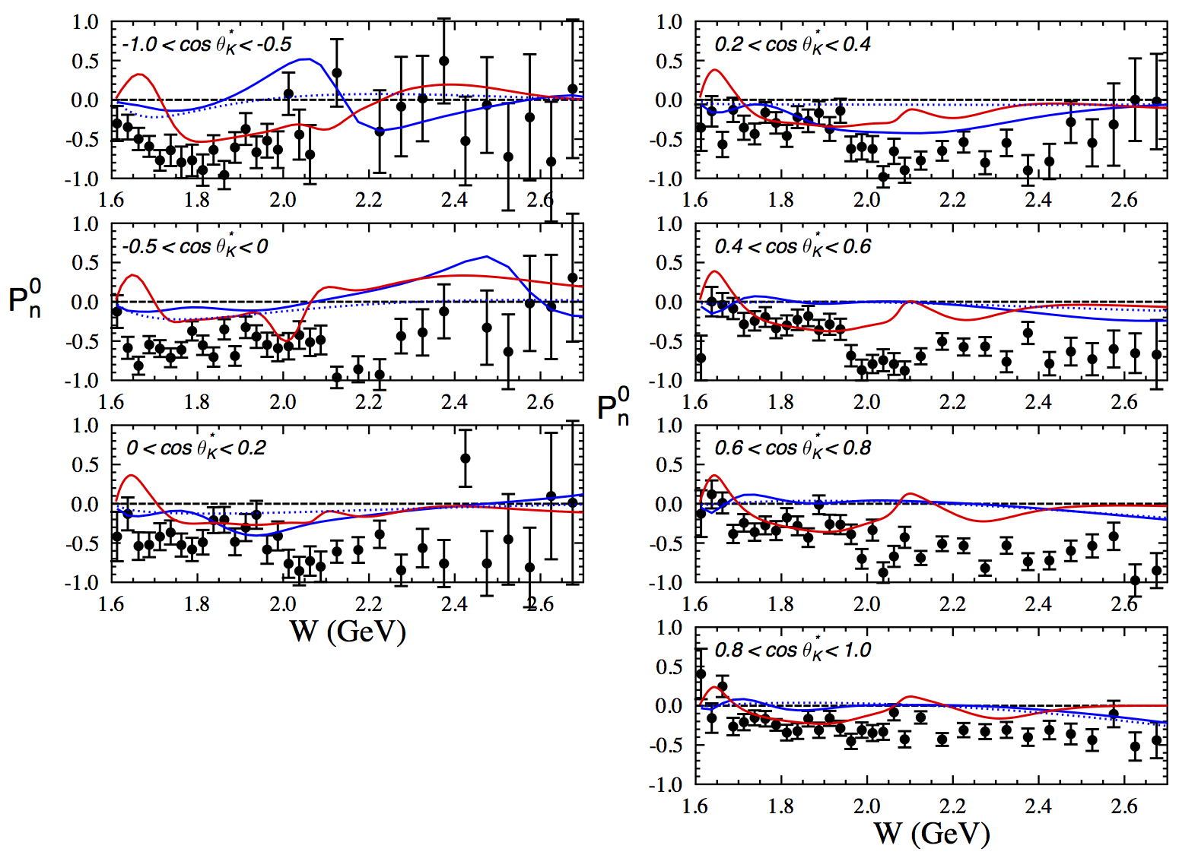
Recoil Polarization ep → e’K⁺Λ
<Q²> = 1.9 GeV²
MX, RPR-2011 (full)
(nores)
[Gabrielyan et al., PRC 90, 035202 (2014)]
Notes:
Replace with figure including photoproduction; Remove Kaon-Maid curve

Slide 14
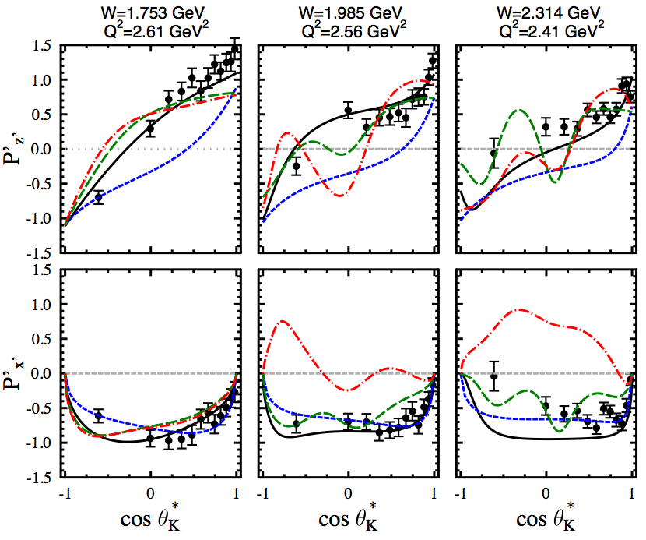
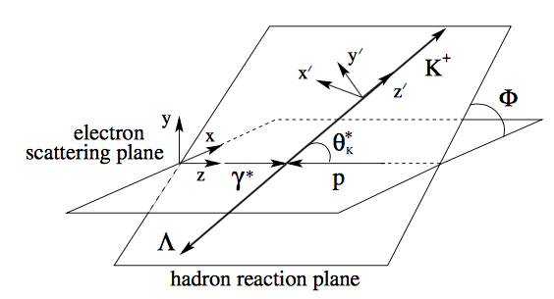
Transferred Polarization ep → e’K⁺Λ
5.754 GeV
Summed over Q², Φ
Isobar Model – Mart
Regge Model – GLV
RPR07 w P₁₁(1900)
RPR07 w D₁₃(1900)
[Carman et al., PRC 79, 065205 (2009)]

Slide 15
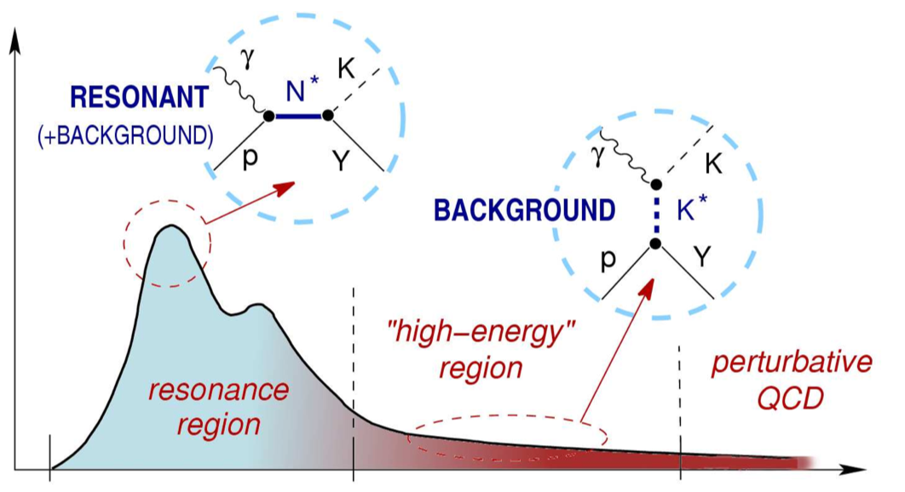
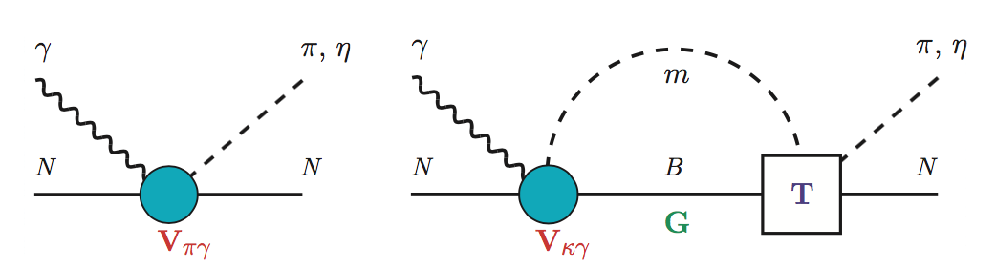
KY Reaction Models
Single Channel Models:
“simplicity” (isobar, effective Lagrangian, multipoles)
Single framework to study different channels
Not a complete physics model but have proven to be useful and relevant
cross section
W
Single-channel approaches:
RPR, GLV (Regge), Isobar models (Mart, Maxwell)
γ∗
π,η,K
γ∗
π,η,K
Coupled-Channel Models:
Simultaneous fits to multiple independent channels
Treatment of FSI and rescattering effects
N
Y
N
Y
Coupled-channel approaches:
ANL-Osaka (EBAC), Dubna-Mainz-Taipei, Julich-Bonn

Slide 16
KY Reaction Models
Single Channel Models:
“simplicity” (isobar, effective Lagrangian, multipoles)
Single framework to study different channels
Not a complete physics model but have proven to be useful and relevant
cross section
There is an urgent need for KY reaction models - first for lower Q² data from CLAS and then for higher Q² data from CLAS12
W
Single-channel approaches:
RPR, GLV (Regge), Isobar models (Mart, Maxwell)
γ∗
π,η,K
γ∗
π,η,K
Coupled-Channel Models:
Simultaneous fits to multiple independent channels
Treatment of FSI and rescattering effects
N
Y
N
Y
Coupled-channel approaches:
ANL-Osaka (EBAC), Dubna-Mainz-Taipei, Julich-Bonn

Slide 17
CLAS12 N* Program
E12-09-003 | Nucleon Resonance Studies with CLAS12
E12-06-108A | KY Electroproduction with CLAS12
E12-16-010A | N* Studies Via KY Electroproduction at 6.6 and 8.8 GeV
Measure exclusive electroproduction of Nπ, Nη, Nππ, KY final states from an unpolarized proton target with longitudinally polarized electron beam
  E_{b} = 6.6, 8.8, 11 GeV, Q² = 2 → 12 GeV², W → 3.0 GeV, cos θ_{m}* = [-1:1]
Study spectrum and structure of all prominent N* states vs. Q²
- A unique opportunity to explore the nature of confinement that is responsible for the dominant part of N* masses and the emergence of N* states from QCD
KY data complement the Nππ data as independent information for high-mass states inaccessible with Nπ final states
- Promising way to confirm signals of new N* states observed in photoproduction using search in multiple independent Q² bins

Slide 18
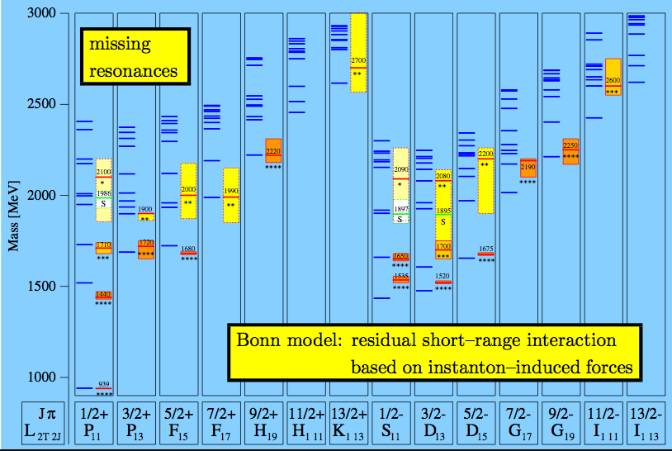
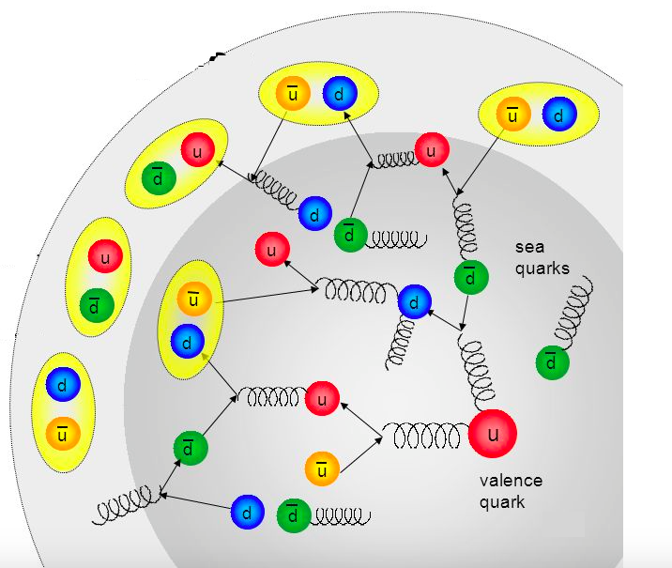
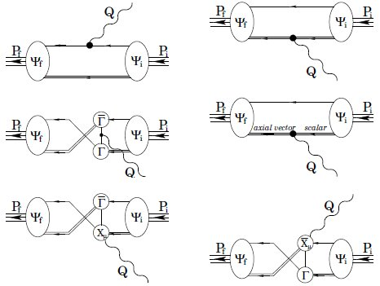
N* Spectrum and Structure Via KY
Study higher-lying states in N* spectrum:
important precision tests to confirm signals of new baryon states observed in KY photoproduction
require consistency between photo- and electroproduction data
Understand the effect of N* structure from M-B cloud:
use transition regime to explore the emergence of the external M-B cloud from the core of confined quarks and gluons
check the theoretical expectations on the M-B cloud generation from the confinement regime
Access di-quark correlations in N* structure:
important part of N* structure and γ_{v}NN* transition amplitudes
determined by dressed quark mass function through DCSB
dependent on N* quantum numbers
sizable for Q² < 5 GeV²; reduced contributions from M-B cloud in range from Q² = 2 → 5 GeV²
non-point-like diquarks

Slide 19
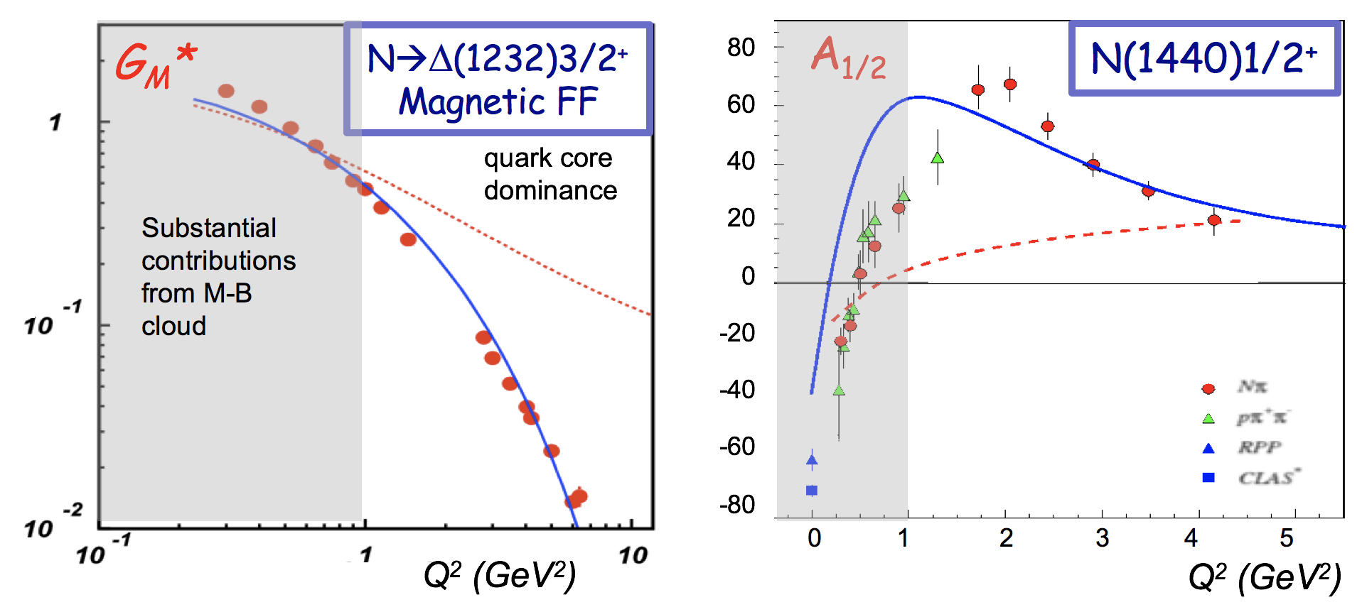
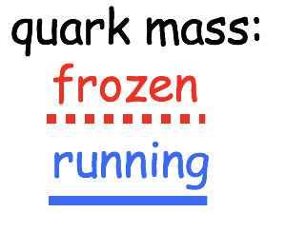

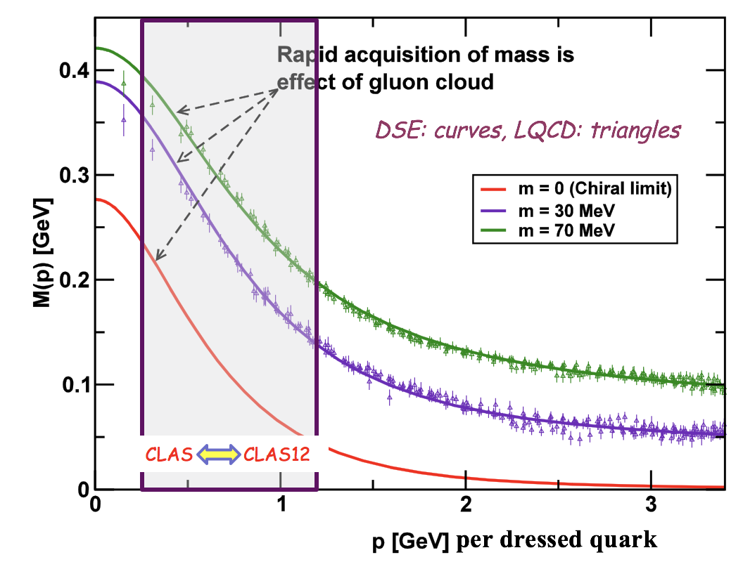
Exploring Hadron Mass Generation
Dressed quark mass function:
DSE calculations of FFs for N* states can test the relevance of dressed quarks with dynamically generated masses
The mass function can be “measured” as it influences and determines the electrocoupling amplitudes
Open questions in Standard Model:
Data spanning the transition region from low to high Q² can help to map out the momentum-dependent dressed quark mass
These dynamical contributions account for more than 98% of the dressed quark mass
Help to address the essence of confinement, mass generation, and its distribution within hadrons

Slide 20
Concluding Remarks
The study of N* states is one of the key foundations of the Hall B physics program with CLAS and CLAS12:
CLAS has provided the lion’s share of the world’s electroproduction data for the KY final states spanning W from 1.6 to 2.5 GeV and Q² from 0 to 4.5 GeV²
  The KY final states have been proven to be an important tool in the studies of high-mass N* states
  These data are of quality more than sufficient to be used to extract detailed structure information regarding higher-lying N* states
  Such results have been held up to the lack of a realistic KY reaction model
The CLAS12 physics program will enable an extension of these KY studies for 2 < Q² < 12 GeV² and the reaction models must be extended to this kinematic domain
Support from the JLab Theory Group on KY reaction model development is important to make the most of the opportunities that these data provide

Slide 21


Slide 22
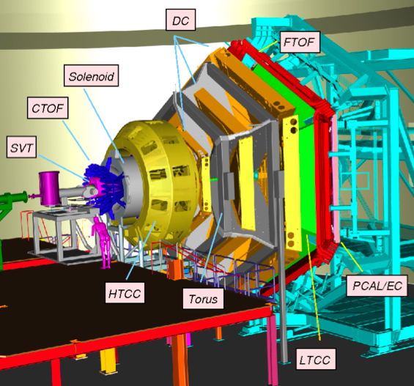
CLAS12 Spectrometer
CLAS12 Specifications
 | Forward | Central
Angular coverage | 5º – 35º | 35º – 135º
Momentum resolution | δp/p < 1% | δp/p < 5%
θ resolution | 1 mrad | 5 – 10 mrad
φ resolution | 1 mrad/sinθ | 5 mrad/sinθ
PID:
π/K | 4σ to 2.8 GeV | 3σ to 0.6 GeV
K/p | 4σ to 4.8 GeV | 3σ to 1.0 GeV
π/p | 4σ to 5.4 GeV | 3σ to 1.2 GeV
Calorimeter resolution | σ_{E} ~ 0.1√E
Luminosity | 10³⁵ cm⁻²s⁻¹

Slide 23
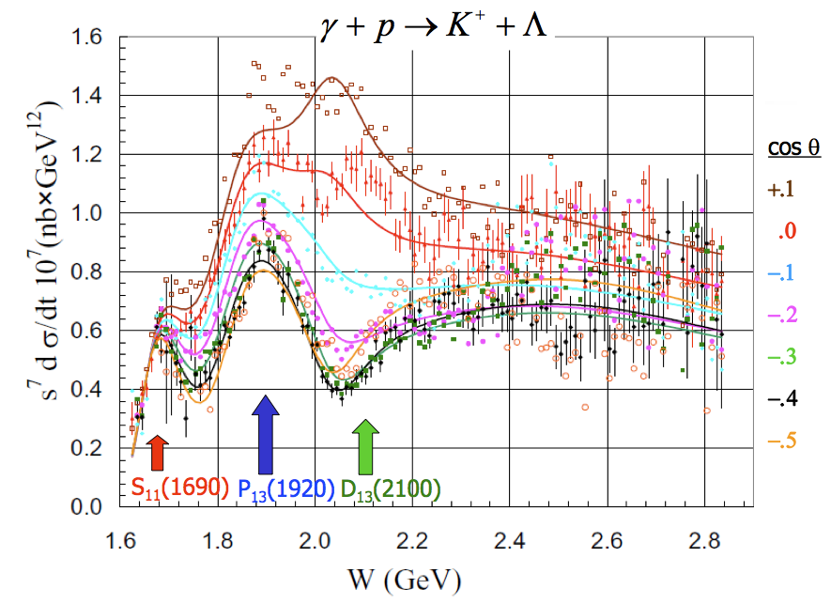
N* → K⁺Λ Amplitude Analysis
[Schumacher & Sargsian, PRC 83, 025207 (2011)]
Compute coherent total amplitude:
Fit to observed angular distributions:
Test various resonance sets vs. mass
Free parameters: mass, width, couplings
Reasonable correspondence with Bonn-Gatchina/EBAC fits:
- cross section fits reveal dominant N* states
- confirm P-wave character for state at 1.9 GeV
- other contributions could be investigated including spin observables

Slide 24
Dominant Couplings: N* → K⁺Λ
PDG status for 30 years: Core set of states: S₁₁(1650), P₁₁(1710), P₁₃(1720)
Recent emergence of: P₁₃(1900) (from γp fits)
Coupled-Channel Model (Bonn-Gatchina):
Most relevant: S₁₁(1650), P₁₁(1710), D₁₃(1895), P₁₃(1900)
Other required states: F₁₅(1680), P₁₃(1720), P₁₁(1880), S₁₁(1895), F₁₅(2000), D₁₃(2150)
Coupled-Channel Model (EBAC):
Most relevant: S₁₁(1650), P₁₁(1710), P₁₃(1900)
Other required states: D₁₅(1675), F₁₅(1680), D₁₃(1700), P₁₃(1720)
Isobar Model (Mart):
Most relevant: S₁₁(1650), P₁₃(1720), P₁₁(1880), P₁₃(1900), D₁₃(2080)
[Anisovich et al., EPJA 48, 15 (2012)]
[Kamano et al., PRC 88, 035209 (2013)]
[Mart and Kholili, PRC 86, 022201 (2012)]
Models mostly agree on dominant couplings, but full consistency is lacking
Include electroproduction data in fits – complementary to γp data

Slide 25
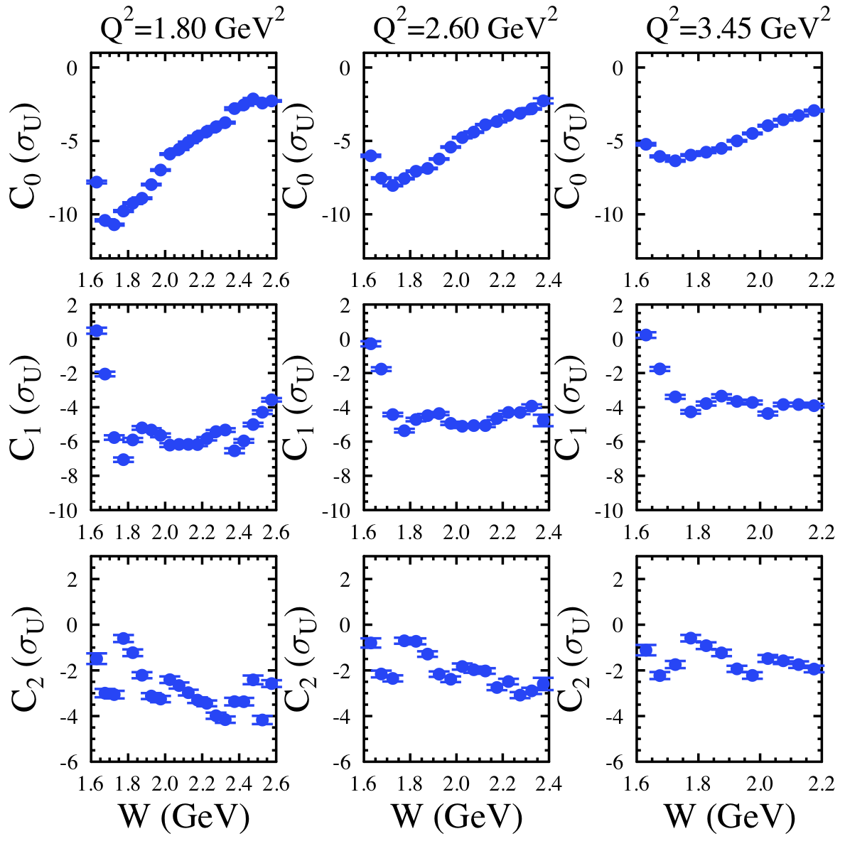
Legendre Analysis ep → K⁺Λ
Coherent Legendre fit:
S-wave state at 1650 MeV
P-wave states at 1700, 1900 MeV
D-wave state at 2000 MeV
Consistency of dominant N* → K⁺Λ couplings with advanced models
… again a complete reaction model is needed for a proper analysis
Notes:
Better label dominant states

Slide 26
KY Reaction Model – Single Channel
Work is underway to develop the Ghent Regge plus Resonance (RPR) model:
Update RPR electrocoupling parameters to be consistent with results from CLAS
Refit model to CLAS γp and γ_{v}p data:
W → 2.6 GeV, Q² → 4 GeV²
Extend model to CLAS12 kinematics:
W → 3 GeV, Q² → 12 GeV²
[DeCruz et al., PRC 86, 015212 (2012)]
cross section
W
Resonances:
Standard isobar model N* states with J=1/2, 3/2, 5/2
EM form factors from Bonn CQM
11 s-channel resonance candidates with W < 2 GeV
Fit model to world γp data over full angular range
Model not constrained by CLAS electroproduction data
Background:
Exchange of K(494)/K*(892) Regge trajectories
Parameterized by 3 coupling strengths/2 phases
Background tuned to high-energy data and CLAS data in resonance region
Significant under-prediction of strength will require addition of contact term F(Q²,t)

Slide 27
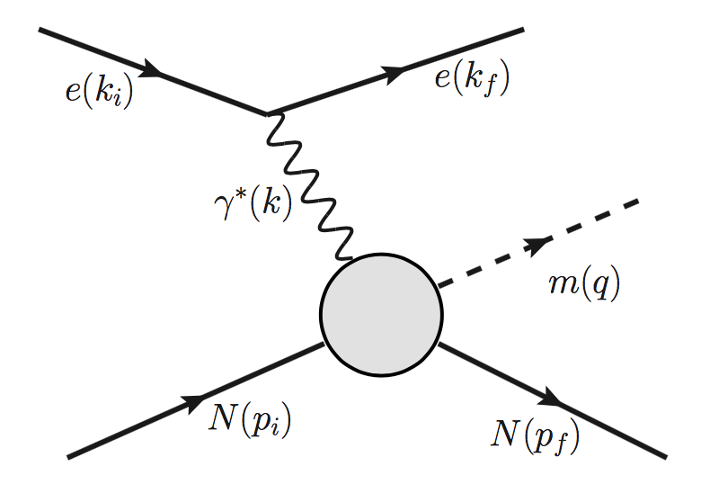

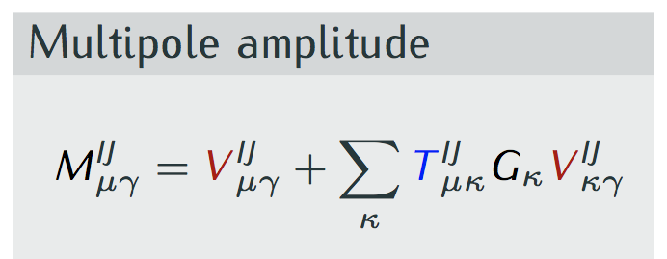
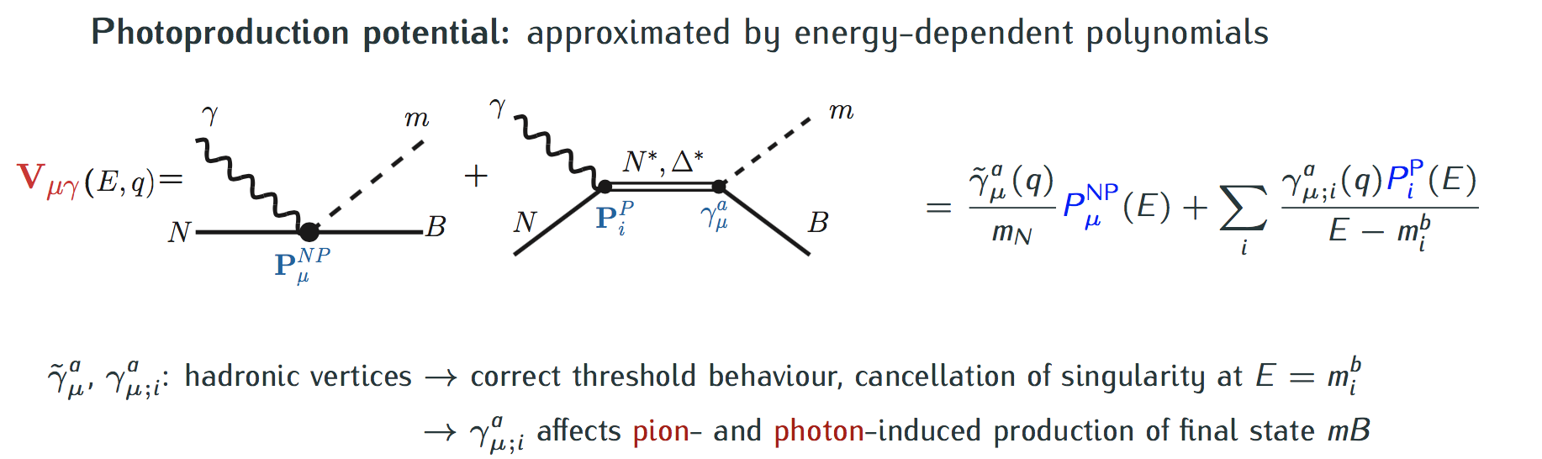
KY Reaction Model – Coupled Channel
Coupled-channel approaches:
ANL-Osaka (EBAC), Dubna-Mainz-Taipei, Julich-Bonn
γ∗
π,η,K
γ∗
π,η,K
Y(p_{f})
Y
N
Y
N
T_{μκ}: hadronic T-matrix (analytic, unitary)
partial wave basis
Potential approximated by energy-dependent polynomials

Slide 28
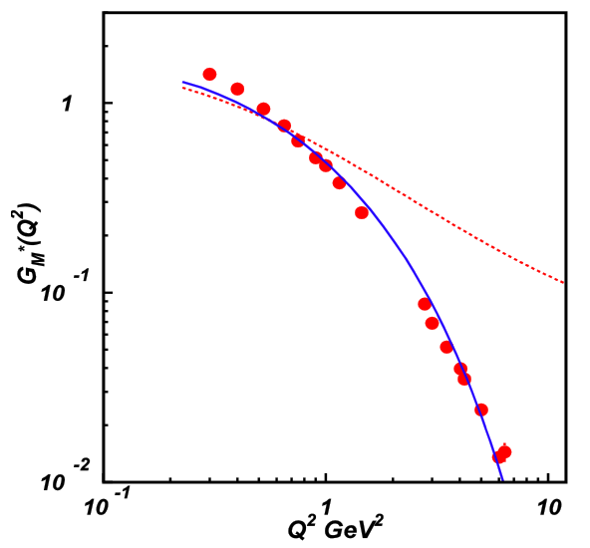
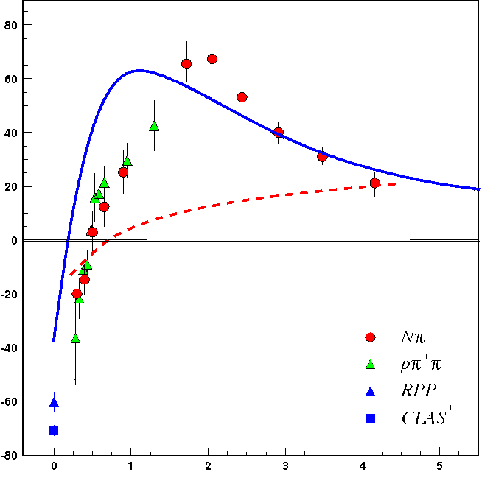

Exploring Hadron Mass Generation
G_{M}*
N→Δ(1232)3/2⁺ Magnetic FF
80
60
40
20
0
-20
-40
-60
-80
A_{1/2}
N(1440)1/2⁺
quark core dominance
DSE calculations
Substantial contributions from M-B cloud
quark mass:
frozen
running
Q² (GeV²)
0 1 2 3 4 5
Q² (GeV²)
[DSE: Segovia, Few Body Syst. 57, 461 (2015); LF RQM: Aznauryan/Burkert, arXiv:1603.06692, (2016)]
DSE calculations of FFs for both ground and excited N* states using the same running dressed quark mass function describe the data for Q² > 2.0 GeV². This provides strong evidence for:
- the relevance of dressed quarks with dynamically generated masses
- that the dressed-quark mass function can be “measured” as it influences and determines many experimental observables

Slide 29

Dynamical Mass of Light Dressed Quarks
Theory predicts the dynamical generation of the momentum-dependent dressed quark mass due to presence of gluon field
These dynamical contributions account for more than 98% of the dressed light quark mass
Data from CLAS/CLAS12 span Q² from 1 → 12 GeV²
DSE: curves, LQCD: triangles
CLAS CLAS12
per dressed quark
dressed quarks
bare quarks
N* electrocouplings for 1 < Q² < 12 GeV² will allow us to map the evolution of the dressed quark mass in the transition regime

