Slide 1
BCAL Interlock System
Pulsed Output from Flow meter to PLC
US BCAL PLC
5V TTL
US BCAL MPOD 1
From US BCAL cooling loop
US BCAL Chiller
RS485 from Chiller
To PLC
US BCAL MPOD 1
PLC Remote On/Off 24V
Pulsed Output from Flow meter to PLC
DS BCAL PLC
5V TTL
DS BCAL MPOD 1
From DS BCAL cooling loop
DS BCAL Chiller
RS485 from Chiller
To PLC
DS BCAL MPOD 2
PLC Remote On/Off 24V
The flow meters act as a failsafe in case the RS485 serial communication fails
The PLC can use flow data and RTD temperature data to determine if the low voltage should be turned off

Slide 2
BCAL Interlock System
US BCAL PLC 24V Output
5V TTL
Relay
US BCAL MPOD 1
5 Volt Power Supply
5V TTL
Relay
US BCAL MPOD 1
There is no Point IO module that puts out 5V with enough current (5ma) to enable the MPOD
The PLC can use flow data and RTD temperature data to determine if the low voltage should be turned off

Slide 3
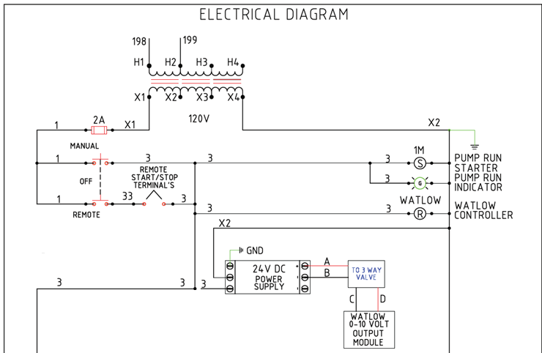
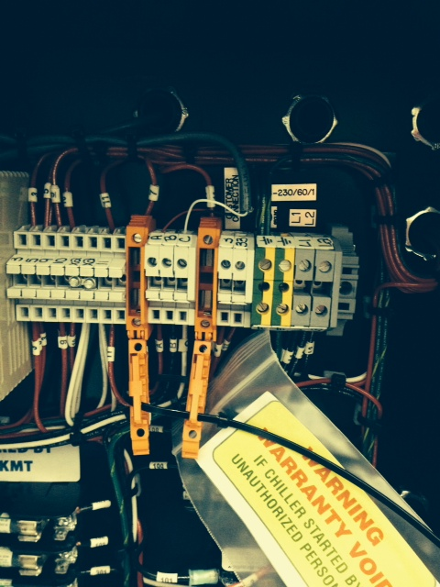
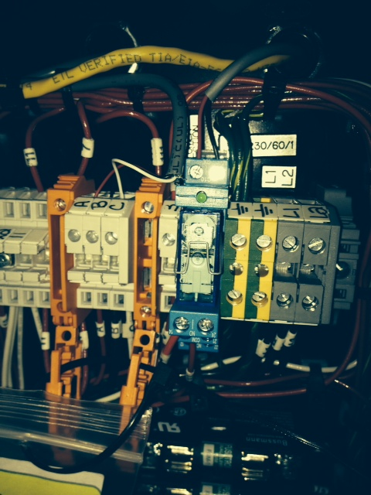
BCAL Interlock System

Slide 4
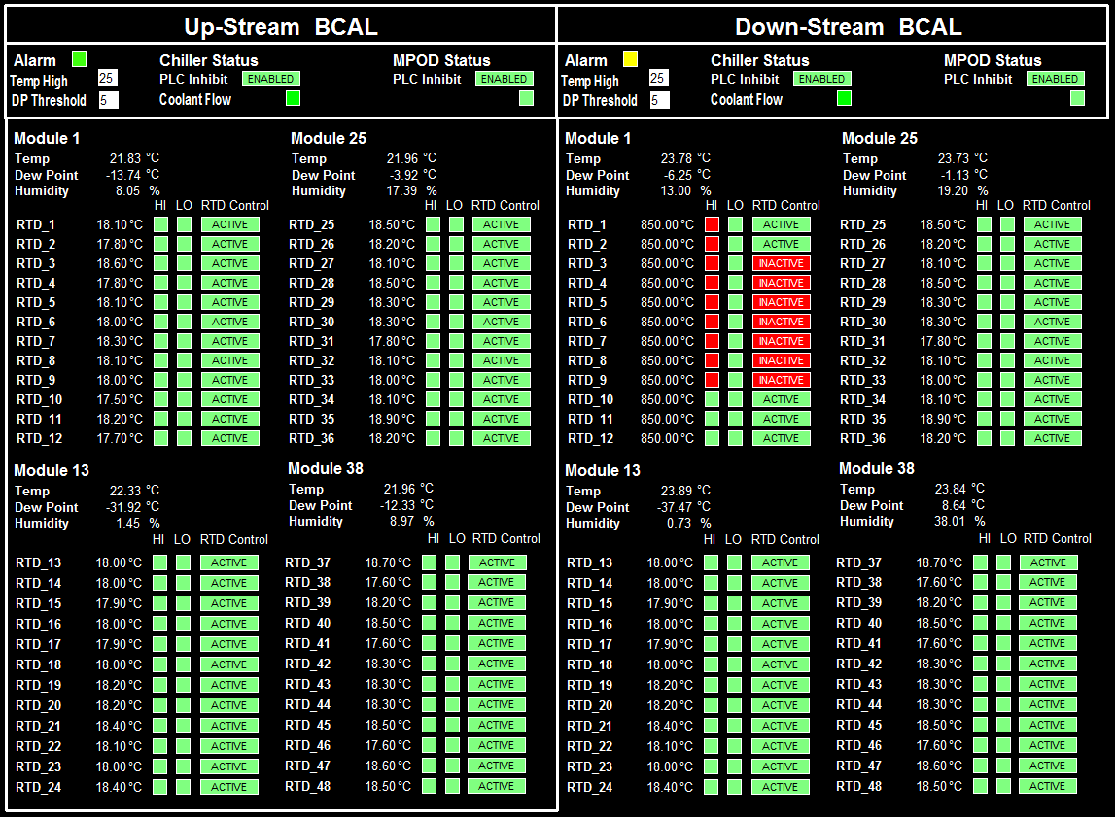
BCAL Interlock System

Slide 5
BCAL Interlock System

