Slide 1
ClaRA & JANA
Vardan Gyurjyan
DAQ group

Slide 2
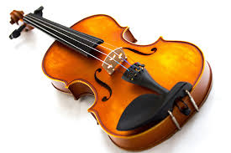
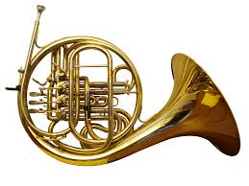
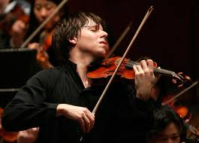
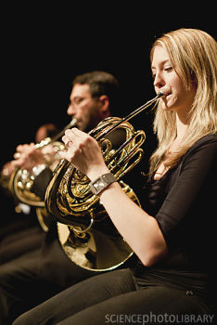
Software Framework
Out of sight
The core of a framework, architecture of a software system
component of the framework that manages developer provided code
For developers
Represent those parts where the programmers using the framework add their own code to add the functionality specific to their own project.
Software application

Slide 3
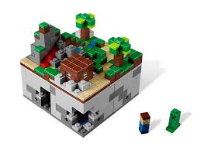
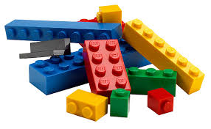
Similarities, yet…
Both are multi-threaded physics data processing application development frameworks
For developers
JANA: Data and Algorithm classes (C++) to create data and factory objects.
The factory needing a type of data object as input doesn't need direct knowledge of the factory that actually generates those objects.
ClaRA: Jservice abstract classes (Java, C++, Python) to create application modules (services) (for e.g. TOF, EC, CPT, etc…)
Services are autonomous (loosely coupled: can be run as a stand alone applications or be assembled in a larger application)
For users
JANA: JEventProcessor Application is a single process that must be compiled.
ClaRA: JOrchestrator Application is designed by linking modules together (no coding and/or compilation).
> clara r-tof-ec-ct-ft-w –l flist.xml
ClaRA user:
Use of services developed in different languages in a single application (e.g. HPS reconstruction in Java)
Ease of optimization, maintenance and contribution.

Slide 4
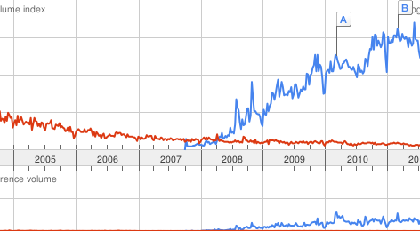
The Difference
Conceptual difference
ClaRA is based on SOA (Service Oriented Architecture)
JANA is based on OOA (Object Oriented Architecture)
ClaRA vs. JANA
ClaRA application: multi-process & multi-threaded. The ClaRA service can be a process or a thread within a single process that communicates with other services through message passing. The message initiates the service execution.
JANA application: single-process & multi-threaded. In JANA all the data and factory objects of an application are running in a same thread, sharing thread memory space (thread stack and thread controlled heap), as well as thread’s set of machine registers. Pointers are used to pass data between data and factory object.
As a result ClaRA presents
Environment for cloud computing and distributed data handling.
Location independent resource pooling.
Cloud Computing
Grid Computing
ClaRA cloud processing.
CLAS data from the ODU data-center is being actively analyzed by users from
Scotland, Germany, Chile, India, Israel, MIT, FSU, ODU and others.

Slide 5
Side by Side
Functionality | ClaRA | JANA | Comments
Multi-threaded | ✔ | ✔ | Equal amount of effort is required to be implemented by a developer to write multithreaded code in both frameworks.
Modularity | ✔ | ✔ | Both OOA and SOA present modularity
Loose coupling of modules | ✔ |  | ClaRA modules (services) are less coupled than JANA modules (factories). As a result ClaRA modules are more easy to debug, test and maintain.
Multi-lingual | ✔ |  | Modules can written in Java, C++ and Python
Traditional batch processing | ✔ | ✔
IO/application separation, and application persistence | ✔ |  | JANA has a File-Job correspondence. JANA job is an application. File ends – job ends. ClaRA job is a Node. ClaRA application is persistent.
Cloud (distributed) processing | ✔
Facts |  |  | ClaRA based distributed data processing environment (Data Mining Project) Manpower: Single physicist <1 year . Status: Actively in use. User comments: “very easy to use”. Review comment: “forward thinking” , “interesting solution for the large data preservation, and distributed processing.” Clas12 event reconstruction system (SOT project) Manpower: Single students <1.5 year. Status: Retired. Gradual replacement with new services Review comment: “Innovative framework”.

Slide 6
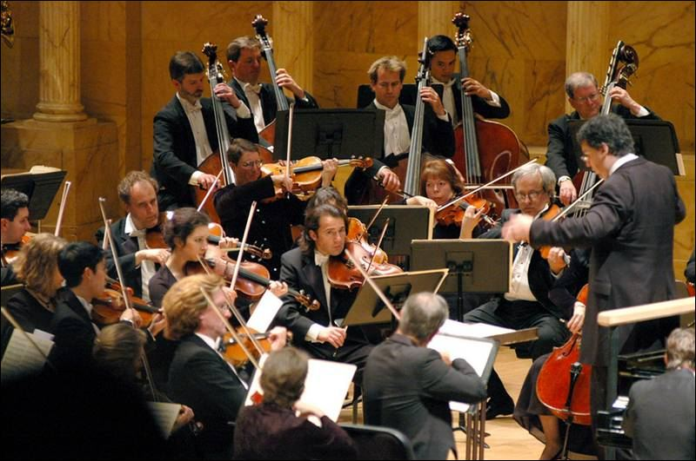
Collaboration
ClaRA service engines can be developed using Jana tools and libraries.
ClaRA C++ services presented as JANA factories can run within the JANA framework.
only ClaRA C++ service engines can be presented as JANA factories (no support for other languages in JANA)
JANA factories can extend ClaRA interface, thus
being able to be used both within the JANA framework and be deployed within the ClaRA cloud computing environment for distributed data processing.
Within ClaRA environment JANA factories will collaborate with available third party services (possibly written other than C++ based technologies)
Note. In order JANA to be distributed it must use external middleware (e.g. DAQ distributed middleware for L3 or data quality monitor, ClaRA or any other cloud middleware.)
Hall B and D frameworks

Slide 7
ClaRA
Cloud computing framework.
Implements SOA architecture
Data processing major software components as services (SaaS)
Multilingual support
Services can be written in C++, Java and Python
Data (storage and persistency) as a services (IaaS)
Supports both traditional and cloud computing models
Single process as well as distributed application design modes
Centralized batch processing
Distributed cloud processing
Utilization of multicore processor systems
Built in Multi-threading of a user service
Requires thread safety of a service code
Ability to expand computing power with minimal capital expenditure
Dynamic elasticity.
Utilization of IT resources of collaborating Universities.
Take advantage of available commercial computing resources.
On-demand data processing.
Location independent resource pooling.
In short
simplifies user contribution in developing physics data processing applications
prevents future chaotic software fragmentations
provides an environment for cloud computing and distributed big data handling
Publication:
V. Gyurjayn, et al. “CLARA: A Contemporary Approach to Physics Data Processing
Journal of Physics: Conference Series 331 (2011) 032013
Cloud processing.
CLAS data on the ODU data-center is being actively analyzed by users from
Scotland, Germany, Chile, India, Israel, MIT, FSU, ODU and others.

Slide 8
Thank You.

Slide 9
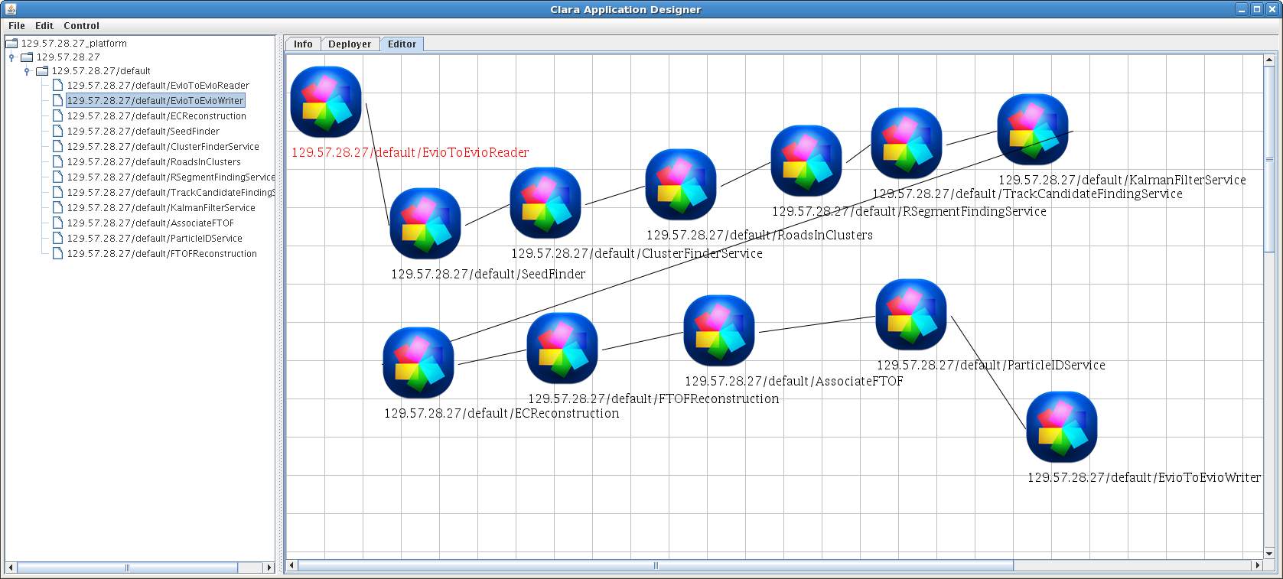
Application Graphical Designer

Slide 10
Advanced Computing Emerging Trends
Helix Nebuls project at CERN (02 Mar 2012 V3.co.uk digital publishing company ) .
CERN has announced it is developing a pan-European cloud computing platform, with two other leading scientific organizations, which will take advantage of the increased computing power cloud systems offer to help scientists better analyze data. Interview with the Frédéric Hemmer, head of CERN's IT department. "CERN's computing capacity needs to keep up with the enormous amount of data coming from the Large Hadron Collider (LHC) and we see Helix Nebula, the Science Cloud, as a great way of working with industry to meet this challenge.”
Magellan project at US Department of Energy.
USDE will spend $32 million on a project that will deploy a large cloud computing test bed with thousands of Intel Nehalem CPU cores and explore the work of commercial cloud offerings from Amazon, Microsoft and Google for scientific purposes.
Cloud Computing
Grid Computing
Google Trends.
Scale is based on the average worldwide traffic of cloud computing in all years.

Slide 11
Clara and Clara-based effort
Project | Start Date | Status | Number of Lines | Comments
ClaRA | 2009 | Maintenance | 23611 | Cloud computing framework
EC reconstruction | 2012 | Maintenance | 8734 | ClaRA services that implements the EC reconstruction algorithms and map utilities interfaces to databases
PCAL reconstruction | 2013 | Active | 2864 | ClaRA services that implements the PCAL reconstruction algorithms
TOF reconstruction | 2012 | Commissioning | 17084 | ClaRA services that implements the TOF reconstruction algorithms for the FTOF and the CTOF and interfaces to the CLAS6 configuration database for the FTOF
FTOF calibration | 2013 | Active |  | FTOF calibration services
TRAC (Track Reconstruction Application for CLAS12) | 2012 | Active | 16401 | Contains packages for track reconstruction algorithms and services for tracking in the central and forward detector systems, respectively
Forward Tagger Reconstruction | 2013 | Active | 1305 | ClaRA services that implements the FT Calorimeter reconstruction algorithms
Geometry Service | 2012 | Active |  | Service to provide simulation and reconstruction clients with detector geometry
Histogram Services | 2013 | Active | 7269 | Statistical data histogramming for reconstruction output validation
Event Builder | 2013 | Active | 1197 | Event Builder Service
Persistency Services | 2013 | Commissioning | 6048 | Contains various utility services such as magnetic field, banks and event reader/writer services, etc.
Data Mining | 2012 | Maintenance
SOT | 2010 | Retired | 177663 | Charge particle tracking, TOF, EC, PID, Histogram, etc.

Slide 12
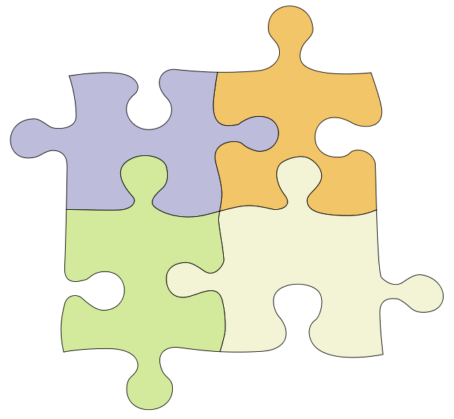
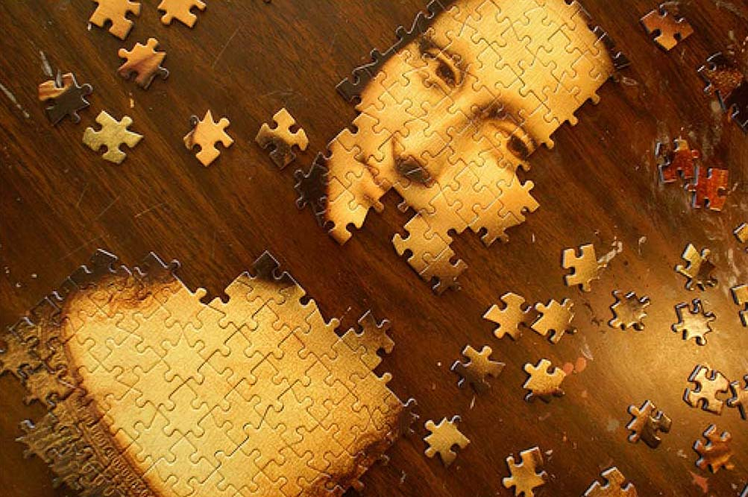
ClaRA application design
Programmer
Designer
without programming skills
Services
PDP Applications

Slide 13
ClaRA Components
Platform
(cloud controller)
DPE
C
S
DPE
DPE
C
S
C
Orchestrator
S

Slide 14
Transient Data Envelope

Slide 15
ClaRA SaaS Implementation
User
Software
(shared object)
Message processing
Engine interface

Slide 16
ClaRA Cloud Formation
Java Container
Transient Data Storage
Service Bus
Computing Node 1
Service 1
Service 2
Service N
Service Bus
Service Bus
Computing Node 2
Service 1
Service 2
Service N
Transient Data Storage
Service Bus
C++ Container
Computing Node N
Computing Node 1

Slide 17
Event Reconstruction
Node 1
Central Tracking
Forward Tracking
Calorimeter
BSMTHitFilter
DCClusterFinder
ECStripsCreator
Database
Services
BSMTMergeHits
DCRoadsInClusterFinder
Shared memory
ECHitsFinder
PointHitFinder
DCRegionSegmentFinder
pub-sub
Transient Data Storage. Shared memory
Transient Data Storage. Shared memory
FTOF
ForwardTOFReconstruction
HoughTransform
DCTrackCandidateFinder
Event Reconstruction Application Orchestrator
Permanent Storage
HelixTrackEstimator
FMTHitsToTrackSegment
ParticleIdentification
PID
TrackFitter
ForwardKalmanFilter
JVM
C++ VM
Node n

Slide 19
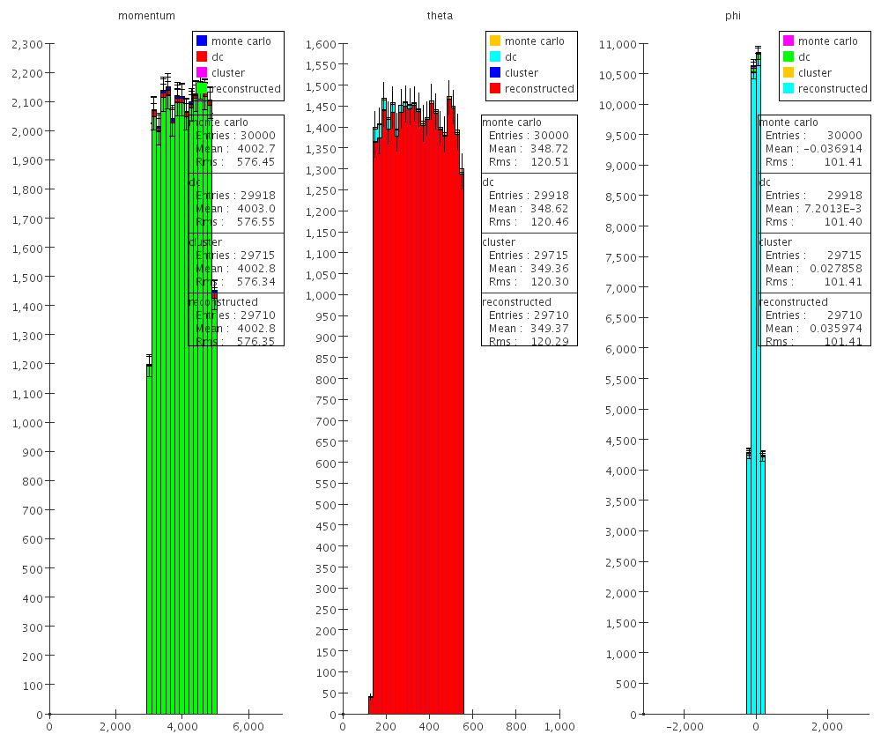

Slide 20
Online Cloud
Offline University Cloud 1
Clas12 Detector
Electronics
Trigger
ET
Online Transient Data Storage
Online Monitoring
Services
Service Registration
Service Registration
Conditions
Database
Slow Controls
Online
EB
Services
Event
Visualization
Services
Permanent
Data Storage
Cloud Control
Cloud Control
Run Conditions
Services
Permanent
Data Storage
Online
Calibration
Services
Geometry
Calibration
Services
Calibration
Database
Online Application
Orchestrator
Service Control
Service Control
Conditions
Database
Calibration
Database
Cloud Scheduler
Run Conditions
Services
Physics Data Processing
Application Orchestrator
Geometry Calibration Services
Service Registration
Service Registration
Conditions
Database
Permanent
Data Storage
Cloud Control
Permanent
Data Storage
Geant 4
EB
Services
Calibration
Services
Cloud Control
DST
Histogram
Visualization
Services
Service Control
Service Control
Calibration
Database
GEMC
Simulation
Permanent
Data Storage
Analysis
Services
Offline JLAB Cloud
Offline University Cloud n

Slide 21
Single Data-stream Application
Farm Node N
S1
S2
Sn
S1
S2
Sn
S1
S2
Sn
Executive Node
ClaRA Master DPE
R
AO
Persistent
Storage
W
Administrative
Services

Slide 22
Single Data-stream Application Clas12 Reconstruction: JLAB batch farm

Slide 23
Multiple Data-stream Application
S1
S2
Sn
S1
S2
Sn
S1
S2
Sn
R
Persistent
Storage
W
DS
Farm Node N
Persistent
Storage
Executive Node
AO
Administrative
Services
ClaRA Master DPE

Slide 24
Multiple Data-stream Application Clas12 Reconstruction: JLAB batch farm

Slide 25
Service Bus Performance measurements

