Slide 1
BCAL Interlock System
Pulsed Output from Flow meter to PLC
US BCAL PLC
5V TTL
US BCAL MPOD 1
From US BCAL cooling loop
US BCAL Chiller
RS485 from Chiller
To PLC
US BCAL MPOD 1
PLC Remote On/Off 24V
Pulsed Output from Flow meter to PLC
DS BCAL PLC
5V TTL
DS BCAL MPOD 1
From DS BCAL cooling loop
DS BCAL Chiller
RS485 from Chiller
To PLC
DS BCAL MPOD 2
PLC Remote On/Off 24V

Slide 2
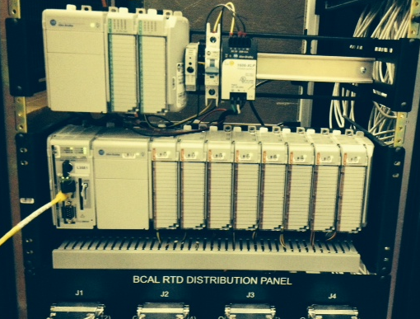
BCAL Interlock System

Slide 3
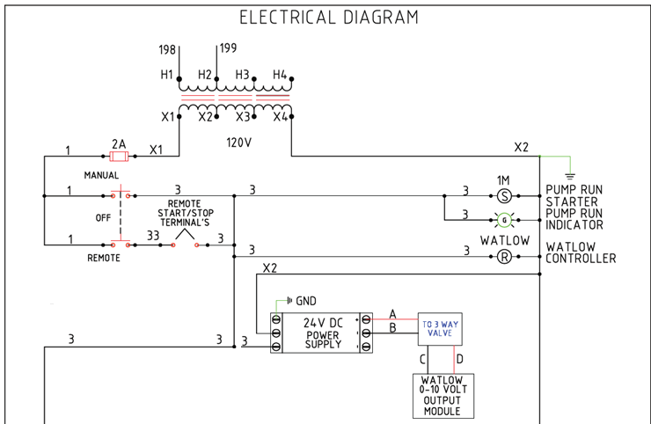
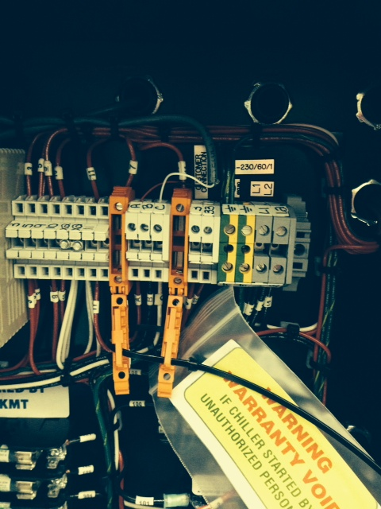
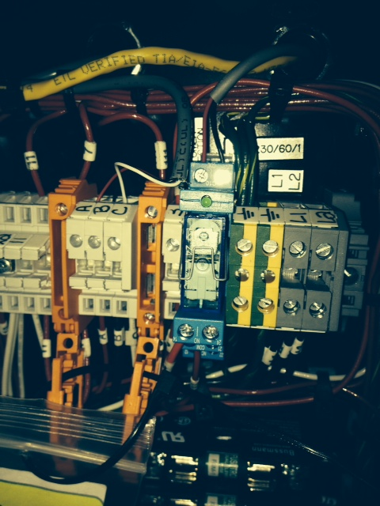
BCAL Interlock System

Slide 4
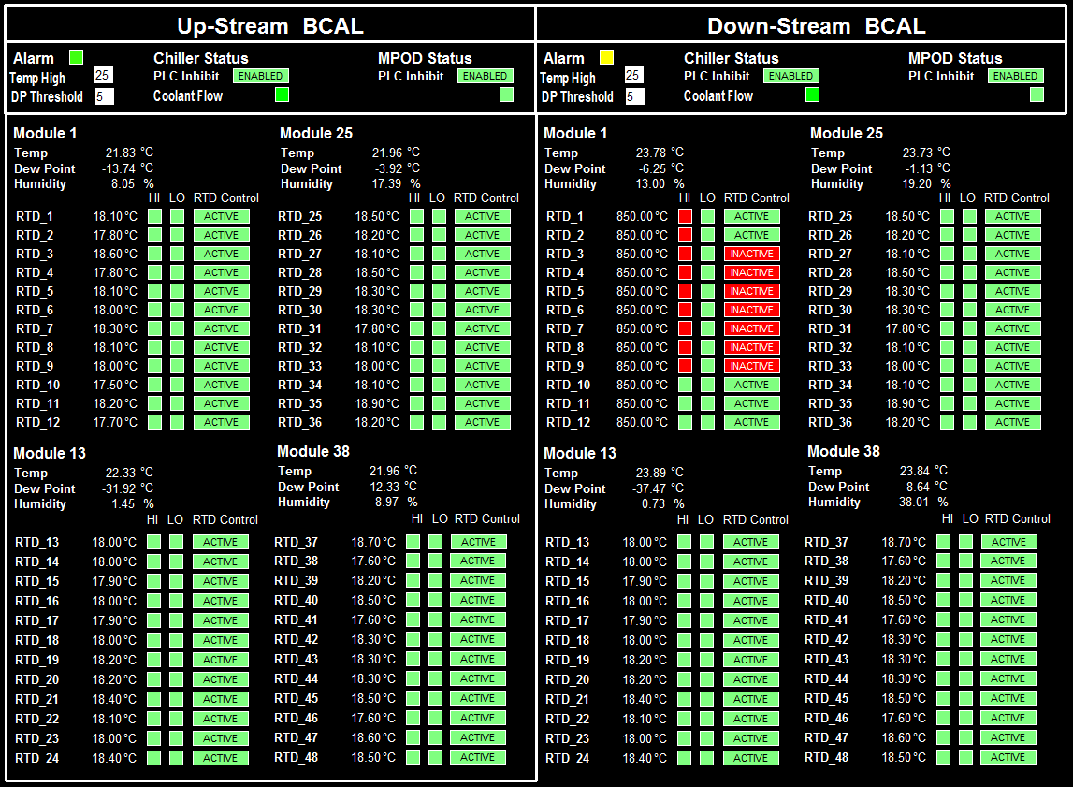
BCAL Interlock System

